Slide 1



Core Dash Board Integrated Hospital Sanitation Monitoring System In Andhra Pradesh

Slide 2
Introduction
Maintenance of hygiene and cleanliness of health facilities was found to be not only related to aesthetics and patient satisfaction but also as an essential step that reduces the incidence of Hospital Acquired (Nosocomial) infections.
The Govt of AP has formulated and approved the New Scientific Sanitation Policy-2015 for better implementation of sanitation in government hospitals wherein Sanitation, Security, Pest & Rodent control services would be implemented different Service Providers for better implementation of the services to create a visible impact in maintaining Health facilities up to the satisfaction of the patients.

Slide 3
Comparison
Before SSP
After SSP
Low sanitation standards
Manual monitoring mechanism(Monthly)
Centralized services (one service provider maintenance Sanitation, Security, Pest Rodent control).
Low accountability and transparency
Payments – Manual mode
Increase sanitation standards
Scientific (Real time) Monitoring mechanism (daily)
Decentralized services (specialized service provider for individual services Sanitation, Security, Pest Rodent control)
Increase accountability and transparency
Payments – Online mode

Slide 4

Service Standards
The new policy document lays down service standards of sanitation for different areas in a hospital ,as per ‘Swattchata guidelines for public health facilities’ issued by the Union Ministry of Health, Medical and Family Welfare, Govt of INDIA.
State-level committee headed by Commissioner of Health and Family Welfare , Managing Director APMSIDC, Director of Medical Education and Commissioner of APVVP as members to Supervise and monitor the implementation of the new policy.
Facilities under Scientific Sanitation Policy
DME(33)
11 Teaching Hospitals
11 Specialty Hospitals
11 Medical Colleges & Hostels
APVVP (45)
7 DH 33 AH 3MCH 2CHCs

Slide 5
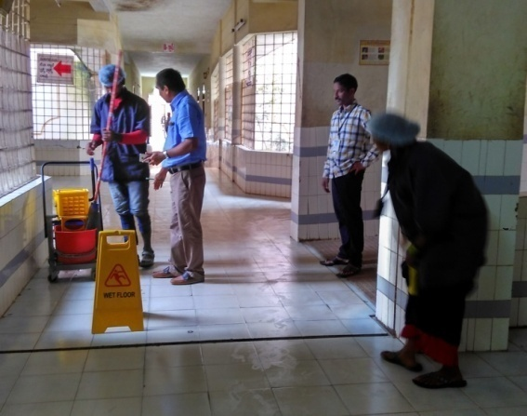
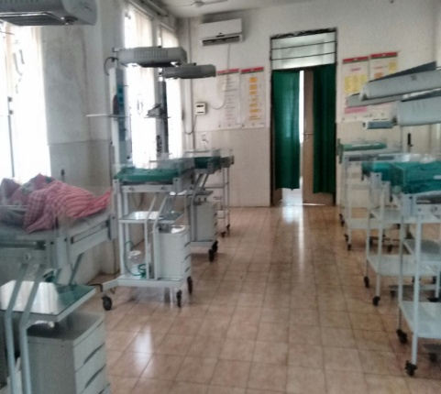
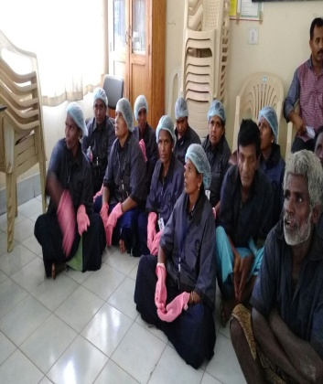
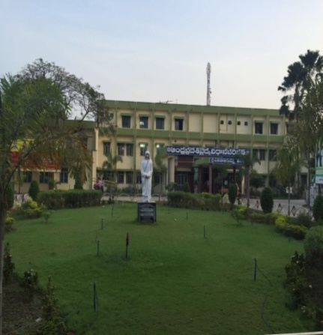
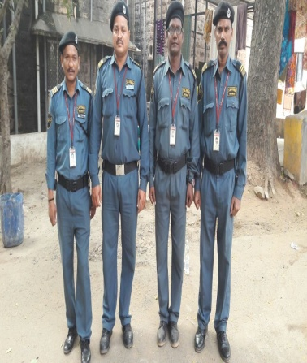
Outcomes of Scientific Sanitation Policy
Public Perception and Patient satisfaction towards Hospital Sanitation ,Security Services have Increased. (as per Patient satisfaction Survey in Likert Scale)
Reduced Hospital Acquired infection rate .
Increased Footfalls ( Increased No. of public utilising Public Health Services)
Hospital Scores are kept in the public Domain in order to maintain the transparency accountability and to maintain the integrity of the programme.
65 Hospitals | 23400 Patients Feed Back | 2% Poor | 4% Fair | 18% Good | 68% Very Good | 8% Excellent

Slide 6
Hospital Sanitation Monitoring Application (HSMS)
Hospital Sanitation Online Monitoring Application (HSMS)
HSMS Application is designed & Developed by Andhra Pradesh Quality Assurance Division is meant for improving efficiency and efficacy by creating a real time monitoring tool. The monitoring items have been grouped within the ten parameters according to the Weightage.
Each monitoring items further has specific measurable elements. These measurable elements are checked in each department of a health facility through specific checkpoints.
All Checkpoints for monitoring items are collated, and together they form assessment tool called ‘Checklist’. Scored/ filled-in Checklists would generate scores reflecting percentage of performance along with hospital average score (Sanitation, Security, P&R control)
Each facility under Scientific Sanitation Policy-2015 should perform online assessment thrice a day in different shifts by 1.Medical Superintendent 2.RMO 3.Hospital Administrator /Nursing Superintendent /Head Nurse.
Scores will be reflected only after minimum of 2 Assessments of each service
Scores entered by Facilities will be reflected on the CM COREDASH BOARD along with the facility photographs.

Slide 7

Measurement Metrics
Data is captured on daily basis which gives the thorough knowledge & understanding not only about the processes, functionality but also overall performance.
Processes
Data
Overall
Performance
Functionality
Monitoring
“When you can measure what you are speaking about and express it in numbers, you know something about it.”

Slide 8
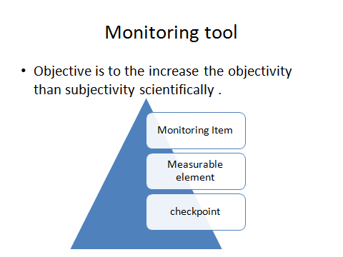
Assessment Process

Slide 9
Hospital Sanitation Monitoring
Application (HSMS)
Monitoring Item
Measurable Elements
Hospital Score card
Measurable Elements
Checkpoint
Checkpoint
Checkpoint
Checkpoint
Services
SSP2015
Monitoring Item

Slide 10
Measuring Parameters
 | No. of Monitoring Items | No. of Measurable Elements | No. of Check points
Sanitation | 9 | 53 | 53
Security | 6 | 5 | 54
Pest Rodent Control | 7 | 39 | 48

Slide 11
MONITORING ITEMS
Sanitation
S.No | Monitoring Item | Weightage
1 | Cleanliness of Toilets / Urinals / Wash basins | 10
2 | Cleanliness of Wards | 10
3 | Cleanliness of Labour Room / OT / Emergency / OP/ Lab | 10
4 | Cleanliness of Other Areas | 10
5 | Cleanliness of Drainage and Sewerage | 10
6 | Garbage Disposal | 10
7 | Cleanliness of open areas | 10
8 | Attendance and Uniform | 20
9 | Consumables | 10
Grand Total |  | 100
Security
S.No | Monitoring Item | Weightage
1 | Attendance of the Staff | 25
2 | Uniform of the Staff | 10
3 | Control of Stray Animals | 20
4 | Crowd Control and Systematic Parking of Vehicles | 20
5 | Complaints from Public | 10
6 | Regular Trainings to Staff | 15
Grand Total |  | 100
Pest & Rodent Control
S.No | Monitoring Item | Weightage
1 | Attendance & Uniform of the Staff | 10
2 | Control of Pest & Rodents | 30
3 | Dis-infestation Treatment as per periodicity | 10
4 | Recommended Preventive measure for re-infestation | 10
5 | Usage of Reputed Chemical/ Pesticides Reports | 10
6 | Evidence of any pest and knowledge of infestation associated with the neighboring premises which may affect the hospital.(complaints from public) | 20
7 | Regular Trainings to Staff | 10
Grand Total |  | 100

Slide 12
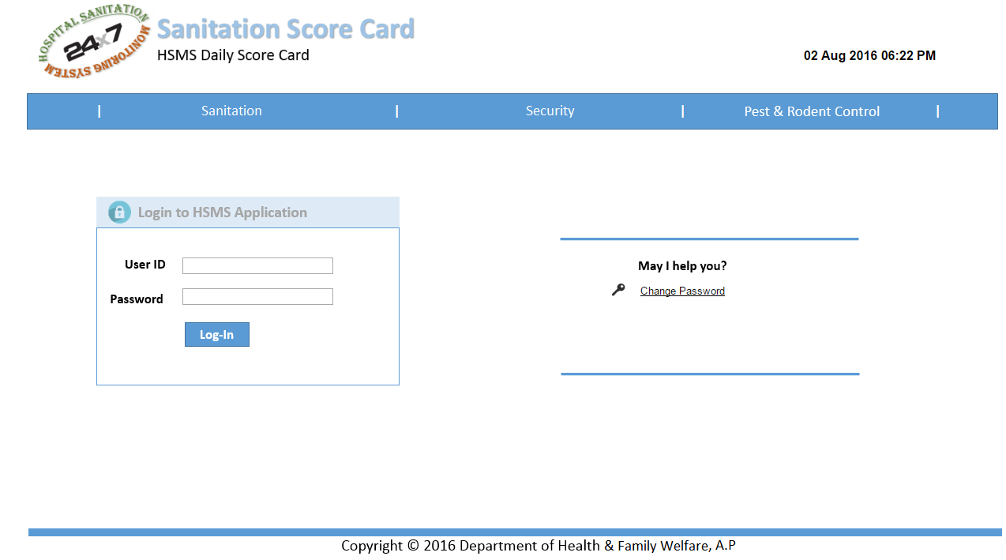

HSMS Home Page for Facilities
http://aphospitalsanitation.com

Slide 13
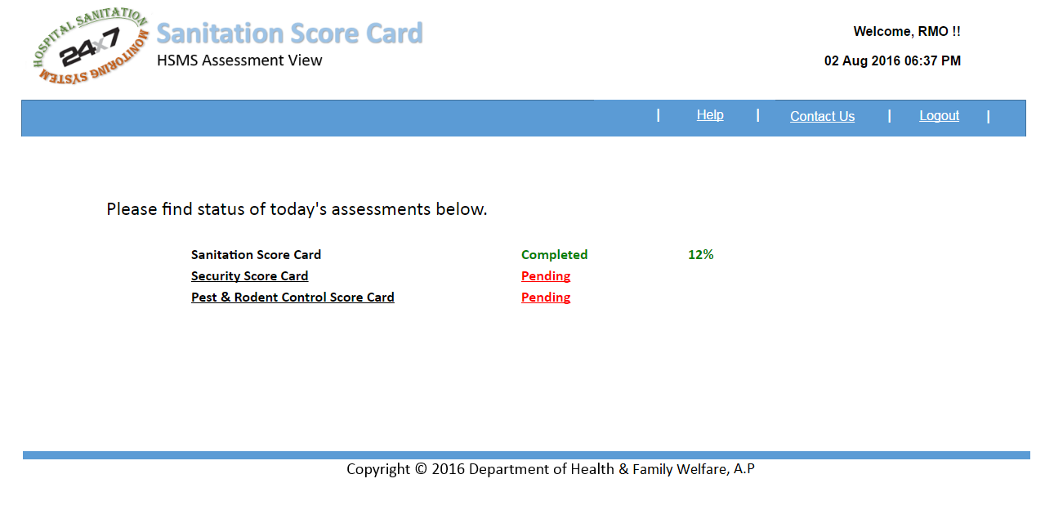

HSMS Dashboard for Facilities

Slide 14
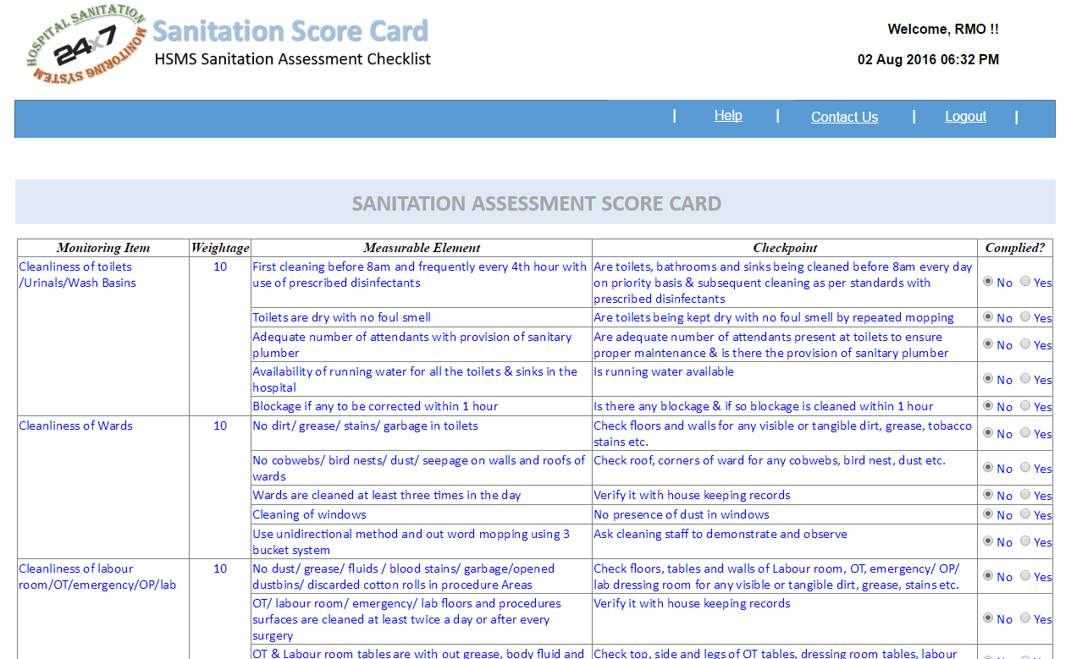
HSMS Data Entry View for Facilities

Slide 15
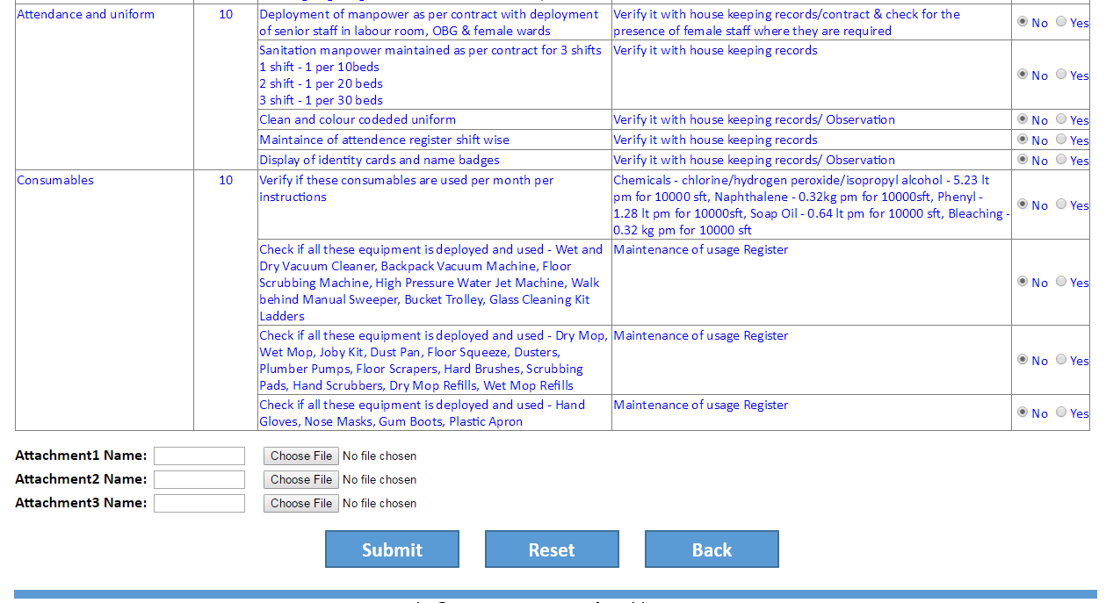
HSMS Sanitation Photos Upload View

Slide 16
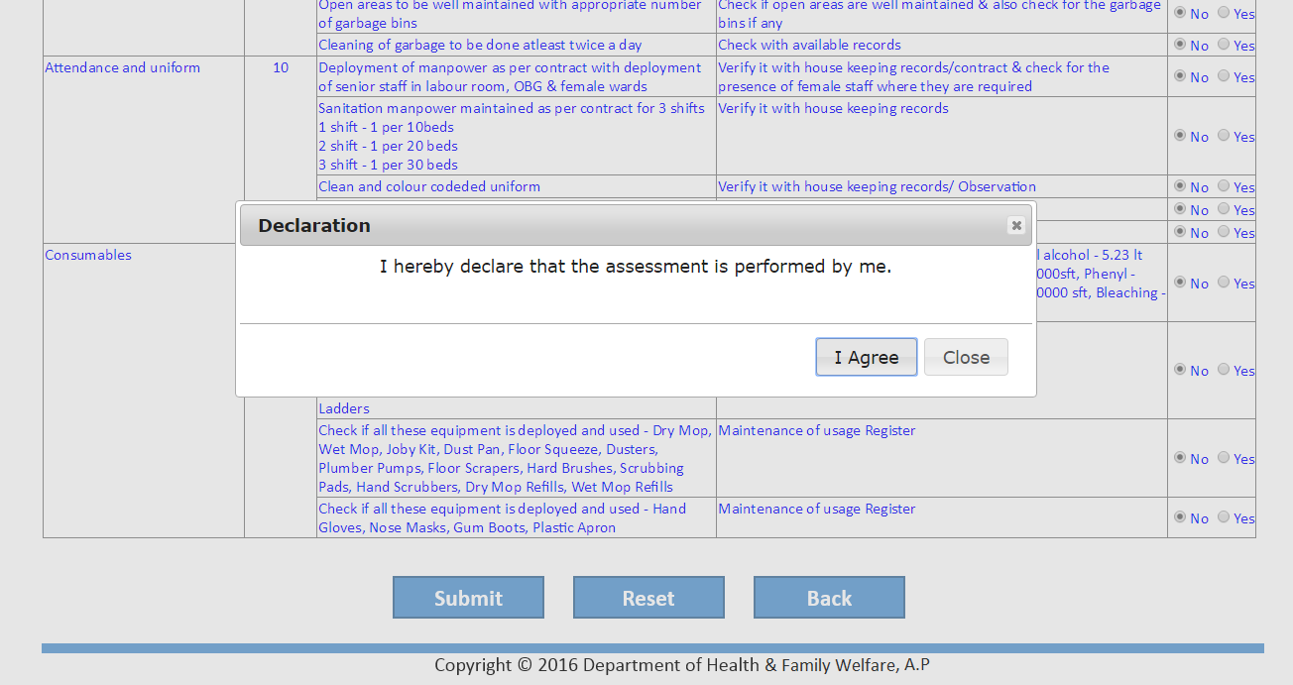
HSMS Data Entry View for Facilities

Slide 17
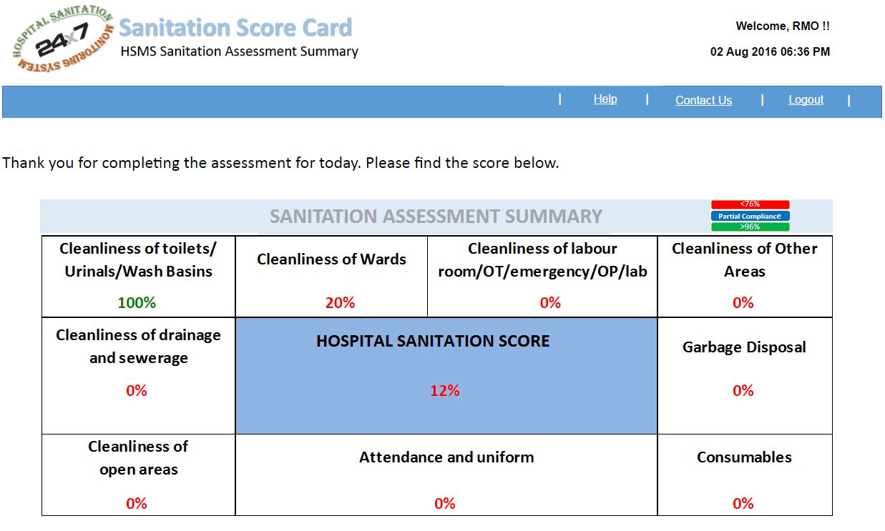

HSMS Score Card for Facility

Slide 18
HSMS Dashboard for Facilities

Slide 19

HSMS Integrates with CM CORE Dashboard

Slide 20
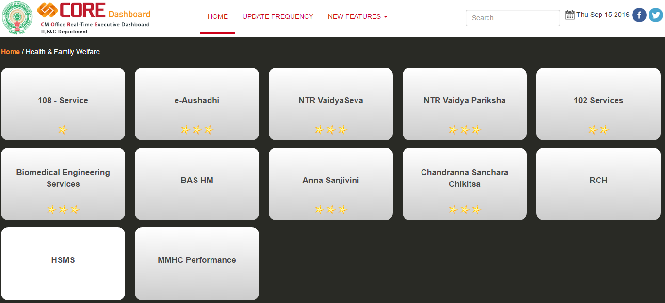
CM CORE DASHBOARD – HSMS Integration

Slide 21
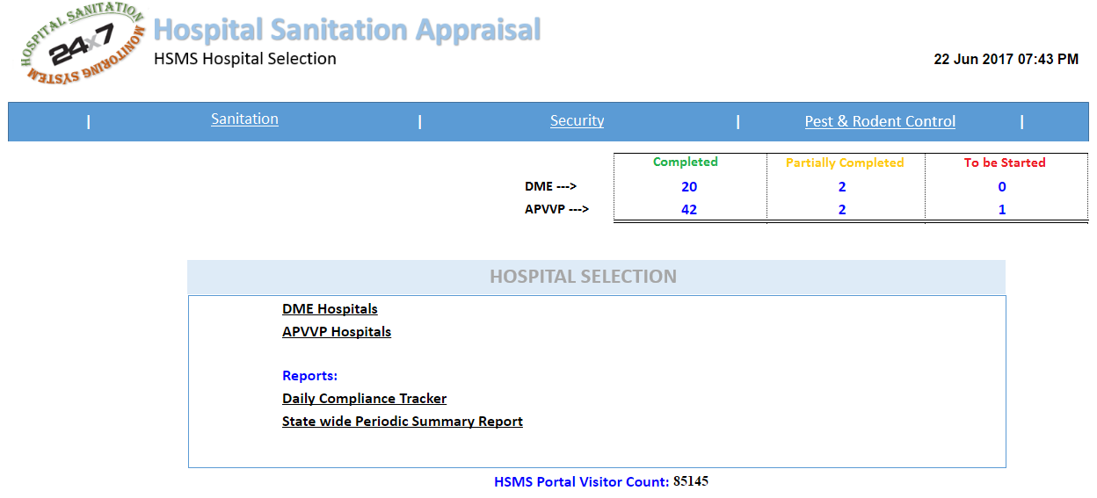
HSMS Hospital Sanitation Appraisal
http://aphospitalsanitation.com/HspSelection.aspx

Slide 22
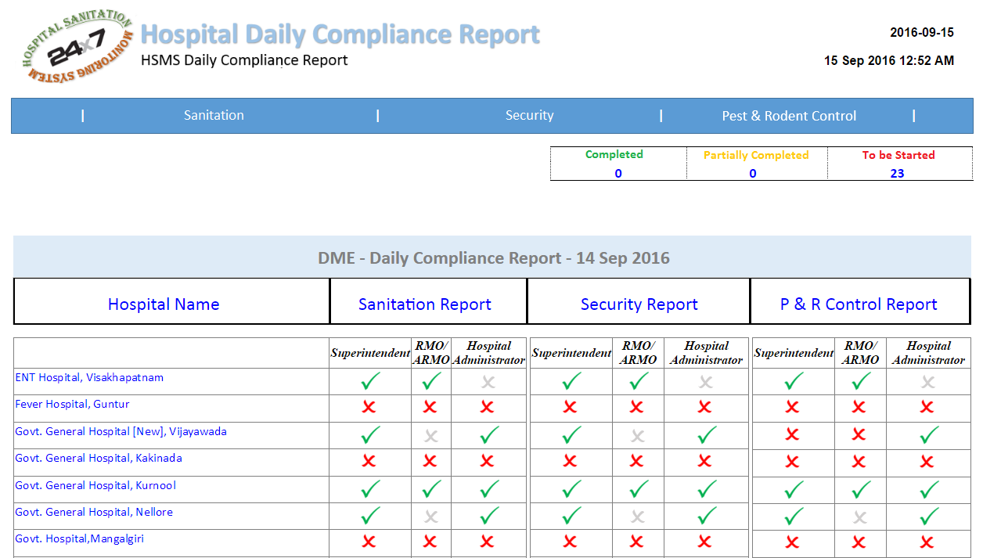

HSMS Daily Compliance Report

Slide 23
HSMS Hospital Sanitation Appraisal
http://aphospitalsanitation.com/HspSelection.aspx

Slide 24
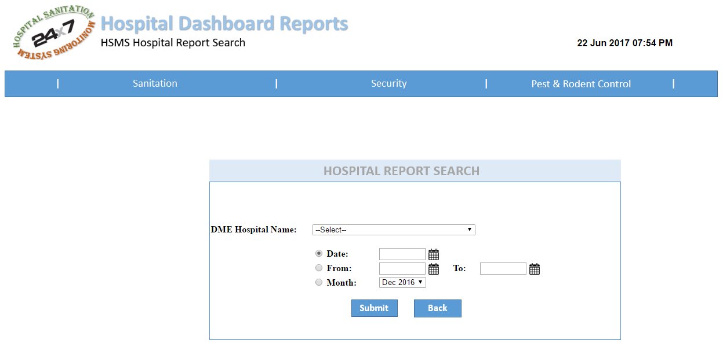
HSMS Hospital Dashboard Reports

Slide 25
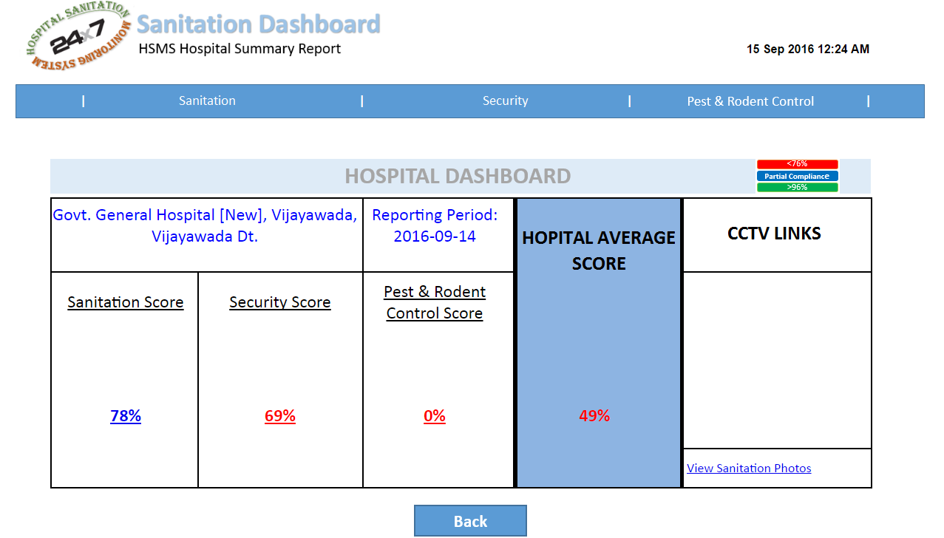
HSMS Hospital Dashboard Report

Slide 26
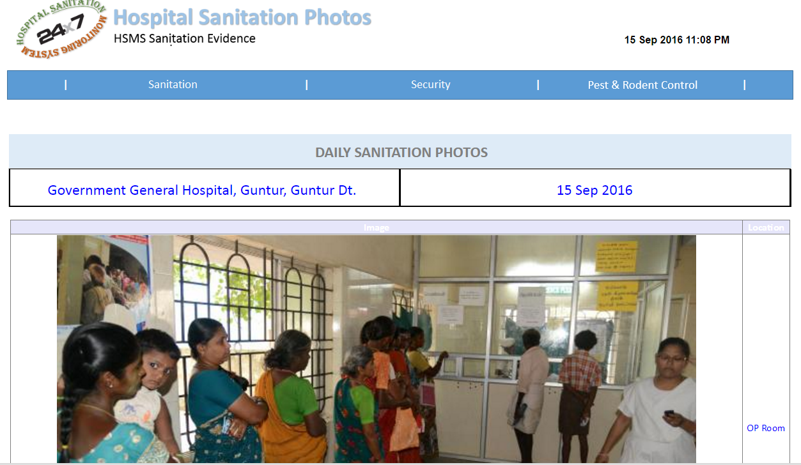

HSMS Hospital Sanitation Photos

Slide 27
HSMS Hospital Dashboard Report

Slide 28
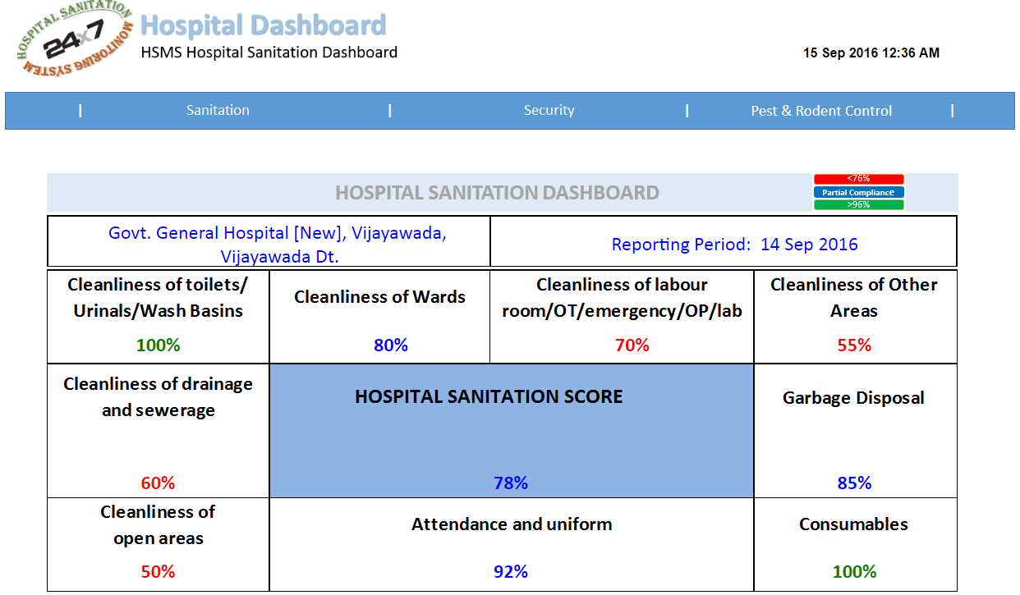


HSMS Hospital Dashboard Report

Slide 29
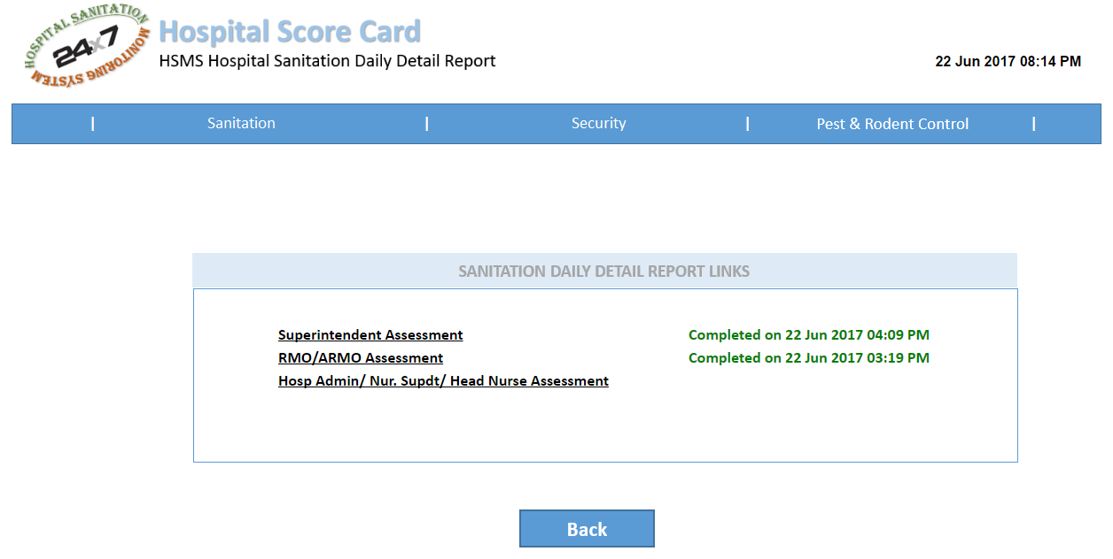
HSMS Daily Detail Report

Slide 30
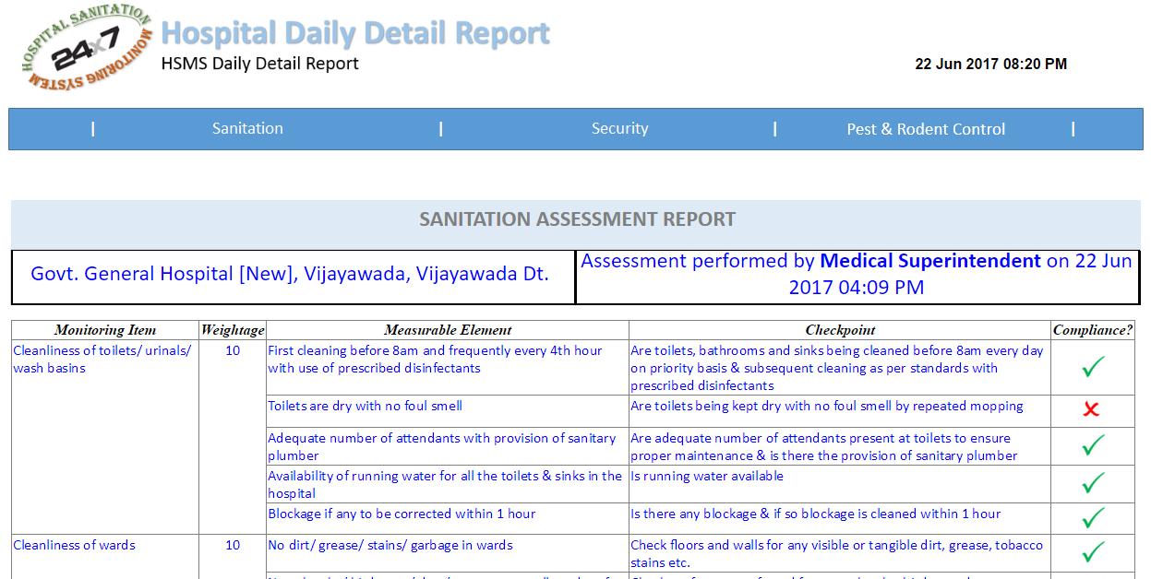
HSMS Daily Detail Report

Slide 31
HSMS Hospital Dashboard Reports

Slide 32


HSMS Hospital Dashboard Report - Monthly

Slide 33
HSMS Hospital Sanitation Appraisal
http://aphospitalsanitation.com/HspSelection.aspx

Slide 34
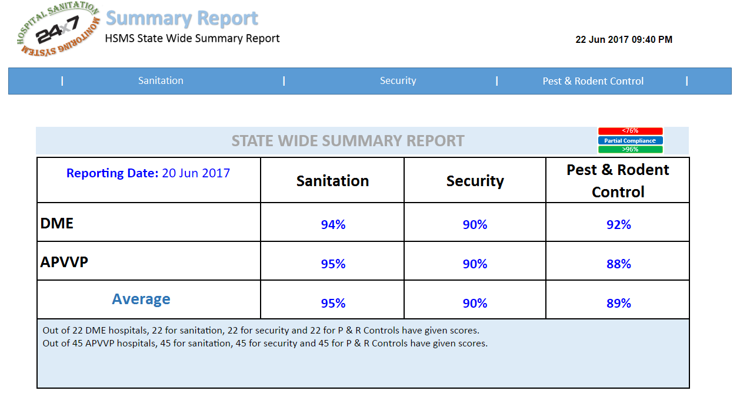
HSMS State Summary Report

Slide 35
Thank You

