Slide 1


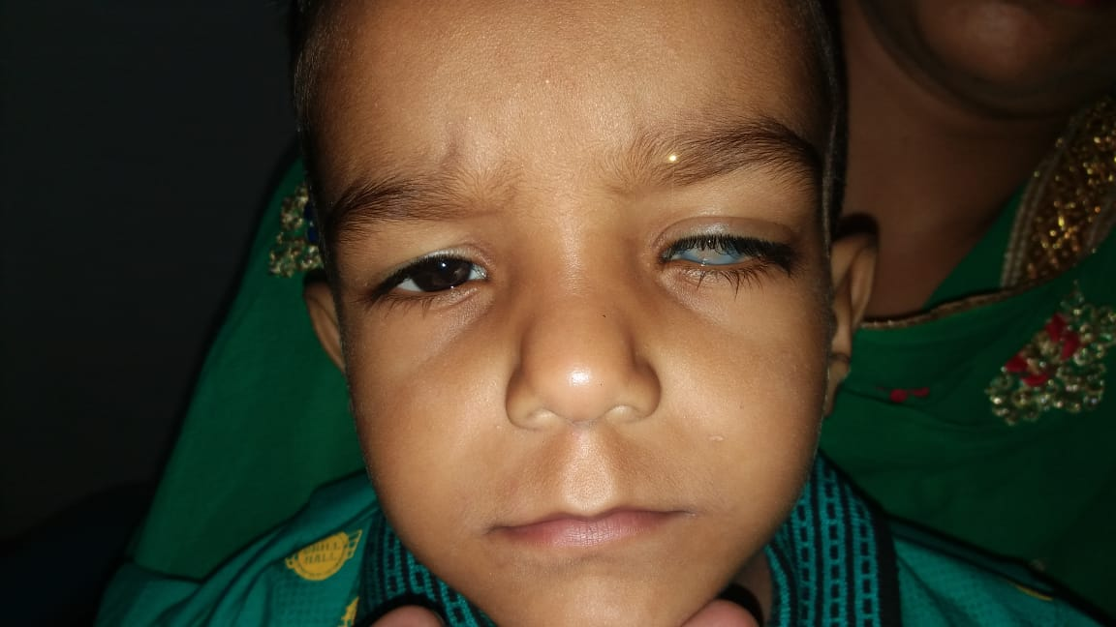
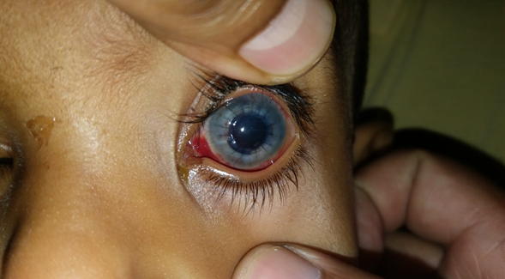
Committed To
CORNEAL BLINDNESS BACKLOG FREE PUNJAB

Slide 2
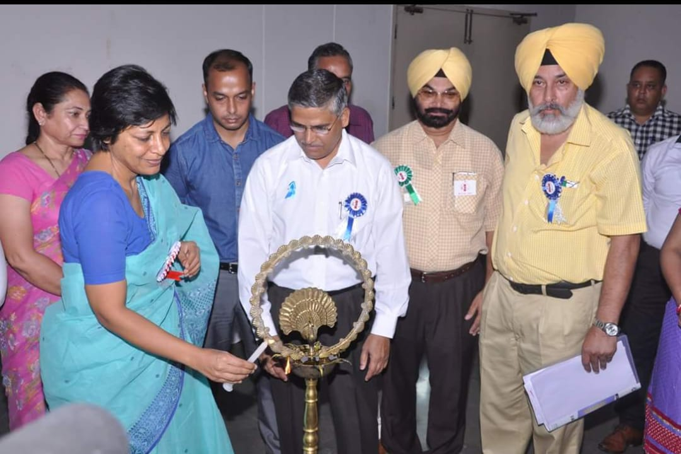
Initiative to make Punjab Corneal Blindness Backlog Free
Punjab Health Department took the initiative for “Corneal Blindness Backlog Free Punjab (CBBF)” in September 2015 with a view to eradicate corneal blindness using a DREAM (Digitization, Re-energization, Education & Empowerment, Advocacy and Multitasking) concept involving all stakeholders.

Slide 3
Situational analysis
A combined approach involving all stake holders with government agencies, professional eye banks, private institutions and non-governmental agencies was initiated to estimate the rough number of corneal blind patients requiring transplants.
Population of Punjab is about 3 crores. VA < 3/60 is expected to be found in about 1% of the population. Of these about 0.3% people are corneal blind. Therefore we were expecting about 10,000 people to be having corneal blindness. Of these , about half of them will be fit for surgery.
The list was prepared by compiling the waiting list taken from eye banks of the State, patient screened in OPDs & Eye Camps and sensitization of health workers including ASHAs to identify the people with visual disability and bring them to health institutions.
Initial results were reviewed and a situational analysis was done to estimate the actual burden of disease, followed by the setting of achievable targets

Slide 4
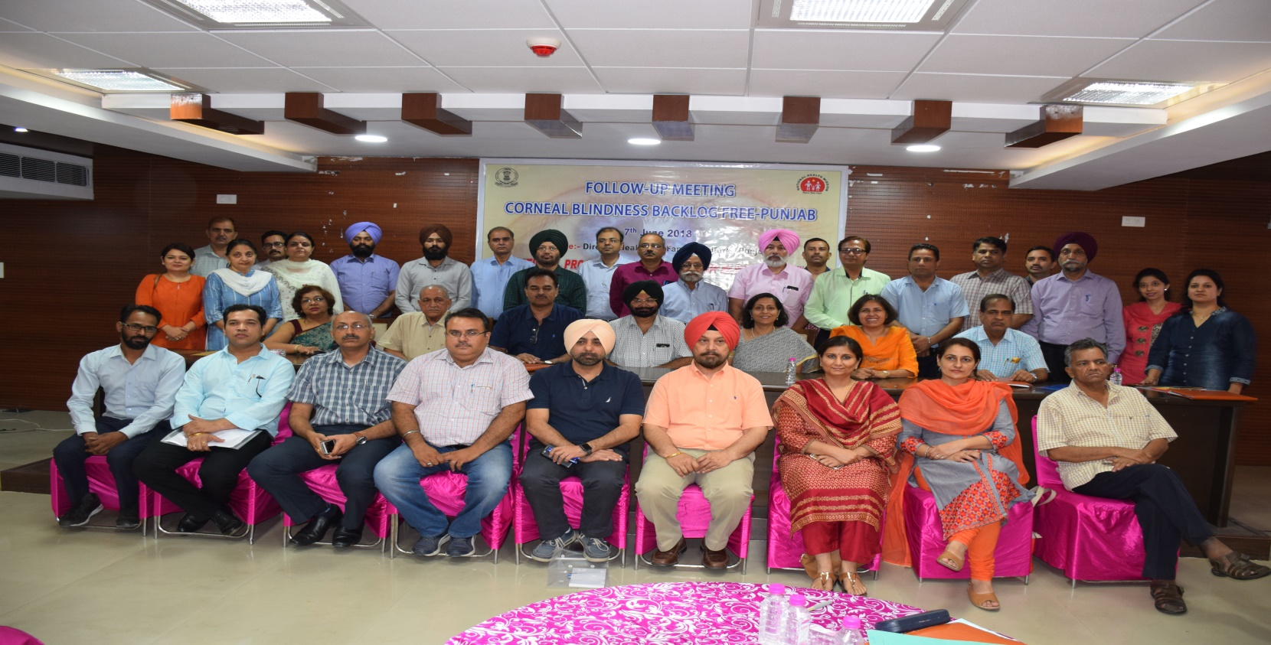
Collaboration with Civil Society
NGOs, Private Eye Banks & Private Eye Surgeons were involved in the initiative since its inception.
District Program Managers, Medical colleges of the State and PGIMER, Chandigarh formed the core team.

Slide 5
Social Network "Whatsapp Group"
Social Network "WhatsApp Group" of corneal transplant surgeons, eye banks and social workers was formed which remarkably reduced the wastage of retrieved corneas as there was direct communication between corneal surgeons and Organizations/ Institutions retrieving corneas.

Slide 6
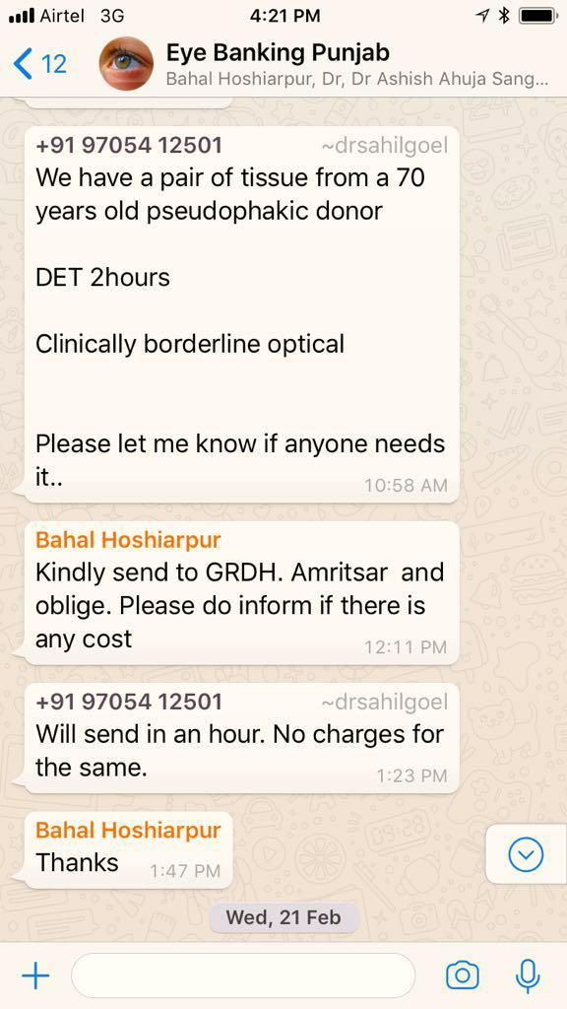

Slide 7
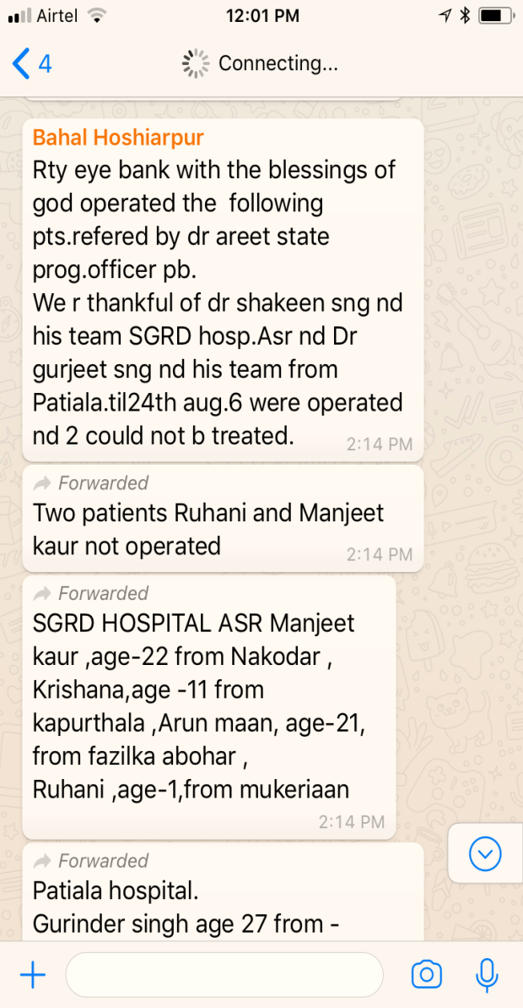

Slide 8
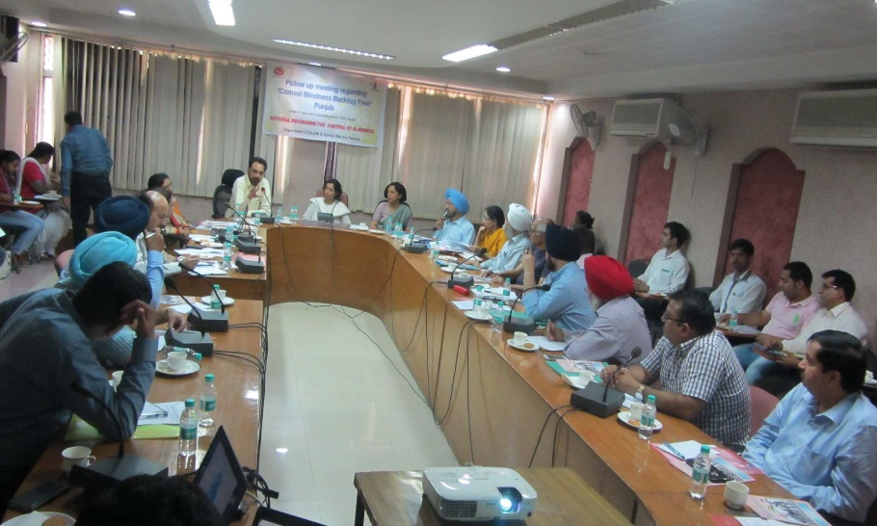
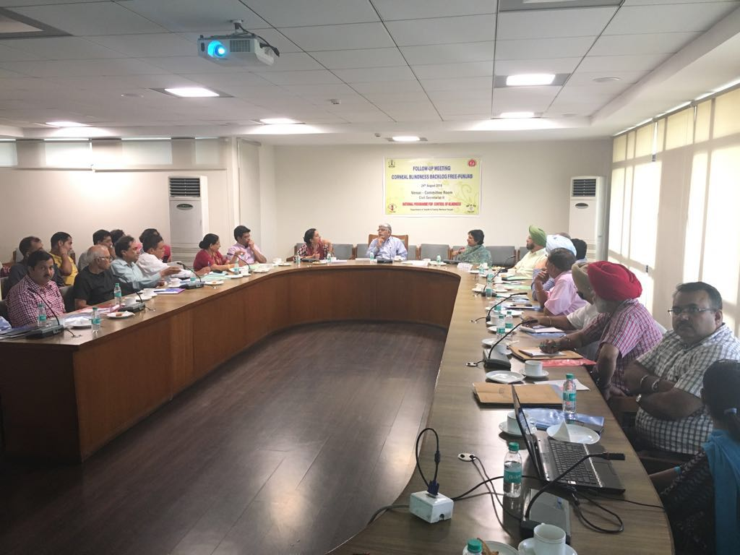
Meetings on CBBF initiative
Periodic review meetings were held and corrective measures taken to resolve issues as and when required.

Slide 9
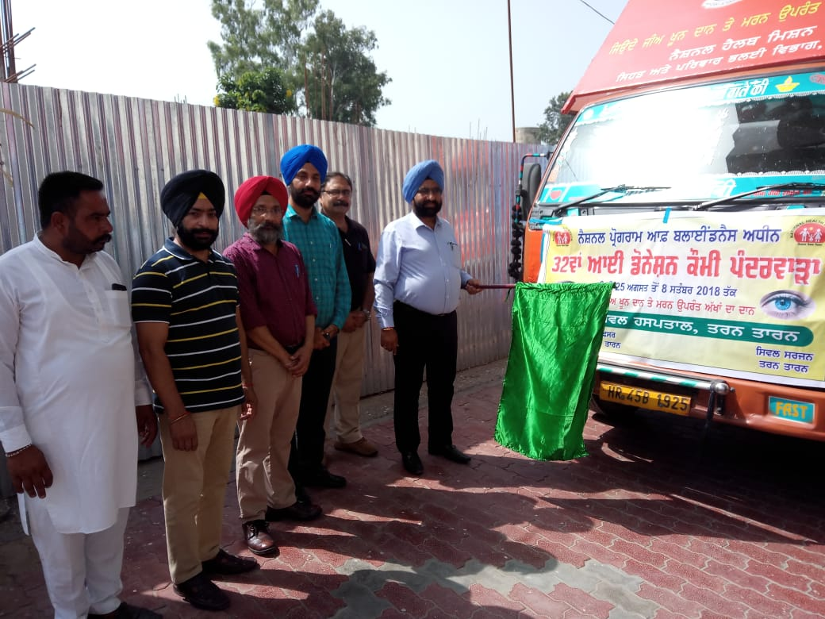
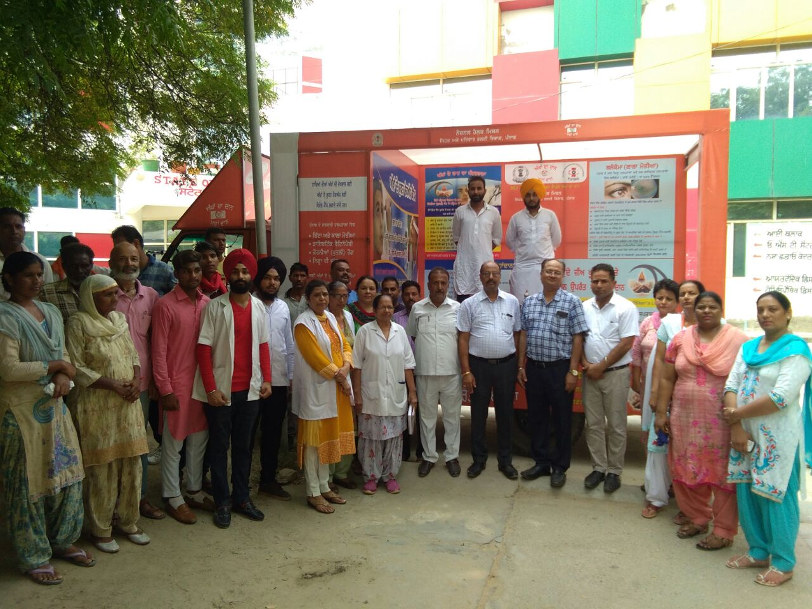
Eye Donation Fortnight
Eye Donation in the State strengthened by enhanced IEC activities.
Eye Donation Fortnight is celebrated every year during the month of August 2018.
  For creating awareness regarding Eye Donation,
    Awareness Van is launched which visits the major towns of all the districts of the State. This van carries eye donation cards. These cards are filled and a registry of eye donors in the State is being maintained.

Slide 10
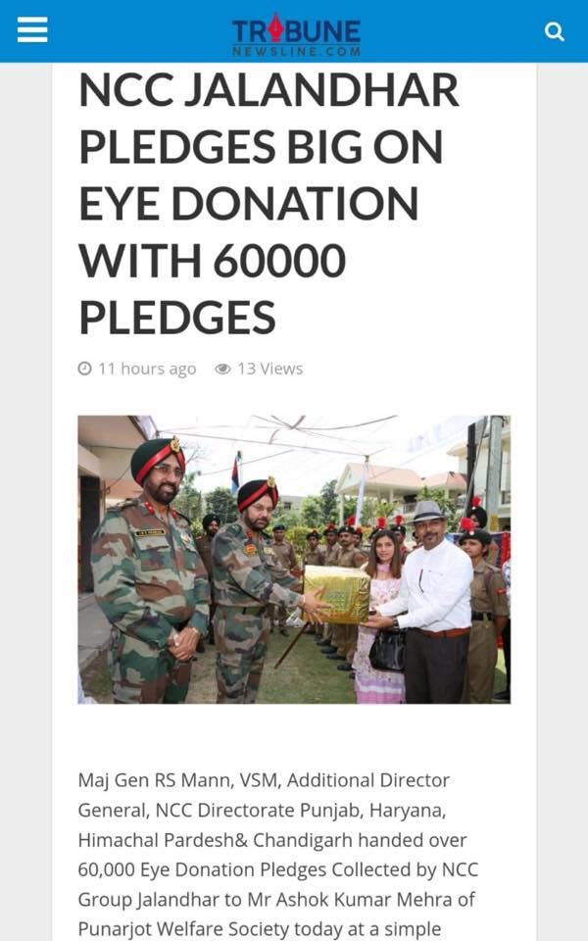

Slide 11
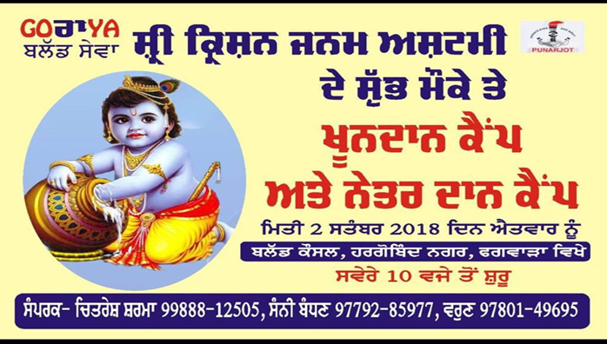
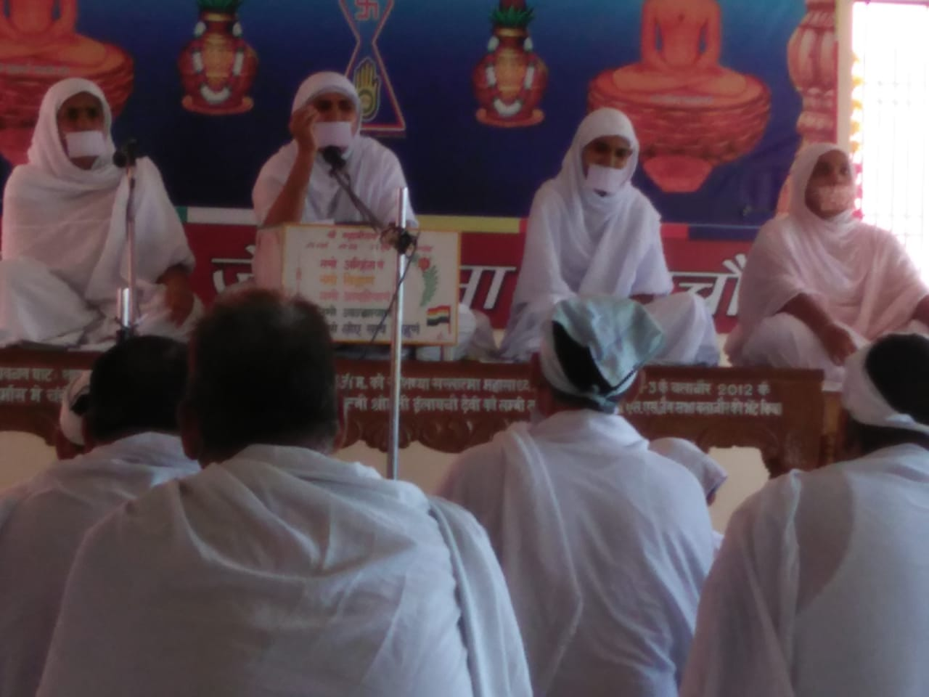
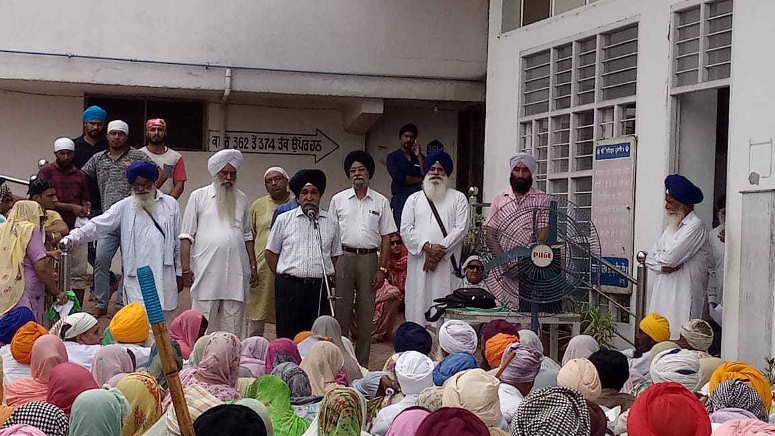
Religious gatherings for promoting Eye donations
Religious gatherings are also held during Eye Donation Fortnight to promote eye donations

Slide 12
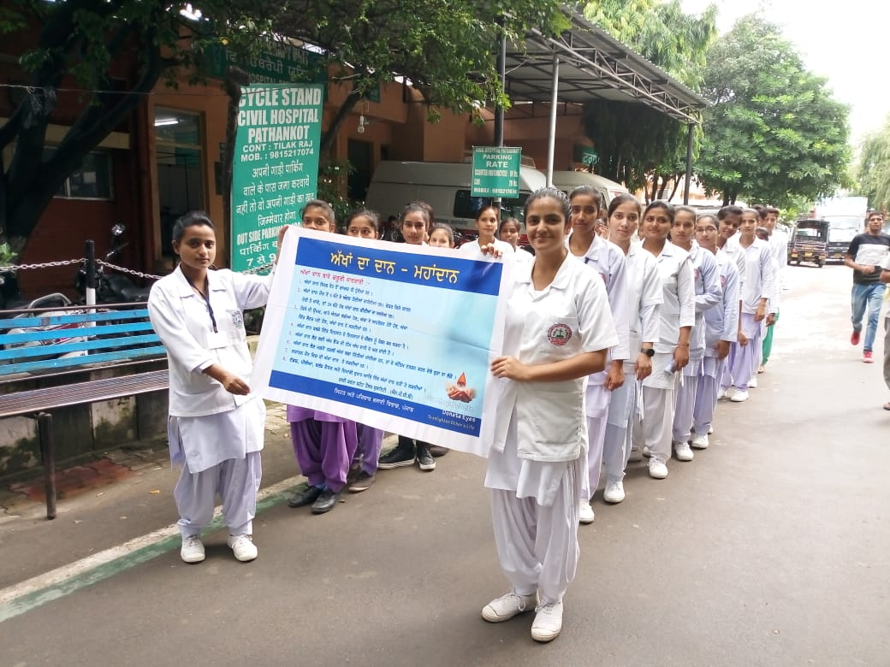
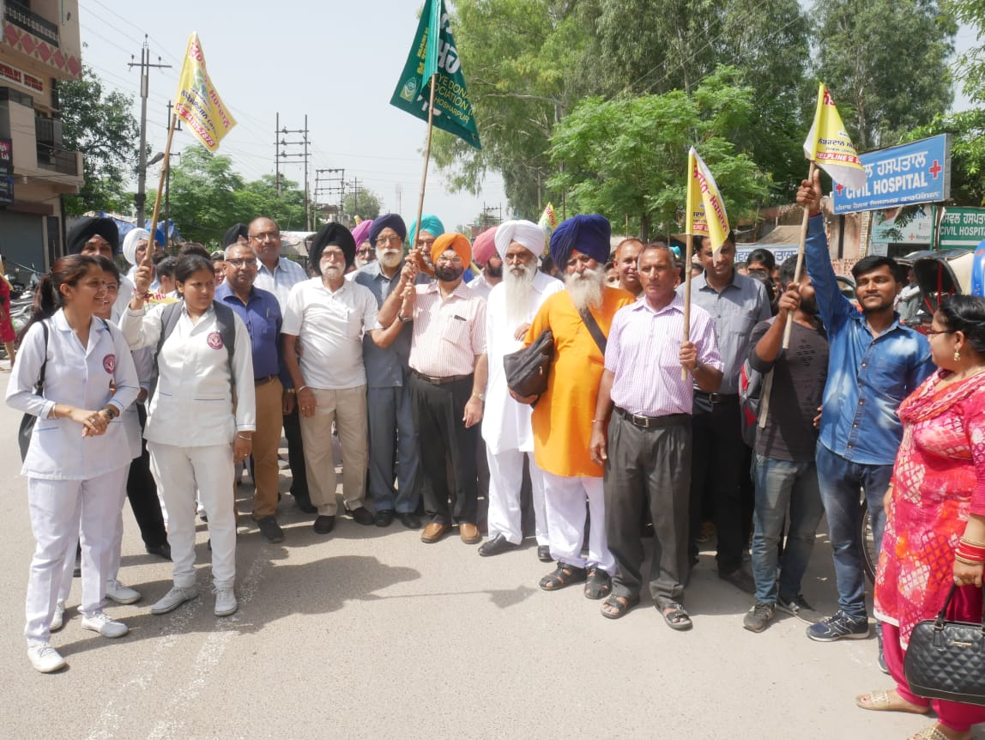
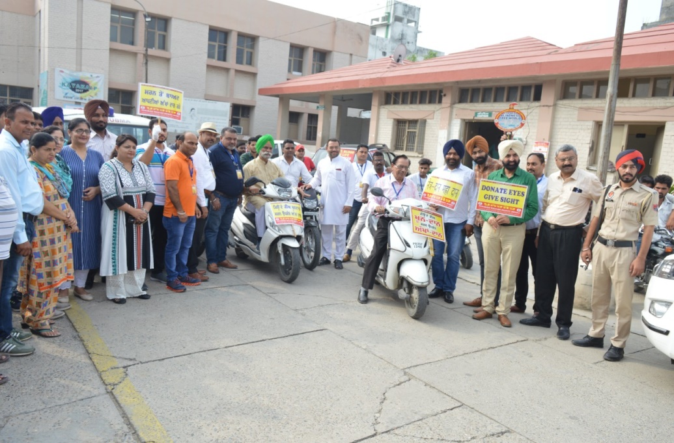
Awareness Rallies

Slide 13
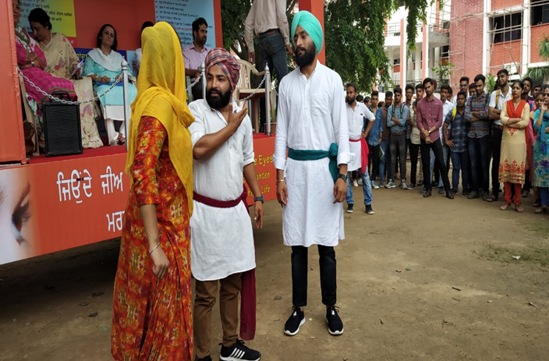
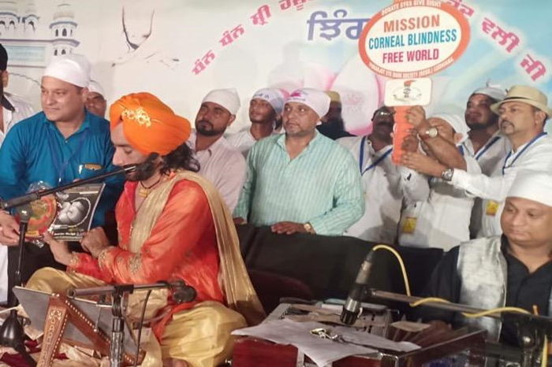
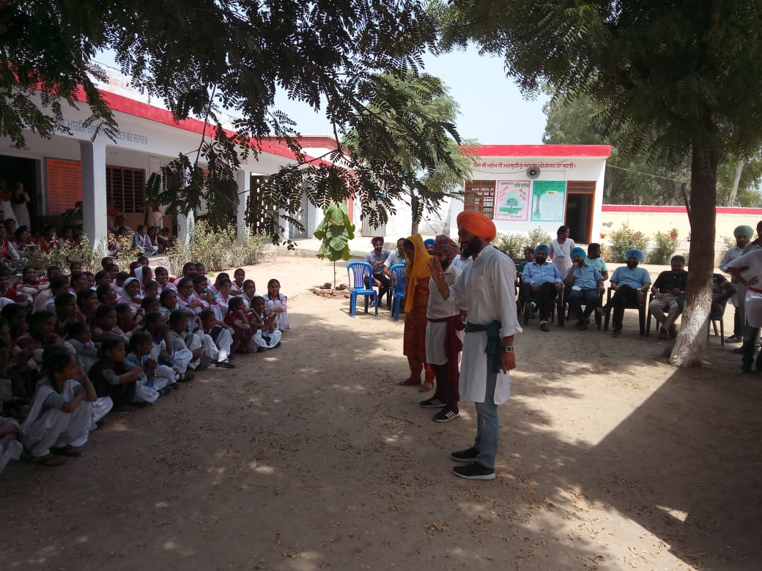
Nukkad Nataks & Cultural activities

Slide 14
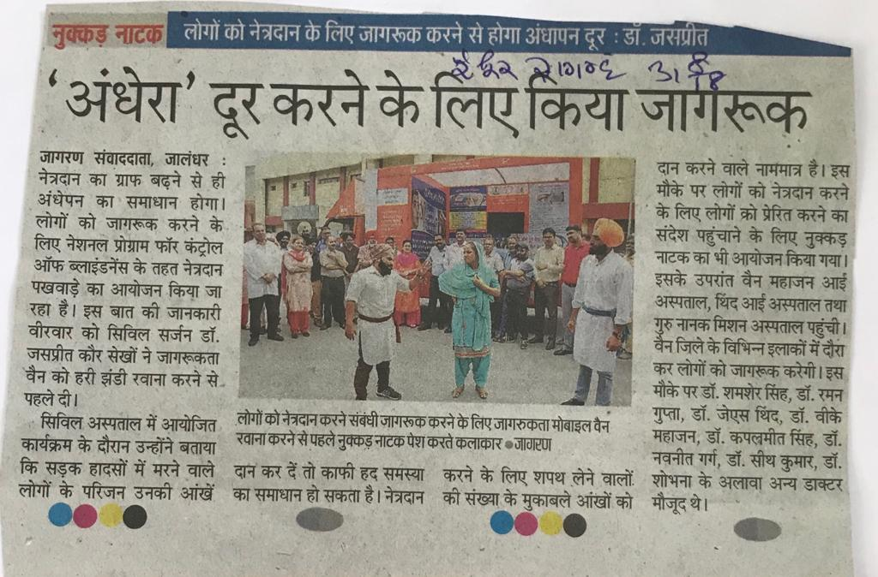
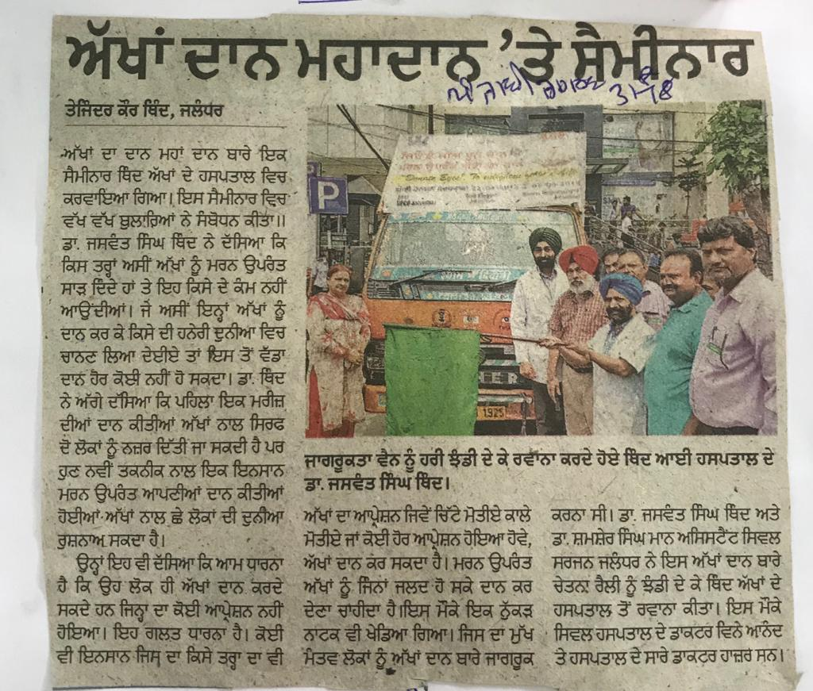
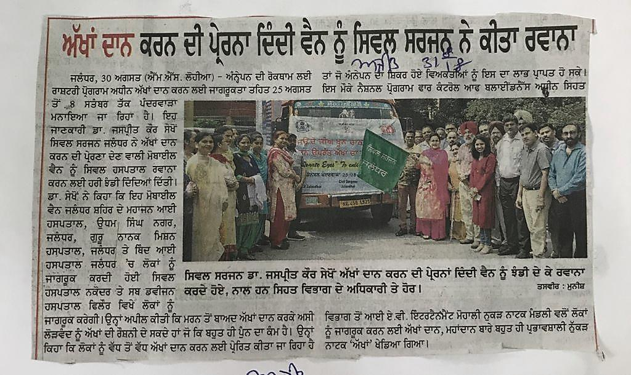
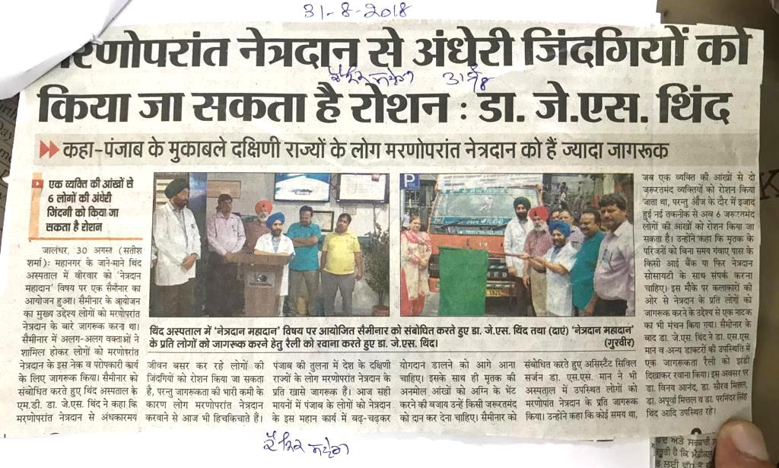
Media Reports
Eye Donation Fortnight 2018

Slide 15
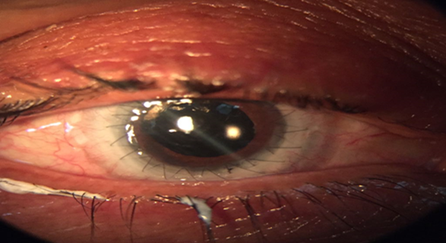

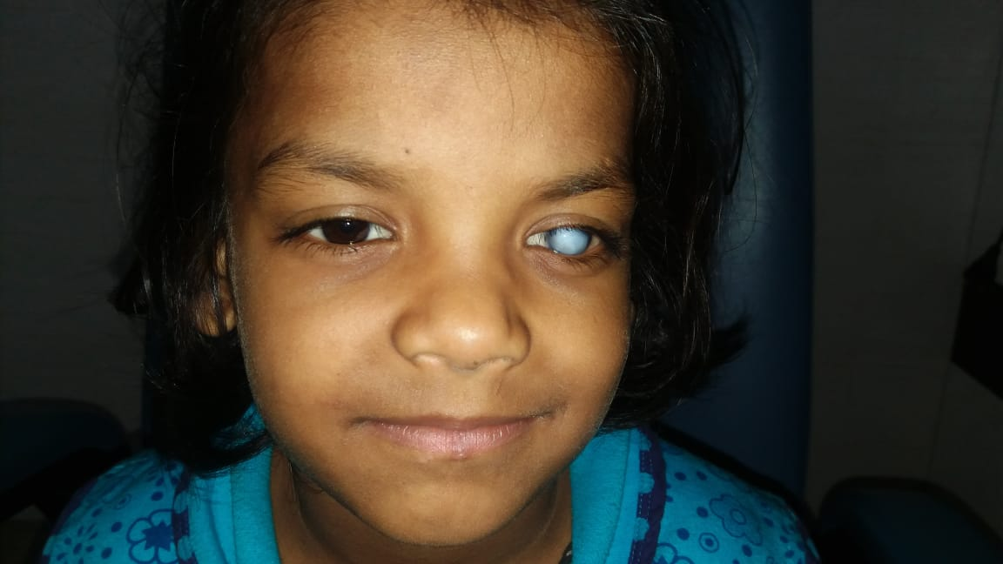
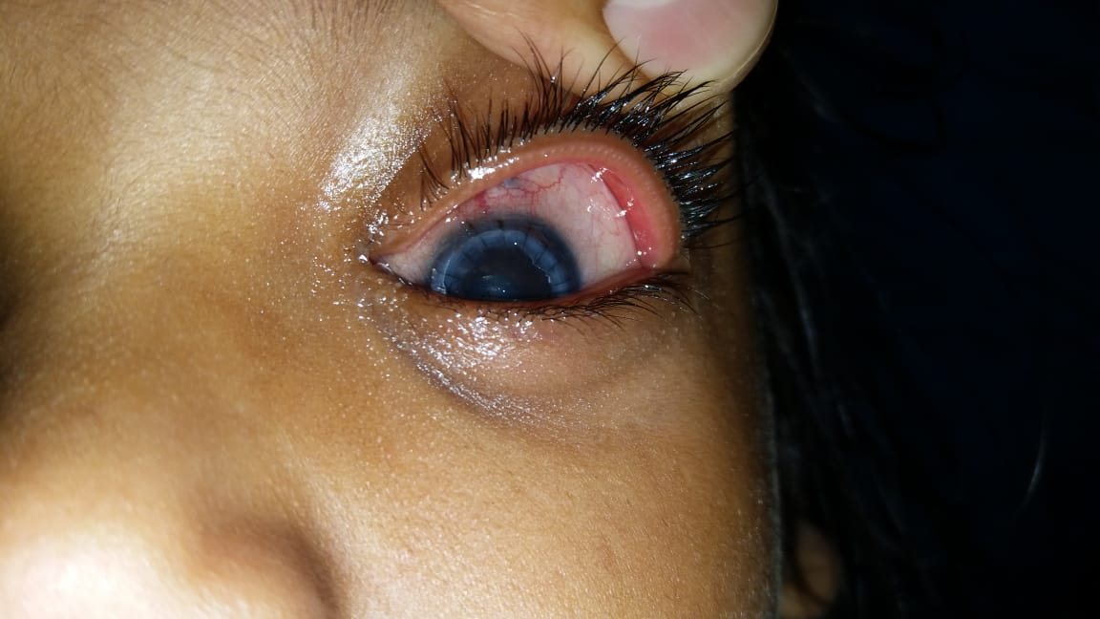
Free Surgeries by Private Ophthalmologists
Punjab has a network of private ophthalmologists who are actively participating in this initiative by doing free surgeries.

Slide 16
Stake Holder Departments
A circular was issued from Police Department of Punjab regarding eye donation in medico legal cases before post-mortem.
During year 2016, Directorate of Research & Medical Education, Punjab has reduced the fees for registration of eye banks and keratoplasty centers so that more keratoplasties could be performed.

Slide 17
Identification of Cases requiring Keratoplasty
1.
Ophthalmic Officers/PMOAs are identifying corneal blind patients & checking vision for minimum PL and PR.
2.
The Ophthalmic Officers send these patients to the nearest Ophthalmologist for further assessment of feasibility for Keratoplasty.
3.
The Ophthalmologists in turn refer these patients to the nearest corneal transplant surgeon to assess the posterior segment and registration for Keratoplasty.
4.
A list of eye banks, Keratoplasty Centers and Corneal surgeons is available to all the Ophthalmic Officers and to the Ophthalmologists.

Slide 18
Monitoring
1. All the KP Centers in Punjab are sending waiting list of patients so that district wise list of patients can be prepared.
2.Visual outcome is being monitored and records maintained so that remedial measures can be taken for qualitative improvement.

Slide 19

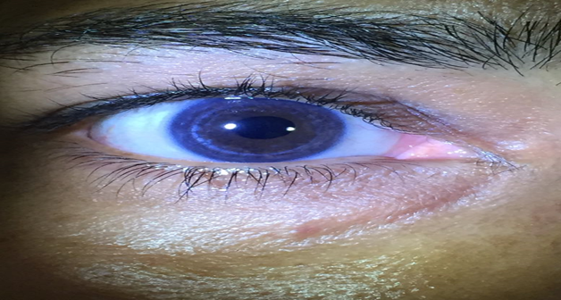

Slide 20
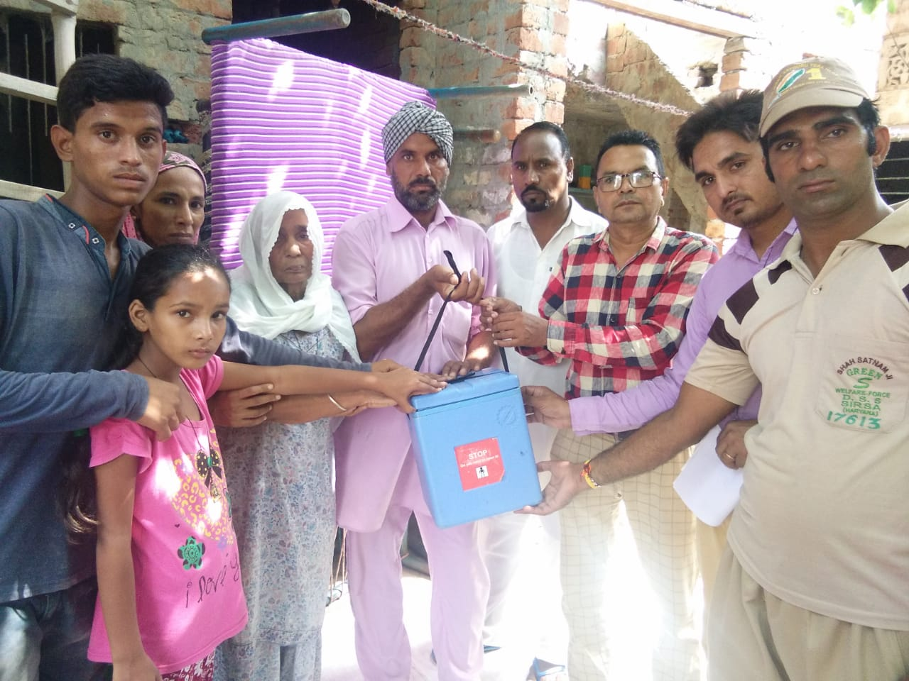
Eye donations
Eye Care Services | Targets year 2017-18 | Achievement for the year 2017-18
Eye Donations | 700 | 1,274

Slide 21
Year Wise Keratoplasties
Total Keratoplasties performed in 2015 to 2018
Year | Keratoplasty performed in Govt. Sector | Keratoplasty performed in Pvt. Eye Banks | Total Keratoplasties performed | Keratoplasties performed by PGIMER Chandigarh
2015-16 | 110 | 536 | 646
2016-17 | 90 | 531 | 621
2017-18 | 68 | 667 | 735 | 227*
Total | 268 | 1734 | 2002 | 227
Total |  |  | 2229

Slide 22

Waiting List
There is no bilateral blind patient awaiting keratoplasty for a long time in Punjab at present.
At present, there are 178 patients in the waiting list of State. All these are fresh cases.
  Patients have to wait for surgery due to shortage of good quality cornea.
  Approx 250 corneal blind patients from Punjab are waiting for surgery in PGIMER Chandigarh .

Slide 23
Challenges
Community level Survey needs to be conducted to identify left out cases of corneal blindness.
Despite best efforts, eye donation is still not popular.
Line listing of corneal blind patients every month is not being done.
Long term follow up record of every patient is not available.

Slide 24
Conclusion
A community based identification of cases with referral, mobilization of resources and surgery was able to achieve the desired results.
All the Civil Surgeons/Head of Department, GMCs have been asked to promote Hospital Corneal Retrieval Programme (HCRP).
The Eye Donation movement would be further strengthened so that there is no waiting time for Corneal Blind patients.
The state is starting new keratoplasty centre at Civil Hospital, Patiala to further enhance the number of keratoplasties.

Slide 25

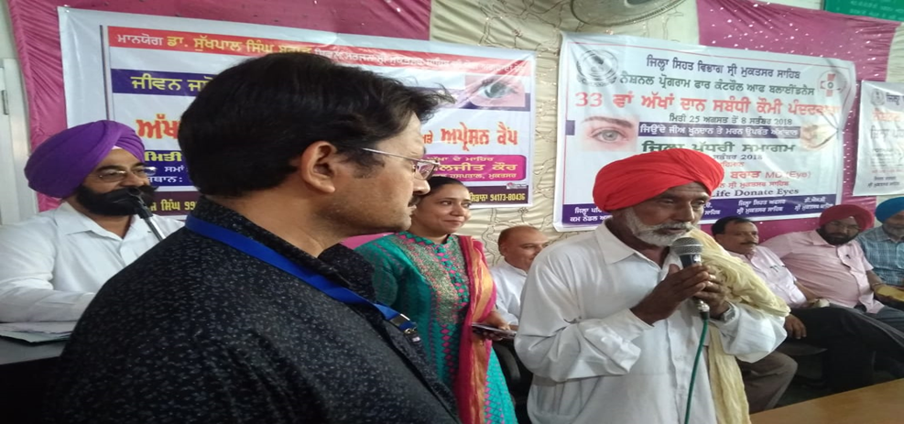
The initiative could not have achieved desired results without the whole hearted support and selfless service of NGOs.
Leading Private keratoplasty surgeons contributed immensely to the cause by performing most of the surgeries with good results.
Bilateral blind patient from Sri Muktsar Sahib post KP VA 6/12

Slide 26

Thank You

Slide 27
Independent Evaluation of CBBFP by Dr Radhika Tandon, Professor of Ophthalmology, Dr Rajendra Prasad Centre for Ophthalmic Sciences, AIIMS
Methodology: Govt of Punjab approached Dr Radhika Tandon as expert for guidance to formulate and implement an action plan to clear the backlog of surgically treatable corneal blindness in Punjab and conduct an independent review of the progress and development and suggest course corrective measures from time to time as and when needed. The study was initiated in September 2015 as a prospective operational research-cum observational study. Firstly a situational analysis of the existing status in 2015 was done covering the resources in terms of eye banks, corneal transplant centres, corneal surgeons, trained manpower, patients registered and waiting for keratoplasty, patients in the community to be screened and referred and mechanisms in place. Brainstorming sessions with administrative officials Govt of Punjab, DRME officials, HOD Ophthalmology of Medical Colleges and RIOs, PGIMER Chandigarh, GMC Chandigarh, private corneal surgeons and medical officers were held and action plan and targets set. It was decided that data collection will be central and periodic analysis and review done.

Slide 28
Independent Evaluation contd…
Services to be strengthened and hurdles to be overcome were listed. Medical officers and PMOAs were commissioned to identify patients who had corneal opacity and refer to ophthalmologist who would screen and refer to corneal surgeons. Corneal surgeons would evaluate and register patients who would benefit from keratoplasty. Eye Bank facilities had to be strengthened, manpower to be trained, help from NGOs in arranging resources and also cover costs for obtaining corneas from other eye banks through centralized distribution system. Periodic 6 monthly reviews were arranged. Data collection proformas were piloted, refined, finalized and then circulated to all eye banks and keratoplasty centres. Screening camps were held giving wide publicity to community to come for eye check up and get screened. Patients detected to have corneal opacity were referred for further evaluation. Patient waiting list records of PGIMER and GMC Chandigarh and also waiting lists of other corneal transplant centres in Chandigarh were checked for any patients coming from Punjab.

Slide 29
References:
Dandona L, Dandona R, John RK. Estimation of blindness in India from 2000 through 2020: implications for the blindness control policy. Nat Med J India 2001; 14:327-34.
Tandon R, Sinha R, Moulick P, Agarwal P, Titiyal JS. Vajpayee RB. Pattern of bilateral blinding corneal disease in patients waiting for keratoplasty in a tertiary eye care centre in northern India. Cornea 2010; 29:269-71.
Gupta N, Vashist P, Tandon R, Gupta SK, Dwivedi S, Kalaivani M. Prevalence of corneal diseases in the rural Indian population: the Corneal Opacity Rural Epidemiological (CORE) study. Br J Ophthalmol 2015; 99: 147-152.

Slide 30
What Change Happened in Punjab
The key change was that this was the first time that corneal blindness was recognized to be a problem worth tackling on mission mode and Government of Punjab was the first State Govt to launch an initiative for corneal blindness backlog free State. In practical terms it was realized that waiting lists are dynamic, but at least backlog of corneal blind patients treatable with keratoplasty should be taken care of. It was estimated that there would be 1400 patients and to round off assuming average 50% utilization rate 3000 corneal donations would have to be arranged.
Additional measures taken to strengthen services were taken making sure that all identified hurdles were solved by team effort including inter-departmental cooperation of key government agencies including mainly NPCB, DRME and police, collaboration of surgeons, govt and private centres, eye banks and NGOs. DRME expedited the notification of THOTA with reduction in fees and extension of eligibility criteria for surgeons, registration of keratoplasty centres and eye banks was expedited, corneal surgeon training and training of PMOAs for eye retrieval and setting up eye donation centres in district hospitals and also permission for donation from post-mortem cases was facilitated. It was also decided that follow up and 6-12 months outcome of surgery should also be monitored.

Slide 31
Outcome: Demonstration of effectiveness of government machinery in serving as driving force in mobilization of resources and leading a concerted effort for important aspect of blindness control. Mission led to successful creation of a sound ecosystem to eliminate corneal blindness eventually. Government of Punjab became first state government in India to set and achieve this notable target in short period of time. Key further goals and steps have been identified namely to become self sufficient in corneas, facilities for HCRP must be improved. New cases being added should be checked and better blindness prevention measures taken to stop needless corneal blindness.

Slide 32
Cornea Blindness Backlog Free Punjab
Dr Radhika Tandon
Professor of Ophthalmology
All India Institute of Medical Sciences
New Delhi
Member Apex Technical Committee NOTTO
Notes:
Thank you for the opportunity to present the recommendations of the Apex Technical Committee NOTTO as approved by DGHS. As I am unable to attend the meeting am most grateful to Dr Roshni from RIO Chennai for presenting the guidelines.

Slide 33
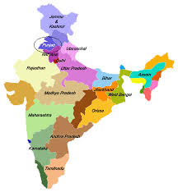
Review
Commendable Effort
Excellent Team Work
Good Beginning
Leadership Role Model

Slide 34
Achievements
Data
Format
Monitoring
Periodic
Centralized
Fast Track
Registration
Adoption of THOTA amendment
Support for HCRP
Police support and Govt Circular

Slide 35
THOTA Amendment
Key issues
Promote
Highlights
Focus
Rules Notified Mar 2014

Slide 36
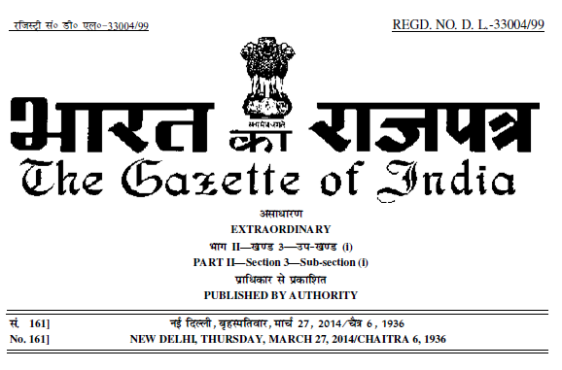

Slide 37
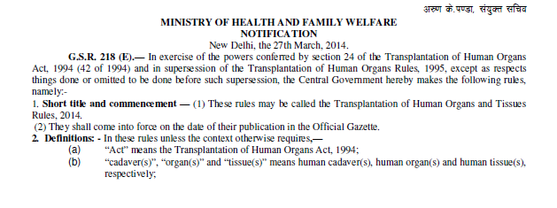
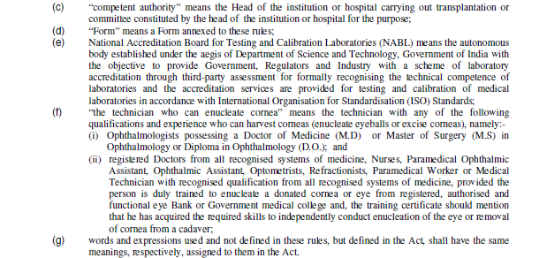

Slide 38
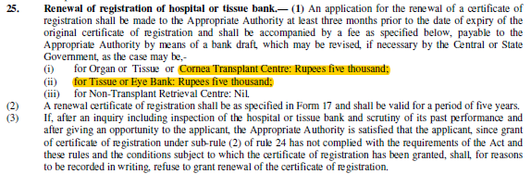

Slide 39
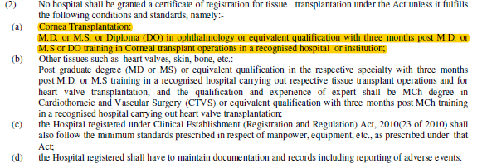

Slide 40
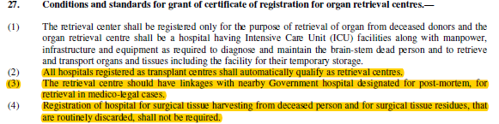

Slide 41


Slide 42


Slide 43
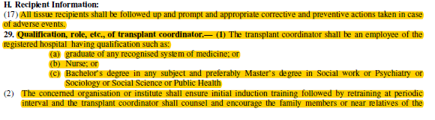


Slide 44
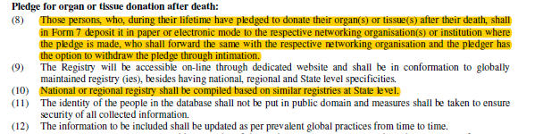

Slide 45
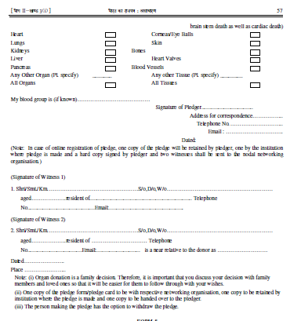
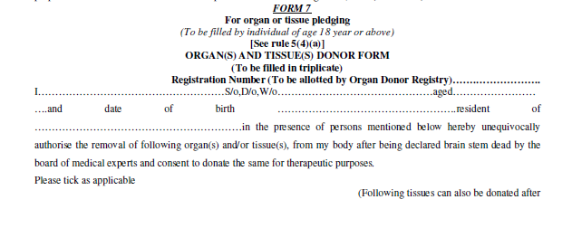

Slide 47
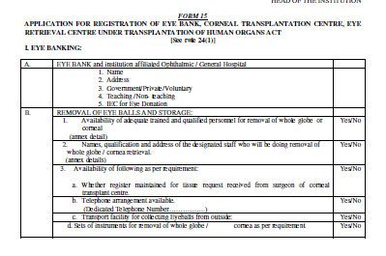

Slide 48
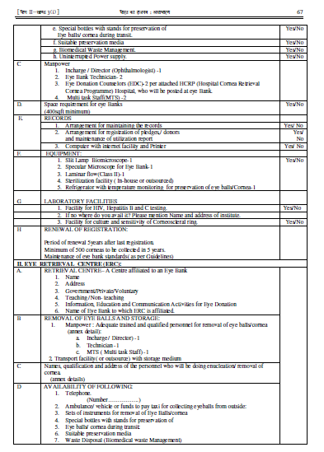

Slide 49
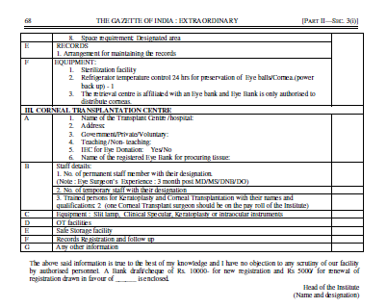

Slide 50
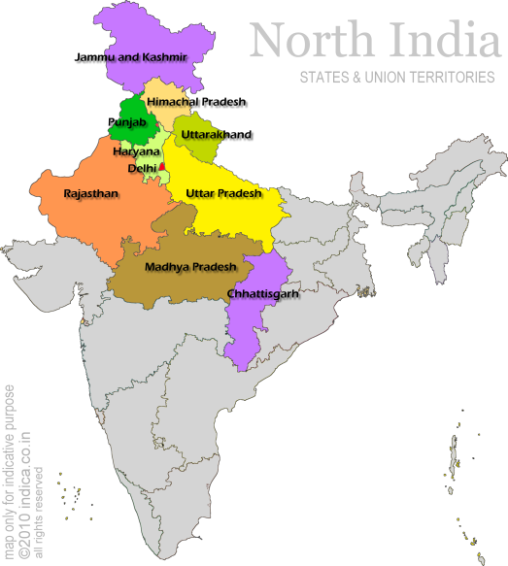
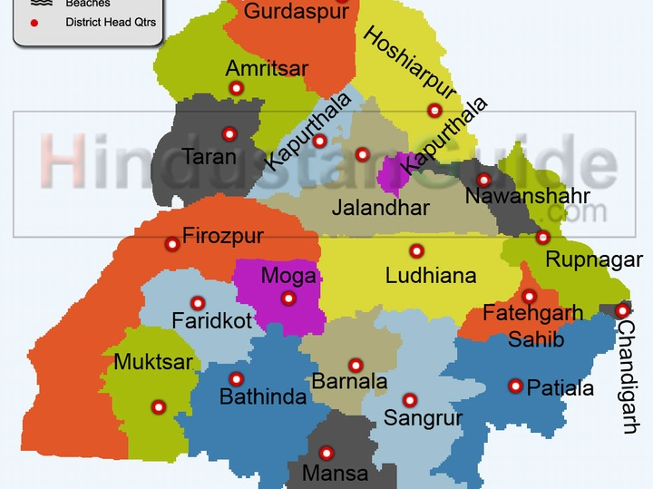
CBBF Punjab
Review

Slide 51
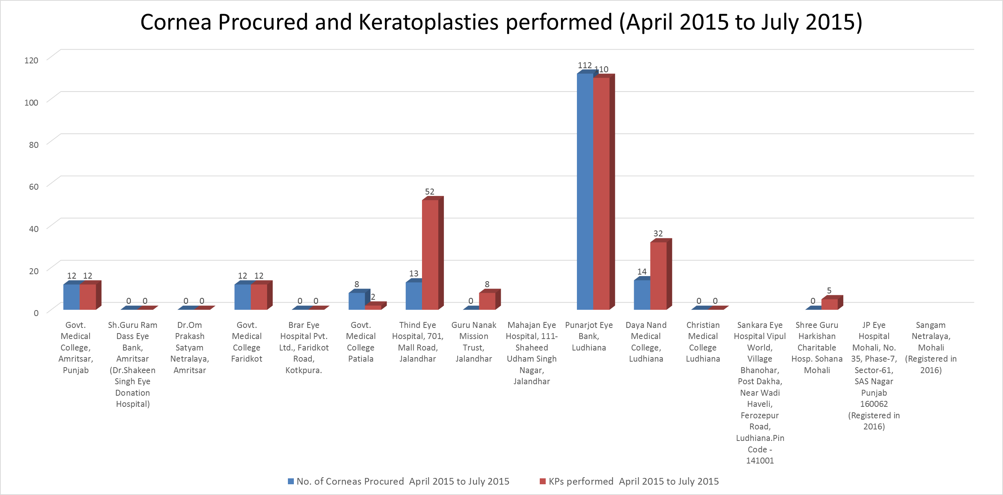

Slide 52
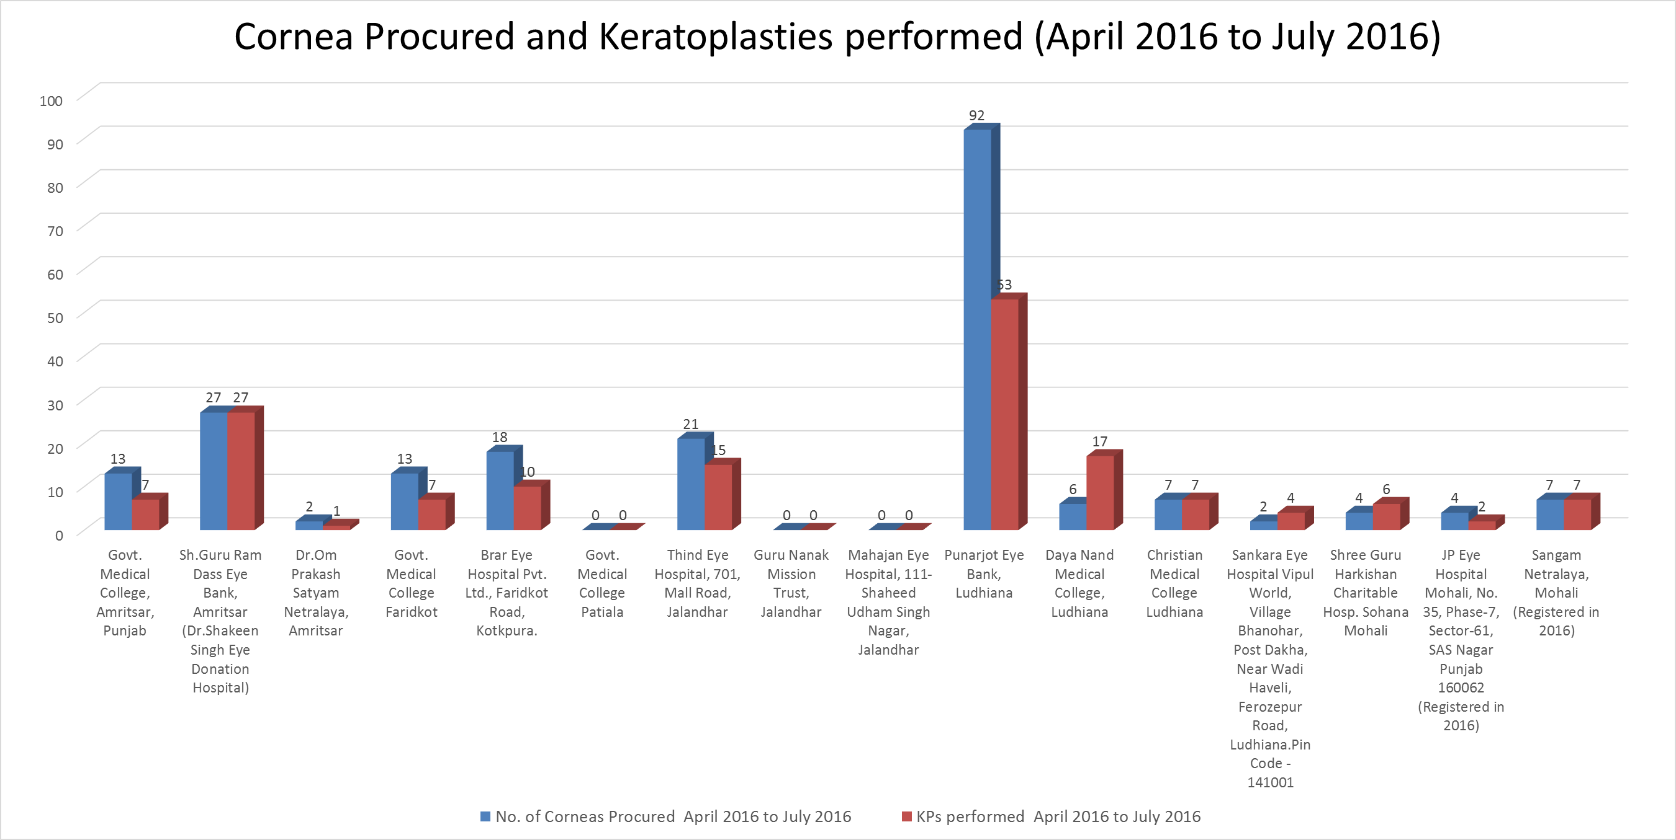

Slide 55
District wise no of corneal blind patients registered in KP Center up to July 2016
Total 359

Slide 56
District wise no of corneal blind patients registered in KP Center as on 19.08.2016
Total 252

Slide 57
Cornea Allocation Policy
Dr Radhika Tandon
Professor of Ophthalmology
All India Institute of Medical Sciences
New Delhi
Member Apex Technical Committee NOTTO
Notes:
Thank you for the opportunity to present the recommendations of the Apex Technical Committee NOTTO as approved by DGHS. As I am unable to attend the meeting am most grateful to Dr Roshni from RIO Chennai for presenting the guidelines.

Slide 58
Cornea Allocation Principles
Based on THOTA
NOTTO
Public Domain
Feedback
Notes:
The policy has been formulated based on the legal requirements. Meeting of cornea experts was convened by NOTTO and a draft allocation guideline prepared. This was shared in public domain asking for feedback. Responses received were studied and suggestions incorporated. The document was modified and submitted to DGHS. DGHS in turn consulted DDGO and after including the feedback it is now approved for distribution and implementation.

Slide 59
Guidelines
National Apex Technical Committee
NOTTO
DDGO
DGHS
Notes:
Due process has been followed at all levels. Still there may be issues that may arise in various states and any further suggestions will be given due consideration. Please submit any comments to Director NOTTO

Slide 60
Key Legal Aspects
THOTA 2011
HOTA 1994
Amendment passed 2011
Gazette Notification of Rules in 2014
Concept of Tissues added
Cornea recognized as a tissue
Rectified the anomalies
Law introduced 1994
Gazette Notification of Rules in 1995
Catered to Organs
Cornea was covered with solid organs
Eye Act of 1983 was repealed
Notes:
Brief Historical Perspective must be kept in mind. Cornea Act of 1983 was repealed when HOTA was passed in 1994. There were some problematic issues as far as eye donation, banking and corneal transplantation were concerned. For example the requirement for MBBS doctors only to harvest the eye/cornea and lack of legal permission for usage of eyes not suitable for transplantation in surgical training or research. The Act was amended in 2011 and the Rules framed in 2014. Many of the problematic issues were taken care of.

Slide 61
THOTA 2013 Guidelines
Trained Technician
Transplant Coordinator
Consent for medical education/research
Required Request
Distribution Policy
Implementation
Rules 2014
Notes:
Key helpful provisions introduced include the permission for trained eye bank technician to harvest the eyes/corneas if death is certified by a medical practitioner. Recognition of requirement for having a transplant coordinator is another helpful element to support HCRP and also improve coordination to avoid wastage of tissues and improve post-op care. Required Request provision for all ICU deaths is another step to support HCRP. Distribution policy has been clearly outlined. It is confirmed by law that till the National waiting list of patients is not cleared in India, corneas donated cannot be provided for foreign nationals.

Slide 62
Cornea Allocation
Eye Bank
  Registered CTC
  Waiting List
  Criteria
  Accountability
Transplant Centre
  Registered Patients
  Waiting List
  Criteria
  Accountability
Notes:
Corneas collected and processed by the eye bank after clearance for clinical use will be offered to the registered transplant surgeons at registered transplant centres. The Transplant Centre must follow the recommended guidelines and operate on the registered patients according to the waiting list and following the priority in terms of medical indication, social need and serial chronological sequence keeping in view the medical criteria for suitability and tissue matching in terms of age of patient, grade of cornea and type of surgery planned.

Slide 63
Cornea Allocation Keys
Deceased Donor
Recipient Allocation
Standardization
Individual Situations
  Medical Priority
  Urgency
  Donor-Recipient Matching
  Logistic Factors
Notes:
Several factors are taken into consideration by eye banks and corneal surgeons in determining how best to place the tissue for transplantation. Some level of broad consensus or agreement has been created by the NOTTO. There is still scope for some individual variations as the situation demands. The basic aim should be to make sure the gift of sight is best delivered without wastage or misuse.

Slide 64
Cornea Distribution Facts
Disparity in Supply vs Demand
Medical Priority
  Emergency situations
    Perforated ulcers
    Impending perforation
    Trauma with tissue loss
  Children
  Bilateral Progressive Disease
  Endothelial Keratopasty
Social Priority
  Bilateral Blind
Notes:
Medical situations vary and the cornea being perishable may not always be best placed. Every effort should be made to have a proper system in place. Each eye bank will have to administer the policy keeping SOTTO, ROTTO and NOTTO informed of status and any deviations may have to be justifiably explained.

Slide 65
Cornea Distribution Order
Local
State
National
International (presently this is not allowed)
Notes:
Cornea if available is expected to first be offered by the eye bank to the local transplant centres. If there is no suitable recipient with any of the local surgeons waiting list then it can be offered at State level and then Nationally. EBAI has worked with SightLife to develop a pilot centralized cornea distribution system CDS which is quite successful. However, this pilot system needs to be expanded to include more eye banks and transplant centres.

Slide 66
Allocation Policy Document
NOTTO
Website
Notes:
The document submitted to DGHS has been approved in principle incorporating DDGO suggestion that it must be clearly specified that as of now in India cornea cannot be offered for foreign nationals as there are too many patients waiting. This corrected document will be uploaded on NOTTO website and ROTTO and SOTTO are expected to monitor and ensure compliance or submit suggestions/recommendations for modifications through proper channel.

Slide 67

Thank YOU
radhika_tan@yahoo.com

