Slide 1

Covering Private Sector TB Patients through
Public Health System – Mehsana Model of Universal Access to Free TB Care, Gujarat
Dr. Gaurav Dahiya, IAS
Mission Director
National Health Mission,
Department of Health & Family Welfare, Gujarat

Slide 2
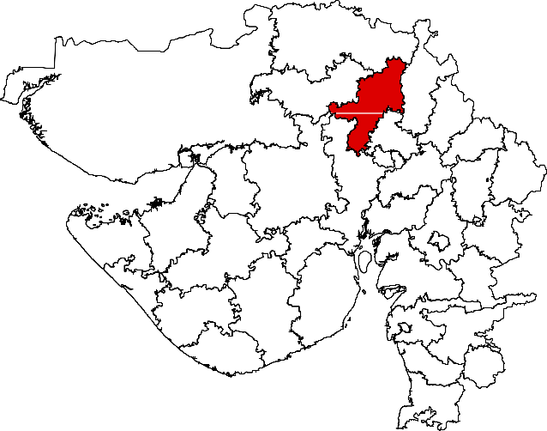
District Geography and Profile
District Profile & Staff |  | Mehsana
Population | Total population | 22,88,327
 | Urban population | 5,60,000
Public health facilities | TB Units | 10
 | DMCs | 37
 | PHI | 86
Private health facilities | Private doctors | 588
 | Chemists | 437
Staffing | DTO | 1
 | MO TB Care | 10
 | District Programme Coordinator | 1
 | District PPM Coordinator | 1
 | DR-TB Supervisor | 1
 | Senior Treatment Supervisor | 10
 | Senior TB Lab Supervisor | 4
 | TB Health Visitor | 5
Initiated from 31st July, 2014.
Objective & Approach
Universal Access To quality TB Care
ICT-based notification
Free TB Drugs via e-voucher
Adherence support
Contact & co-morbidity screening

Slide 3
Value Addition / Benefit to Patients and Providers
Free services to Patients
First line drugs
Drug sensitivity testing
Provider benefits
Training on STCI
End to end case tracking
Additional benefits
ICT based Adherence support
Public Health Action Support
Electronic patient notification
Increase in patient load
Near real time payment transfer to chemists

Slide 4
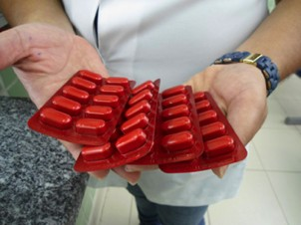
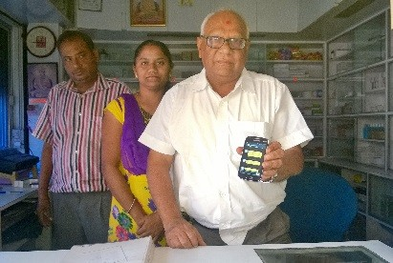


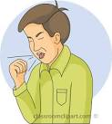
Routine Scenario of Private TB Care
Patient
Private Practitioner
Patient purchase drugs
Chemist
A patient consults private practitioner and diagnosed with TB
Prescribe anti-TB drugs
Dispense drugs as per prescription
Patient
Private Practitioner
Chemist
Contact Centre
Free drugs to patients
Intervention model
A patient diagnosed with TB by private practitioner
Easy notification via call centre
e voucher for free medicines
Hassle free drug dispense
Notes:
Routine situation in private sector for TB care without project – a patient consults practitioner and diagnosed as TB (basis of diagnosis is not known to programme), private practitioner prescribes anti-TB drug (prescription is not known to the programme), delay in notification of patients or no notification because of lack of motive or enabling environment, chemist dispense medicine ant patient expense from their pocket, no follow up or adherence support due to lack of rapport / strong system of coordination, no efforts to improve diagnosis practices / if any, doctors may not be receipt due to lack of strong support mechanism.

Slide 5
Conceptualization
Meeting with IMA & Pharmacist association
Surveillance of Doctors and community pharmacist
Received prescriptions from PPs
Develop drug master
Training of RNTCP staff
Training of Doctors and Pharmacist
Establishment of call centre with sensitization of staff
Trial
Advocacy meeting with state officials and Stakeholders
Roll out
Preparation guidance document
Corrective action

Slide 6
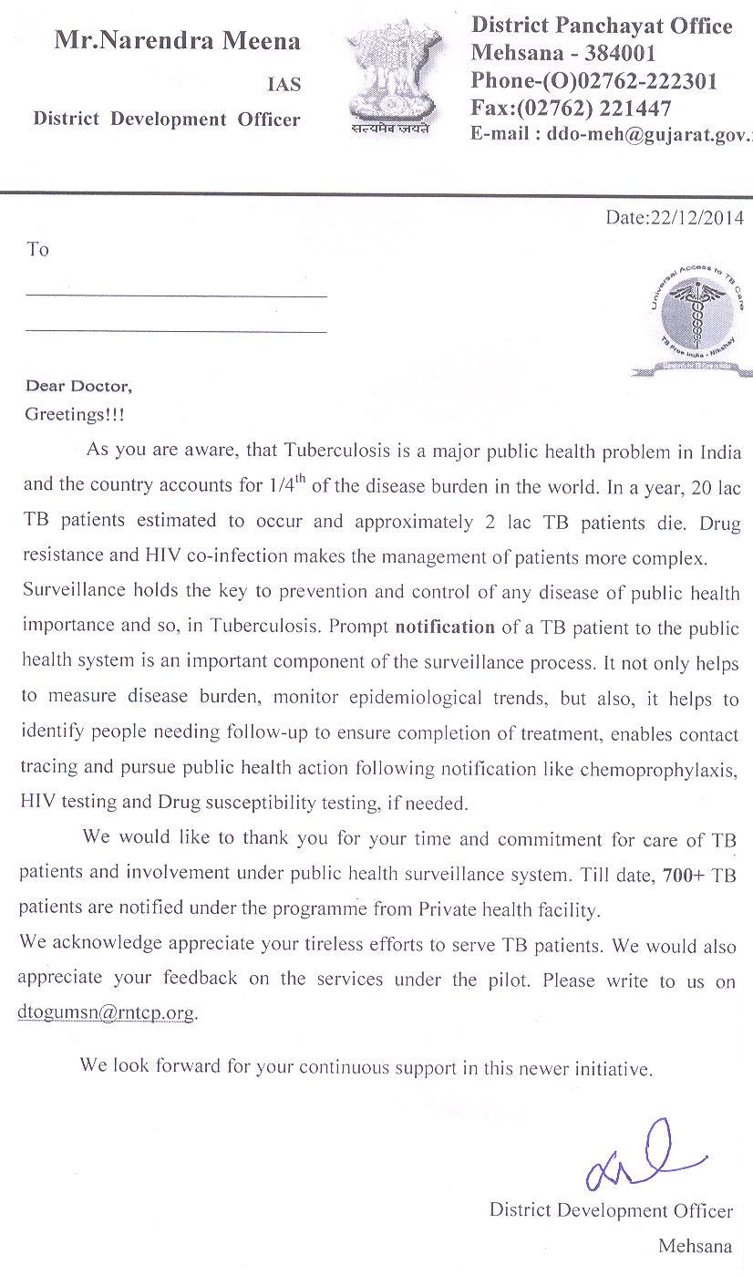
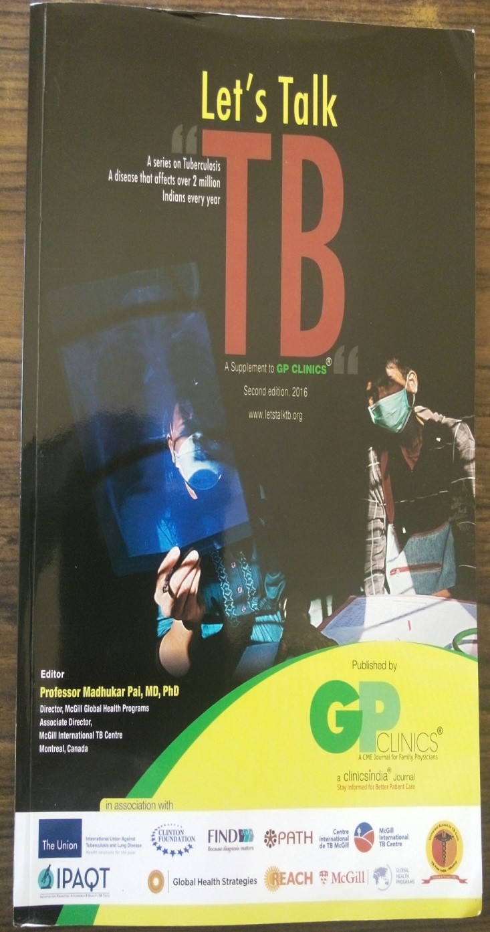
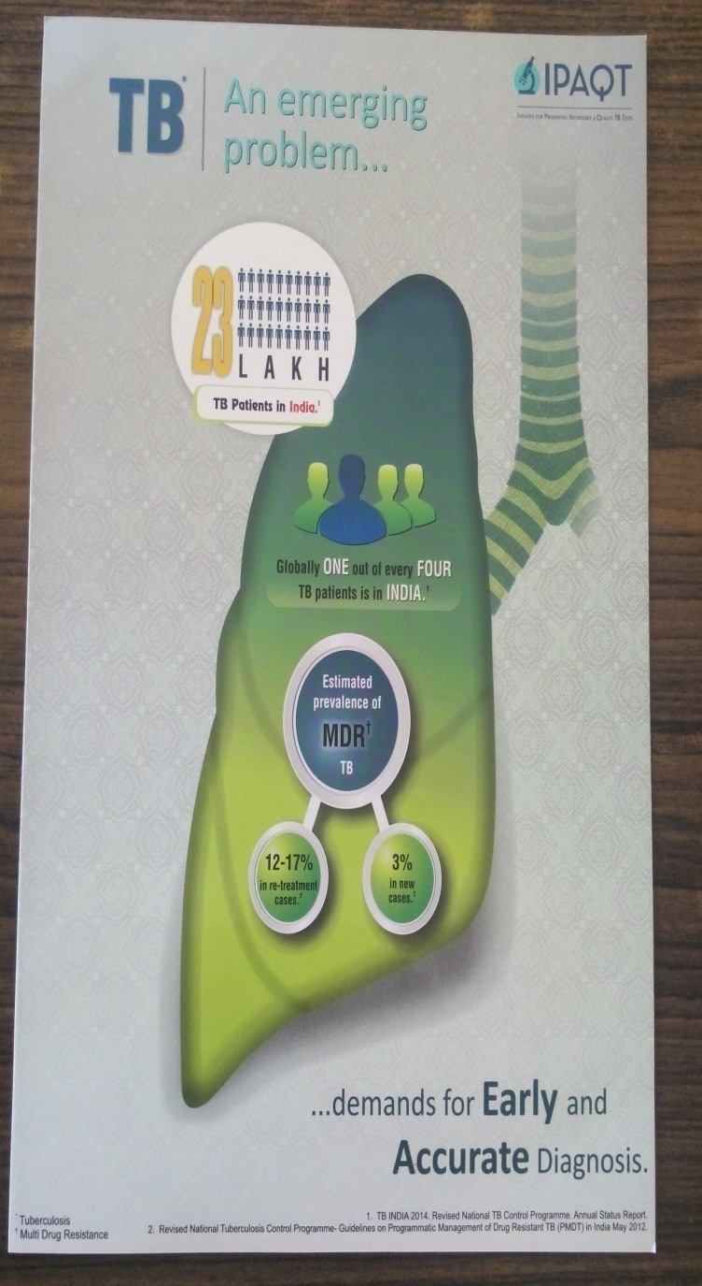
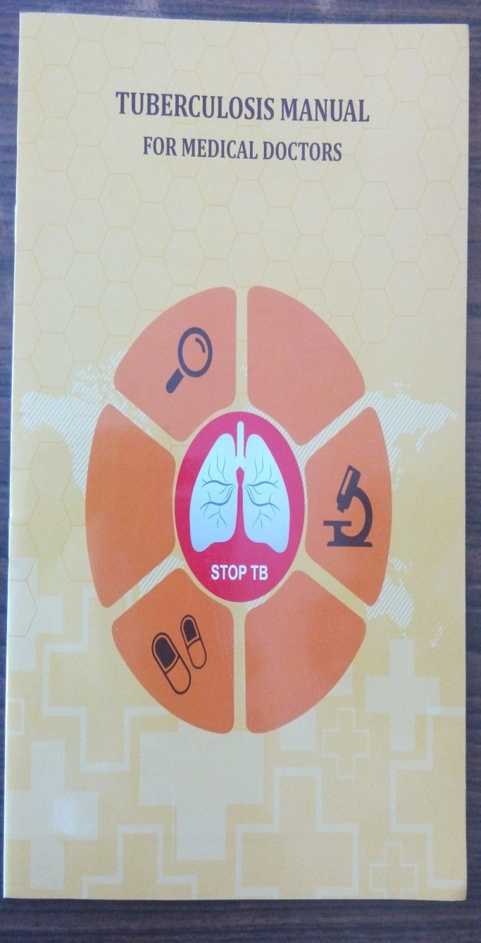
Appreciation Letter for PP & Chemist by DDO
TB CME Materials distributed to Private Providers

Slide 7
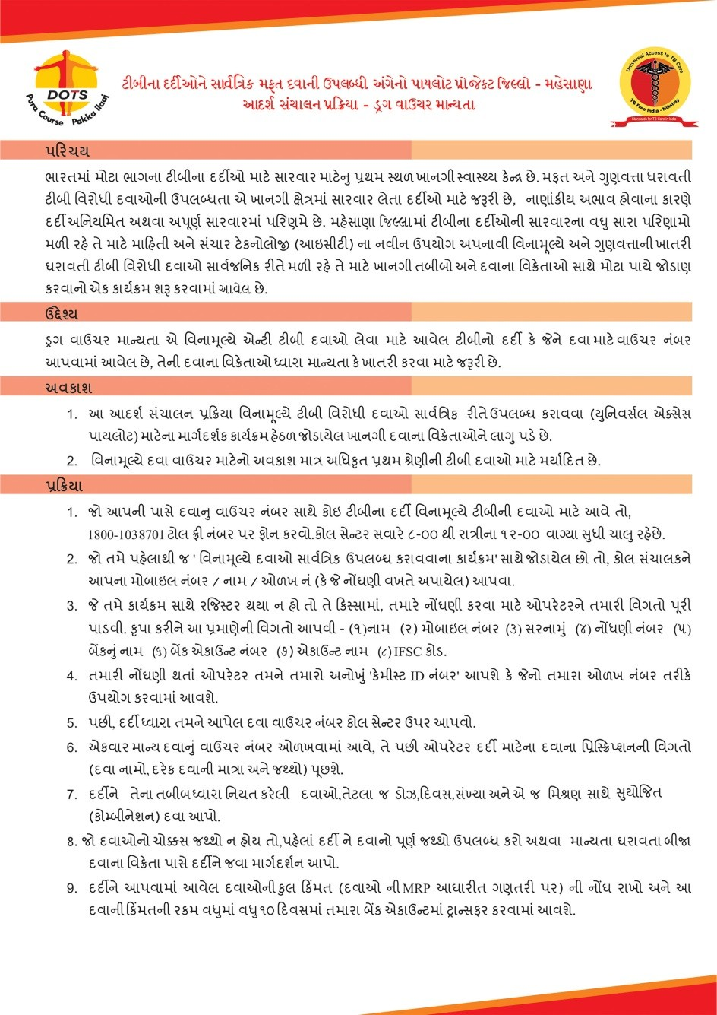
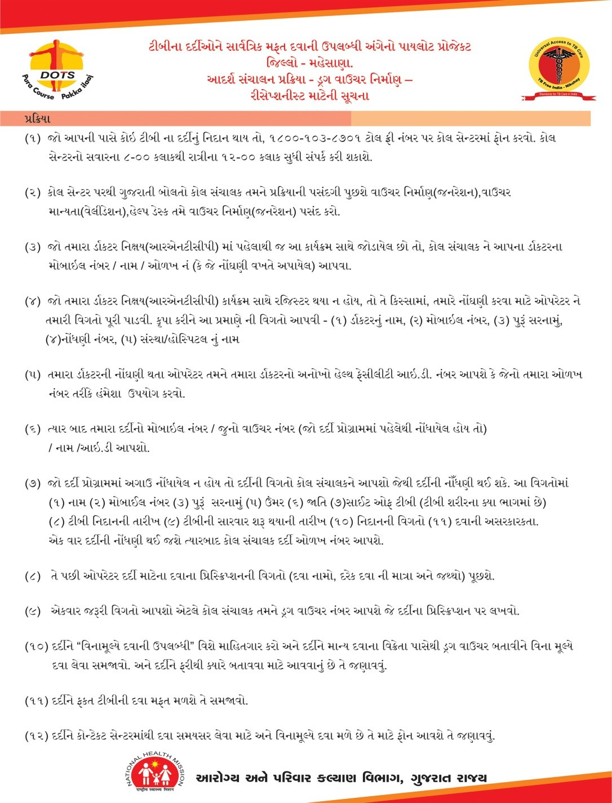
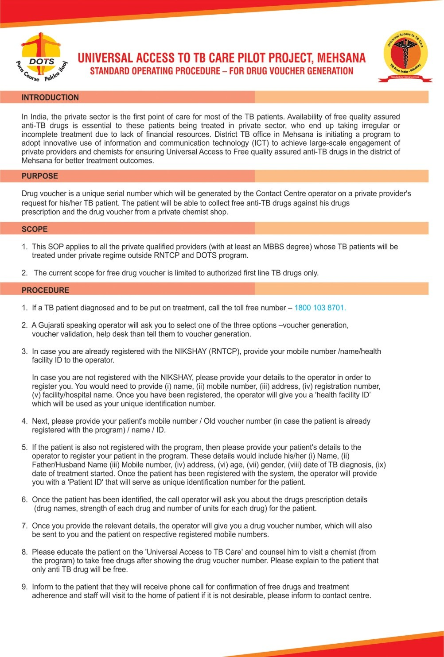
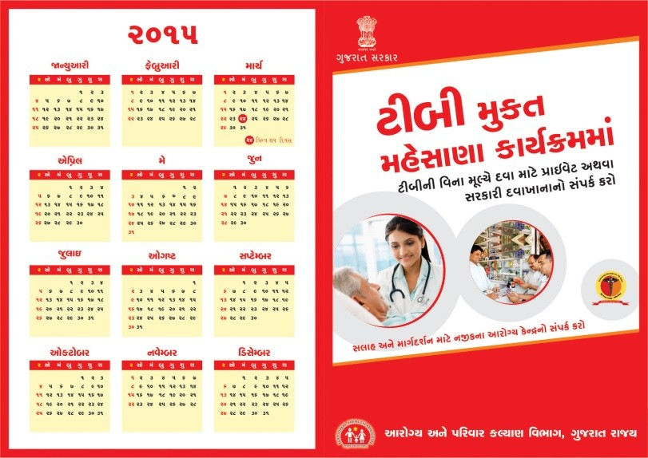
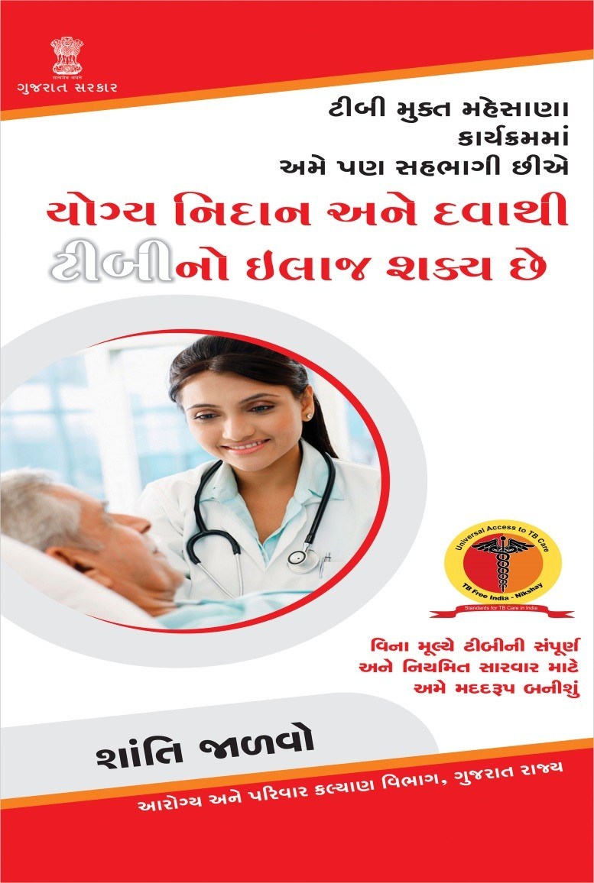
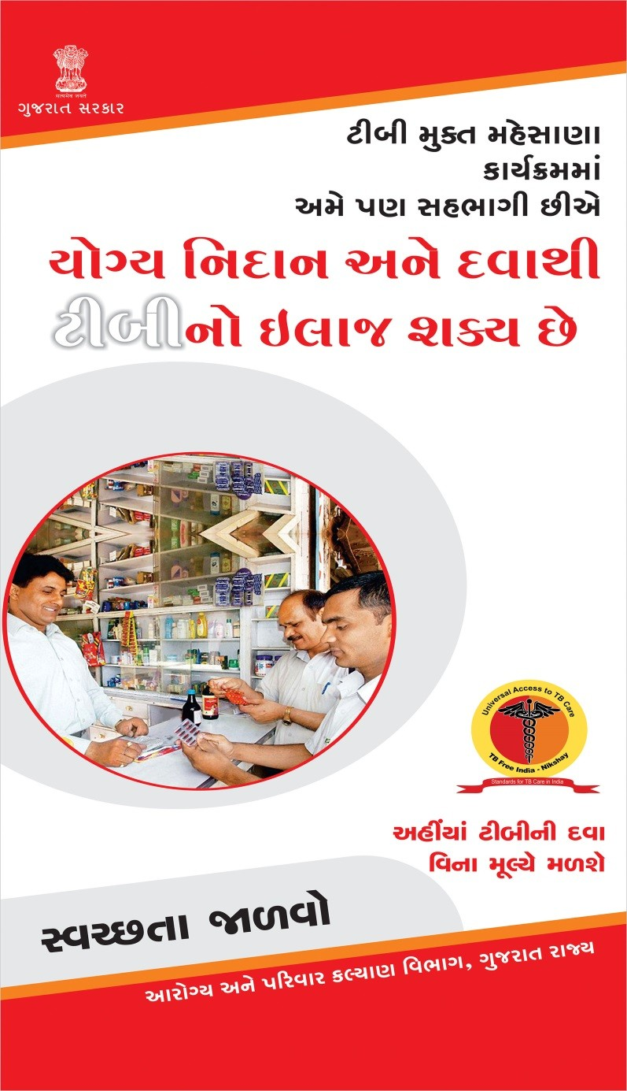
SOPs for Staff & Communication Materials
Chemist
Receptionist
Doctor
Calendar for TB patient & chemist
IEC material for Chemists
IEC material for Doctors

Slide 8
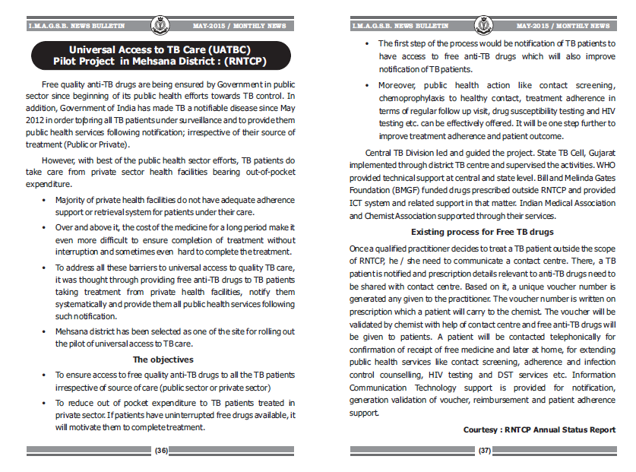
Model Outline Publication in IMA Bulletin

Slide 9
Provider coverage (March ’18)
Doctors
Chemists
Targeted 312
Engaged 312
Active 130
Mapped 344
Targeted 177
Engaged 175
Active
102
Mapped 435

Slide 10
Impact on Quarterly TB notifications :
Public and Private

Slide 11
Year wise Total TB Case Notification Rate
(Per 1 lakh population)

Slide 12
Microbiological Confirmation (Dist-Mehsana)
Year - Qtr | No. of TB patients notified | No. of TB patients received microbiological test | % | No. of TB patients microbiological confirmed (among tested) | %
2015 (3Q-4Q) | 1037 | 192 | 19% | 100 | 52%
2016 | 2237 | 357 | 16% | 100 | 28%
2017 (1Q-2Q) | 1080 | 209 | 19% | 63 | 30%
Low microbiologically confirmed patients as compared to clinically diagnosed due to fact PP are rely on x-ray for diagnosis despite frequent sensitization
Use of incentive for patients and logistic was challenge faced

Slide 13
Public health action following Notification
Immediate action
Call patient
STS (Field observer) Received SMS immediately at the time of voucher generation / validation
Confirm for free drugs
Counselling
Ask for address
Fix home visit date
Downloading sheet from UATBC webpage
Segregating patient as per TU
Handover to STS & TBHV during monthly meeting
Field visit of notified patients
HIV testing, DST, DM screening
Later action (monthly)

Slide 14
Public Health Action following notification
Indicators | N
No. of TB patients notified since implementation (up to Dec-17) | 11194
No. of TB patients visited at home | 7235 (65%)
No. of household contact (under 6 years) given chemoprophylaxis | 186
No. of household contacts identified as presumptive | 269
No of HH contacts evaluated for diagnosis of TB | 155
No. of household contacts diagnosed as TB | 6
No. of TB patients Offered HIV testing | 5475
No. of TB patients Offered DM screening | 5506
Number of notified microbiologically confirmed cases that received a DST | 272
Number of cases diagnosed as Rifampicin resistant TB | 35
Number of RR TB cases put on Category IV treatment | 33
e – data updated up to Dec’17

Slide 15
Treatment Outcomes [2015-2016]
 | 2015 cohort |  | 2016 cohort
Treatment Completed | 1085 | 72% | 1581 | 71%
Death | 62 | 4% | 139 | 6%
Lost to Follow up | 345 | 23% | 502 | 22%
Switch to Cat IV | 10 | 1% | 10 | 0.4%
Total | 1502 | 100% | 2232 | 100%
Reason for Lost to follow up – Not traceable / Wrong Address / Incomplete address / ADR / migrated / Confidential matter
Outcome of patients those who are from outside district is a challenge

Slide 16
Payment Reimbursement Status & Cost Evaluation
31st July-14 to 31st January - 2018
Voucher History | No.
No. of TB patients notified | 11,456
Number of vouchers generated | 42,914
Number of vouchers validated (% ) | 40151 (94%)
Total amount of drugs reimbursed | Rs. 1,83,77,395
Indicators ( at time of Cost evaluation Study) Dec 2017 | Mehsana
No. of TB patients notified | 4837
No. of TB patients given free drugs | 4578
No. of patients months of vouchers reimbursed | 15,822
Total amount of drugs reimbursed | Rs. 60,75,324
Cost of drugs saved to patients by interventions | Rs. 1,327.06
Payments are processed online through Third Party Agency
Turn Around Time for Payment Credit from the time of Payment Approval is 3 to 4 days

