Slide 1



Dakshata Mentor Application
NHM Rajasthan

Slide 2
Goal
Rationale
The app launched on 18th ,may 2018 in the State.
Objectives
List out the priority areas of improvement and measures to be taken to build up the capacity of the service providers.
Ensuring a constant mentoring mechanism for provision of quality intra-natal and immediate post-partum care.
To strengthen facility level mentoring and supervision of LR through user friendly application which allows efficient data collection and generates actionable outputs.

Slide 3
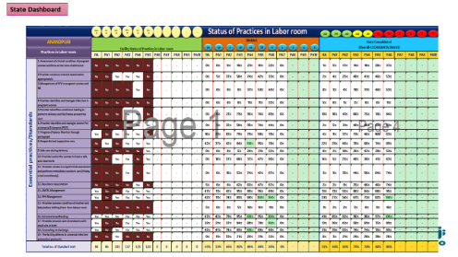

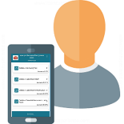

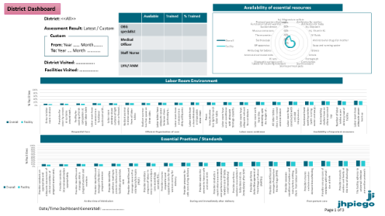

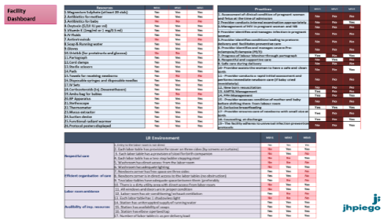
System architecture of Dakshata Mentor App
Online Application
State
District
State/ District/ Facility
Dakshata Mentors
@ Facility
Facility
Summary Reports
Notes:
We will provide mobile application to all the Dakshata Mentors
They will able to fill data offline in their android handset
After completion of assessment, they can connect their handset will internet and report data in online application.
State, District and Facility level staffs will able to see the progress using dashboard.
All level of user will have access to summary reports for their respective location.

Slide 4
Data Elements used
Aligned with Dakshata Package
Training status of Labor Room Staff
Essential Resources in labor room
Adherence to 19 Clinical Practices
Topics Covered During Mentoring Visit
Labor Room Infrastructure

Slide 5
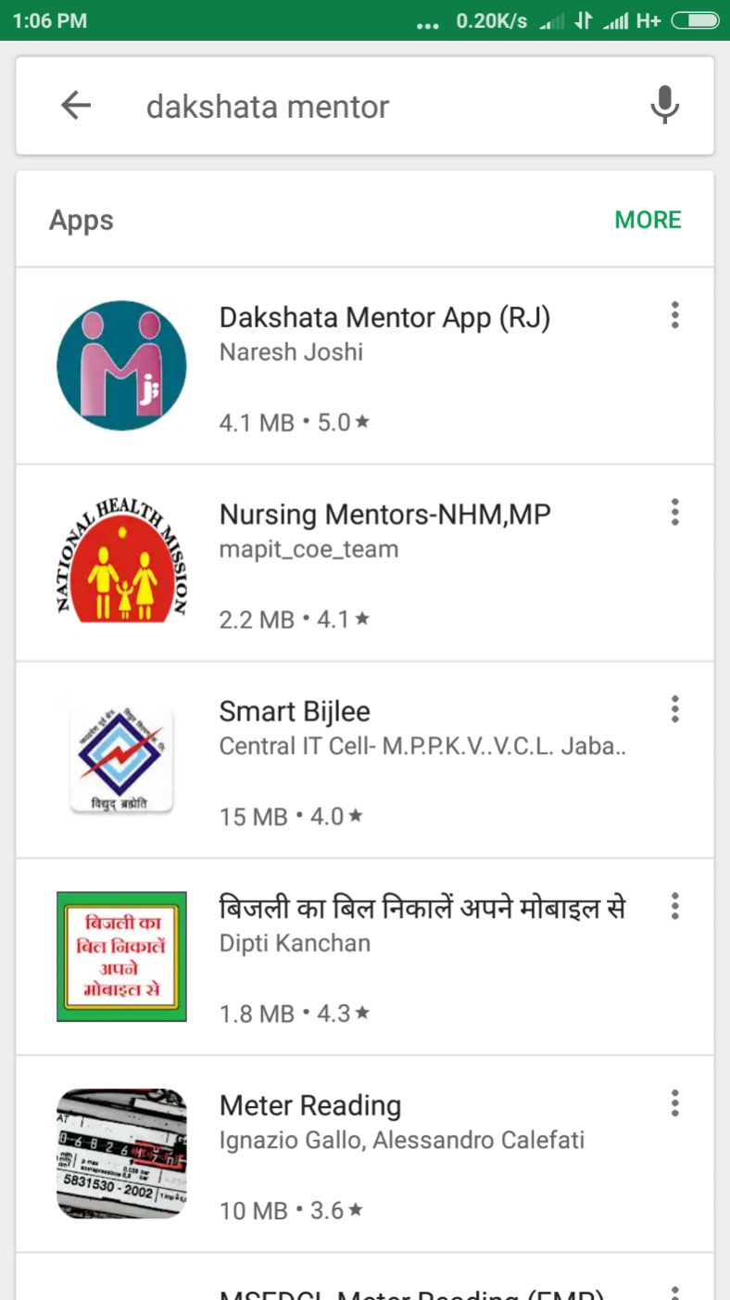
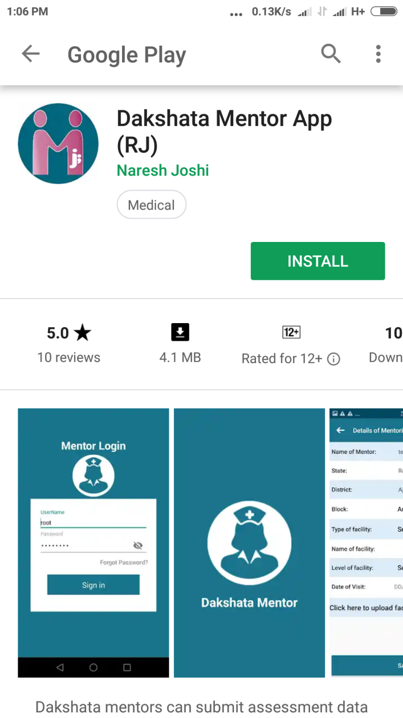
Installation
Available for free download on Google Playstore

Slide 6
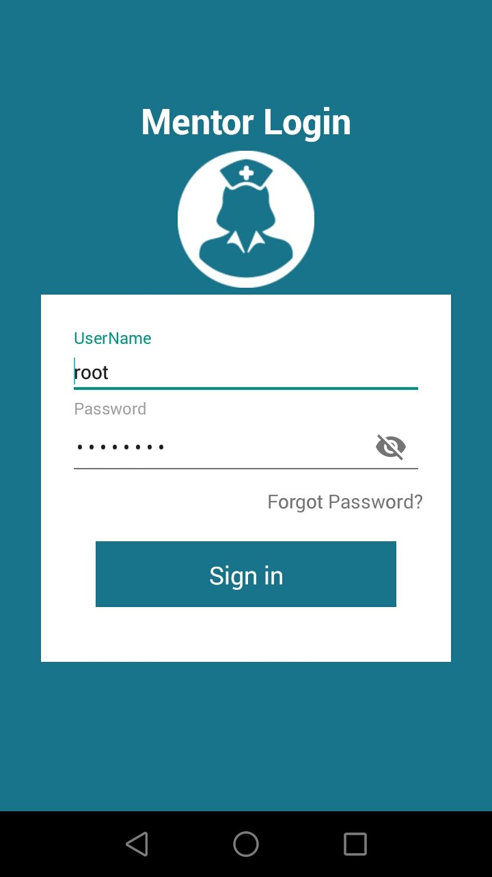
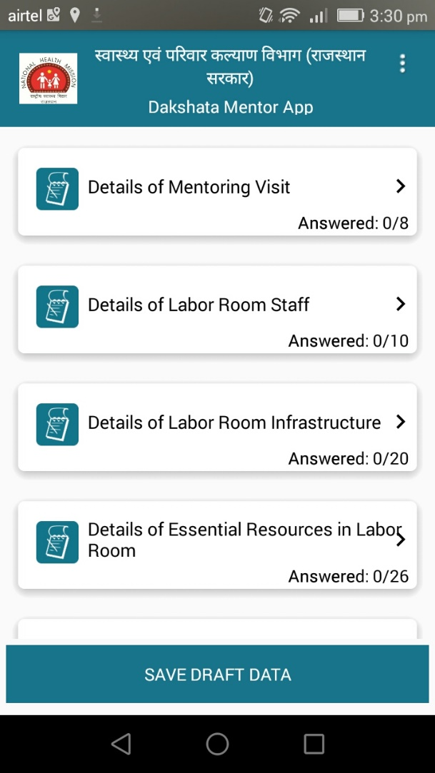
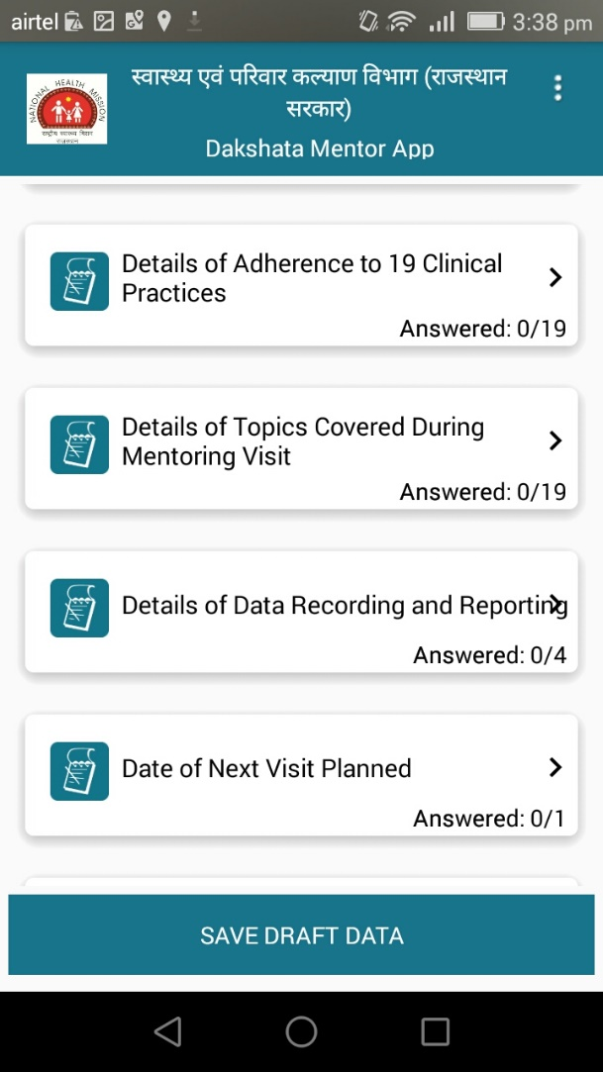
Interface
Navigation Screen

Slide 7
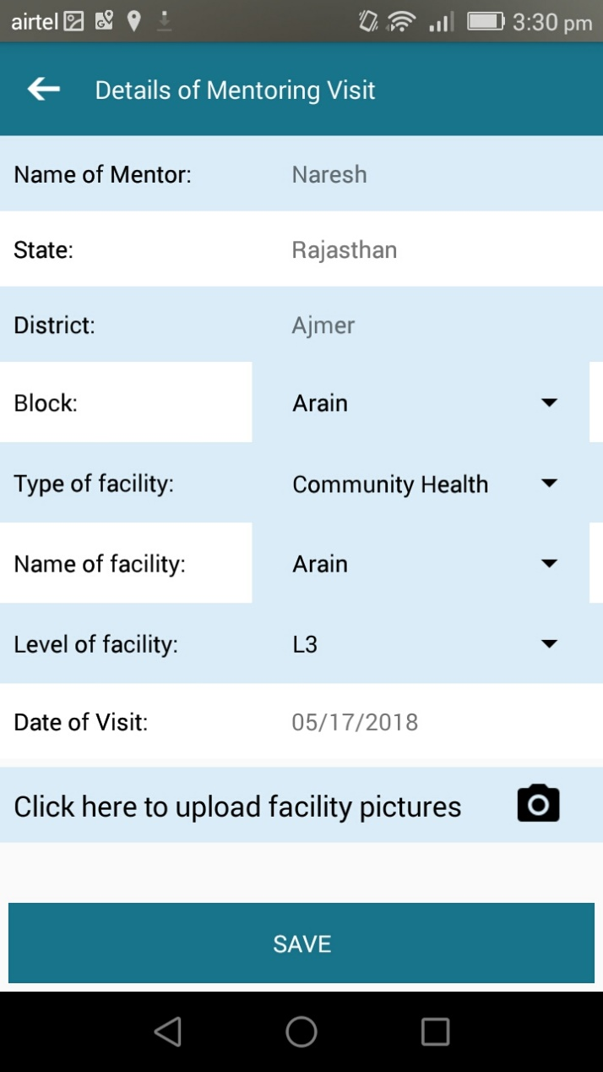
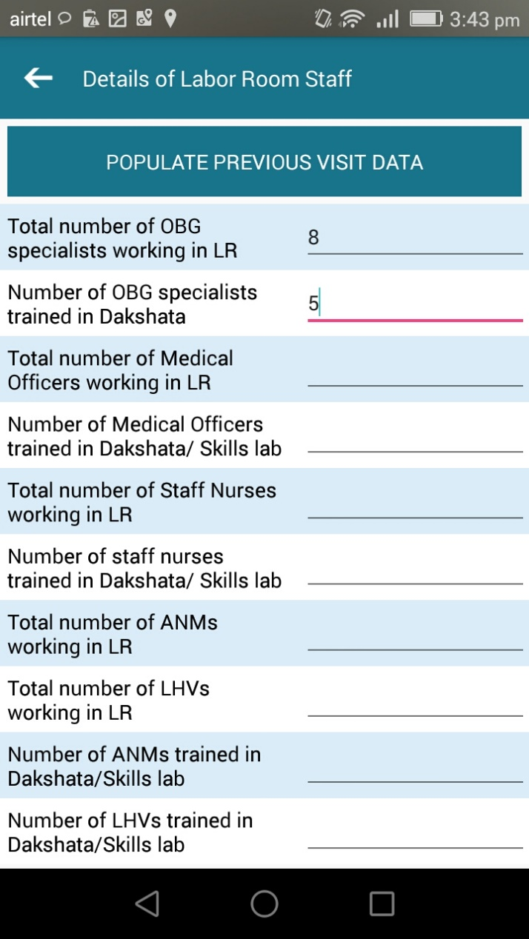
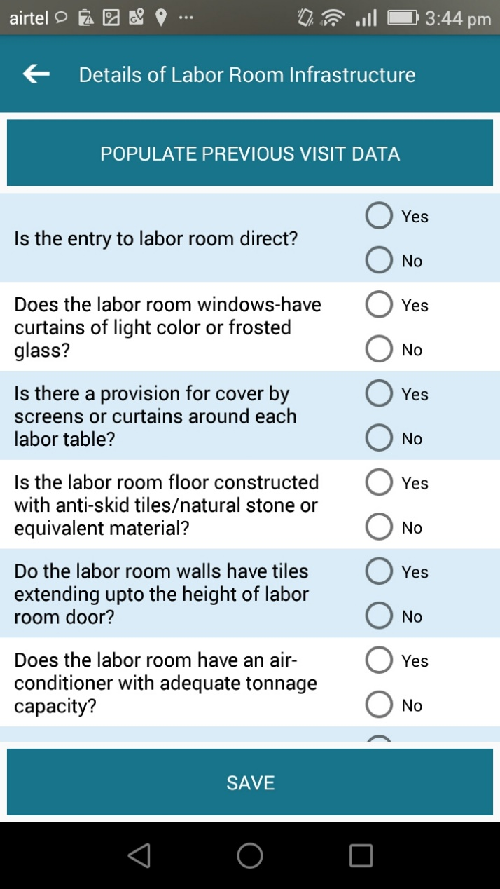
Facility Mentoring : Sections
Section-A: Details of Mentoring Visit
Section-B: Details of Labor Room Staff
Section-C: Details of Labor Room Infrastructure

Slide 8
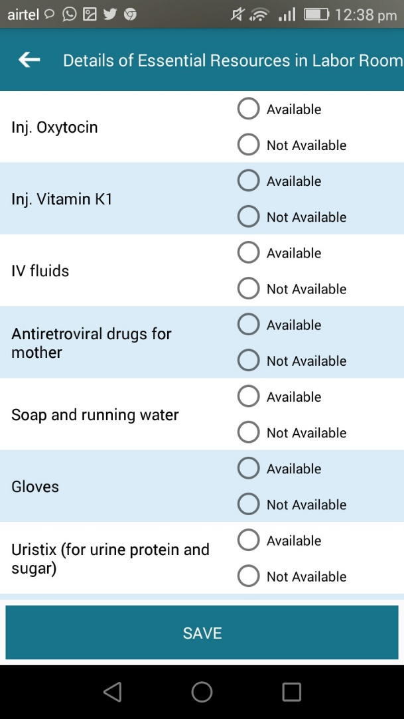
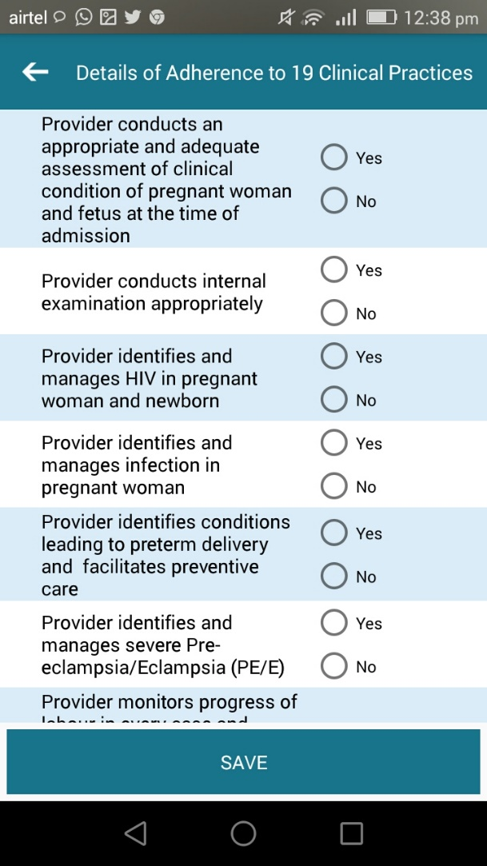
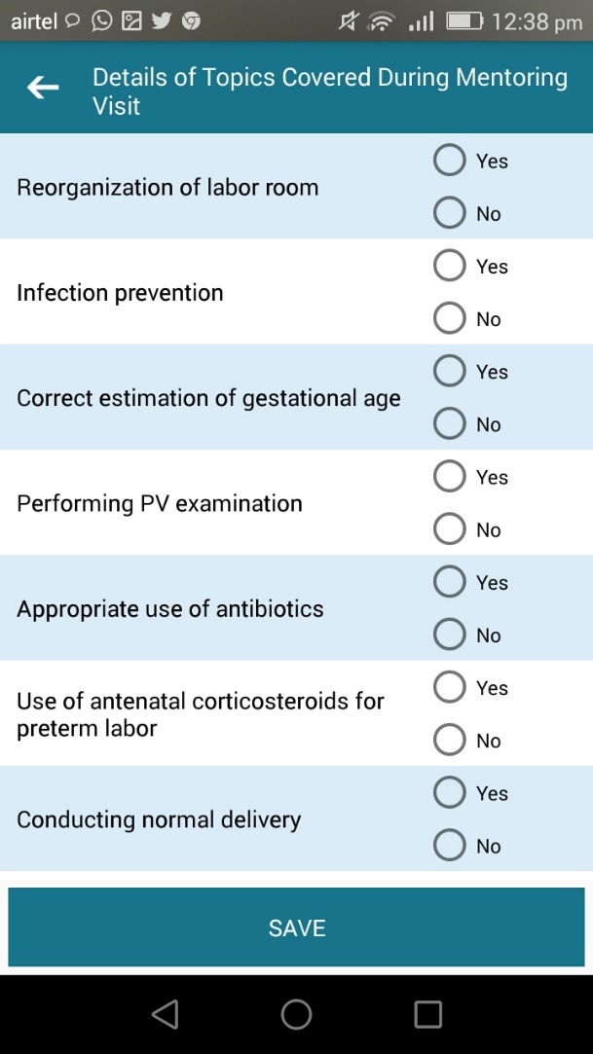
Facility Mentoring : Sections
Section-D: Details of essential resources in labor room
Section-E: Details of Adherence to 19 Clinical Practices
Section-F: Details of Topics Covered During Mentoring Visit

Slide 9
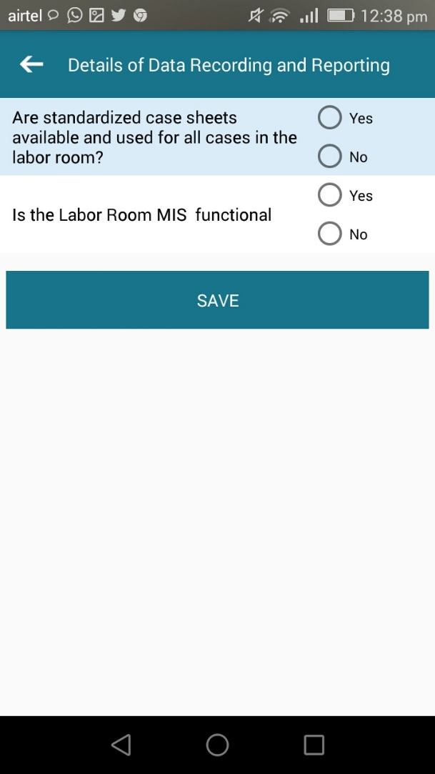
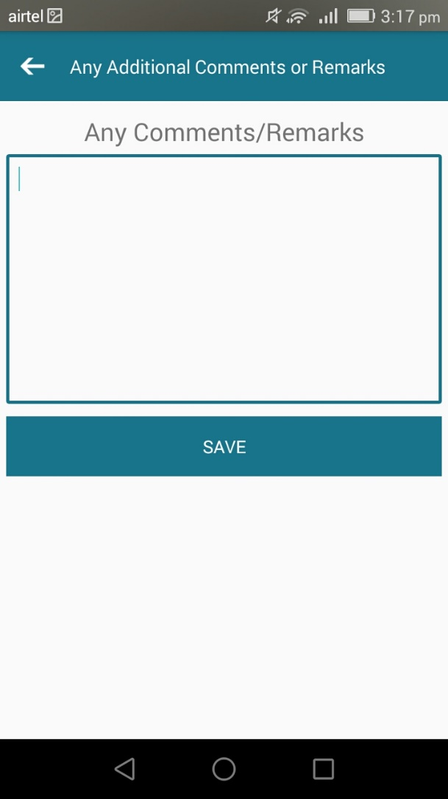
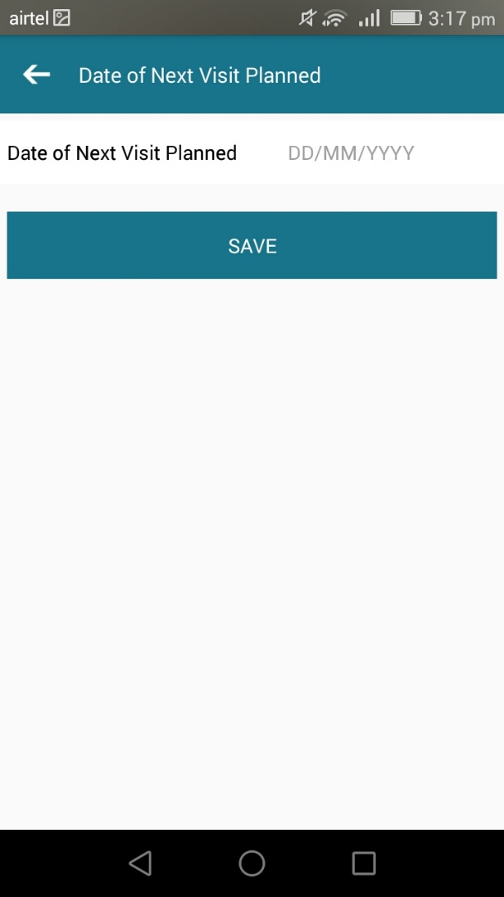
Facility Mentoring : Sections
Section-G: Details of Data Recording, Reporting and other

Slide 10
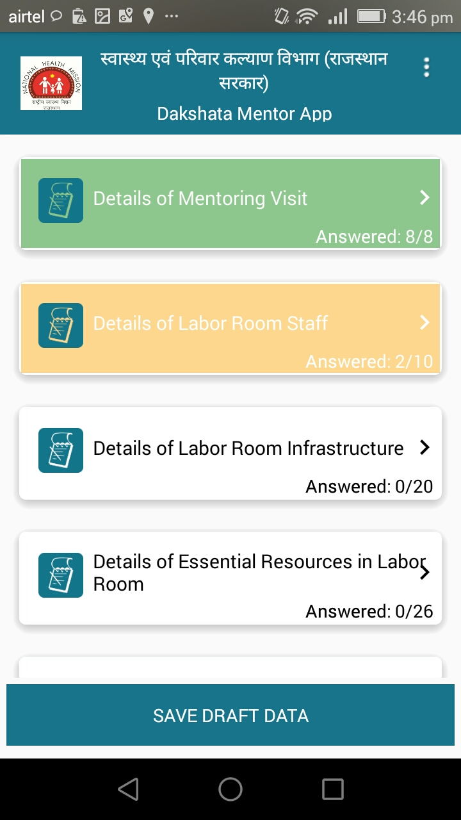
Colour coded Tabs
Reported all the data elements.
Some of the data elements are blank.
No question answered.
Save data in mobile to review and edit

Slide 11
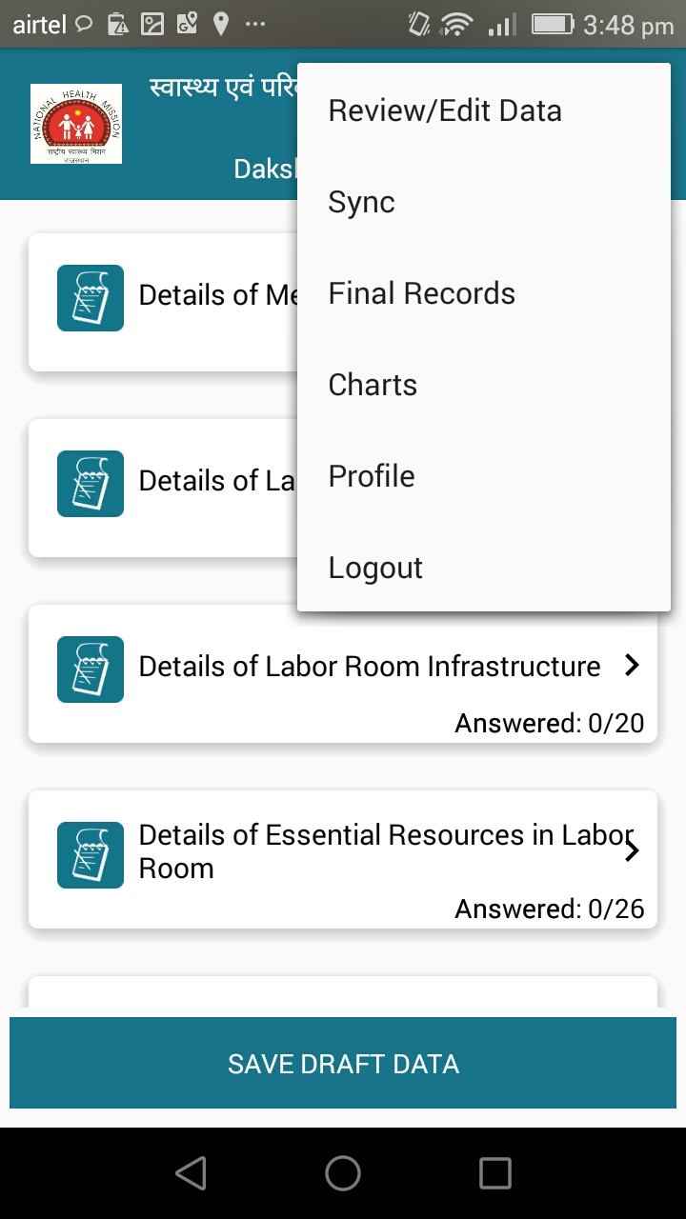
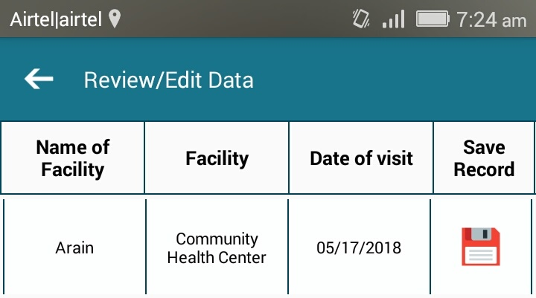
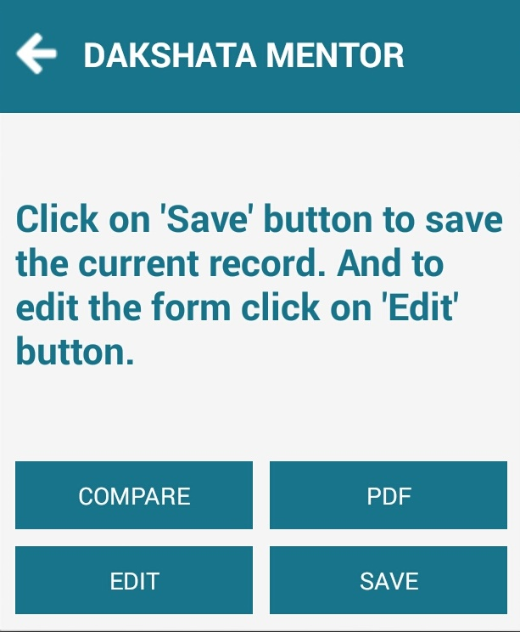
Features : Saving and Reviewing Records
Assessment Form in pdf
Compare Assessment data with previous assessment
View & Edit Data
Finalize Data

Slide 12
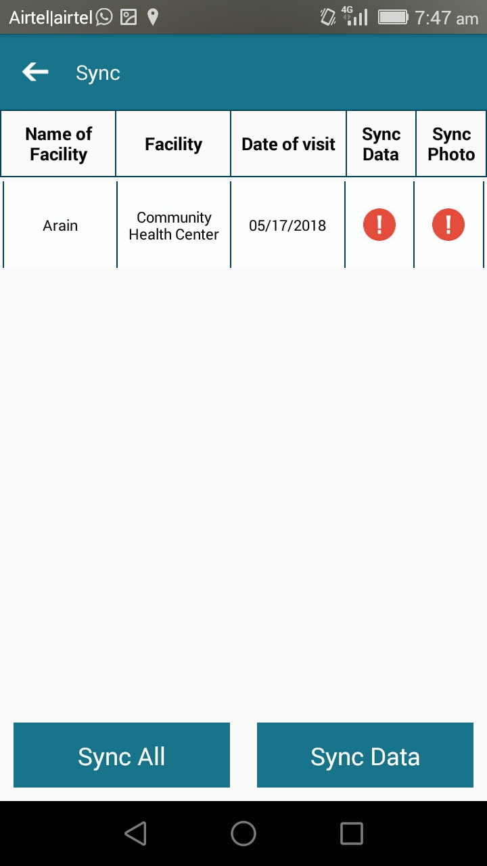
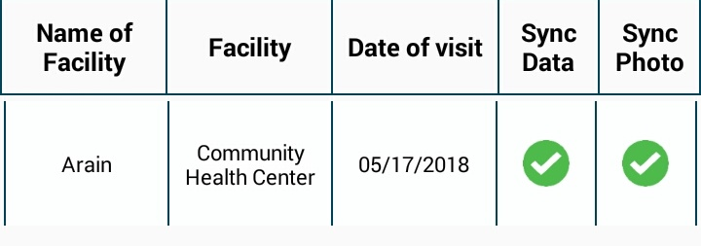
Features : Sync Data

Slide 13
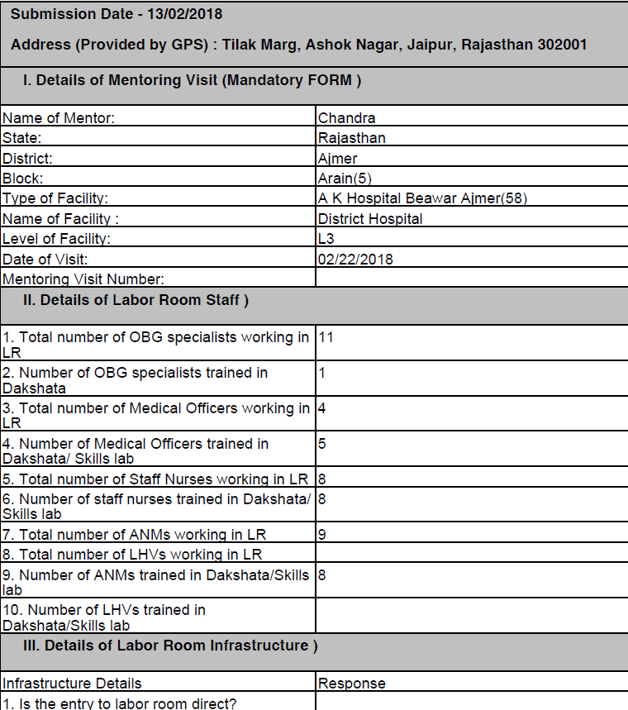
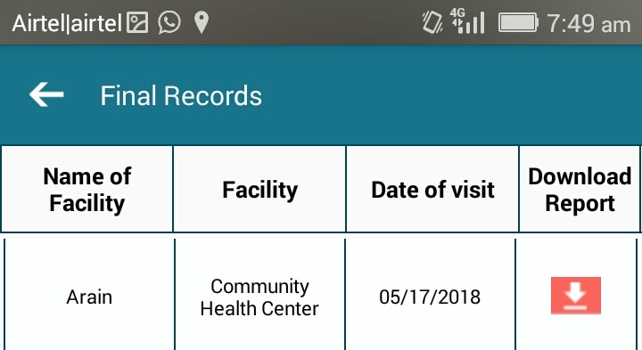
Features: Finalizing Records and Download

Slide 14
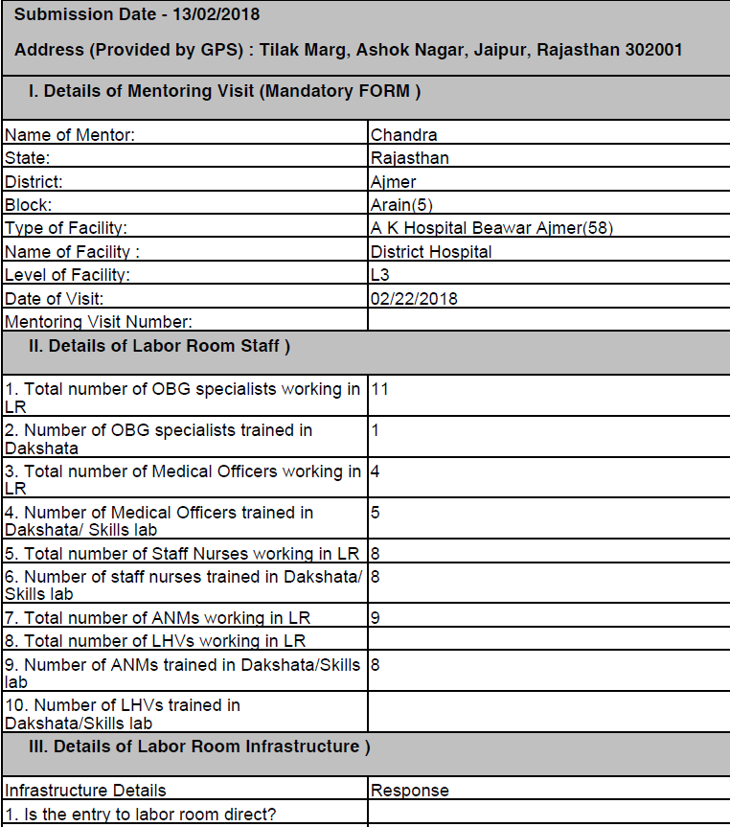
App generated facility visit report
GPS stamping in all the data collection format.
Mentoring Visit Summary Report

Slide 15
Analytics : Reports Generated
Report 1: Detail of Labor Room Staff trained in Dakshata/Skills lab/ SBA
Report 2: Status of Unmet Criteria (Labor Room Infrastructure)
Report3: Summary Report (Labor Room Infrastructure)
Report 4: Essential Resources Not Available/Not Functional at Labor Room in Last Visit
Report 5: Summary Report (Availability of Essential Resources)
Report 6: Status of facility wise essential resources available (Result of Latest Assessment)
Report 7: Status of Unmet Criteria (Adherence to 19 Clinical Practices)
Report 8: Summary Report (Adherence to 19 Clinical Practices) – Result of Latest Assessment
Report 9: Status of Topics Covered During Mentoring Visit (Result of Latest Assessment)
Report 10: Facility Ranking (Result of Latest Assessment)

Slide 16
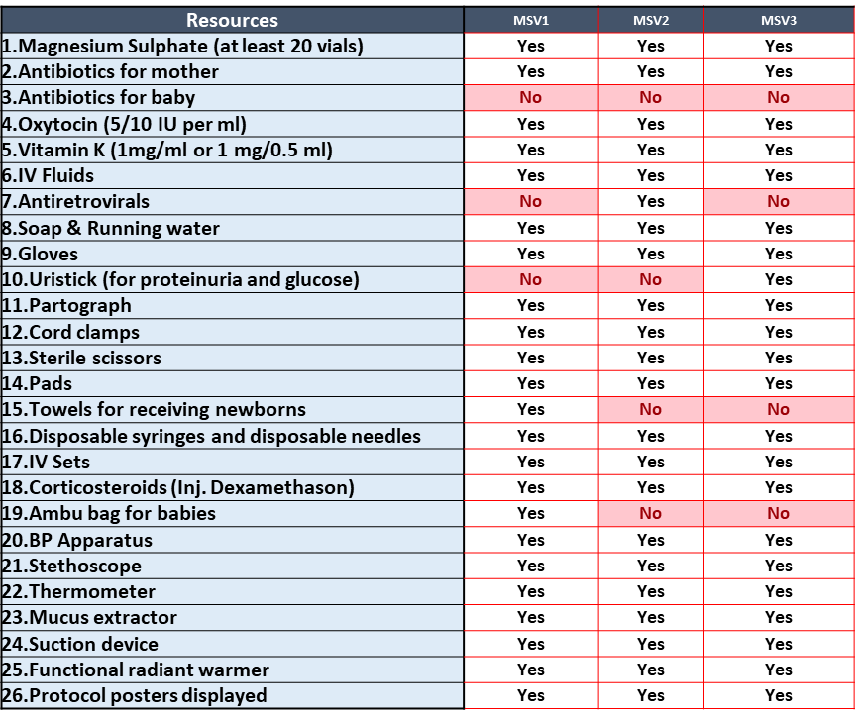
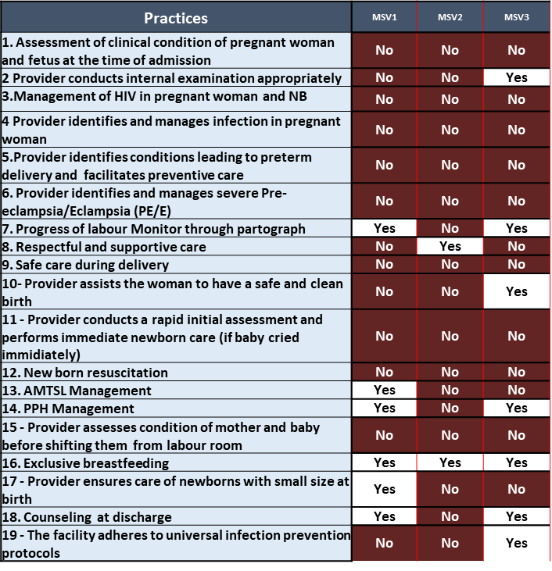
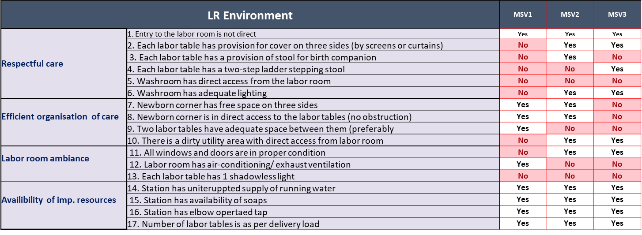
Facility Dashboard
Resource Availability
Practices
LR Environment

Slide 17
District Level Dashboard
District: <<All>>
 | Available | Trained | % Trained
OBG specialist
Medical Officer
Staff Nurse
LHV/ ANM
Availability of essential resources
Assessment Result: Latest / Custom
Custom
From: Year …… Month……..
To: Year …. Month …………
District Visited: ……………..
Facilities Visited: ……………..
Labor Room Environment
Essential Practices / Standards
Page 1 of 3
Date/Time Dashboard Generated : ………………….

Slide 18
District Level Dashboard
District: <<All>>
 | Available | Trained | % Trained
OBG specialist
Medical Officer
Staff Nurse
LHV/ ANM
Availability of essential resources
Assessment Result: Latest / Custom
Custom
From: Year …… Month……..
To: Year …. Month …………
District Visited: ……………..
Facilities Visited: ……………..
Labor Room Environment
Essential Practices / Standards
Page 1 of 3
Date/Time Dashboard Generated : ………………….

Slide 19
Outcomes
241 visits covering 131 facilities across 25 districts
165 Total User Created so far
The app is helping in facility performance tracking, onsite staff mentoring and also data for action
  The app is giving us facility specific data on status of trained LR staff, gaps in resources, LR environment, and LR practices
  The app also captures the area on which mentoring had been provided
  It helps the mentor to compare the status with that of previous visits
  It is helping State MH division to track the facility performance as well as movement of mentors.
  It also assists in release of incentives to in service mentors for visit.

Slide 20
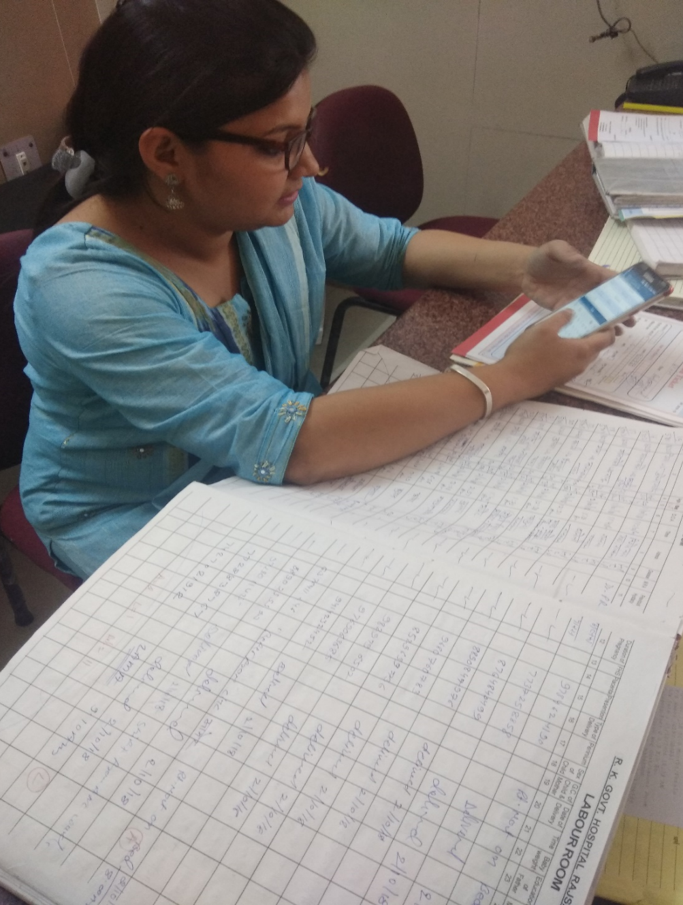
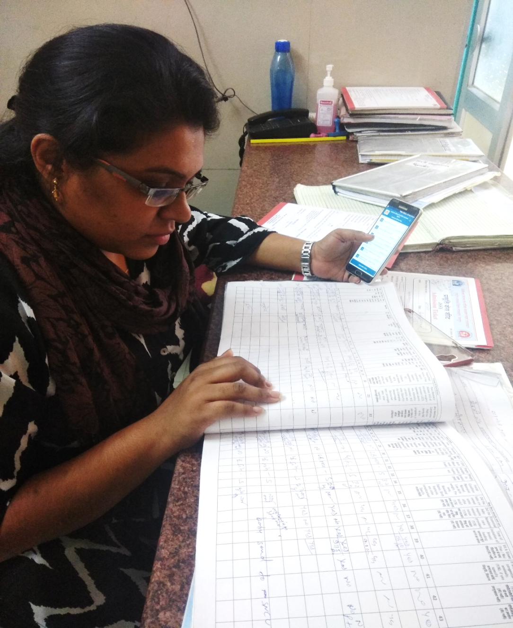
Mentor App in Use

Slide 21
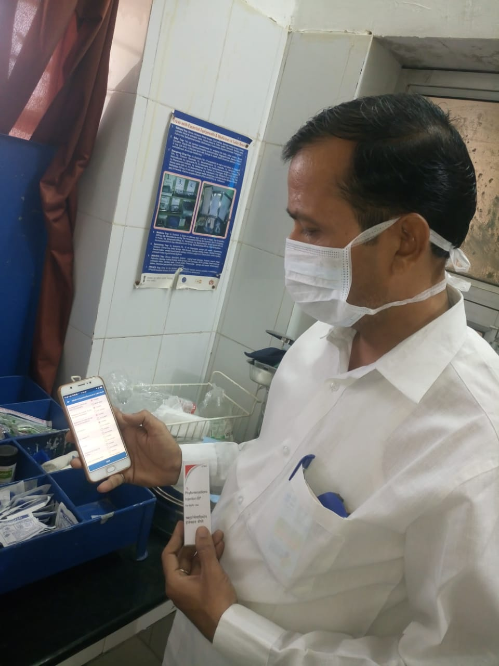
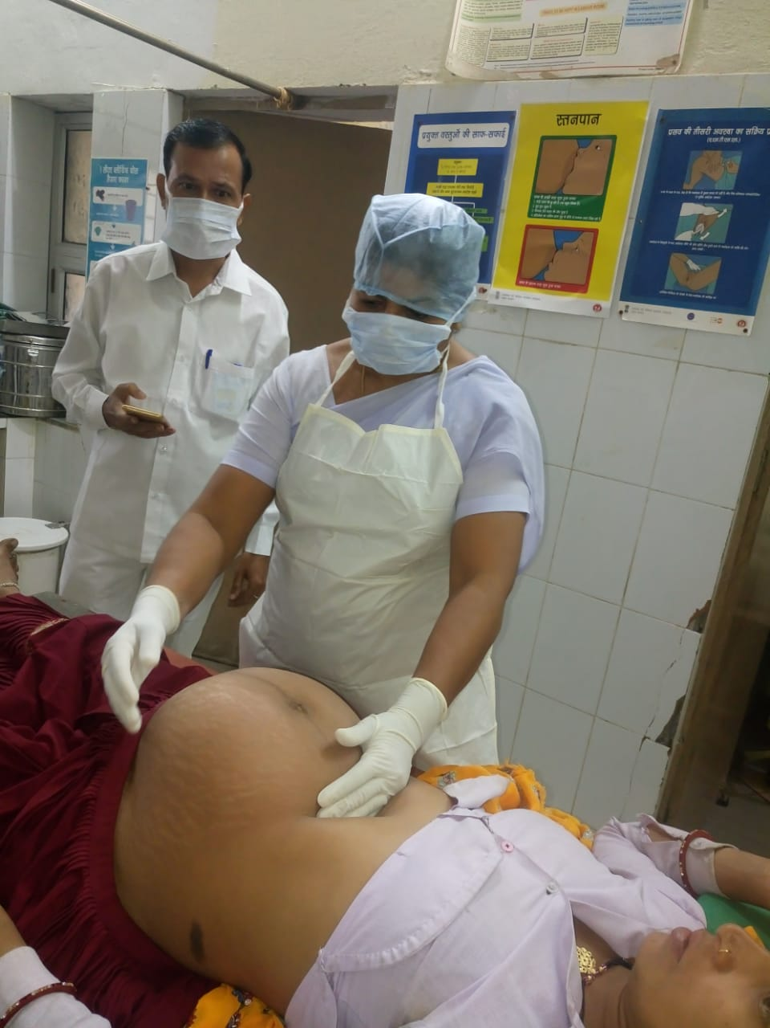
Mentor App in Use

Slide 22
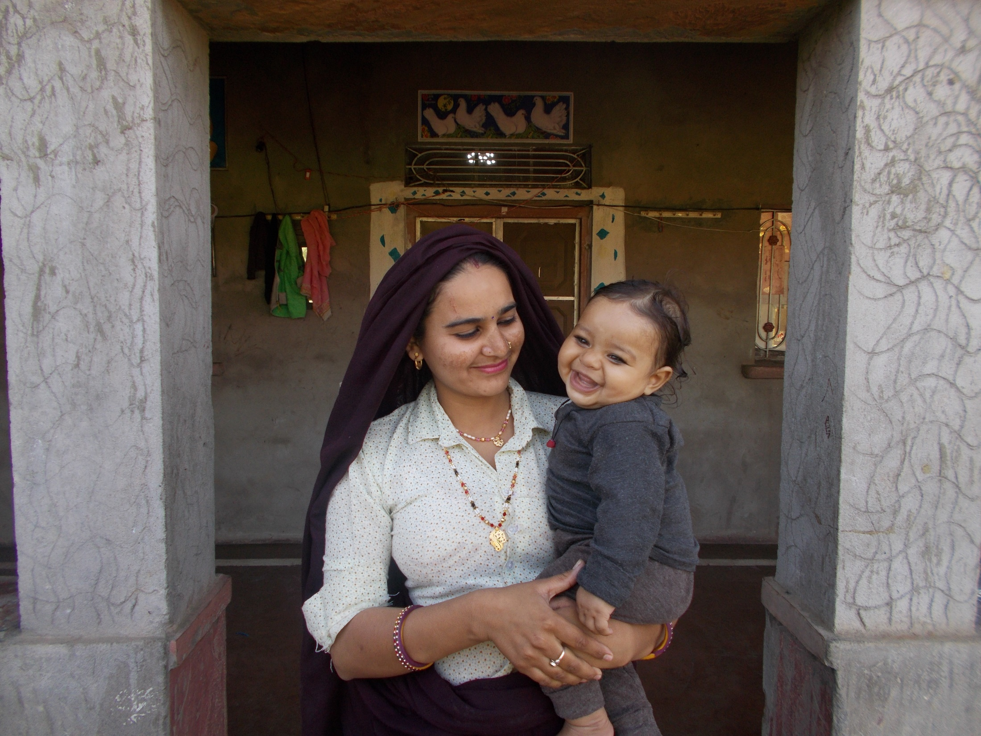
Thank
You

