Slide 1
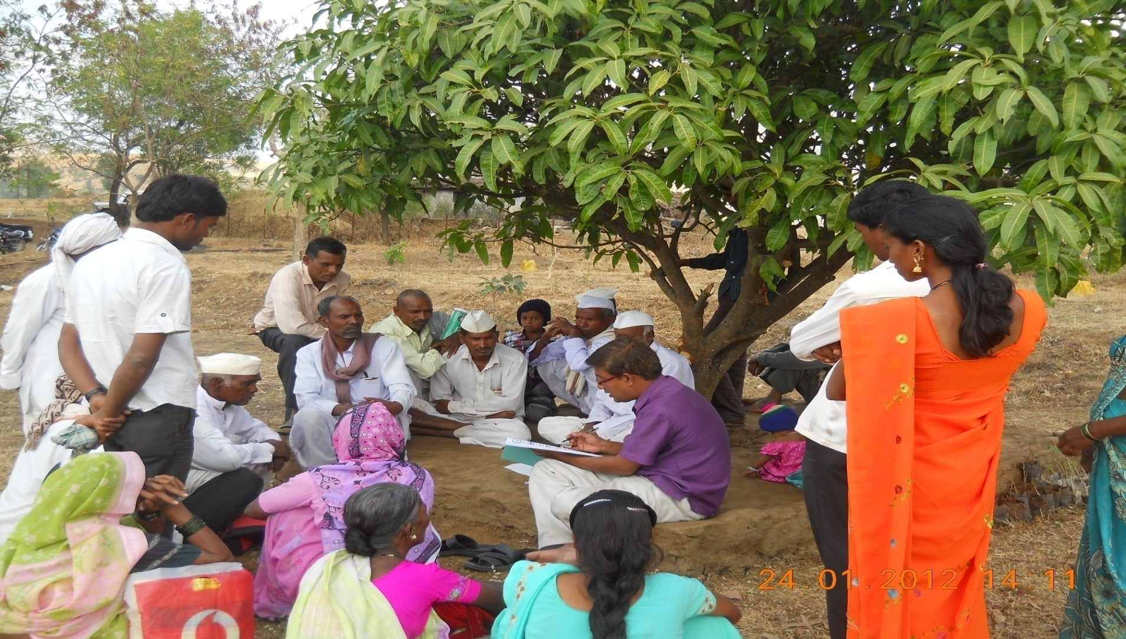



Decentralised Health Planning:
“The Process of Conversion of key Community Health demands into Budget/PIP”
Maharashtra
National Summit on Good, Replicable and Innovative practices
29th – 31st August 2016

Slide 2

Background
Decentralized health Planning is an approach to address people’s demands through community involvement in planning process.
It is multi-level, complex and continuous process which requires adequate time, resources and most importantly space for interaction of health providers and community.
Key challenges:
a. Participation of community in planning processes and Community Empowerment
b. Capacities of district teams to facilitate the planning process
c. Budget templates
d. Limited use of the Health Management Information System (HMIS) data to guide and prioritize interventions

Slide 3
Background Continued..
The main objective of this intervention is to develop mechanisms for incorporating people’s demands into PIP/Annual Budget plan.
Focused intervention on pilot basis in Gadchiroli by team of representatives of PRIs and community, NHM, SHSRC-Maharashtra, SATHI (State Nodal NGO), Amhi Amchya Arogya Sathi (Local NGO).
Collaborating partners: CEO ZP, Gadchiroli, DHS team

Slide 4
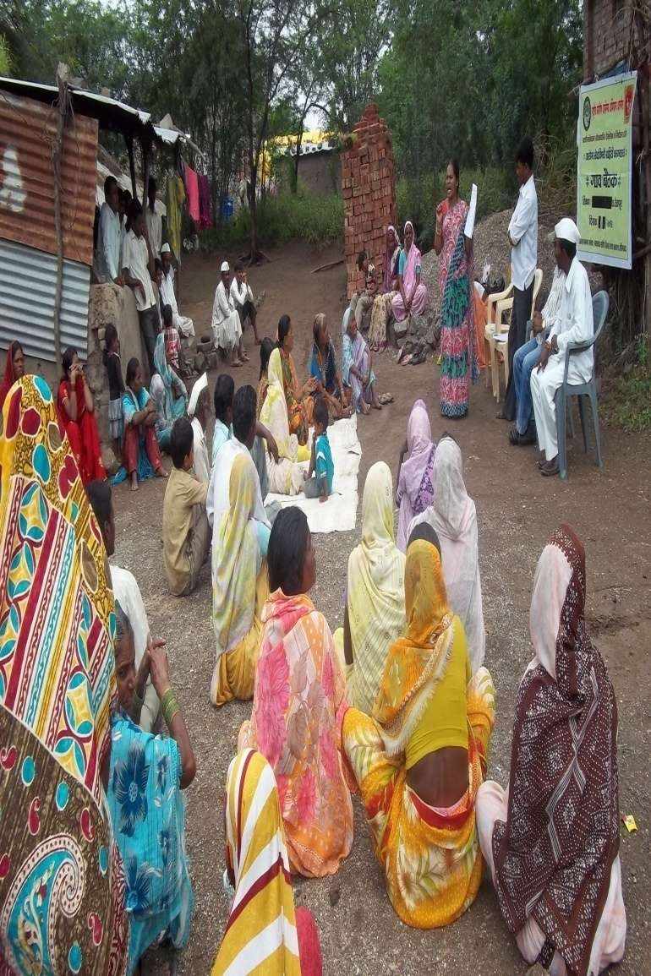
Intervention involved 4 key processes
Key Processes
Developing mechanisms to implement the action plan
Developing appropriate strategies/ action plan to address those demands
Analysis and prioritization of demands
Community mobilization for identification of people's demands
Duration: From June 2015 to October 2015 (5 Months)

Slide 5
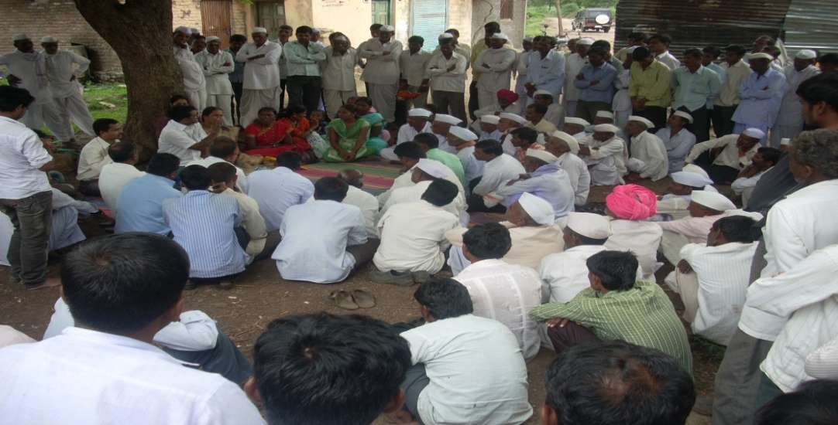
Community Mobilization for identification of People’s demands
Process under taken in
- Armori
- Kurkheda
- Korchi blocks of Gadchiroli on sample basis.
From each block, 3 PHCs and from each PHC, 2 villages attached to Subcenters were selected.
Community mobilisation through VHNSCs, Community leaders and influential people from community and local organisations
A detailed process of consultation is carried out in each village to discuss demands of the community regarding their health problems and accessibility to health services

Slide 6
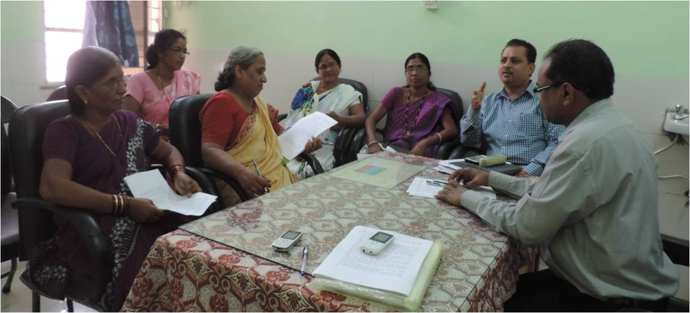
Community Mobilization for identification of Peoples demands
Minimum two such meetings were conducted in each selected village and around 60-100 people participated in each of these meetings.
Thus total 499 demands regarding Health, Education, Employment, Food security, Nutrition, Water and Sanitation and Transportation etc. were raised.
Of which around 145 demands were related to health sector.

Slide 7
Analysis and Prioritization of demands
Sr. No | Groups | Frequency
Construction Total = 40 | New building construction (SC,PHC, Labor room) | 16
 | Repairs and maintenance | 6
 | Toilet facility | 16
 | Other (Kitchen shade etc.) | 2
Facilities and Services Total = 84 | Awareness and campaigns | 10
 | Entitlements | 13
 | Up gradation of services | 20
 | Field visits by staff | 6
 | Cleanliness | 5
 | Attitude and behavior | 5
 | Referral transport | 6
 | Regular checkups | 8
 | Water | 8
 | Other | 3
HR | Vacancies | 14
Medicine | Availability of medicines | 7
 | Total | 145

Slide 8
Analysis and Prioritization of demands
145 Health related demands were analysed and categorized in to three main categories
Resolution through community negotiations

Slide 9
Developing appropriate strategies/ action plan to address demands
Resolution through budget/funds issues which can be resolved through allocation of funds)
  NHM- PIP
  Integrated Action Plan (IAP)
  District Planning and Development Committee (DPDC)
  Local level funds (Gram Panchayat, RKS untied fund)
  State level fund
B. Resolution through Existing System (Where modification is required in existing system): Examples of demands (
  Demand for insecticide spraying (resoled at DHO level)
  Availability of 108 ambulance on time.
  Timely ANC check up.
C. Resolution at field level through local negotiations from VHSNC, Community leaders and or CBMP committee : Examples of demands
  Quality of food for in-patients.
  Attitude and behaviour of Health Care providers towards patients.

Slide 10
Output of intervention
Finally total 10 proposals were developed and submitted
- 2 proposals were developed and submitted to District Planning and Development Committee (DPDC)
- 2 proposals (Diet at Sub-center level & ASHA recruitment flexibility) were submitted to State National Health Mission for availing supplementary Program Implementation Plan (PIP) funds in 2015-16.
- 6 proposals were submitted to Tribal development department for availing Integrated Action Plan (IAP) Funds and

Slide 11
Output of intervention
Sr. No | Description of Proposal | Submitted at | Number of demands
1 | Provision of diet for the mothers delivering in Sub-centre | NHM | 1
2 | Requirement of additional ASHA & flexibility in recruitment of ASHA | NHM | 1
3 | Construction of separate delivery room in Sub-Centre | Tribal department IAP | 8
4 | Kitchen facility at PHC, separate toilet and staying facility for accompanying family member | Tribal department IAP | 5
5 | As old PHC building not in proper condition new building construction | Tribal department IAP | 1
6 | SC level water supply and availability | Tribal department IAP | 8
7 | Minor repairs and maintenance at SC level | Tribal department IAP | 4
8 | Regular water supply to PHC and staff quarters | DPDC | 1
9 | PHC building repairs work from NHM on hold due to administrative issues thus can be completed through | DPDC | 1
10 | Separate delivery table For SC delivery rooms | DPDC | 1
 | Total |  | 31

Slide 12
Strategic Advantages
People empowerment through awareness generation.
Demand generation in terms of both number of services & quality delivered.
Increased awareness amongst community resulting in enhanced accountability amongst the functionaries :.
Process also helps in inter-sectoral convergence & getting support from the departments indirectly contributing to health at community level : the collateral advantage
Behavior modification amongst beneficiaries as well as functionaries resulting in increased uptake of services

Slide 13
Learning
Cooperation, coordination and information from all concerned and line departments is important component for successful completion of intervention.
Strong facilitation and commitment at District and State level helped in tapping resources from other agencies and departments.
External facilitation (SHSRC, State NHM and Local NGOs whose base deeply rooted in community, Nodal NGOs etc.) is essential for initiation and sustainability of this kind of processes.
It was realized that some of the community demands can be met through available resources in the budget.

Slide 14
Thank you!
Contact:
www.nrhm.maharashtra.gov.in,
mdnrhm09@gmail.com,
shsrc.gom@gmail.com

