Slide 1
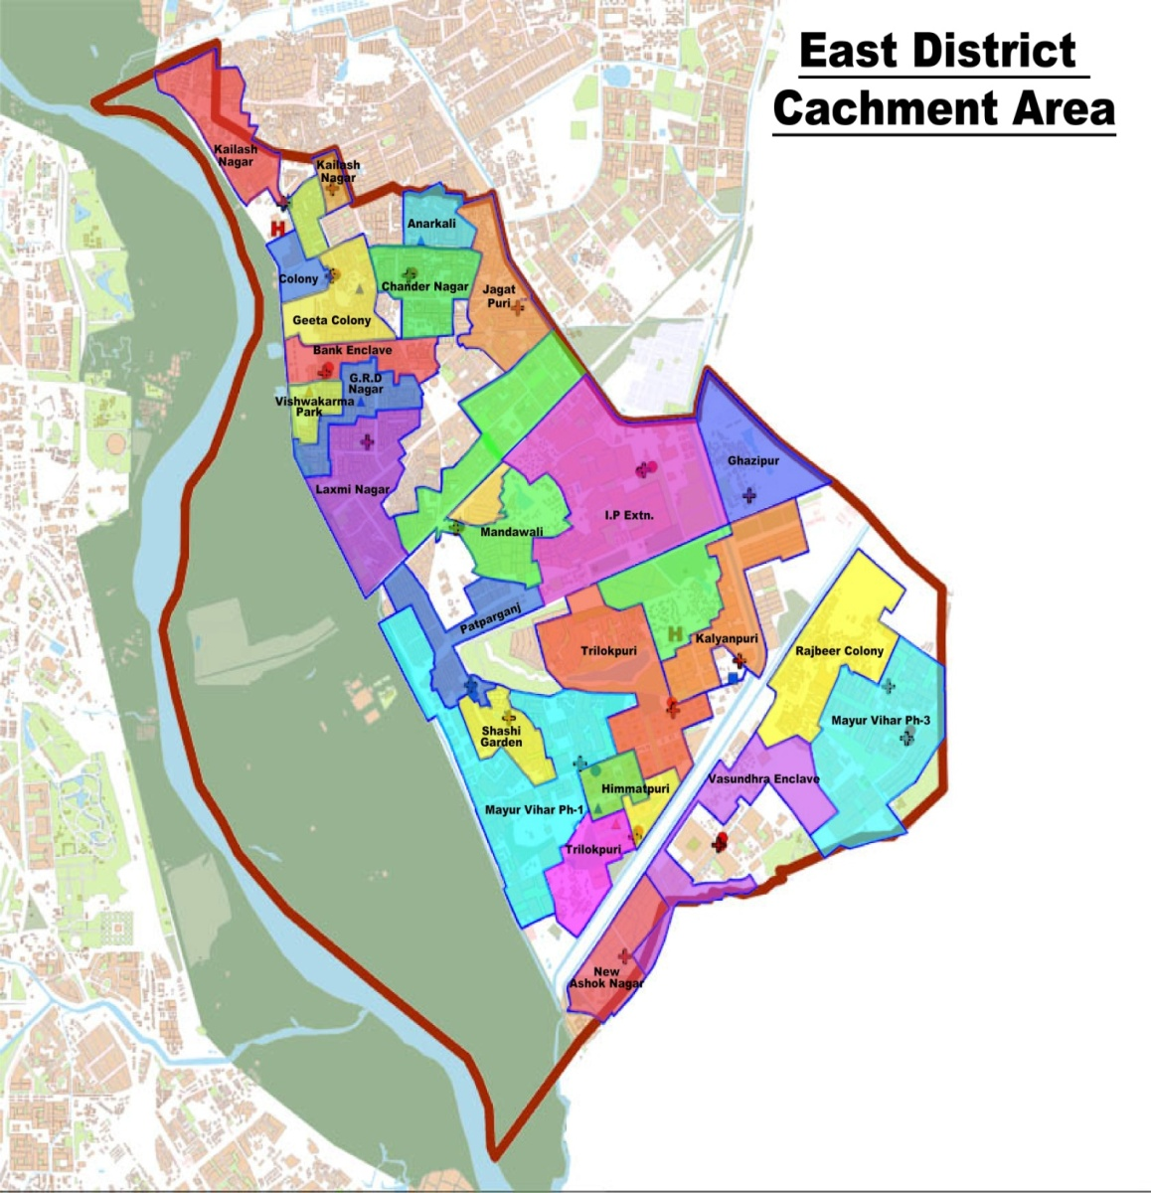
Defining & Documenting the Catchment areas of UPHCs & ANMs on Web Portal in Urban Areas Delhi
Dr.Monika Rana Datta , SPO , NHM
01123812938 , 9811484474 , E-mail : kmanika1960@yahoo.co.in

Slide 2
Need for the exercise
Mandatory Pre-requisites for CPHC:
Each member of the population has to be owned up by the nearest health facility and a designated field worker ie ANM .
This is possible only if the area of responsibility of the PHC / ANM /ASHAs is defined geographically and demographically . It is also essential for :
i. Assessing the workload / allocating resources.
ii.Setting and monitoring benchmarks.
iii.Ensuring accountability .
iv. Eliminating overlaps in the multi – agency provider setting in Delhi.

Slide 3
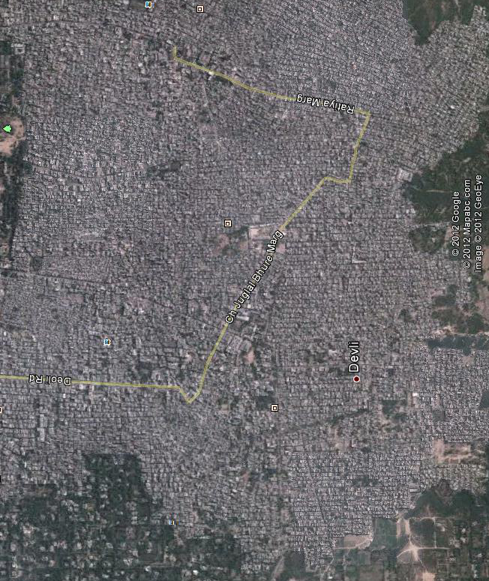
RURAL AREAS
URBAN AREAS

Slide 4
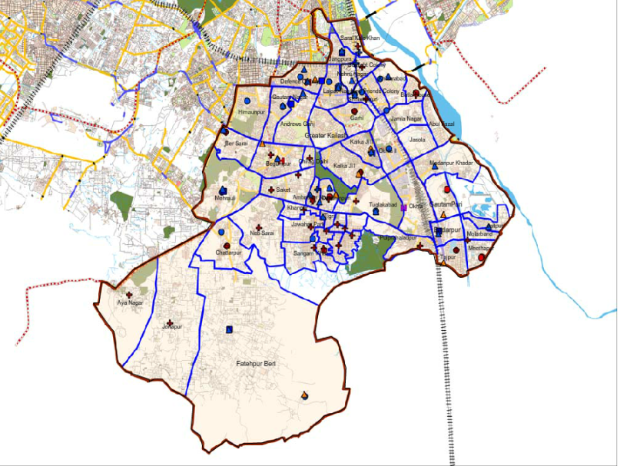
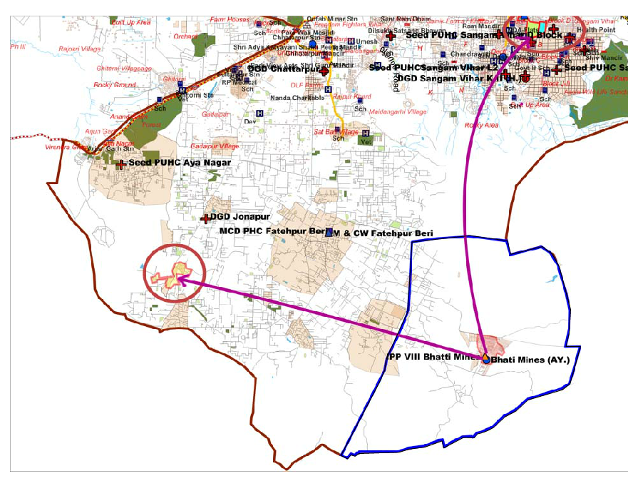
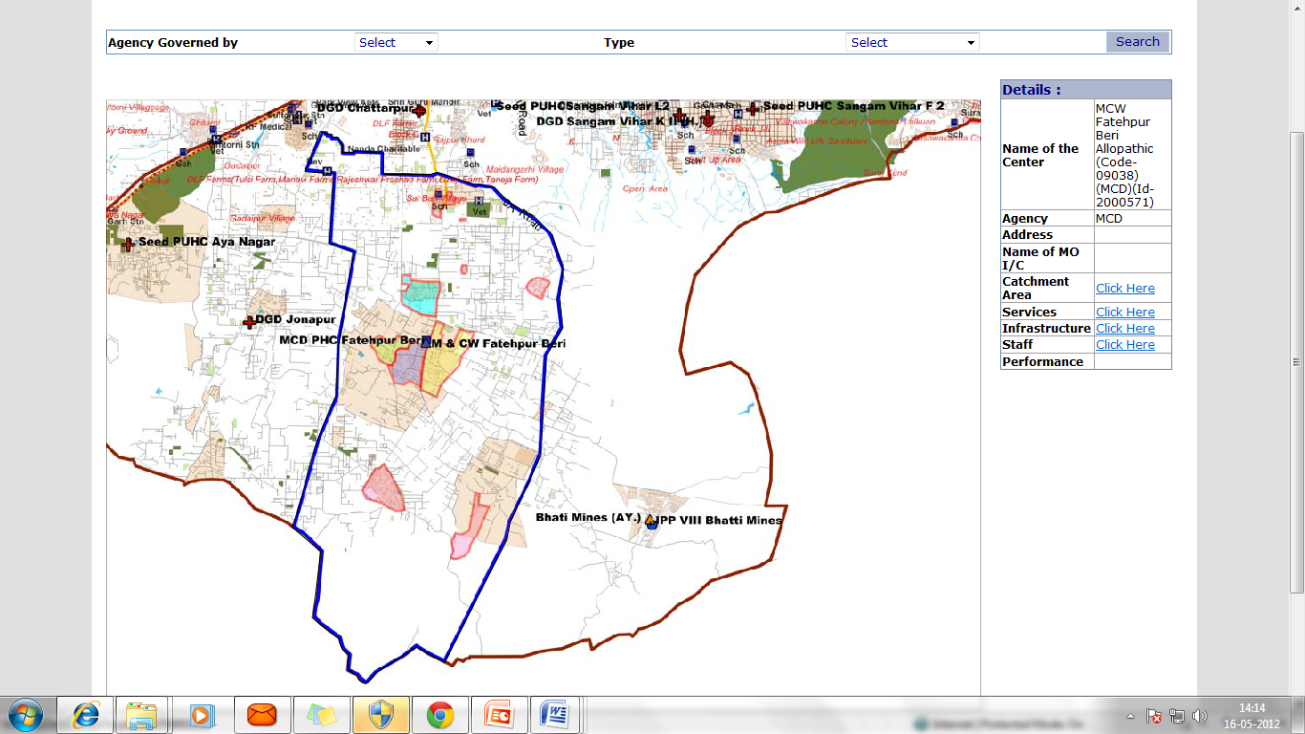
Pilot project
Facility Survey
Overlaps to the tune of 65 lacs
Some population pockets
were far from heath centers.
2. Gaps in Population coverage??
3. Staff covering far flung areas.

Slide 5
Process of Implementation
It was decided to use the electoral database information for an objective , comprehensive mapping of the areas of responsibility of
the UPHC / ANM.
Web based Software was prepared to capture the name / agency/ address / types of services / linked facilities / staff of the facility and the population being covered by it .
GNCTD / MCD Health Facilities mapped.

Slide 6
Process of Implementation
Each center given a unique ID / Password
Software was populated with the geographic and demographic description of Population units as described in terms of polling stations / booths . ( around 11000 such units)
Around 1100 personnel – Medical Officers / ANMs / CDEOs ( GNCTD / MCD) trained to use the software and feed the information of their centers .

Slide 7
Process of Implementation
Owning up the population -- Guiding principle :
i. Around 50,000 population wherever possible .
ii. Within 1-2 km / 20-30 minutes walking distance .
iii. Impediments like railway line / highway / water bodies etc to be kept in mind .
Entire State divided into population pockets of around 10,000 which were codified as unique ANM areas. (Each ANM area further divided into ASHA Areas of around 2000 population).
The information made available on the web based portal – State / District / Facility / ANM.

Slide 8
Process of Implementation
Mapping exercise provided :
List of polling stations owned up by more than one center.
List of polling stations not owned up by any center.
District Working groups comprising of GNCTD and MCD officials formed . State level meeting held with each group.
Resolution of overlaps .
Attachment of unserved.
Listing of unserved / underserved areas for setting up new centers.

Slide 9
Outcome
Carving out codified ANM / ASHA Areas with geographic and demographic description and made available on web based portal.
Availability of Targets / benchmarks .
Implement ASHA Scheme more objectively .
Ensure accountability at various levels.
Remove overlaps and thus optimize resource allocation and utilization .
Plan opening of new centers in need based manner.
Enable backward linkages from the hospital.

Slide 10
Outcome

Slide 11
Scalability
Entire population of the state has been mapped.
Can provide a platform for Population assignment for Ayushman Bharat.
PS is a well defined administrative unit and its use by– Water / sanitation / WCD / Social Welfare/Education / Urban development will facilitate Inter departmental convergence.
Population attachment is to define the area of responsibility of
health facility for provision of promised healthcare , especially
outreach/preventive/promotive components . It does not
prevent patient from availing services from any health facility .

Slide 12
Limitations
A Chunk of Population may not be included in the electoral data bases. Provision is available made for adding population as per the actual ANM survey of the geographical area assigned to her. Migratory population also gets added .
May not be the perfect way but to begin with it offers an universally available , reasonably accurate and doable way .

Slide 13
Way Forward
Placing the data in public domain .
Mapping the areas on a dynamic geospatial map
Adding the peripheral most layer of Family folders to the ANM / ASHA layer.
Generation of Health plan for each ANM area from the family folder data .
IT enabled linkage of each household to a health facility / field functionary for back referrals.
All public healthcare agencies to participate.
Regular updation.

Slide 14
Thankyou

