Slide 1
Delivering of Home-based Palliative Care by
Sub-Health Centre
Gandhinagar, Gujarat
16th – 18th November 2019
By: V. Vumlunmang, IAS
Principal Secretary Health & FW, Government of Manipur

Slide 2
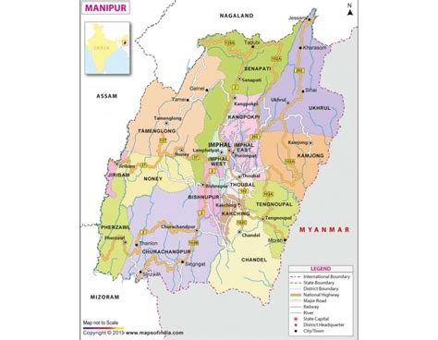
Outline of the presentation
Delivering of Home-based Palliative Care by Sub-Health Centre
  For transformative CPHC, Manipur - first emphasis on PHSCs.
  Additional Services at HWCs
  Making Communities – a part of HWCs initiative. Enhanced Community Participation
  Home Based Care of Palliative Services under HWCs
CPHC is implemented in all 16 districts 0f Manipur

Slide 3
For transformative CPHC, Manipur gave first emphasis on PHSCs.
Technical Partner: USAID MCSP/ Jhpiego

Slide 4
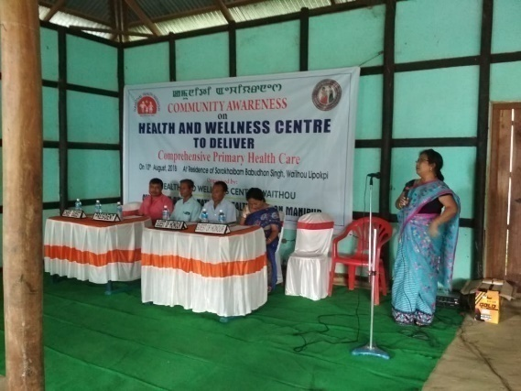
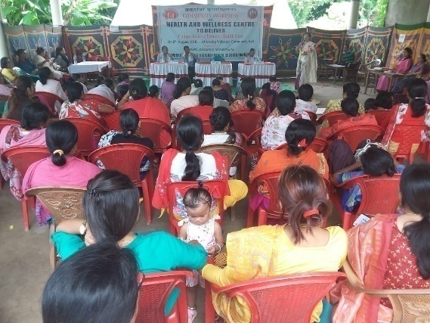
Enhanced Community Participation
Key challenges faced
A new intervention – Health & Wellness Centre
Limited awareness about additional services in community through HWCs
Perceived MCH centric care at SCs
Limited community ownership
Solutions Devised
Community Awareness Program in Manipur
Conduct community awareness program at every SC-HWCs before inauguration through newly posted CHOs
Engaging village chiefs and local PRI members
Held under every identified SHC-HWCs through the newly posted CHOs
Conducted before the inauguration or launching of the HWCs
Informed about the program and services which are to be rendered under HWCs
Gathering ranges from 30-80 people

Slide 5
Making Communities – a part of HWCs initiative
(To preserve Cultural and Traditional Practices)
When women is in her 6-8th month of pregnancy, family members, friends and relatives start organizing schedules for inviting her to their homes for special lunch or dinner. During such gatherings a first time would be mother is advised or taught on child birth lessons, what to expect, what signs to be checked for or inform elders for a delivery etc.
Mandatory initiation of breastfeeding within 1 hour(Colostrum).
In Meitei community, locally called ritual named “Chak Umba” where infant is not given any form of semi solid food, water etc. till 6 months
Very good practice of exclusive breastfeeding (73.6%- NFHS 4).

Slide 6
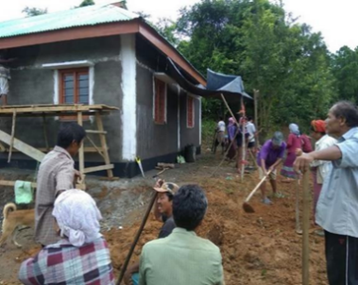
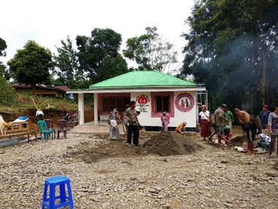
Results
Platform helps in team building and communication with the community –
Creates the responsibility among the villagers and help them in taking ownership of the HWCs.
Helps in monitoring of the ongoing infrastructural development works – feedback given to concerned Mo/c, CMO of the district for status, help in organizing inauguration program also
Ensured timely completion & operationalization of the facilities
Increase in availing health care - regular check-up increases epecially on NCDs
Scale up in 2nd phase too with fund from IEC activities
The villagers or the workers under NREGA conduct social service

Slide 7
Home Based Care of Palliative Services under HWCs

Slide 8
Palliative Care is a challenging subject
Partnership with all Stakeholders
Palliative care at HWCs
Karunashraya Bangalore & NIMHANS
Palliative Care Society,
Imphal
RIMS Palliative Unit
IPM Calicut
RIMS Palliative Unit
Home based Model through HWCs
DH palliative ward (10 bedded)

Slide 9
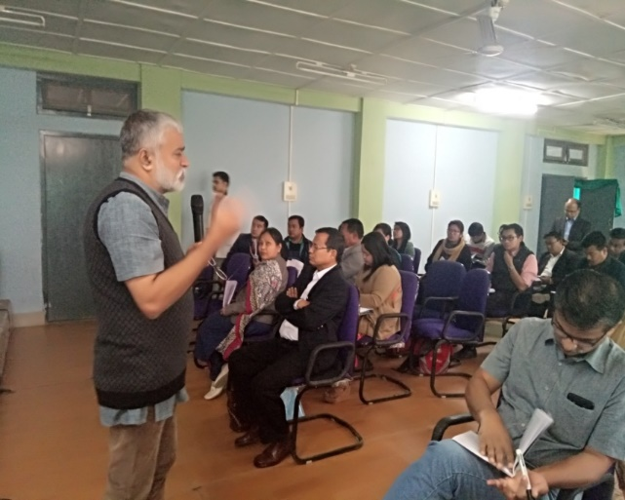
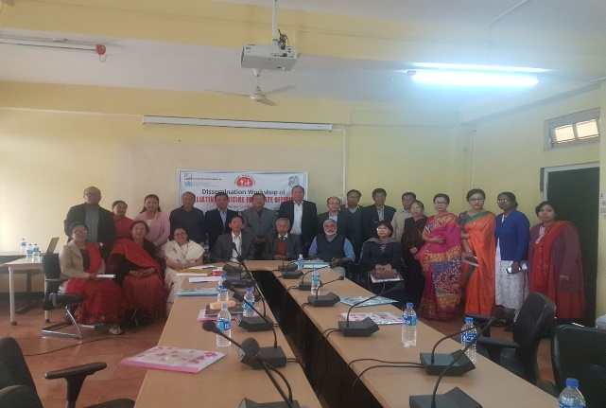
TRAINING & DISSEMINATION
Foundation Course In Palliative Medicine for 96 Medical Officers and specialist Doctors done under the aegies of WHO collaborating Institute -Institute of Palliative medicine Calicut at SAT and RIMS in 16-25 February 2018 and 28 jan –1st Feb 2019
Foundation Course in Palliative care : For 27 Community Health officers ,50 Staff Nurse , 28 ANM . Physiotherapist and Counsellors held simultaneously

Slide 10
Diseases Cases: In Home Based Palliative Care
Cancers: Cervical/Oral/Breast/Lungs/Stomach
Chronic infection such as HIV
Chronic Cardiac conditions such as ischemic cardiac failure, cardio-myopathies, congenital heart etc.
Chronic Renal Failure
Neurological conditions such as stroke, multiple sclerosis, Alzheimer’s diseases, chronic progressive neurological conditions.
Chronic liver diseases such as liver failure, alcoholic diseases and chronic hepatitis .
Rheumatologic conditions such as SLE, Rheumatoid arthritis .

Slide 11
Process for Home Based Palliative Care
FIELD VISIT BY ASHA & ANM
TO FIND OUT PATIENTS WHO NEED HOME BASED PALLIATIVE CARE
CHO PUT UP PROPOSAL TO MO ic & CMO
MO and CMO CONFIRM THE CASE FOR WEEKLY HOME VISIT

Slide 12
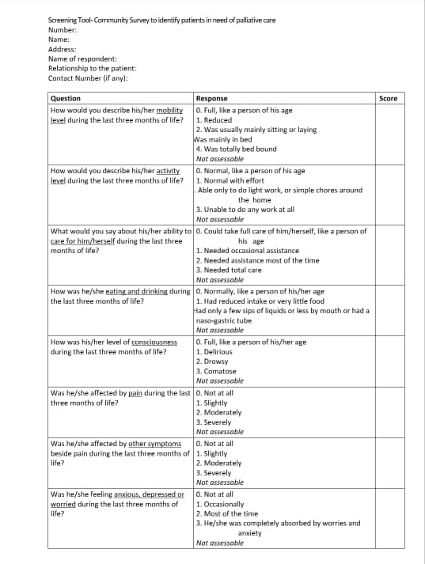
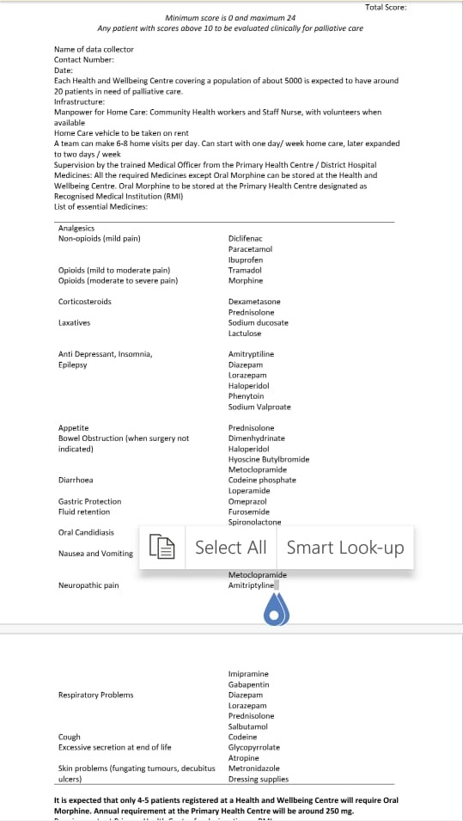

Slide 13
DISTRICT WISE Patient (NEW &OLD)
PERIOD | IMPHAL EAST | IMPHAL WEST | THOUBAL | CHANDEL | CCPUR | BPR | KPI | Total
July- Sept 2018 | NIL | 3 | 2 | Nil | Nil | NIl | Nil
Oct- Dec | NIL | 3 | 2 | Nil | Nil | Nil | NIL
Jan- march | 41 | 6 | 8 | Nil | Nil | 12 | NIL
April -June | 41 | 40 | 16 | 27 | 12 | 14 | 03
July-sept | 41 | 40 | 16 | 27 | 22 | 39 | 03
Total | 41 | 40 | 16 | 27 | 22 | 39 | 03 | 188

Slide 14
District Wise HWC having home based palliative care

Slide 15
Good Practice Lessions
1. Vital to assess environment and calibrate interventions suitably.
2. Strong focus on transformative change and improved services (importance of measuring out comes.

Slide 16
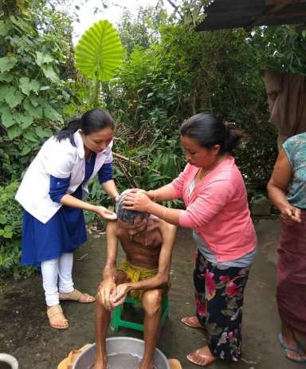
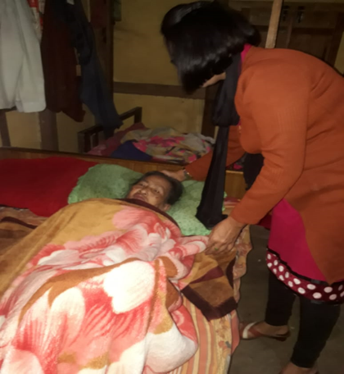
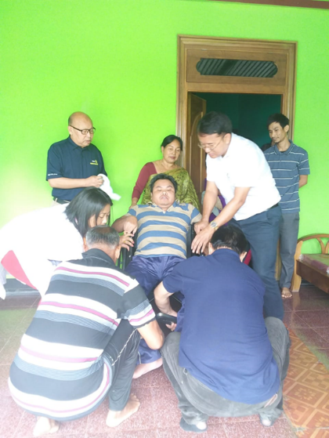
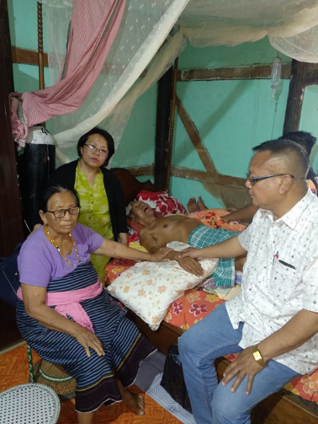
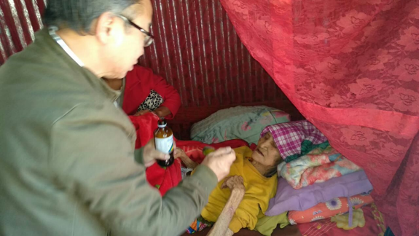

3. Community Engagement is vital for improved Services (Palliative care involves intensive community engagement)
Wheelchair & air mattresses under HWC
With church leaders

Slide 17
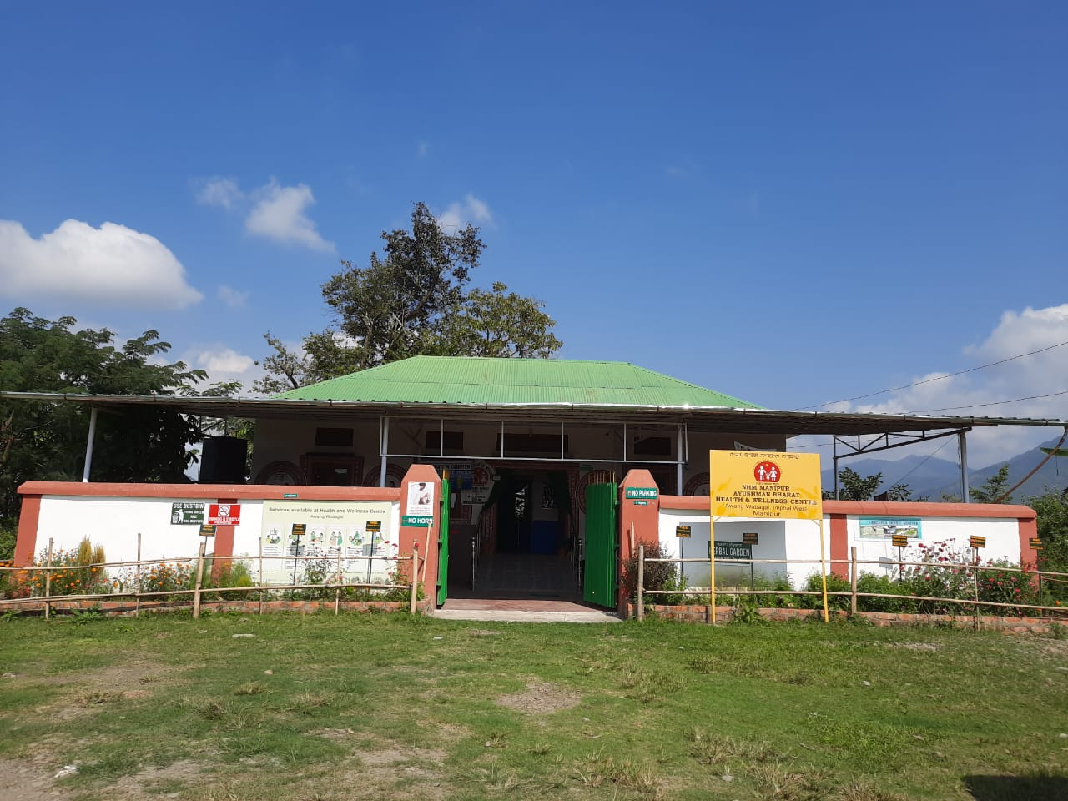
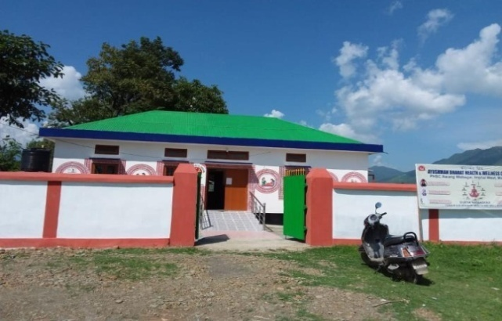
Journey of Awang Wabagai: PHSC to HWC-SC
AWANG WABAGAI
Before
Present
After

Slide 18
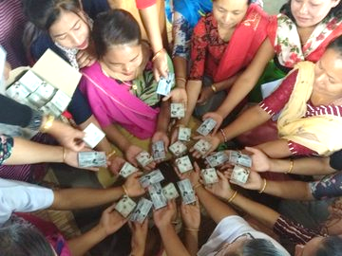
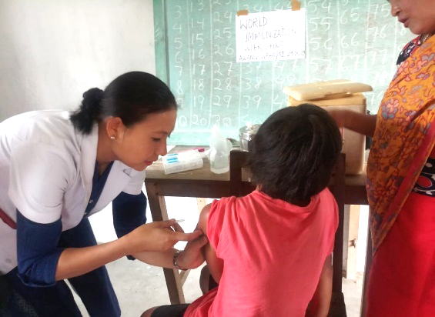
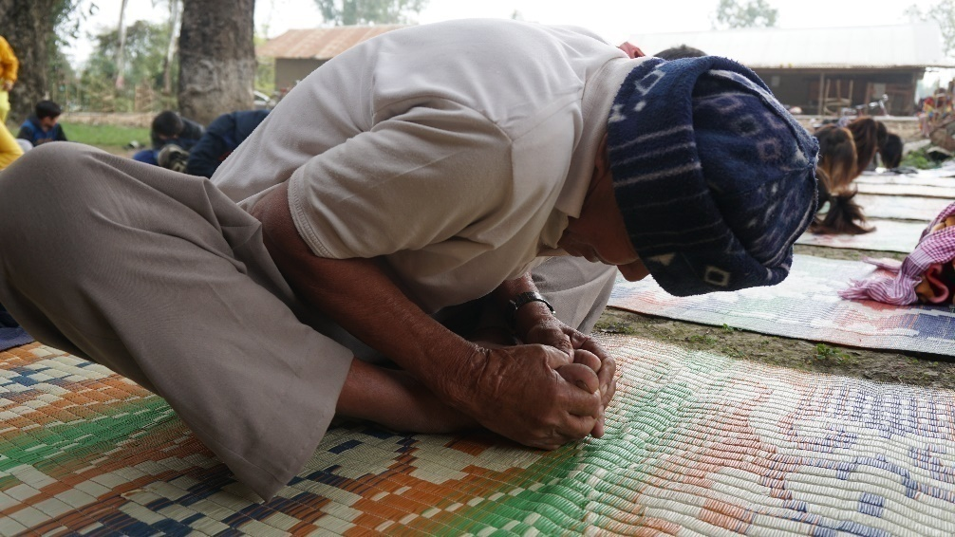
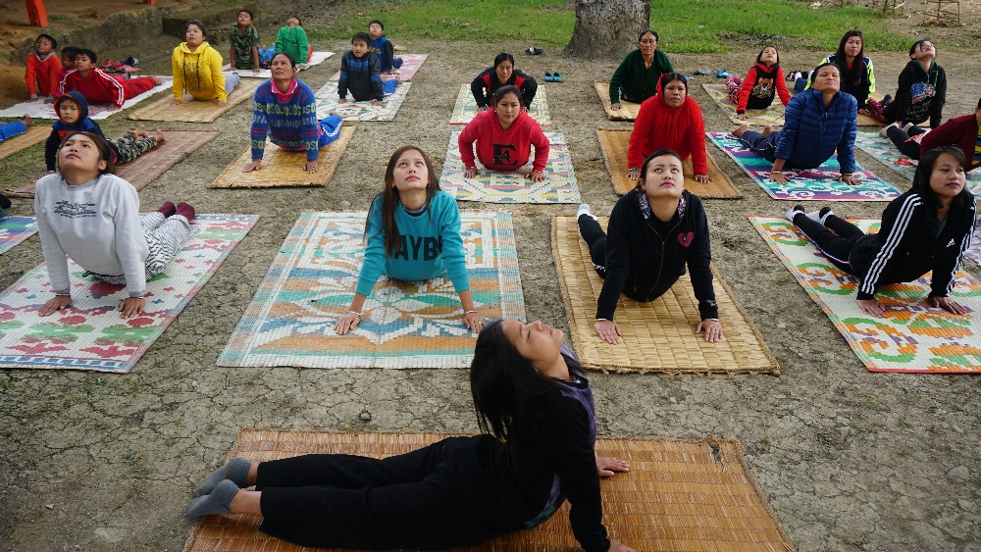
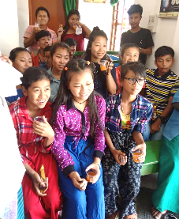
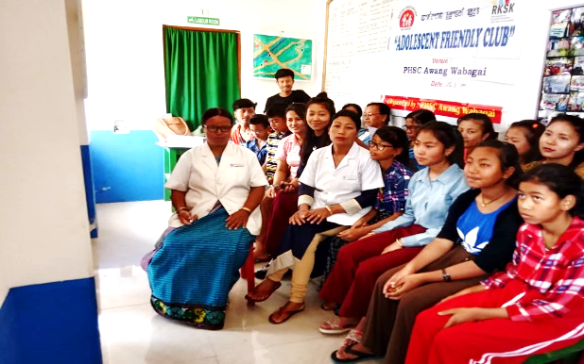
HWCs becoming hub of wellness, health and palliative care
World Population Day in Manipur
Immunization Week in Manipur
Yoga Activities
Yoga as Wellness Activity
Adolescent Friendly Clubs in Manipur

Slide 19
Thank You

Slide 20
Screening Tool –Community Survey to identify Patient in need of palliative care
 | Question | Response | Score
1 | How would you describe his/her mobility level during the last three months of life? | 0. Full, like a person of his age 1. Reduced 2. Was usually mainly sitting or laying 3. Was mainly in bed 4. Was totally bed bound Not assessable
2 | How would you describe his/her activity level during the last three months of life? | 0. Normal, like a person of his age 1. Normal with effort 2. Able only to do light work, or simple chores around the home 3. Unable to do any work at all Not assessable
3 | What would you say about his/her ability to care for him/herself during the last three months of life? | 0. Could take full care of him/herself, like a person of his age 1. Needed occasional assistance 2. Needed assistance most of the time 3. Needed total care Not assessable
 | (IPM-BSMMU-TMSS)Minimum Score =0. Maximum Score =24. Any patient with score above 10 to be clinically evaluated for palliative care

Slide 21
 | Question | Response | Score
4 | How was he/she eating and drinking during the last three months of life? | 0. Normally, like a person of his/her age 1. Had reduced intake or very little food 2. Had only a few sips of liquids or less by mouth or had a naso-gastric tube Not assessable
5 | How was his/her level of consciousness during the last three months of life? | 0. Full, like a person of his/her age 1. Delirious 2. Drowsy 3. Comatose Not assessable
6 | Was he/she affected by pain during the last three months of life? | 0. Not at all 1. Slightly 2. Moderately 3. Severely Not assessable
7 | Was he/she affected by other symptoms beside pain during the last three months of life? | 0. Not at all 1. Slightly 2. Moderately 3. Severely Not assessable
8 | Was he /she feeling anxious ,depressed or worried during last 3 months of life | 0. Not at all 1. Ocassional 2. Most of the time 3. Completely absorbed by worries and anxiety Not assessable

