Slide 1



7th National Summit on
“Good & Replicable Practices and Innovations in Public Healthcare Systems”
DELIVERY OF NCD DRUGS TO PATIENTS DURING COVID-19 PANDEMIC
Dr. J. Radhakrishnan., IAS
Principal Secretary to Government
Health and Family Welfare Department
Government of Tamil Nadu

Slide 2
INTRODUCTION
Covid-19 is a communicable disease which swept all over the world resulting in morbidity and mortality.
According to the WHO report, mortality is high among those with comorbidities like Diabetes Mellitus, Hypertension, Chronic kidney disease and Cancer.
During Covid-19 Pandemic, Health Services for providing Non-communicable disease drugs in the routine way got hindered due to complete lockdown.
Tamil Nadu came forth with suitable innovation to overcome this hurdle and reach the drugs at patients door steps.

Slide 3
TAMIL NADU - AGE SPECIFIC COVID DEATHS (n=12166)
Age Group | No. of Death
0-10 | 12
11-20 | 23
21-30 | 140
31-40 | 455
41-50 | 1173
51-60 | 2766
61-70 | 3713
71-80 | 2723
81-90 | 1044
90 Plus | 117
Total | 12166

Slide 4
CO-MORBIDITY AMONG THE DEATH CASES (N=12166)
Co-morbid conditions | Number of cases(%) | 0-20 (%) | 21-40 (%) | 41-60 (%) | Above 60 (%)
Diabetes and Hypertension | 33% | 0 | 0 | 10 | 23
Only Diabetes | 24% | 0 | 1 | 9 | 14
Only Hypertension | 14% | 0 | 1 | 4 | 9
Other co-morbidity | 11% | 0 | 1 | 4 | 6
No-comorbidity | 18% | 0 | 2 | 6 | 10
Total | 100% | 0 | 5 | 33 | 62

Slide 5
PROACTIVE CARE OF ELDERLY & PEOPLE WITH CO-MORBIDITY
Cocooning of vulnerable was the strategy focused
12 Expert Committees were formed to frame specific guidelines for health care providers
Two months dose of NCD drugs were dispensed for all NCD patients
Women Self Help Group members, Volunteers, Palliative Care team staff contacted line-listed NCD patients and their families for educating on special precautions to be taken during Covid-19.
Women Health Volunteers (WHVs), ASHAs, with the support of field staff, carried out regular surveillance of elderly and NCD patients to address their medical problems.

Slide 6
RATIONALE
During the complete lockdown, there was practically no transport service for the patients to reach health care facilities.
This, if not addressed, would have resulted in poor drug compliance and worsening of the disease condition.
Since Covid-19 morbidity and mortality is high among those with co-morbidities there was absolute need to maintain uninterupted supply of NCD drugs. Hence Tamil Nadu took up certain innovative measures to deliver the services through an organised network system.

Slide 7
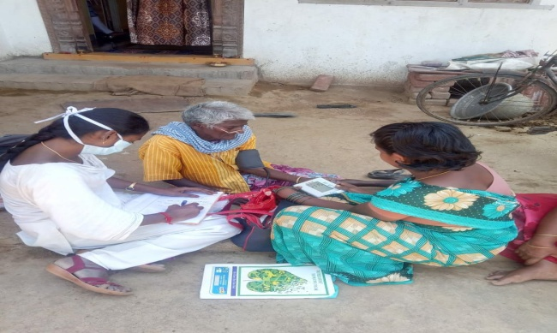
TN MODEL OF DRUG DELIVERY
Two months of NCD drugs were delivered for all NCD patients registered at Primary, Secondary and Tertiary Health care facilities through Multiple decentralised mechanisms.
Priority was given to NCD patients under specific categories such as those in the Geriatric Age group, Home bound and requiring palliation.

Slide 8
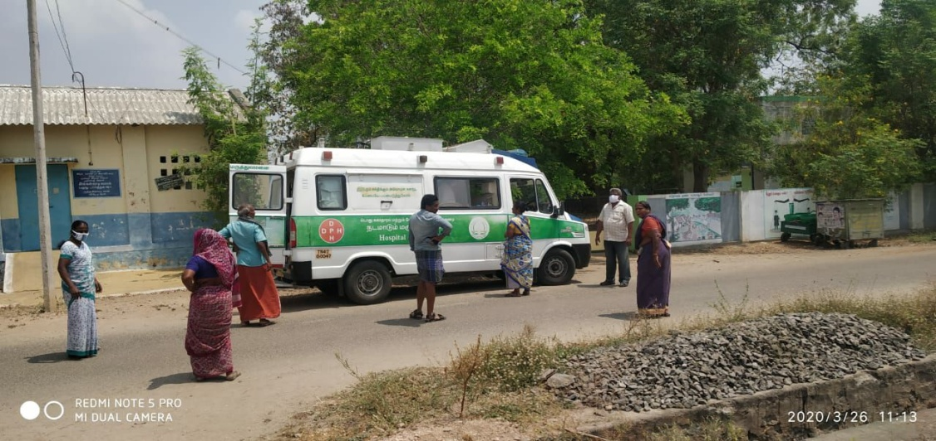
TN MODEL OF DRUG DELIVERY
Line-list of all NCD Patients were made available at Sub Centres and HWCs
Among them, a high priority list of NCD patients was made ready
  Palliative care patients
  Bed Ridden and sick patients with NCD
  Geriatric Patients with complications
  Others needing special care (as listed by Community Volunteers)
The patient whose contact numbers were not available in the registration details were traced and identified through Women Health Volunteers/Public Health field staff

Slide 9
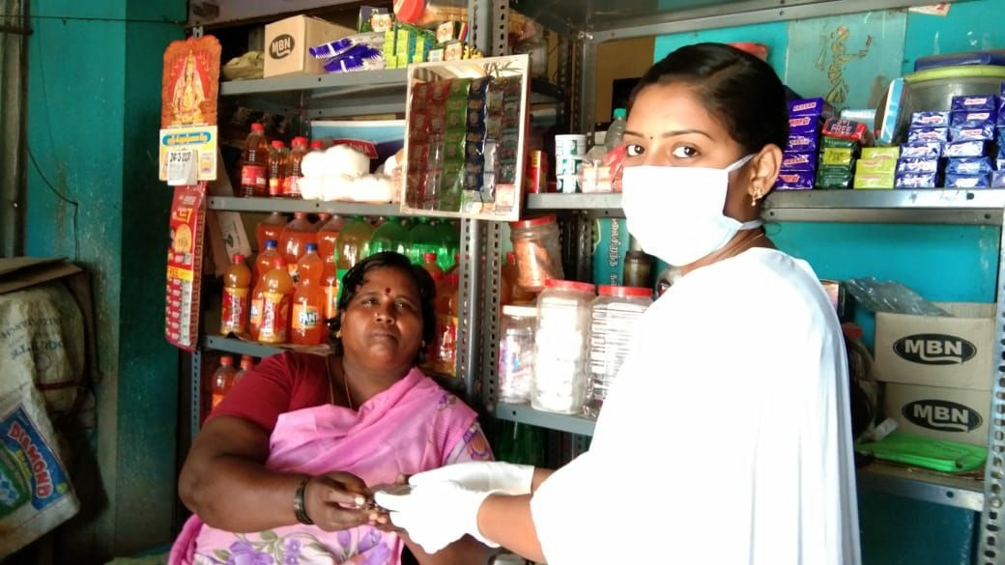
TN MODEL OF DRUG DELIVERY
Drugs were distributed to them at the doorsteps through Village Health Nurses, Mobile Medical Unit, RBSK teams, Women Health Volunteers (WHVs) and other volunteers identified in the community.
Proper personal protective measures and social distancing were observed while distributing the drugs at the doorstep.
Women Health Volunteers at HWCs played a pivotal role in screening of complications also
TNMSC played a key role in ensuring uninterrupted drug supply
No event / news on drug shortage was reported from any source including media.

Slide 10
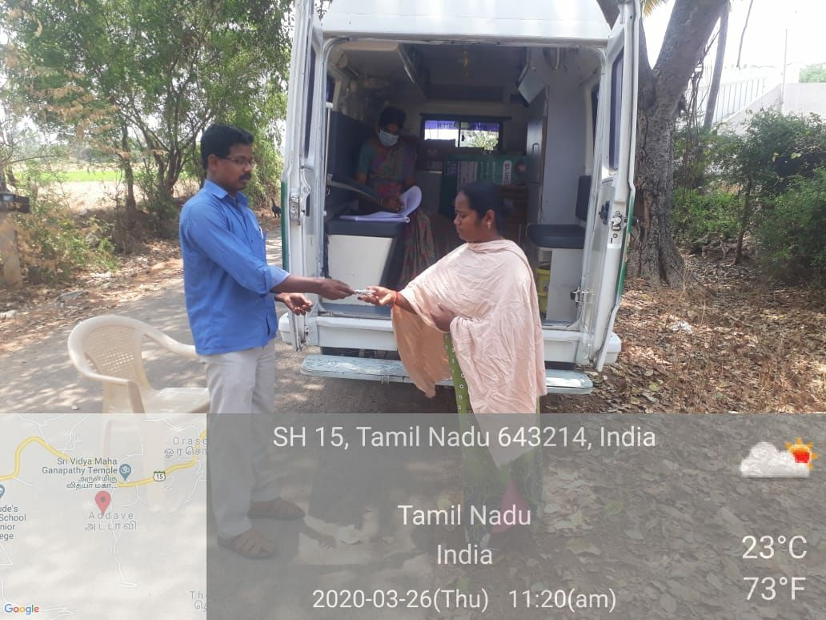
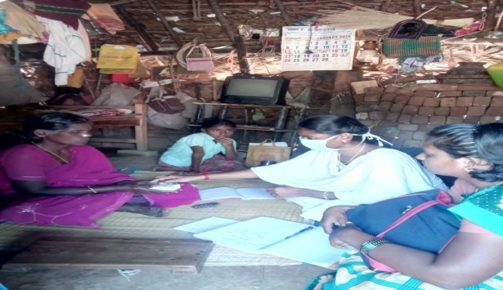
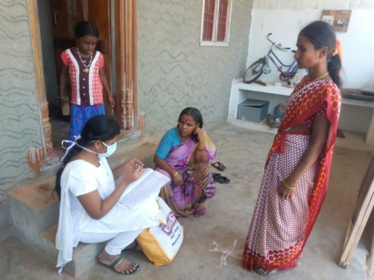
NCD DRUGS DISTRIBUTED AT THE DOORSTEPS OF THE PATIENTS

Slide 11
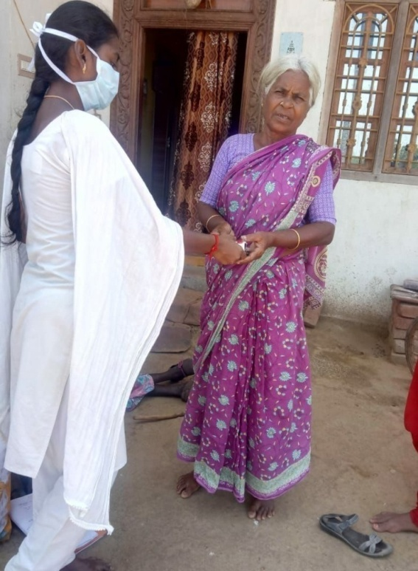
HUMAN RESOURCES
For this model, the following human resource were utilised:
  Village Health Nurse (VHNs)
  Mobile Medical Unit (MMUs)
  RBSK team
  Women Health Volunteers (WHVs)
  Other volunteers are utilized to provide NCD service

Slide 12
EVIDENCE OF EFFECTIVENESS
The number of patients benefited (April to May 2020):
DM |  |  | HT |  |  | HT & DM |  |  | Total No of line-listed NCD Patients | Total No. of NCD patients who received 2 months of drugs | % of Drug Issued
Total Number of line-listed Diabetes Mellitus Patients | No. of Diabetes Mellitus patients for whom 2 months of drugs were issued | % of Drug Issued | Total Number of line-listed Hypertension Patients | No. of Hypertension patients for whom 2 months drugs were issued | % of Drug Issued | Total Number of Diabetes Mellitus & Hypertension Patients | No. of Diabetes Mellitus & Hypertension patients for whom 2 months drugs were issued | % of Drug Issued
(a) | (b) |  | (c) | (d) |  | (e) | (f) |  | (a+c+e) | (b+d+f)
7,30,339 | 5,37,977 | 73.7 | 11,73,321 | 8,36,770 | 71.3 | 4,80,908 | 3,47,364 | 72.2 | 23,84,568 | 17,22,111 | 72.2
72.2% of registered NCD patients received drugs through volunteers or field staff at their doorstep during COVID 19 lockdown.

Slide 13
COST-EFFECTIVENESS
For this model, National Health Mission engaged the existing human resources like Village Health Nurses, Women Health Volunteers, teams working in Mobile Medical Unit and RBSK teams were utilised to distribute the NCD Drugs to the doorsteps of the patients based on the line-list.
In addition to that, a portal for volunteers was created at the State Level. Volunteers registered were also utilized by the local District Administrations to deliver drugs at the doorsteps of the NCD patients.
MMUs and RBSK vehicles were utilized for mobility in the above model. Hence the cost for separate vehicles for transportation was not required.
Thus, the State was able to effectively deliver drugs at the doorstep of NCD patients in a cost-effective manner.

Slide 14
LESSONS AND CHALLENGES
Covid19 pandemic has showed that we should have alternate viable plan for providing Health care services to the most vulnerable population.
Existing field level functionaries and other community volunteer services were aptly used for providing healthcare services to the needy population.
Decentralized planning of drug delivery is the key for NCD control in future through dedicated community volunteers

Slide 15
POTENTIAL FOR SCALE
Delivery of drugs at the doorstep is a novel idea which can be utilized in future during any form of disasters including natural calamity.
Cost-effective
Dedicated Trained Community Volunteers ready–at-hand work force in the community.
This Model can be implemented on a larger scale in future because it doesn’t involve extra human resources and it is also an effective way to reach people.
A centralised drug procurement and logistics agency like TNMSC is also the backbone for the success of this innovative practice.

Slide 16
PARTNERS IN IMPLEMENTATION WITH NHM
Tamilnadu Medical Services Corporation
Directorate of Public Health and Preventive Medicine
TNCDW – Self Help Group network.
Volunteers in the community

Slide 17
Thanks

