Slide 1


Demonstrating
Sub-Centre as
Health & Wellness Centre
LEHS|WISH

Slide 2
Introduction
Wadhwani Initiative for Sustainable Healthcare (WISH) is flagship program of Lords Education and Health Society (LEHS)
Haryana
Delhi
Rajasthan
Improving quality and access to primary healthcare
MP
Various models after encouragement by state governments, especially in Rajasthan
Assam
Various healthcare innovations with BIRAC & Others

Slide 3
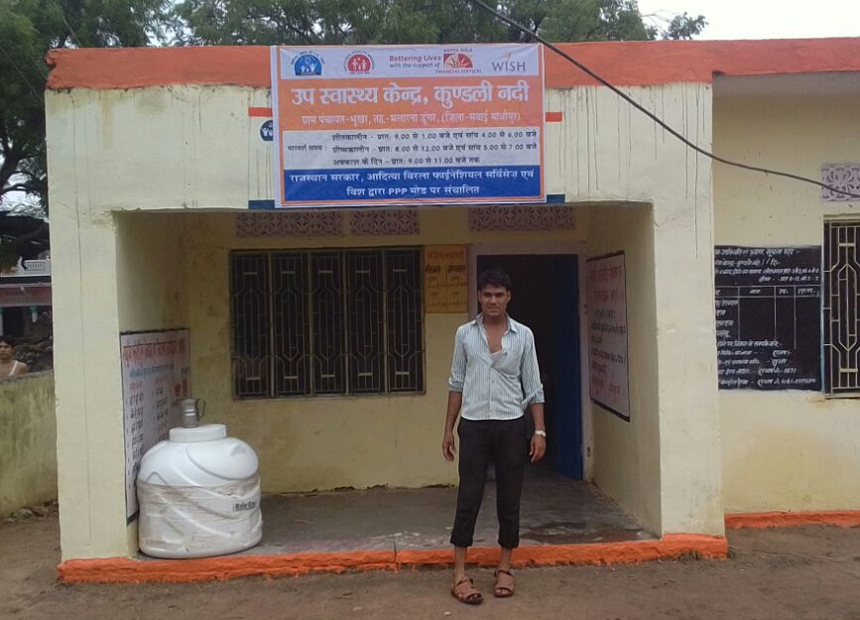
Health & Wellness Centre
Background - Sub-Centres remain the most important touch- point & response node in the entire healthcare delivery chain assuming greater significance in providing Universal Health Coverage, especially in view of the vast rural population we have.
Objective - To enhance role & efficiency of Sub-Centres aided by technological advances with accompanying qualitative improvements and assured provision of comprehensive primary health-care package thus becoming Health & Wellness Centres

Slide 4





Health & Wellness Centre
The Challenges
Low quality healthcare infrastructure with inadequate power & water supply
Absence of trained medical practitioners
Poor connectivity and lack of monitoring and surveillance
Narrow range of Diagnostic tests, with poor availability
Supply chain management challenges

Slide 5
Health & Wellness Centre
The Solution
Reposition SubCentres by transforming them into Health and Wellness centres;
Upgrade SubCentres above the Indian Public Health Standards by adding telemedicine for medical consult
Rolling out Universal Health Coverage pilot projects
Scaling up free Drugs and Diagnostic initiatives
Use of technology at rural setting may act as the game changer

Slide 6



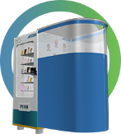




Health & Wellness Centre
Health & Wellness Centres
Round the clock primary healthcare services
Sub centre
Deployment of desired number of HR
(as per IPHS Guidelines)
Health ATM for tele-consultation, digital prescription, digital-diagnostics and automatic medicine dispensing
Diagnostics
24 Hr Services
Referral services
mHealth
H&W Centre
Telemedicine
NCD Screening (Diabetes, HT & Cancer) by PoC devices
NCD Screening
Medicine Vending Machine

Slide 7

Health & Wellness Centre- Advanced
Nutrition
PoC Digital Diagnostics
Health & Wellness Centre
Nutritional Supplementation to 1000 pregnant women;
Nutrition Bars to 1000 children
m-Partograph for better delivery care;
m-ECG for better cardiac care
NCD Screening
Menstrual Hygiene
Cancer Screening (Oral Cancer, Breast Cancer, Cervical Cancer)
Diabetes and HT Screening by PoC devices
Sanitary Napkin vending & disposal machine at SC;
MH Education to adolescent girls
Diet Counselling to pregnant women;
Mental Health Counselling
Disability Care
Counselling
Smart Cane for visually challenged;
Wheel chairs for mobility challenged;
Yoga
Referral to 108/104

Slide 8
Health & Wellness Centre
Support requested from the Government
Ensure basic infrastructure and Human Resource
Availability of High Speed internet connection (~2 MBPS)
Ensure availability of Medicines and Diagnostics
IEC/SBCC support for community engagement
Convergence of Yoga
Convergence of 108 & 104

Slide 9
Health & Wellness Centre
Impact Expected
Improved early detection & prompt treatment of common ailments using innovations
EHR and higher quality MIS for Healthcare decision making
Improved community & Service Outreach
Reduced out-of-pocket Expenditure
Improved referral and Reduce burden on PHCs

Slide 10
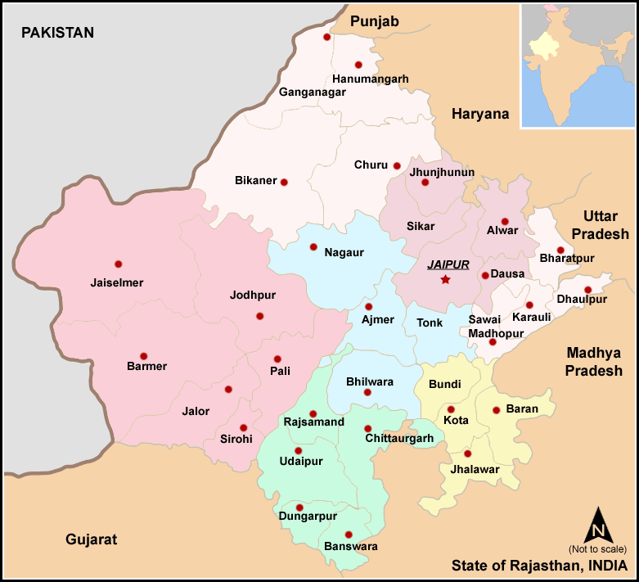
Health & Wellness Centre- Pilot
To be deployed in sub-centres across 4 districts of Rajasthan
Plan to develop H&W Centres through telemedicine, automatic medicine dispensing and PoC screening devices and diagnostics
Community outreach is improving
Load of PHCs is reducing

Slide 11
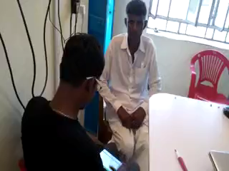
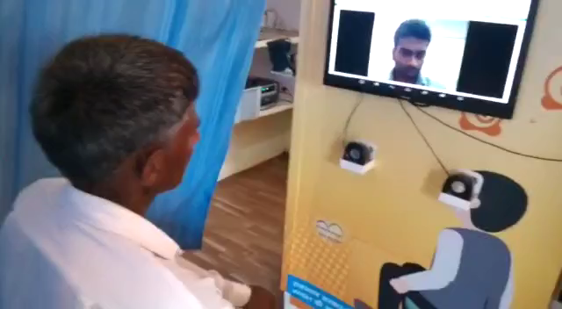
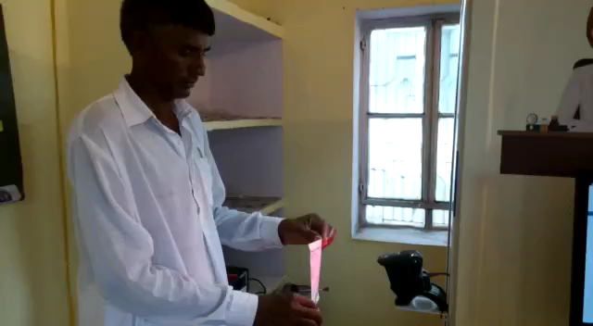
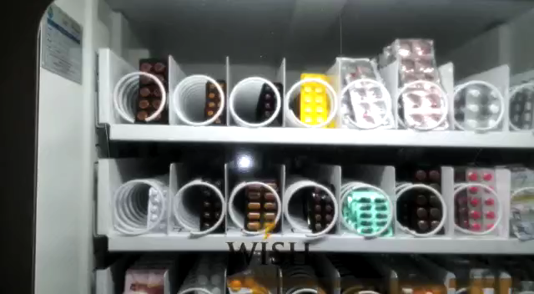
Patient Registration
Doctor Consultation
Prescription Scanning
Medicine Dispensing

Slide 12
THANK YOU

