Slide 1
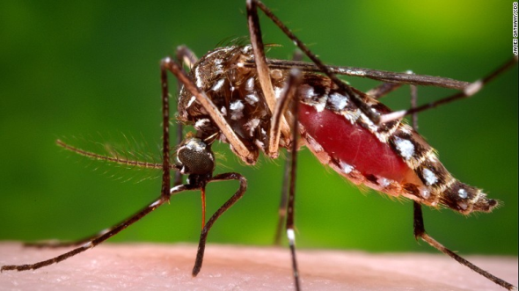
India Fights Dengue
Presentation
By
Dr. C.V. Dharma Rao
Joint Secretary
MoHFW
Govt of India
on 31.08.2016

Slide 2

Dengue
Dengue is the most rapidly spreading mosquito-borne viral disease.
All the States are endemic for Dengue
About one lakh dengue cases have been reported in our country during 2015
Dengue is transmitted by Aedes mosquito which bites during daytime.
Aedes mosquito breeds in domestic and peri-domestic containers.

Slide 3
There is no vaccine or any specific treatment for dengue. Community participation and ownership is crucial for prevention of Dengue.
The mobile App ‘India Fights Dengue’ is an innovation to empower and educate the community for prevention of Dengue.
A game, video, myths, FAQs etc have been incorporated.
It will be an interface between the community and the programme.

Slide 4
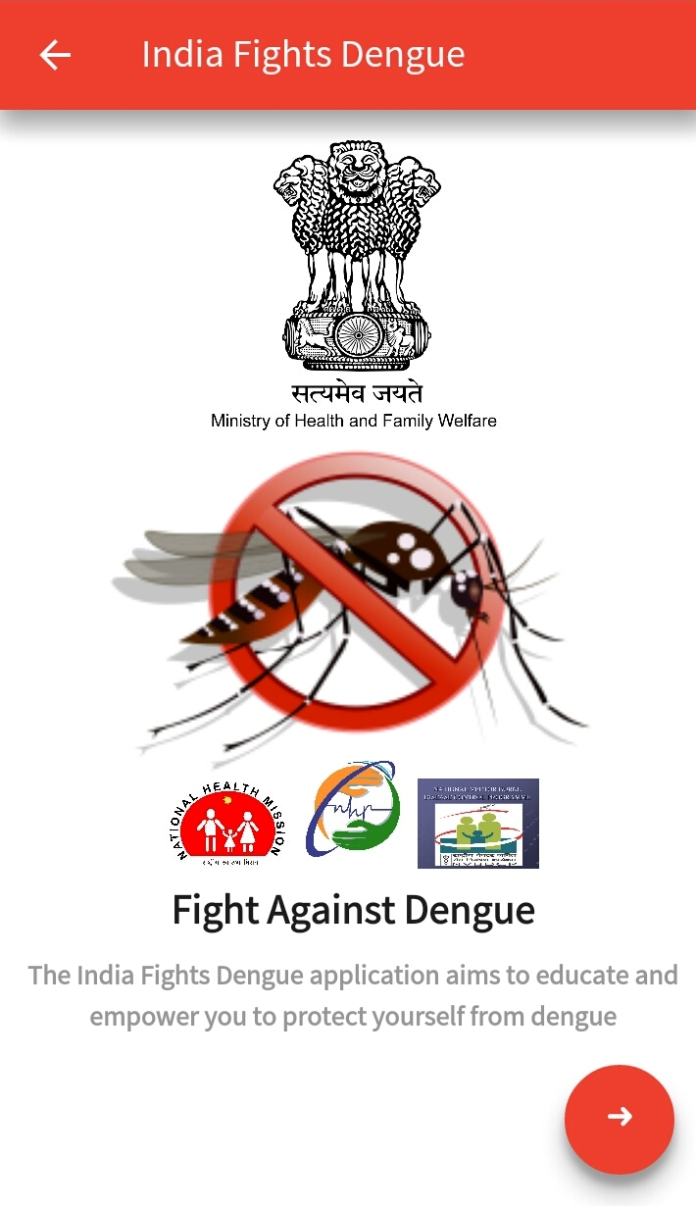
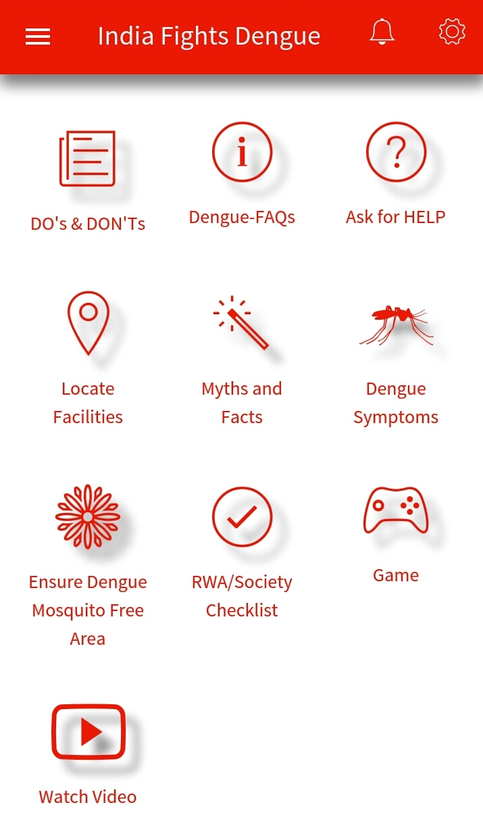

Slide 5
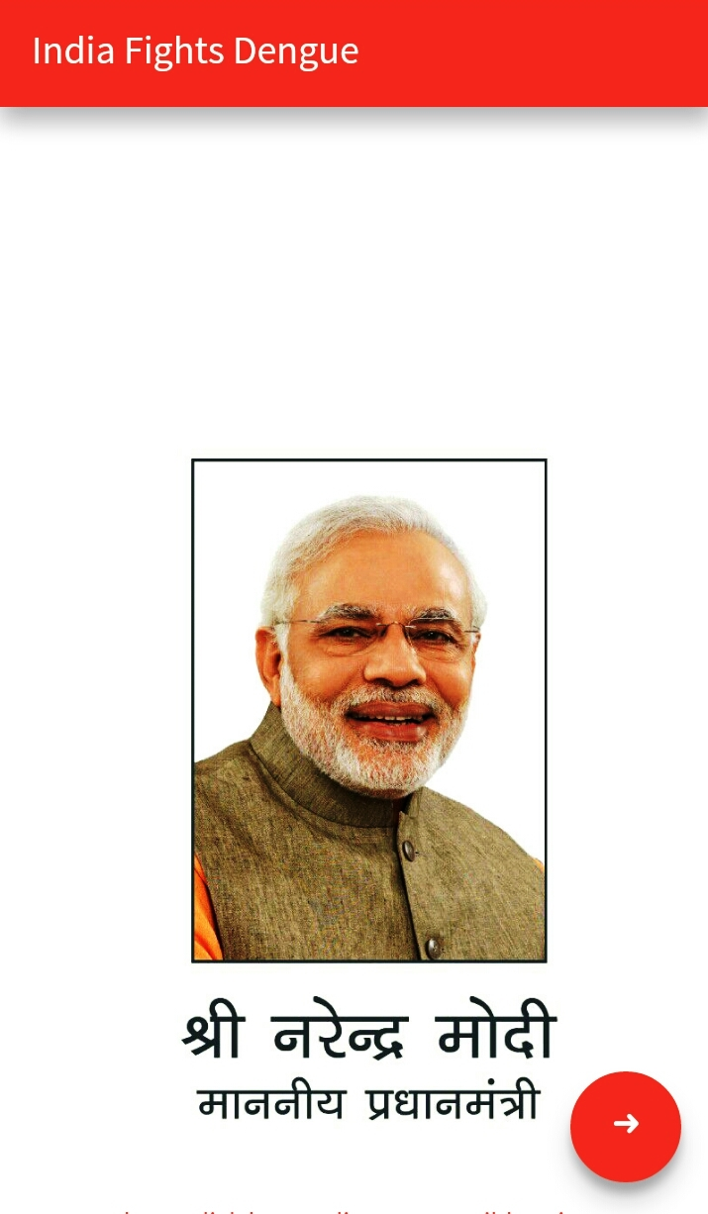

Slide 6

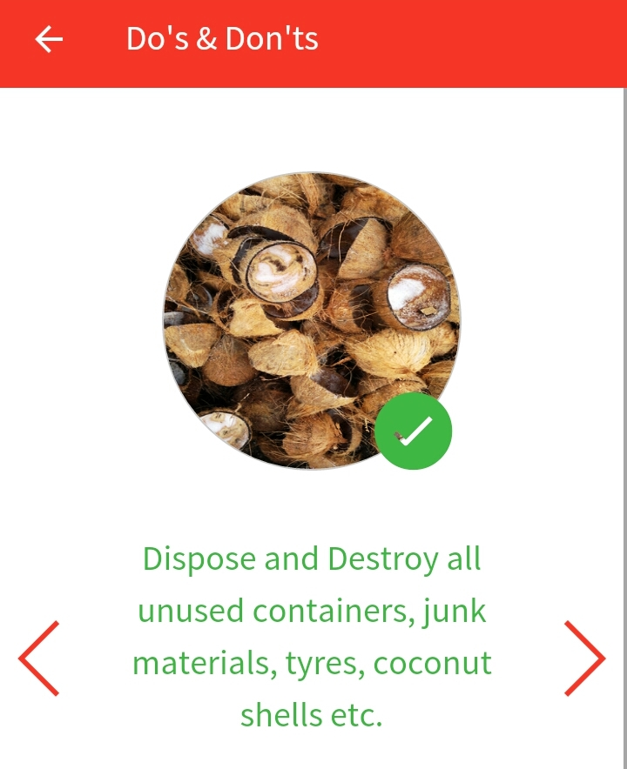

Slide 7
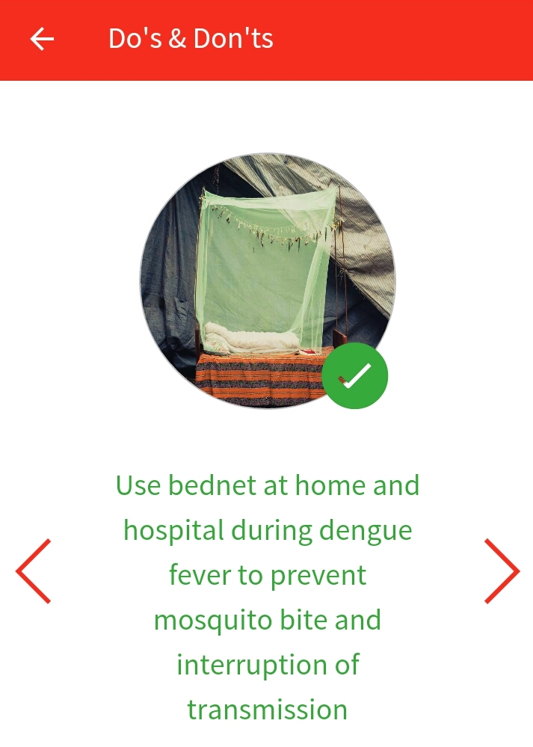
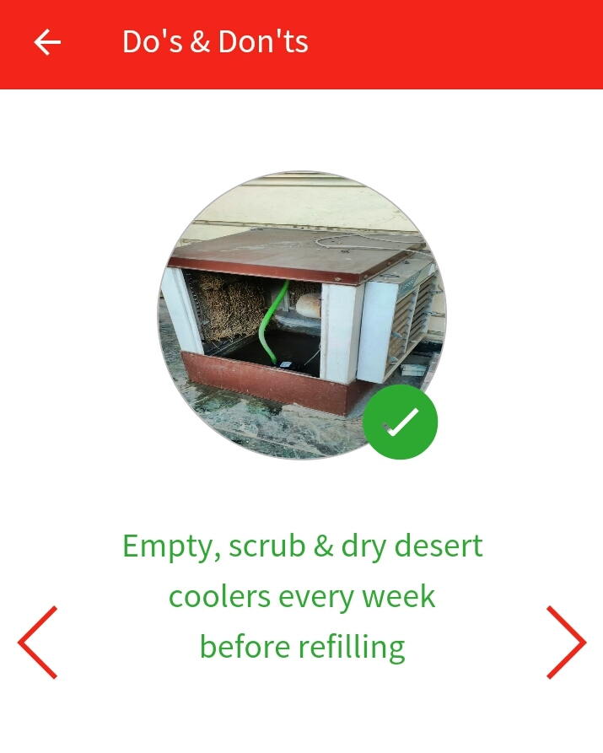

Slide 8
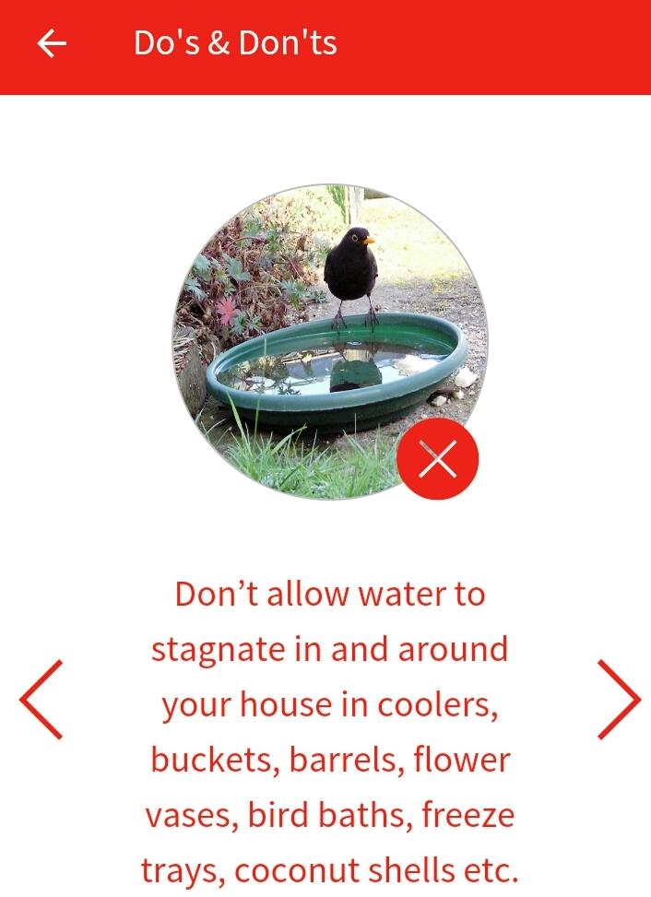
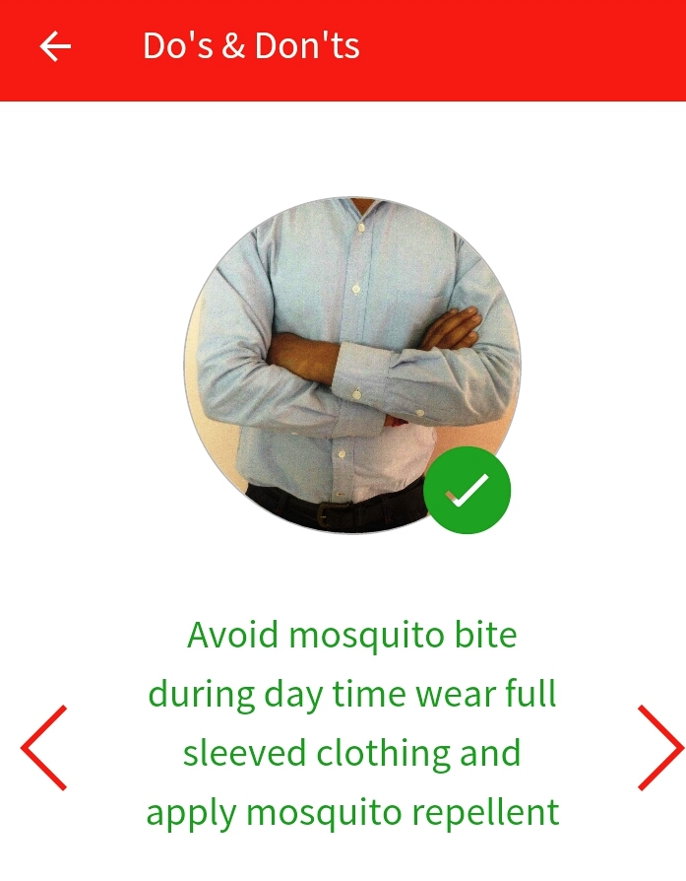

Slide 9
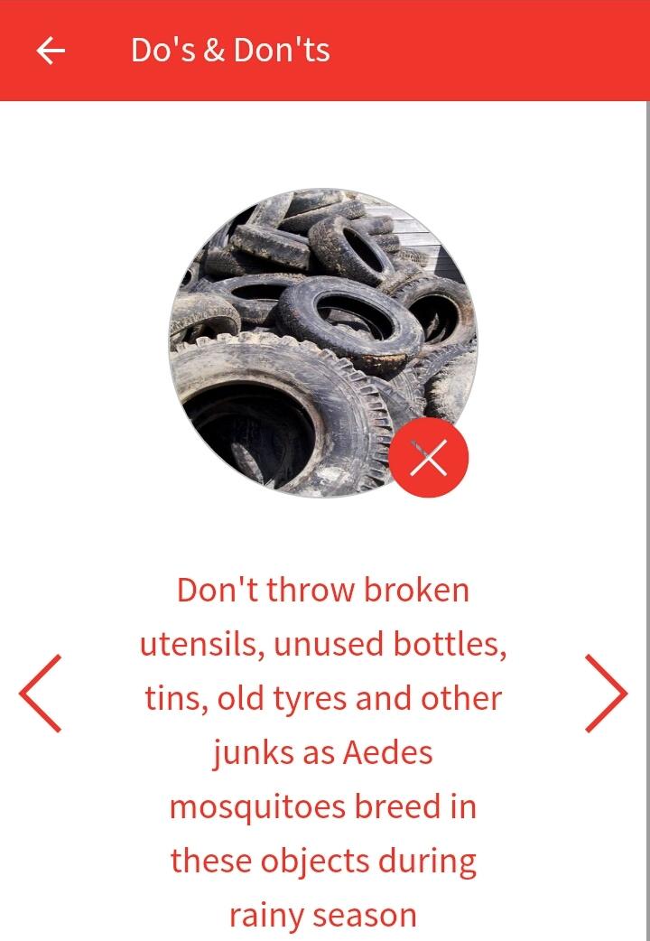


Slide 10

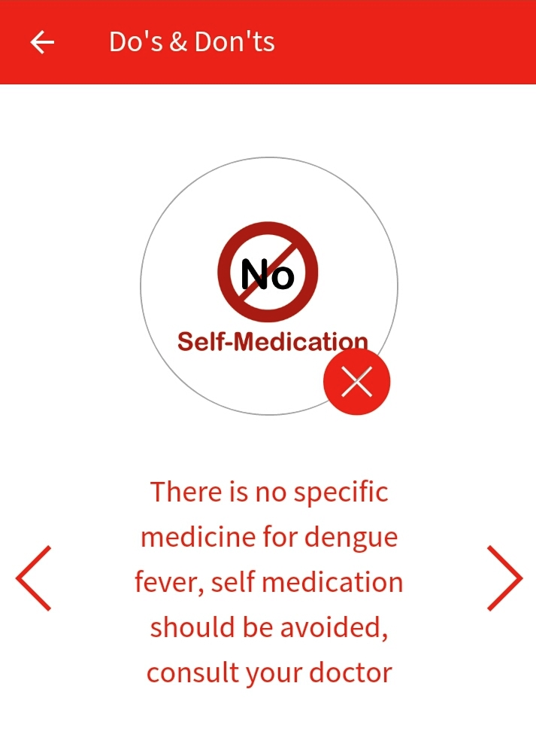

Slide 11
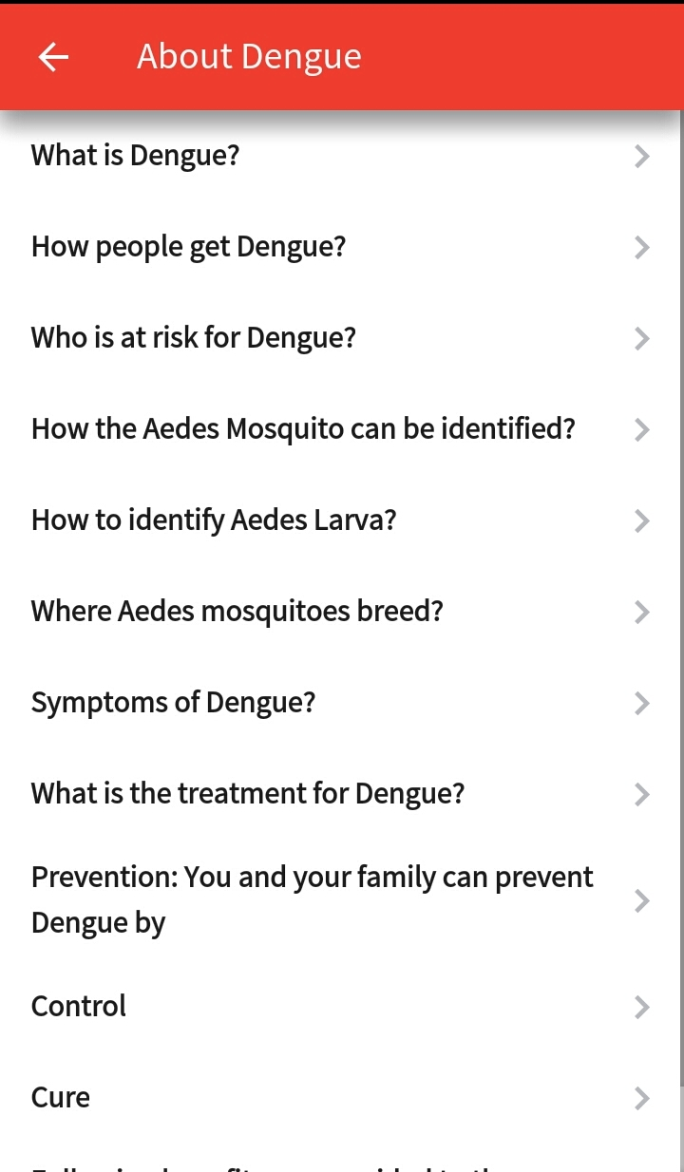
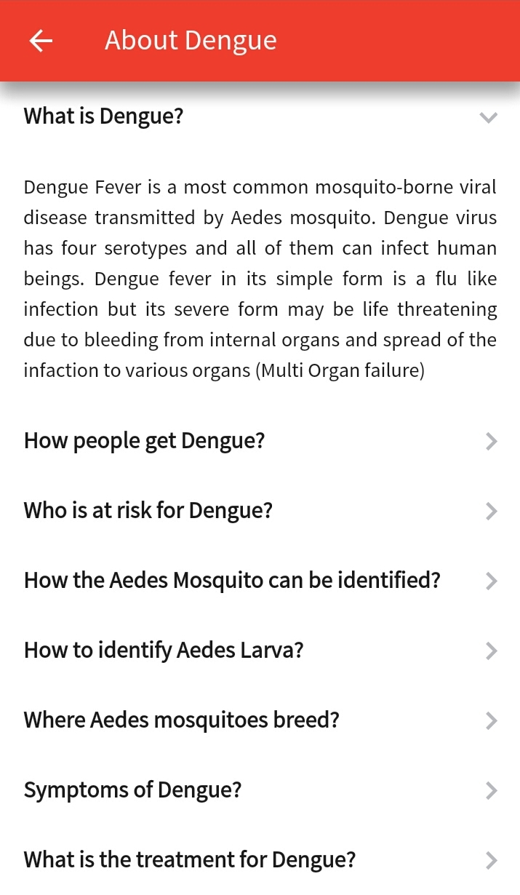

Slide 12
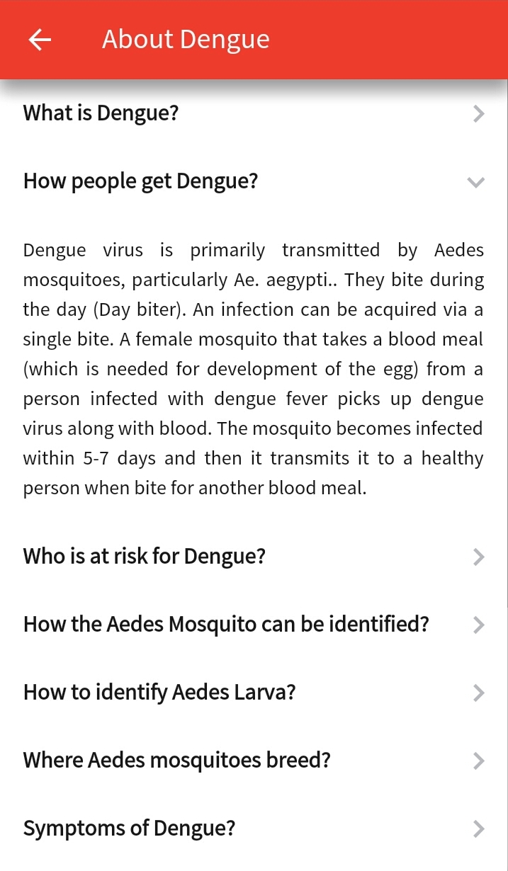
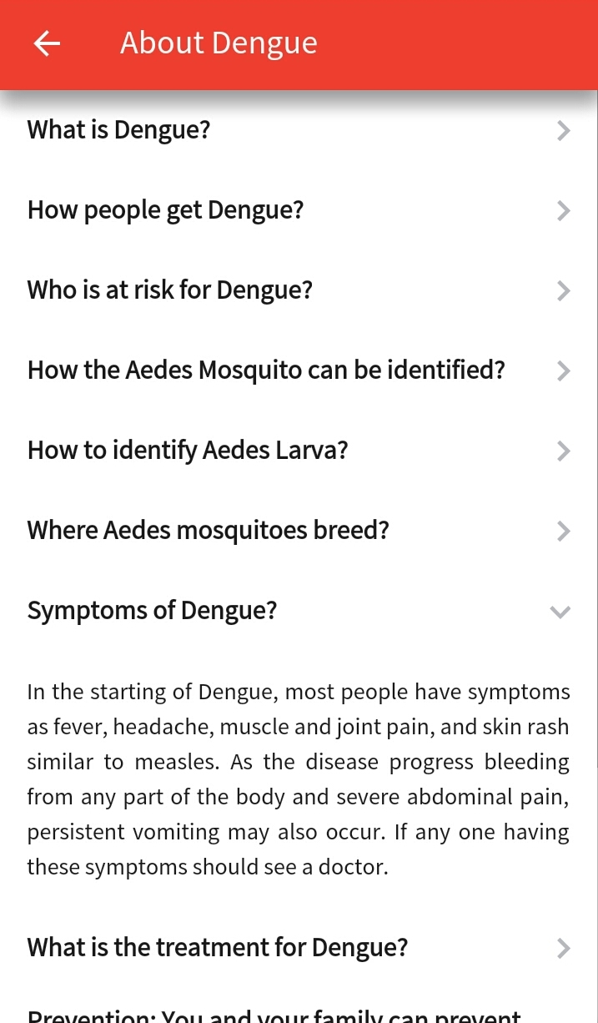

Slide 13
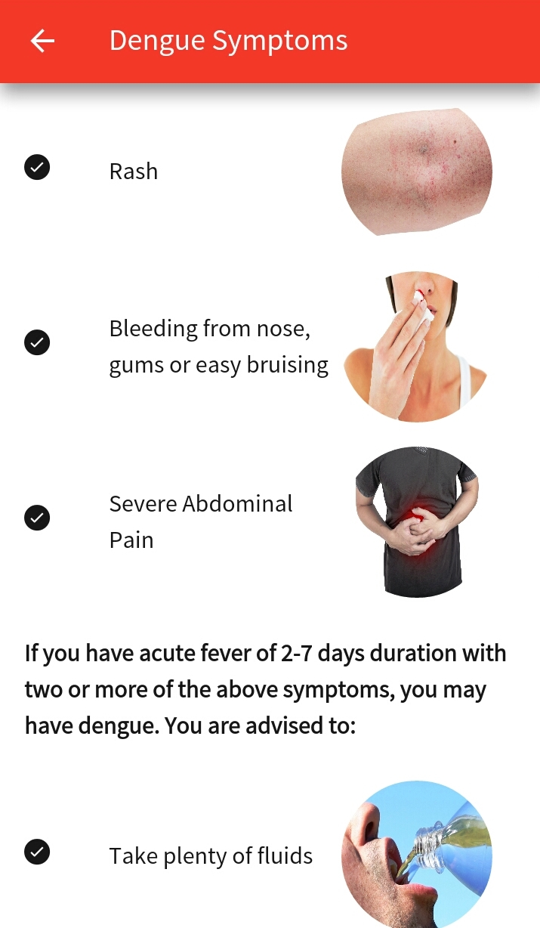
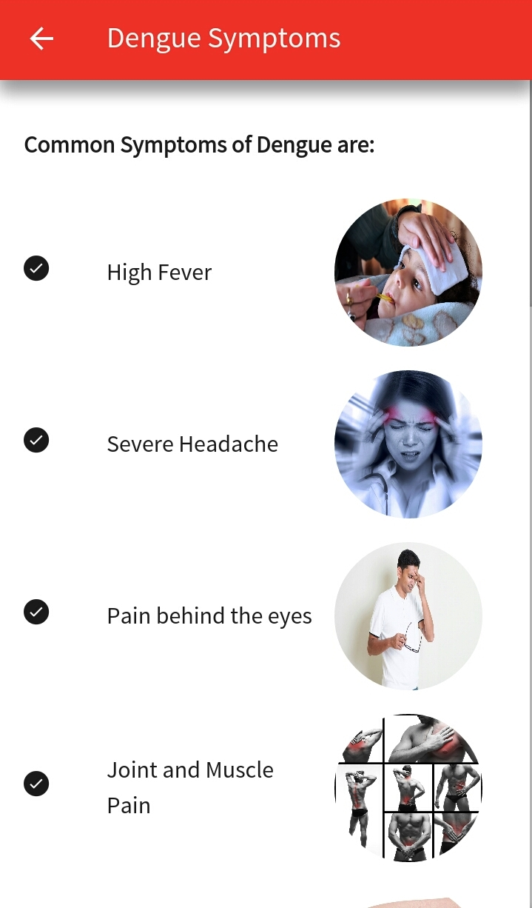
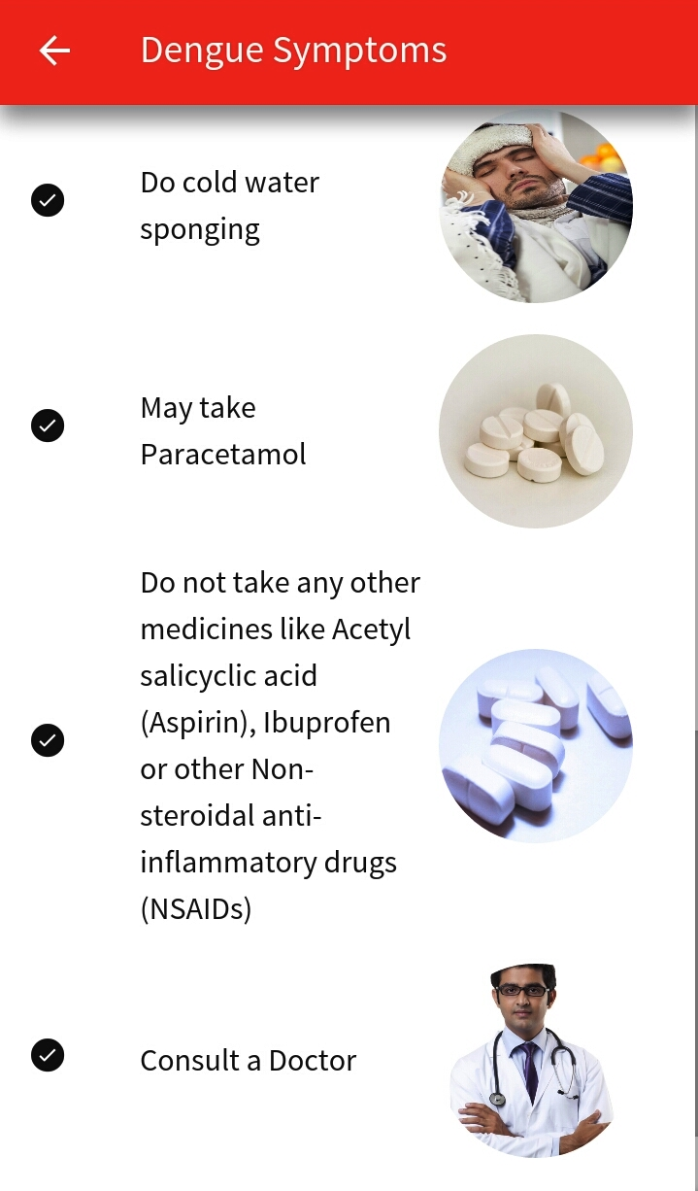

Slide 14
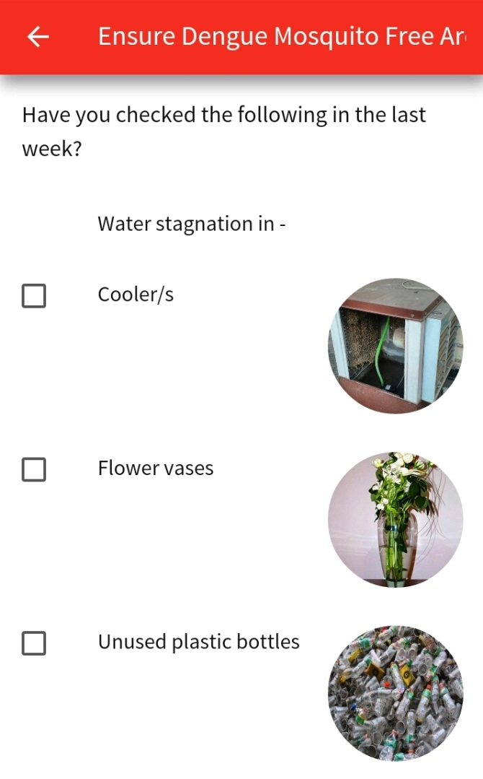
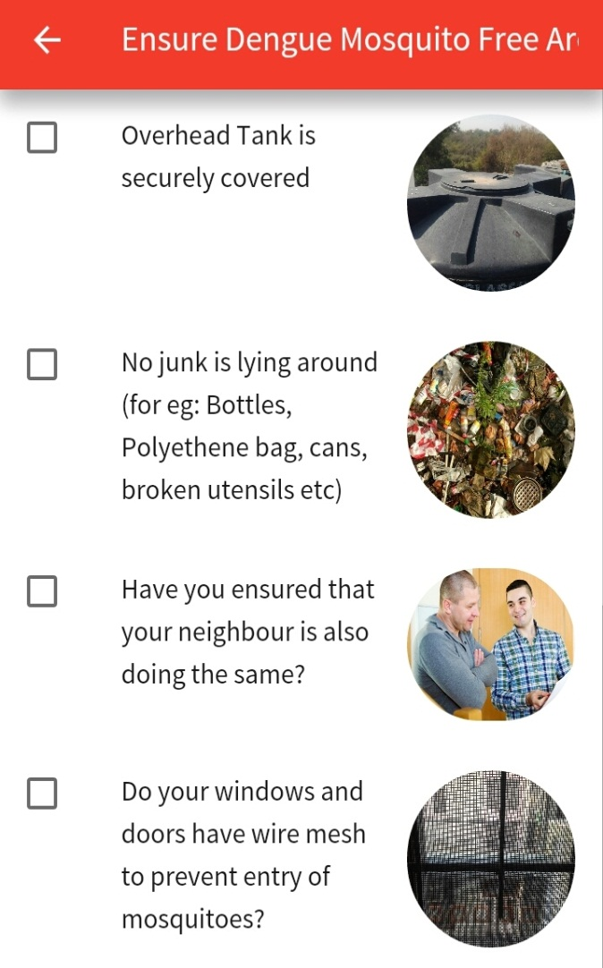
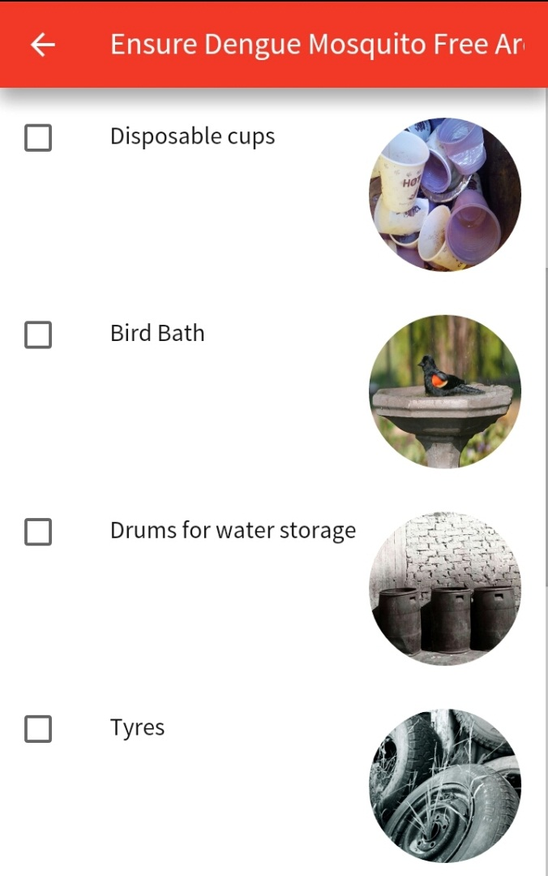

Slide 15
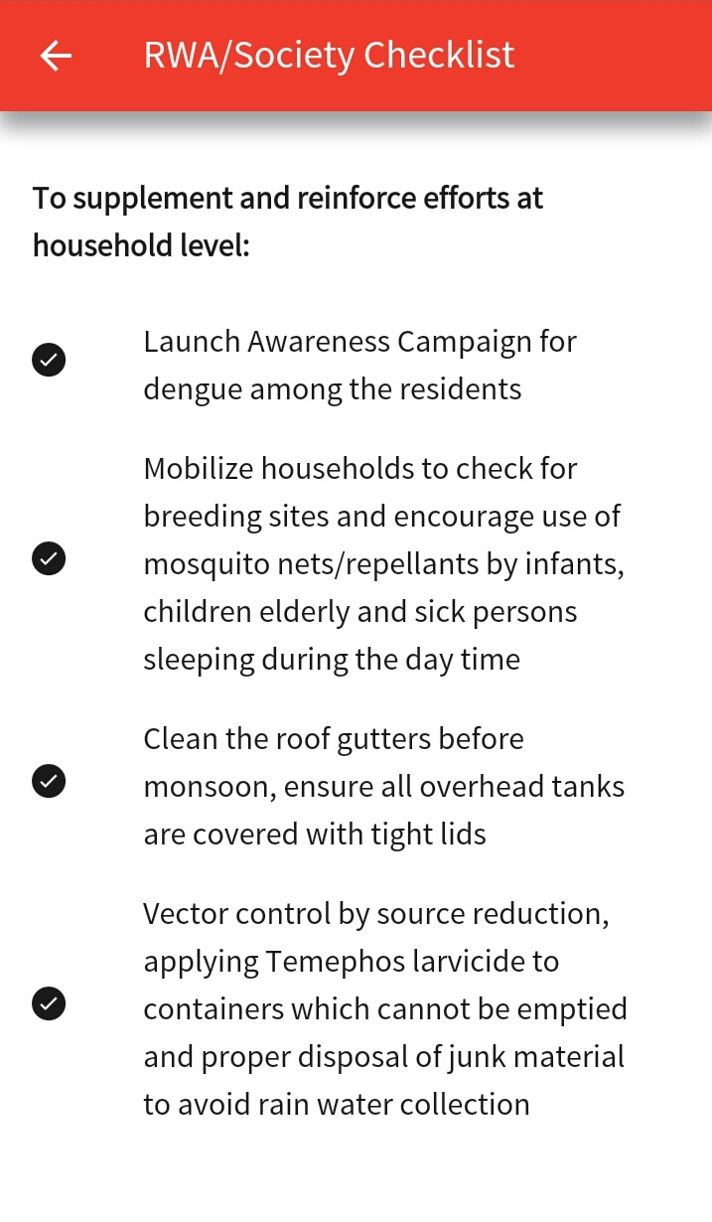

Slide 16
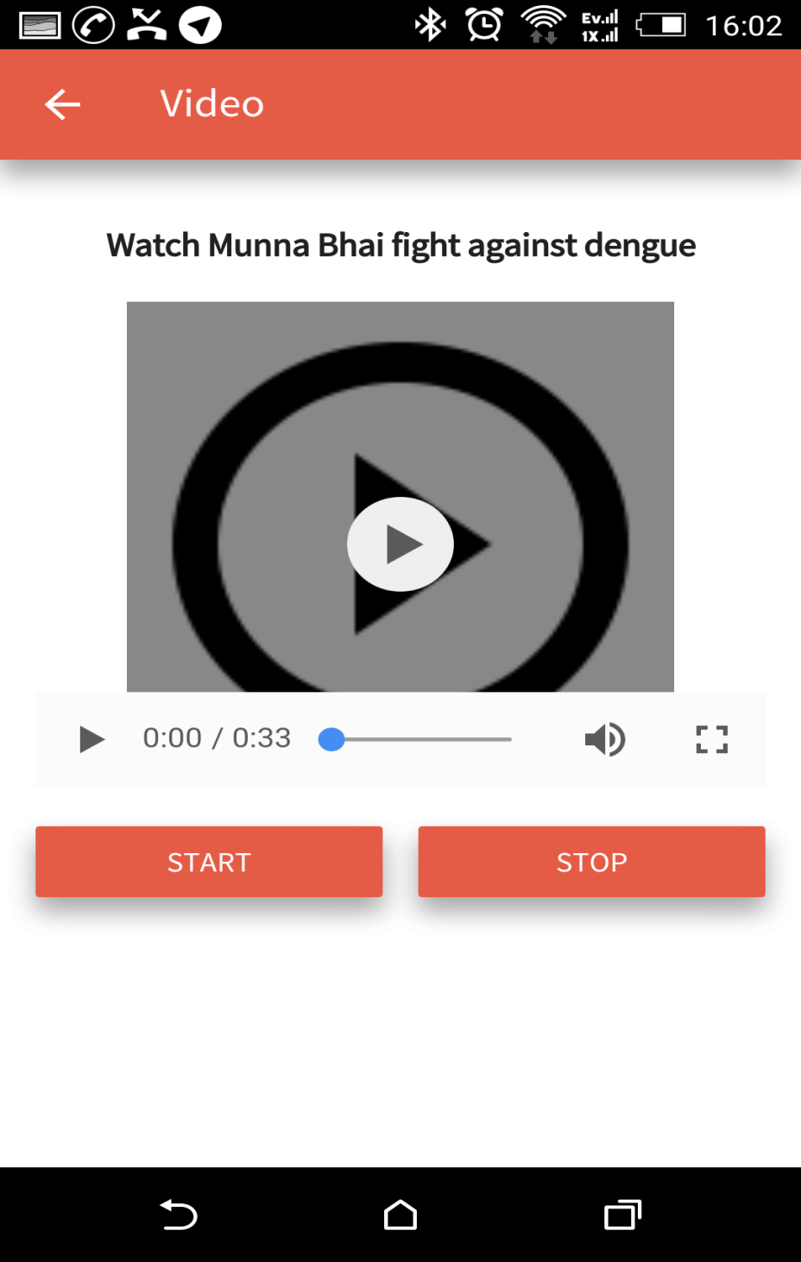
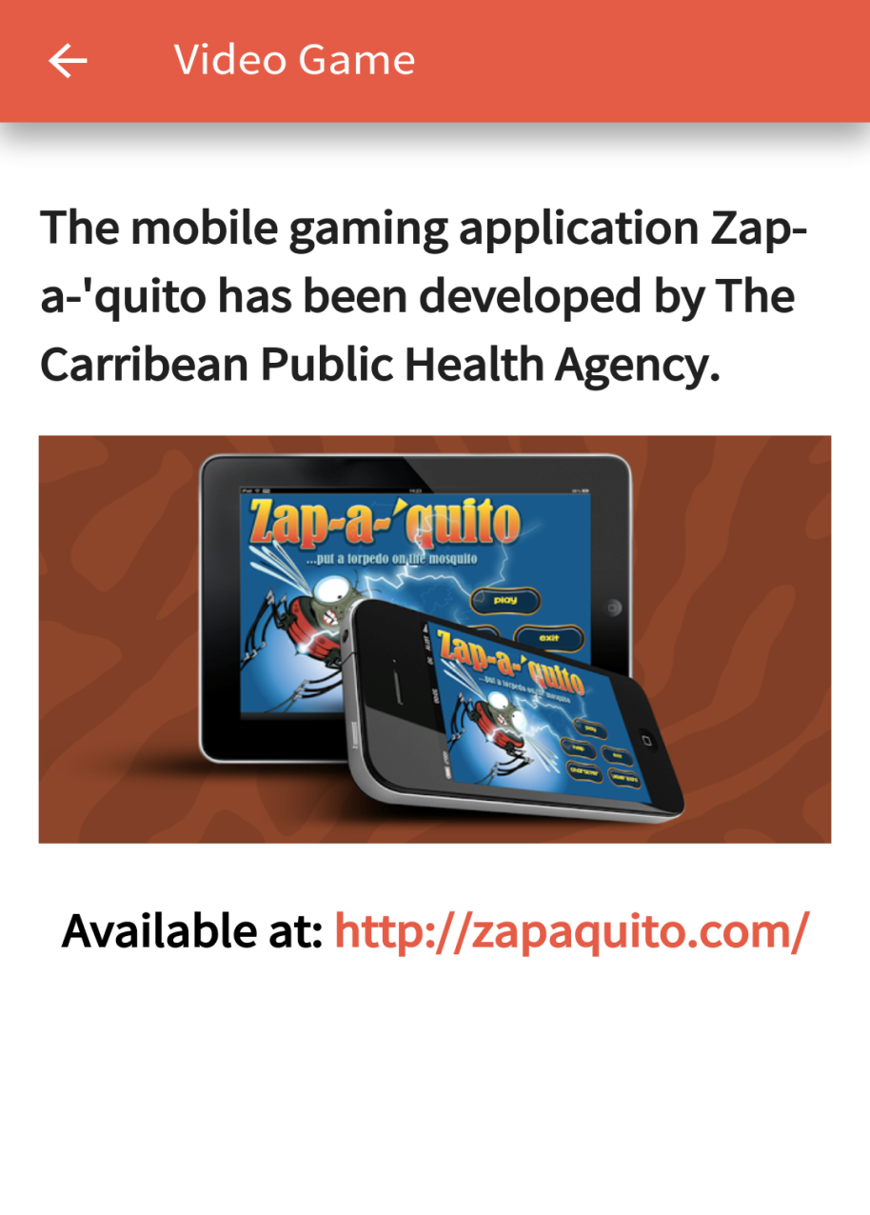
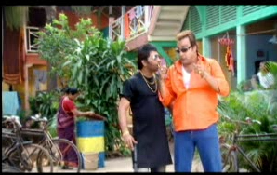
India Fights Dengue
Game and Video

Slide 17
THANK YOU

