Slide 1

e-Upkaran
Equipment Management and Maintenance System
Presented BY:
Naveen Jain, MD NHM, Rajasthan

Slide 2
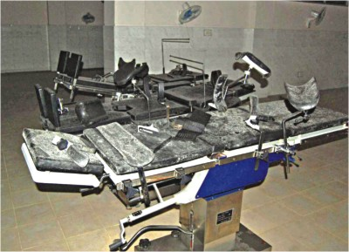
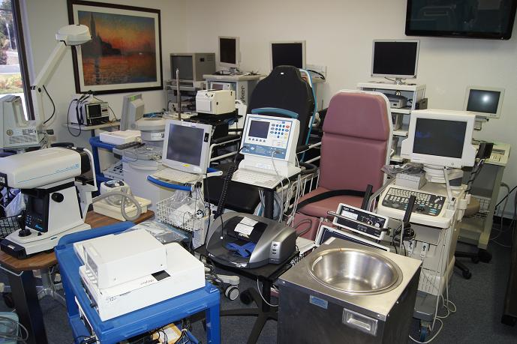
Status of Equipment
In India, it is estimated that anywhere between 30% and 63% of roughly Rs 10,000 crore worth of existing medical equipment in public health facilities across all states is dysfunctional (NHSRC, 2014).
2% of machines in government facilities are under any kind of maintenance contracts (NHSRC, 2014).
The study says even minor improvements in the inventory management performance can have a large effect on health institutes and health system performance, reducing its cost by 10% to 12%, Optimizing inventory can account for 10% of overall savings. (Hospital Based study done by PWC 2010)
Approximately a third of all countries lack a designated unit responsible for managing medical equipment.
Non functional Equipment
Unused Equipment
Notes:
PWC: Price waterhouse Coopers

Slide 3
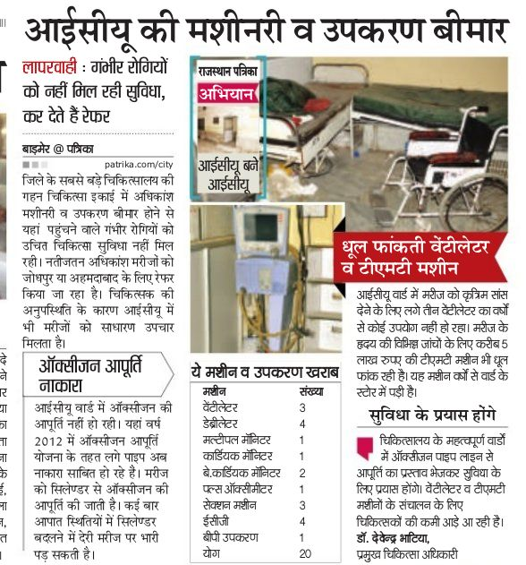
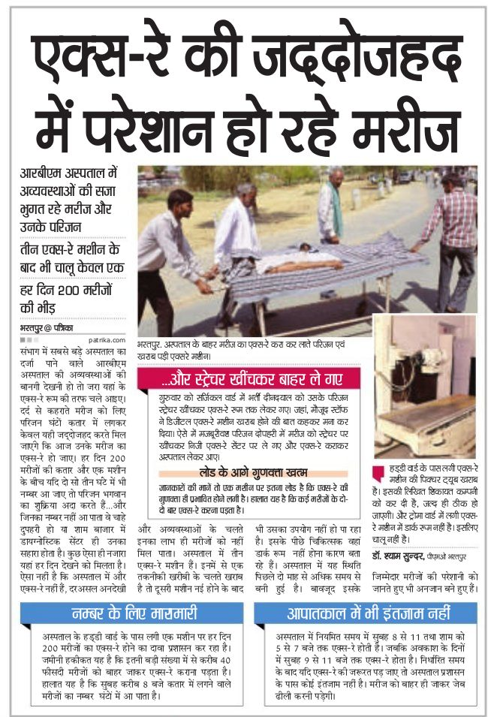
News in Media

Slide 4
Why we need EMMS?
Inefficient Management of Equipments and instruments
  Unutilized equipment/ instruments lying in the stores
  Gross deficit of equipments / instruments at some places
  Non-functional equipments with minor problems
Non existence of repair & maintenance system for hospital equipments.
No provision of preventive maintenance system for equipments
mismanagement – Duplication or unwanted procurement

Slide 5
E-Upkaran (EMMS)
A comprehensive solution using the IT interface to improve the Inventory Management & Maintenance Services of Equipments in Hospitals across the Rajasthan.
Key Features:
IT based centralized Equipment Inventory Management
Comprehensive Details of Equipment including Commissioning, Decommissioning, vendor details, AMC details etc
Complaint Monitoring
Equipment Status Monitoring
Equipment Usage Monitoring
Preventive Maintenance Service Monitoring
Breakdown Details of the Equipment
Equipment service History
Ascertain new needs
Customizable Report

Slide 6

e-Upkaran …. it is not just a program…. it is a system
Inventory and equipments Management
Inventory Management
Equipment Status - (Functional, not in use, installation pending, non functional & Repairable, non functional not repairable)
Usage
Usage of equipments
- Equipments linked with revenue
-Monitoring and analysis of breakdown time and misuse
Maintenance management (R & M System)
R&M
Complaint Raising
Inventory cell(NHM) and BME (RMSC)
+

Slide 7
Module 1: Equipment Inventory
Online updating of inventory(Equipments &Instruments) including
Verification of entered instruments
  Status of equipment
    Functional
    Non-functional
    Reparable / Non-Reparable
Guarantee & Maintenance Contract
Module 2: Equipment Complaint Management
Online monitoring management through breakdown complaint / service & repair / preventive maintenance (PM) services.
Module 3: Equipment Usage
This module is used to update daily use of equipments online from individual healthcare facilities up to PHC level. Including who is used and the last time when particular equipment used.
Module 4: Reporting
This module is used to monitor daily online reporting tools from individual healthcare facilities up to PHC level. Due to role based access user can access and the operations that he/she can administer through the application.

Slide 8
MAPPING FORMAT
Parameter | Response
State | Rajasthan (State Code 30,31,32)
District | Alwar ( district Code 01)
Health Facility Type | District Hospital/SDH/CHC/PHC
Department | Operation Theater
Equipment Type | Defibrillator
Make | Philips
Model | Heart start XL
Sr. No. | SNFR210001
AMC/CMC | Yes
Date of Installation | 10/10/2010
Critical | Yes/No
Supplied By | XYZ Vendor
Barcode | (31010001)
13

Slide 9
Equipment Status in State
(as on 26-07-2016 in e-Upkaran)
STATUS OF 147 BIO-MEDICAL EQUIPMENTS under Repair & Maintenance
STATUS | TOTAL
Functional | 38583
Installation Pending | 621
Not in use | 512
Non Functional Repairable | 1013
Non Functional Not Repairable | 874
TOTAL | 41603
Costing of equipments: Done by NHSRC under biomedical equipment programme; 221 crore estimated

Slide 10
Equipments Mapping & Values
Equipment Name | numbers | Rate | value
Baby Weighing Machine | 2098 | 5000 | 10490000
Binocular microscope | 2868 | 30000 | 86040000
Bipolar Cautery Machine | 4 | 200000 | 800000
Centrifuge Machine ( 12 Tube ) | 242 | 25000 | 6050000
Centrifuge Machine ( 4 Tube ) | 962 | 15000 | 144300000
Instrument Sterilizer | 1466 | 5000 | 7330000
Radiant Heat Warmer | 2337 | 60000 | 140220000
Syringe Needle Destroyer | 4971 | 1200 | 5965200
Ultra Sonography (USG) & Colour Dopler Machine | 83 | 1100000 | 91300000
Ventilator | 203 | 1100000 | 223300000

Slide 11
Institute wise availability of Max and Min equipment comparison with IPHS:

Slide 12
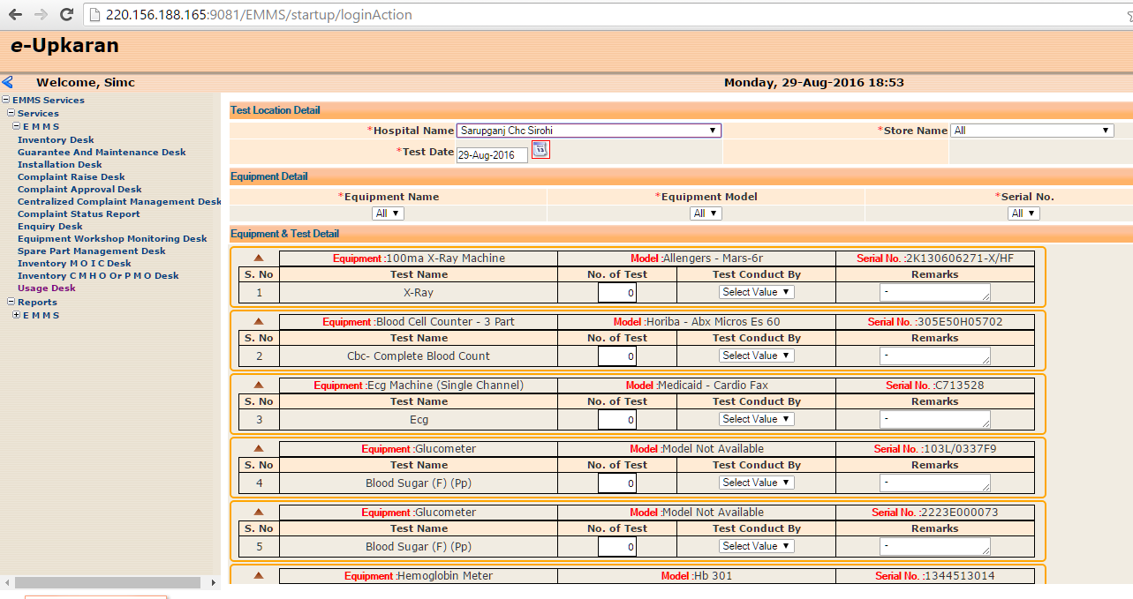
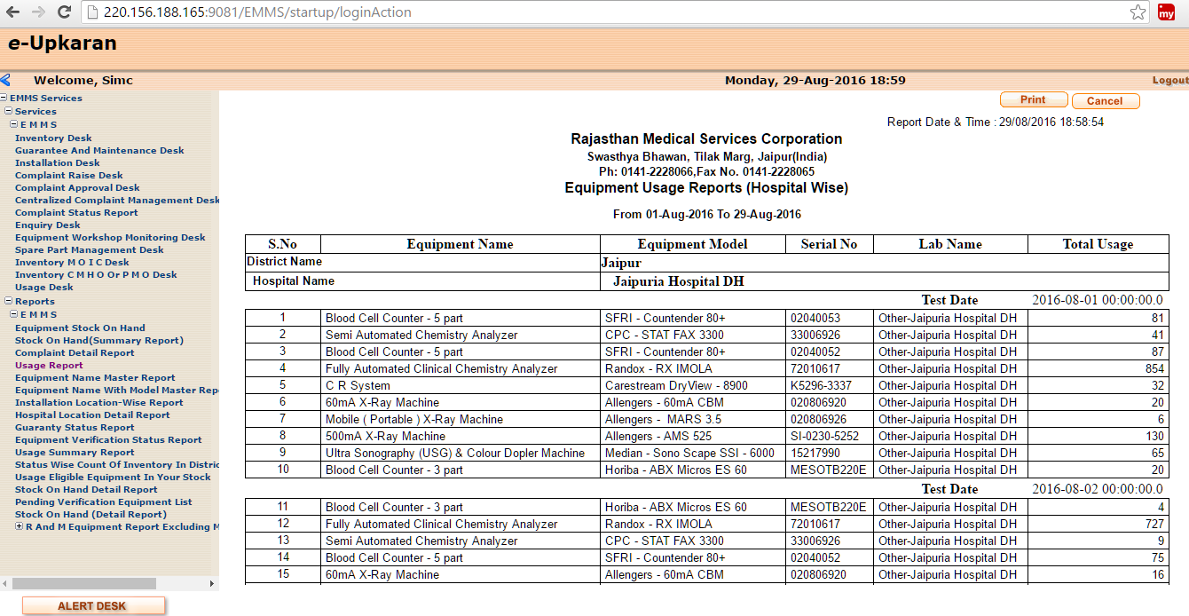
Equipment Usage Monitoring
Daily Monitoring of Equipment Usage
Utility of equipment in Institution
Monitoring of Equipments which are using for revenue generation
Immediate information of Break Down of Equipment
Identification of Malpractices if any
Analysis and record of Equipment’s Usage

Slide 13
Equipment wise biomedical equipment usage

Slide 14
District Level - equipment unused details
(District Ajmer)

Slide 15
Action initiated on the base of e-Upkaran data base
Institutions became proactive for biomedical equipment management (earlier this issue was of least concern )
Facility started to work on e-Upkaran and entering equipments status in e-Upkaran software
    Approx 9000 new/old equipments and instruments are entered in software by institutions themselves.
Not in use equipments ( Action initiated for further use of 771 equipments):
    HQ received transfer proposal where it can be used;
    Utilization in other dept in same hospital;
    By attention of administration, institute has started use of equipments.
Proposal for transfer of 122 equipments received from facilities for transfer to other facilities
Installation Pending equipments: more then 117 equipments are installed recently
Non functional non repairable equipments: initated condemnation processes of approx 800 equipments.
Repair and Maintenance RFP floated on the base of total cost of biomedical equipments in e-Upkaran.

Slide 16
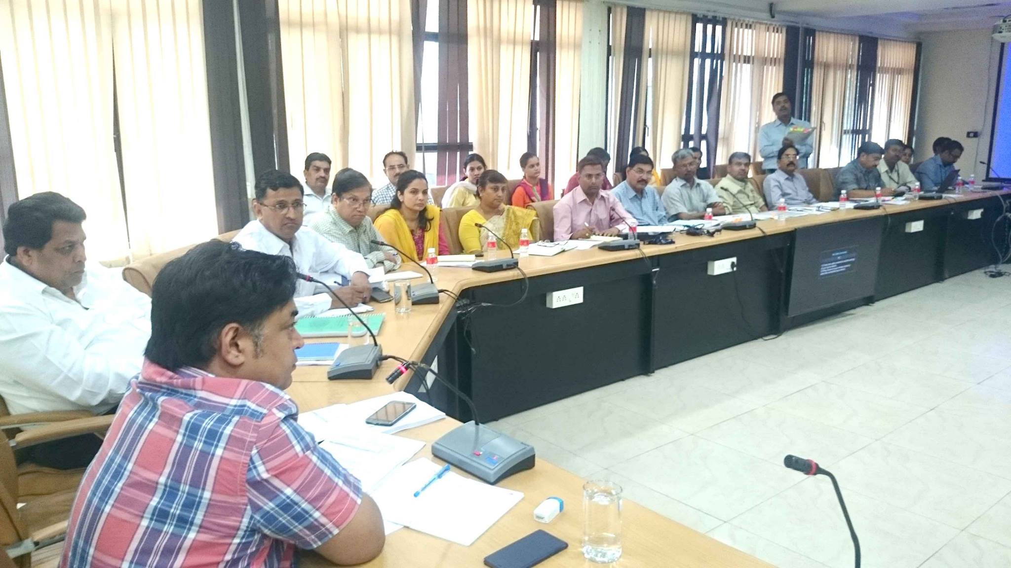
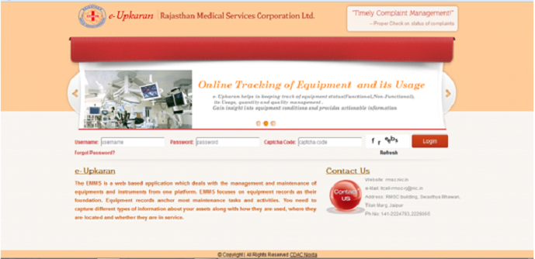
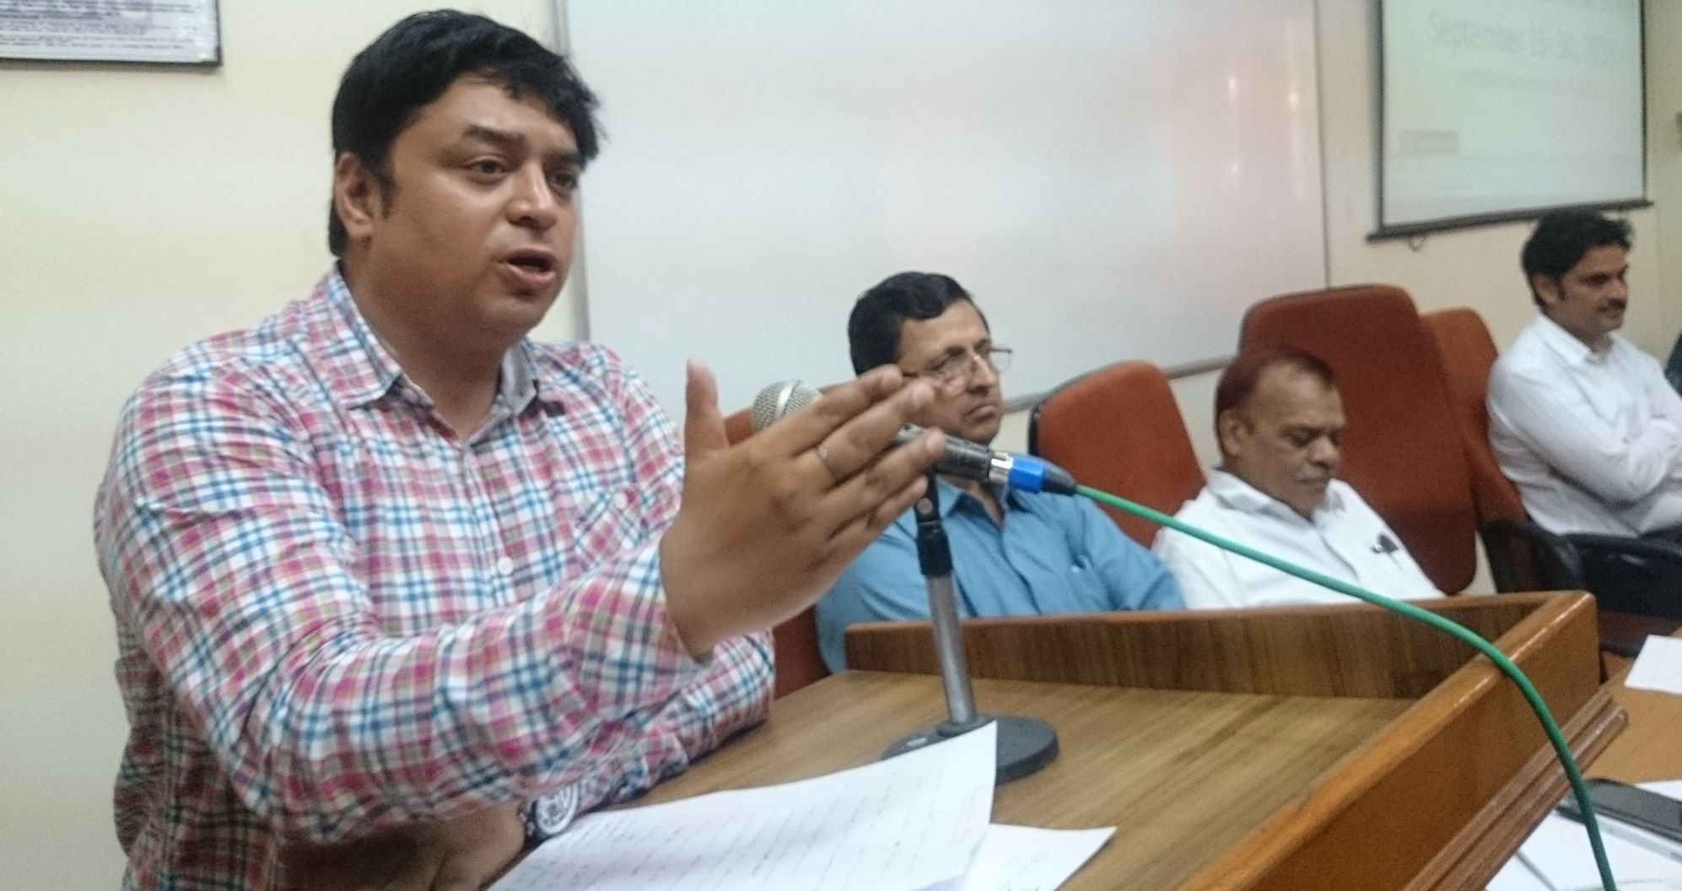
HelpLine No. - 7597627008
Implementation:
CM budget announcement
Mapping of Equipments
Verification (Twice)
Equipment valuation by NHSRC
Monitoring
Hiring of maintenance agency (KTPL) though RMSC
Schedule for repair and maintenance
Time bounded Administrative activities and orders
Use of opportunity (CM Announcement & Equipment Maintenance Program of GoI )
Inventory Management Cell
Software development (e-Upkaran)

Slide 17
Scope of work/Key Features of Agreement
Biomedical maintenance program –
Biomedical maintenance 24 X 7, 365 days (90% uptime)
Equipment Downtime < 4 days
Exclusive customer care (24X7 toll free Call Center)
Maintenance of all Non Functional & Repairable Equipments
No Advance paid, first installment after 3 months
Availability of Bio Medical Engineers at every District HQ
Penalties for noncompliance on tender conditions

Slide 18
Maintenance Methodology
Mapping: A detailed physical survey of each Equipment
Coding: UIN is created & tagged for each equipment
Assessment: Hands-on performance & safety checks
Recovery: Dysfunctional to Functional
Type of Maintenance : Preventive and Breakdown calls
Condemnation: 3 level in-house technical assessment
IVRS : Cloud based call management system & synchronization with e-Upkaran.

Slide 19
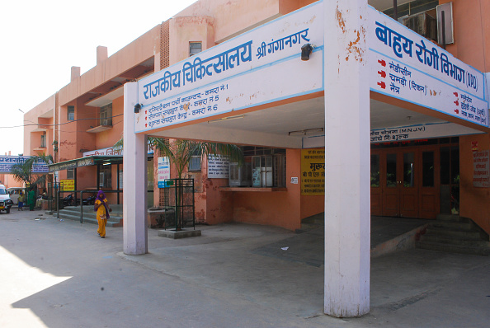
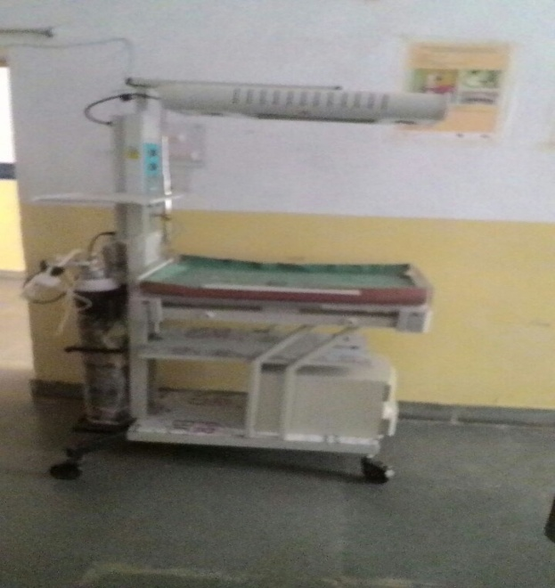

Overview of E-Upkaran System
Total Facilities = 2971
Total Equipments = 41603
Hospital
Equipments
Mapping of
Equipments
Repair & Maintenance
Of Equipments
24 X 7, 365 days (90% uptime)
Equipment Downtime < 4 days
No Advance paid, first installment after 3 months
Maintenance
Agency
Verification of
Equipments

Slide 20
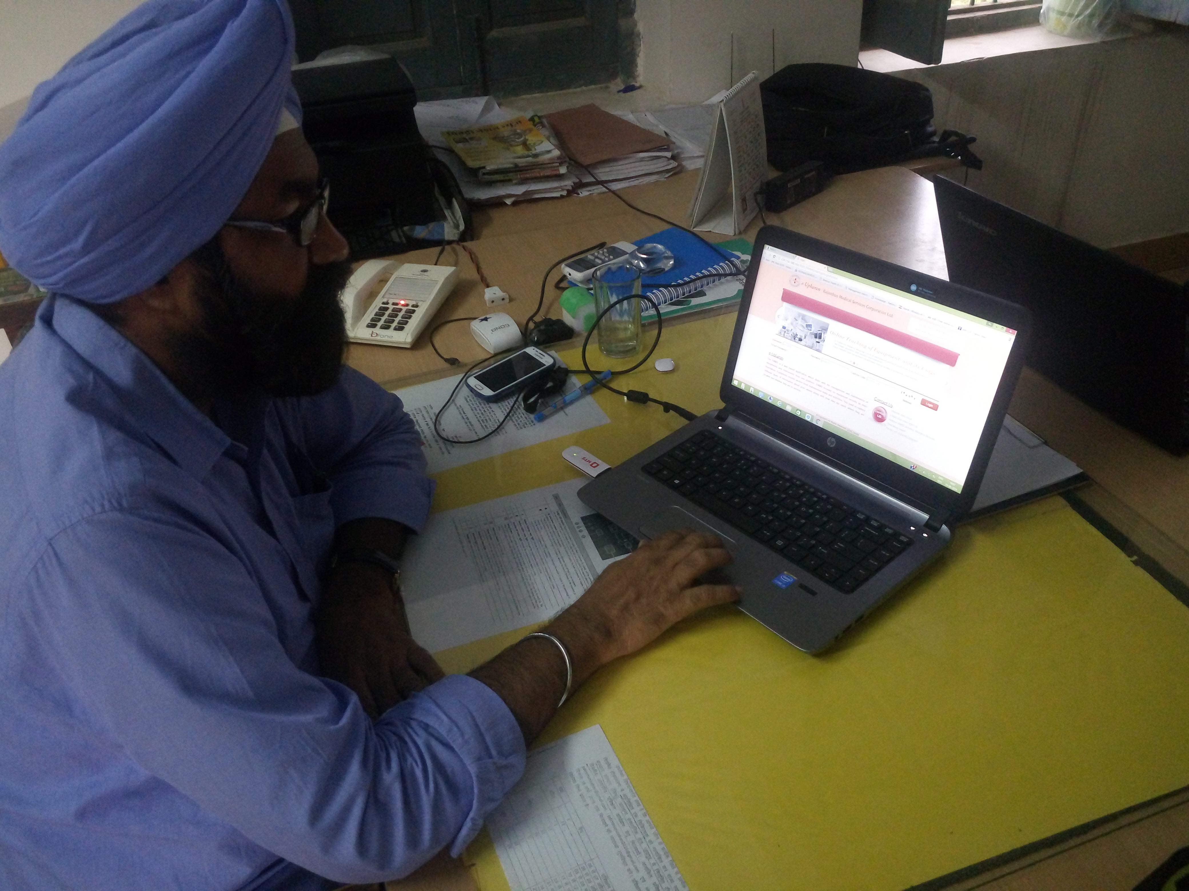
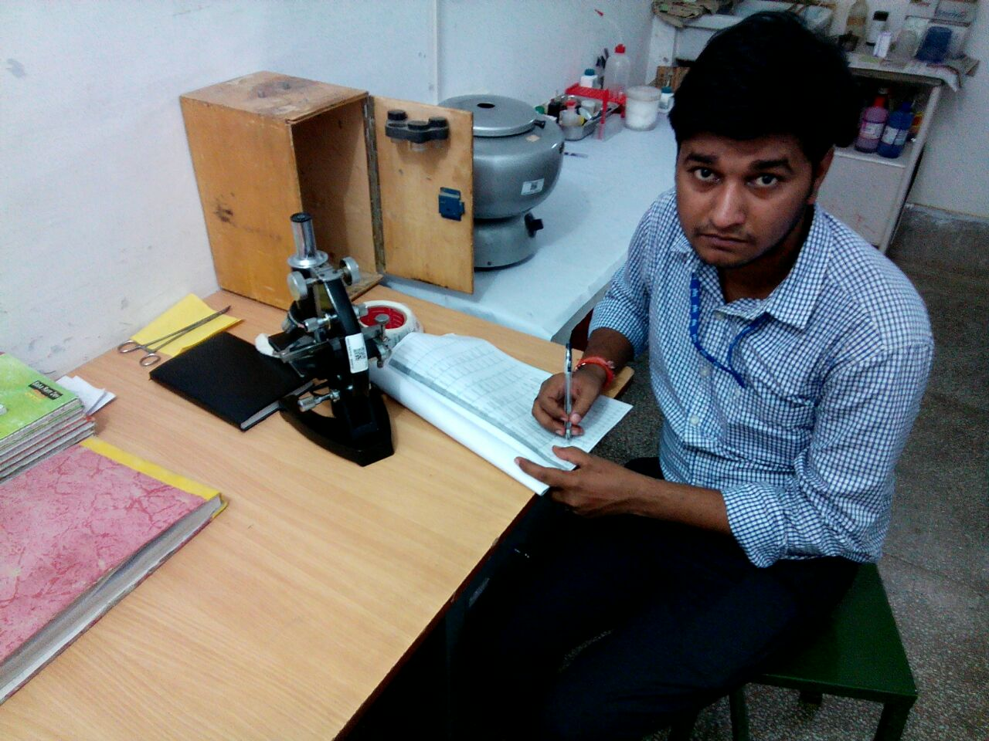
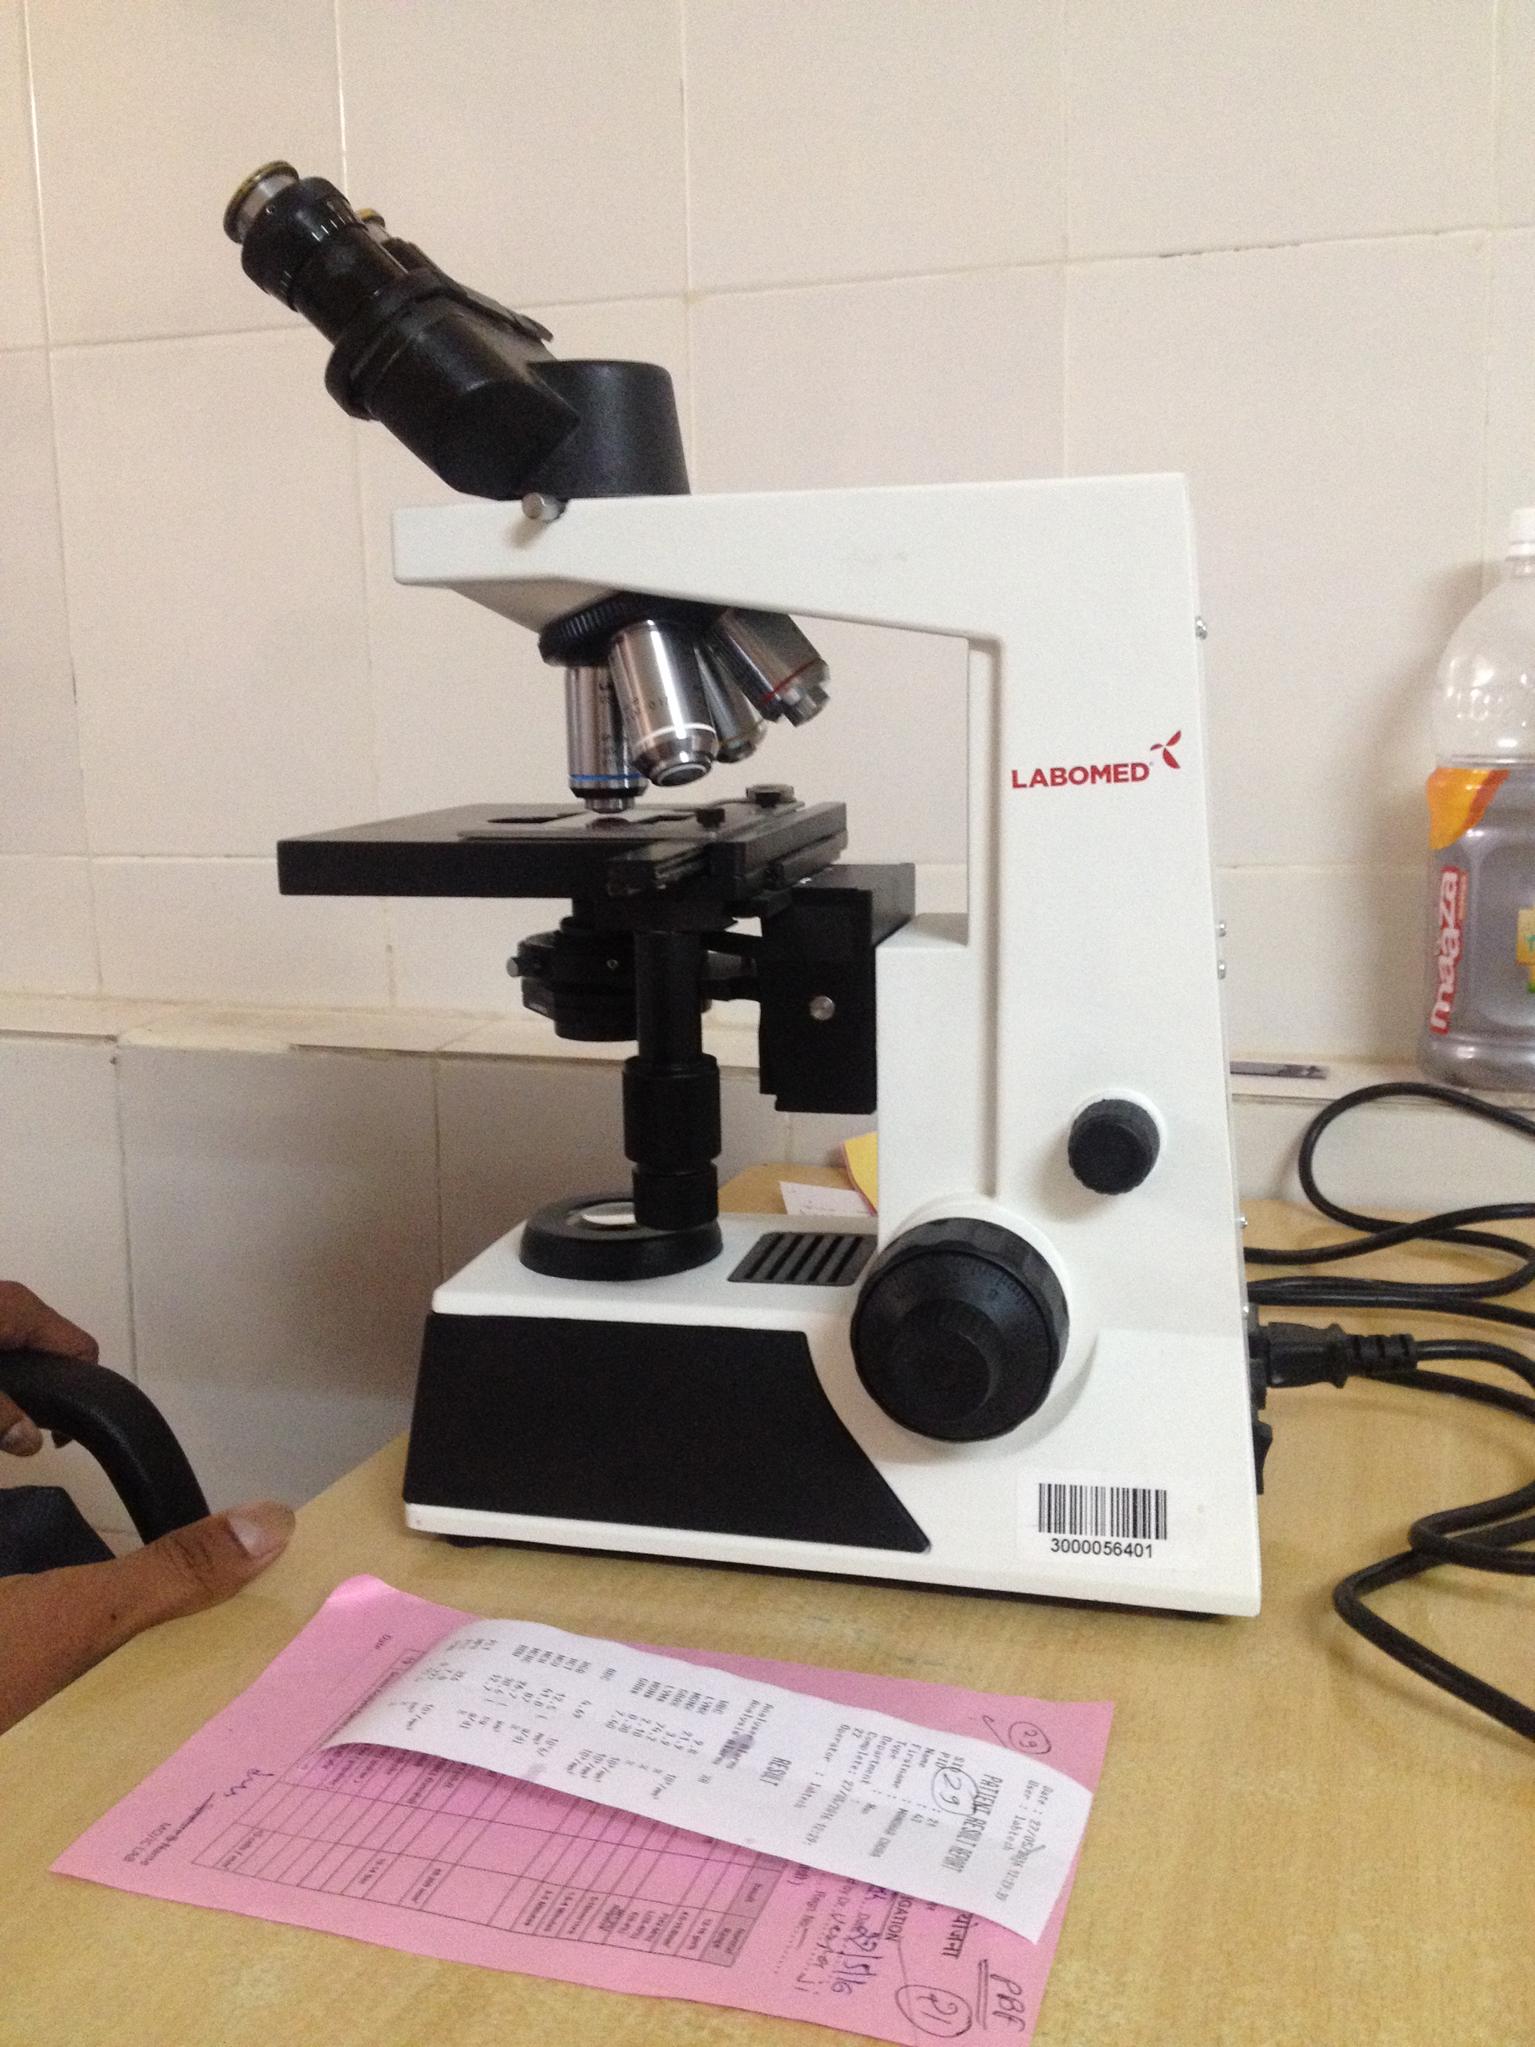
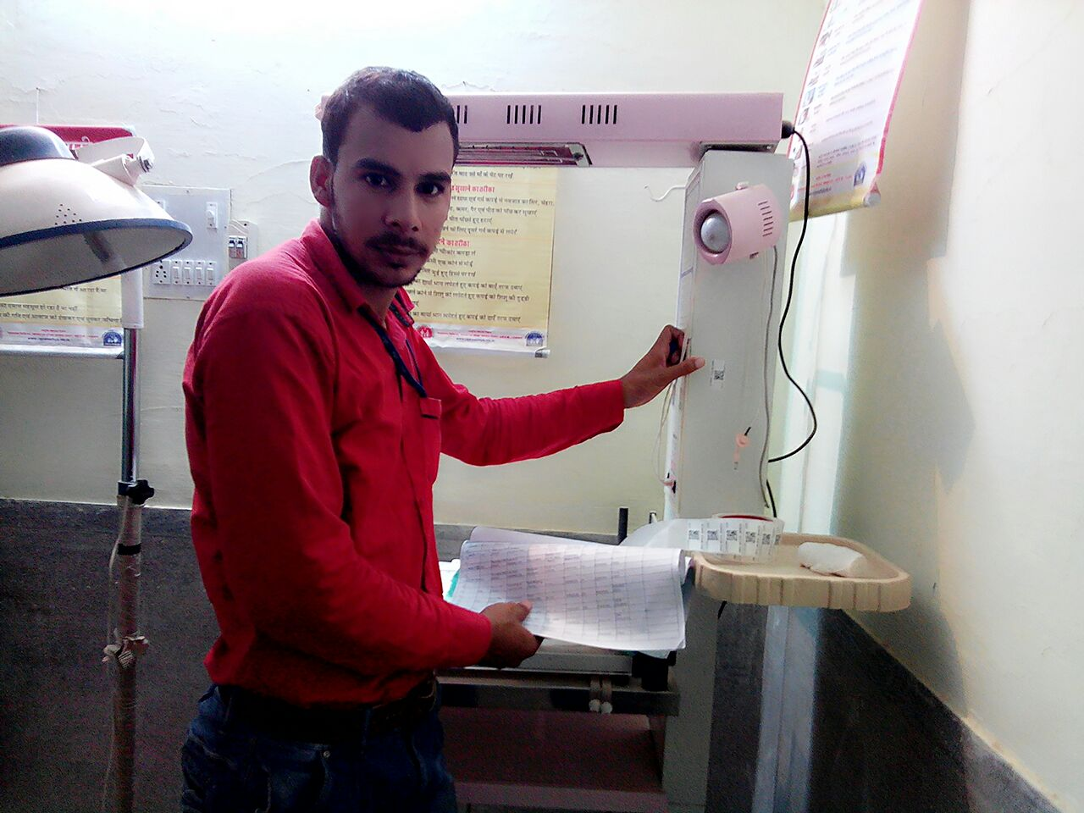
Implementation in field
Monitoring by Joint Director
Verification by BME
Barcoding for identification

Slide 21







Call Management for complaint raise system
Complaint Raise (Online by User)
Notification of Task Completion
Service Request
Acknowledge
Service Request
Task Completion (SMS)
Receiving Updates
Notification
For Lifesaving Equipments
Complaint via Mobile App
Task Completion SMS

Slide 22




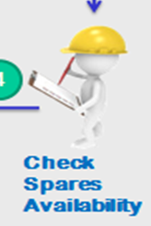


Maintenance Service Management
Analyze Fault &
Service Asset
Additional Spare
Parts Required
Engineer
Resolved
Resolved Notification
Resolved
Stock
Indent
Purchase
Indent
Check Spares
Availability
Receive Spares &
service Asset

Slide 23
Modules under Testing
Demand Module-
  Demand based upon:
    OPD & IPD
    Availability of Specialist / Technician
    Availability of Free Space
    Status of Equipment
    Programme Specific Requirements
Transfer Module-
  Demand of Equipment
    Equipment demanded by Institution (Store Incharge / IA/ DEO) on the base of OPD load, availability of specialist, space etc.
  Return of Equipment
    Equipment Selection by Institution (Store Incharge / IA/ DEO) on the base of Not in use / Excess / Zero availability of Specialist/ Trained Manpower/ Space / other reasons

Slide 24
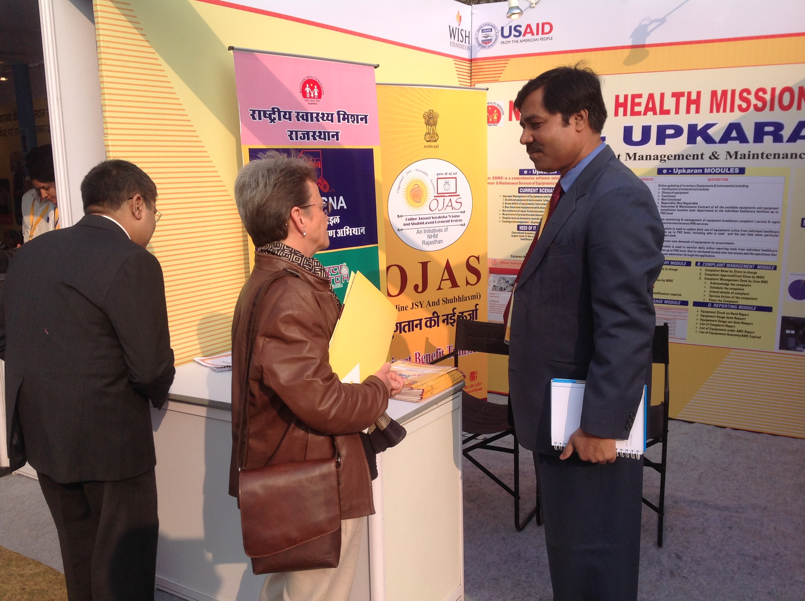
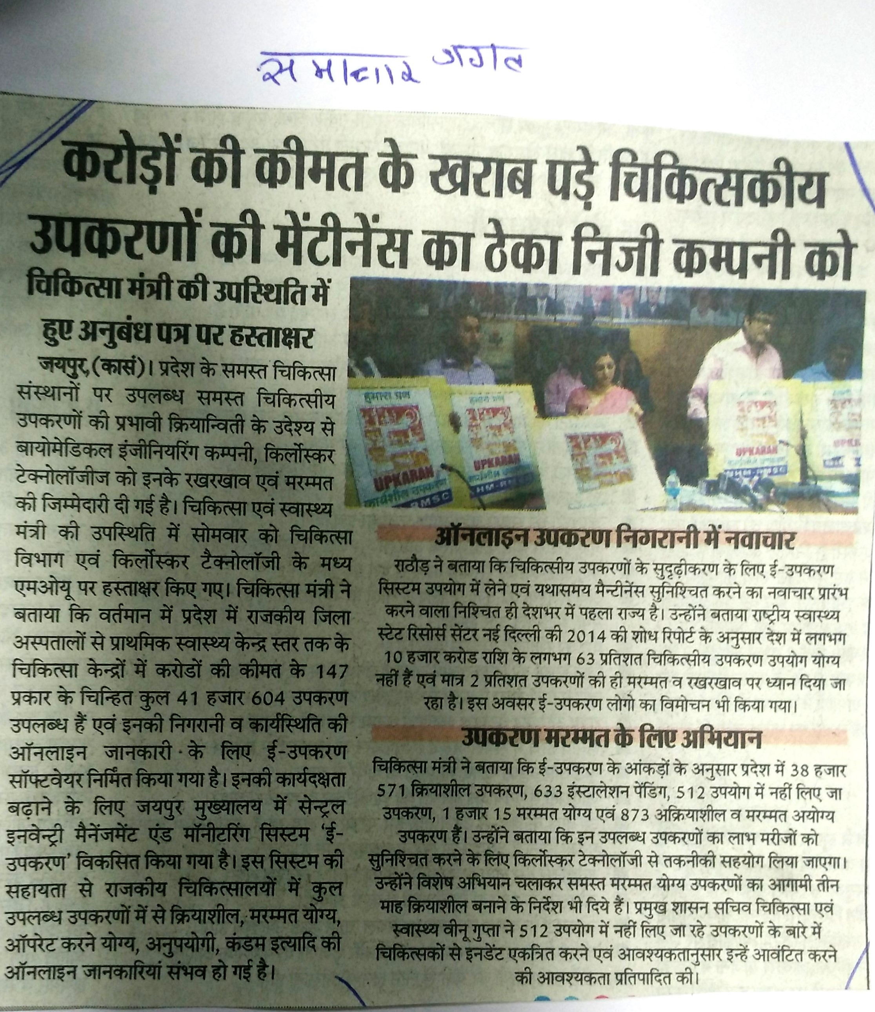
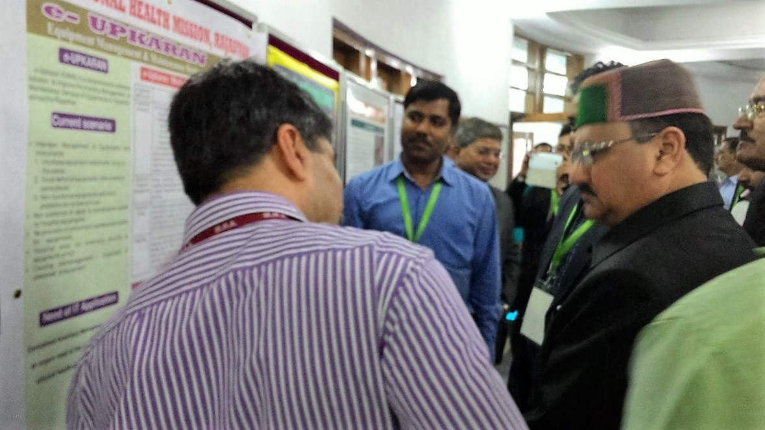
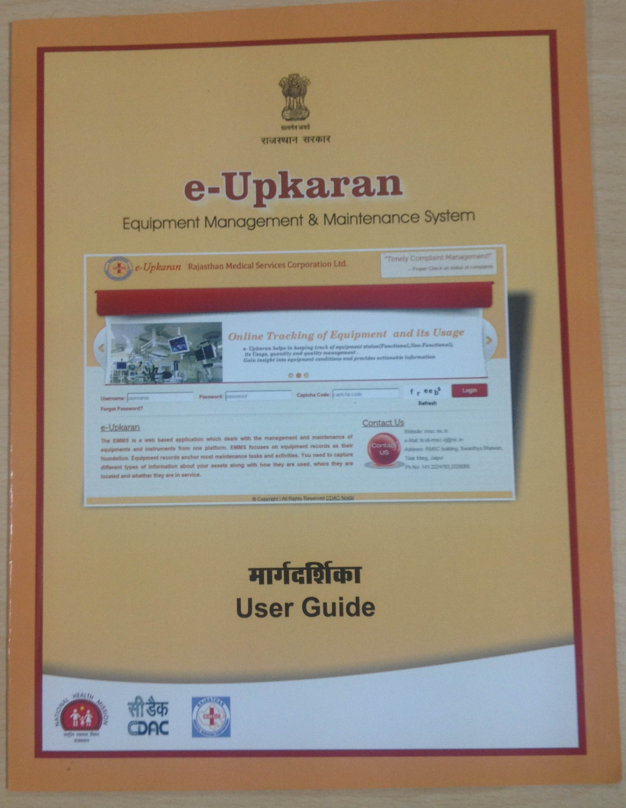
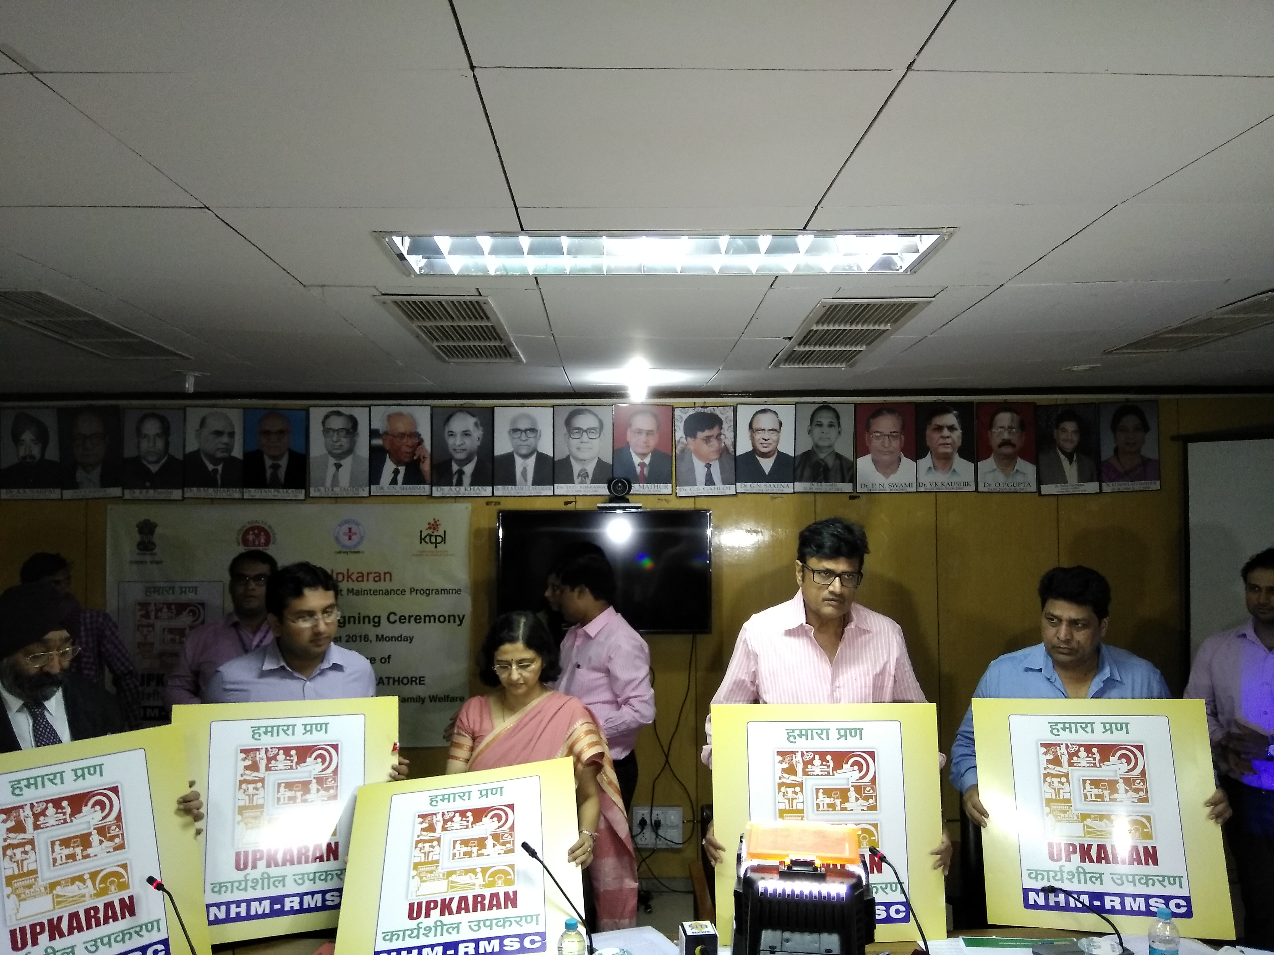
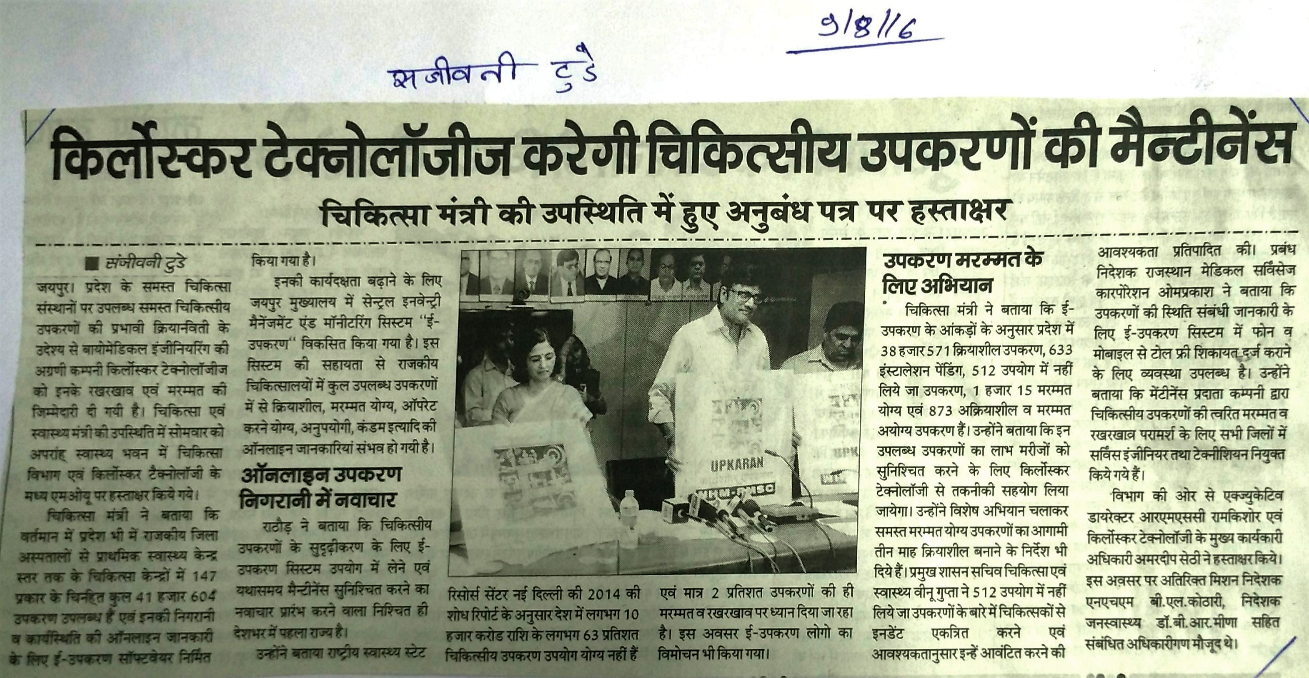
Thank You…

