Slide 1


Equipment Management & Maintenance System (EMMS)
Madhya Pradesh

Slide 2
What is EMMS
An end to end web based solution with a life cycle approach of equipment.
An online platform for:
Monitoring of goods and services contracts
High value contracts
Auto penalty calculation as per the RFP clauses
Maintaining process transparency for generating bills
setting accountabilities of various stakeholders involved in equipment procurement and maintenance (storekeeper/facility in charge/OEM/service engineer/suppliers/vendors)

Slide 3
Stages captured in EMMS
  Demand estimation
  equipment procurement against central rate contracts
  Inventorisation
  Calibration
  Preventive maintenance
  Complaint management in case of equipment downtime
  Bill calculation of vendor/suppliers including penalties
  Payment approval using e-sign of DDOs
  Online payment through bank integration to vendor/supplier
  Decision Support System

Slide 4
Sequence of events
  PHASE I
  1. Equipment Inventorisation offline followed by online after verification by facility in charge (T0 +90) – June to Sept 2017
  2. Calculation of NAV for each facility (T0+180) – Oct to Dec 2017
  3. Standardization of equipment list for NAV (simultaneous to step 1 & 2).
  4. Commencement of Complaint module and exercising of penalty clauses w.r.t. Downtime (Jan 2018)
  5. Commencement of Preventive Maintenance & Calibration module with penalties (June 2018)
  PHASE II
  1. Demand estimation, offline, for each health facility (June to Aug 2018)
  2. Gap analysis basis demand and inventory
  3. Sealing of facility wise Annual demand
  4. Commencement of Equipment procurement module
  PHASE III
  1. Utility for FTO generation against payment approval with Biometric Aadhar based authentication
  2. Bank integration for bill generation

Slide 5
Users
  Total users: 4000
  Nodes: 51 CMHO+51 CS+313 CHC+ 1158 PHC
  Users profile:
  State level Management
  MPPHSCL
  CMHO
  Civil Surgeon
  Storekeeper (of DH/CHC/PHC)
  Accountant (of CMHO & CS)
  BMO (Block Medical Officer of CHC)
  MoIC ( Medical officer In Charge of PHCs)
  Equipment suppliers
  Service provider of CMC

Slide 6
Journey so far Maintenance Module
Tender for L1
As per the agreement define the business logic in EMMS
Define the role and responsibilities and mapped accordingly in EMMS
Training to users and monitor the output in Dashboards
Inventory with Barcode
Inventory Verification by Facility In-charge
Payment to vendor

Slide 7
Conversion of RFP clauses into business logic
Calculation of Net Asset Value
NAV = ( Cost of selected equipment as per the inventory and not under warranty/ CMC/ AMC + Cost of already inventorised equipment whose warranty/ CMC/ AMC has expired in the previous quarter + cost of any additional equipment inventorised in the previous quarter ) – ( Equipment gone for condemnation in previous quarter)
Penalty calculation of Complaint management
Equipment value | Penalty
INR 1 to 10,000 | 300 rupees per day
INR 10 K to 1 lakhs | 500 rupees per day
INR 1 lakh to 10 lakhs | 1000 rupees per day
INR > 10 lakhs | 3000 rupees per day

Slide 8
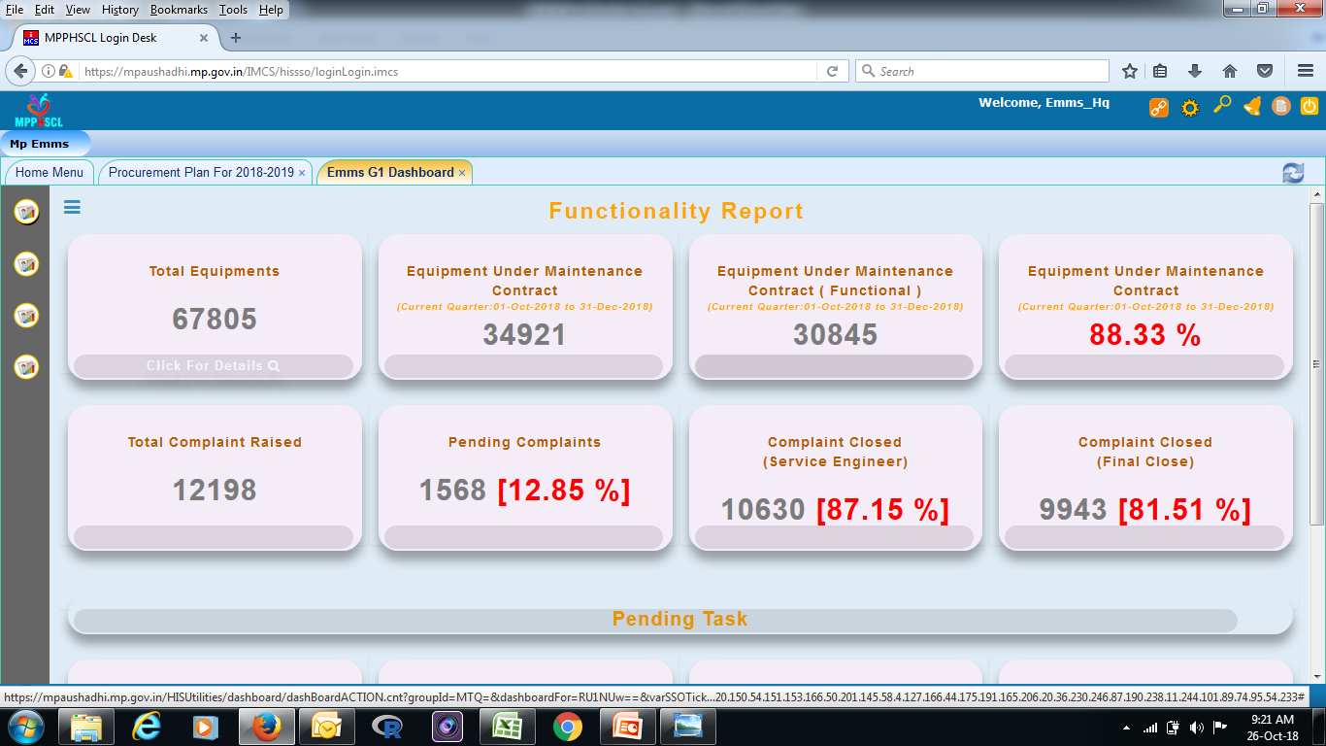
Equipment Inventorisation
Inventorisation of 51 District Hospitals, 332 CHC, 60 Civil Hospitals & 1158 PHC
Total equipment count of state = 67805 (as on Oct 2018)
Total types of equipment= 151Z

Slide 9
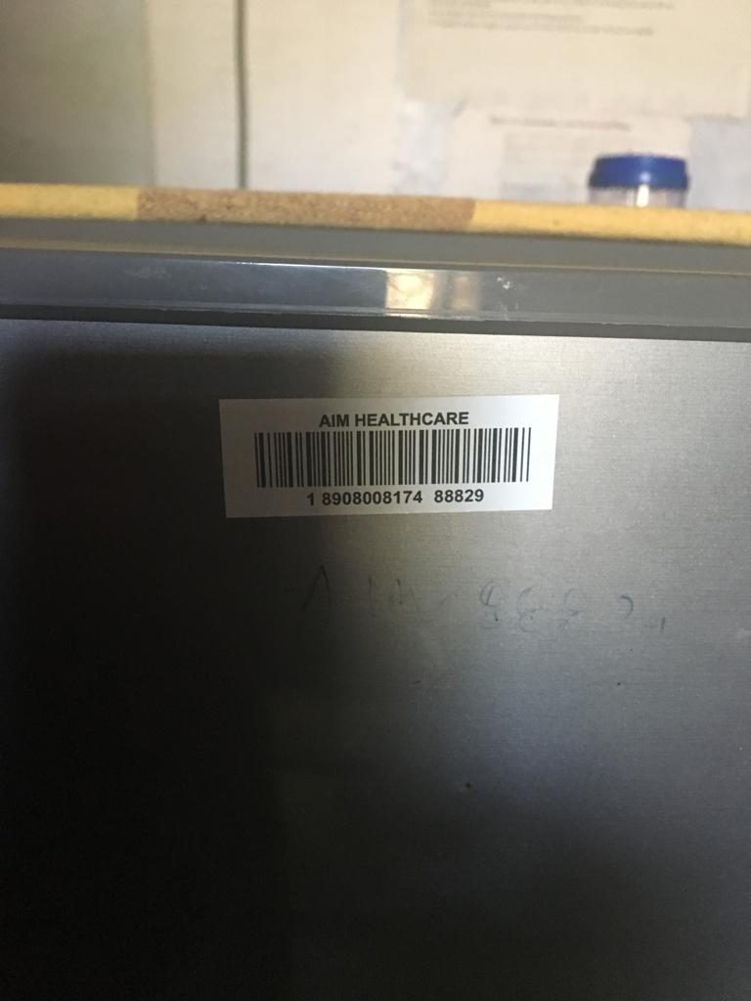
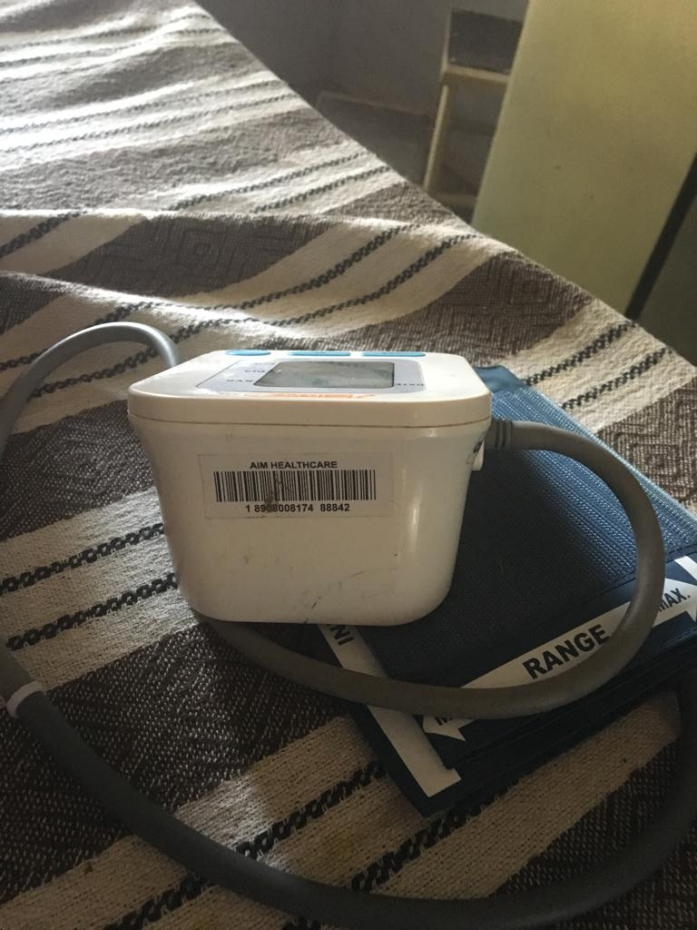
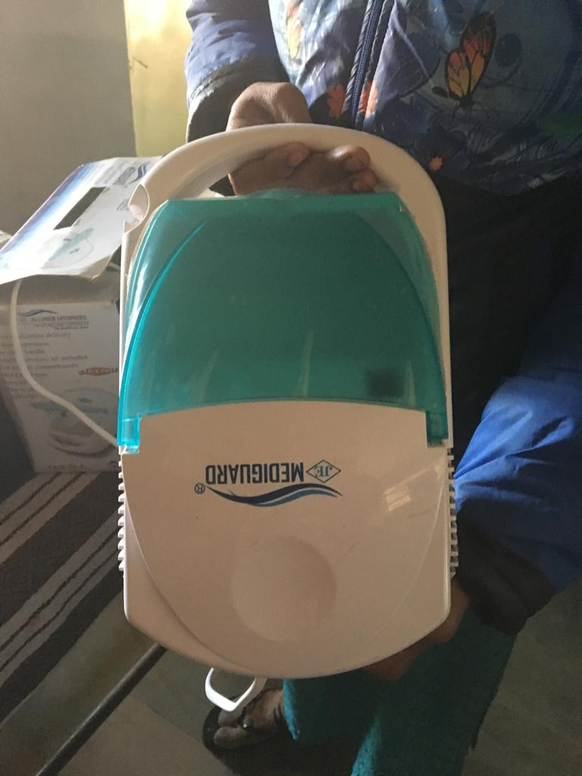
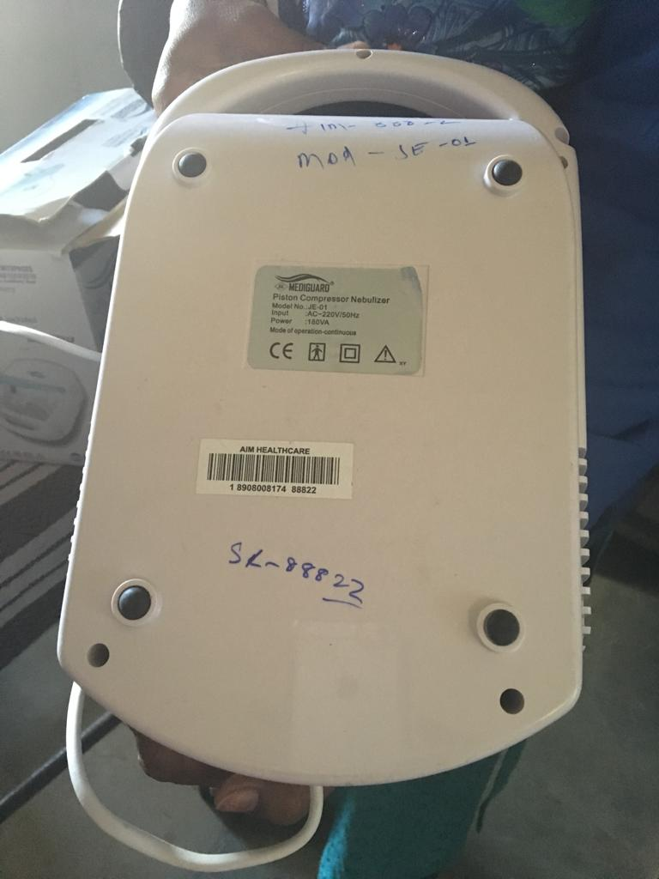
Equipment Inventorisation Cont..

Slide 10
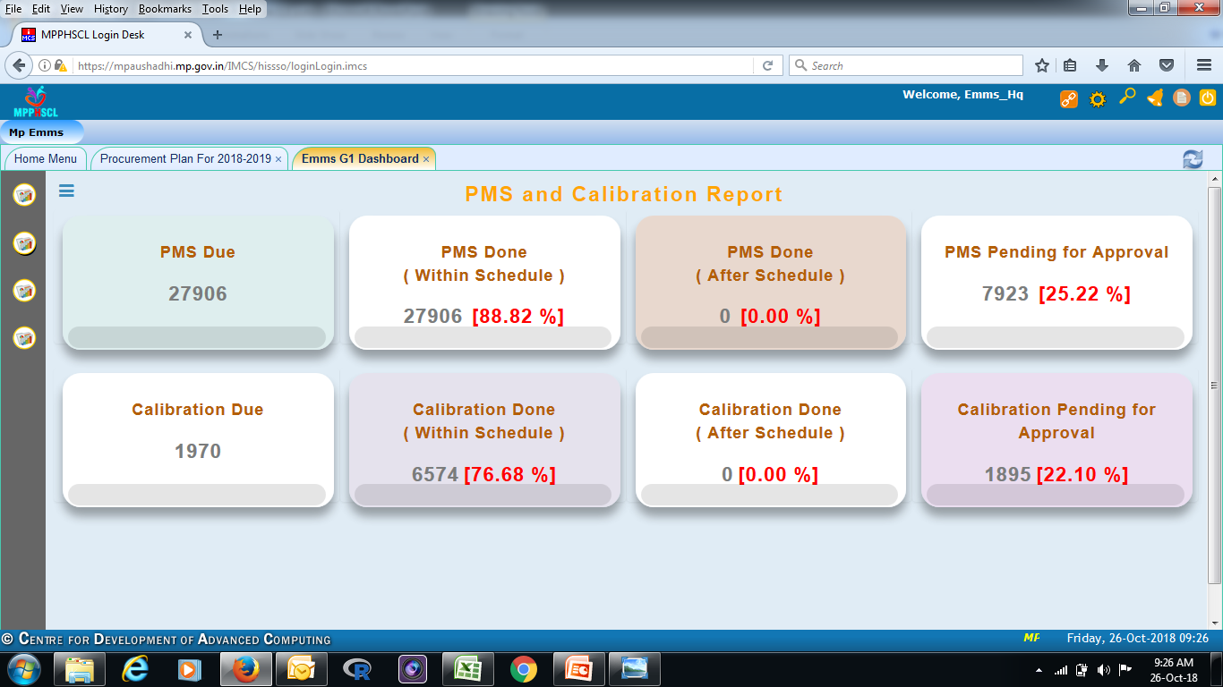
Calibration & Preventive Maintenance
  Each equipment has its cycle of PM & Calibration scheduled
  App based and system based alerts on scheduled dates per equipment to both service provider and facility in charge
  PMS done within schedule – 27906
  Calibration done within schedule – 6574

Slide 11
  Complaint management cycle
Bar Code by service provider
Complain closure
Complaint generation through desktop, IVRS and mobile app.
Service engineer has to reach site within 48 hours
Complaint close with 7 days by service engineer
Satisfaction report by Facility in charge within 3 days
If facility in charge not satisfied then equipment enters penalty cycle.

Slide 12
Average time to close the complaints

Slide 13
Functional % Comparison

Slide 14
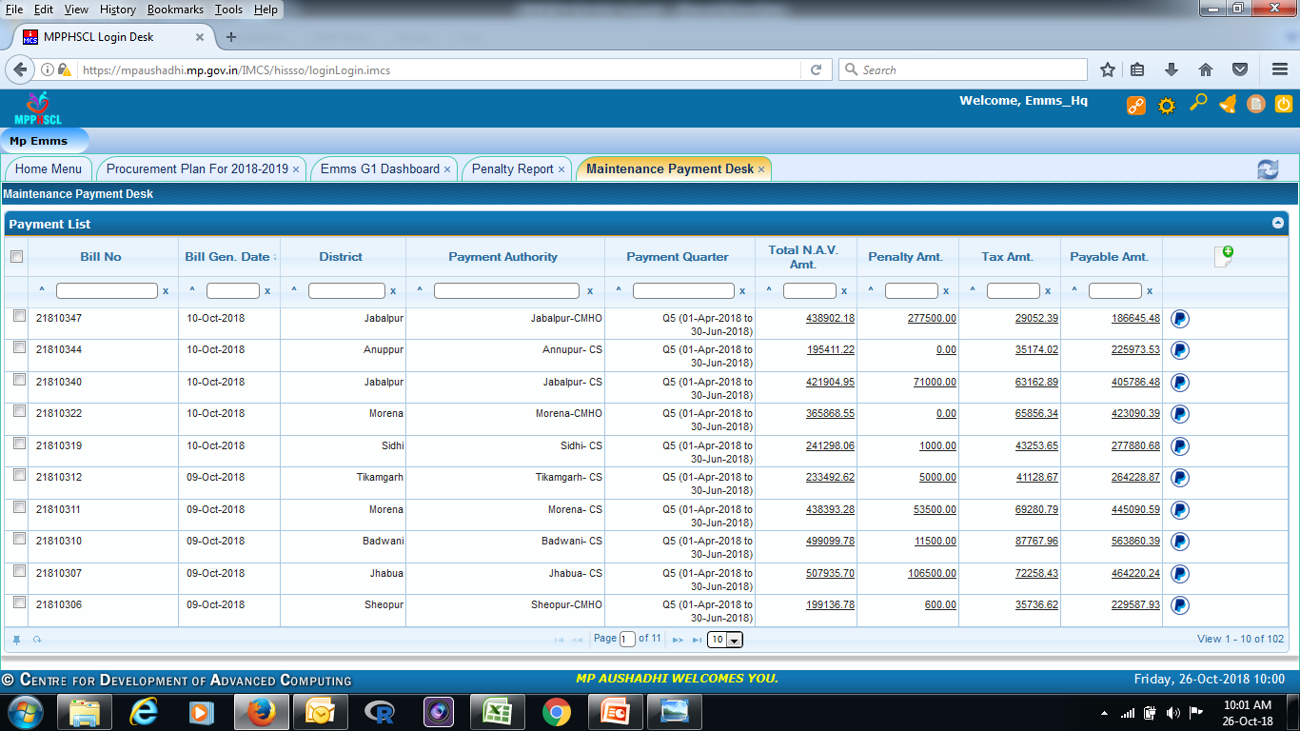
  Finance module for Maintenance Module
Bill is generated automatically through EMMS on the basis of business logics decided in agreement between Department and service provider/vendor.
Bills are paid by each authority using e sign directly through the bank i.e. no manual intervention in the whole process till payments.

Slide 15
Journey so far Procurement Module
Implementation strategy to implement Procurement Module
Demand Analysis
Budget is allocated to all DDOs as per the need and demand
Rate contract is finalized from MPPHSCL
Purchase Order is generated by DDOs as and when required
Online Payment to suppliers

Slide 16
Equipment Procurement to Pay (P2P)
On the basis of central Rate Contract
By 110 DDOs across the state
Procurement as per the annual drug plan and Budget allocation
Supplies at the consignee location
Equipment Receipt Certificate by Consignee
ERC Verification by DDO
Bill Verification by Accountant
Online Payment by DDO

Slide 17
Demand estimation Life Cycle
Rationalization against available post
Optimum facility wise List of Vital/Essential/Desirable
Gap analysis of Equipments to define Demand (Inventory Vs VED)
Reference IPHS Norms
Inventory creation by Vendor

Slide 18
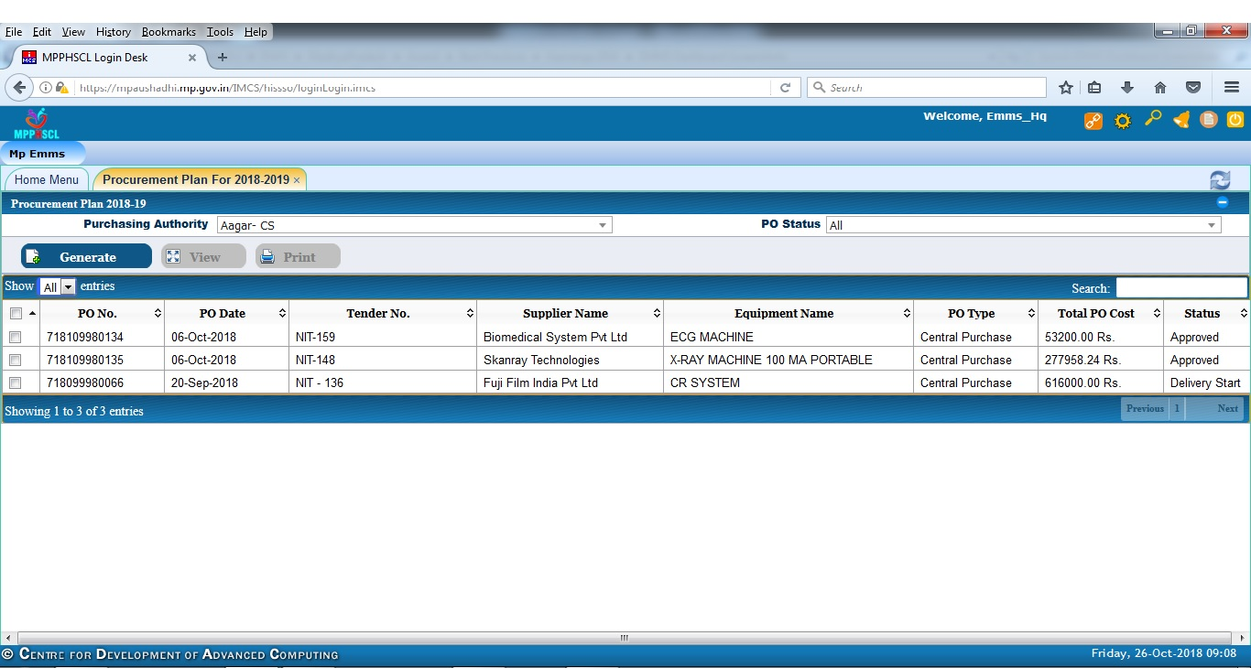
Demand Estimation

Slide 19
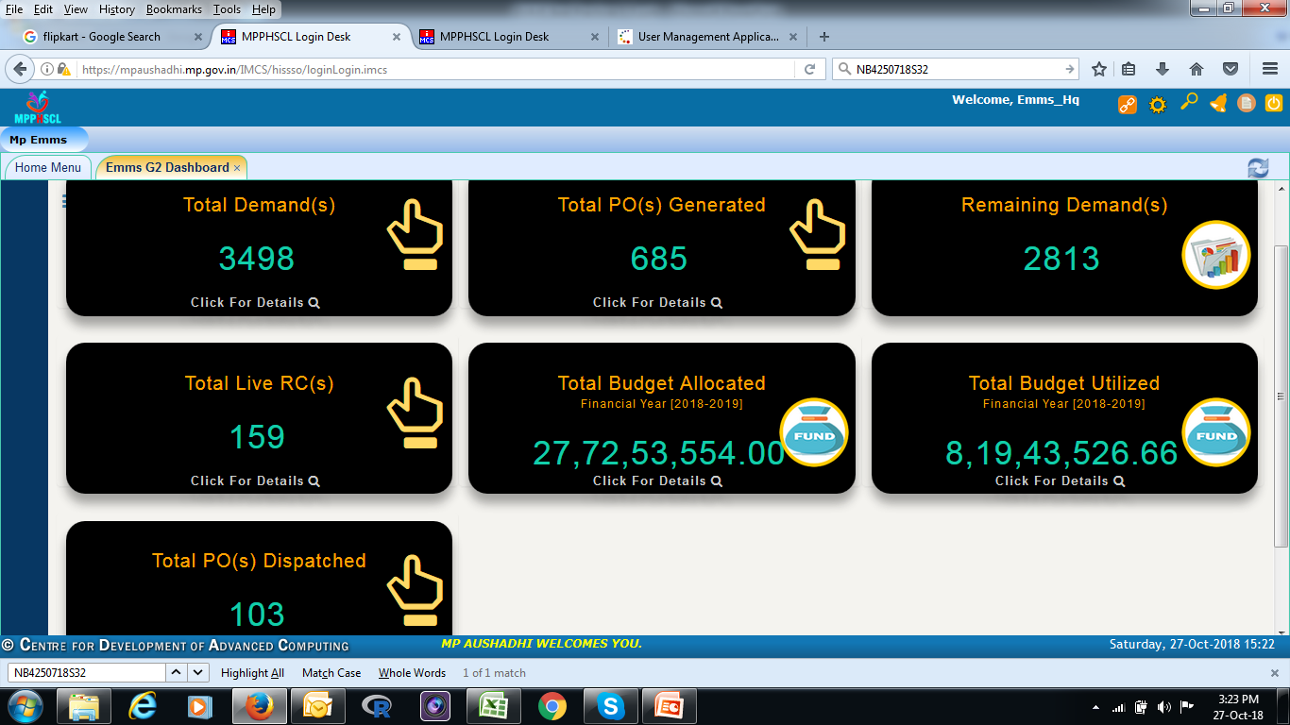
  Procurement Dashboard

Slide 20
Process Re-Engineering
No | Activity | Manual Procedure | Automated Procedure
1 | Purchase Order | Manually Typing for details of items, consignee and terms and condition | Generated automatically after filling rate contract and annual demand.
2 | Inventory | Manual record keeping of Equipments | Automatically keeping inventory through bar codes . Inventory updation based on new procurement.
3 | Installation and training of equipment | Equipment were being unused due to lack of information of installation and training. | User gets informed through prefilled masters as per tender conditions.
4 | Warranty of equipments | Lack of information w.r.t. warranty. & lack of communication gap with OEM . | The complaint is directly routed to OEM in case equipment is in warranty.

Slide 21
Process Re-Engineering Cont..
No | Activity | Manual Procedure | Automated Procedure
5 | Annual Maintenance Contract | Manually maintained. | Routing of equipment coming out of warranty in service provider’s list.
6 | Complaints and calibration | High dependence on OEM | CMC by service provider.
7 | Role based access | Ambiguity in roles and responsibilities | Role base access is mapped to each stakeholder.
8 | Payment to suppliers | Subjective and delay in payment. | The Time Around Time (TAT) is considerably reduced.

Slide 22
Results
Parameter | Intervention | Result
Equipment inventorisation | Online inventory including newly procured and under warranty equipment. | Total 66,000 equipment inventorised.
Up time of Equipment | Outsource the maintenance of equipments to achieve 95% uptime | 88.94 % uptime
Complaint Redressal | Online Complaint raising through a centralised call centre | 11319 complaints lodged since Jan 2018.
Payments to Vendor | DDO wise bill generation and online payment provision. | INR 2.8 CR online bill generation till now.

Slide 23
Challenges Faced –G 1
Realistic data for Inventorisation including verification.
Deciding roles
HR and Skill gaps
Work flow for contract monitoring
Business logic for penalty calculation according to RFP
Time synchronization between system go live and contract cycle

Slide 24
Challenges Faced – G2
Mapping the tender conditions at the backend
Equipment wise penalty calculations
Differential payment strategy
Developing a completely new utility of payment through e sign using Biometrics +aadhar based authentication with bank.

Slide 25
Functional % Comparison

Slide 26
Thanks

