Slide 1


5th National Summit on Good and Replicable Practices and Innovations in Public Healthcare Systems for 2018
Extension of CPHC in the remote corners of Assam- Through HWC, MMU, Boat Clinic
J.V.N. Subramanyam, IAS
Mission Director
National Health Mission, Assam
Date: 1st November 2018
Venue: Kaziranga, Assam

Slide 2
Assam: Diverse Demography:: Difficulty Topography
Around 20% of population.
Poor health outcomes.
High MMR.
Inadequate numbers of Doctors, Nurses and Paramedics
Around 10% of population.
Healthcare remains a critical challenge.
Inadequate numbers of Health Infrastructure, Doctors, Nurses and Paramedics.
Tea Garden Areas
Char Areas
Hilly Areas
Border Areas
Two Hill Districts:Karbi Anglong and Dima Hasao
Accessibility an issue with population density is very low.
Manpower availability is a huge issue.
Low coverage of health care services in bordering areas adjacent to Bhutan, Bangladesh, Nagaland, Tripura, Arunachal Pradesh etc.
Notes:
There is no DH in Jorhat.
New SDCH: Jonai, Tamulpur, Jakhalabandha, Mukalmua, Lakhipur-Goalpara, Sarbhog, Sodiya, Bokakhat (2017-18, 7 out of 8 are new)
Gahpur, Patshala, Bhetagaon, Gossaigaon (2018-19, 2 out of 4 are new)

Slide 3
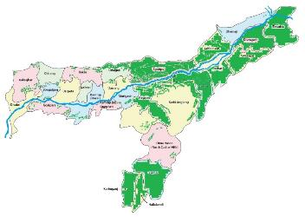
The Challenge
Assam has highest MMR
Upper Assam has MMR of 404
Upper Assam also happens to be the tea intense districts
  higher maternal mortality
  higher infection rates
  higher prevalence of hypertension
  less health seeking behaviour
  higher unmet needs and therefore higher rates of abortion.
251
254
Dhemaji
Tinsukia
Dibrugarh
Lakhimpur
Sivasagar
Udalguri
Sonitpur
Golaghat
Jorhat
404
Chirang
Baksa
Kokrajhar
Bongaigaon
Barpeta
Nalbari
Darrang
Morigaon
Kamrup metropolitan
Nagaon
Karbi Anglong
AHS 2012-13
Dhubri
Goalpara
Kamrup Rural
Dima Hasao
281
Karimganj
Cachar
Hailakandi
1600+ mothers die annually from causes related to pregnancy and delivery
(Assam contributes to only 2.5% of India’s population but a whopping 5% of maternal deaths in India)
Notes:
Within the country there are other states which are much better off with maternal health situation and these states have almost same health system and budget provisions. MMR – 300 / 100000 LB (SRS 2011-13) which translates to estimated 2100 maternal deaths per annum, i.e. 175 deaths per month; i.e. 6 deaths per day;
Upper Assam districts which are also tea intense areas have
higher maternal mortality,
higher infection rates,
less health seeking behaviour,
higher prevalence of hypertension,
higher unmet needs and therefore higher rates of abortion.

Slide 4
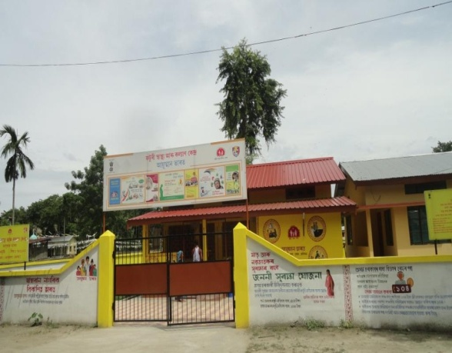
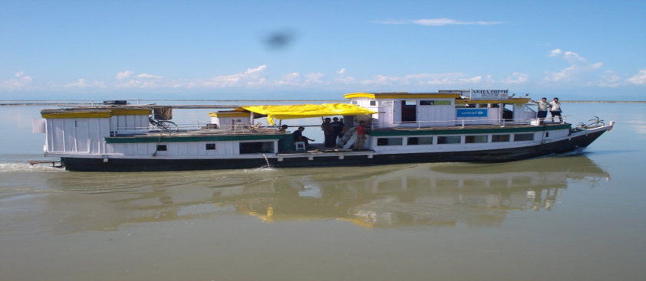
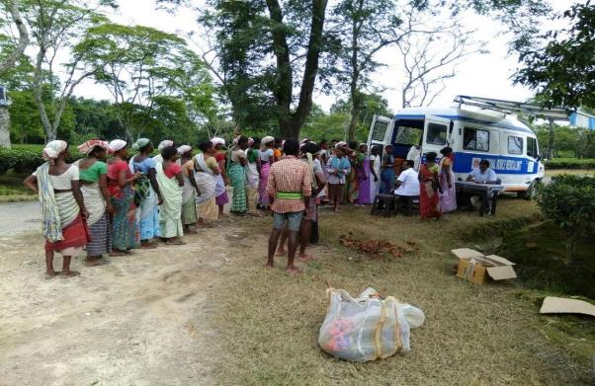
Extension of Primary Health Care to Remote corners
Health & Wellness Centre : Mid Level Service Provider run Model
Mobile Medical Unit (MMU) : Doctor run Model
(Special focus on Tea Garden, Hard to reach areas and Boarder areas)
Boat Clinic : Doctor run Model
(Special focus on Char/ Riverine areas)

Slide 5
Health & Wellness Centre run by Community Health Officers (CHOs)
Mid Level Service Provider Model – Initiative of Govt. of Assam

Slide 6
Rationale of Mid Level Service Provider
More intense shortage of medics and para medics in remote areas.
Mid Level Provider became the most optional mechanism for providing health services
Government of Assam had taken an initiative to create a cadre named Community Health Officers (formerly known as Rural Health Practitioners) to serve the underserved.
Provide Primary Healthcare at the Sub Centre level even at the remotest areas of the State.

Slide 7

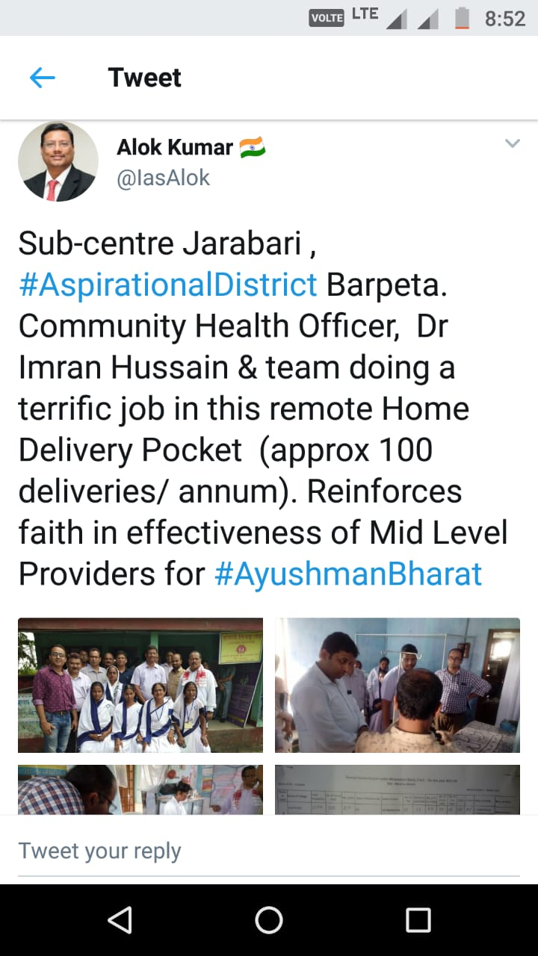
Tweet by Shri Alok Kumar, IAS, Advisor, NITI Aayog!!!
More than 104.21 Lakh OPDs by CHOs till date
More than 1.77 Lakh deliveries conducted in the farthest corners of Assam

Slide 8
Community Health Officer – Mid Level Service Provider
Government of Assam created a cadre named Community Health Officers (formerly known as Rural Health Practitioners) to serve the underserved.
The Assam legislature had enacted the Assam Rural Health Regulatory Authority (ARHRA) Act, which came into effect in September 18, 2004.
  Objective - to create a pool of qualified manpower to serve in underserved areas so as to cater to the health needs of rural communities.
The law envisaged a Diploma in Rural Health Care and Medicine (DMRHC).
The state needed the Rural Health Practitioners, as doctors refuse to go and serve in rural areas.
After the act was challenged, Government of Assam has notified The Assam Community Health Professionals’ (Registration and Competency) Act, 2015 vide LGL.179/2014/19 dated 29th May 2015.
Those who already completed the DHMRC Course Notified as “Community Health Officer (CHO)” subject to submission of the certificate of registration as B.Sc.(Community Health Professionals) issued by the Director of Medical Education, Assam vide Sec. 3 of the Act.

Slide 9
Journey of CHO Programme in Assam
Assam legislature had enacted the Assam Rural Health Regulatory Authority (ARHRA) Act
Established Medical Institute, Jorhat
(100 seat capacity)
1st Batch of Diploma in Rural Health Care and Medicine (DMRHC) started
1st Batch of 92 students completed DMRHC
1st Batch of 92 appointed under NHM
18th September 2004
8th April 2005
September 2005
September 2008
1st June 2009

Slide 10
Journey of CHO Programme in Assam
IMA challenged Constitutional validity of the ARHRA Act, 2004 in the Hon’ble Gauhati High Court
The Hon’ble Gauhati High Court struck down the ARHRA Act, 2004
Govt. of Assam notified The Assam Community Health Professionals’ (Registration and Competency) Act, 2015
Govt. Gazatte Notification re-designation as “Community Health Officer”
Mid Level Service Provider in Health & Wellness Centre for providing CPHC
30th October 2014
29th May 2015
29th May 2015
7th June 2018

Slide 11
Selection Procedure and Course Curriculum
Selection Criteria:
  10+ 2 in Science - minimum qualification for B.Sc. (Community Health) .
  Selected on district wise merit based on marks of Physics, Chemistry and Biology in 10+2.
Course Duration:
  3 years 6 months (3 years theory & practical and 6 month internship)
Course Curriculum:
  1st Year: Anatomy, Physiology, Biochemistry & Community Medicine
  2nd Year: Pharmacology, Pathology & Microbiology and Community Medicine
  3rd Year: Medicine & Paediatrics, Surgery, Orthopedics, ENT, Eye, O&G
  Practical: Jorhat Medical Institute, Jorhat Medical College & Hospital and at Community level
  Internship: Jorhat Medical College & Hospital

Slide 12
Job Responsibilities of Community Health Officer
Curative Work:
Regular OPD duty and to attend emergency cases
Treatment for Minor Illnesses/ Communicable & Non communicable diseases.
Organize laboratory services in the sub centre for testing urine for albumin and sugar and blood for haemoglobin.
Passive Surveillance – Blood Slides are to be taken for all fever cases and necessary treatment is to be given as per new drugs regime from NVBDCP.
Revised National Tuberculosis Control Programme (RNTCP): to detect symptomatic of T.B. cases during OPD and social visit.
National Leprosy Eradication Programme (NLEP): to identify suspected case of Leprosy during OPD hours and social meeting with the community
National Iodine Deficiency Disease Control Programme (NIDDCP): To promote intake of Iodised salt

Slide 13
Job Responsibilities of Community Health Officer
Maternal Health Services:
Ante Natal Care Services.
Delivery Services.
Post natal Care Services.
Child Health Services:
  Manage cases of Asphyxia.
  Prevent Hypothermia and infection after birth.
  Promotion of early and exclusive breast feeding
  Routine immunization and Vitamin -A supplementation.
  Provide treatment of Diarrhoea and ARI cases
Family Planning Services :
Create awareness about contraceptive and advantages of small family
Male participation in family planning by adopting modern family planning methods.

Slide 14
Output of Mid Level Service Provider Model
Assam experiences success of Mid Level Service Provider Model.
691 CHOs are providing Primary Healthcare at the Sub Centre level even at the remotest areas of the State.
Primary Healthcare is available at the locations where Medical Officers could not be posted earlier.
Total, 1,04,21,341 OPDs by CHOs till September 2018 since inception.
Total 1,76,900 Deliveries by CHOs till September 2018 since inception.

Slide 15
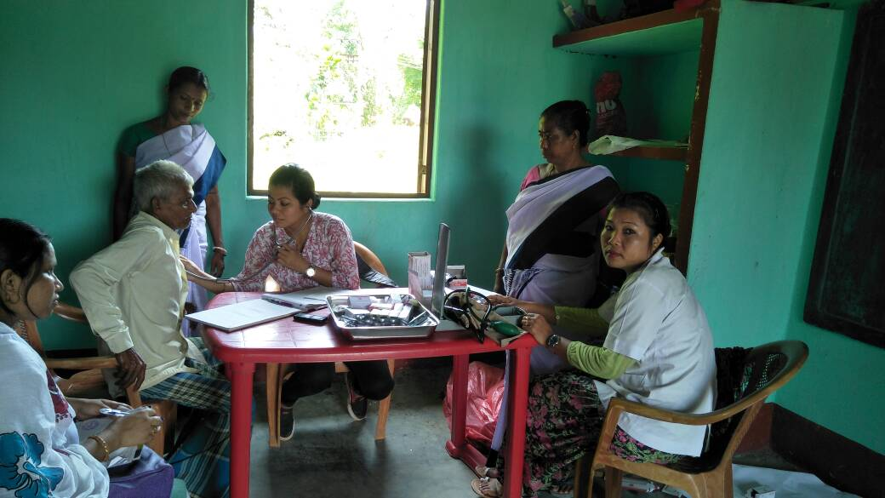
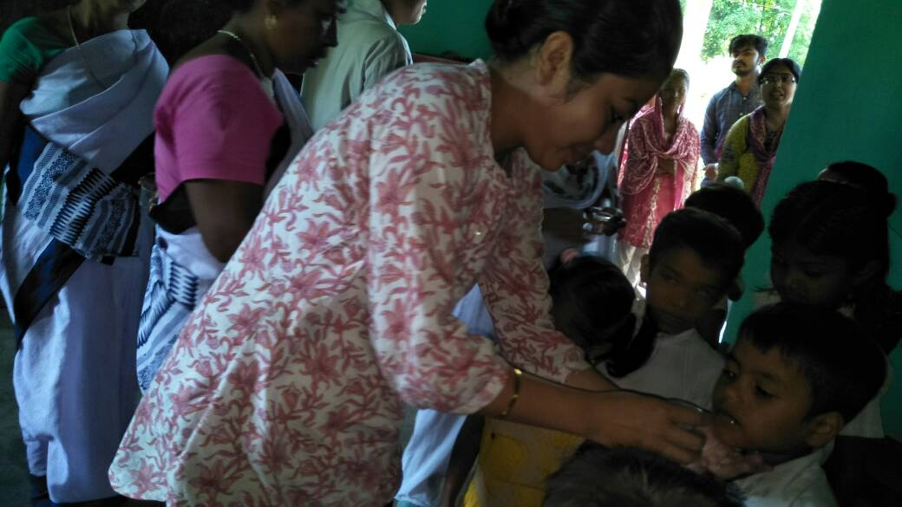
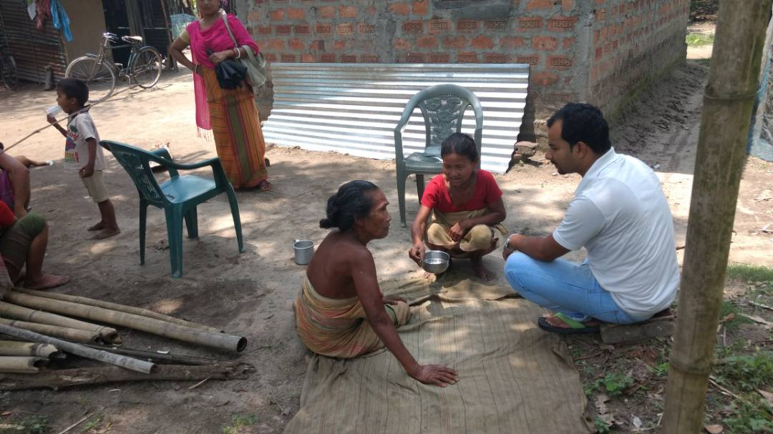
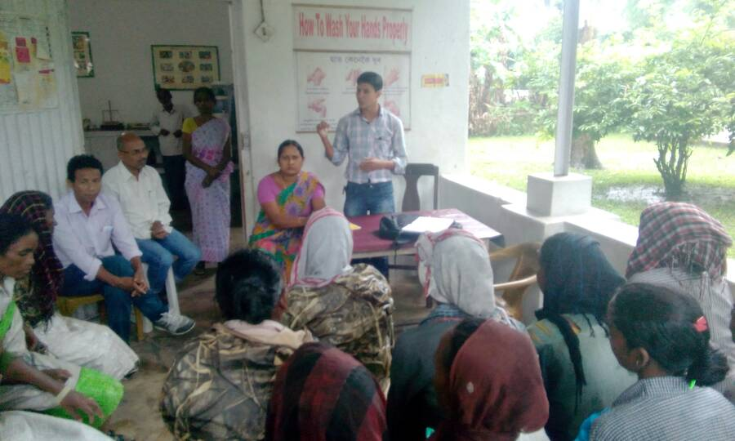
CHOs: Our Warriors in the farthest Corridors
CHO during OPD hour in the Sub centre
CHO involvement in NDD campaign
Interaction with community members during community visit by CHO
Interaction with community members during community visit by CHO

Slide 16
Expansion of services to provide CPHC
Expanded Services:
  NCD screening-
  - Diabetes,
  - Hypertension and
  - 3 common cancers (Oral, Breast, Cervical)
  Drugs for Diabetes and Hypertension
  Follow up of NCD patients.
  Ensuring 7 diagnostic Tests
Diagnostic Services:
  At Sub centre- HWC- 7 Diagnostic Tests
Drugs:
  Ensured Drugs as per EDL plus drugs for Hypertension (Amlodipine , Losartan & Atenolol) and Diabetes (Metformin & Glimepiride)

Slide 17
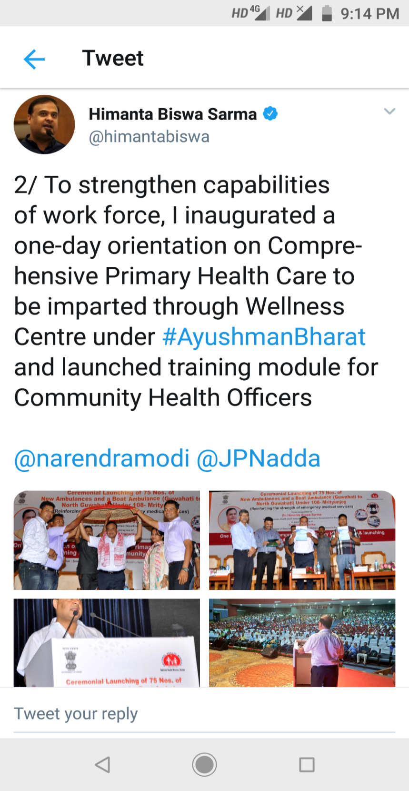
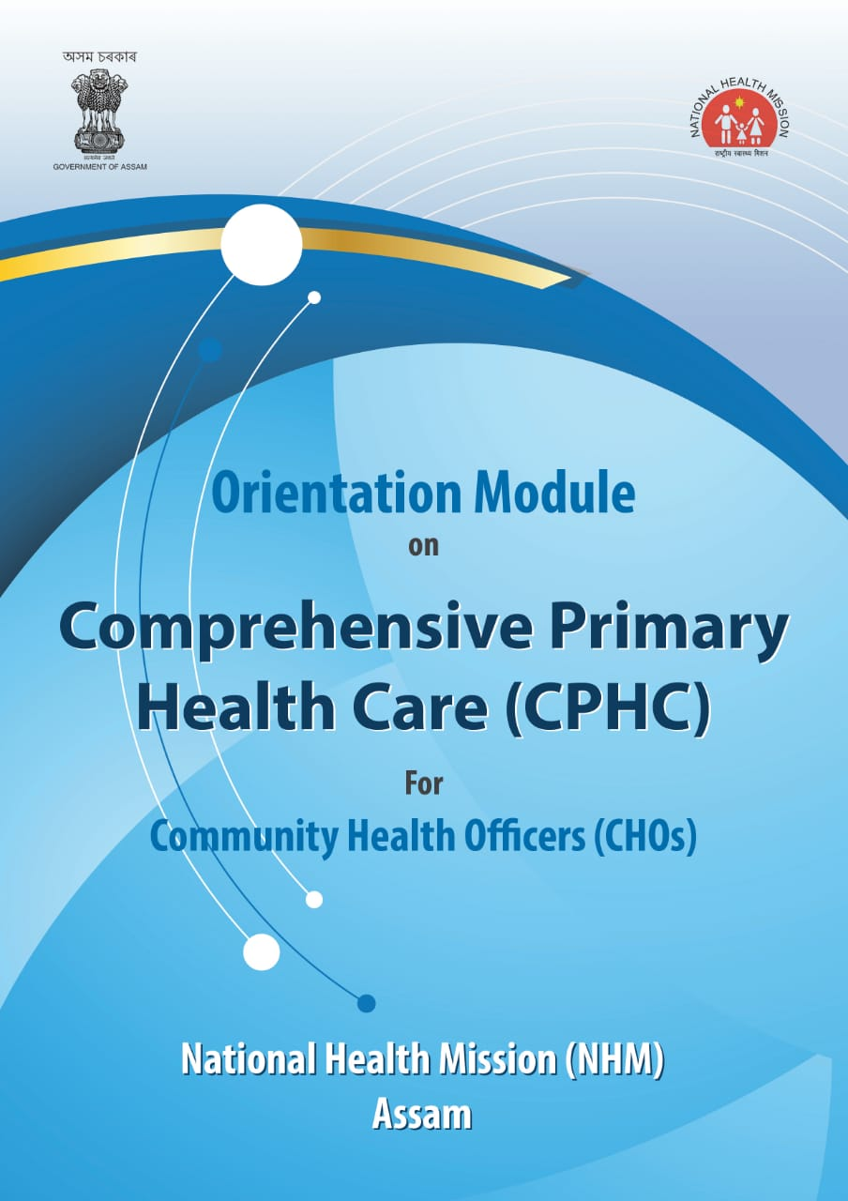
Expansion of services to provide CPHC
State has developed training module on Comprehensive Primary Health Care for Mid Level Service Providers (CHOs) with support from RRC-NE.
Training module provided to all CHOs.
One day orientation of all CHOs along with Jt. DHS, DPMU members completed.

Slide 18
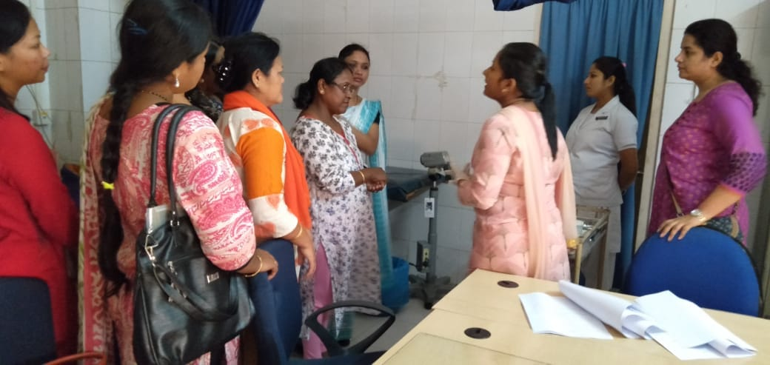
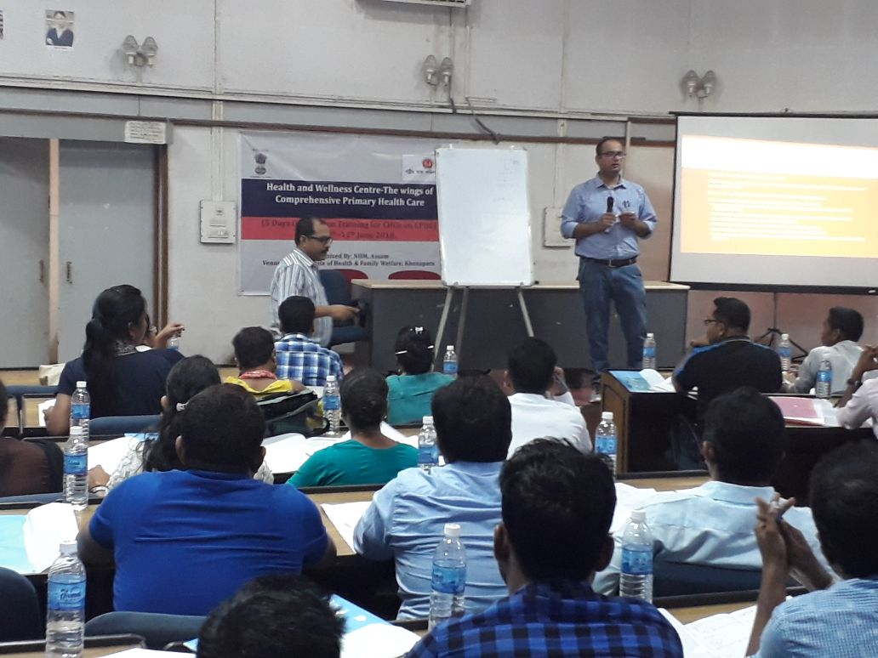
Expansion of service package to provide CPHC
Training conducted for CPHC- HWC implementation:
  Medical officer: 16
  CHO (MLSP): 179
  Staff Nurse: 16
  ANM ToT: 52 (MO-26, SN-26)
  ASHA TOT: 33
  ANM & MPW: 248
  ASHA: 618
VIA Training- for early Diagnosis of Cervical Cancer :
  State has started 14 days training of Staff Nurses at Dr Borooah Cancer Institute.
  The training is very unique and includes screening of women belonging to Urban Slums (Kamrup Metro) and also screening camps at rural PHCs.

Slide 19
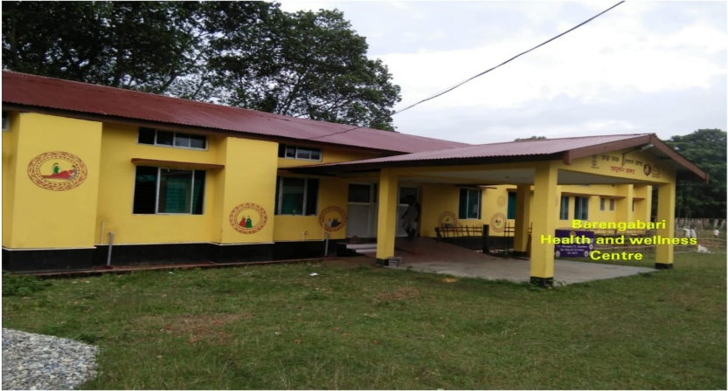
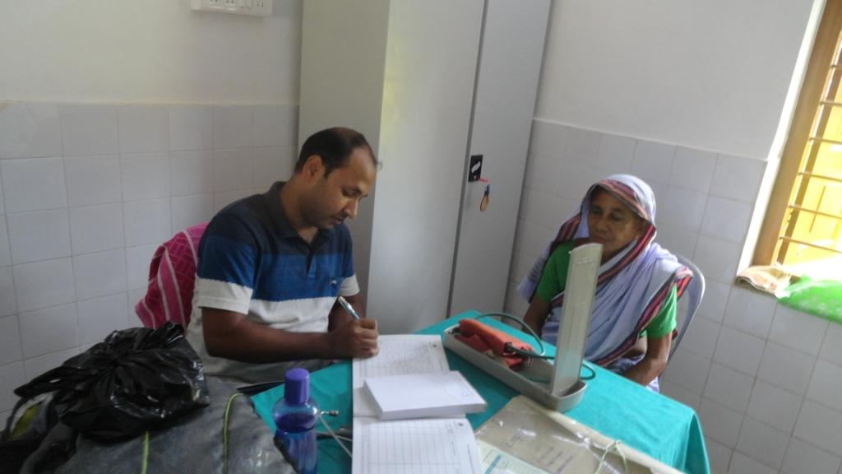
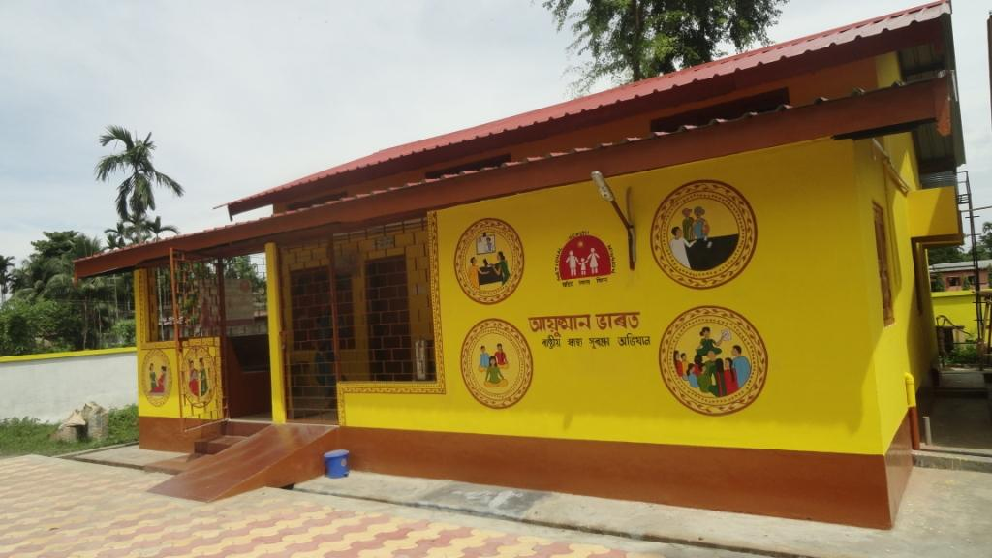
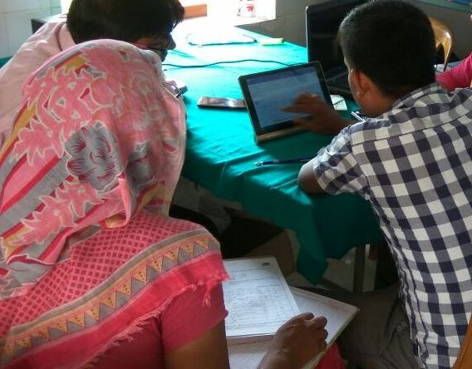
Health & Wellness Centres

Slide 20
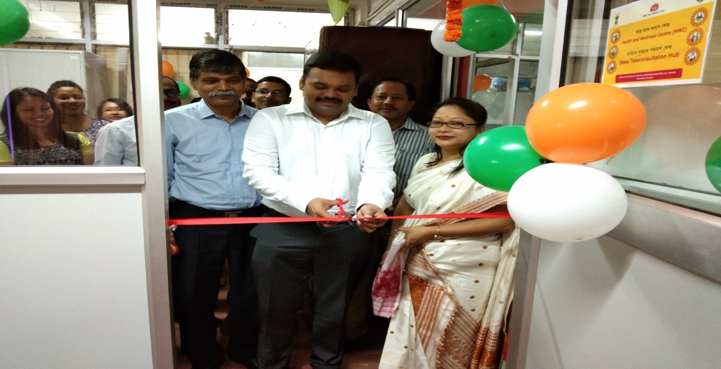
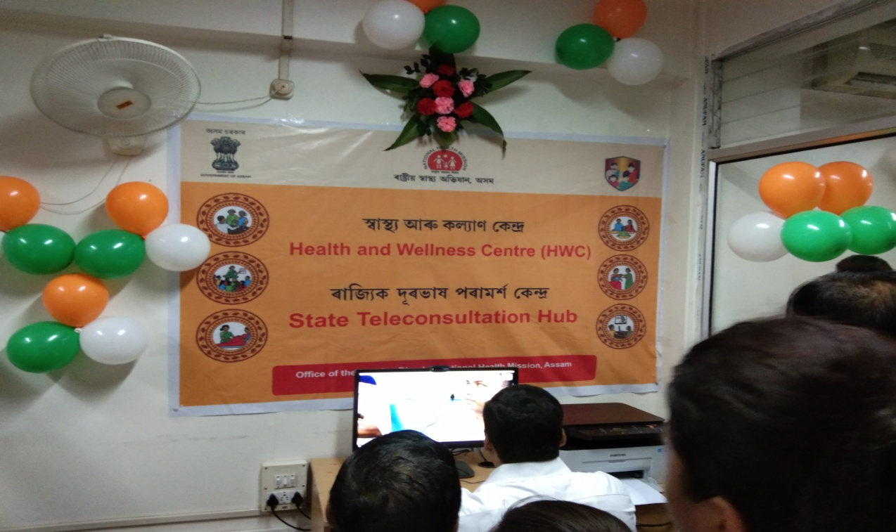
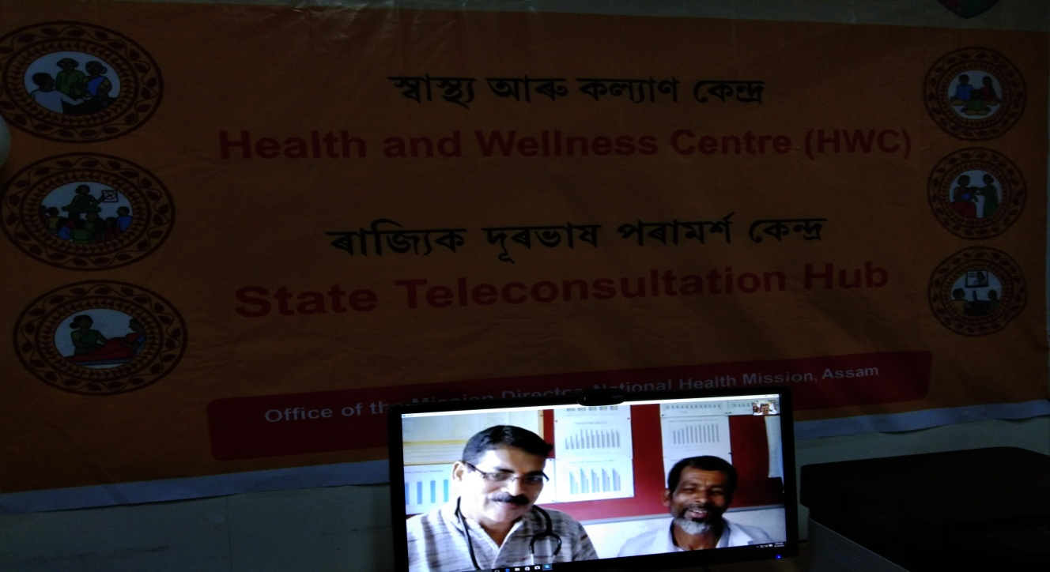
HWC – State Tele-consultation Hub
Recent initiative
HWC State Tele-Consultation Hub to provide specialized Tele-consultation
At present 13 PHC-HWC connected with State Hub

Slide 21
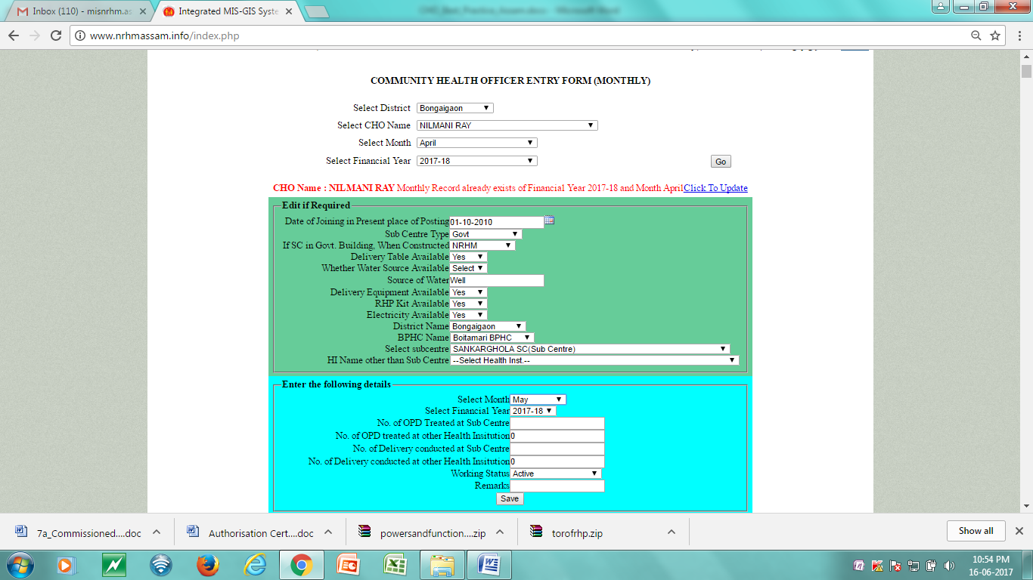
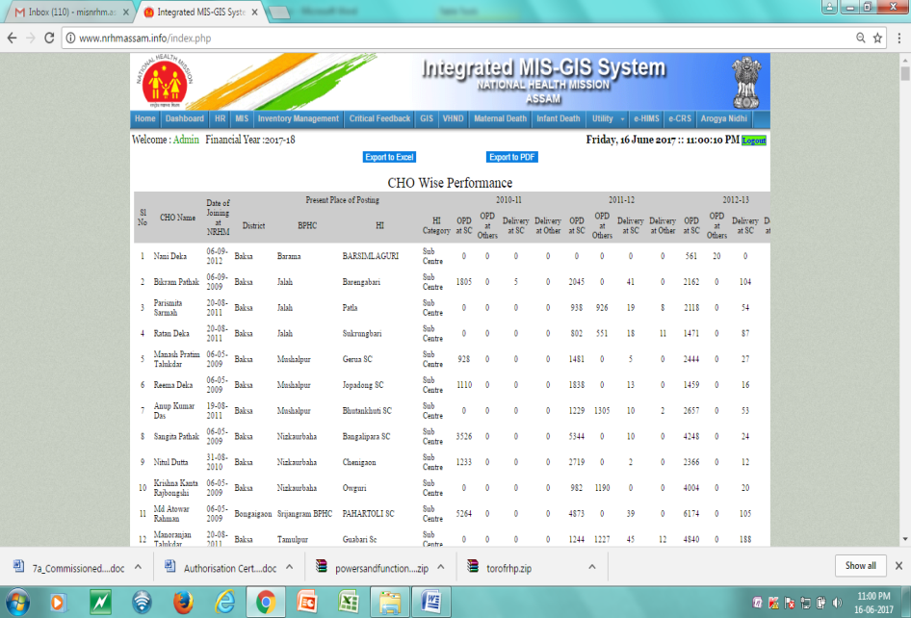
Monitoring Mechanism
National Health Mission, Assam has in-house developed online system for tracking monthly performance of Community Health Officers.
The same system is being upgraded to capture all indicators of CPHC to cover all 12 packages.
Performance of each and every CHO is analysed at State HQ and monthly feedback is provided.
Regular review meetings are also organized with the underperforming CHOs at the State HQ to assess the reasons for under performance.
NCD application and ANMOL is also being rolled out in all H&WCs.
Entry Form
Analytical Reports

Slide 22
Sustainability and Way Forward
All the CHOs have now started assisting the MOs in their respective Health Institutions whether it is OPD or delivery cases.
The burden of the MOs has been taken over by a great deal by these CHOs.
At least now public find someone in the hospital to cater to their medical needs.
Bridge course specified by the Government of India run by the IGNOU through study centers is in the process to be taken by Srimanta Sankardeva University of Health Sciences for CHOs.
Step has been initiated to promote them as public Health Officer in PHC.
Performance based incentive to motivate the CHOs.

Slide 23
Mobile Medical Unit (MMU) – Mobile Health & Wellness Centre
Doctor run Model - Special focus on Tea Garden, Hard to reach areas and Boarder areas

Slide 24
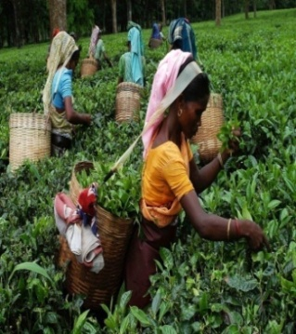
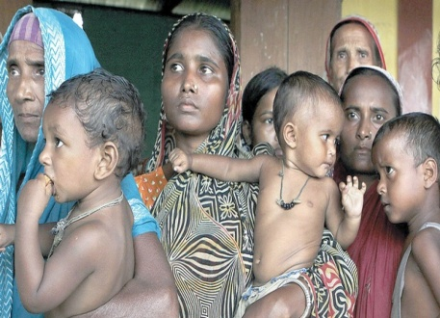
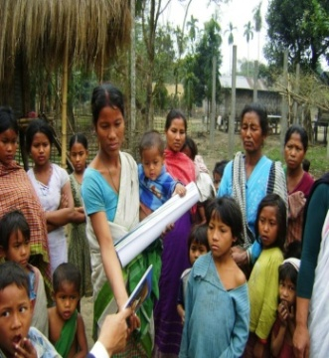
Healthcare Issues in Tea Garden areas
Around 20% of State population
Poor health outcomes
High MMR- Low health seeking behaviours
TG population has health issues of
  High Risk Pregnant Women (HRPW)
    Anemia
    Hypertension
  Poor nutritional status- High Alcoholism
  Low Birth Weight Babies (LBW)
  High prevalence of TB
  High Prevalence of Leprosy
Tea Garden Area
Char Area

Slide 25
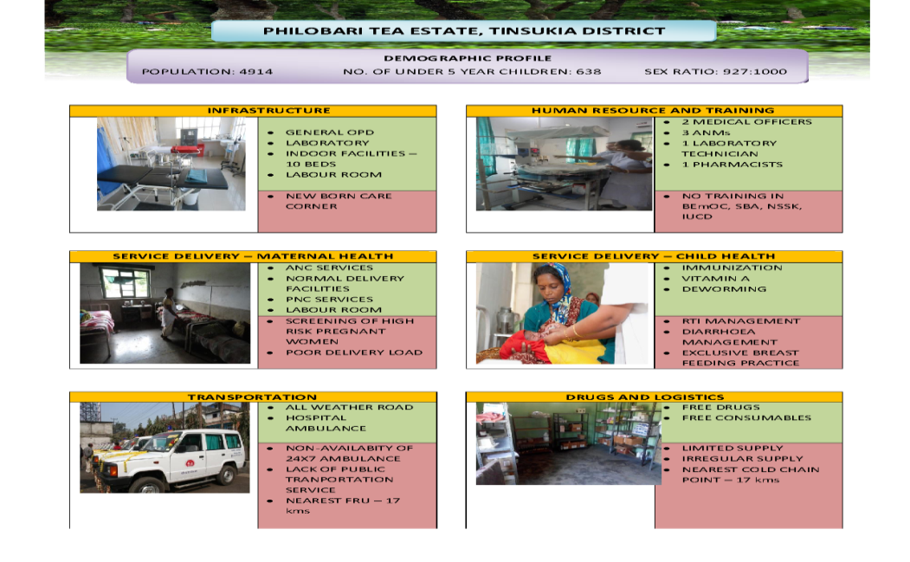
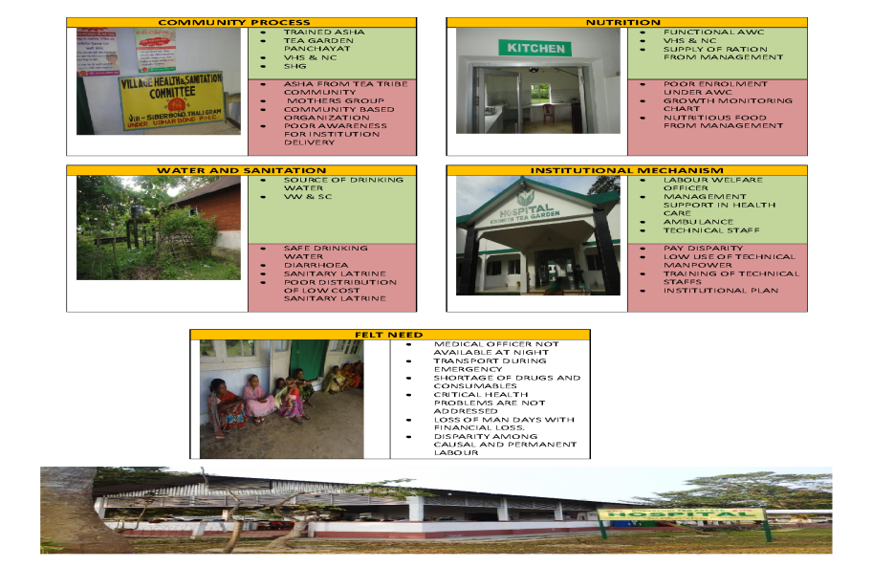
Healthcare Issues in Tea Garden areas
Comprehensive survey of all Tea gardens with support from RRC-NE
Survey Findings:
  428 (57%) Tea gardens have functional hospital out of total 758 Tea gardens surveyed
  out of total 649 Tea garden hospitals:
    Only 324 (49.9%) have Medical Officer (Allopathic)
    Only 258 (40%) have Staff Nurse
    Only 301 (46%) have Functional Labour Room
    Only 118 (18%) have Functional NBCC
    Only 146 (22.5%) have Functional laboratory
Tea Garden Area
Char Area
Coffee Table Book on Tea Garden

Slide 26
Mobile Medical Units (MMUs) – To reach the unreached
To provide primary health care services along with diagnostics facilities
  Tea Garden areas = 80 MMUs
  Non tea garden areas = 50 MMUs
Each MMU equipped with lab diagnostics and consumables.
Each MMU:-
  One doctor
  Two GNMs/ANMs
  One Pharmacist
  One Lab Tech
  Two Drivers
Each MMU will have two vehicle one fitted with lab and diagnostics and next one for staff mobility
Comprehensive primary healthcare services at the doorstep
Free drugs and free Lab diagnostics in the labour lines at the door step
Early identification and treatment of communicable and non communicable diseases
At present 414 Tea gardens are covered by MMU services

Slide 27
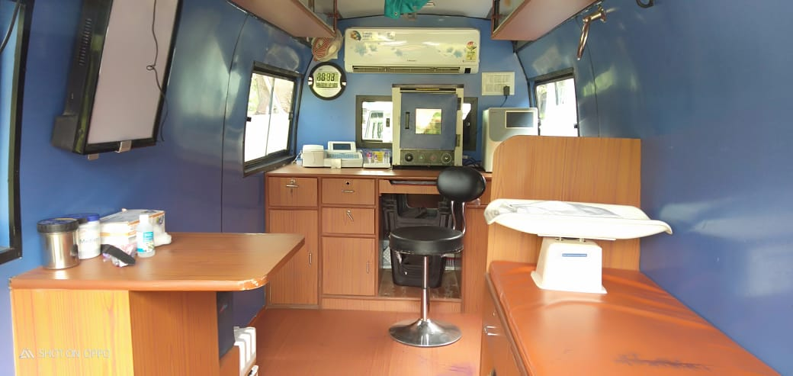
Expanding MMU services to provide CPHC
Existing MMU services expanded to cover Comprehensive Primary Health Care
Comprehensive Service Package and Training plan prepared covering all Communicable and Non Communicable disease control programmes
Comprehensive Family Health Card prepared to cover all programmes
Digitization of Family Health Card under process

Slide 28
Expanding MMU services to provide CPHC
Primary health services-Basic OPD care- (acute simple illness)
Maternal Health Services
Neonatal and Infant Health ( 0 to 1 year old)
Child Health Services including Immunization services (for dropout and fresh)
Nutritional services.
Adolescent Health Services
Reproductive health and Contraceptive Services (Family Planning)
Management of chronic communicable Diseases
Eye/ENT care
BCC services
Diagnostic Services
Higher facility referral for management of complicated cases.
Screening and Basic management of Mental health ailments.
Care for Common Ophthalmic and ENT problems.
Basic Dental health care.
Geriatric and palliative health care services.

Slide 29
Outcome of Tea Garden MMU
Key Outcome: Comprehensive primary health care with focus on population based screening covering all labour line residents including temporary workers
Primary Curative healthcare services covering communicable & non-communicable diseases.
Reduced Out of Pocket Expenditure (OOPE) with free drugs and diagnostics.
Substantial increase in health seeking behaviour of tea garden population.
Early identification and referral of High Risk cases.
Strengthening of Referral network through 108/102 - total 43,287 patients referred till September 2018.
Dedicated Help Desk for tea garden community at Medical College & District Hospiatls - helped to overcome language barer and fear of unknown, which resulted improved health seeking behaviours.
Making public delivery systems responsive, transparent and efficient particularly by leveraging technology - Web based dash boards with GPS based tracking and biometric attendance system

Slide 30
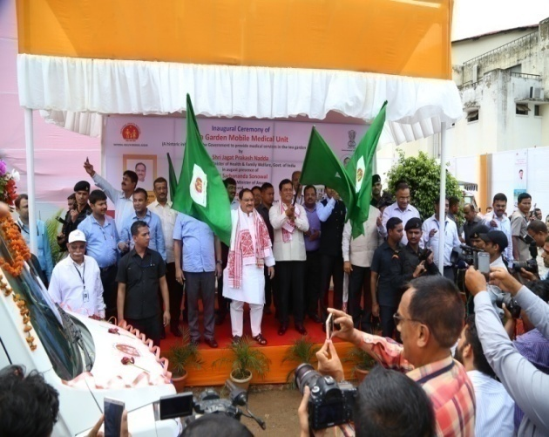
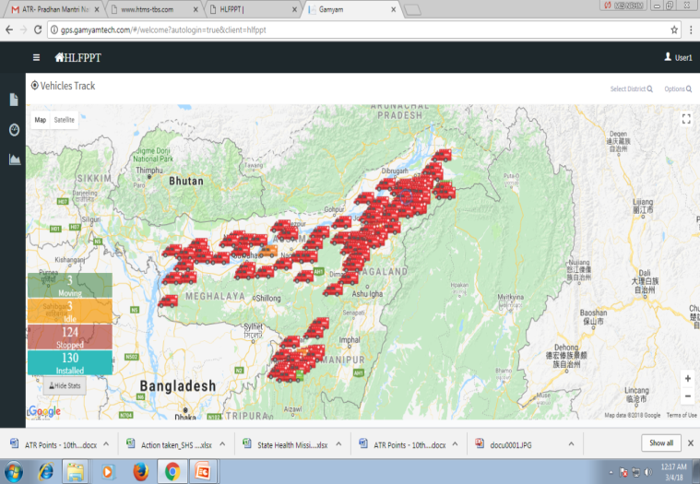
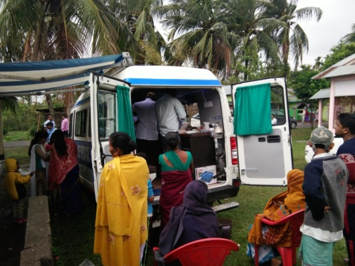
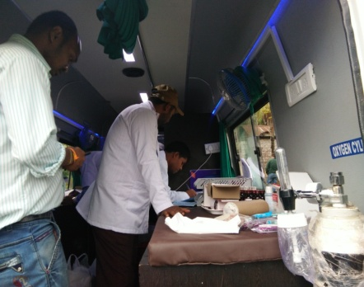
Performance of MMU services up to 30th September 2018
Type of MMU Services | No of MMUs | No of Camps Held | No of Patients Treated | No of ANC | No of PNC | No of ECG | No of Opthalmic Advice | No of Blood Tested Patient | No of Urine Tested Patient | No of Patients Referred
Tea Garden MMU | 80 | 24085 | 830512 | 11467 | 2578 | 2377 | 16500 | 128173 | 17421 | 21703
Non-Tea Garden MMU | 50 | 11514 | 662296 | 15531 | 3467 | 1317 | 33482 | 81127 | 7686 | 21584
TOTAL | 130 | 35599 | 1492808 | 26998 | 6045 | 3694 | 49982 | 209300 | 25107 | 43287

Slide 31
Boat Clinic – Floating Health & Wellness Centre
Doctor run Model - Special focus on Char/ Riverine areas

Slide 32
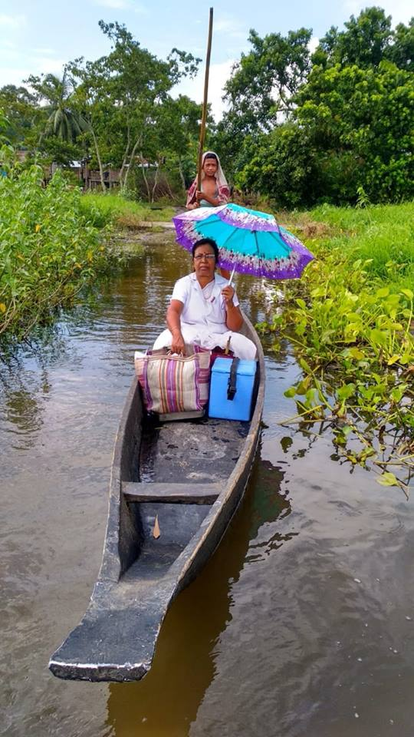
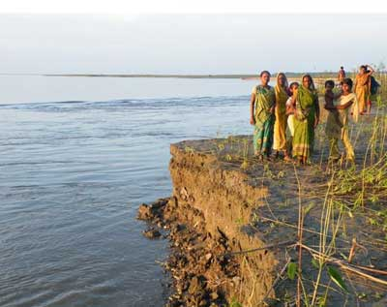
Healthcare Issues in Char/ Riverine areas
Around 10% of population facing Annual Flooding/erosion
Inadequate Health Infrastructure – permanent health infrastructure is a challenge
Accessibility issues resulting in home deliveries
High teenage pregnancy
Poor nutritional status
Anemia
Diarrhea
Poor health seeking behaviours
Tea Garden Area
Char Area

Slide 33
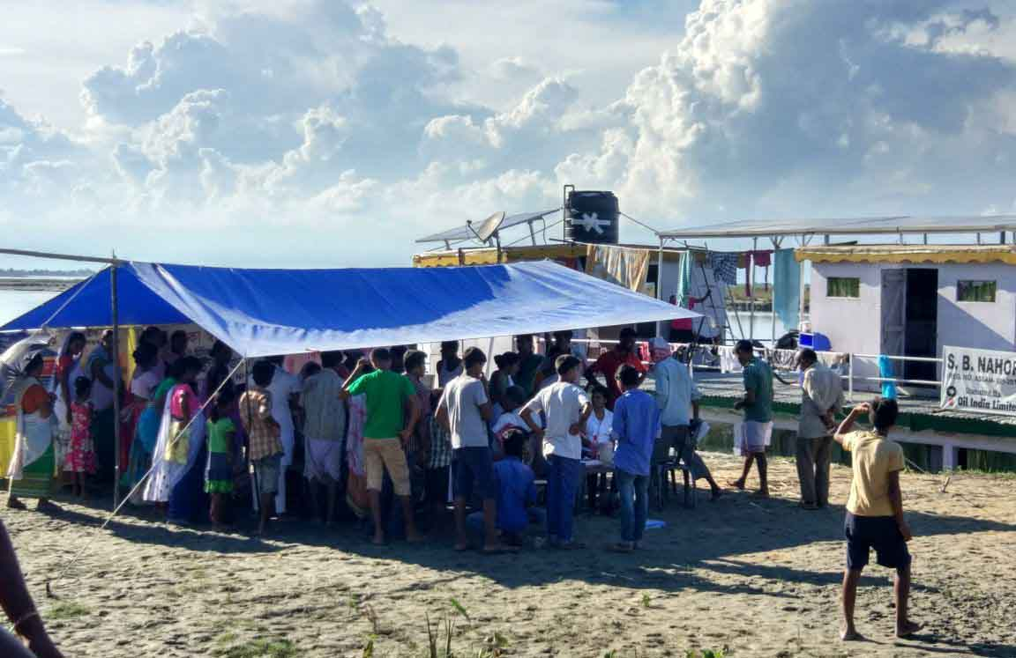
Boat Clinic - To provide healthcare services in Riverine areas
To provide health services to the communities residing in the remote river islands (Char/Saporis) Boat Clinic Services started.
At present 15 Boat Clinics functioning in 13 Districts.
It is in PPP mode

Slide 34
Expansion of services for Boat Clinic
Services provided by boat clinic:
  Curative care, referral of complicated cases, early detection of TB, Malaria, Leprosy, Kala-Azar and other locally endemic communicable diseases and non – communicable diseases such as diabetes and cataract cases etc
  Minor surgical procedure and suturing
  Reproductive and Child health care including ante-natal check up and related services e.g. injection – tetanus toxoid, iron and folic acid tablets, referral for complicated pregnancies, Promotion of institutional deliveries and post – natal check up
  Immunization clinics
  Family Planning Services
All the services under H&WC being included in the Boat Clinic
Trainings for the staff of Boat clinics Underway to bring continuum of care
Linked to the Boat Ambulances of Mritunjoy 108

Slide 35
Outcome of Boat Clinic Services
Total 20.73 lakhs patients were treated in 27,959 of camps organized by Boat Clinic since 2008-09 till September 2018

Slide 36
“Goodness is the language which the deaf can hear and the blind can see”…Mark Twain
We resonate “Goodness” with the CPHC

Slide 37
Thank You

