Slide 1

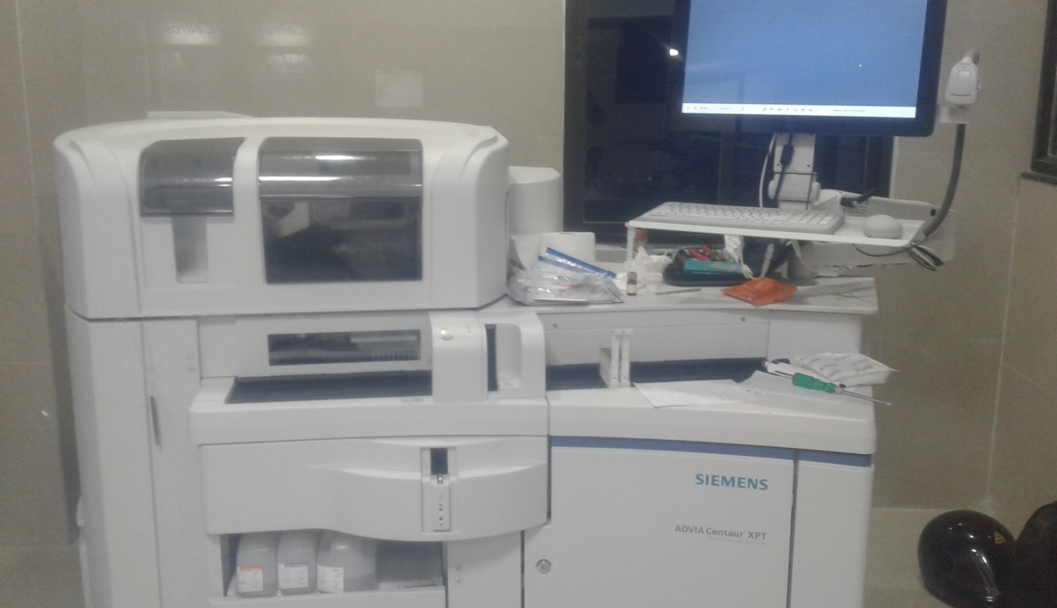
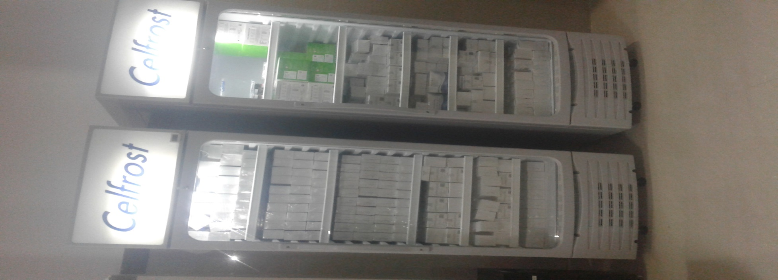
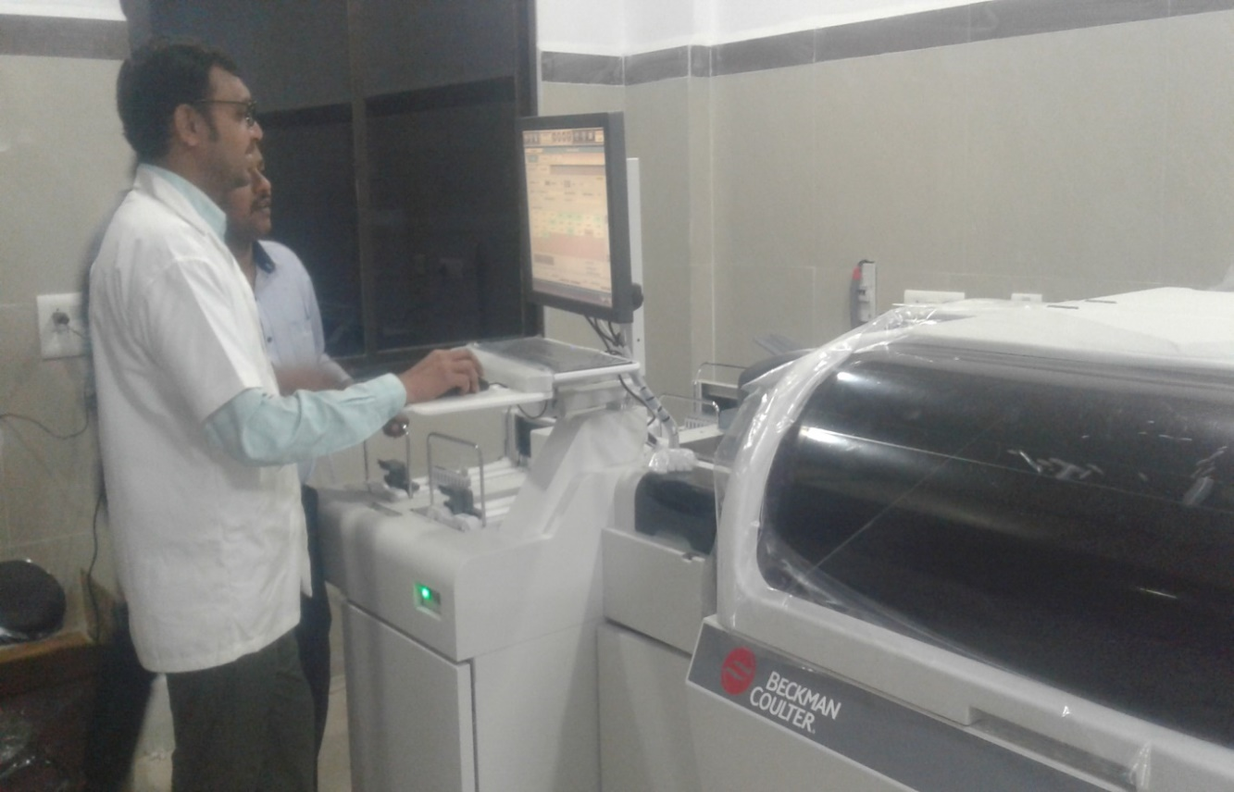
Telangana Diagnostics – A cost effective, free diagnostics delivery initiative
28-Dec-2020

Slide 2

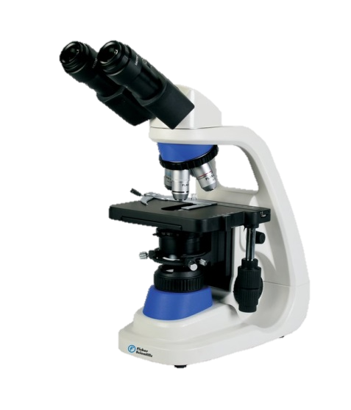
Problem Statement
Diagnostics based patient care is the new normal in Healthcare Delivery.
Based on recent study on Cost of Health Care spent by individuals, major pie in expenses is taken up by Diagnostics and Medicines. And their share is increasing day by day in the overall delivery because:
  Diagnostics playing pivotal role in determining the issues without wasting precious time available before starting the treatment.
  Because of Medico Legal Issues, Doctors are not able to proceed without first diagnosing the issue through medical tests.
Also the study reveals middle class is becoming poorer day by day if they are facing any medical issue.
Thus, Government of India provided a greater focus on creating a wholistic solution for making diagnostics an affordable solution for public.
Free Diagnostics is made a mandatory program under NHM designed and executed via State Health Departments in delivering it.

Slide 3
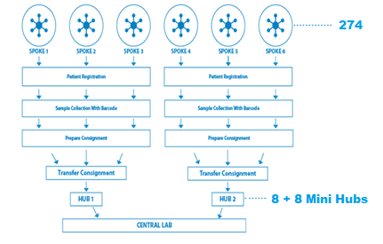
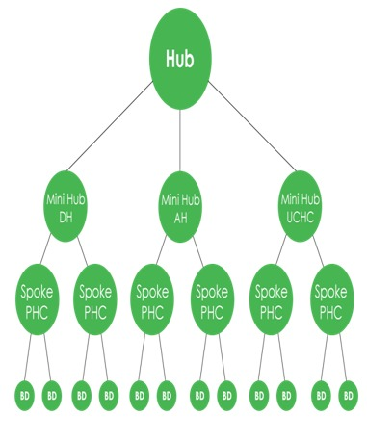
How we adopted?
Different states have different models of this program delivery like
  Fully Outsourced (Ex: AP, Delhi)
  Partly Outsourced (Ex: Gujarat, Rajasthan)
  Telangana opted for Complete In-House model
While setting up in-house model, we designed as Hub & Spoke Model where a Central Laboratory (Hub) caters to all Health Facilities (Spokes) that are in the vicinity of below 60 KMs.

Slide 4
What have we done?
Launched our 1st Central Laboratory (Hub) in August 2018 in Hyderabad.
This Hub supports >300 Health Facilities (Spokes)
60 Investigations are delivered at the central lab - 40 Clinical Biochemistry Tests, 10 Microbiology Tests and 12 Pathological Tests
+ Vitamin D3, Serum Iron & UIBC

Slide 5
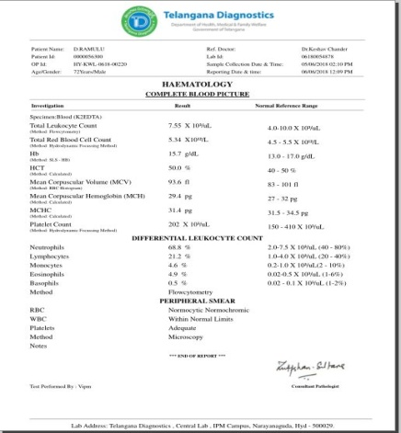
Delivery Excellence
Initially started with 800 samples per day. Currently > 5000 samples are tested daily with TAT of 24 Hours
In 1st year, the patient foot fall was 2 Lakhs and now with present stats, 10 Lakhs patients are utilizing the service per annum.
After setting up the Diagnostics Labs increased the patient footfall at Government Facilities
Reports generated, validated and delivered online to respective Spoke facilities. Patients can directly download their reports from the SMS sent from the system.
Quality Assurance practices have been implemented from the beginning of the program.
  Daily IQCs are run in the laboratory.
  Central Lab is entered into EQAS program with CMC, Vellore and AIIMS, New Delhi since inception of the program and is being complied with the Standards.

Slide 6
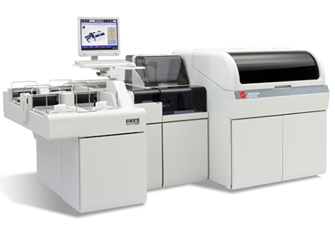
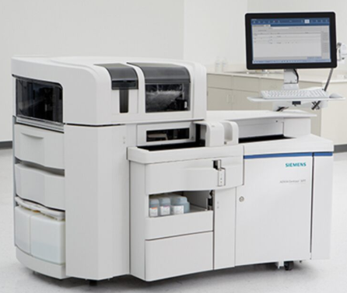
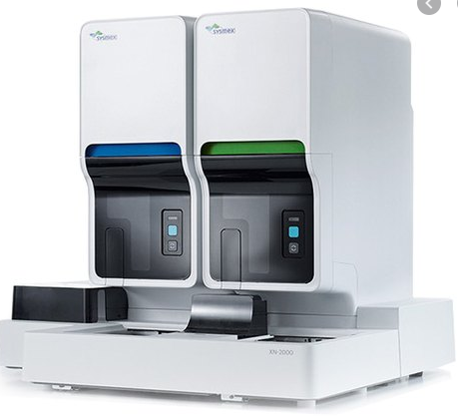
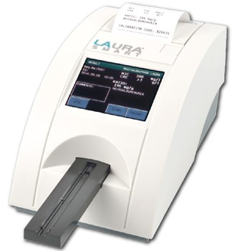
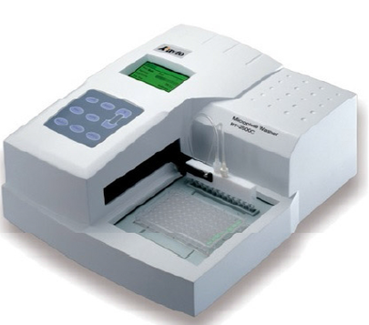
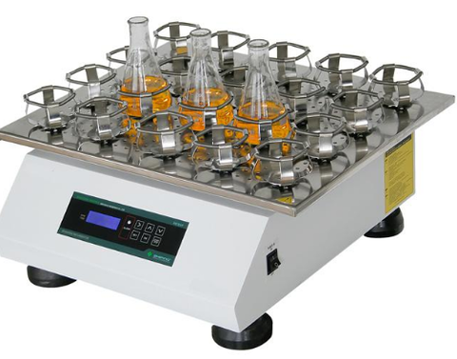
Hub Setup Requirements
Space Requirements:
Infrastructure Requirements:
2500 SFT of lab space
Centralized Air Conditioning
Restricted Entry to Sanitized Environment
HR Requirements:
Clinical Chemistry Analyzers
Immuno Chemistry Analyzers
Hematology Analyzers
Lab Supervisors (2)
Bio Chemist
Pathologist
Microbiologist
Quality Manager (1)
Lab Technicians (8 B.Sc MLTs & 16 DMLTs)
This man power to support 3 shifts of work.
Urine Analyzers
Elisa Reader & Washer
Rotary Shaker

Slide 7
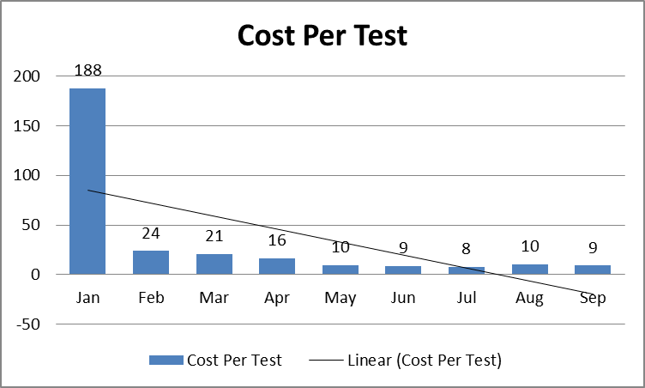
Financials & Outcomes of 1st Year
Based on the study conducted in the initial year, program delivered 16 Cr. worth of tests based on current market value at a fraction of cost.
Each test costed Rs. 10/- Only on average.
Rs. 10 Per Test

Slide 8
Work in Progress
In first 2 years, only Pathological/ Laboratory services were delivered. Now Imaging Services also added in Hyderabad City with a concept of Mini Hubs @ UCHCs or major UPHCs
Initially 8 Mini Hubs are operationalized.
Each Mini Hubs are equipped with Radiology and ECG Services
  Digital X-Ray with Tele-Radiology Reporting
  Ultra Sonography by the Radiologist for Anti-Natal and General Cases
  Tele-ECG with Artificial Intelligence Report & linked to STEMI HUBS for immediate and timely intervention
8 More Mini Hubs would be started soon to saturate Hyderabad City with Imaging and ECG Services.
Based on the current sample load, Central Lab is being further expanded by acquiring additional space
  Histopathology services are being added
  Microbiology lab is being fully automated and also adding cultures etc.
Confidential Document

Slide 9
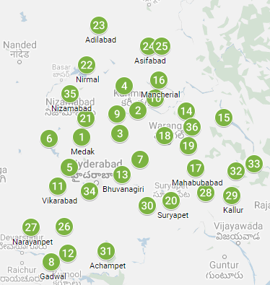
Work in Progress
36 additional Hubs are planned setup across the state with
  Each district to have at least 1 Hub. Larger districts may have 2 Hubs
  Hub to Spoke to be within 60 KMs reach / Sample Transportation time will be less than 5 Hours
Already 20 District Diagnostic Hubs ready for operations in 30 days time
Establishing 16 more would bring entire Telangana State under the Hub and Spoke Model of Diagnostics.
After stabilizing the pathological services, Imaging Services would be added in due course.
Confidential Document

Slide 10
Conclusion
  Delivered a successful model that exceeded the program objectives. More than 9 Lakhs patients are served per year currently.
  # of Tests can be tailor made based on the demand and necessity for a fraction of increase in operational expenditure
  Existing framework on Diagnostics and Quality Assurance can be utilized in setting up the central labs.
  Additional employment generated through lab technicians’ recruitment and vendor transport team.
  Equipment, test methodology knowledge and test data are completely owned by Government; and these get helped in creating new policy for providing better healthcare via preventive & predictive practices
  Current electronic reporting framework would be integrated with Electronic Health Record framework in future.
Confidential Document

Slide 11
Thank You

