Slide 1


GIS MAPPING AND VULNERABILITY ASSESSMENT
IN UPHCS OF MADURAI CORPORATION UNDER NUHM
Presented By
Tmt. Priya K
SPM, NUHM Tamil Nadu

Slide 2
Problem Statement
During Madurai corporation expansion 33 HSC area were converted to 28 wards, which resulted in many no man land coverage area
Area demarcation in urban area and peri-urban areas are of high task.

Slide 3
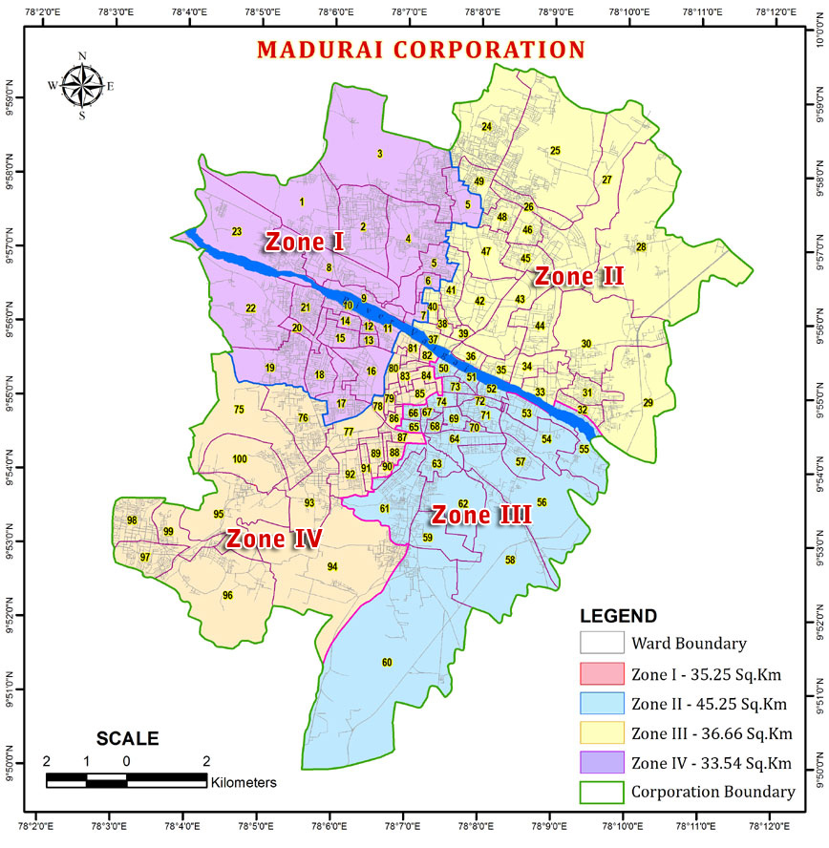

Slide 4
Programme description
Geographical Demarcation Mapping for the vulnerable population was done through a well-trained survey team and uploaded in MAPinr app, a user friendly software capable of data capturing and location point of interest (viz latitude and longitude).
The maps are developed with the details of slums and vulnerable area and population identification with Vulnerability Assessment index ie. Residential Vulnerability, Social Vulnerability, Occupational Vulnerability, Health Related Vulnerability.
Available health facility with buffer of Vulnerable area mapped <1, 1-2, >2 Km and are super-imposed, digitalized and plotted on GIS map.
GIS mapping helps in intersectional coordination of various departments like NULM shelters, Socio Economic caste census under Ayushman Bharat Yojana, Town planning department,Integrated Child Development Services department

Slide 5

GIS MAPPING AND VULNERABILITY ASSESSMENT PROCESS FLOW
PRIMARY DATA
SECONDARY DATA
POI
BASEMAP
JURISDICTION LIMIT
VULNERABILITY ASSESSMENT
WARDBOUNDARY
FINAL OUTPUT IN GIS
NATIONAL URBAN HEALTH MISSION

Slide 6
Scope of work
Creation of a GIS based Spatial Data Base
Digitization Ward Boundaries ,PHC and Sector boundaries ( Scanning ,Geo reference and Digitization)
Digitization Vulnerable Pockets (Slums etc)
Marking of PHCs
Collection of Point of Interest (POI) using Mobile Application by capturing the Geo coordinates /Photo/ Descriptive reference text for Mapping Vulnerable locations

Slide 7
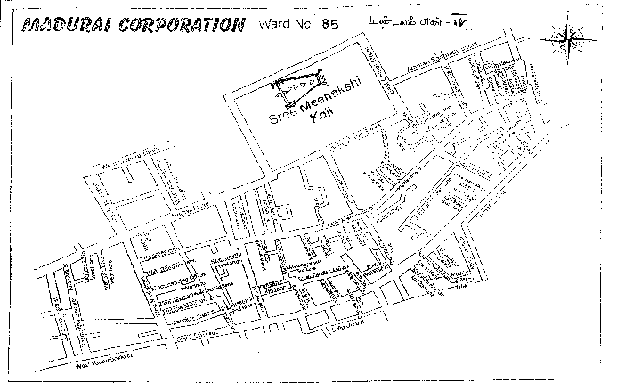
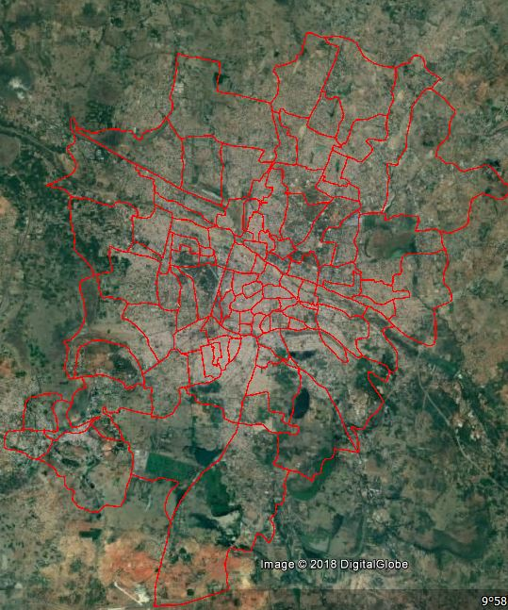
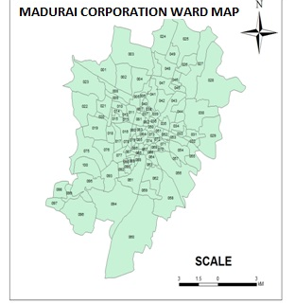
Base Map Geo referenced and Digitized
Source: ULB
NATIONAL URBAN HEALTH MISSION

Slide 8
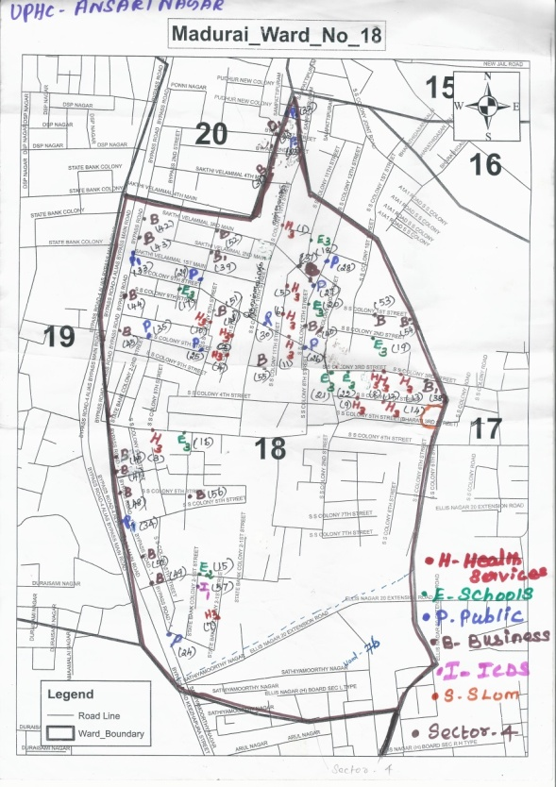
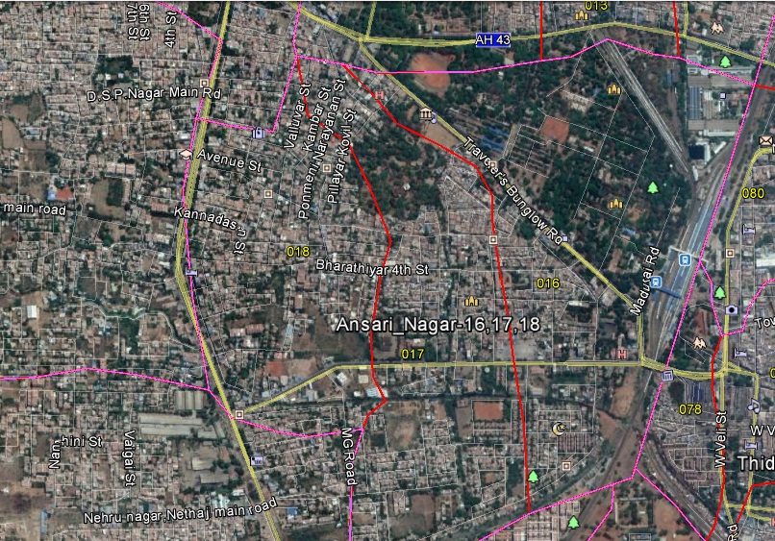
UPHC/Sector Boundary Geo referenced & Digitization

Slide 9
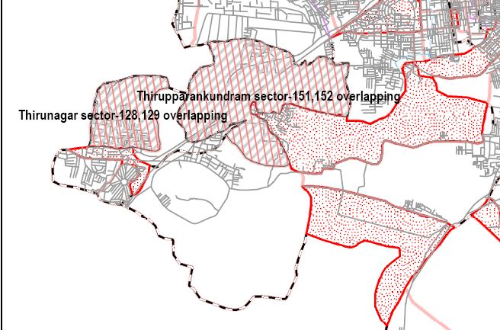
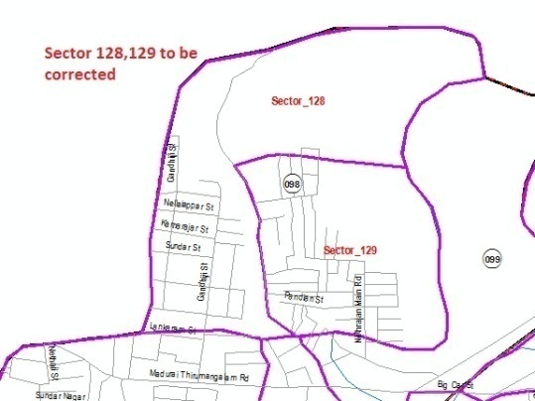
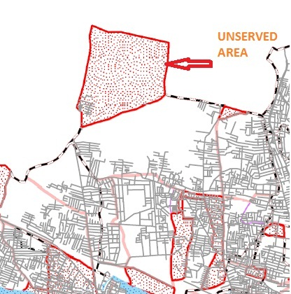
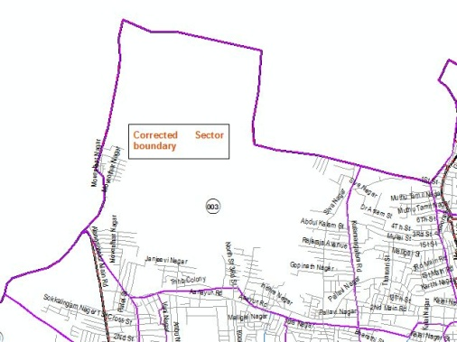
Field Confirmation of Boundaries
Sorted out Real time Jurisdiction Issues
Overlapping issues in Boundaries cleared with the help of officials
Un Served Area annexed to nearest UPHC
Also Vacant Land, Inhabitation Areas mapped to Nearest PHC
Overlapping
Un Served Area Corrected
Un Served Area
Overlapping Corrected

Slide 10





POI Data Collection
POI Survey
Satellite
In house QC processing before Uploading
NATIONAL URBAN HEALTH MISSION

Slide 11
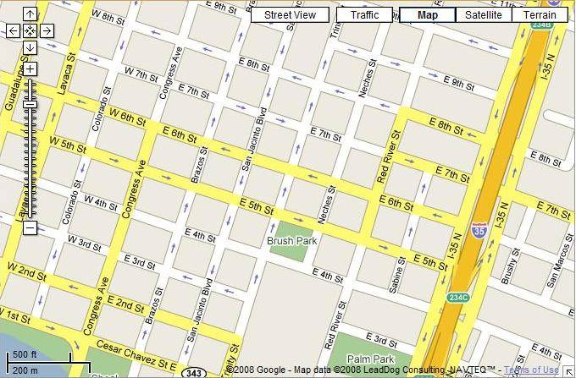


POI collection
Get Position
Collecting the Data
₂
Lat : 12.45687
Long : 79.26486
NATIONAL URBAN HEALTH MISSION

Slide 12
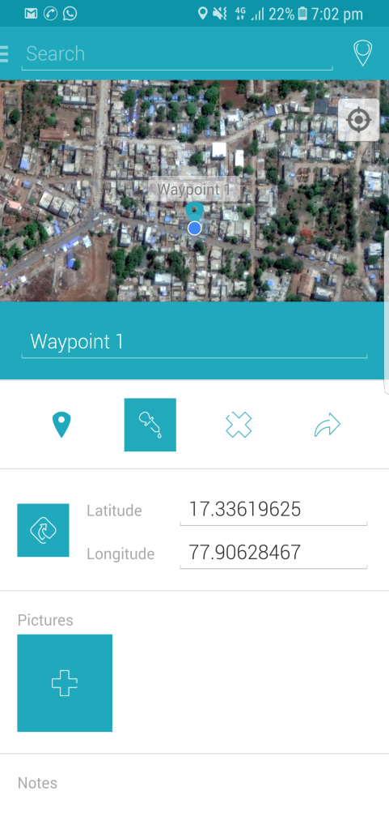
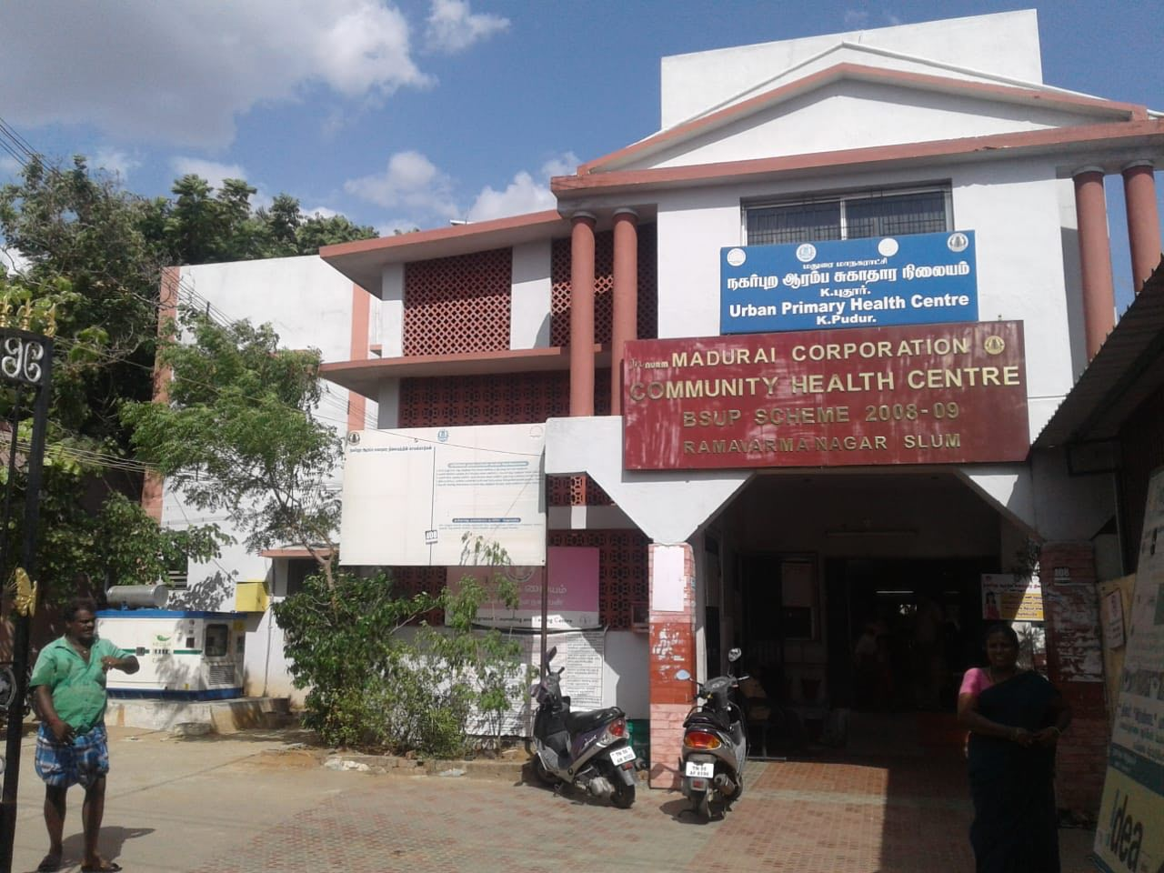
Used Mobile App for Locating POI
Capture the position (latitude and longitude) of POI
Take Photo
Add descriptive Text
K.Pudhur UPHC

Slide 13
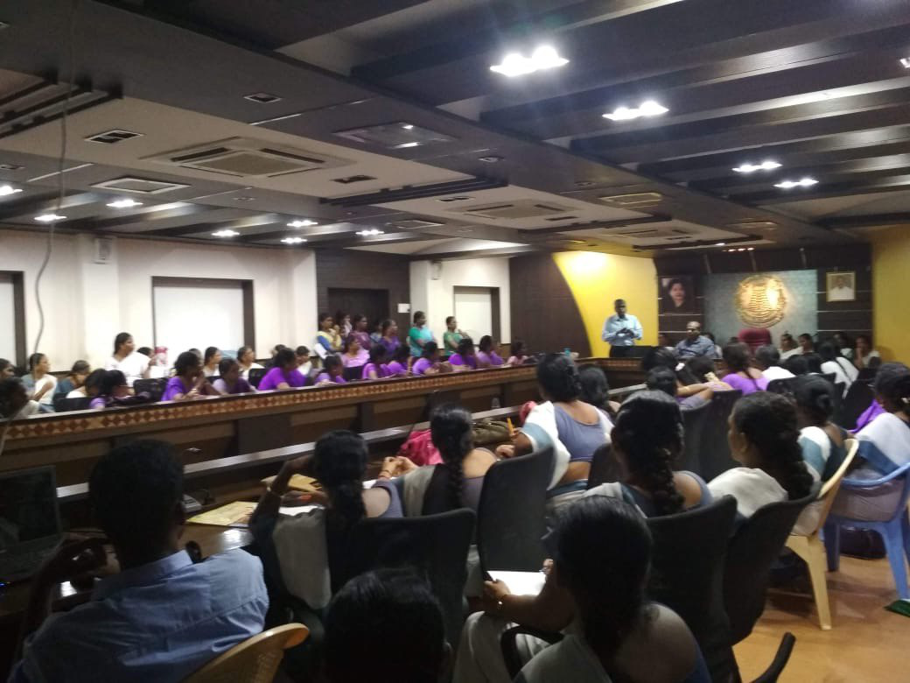
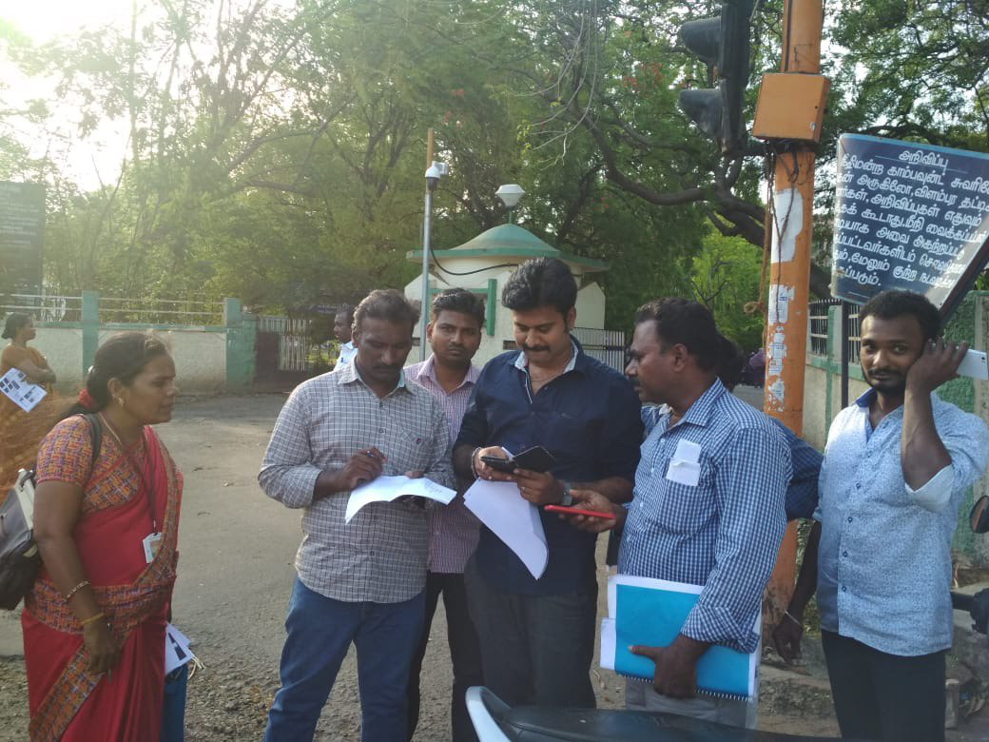
GIS MAPPING
TRANING FOR THE FIELD STAFF
ROAD BY ROAD MAPPING
NATIONAL URBAN HEALTH MISSION

Slide 14
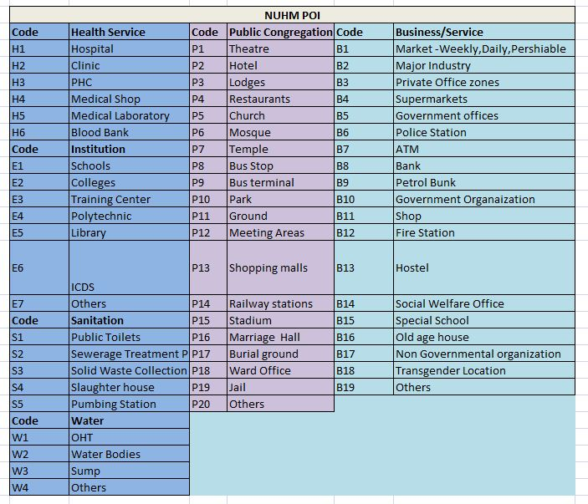
List of POI

Slide 15
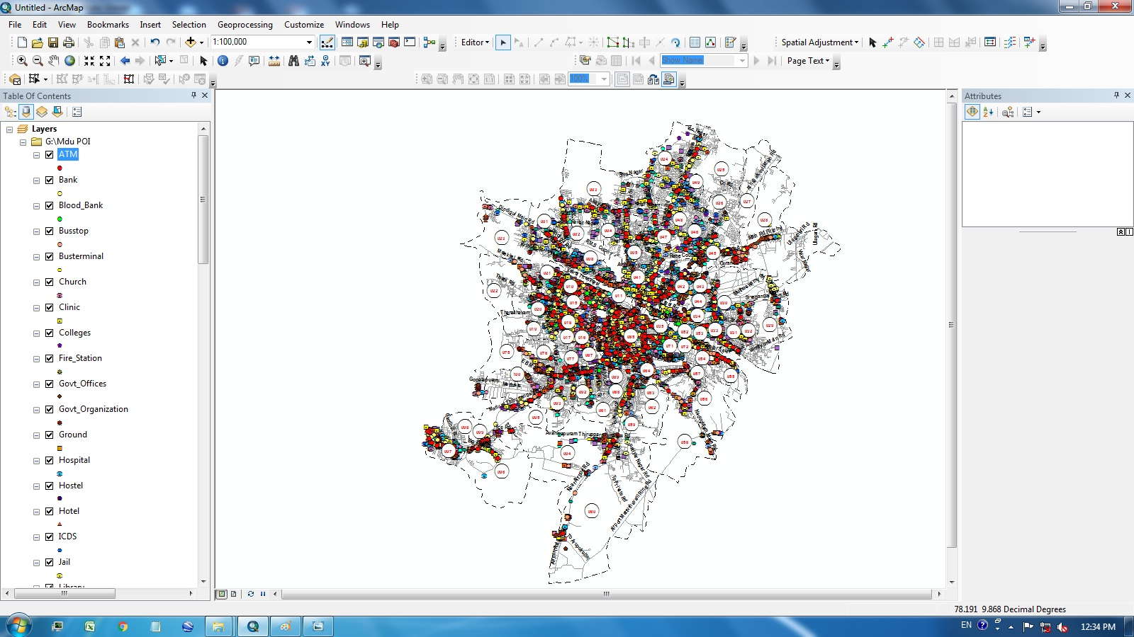
Collected POI Migrated to GIS after QC
NATIONAL URBAN HEALTH MISSION

Slide 16
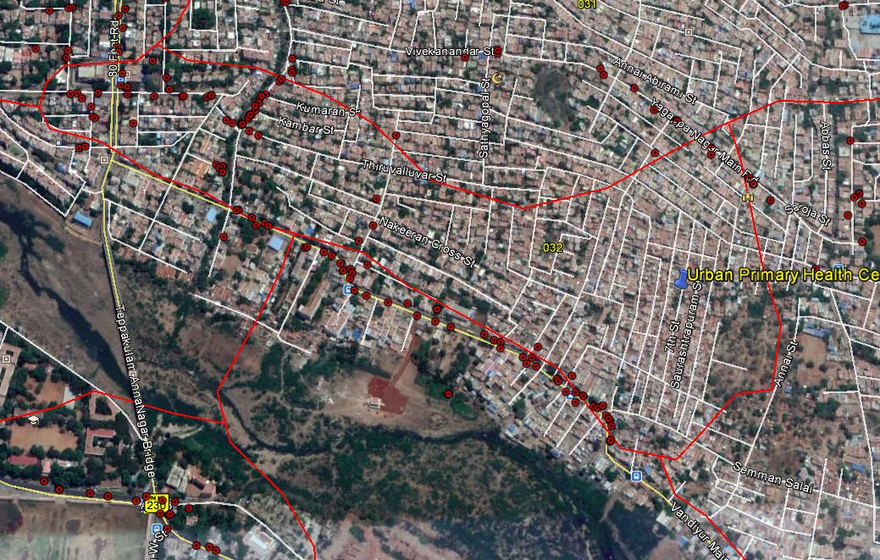
POI Plotted Sample in a PHC
NATIONAL URBAN HEALTH MISSION

Slide 17
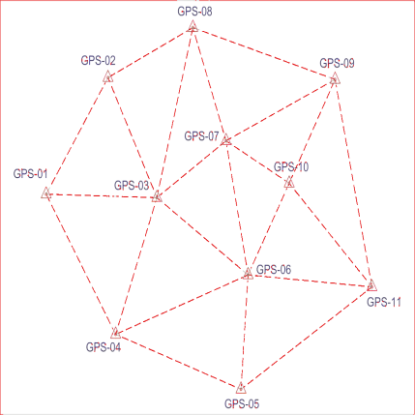
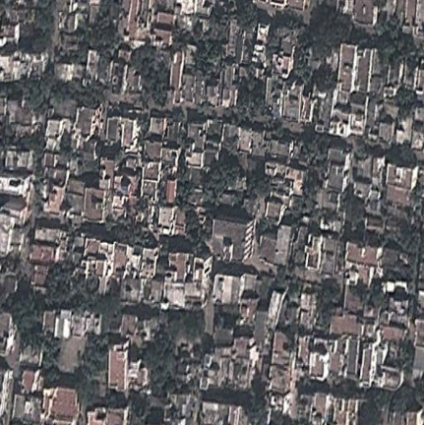
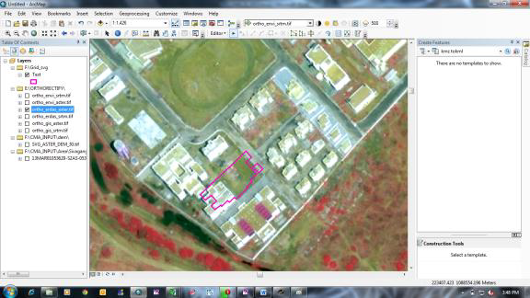
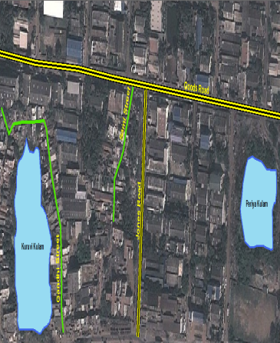
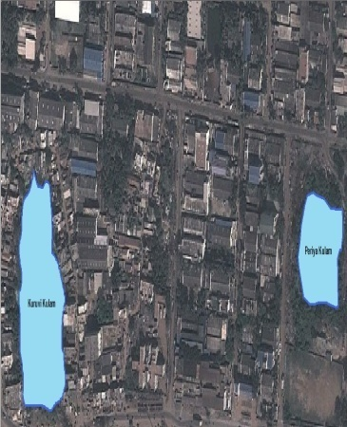
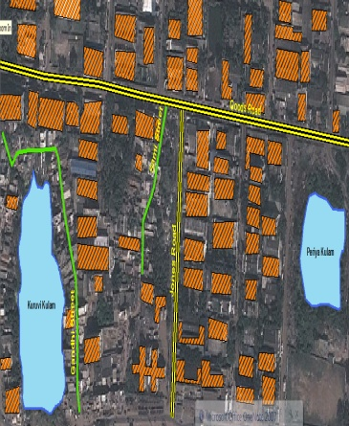
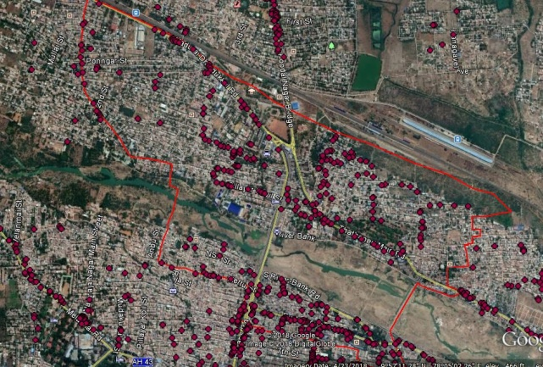
Multi Layered Approach
Vulnerable Spots
Jurisdiction Super imposed
POI
POI plotted
Roads
Water
bodies
NATIONAL URBAN HEALTH MISSION

Slide 18
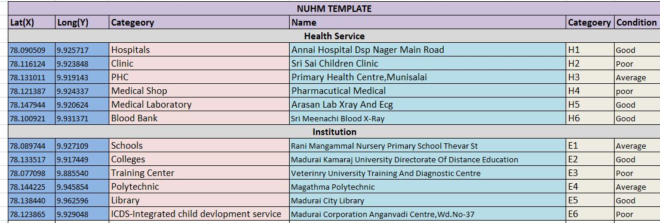
POI With Attributes
NATIONAL URBAN HEALTH MISSION

Slide 19
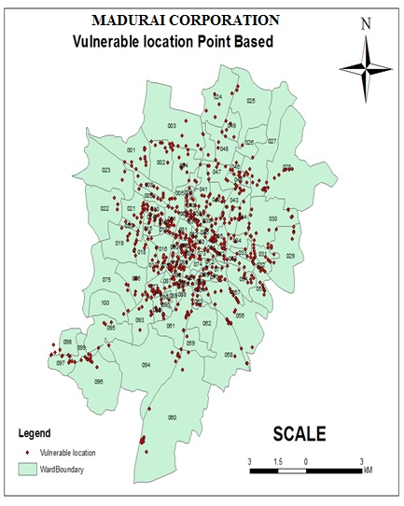
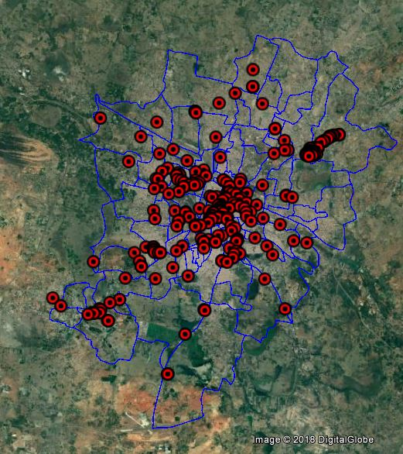
Vulnerable location
Location Based Identification(Point)
NATIONAL URBAN HEALTH MISSION

Slide 20
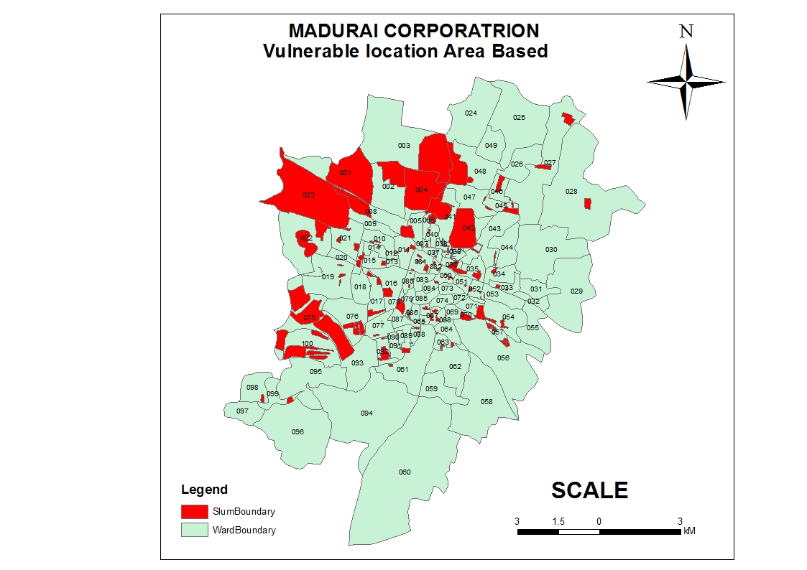
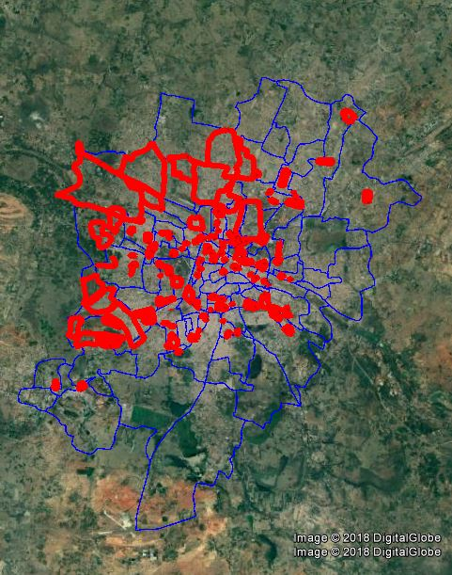
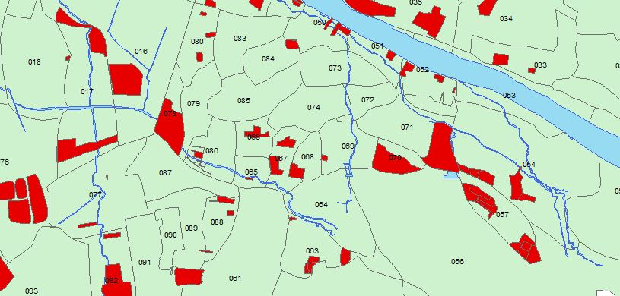
Vulnerable location
Area Based Identification
MADURAI CORPORATION
NATIONAL URBAN HEALTH MISSION

Slide 21
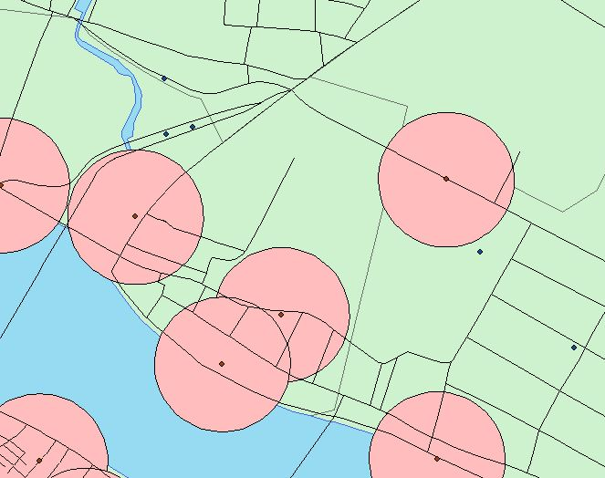
GIS ANALYSIS
Buffer Analysis ( User defined Radius
Eg. Epi centre of Disease to Hospital/ Affected Areas
(possible Spread )
Eg. Around Public Toilets
100 Meters Ring Buffer

Slide 22
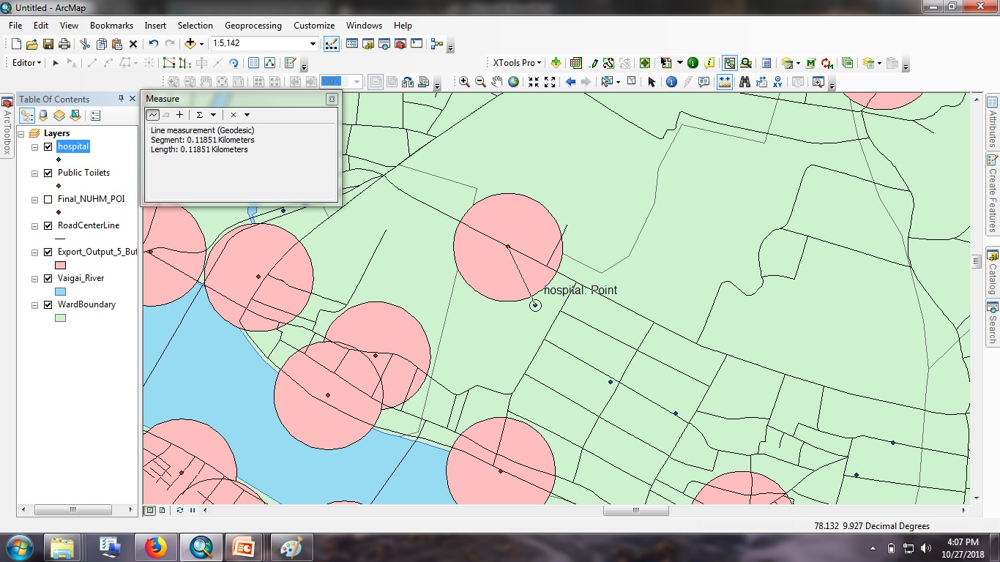
GIS ANLAYSIS
Nearest Neighbour analysis
Calculates a nearest neighbor index based on the average distance from each Location to its nearest neighboring Location
Available resources within specified distance
Eg. Epi centre of Diseases to Hospital/ Affected Areas (possible Spread )
NATIONAL URBAN HEALTH MISSION

Slide 23
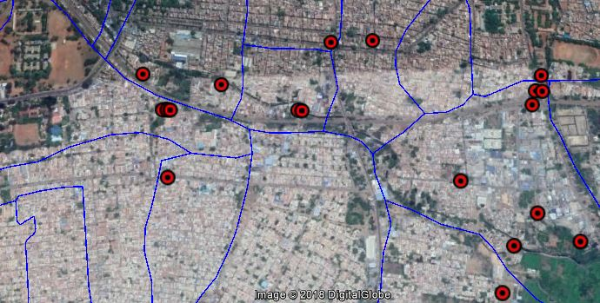
Live Mapping Tool
Trained Nurses to use Mobile app to mark incidence based Vulnerability
Dengue reported location
NATIONAL URBAN HEALTH MISSION

Slide 24

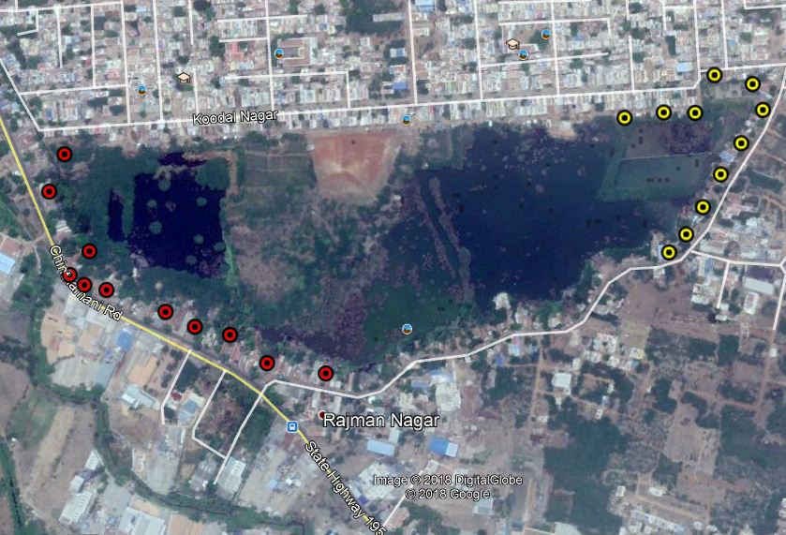
History Based Analysis
( a sample PHC data)
Study Based on Previous occurrences
Projections
Regular During monsoon
Newly
affected area
Last 3 Years

Slide 25
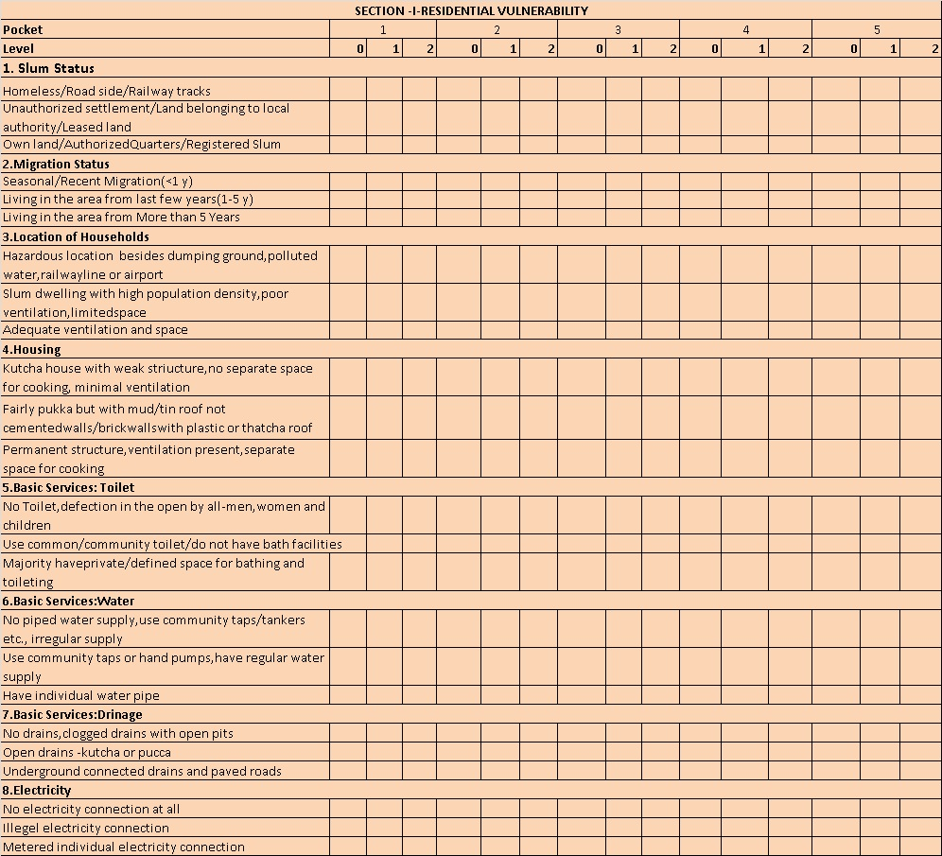
Community Participatory Index for Mapping
Vulnerability Assessment Index Residential Vulnerability
NATIONAL URBAN HEALTH MISSION

Slide 26
Way Forward
NUHM Server
Migrate data from ULBs to a centralized Server
State level Dash board on Monitoring like out break VS action taken
Live Reporting For Nurse, visits recording
Live Disease Mapping
Multi Access for viewers(desk top
Multi Access User App

Slide 27
Implementation partner: Corporation of Madurai, Tamil Nadu, India
Financial Implication: National Health Mission - Project cost of Rs. 8 lakhs, as a pilot project.
Scalability: Can be scalable to entire state with multiple programme/ department compatibility

Slide 28
COST ESTMATE FOR SCALABILITY
Cost of GPS survey for POI, vulnerable pockets mapping , GIS data migration, spatial DB creation per Revenue Ward @ Rs 10,000/- (on the same lines of Madurai)
  For E.g. A corporation with 60 wards require Rs.6 lakhs.
  Includes the cost of one day training session for User group
Out put as .shp/ kmz files compatible as per web server GDB.
One time Cost of creating GIS web server application at HQ to upload all ULB data and monitoring dash board ( excluding hardware for the server ) : Rs. 40 lakh lumpsum
Dedicated GIS engineer for system support @ RS.30,000 per month

Slide 29
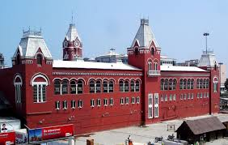
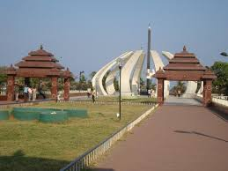


THANK YOU

