Slide 1

Health Technology Assessment in India
Department of Health Research
Ministry of Health and Family Welfare
Government of India

Slide 2
Introduction
1
GoI is committed to extend healthcare services as part of India’s UHC agenda.
Optimal utilization of existing resources to ensure that the greatest amount of health is bought for every rupee spent.
3
A challenge for the government is to devise ways to reduce catastrophic out of pocket health expenditure and ensure affordable access to essential health care
4
Health Technology Assessment (HTA), is a widely used methodology internationally for optimization of resource allocation in health.
2

Slide 3
What is Health Technology Assessment
A multidisciplinary decision-making process that uses information about the medical (clinical), social, economic, organizational and ethical issues related to the use of a HT (such as medicines, vaccines, biologicals, medical devices and clinical interventions) in a systematic, transparent, unbiased, and robust manner. It aims to support the formulation of safe and effective health policies that are patient focused and seek to achieve best value of money and improved patients’ health outcomes.
A tool for evidence based decision making for health care benefits

Slide 4
Health Technology Assessment-Procedure
Efficacy & Effectiveness
Efficacy & Effectiveness
Systematic Evaluation
Value for Money
Value for Money
Choice A
Choice B
Social, Legal & Ethical Considerations
Social, Legal & Ethical Considerations
Equity & Budget Impact
Equity & Budget Impact

Slide 5
Model for HTA
Population to be included
Intervention
Comparator
Outcome
Time frame for assessing
Setting of Interest

Slide 6
Applications of HTA
Streamlining Reimbursement Process
Addressing Calls from User Departments
Developing Standard Treatment Workflows
UHC
Rationalizing Benefit Packages
Efficient Pricing & Procurement

Slide 7
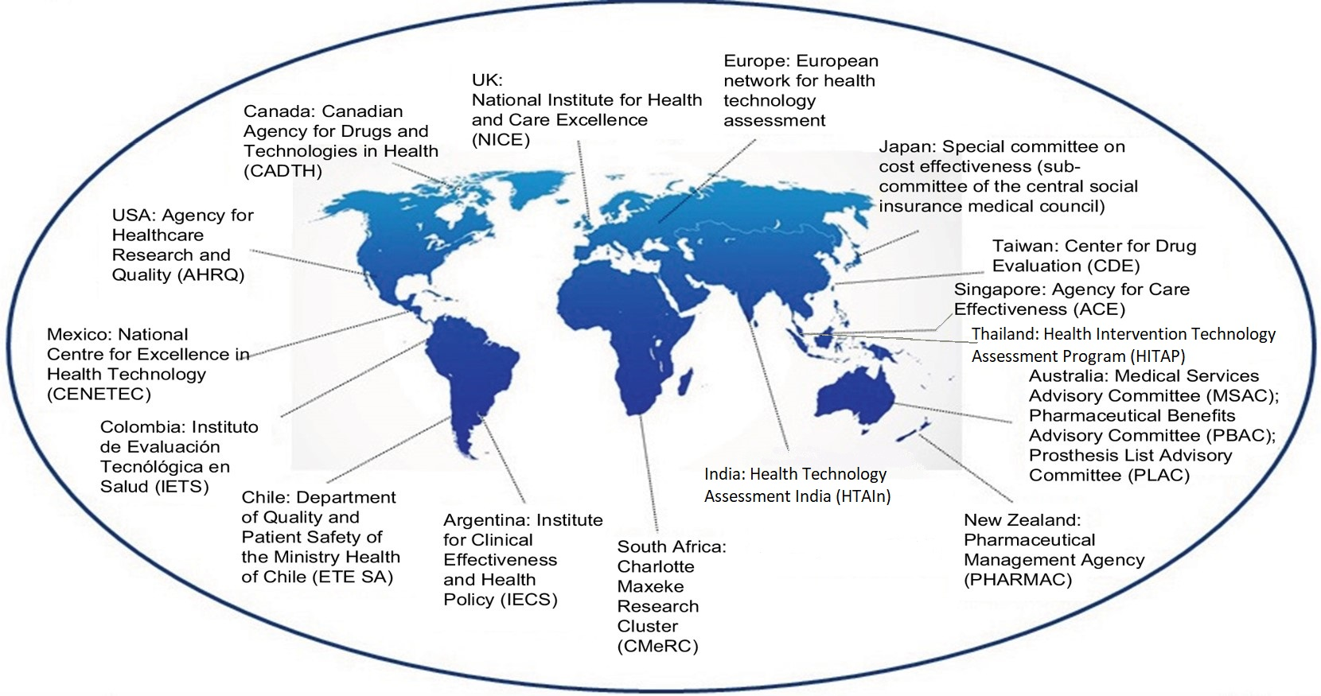
HTA globally
In 2014, the World Health Assembly adopted a resolution on use of HTA to ensure Universal Health Coverage.

Slide 8
Need for HTAIn
The need arose with the 12th Five Year Plan for India by Planning Commission - to take into account 'cost effectiveness studies to frame clinical treatment guidelines‘ and to assess available therapies and technologies
The Parliamentary Standing Committee has also commented that DHR plans to focus on programmes aimed at making healthcare affordable for the poor / marginalized groups/ communities.
The concept note was approved by Hon’ble HFM on 09/09/2016 (F. No. V-25011/476/2016-HR). The board was approved as MTAB board and the division is operational by the name of Health Technology Assessment in India (HTAIn). .
A commitment was made in the Parliament in response to a question raised that 'the need to establish such a board was discussed and recommended by 12th Plan Working Group on Health Research.
The draft National Health Policy, 2015 and 2017 has highlighted the importance of HTA by stating `One important capacity with respect to introduction of new technologies and their uptake into public health programmes is Health Technology Assessment.

Slide 9
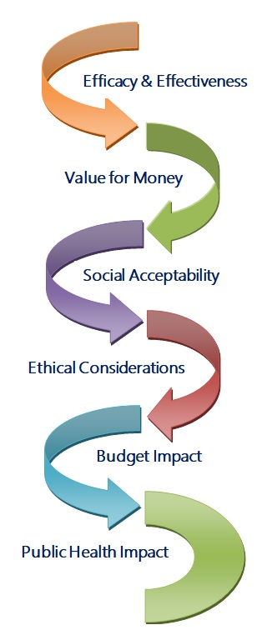
Objectives of HTAIn
Maximising Health – Expanding coverage without compromising the quality of healthcare services.
Reducing out of pocket expenditure - Achieving reduction in proportion of catastrophic households expenditures and consequent impoverishment.
Reducing Inequality - Minimizing disparity on account of gender, poverty, caste, disability, other forms of social exclusion and geographical barriers

Slide 10
HTAIn Structure
HTAIn Secretariat
HTAIn
BOARD
HTA
Project Appraisal Committee
HTA
Technical Appraisal Committee
Technical Partners and Resource Centre

Slide 11
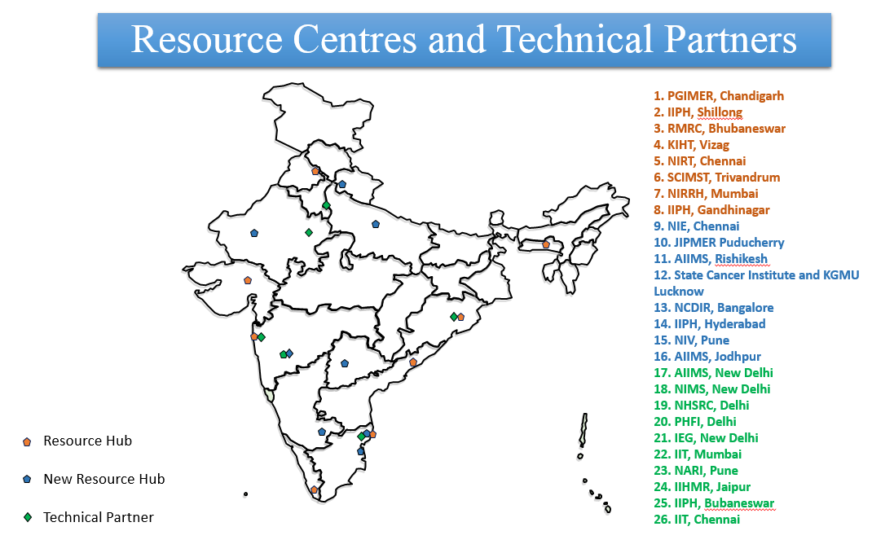

Slide 12
Key Phases of the HTA Process
Topic Selection
Technical partner identification
Proposal development
Research and analysis
Approval by the Board
Appraisal of the evidence
Implementation by the User Departments

Slide 13
Progress of HTAIn from 2017 to August 2019:
16 Resource Centres approved and 8 centres functional
10 Technical Partners established.
16 Technical Appraisal Committee Meetings Conducted
2 Board Meetings Conducted
5 Studies completed and policy brief prepared for disseminations of the recommendations

Slide 14
24 ongoing Studies and 29 new topics received from Central and State Governments of India
A multicentric Costing Study of Health Care Services in India has been initiated in 16 States to support the Ayushmann Bharat-PMJAY.
A multi centric EURO-QOL study for obtaining Quality of Life of Indian Population has been initiated in 8 States
A compendium for 2 year progress, A HTAIn manual and Data repository have been prepared
A website designed for HTAIN (htain.icmr.org.in)

Slide 15
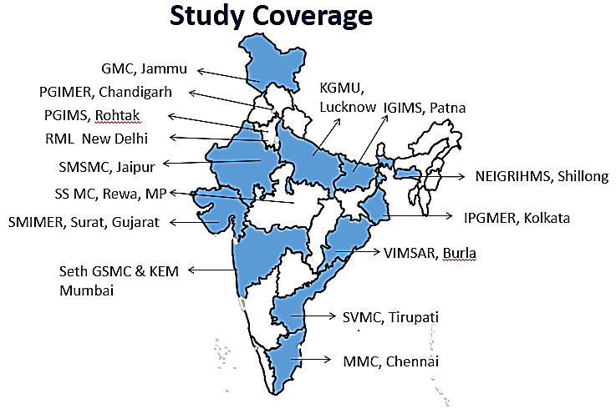
Costing of Health Services in India:
To assess the cost information from different parts of the country, the study utilises the Multidisciplinary Research Units (MRUs) of DHR functional in government medical colleges in different states of India.
This multistate costing study aims to collect cost information from 15 public tertiary medical colleges, 30 district hospitals and 40 private hospitals from across the above mentioned States.
The Costing is used to revise the health benefit packages of Ayushmann Bharat-PMJAY packages.the study has been completed for 855 packages and Phase 2 has been initiated for 493 packagaes
Costing of Health Services – Study Coverage

Slide 16
Methodology: Bottom-up costing methods
Hospital
Care Service centre
Support service centre
Direct Service centre
Indirect Service centre
Ancilliary service centre
Site Management and Service centre
Outpatient clinics
Inpatient wards
Intensive care unit
Operation theatre
Dietetics
Laundry
Medical Records
Water supply
Electricity
Administration
Maintenance
Training
Supervision
Diagnostic centre
Human Resources | Capital | Equipments | Consumables | Non-consumables | Overhead

Slide 17
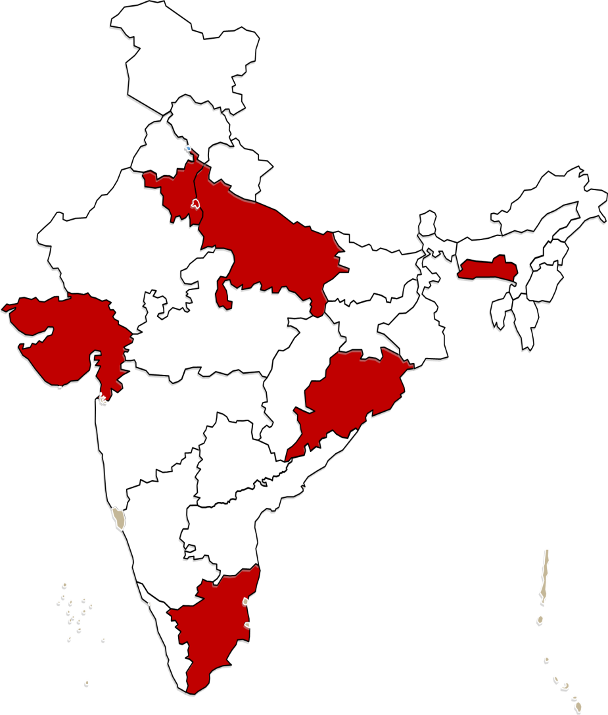
EuroQoL-5-Quality of Life international Study
The present study aims to develop EuroQol five-dimensional (EQ-5D-5L) health states value set for Indian population.
A cross-sectional survey using the EuroQol Group’s Valuation Technology (EQVT) software will be undertaken in representative sample of 2700 respondents.
The respondents will be selected from 12 districts in 6 different states of India using a multistage stratified random sampling technique.
The participants will be interviewed in a face to face setting using CAPI (computer assisted personal interviewing) technique. Time trade off (TTO) valuation will be done using 10 composite (cTTO) tasks and 7 discrete choice experiment (DCE) tasks.
The demographic data will be analyzed by descriptive statistics. TTO values will be modeled using main effects model that will include constant and 20 main effects derived from the EQ- 5D-5L descriptive system, using ordinary least squares (OLS)and tobit models.
The study will give a Health Index Threshold for India
EQ5D : Study Coverage

Slide 18
Studies Completed

Slide 19
Topics Completed
Health Technology Assessment of Intraocular Lenses for treatment of Age-related Cataracts in India – HTAIn Secretariat, Delhi.
Cost Effectiveness of Safety Engineered Syringes for Therapeutic Use In India – PGIMER, Chandigarh.
Health Technology Assessment of Strategies for Cervical Cancer Screening in India – PGIMER, Chandigarh.
Health Technology Assessment of Long Acting Reversible Contraceptives in India – NIRRH, Mumbai.
Health Technology Assessment of Hemoglobinometers-AIIMS

Slide 20
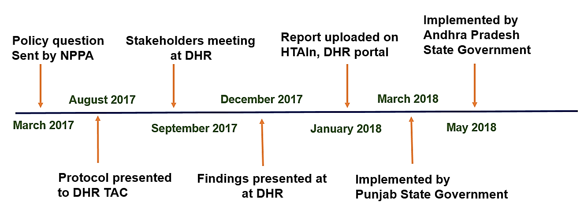
Safety Engineered Syringes
Recommendations
Our recommendations are that RUP should replace disposable/conventional syringes for therapeutic care in India.
The prices of these SES should be reduced either through price negotiation using bulk purchasing, or through price regulation by central agencies such as NPPA.
More future research could be done to assess the cost-effectiveness of SES in combination with behaviour change communication (BCC) strategies which can impact the demand of injections with better sensitization among population.

Slide 21
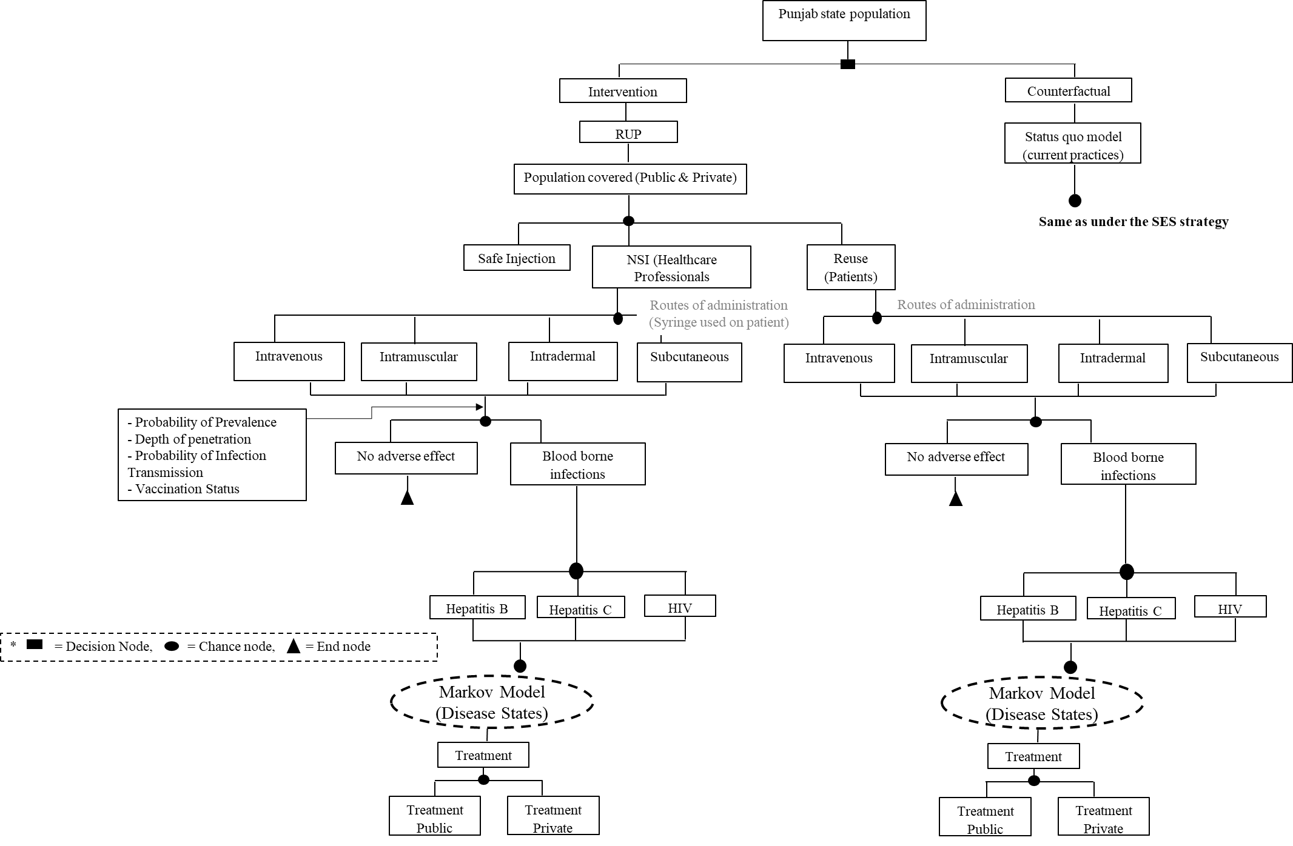
Decision Model
Notes:
AD: Auto-disable- Auto-disabling, single-use needle permanently fixed to a plastic syringe, designed to prevent inadvertent or intentional reuse.,
RUP: Reuse prevention, SIP:

Slide 22
Key Findings for Safety Engineered Syringes
1-Implementing RUP, SIP and RUP+SIP will prevent the new BBIS due to unsafe injections by 96%, 3.9% and 99%, respectively.
2-The introduction of RUP, SIP and RUP+SIP syringes in India will incur an incremental cost of INR 43,064, INR 7,219,687 and INR 209,398 per QALY gained, respectively.
3-RUP has a 93% probability to be cost effective at a threshold of per capita gross domestic product(GDP)).
4-RUP syringe will become cost saving at a unit price of INR 1.9. Similarly, SIP and RUP+SIP syringes will be cost-effective at a unit price less than INR 1.8 and INR 5.9 respectively.
5-At the national level, annual cost of disposable syringes for therapeutic care is INR 3.34 billion (USD 52.6 million). Introduction of RUP, SIP and RUP+SIP incurs an additional cost of INR 10.3 billion (USD 162 million), INR 32.3 billion (USD 509 million) and INR 32.4 billion (USD 511 million) per year. Implementing SES will save INR 4.2 billion (USD 66.2 million), INR 3.07 billion (USD 48.4 million) and INR 4.9 billion (USD 77.2 million) annually with use of RUP, SIP and RUP+SIP, respectively on account of treatment cost averted.
6-The study estimated that if the current injection practices are continued for next 20 years, there will be 99,557, 47,618 and 5,650 new cases of HBV, HCV and HIV, respectively which are attributable to NSI and reuse.

Slide 23
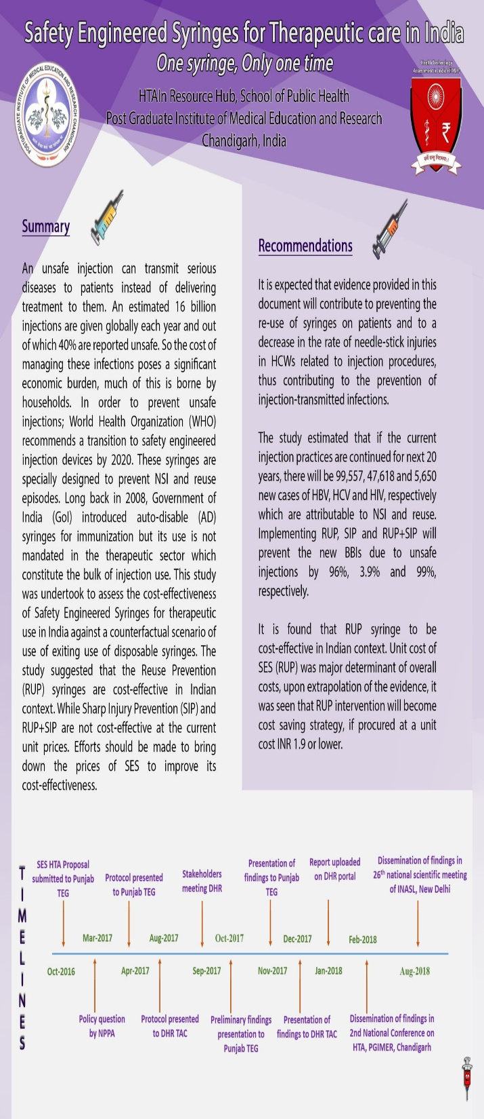
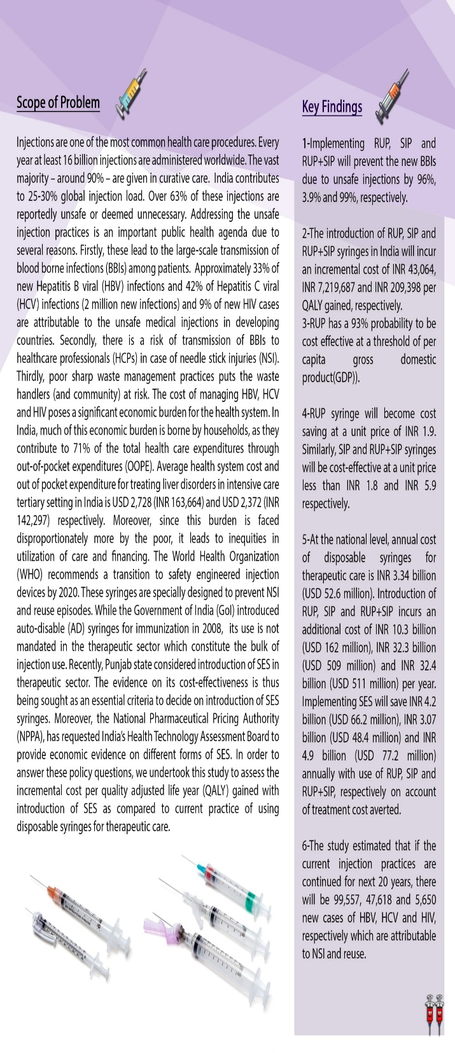
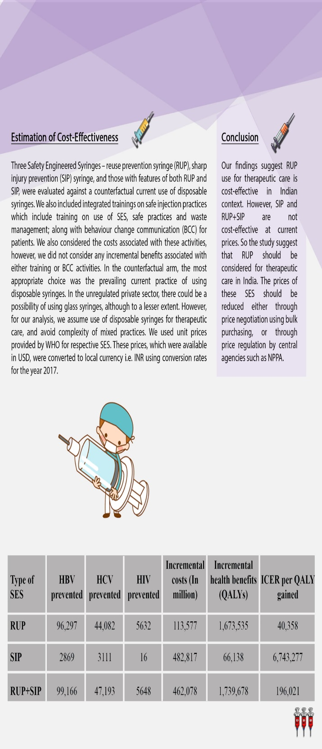

Slide 24
HTA on Intraocular Lens for Cataract Surgery in India
On the basis of clinical efficacy, cost, accessibility, availability and feasibility, MSICS with rigid lens is most appropriate intervention to treat cataract patients in India in current scenario.
Phacoemulsification cataract surgery can be provided in those areas where infrastructure and experts are available for Phaco. surgery.
The benefit packages for Phaco with foldable lens and Small Incision Cataract Surgery with rigid PMMA lenses may cost as 9606 INR and 7405 INR, respectively.
The package is inclusive of initial OPD consultation, diagnostic tests(optometry, vision test etc.), counselling, pre-surgery/ anesthetics, surgery, ward, drugs, medical consumables, lens, food for patient and one attendant and one follow-up visit cost.

Slide 25
HTA on Long Acting Reversible Contraceptives
Addition of Nexplanon to current Family planning scenario in the public health sector of India is found to be cost-effective. It could be considered for program introduction to improve the contraceptive basket of choice in a phased manner. The model shows that larger the proportion of method users, the higher is the cost-effectiveness.
The pre-requisites recommended for Nexplanon introduction into the public health sector of India are to be:
Conducting feasibility and acceptability studies before introducing Nexplanon with due consideration to ethical issues of autonomy and coercion.
Program introduction could be phased top-down from Medical Colleges to 24X7 PHC level manned by Medical Officers (MBBS), as Nexplanon requires surgical removal.
Effective pre-insertion counselling and preparedness for management of side-effects by trained health personnel.
Efficient follow-up and tracking mechanism for users of Nexplanon

Slide 26
Health Technology Assessment of Strategies for Cervical Cancer Screening
Screening with VIA every 5 years among the women of age 30-65 years is recommended for India.
A minimum 30% of screened positive patients are needed to be treated for VIA every 5 years to remain cost effective. Similarly, lifetime risk of cervical cancer of at least 0.7 is required for VIA 5 yearly to be cost effective.
In terms of equity considerations and specifically considering the screening strategy of VIA every 5 years, it was seen that there was around 30% more reduction in cervical cancer cases and subsequent mortality in the bottom1/3rd of the income population group as compared to upper 2/3rd of the income group in India. Similarly, in terms of financial risk protection, bottom 1/3rd of the income group had greater reduction in OOP expenditure (INR 1073 vs INR 770respectively) and more households averted catastrophic health expenditure(520 vs 245 respectively) as compared to upper 2/3rd in the cohort of 1 lakh women screened with VIA 5 yearly.

Slide 27
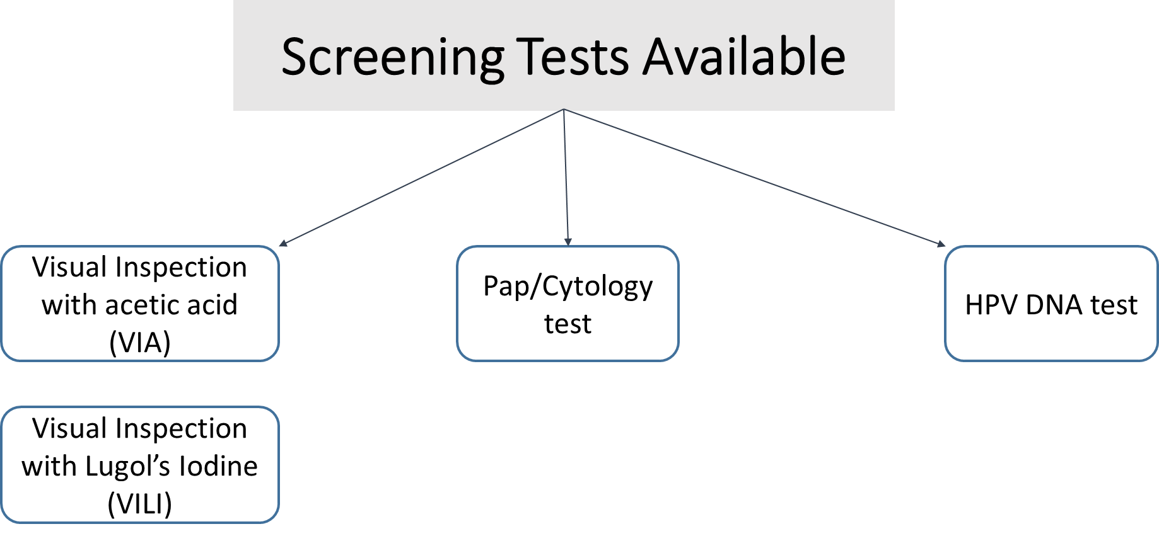
Applications of HTA
Frequency
  3 years
  5 years
  10 years
Selecting Efficient Delivery Platforms

Slide 28
Diagnostic efficacy of digital hemoglobinometer (TrueHb), HemoCue and non- invasive devices for screening patients for anemia in the field settings
Invasive devices shows overall better performance than Non-invasive devices in the field settings.
For screening of Anemia, HemoCue (AUC 0.92, 95% CI 0.88-0.94) and True Hb (AUC 0.85, 95% CI 0.83-0.89) are comparable with no statistically significant difference between the two.
For screening of Severe Anemia, TrueHb (AUC 0.91, 95% CI 0.85-0.97) fares better than all other devices including HemoCue (AUC 0.73, 95% CI 0.67-0.79)
Overall it appears that TrueHb is better than HemoCue in estimating Hb including severe anemia
The cost of True Hb device is less, but the running cost is high as compared to HemoCue. The cost of true Hb device is less but it's running cost is more than hemocue. The running cost to the health system for measuring each test is RS 24.4 in rural areas for hemocue while it is RS 38.7 for true Hb. Considering operational issues, and accuracy across different weather conditions true Hb seems to fare better than hemocue

Slide 29
Studies Approved by TAC
Rapid Health Technology Assessment for incorporating TrueNat as a diagnostic tool for tuberculosis under RNTCP in India
Evaluation of Pulse Oximeter as the Tool to Prevent Childhood Pneumonia related Mortality and Morbidity
Cost effectiveness analysis Hypothermia detection devices (BEPMU, Thrmospot and fever Watch) for pre-mature and low birth weight neonates in India.
Health Technology Assessment of Uterine Balloon Tamponade for Management of Postpartum Haemorrhage in India”
Health Technology Assessment of Portable automated ABR Neonatal Hearing Screening Device-Soham

Slide 30
Ongoing Studies
Breast Cancer Screening
Screening of Hypertension & Diabetes
Mobile Application based health program (TeCHO-plus) In Gujarat State
Sickle-Scan For Diagnosis Of Sickle Cell Anaemia
Real Time RT-PCR For H1N1
Urine Analyzer (Right Biotic)
Automated Portable Blood Analyzer (Shonit/ i-STAT)
Cost Effectiveness Of Community Based Screening Under NACP

Slide 31
Screening Of Hepatitis B & C At PHC In Tamil Nadu
Low Cost Portable Ventilator
Neonatal Resuscitator
PCI Vs CABG For LM Or TVD and PCI Vs. Optimal Medical Therapy For half Vessel Disease
VVI Vs. DDD Pacemakers For Patients With CHB
Inclusion Of Medtronic's ENTraview Device Under The National Programme For Prevention And Control Of Deafness (NPPCD)
Portable ECG Facility at PHCs Of Ahmedabad District Of Gujarat
Burden Of HIV/Patient Load In Private Sector & How To Improve Private Sector Reporting
Home Based New Born Care (HBNC) By ASHA Workers In Select States –An Exploratory Study-ICMR, NIMS, PHFI
Validation Of Optometrists And Cost Analysis Of Glaucoma Screening In Community Based Setting - RPC, AIIMS, New Delhi
Screening for Dengue
HTA for high end equipments
Price Regulation & Value-Based Pricing for Anti-Cancer Drugs: Implications for Patients, Industry, Insurer & Regulator
HTA for Techo +
HTA on portable ECG
29 Cost-effectiveness of administering parenteral iron therapy through Iron-sucrose and Ferrous Carboxyl Maltose for first line management of iron deficiency anemia among pregnant women in a natural program setting at Sabarkantha, Gujarat

Slide 32
Applications of HTA
Inclusion of Interventions in Benefit Package
Selecting Efficient Delivery Platforms
Developing Standard Treatment Guidelines
Regulatory:
Pricing and
Procurement
RUP Syringes for Therapeutic Use
Intra Ocular Lenses for Cataract
Screening for Cervical Cancer with VIA at the Frequency of 5 years
Use of Directly Acting Antivirals (SOF/VAL)
for Hepatitis C
Safety Engineered Syringes
Value Based Pricing of Anti Cancer Drugs

Slide 33
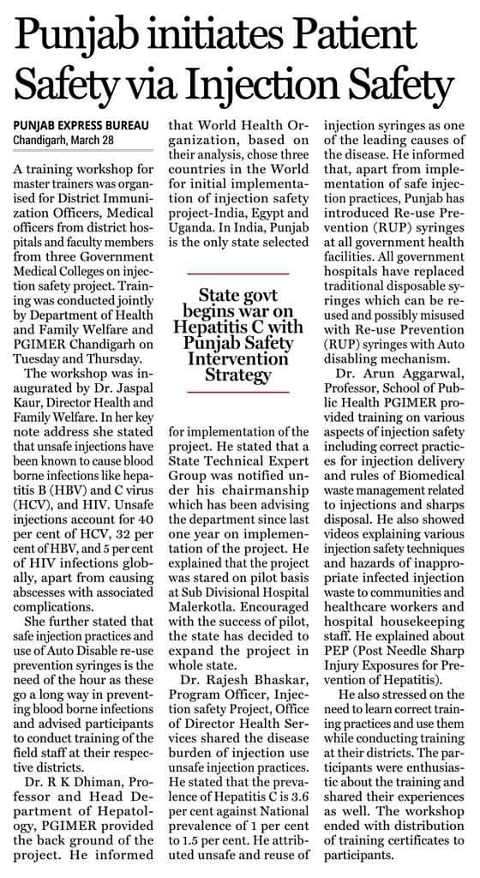
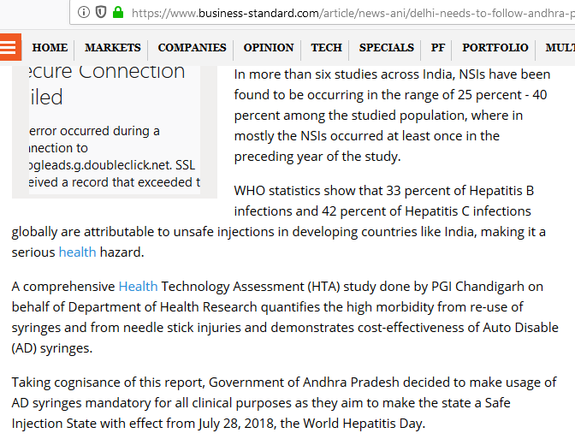
Safety Engineered Syringes
HTA outcome report on Safety Engineered Syringes has been implemented in Punjab and Andhra Pradesh & under the guidelines for National prevention against Hepatitis program

Slide 34
Central/State Participation
22 States have appointed Nodal officers for HTA
Topics Received from States-Maharastra, Kerala, Punjab, Tamil Nadu, Meghalaya, Gujarat
MoU signed with 9 States
Programs like NPCB ,NACO,NPPCD,NPPA have also sent topics

Slide 35
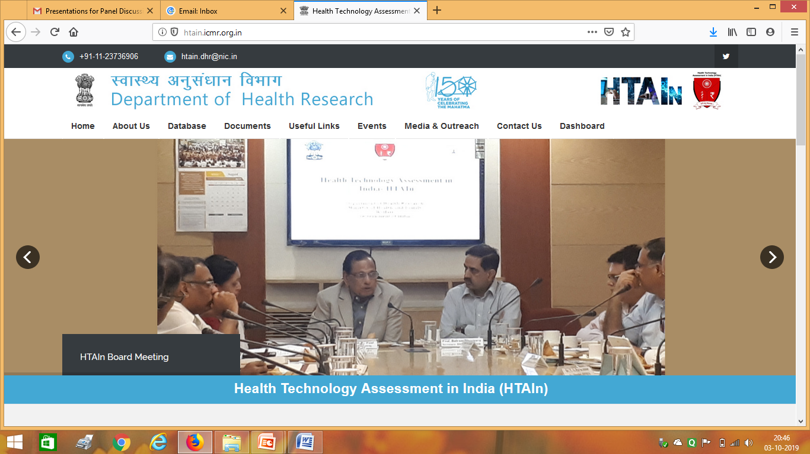
HTAIn Website
http://htain.icmr.org.in/

Slide 36
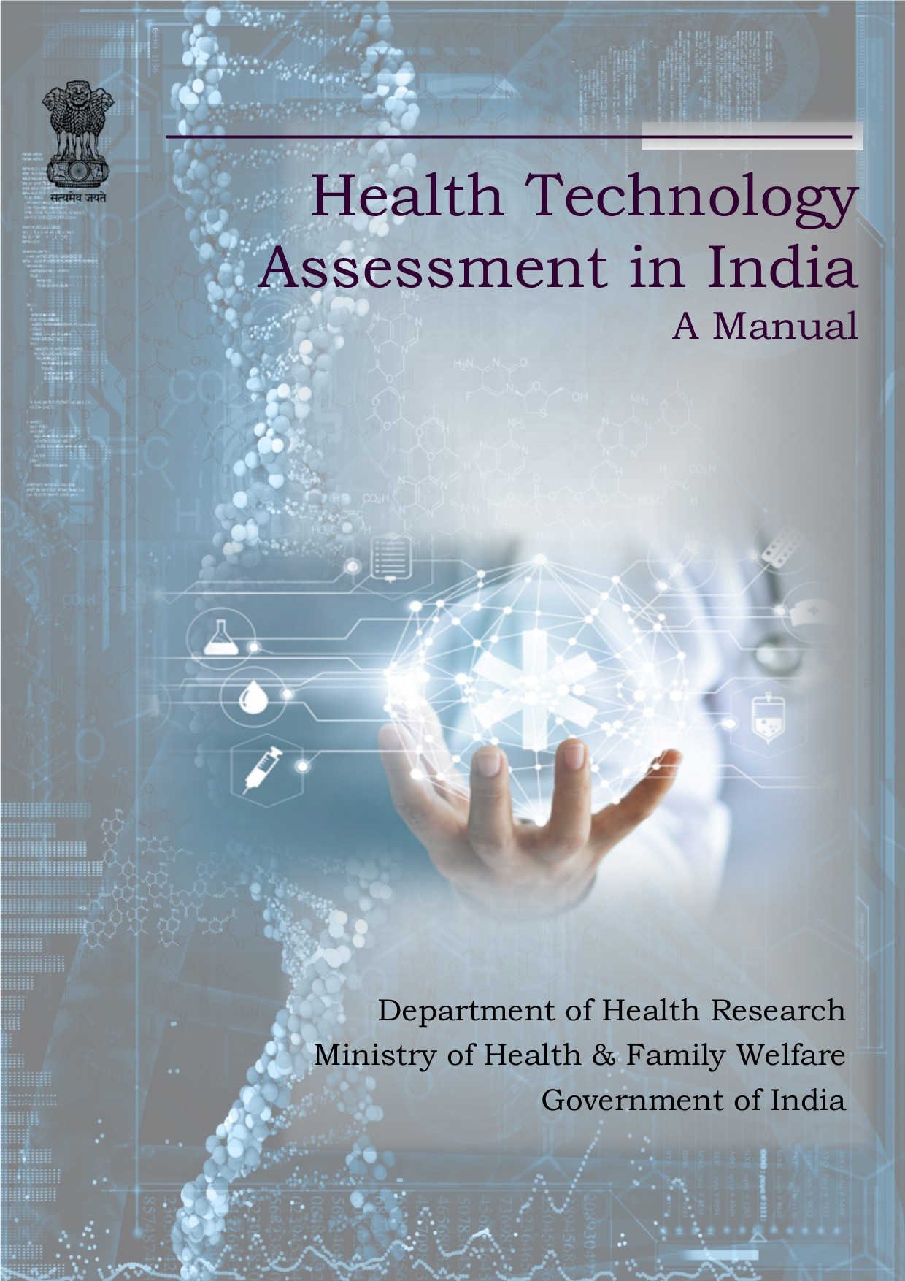

HTAIn Manual

Slide 37
Health Technology Assessment Board Bill, 2019

Slide 38
Need for the Act
An Act to institutionalise the structure and function of the HTAIn body.
It would not only make innovative health tools reach patients faster, but also boost innovation and improve competitiveness of the healthcare sector, which accounts for 10 % of the GDP.
Health technology assessment will inform prioritisation, selection, distribution, management and introduction of interventions for health promotion, disease prevention, diagnosis, treatment and rehabilitation
an opportunity to develop a comprehensive HTA strategy based on an existing foundation.
The establishment of a functioning system will create a policy demand for HTA outputs
HTA outputs may be linked with the explicit decision-making needs of UHC policies
a central finding of gap analysis in the health research domains based on disease burden
New program may be rolled out in priority areas
Introduction on new technologies after due validation at different levels
Budget impact analysis and budget allocation
All points are based on the international best practices

Slide 39
Salient Features of the Bill
The ACT has 5 chapters and 22 sections elaborating
the structure and its functions
the functions and powers of the Board,
Duties of the Technical Appraisal Committees and Secretariat,
procedure for sanction of financial assistance, finance audit/ accounts and miscellaneous.
The power to make rules and regulations

Slide 40
Thank You

