Slide 1

Health and Wellness Centres the first port of call for
Comprehensive Primary Health Care (CPHC) towards “Arogya Karnataka”
National Health Mission
Department of Health and Family Welfare, Government of Karnataka

Slide 2
Arogya Karnataka – Universal Health Coverage
Arogya Karnataka
HR Reforms
DNB, Bidding of Specialists, filling positions - field level functionaries
Comprehensive Primary Health Care
Health and Wellness Centres
Free Drugs
Financial Protection Scheme Harmonization
Free Diagnostics
E-Hospital & Convergence of IT platform
for continuity of care
NHM Karnataka envisions HWCs along with other critical reforms in order to achieve Universal Health Coverage

Slide 3
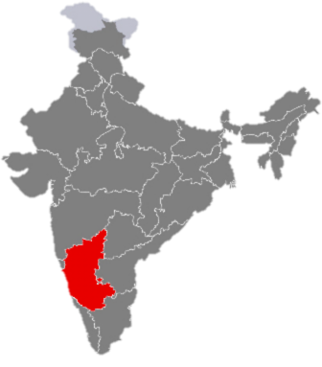

Evidence Led Planning for Health and Wellness Centres
Started in 2015-16 for Piloting Universal Health Coverage in
  Mysore a Non High Priority District
  Raichur a High Priority District
1326 Rural HH surveyed. Assessed for access, expenditure, health seeking, health events
Karnataka
Raichur
Mysore

Slide 4
Baseline Health Status and Care Seeking Pattern
(Source: Assessments and Evaluations by Public Health Foundation of India -2015-16)
Changing disease pattern-Epidemiologic Transition
  NCD* Deaths account for nearly 30- 33% of all mortalities in the districts
  Mortality due to Accident & injuries 3%, infectious diseases -7.4%, Suicides-2%, pregnancy & related causes - 4% and senility - 8% .
Health Seeking was low at PHC level for routine ambulatory care (33% in Mysore; 25% in Raichur)
  85-90% of ambulatory care related to RCH and communicable diseases
29% of Households (HH) reported financial difficulties due to health care**
20% of HHs experienced a catastrophic health event
Regional disparities in distribution of health resources, access, outcomes exist within the state
Parameter | Health Sub Centers (HSC)
Access to HSC | 2 of 3 rural HHs had no access
Rural Mysore | 25% had access 2 Kms distance
Rural Raichur | 40% had access 4.11 kms distance
Reason for not accessing | 51% Not aware about the centre 16% Aware but had no centre
*Cancer, CVD, Diabetes, and Respiratory Diseases, Chronic Liver diseases

Slide 5
Utilization of institution-based services, OOPE, Implications
(Source: Assessments and Evaluations by Public Health Foundation of India -2015-16)
Low uptake of OP and IP care in government facilities
High OOPE incurred accessing care
Annual out of pocket expenditure per HH was Rs 16,189
Catastrophic health events reported by 20% of HH
  25% Rural Raichur; 19% Rural Mysore
  21 % amongst SC, ST HH
  27% amongst the poorest HH; 17% amongst richest HH
Govt
42%
Pvt
58%
Accessing out/in-patient health care services
Out of Pocket Expenditure (OOPE) | Govt in INR | Private in INR
Out-Patient Services | 2,220 | 2,433
In-Patient Services | 11,032 | 30,300

Slide 6
Access and Outreach of Field Functionaries
Reach of ASHAs to vulnerable households is better compared to ANMs
Positioning of Mid Level Health Providers (MLHPs) and operationalizing Health and Wellness Centres would help increase visits by ANMs
Proportion of HHs having ASHA/ ANM in their area
The baseline findings built a strong case to prioritize
HWCs/CPHC for inclusive and equitable distribution of health.

Slide 7
Project Overview
Health and Wellness Centres(HWCs)
Developed through Increased infrastructure and resources for Health Sub-Centres at 5000 population in rural areas
Team of Providers
Graduate Nurses in Addition to Five ASHAs, ANMs and Male Health Worker
High quality training
For expansion of services through Bridge Programme and others
People have free access to
Universal Screening, Prevention and Management of Maternal and Child Health, Communicable, Non-Communicable Diseases in rural remote areas

Slide 8
Step 1 Institutionalizing a Team Led Action
Steps in Implementation of Health and Wellness Centres
as pilots in Mysore & Raichur
NHM, Karnataka
NHSRC and PHFI*
- Technical Partner
Mission Director, NHM
State Nodal Officer
(CPHC-UHC)
State Programme Manager (CPHC UHC)
Consultant(CPHC-UHC)
State Technical Coordinator
District Coordinators
Regional Coordinator
(CPHC UHC)
Undertaking all technical and administrative decisions of the project are
Four Member Technical Committee
Seven member State Working Team for CPHC-UHC
* Public Health Foundation of India Bangalore Unit

Slide 9
Steps in Implementation of Health and Wellness Centres
as pilots in Mysore & Raichur
Step 2: Baseline Measurements
Step 3: Gap Analysis
Healthcare Access-Awareness
Health Accessing Pattern
Morbidity-Mortality
Out of Pocket Expenditures and
System Preparedness - drug availability etc.
Use of findings to plan infrastructure, HR, Equipment.
Health and Wellness Centres with District, Taluk Health Officers
Step 4: Orientation workshops
Step 5: Planning of Budget
Orientation of District, Taluk Health Officers on rationale and objective of CPHC and Health and Wellness Centres
Preparation of PIP- as coordinated action by
District, Taluk Health Officers, Technical Partners and State NHM

Slide 10
Steps in Implementation of Health and Wellness Centres
as pilots in Mysore & Raichur
Step 6 Ensuring Infrastructure & Resources
Buildings and Civil Repair
One room for Mid Level Health Providers (MLHP), Additional Toilet and fittings as per to Type 1 HSC (IPHS)
Type 2 HSC (IPHS) in 5-6 delivery points of Mysore and Raichur for HWCs serving as delivery points
Private rented buildings taken where no government buildings available for HSCs.
Drugs and Equipment
Standard list of Clinical Equipment, Lab Equipment, Furniture, fixtures, Linens and Consumables prepared as per IPHS
Procurement based on HSC wise Needs Assessment
State Norms for Technical and Procurement Specifications by Karnataka Drug Ware House Logistics Society
10% stock of Drugs as per PHC-EDL to be supplied from Jan 2018 onward
(subject to initiation of service delivery)
IPHS – Indian Public Health Standards; HSC - Health Sub-Centre

Slide 11
Steps in Implementation of Health and Wellness Centres
as pilots in Mysore & Raichur
Step 7: Building Human Resources and Skills
Only BSc Nursing/Post Basic Nursing Personnel Identified as Mid Level Healthcare Providers
Good Response and robust selection
  State Planned Local –District Level Selection of candidates
  Selection based on written exam/interview and willingness to serve in rural and remotest areas to ensure minimum attrition and drop outs
Deviation from MoHFW Guidelines
which specify centralized state level selection flexibility of hiring even GNMs

Slide 12
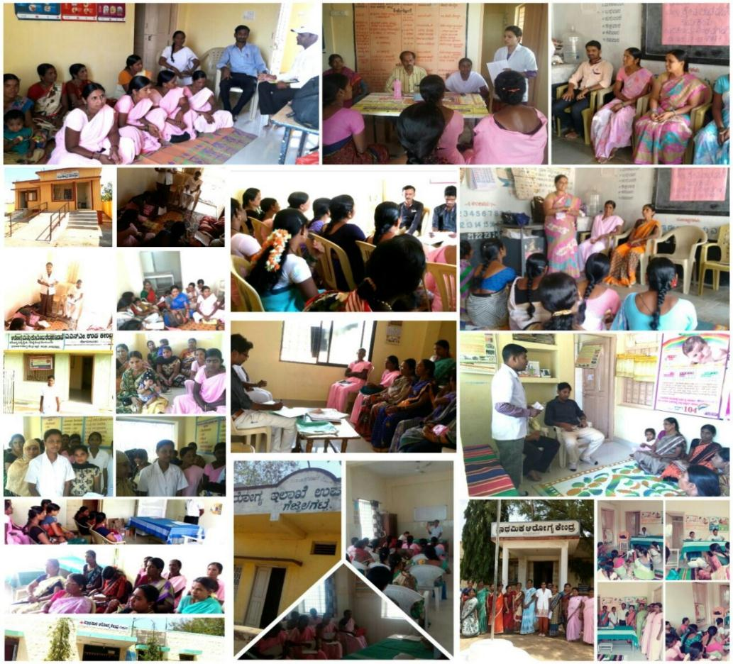
Early Activities accomplished by Nurse
Mid Level Healthcare Providers
Team Building, Orientation Session with ASHAs, ANMs and Gram Panchayat Members on
Roles and Responsibilities of Mid Level Providers
Concept of Bridge Programme
Functions of the Team
Targeted Community immersion & acceptance by existing field functionaries, VHSNC & GP members in 105 HWCs

Slide 13
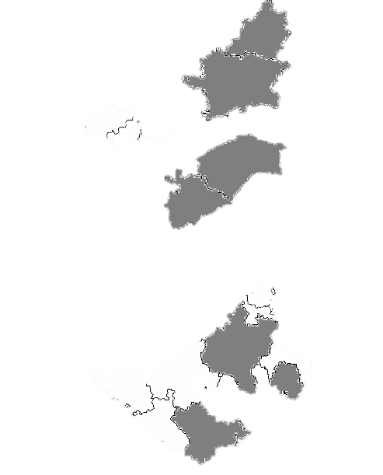
Identification of Programme Study Centers
Karnataka: The only state to harness Medical Colleges as Centre of Excellence in trainings as Programme Study Centres (PSCs) for Certificate course in Community Health.
Bidar Institute of Medical Sciences
Gulbarga Institute of Medical Sciences
Raichur Institute of Medical Sciences
Koppal Institute of Medical Sciences
District Hospital, Tumkur
KC General Hospital, Bangalore
General Hospital, Jayanagar, Bangalore
Mysore Institute of Medical Sciences
Deviation from MoHFW Guidelines
which specify using only > 100 bedded District Hospitals

Slide 14
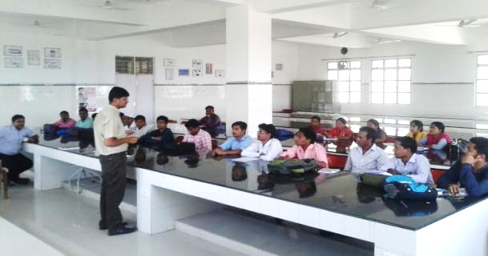
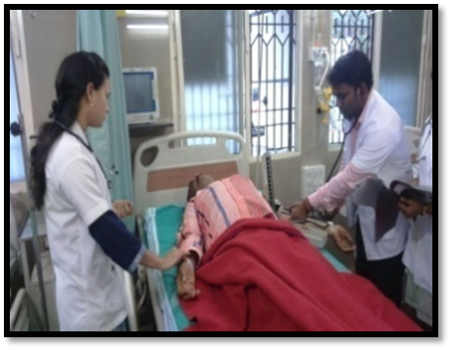
Training under the Bridge Course in Community Health

Slide 15
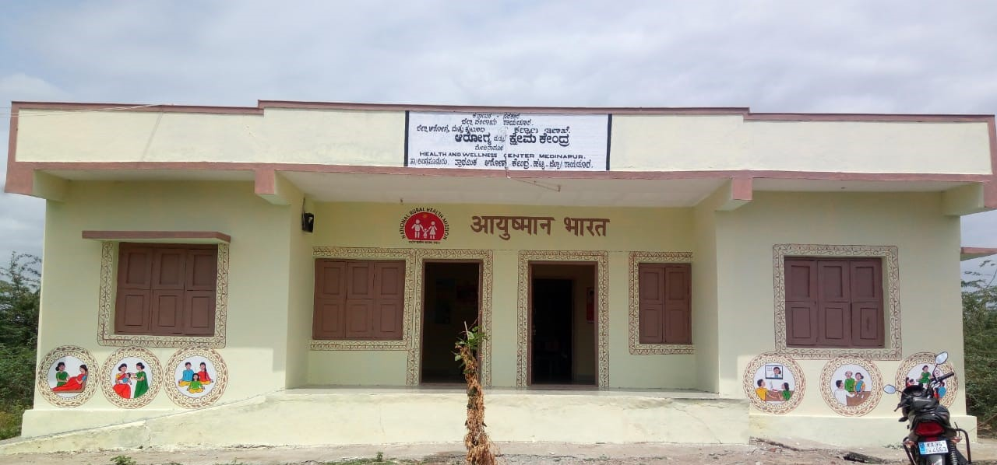
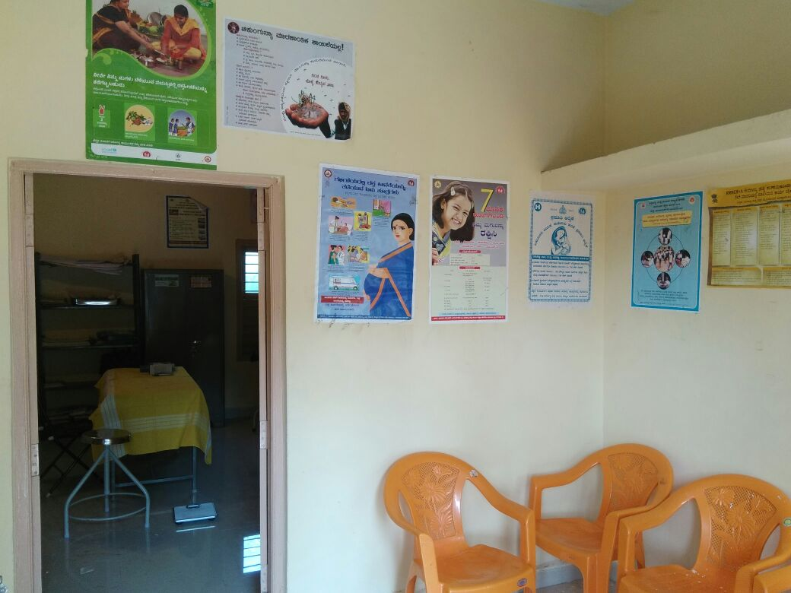
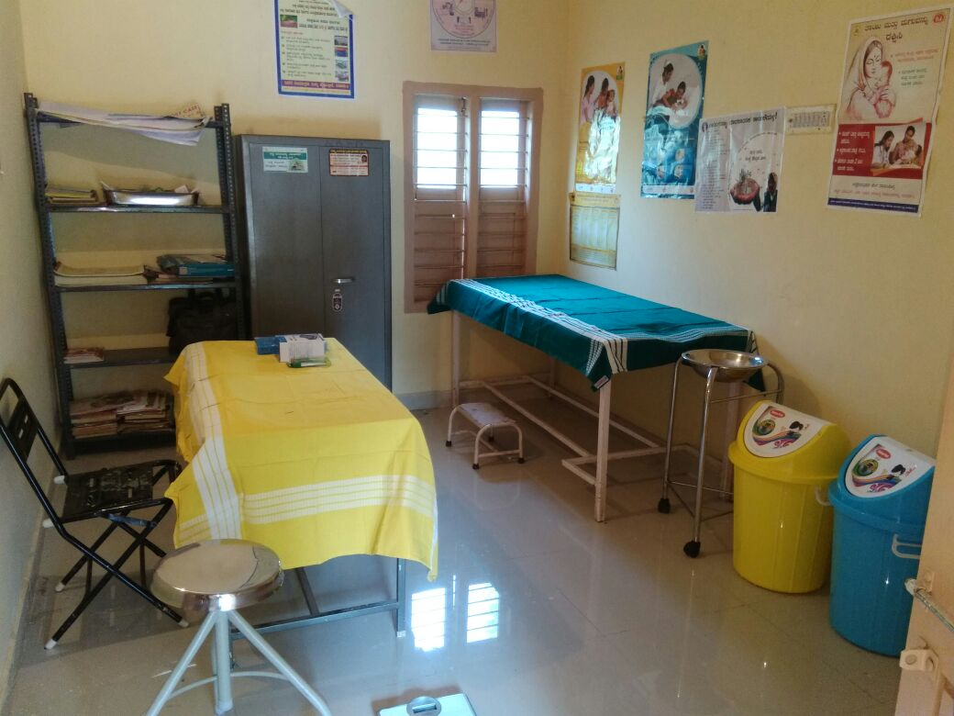
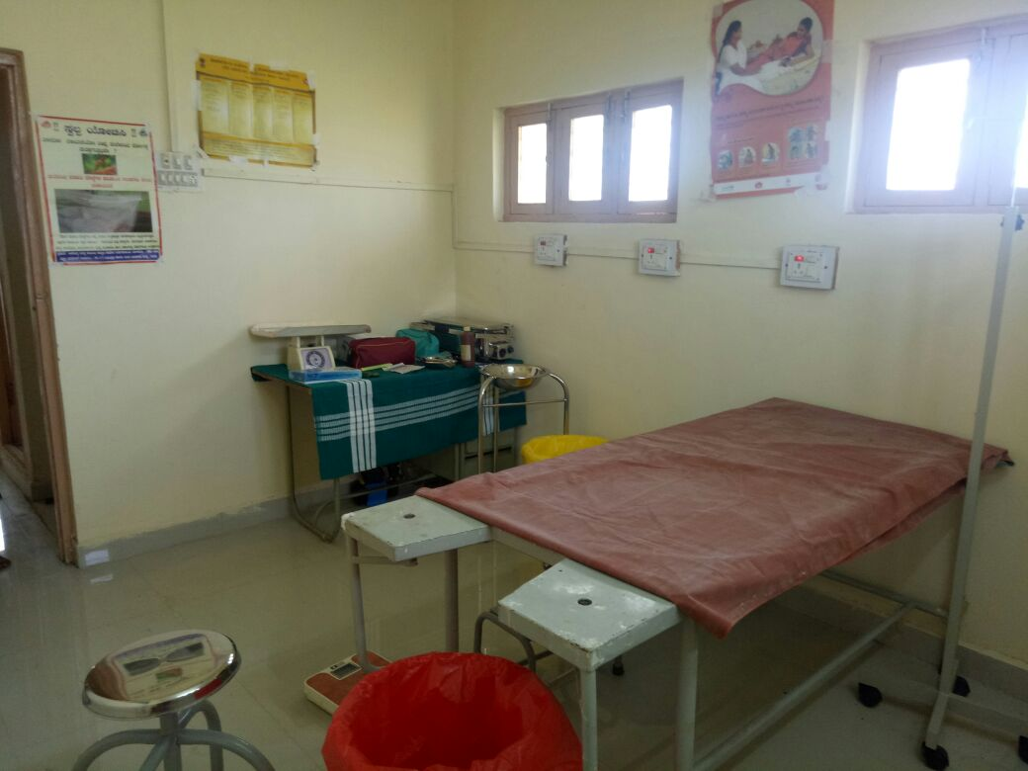
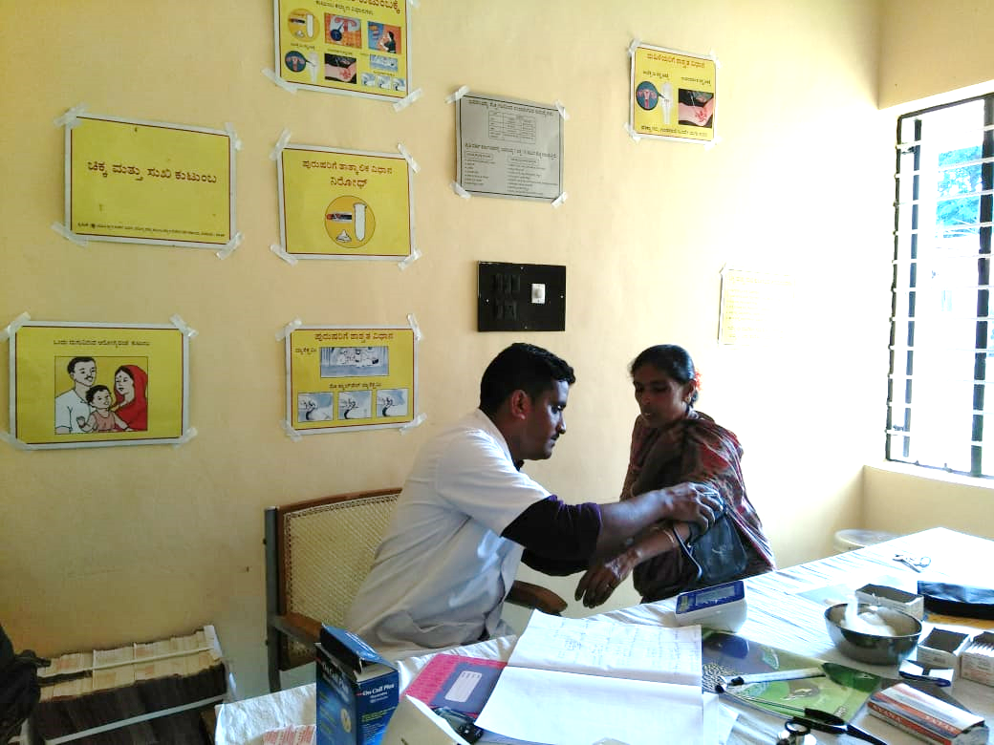
Post- Branding Look- Health & Wellness Centers

Slide 16
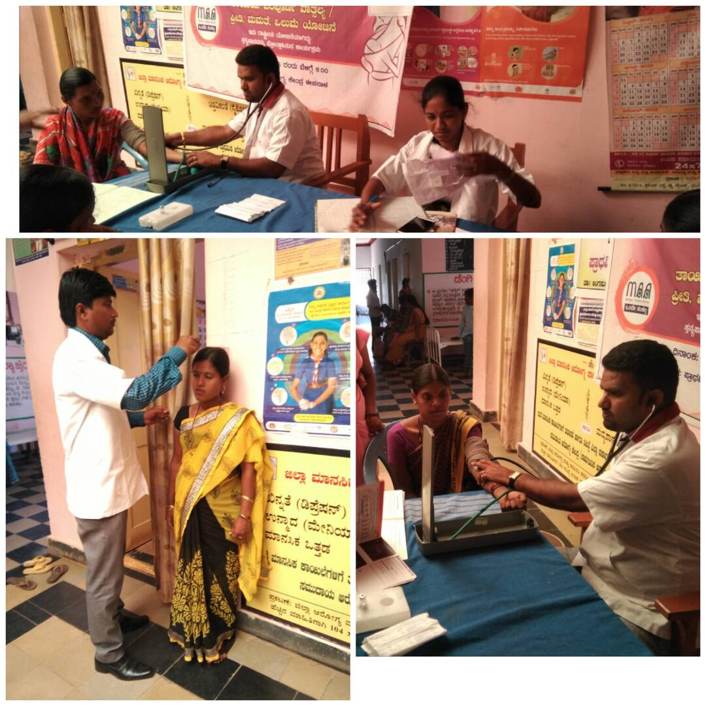
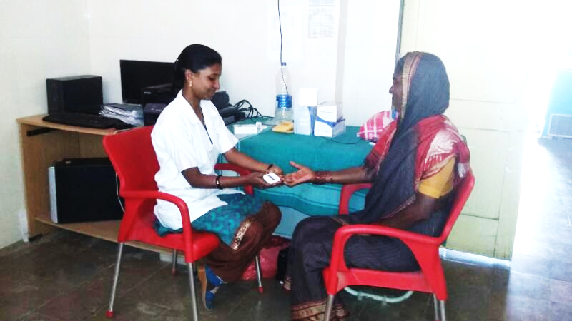
NCD Screening by Nurse Mid Level Healthcare Providers

Slide 17
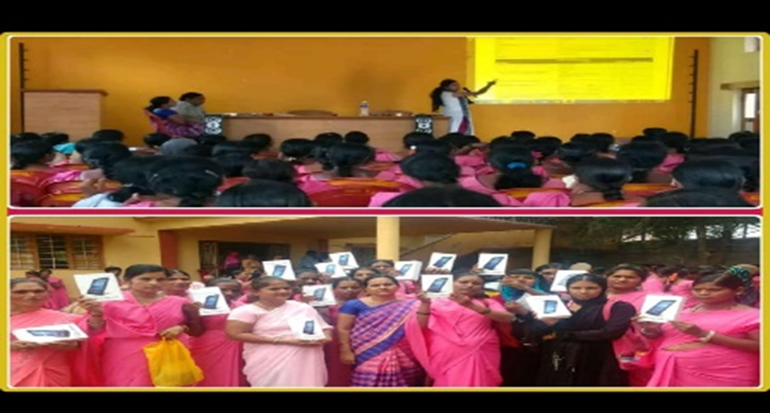
Building Digital Platforms
ANMOL and NCD app institutionalized
Desktops/ tablets and internet connectivity made available at HWCs.
Two representatives from each district given hands-on training by Dell Team who in turn have trained MOs/MLHPS/MPWs in their respective districts.
400 Tablets given to ASHAs and trained on use of digital app for NCD risk assessment.

Slide 18
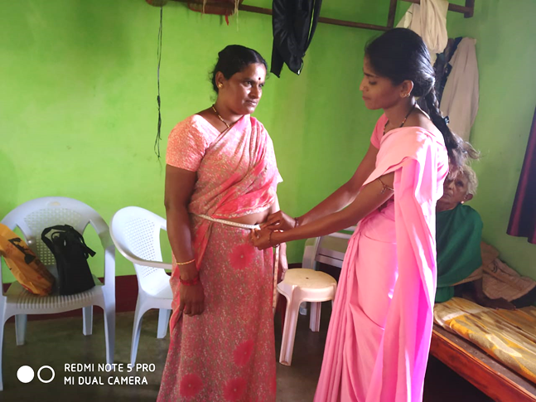
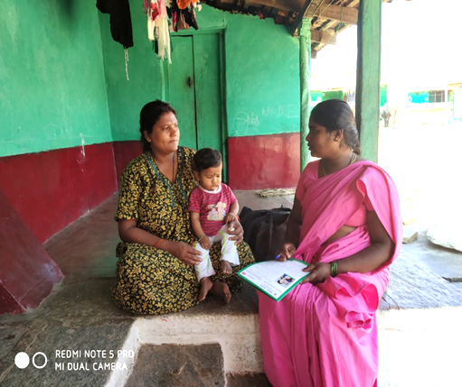
Community Outreach
ASHA
Enabled progress in all Community Outreach activities for HWCs
Community Needs Assessment of population, line listed ~5 lakh persons from 2 blocks
HH visit for population enumeration, risk assessment and distribute folders
HWC team
Patients support groups formation facilitated
School Health Camps, Special Awareness Camps for Tribal, Marginalized population THO supervised
Monthly NCD camps
Involvement in National Programmes

Slide 19
Prioritizing PHC as first referral centers and planning referral pathways
Recruitment of MBBS doctors and Specialists through KPSC
Special efforts to post MBBS MOs in all PHCs and Specialists to Block & District Hospitals of Pilot Districts
At inception only 4/13 PHCs had MBBS MOs; now, 12/13 PHCs of Raichur (Lingasagur Block) have MOs
PHCs serve as first referral centers and specialist consultations are arranged at CHCs and Block Level Hospitals

Slide 20
Arogya Karnataka: Universal Health Coverage for APL and BPL families
(CPHC, Secondary & Tertiary Care Services)
HWC
MLHPs - Treatment/ Referral/ Follow up
PHC
Community
MO – Primary Care/ Treatment/ referral
ASHA/ ANMs- referral/ follow up
Arogya Karnataka
CHC/ GH
Specialist – Primary& Secondary Care Treatment/ referral
Medical College/ Tertiary Hospital
Specialist - treatment
District Hospital
Specialist –Secondary & Tertiary Care Treatment/ referral

Slide 21
Programme Outcomes
Sl no | Service delivery in HWC | Mysore | Raichur
1 | Total OPD Footfall | 2,58,607 | 1,24,227
2 | Reproductive and Child Health (RCH) 1 to 4th packages | 11,416 | 10,777
3 | Common Communicable diseases (includes national programs) 5,6th packages | 63,787 | 29,662
4 | Non Communicable diseases (NCDs) 7th package | 53,452 | 31,880
5 | Mental, Oral, Elderly, ENT, Ophthalmic, Basic trauma care, & additional services 8-12th package | 1,29,952 | 51,908
Progress at the HWCs: 12 Essential Service Packages (February- Sept 2018)

Slide 22
Programme Outcomes
2 | 19 | 17 | 20 | 22 | 22 | 22 | 22 | 22
1 | 4 | 15 | 16 | 17 | 18 | 21 | 19 | 14
Average daily footfall
Month-wise OPD attendance, Average daily footfall at HWCs
in Mysore (T. Narsipura) and (Raichur )Lingasagur Jan - Sept 2018

Slide 23
NCD screening, treatment and follow-up 2K18Q1-Q3

Slide 24
Top 10 Causes of out-patient utilization in HWCs
Sl no | Name of the Condition | Mysore | Raichur
1 | Hypertension | 18.9 % | 13.1 %
2 | Diabetes | 15.9 % | 12.7 %
3 | Joint Pain | 11.3 % | 11.7 %
4 | Body Pain/Myalgia | 9.3 % | 10.2 %
5 | Upper Respiratory Infections | 6.8 % | 4.6%*
6 | Gastritis | 5.7 % | 3.7%*
7 | Fever | 5.6 % | 7.0%*
8 | Headache | 5.1 % | 5.0%*
9 | Skin Infection/Skin Disease | 2.1 % | 3.2%*
10 | Minor wound injury | 2.0 % | 4.5%*
Sl no | Name of the Condition | Mysore | Raichur
1 | Hypertension | 18.9 % | 13.1 %
2 | Diabetes | 15.9 % | 12.7 %
3 | Joint Pain | 11.3 % | 11.7 %
4 | Body Pain/Myalgia | 9.3 % | 10.2 %
Sl no | Name of the Condition | Mysore | Raichur
1 | Hypertension | 18.9 % | 13.1 %
2 | Diabetes | 15.9 % | 12.7 %
* Not according to order of rank

Slide 25
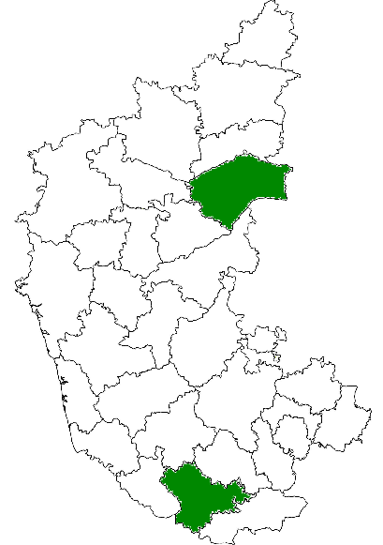
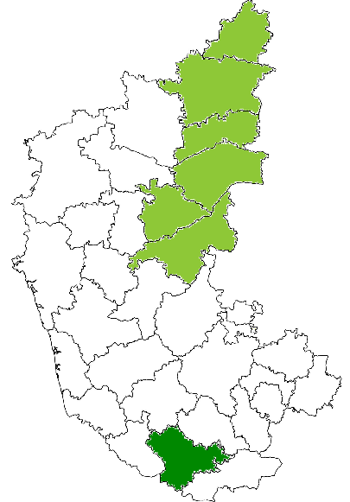
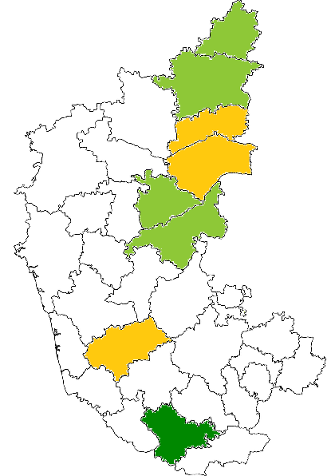
Scale up of Comprehensive Primary Health Care
Pilot phase
FY 2016-17
105 HWCs functionalized
Scale up
FY 2017-18
460 HWCs functionalized
(Aug 2018)
FY 2018-19
Approvals accorded in PIP for 368 HWCs
132 PHCs, 71 UPHCs converted as HWCs

Slide 26
Thank you

