Slide 1
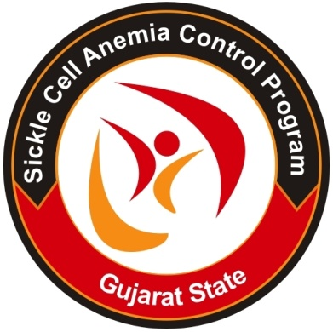
Prevention of Hemoglobinopathies
Health & Family Welfare Department, Gujarat
In co-ordination with IRCS,Gujarat

Slide 2
Hemoglobinopathies-
A Genetic Disorder
Model developed as per guideline of MoHFW, GoI
Yearly 10-12 thousand children with β-thalassemia major(prevalence 3-17%) and 5,200 with Sickle cell disease(prevalence 5-34%) are born in India
Gujarat have 14.8% tribal population having high prevalence of Sickle cell Disease and low accessibility to health services.
Few communities (Lohana,Sindhi) in Gujarat have high prevalence of Thalessemia. (prevalence around 4-15%)
Reducing burden of Hemoglobinopathies, through Screening, Early Diagnosis, Prompt Treatment and Counseling for preventing transmission of disease to next generation.
Minimize morbidity, mortality and thereby increasing productivity, longevity and quality of life
8

Slide 3
Program components
Reduction in crisis & in mortality
  Regular follow up , counseling
  Supportive treatment
  Life saving drugs & Vaccination
  Day Care Center
  Advanced tertiary care centers
  Care during pregnancy
  Regular Training and capacity building of
    Health care providers
    VHSNC (Gram Sanjeevani Samitis) members & Teachers
Early diagnosis through
  Screening-Newborn ,Adolescent Premarital and Antenatal
  Cascade screening and School screening.
  Prenatal Diagnosis
  Prevention through
    Marriage Counseling
    Genetic Counseling
    Building Community Awareness

Slide 4
Program in Gujarat
(92%) tribal population screened for Sickle Cell, 7. 30 lac are Sickle Cell Trait and 29,266 are Sickle Cell Disease.
All SCD patients are given Tab Folic Acid,
More than 21000 SCD patients received pneumococcal vaccine and
Around 700 patients are on Tab Hydroxyurea to minimize the risk of crisis & death
All diagnostics for hemoglobinopathies are Free.
4700 Iron chelation, Factor A free.
50 Bone marrow transplantation. Difficult to get donors. Some siblings and unrelated matched donors were helpful..

Slide 5
Program in Gujarat
In last year , more than 1.10 lakh ANC screened- 2737 ANC were Sickle Cell Trait and 126 were Sickle Cell Disease.
Total 11995 couple counseled for prenatal diagnosis - 892 PND done. From which 195 Thalassemia Major and 12 were SCD , which undergone for MTP. thus total 207 birth with hemoglobinopathies could be prevented.
More than 1.2 lakhs New Borne screened. Out of which 6600 were thalassemia minor, 9 were Thalassemia Major and 145 were SCD

Slide 6
Special Features of the program
Reaching needy and most vulnerable population through active involvement of NGOs and community. Program is now fully integrated with General Health Services ensuring wider reach and long term focus.
Sensitization and awareness building resulted in demand generation from the community.
Lifecycle approach.
Pre natal Diagnosis
Regular Counseling at doorsteps of beneficiaries
Capacity building of both Government , NGO and private practioners.
Disease patient registry and ensuring regular medical check up of disease patient

Slide 7
Learning
Scientific approach, strong political commitment and inter-sectoral convergence reducing disease burden and medical relief to patients.
Blood storage unit in every Taluka provides free blood transfusion to all patients with hemoglobinopathies.
Advanced stem cell research center and Stem Cell Research Laboratory is being established at New Civil Hospital, Surat with collaboration of GIOSTAR, USA.
The scientists’ team from Japan extending help in the research activity.

Slide 8
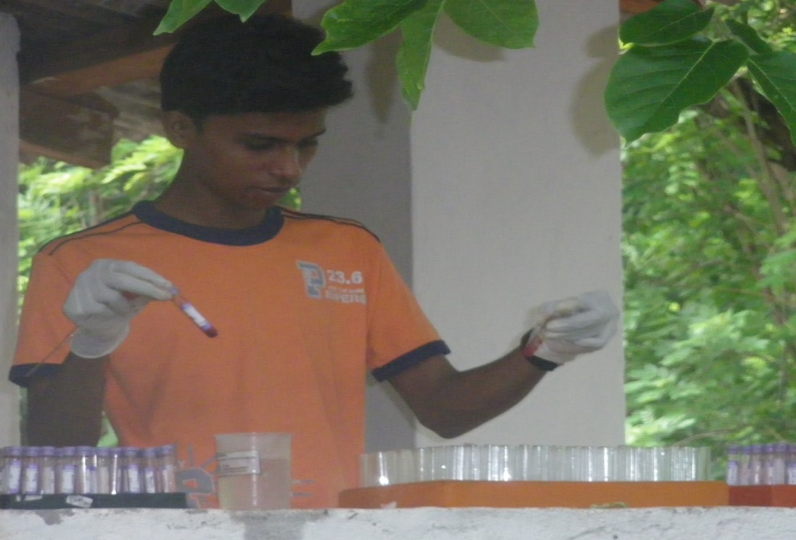
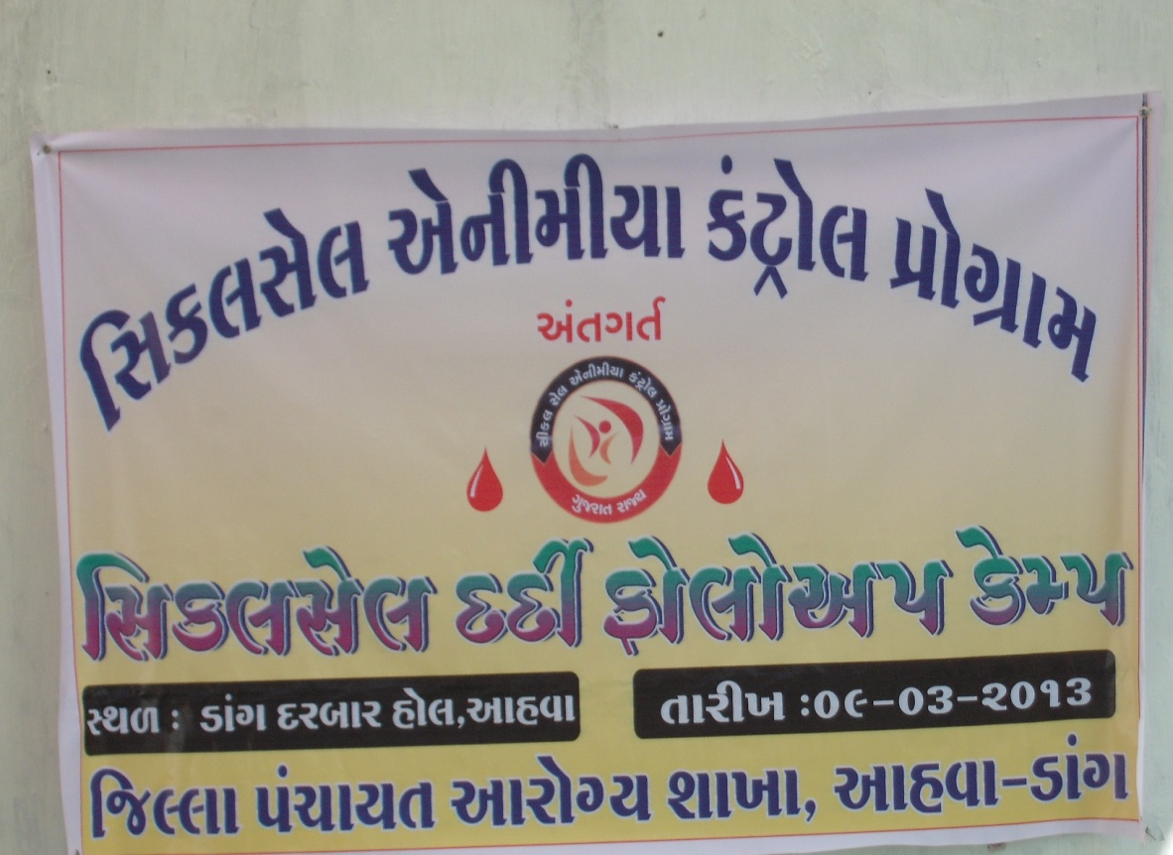
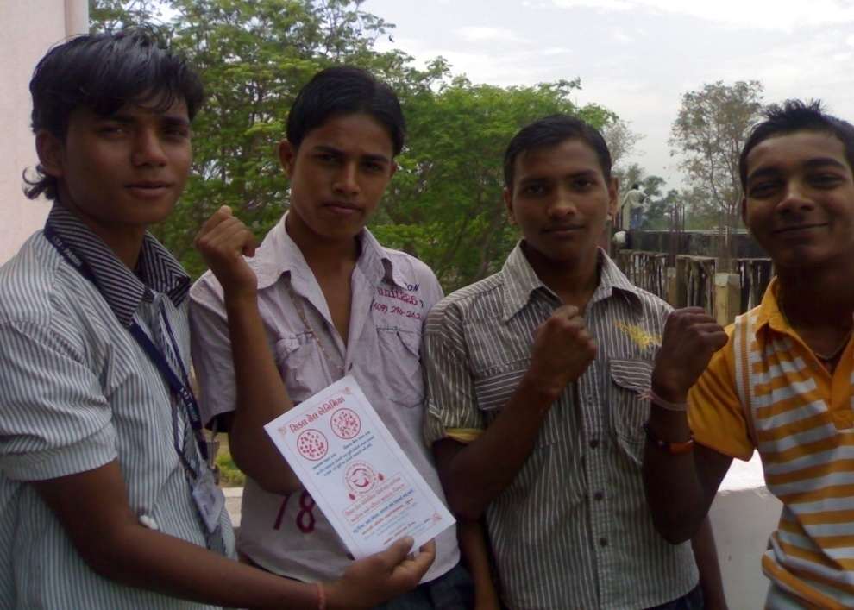
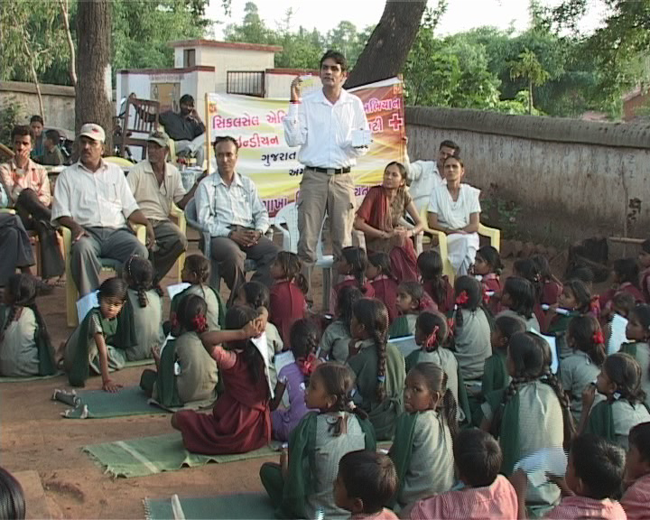
Sickle Cell Screening Camp at Village Level
SCD Follow up Camp at Village Level & Counseling

Slide 9
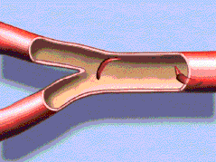
SCA requires Priority Attention….!
Indian patients with hemoglobinopathies
Born with Pain
Live with Pain
&
Die with Pain.
They hardly Complain
No more children to be born with hemoglobinopathies in Gujarat
Thanks…

