Slide 1
Department of Health and Family Welfare Chhattisgarh
Human Resources
Management Information System
Presented by
Mrs. Niharika Barik, IAS
Secretary – Health & Family Welfare, Govt. of Chhattisgarh

Slide 2
What is HRMIS?
Human Resource Management Information System or HRMIS - HR software that combines a number of systems and processes to ensure easy management of human resources, business processes and data
This project captures information of employees of health department.

Slide 3
Software
Advance Data Security. (Server in NIC)
All Your Information is in One Central Place.
Reduce Human Error.
Eliminate Majority of HR Paperwork
Communicate More Effectively
Access at your Fingertips Anywhere, Anytime
(Multifarious uses-Various reports, Leave, pay slip, transfer application etc.)

Slide 4
Modules
Employee Registration
Setup Masters
Designation Master
Salary Module
Transfer Module
Leave Module
APR Module
Logins – Registered Employee, CMHO, DHS, District Accounts Manager etc.

Slide 5
Registered Employee Login
Every registered employee on joining gets an unique ID from the department through e-kosh software
Login with the use of his/her employee ID
Employee can update his/her personal profile information with this ID and password
Forward to the reporting office
Employee can print and keep information for their own records

Slide 6
Registered Employee Dashboard
Profile Up-dation
Objection Raise
Transfer Apply
Leave Apply
Annual Performance Appraisal
Salary Slip Print

Slide 7
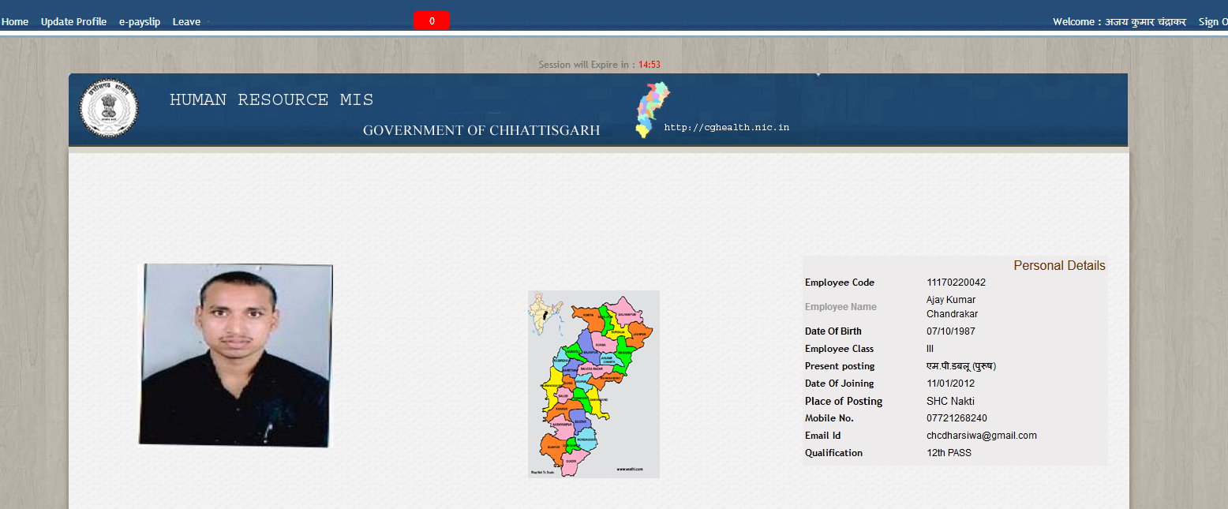
Registered Employee Dashboard

Slide 8
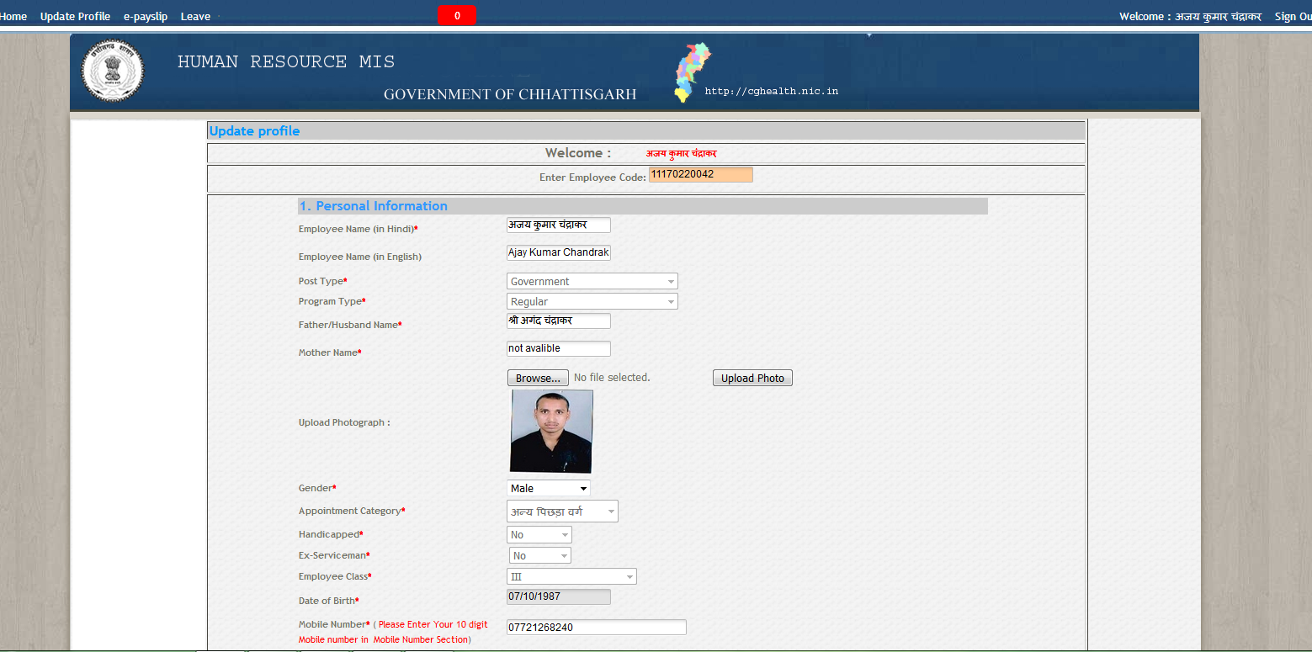
Registered Employee Profile Update

Slide 9
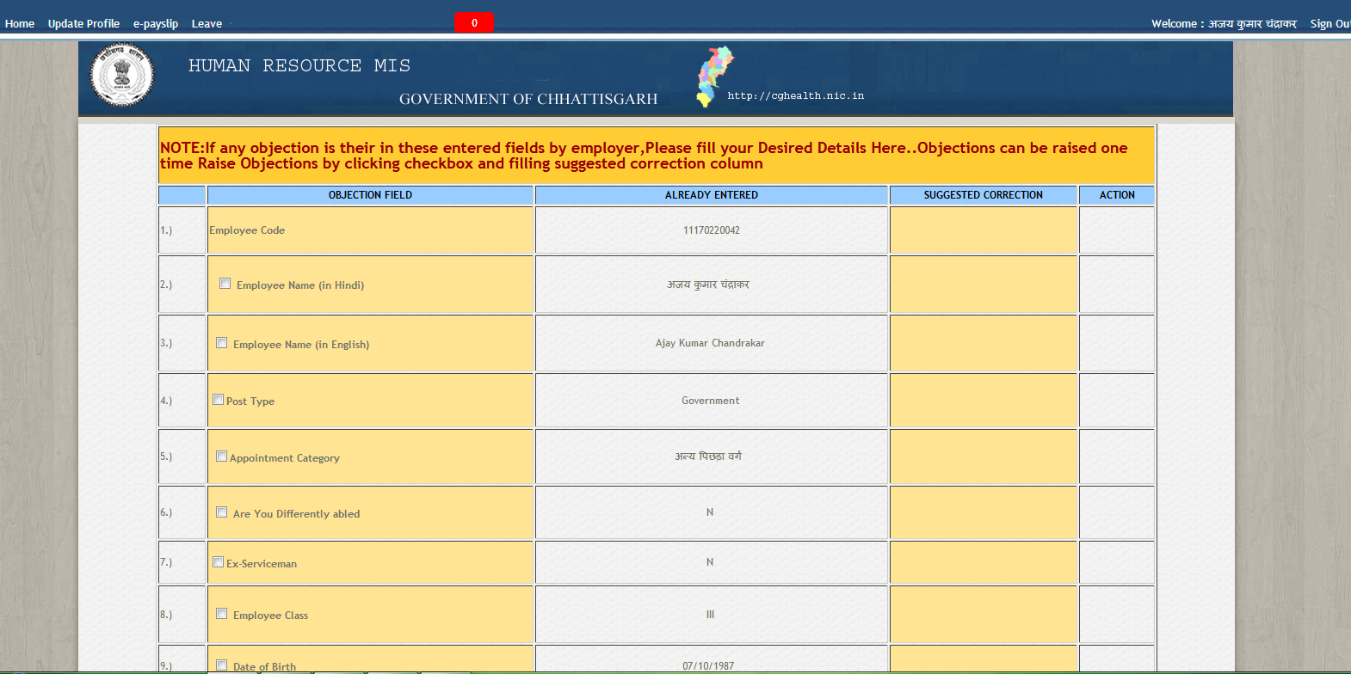
Registered Employee Profile Objection Form

Slide 10
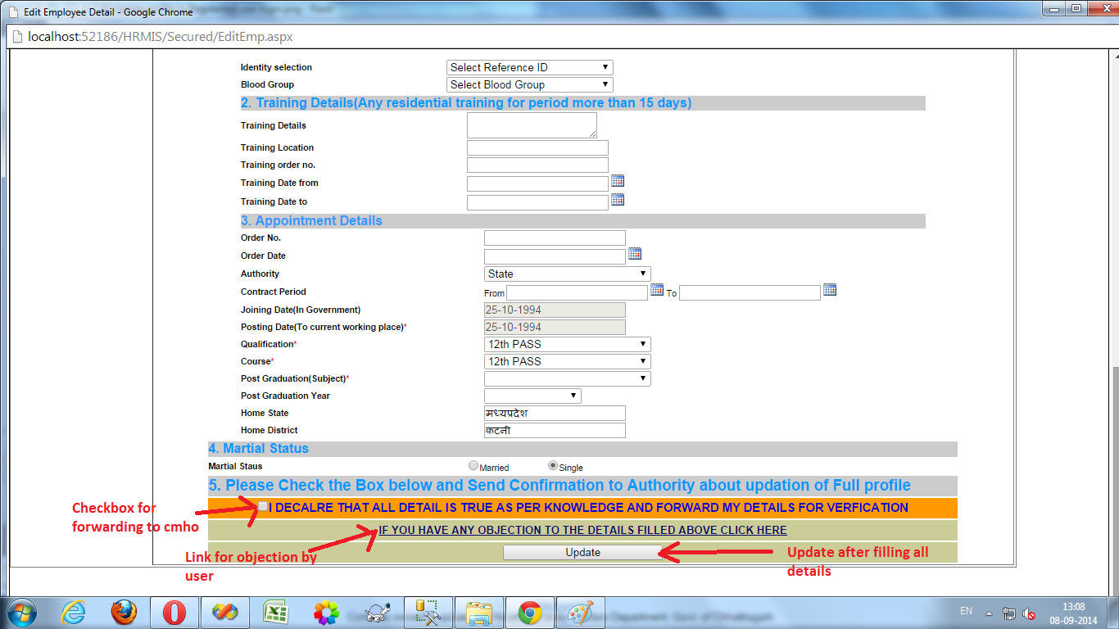
Registered Employee Objection Raise/Update

Slide 11
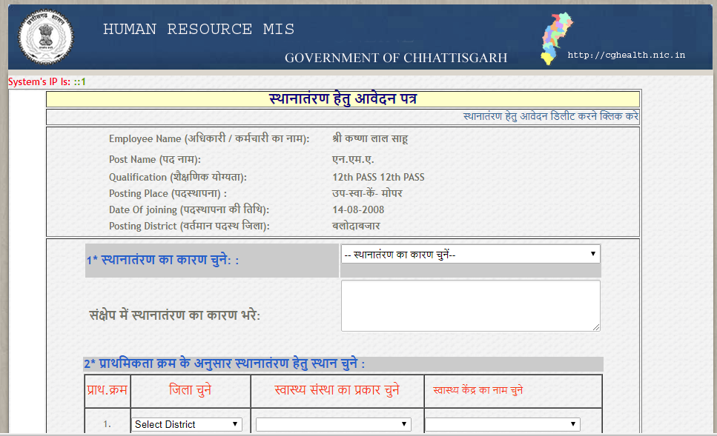
Registered Employee Transfer Application

Slide 12
Registered Employee Leave Apply

Slide 13
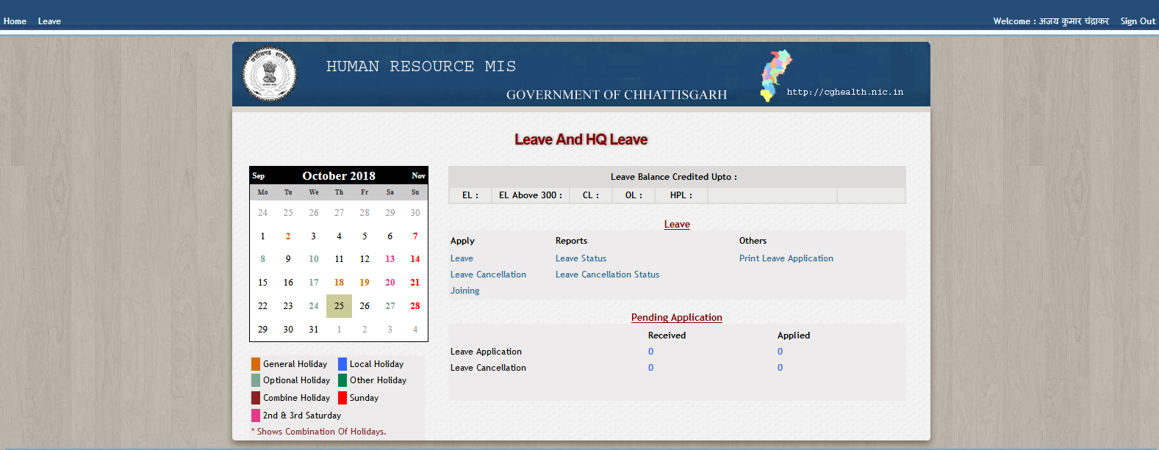
Registered Employee Leave Dashboard

Slide 14
Contractual Employee Annual Performance Appraisal

Slide 15
Registered Employee – Salary Slip

Slide 16
Institutional Setup covered
DHS
Class 1
Class 2
CMHO
Class 3
Class 4
NHM
NHM staff state and district positions (salary>35,000)
NHM district positions (salary<35,000)

Slide 17
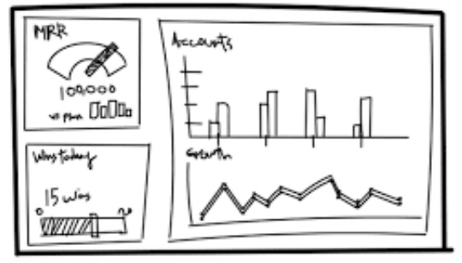
CMHO Login
Dashboard
CMHO dashboard has the summary of all information. It has employees up-dation of profile, objections raised and cleared status
Set-up verification
The CMHO Login can check the Setups of institution and add regular and contractual employees working on these setup

Slide 18
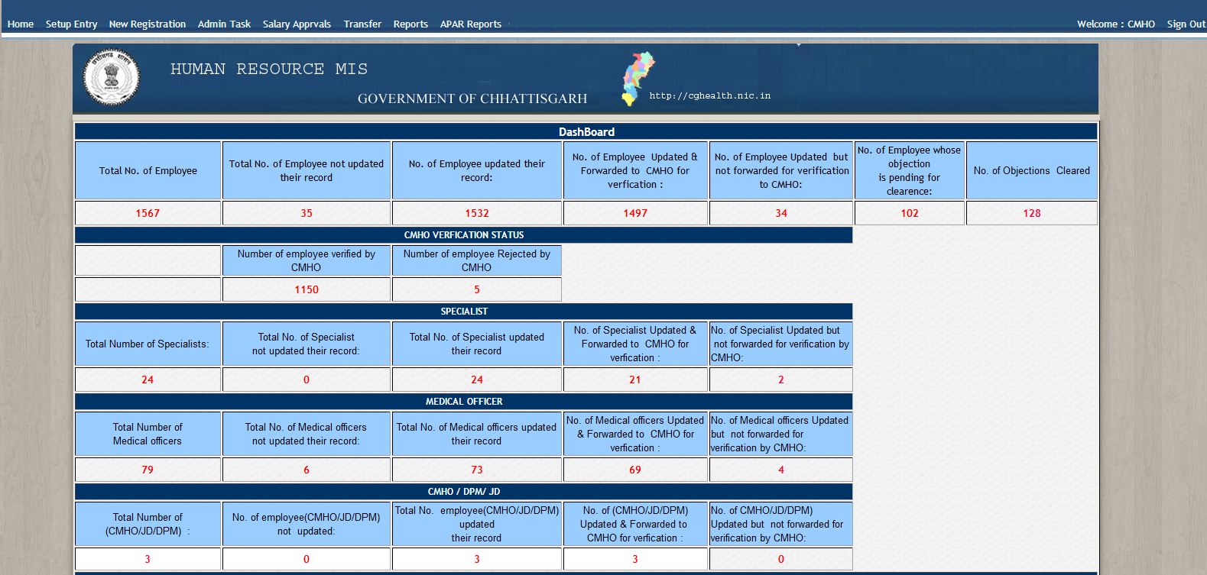
CMHO Dashboard

Slide 19
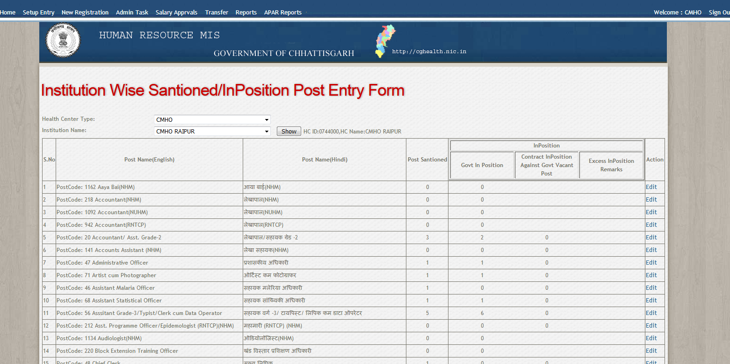
CMHO Setup Verification

Slide 20
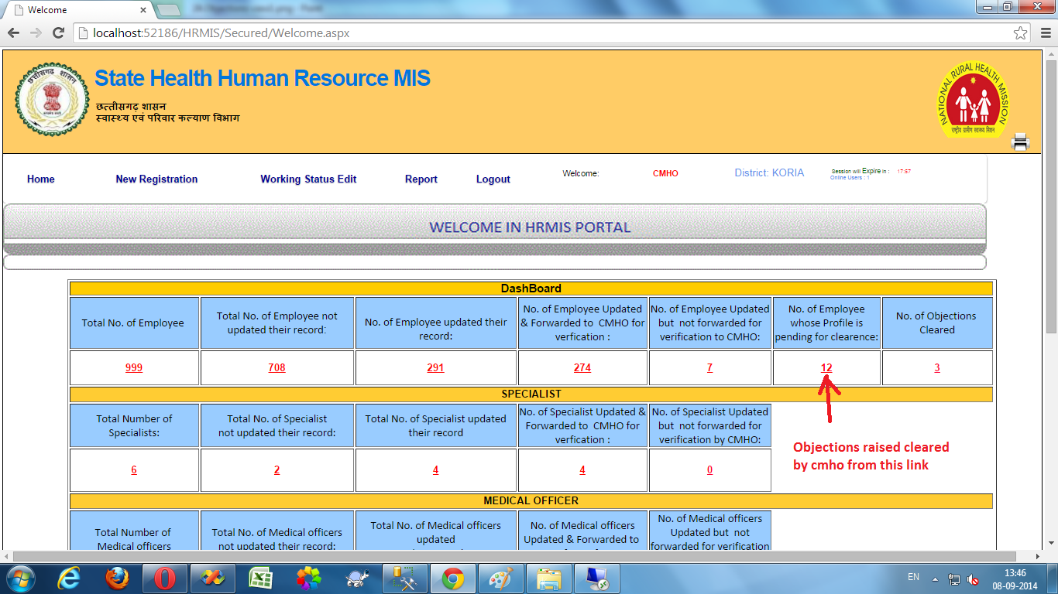
CMHO Objection Clearance
Some fields in the employee profile cannot be edited, for eg. Place of posting. Then the objection is raised by the employee and is checked and cleared by CMHO login with verification from service book.

Slide 21
Transfer module
All applications for transfer are received at DHS and CMHO login
Additionally CMHO login has an option for recommendation of administrative transfer,
CMHOs/CSs can choose an employee and ask DHS to transfer to a particular location
Various reports are required by CMHOs/ CSs

Slide 22
Report
Search Employee
DDO Code Wise Report
In-position/ Vacant Report
Employee Detailed Report
Designation Wise Report
Institute Wise Report
Basic Salary Report
CMHO Verification Status
Other Reports
Death/ Retired/ Other Status Report
APAR Report
Transfer Request List
Transfer Report

Slide 23
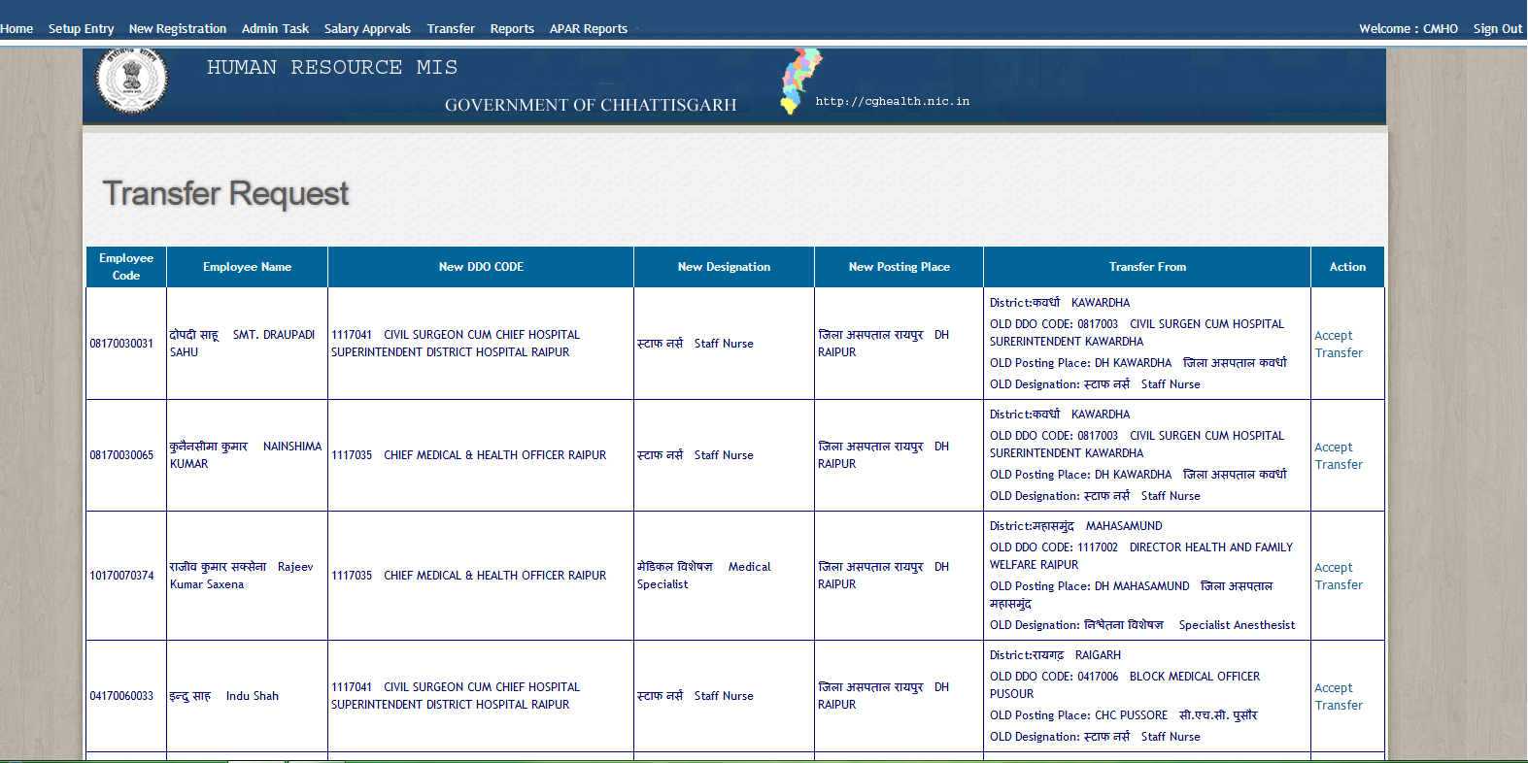
Report -Transfer Request

Slide 24
Benefits / Uses
Rationalization of NMH staff. (150 NHM posts)
Transfer application registration. (11,340 application received of DHS employee in 2018)
Loyalty Bonus distribution. (3028 NHM employees in 2018)
Salary preparation of NHM employee. Pay slip generation.
Annual appraisal of NHM employee. (7639 NHM employees in 2018)
Recruitment – vacancy status.
HR data availability for PIP and other project/training.

Slide 25
Way Forward
CRMC (Hardship Incentive) performance calculation and incentive payment.
District Mineral Fund (DMF) and Rogi Kalyan Sameeti’s employee module.
Inclusion of DME, AYUSH, CFD and CGMSC employees.
Link to
TMIS (Training MIS)
Biometric attendance
Supportive supervision

Slide 26
Department of Health and Family Welfare, Chhattisgarh
Human Resources
Management Information System
Presented by
Mrs. Niharika Barik, IAS
Secretary – Health & Family Welfare, Govt. of Chhattisgarh

