Slide 1

ICT enabled (99DOT) free access to TB drug for
private sector patients in Rajkot
(TB free project Gujarat)
Dr. Suresh G. Lakkad,
District TB officer, Rajkot
Gujarat
Notes:
ICT enabled intervention project is currently running in Rajkot district of Gujarat state where technology support is provided by 99 DOT which is an innovation of Microsoft research.

Slide 2
Problem statement
Private sector is dominant in Gujarat especially in urban area
Out of pocket expenditure is high for private patients
Patient unwilling to approach Government health facility for treatment initiation
Objective of intervention
Drugs
Easy access to Govt. drugs
Adherence support
IT enabled Treatment support
Public Health Action
HIV screening
Diabetes screening
DR TB screening
Patient counselling
Notes:
The challenge for the Revised National TB Control Programme in Gujarat is involving dominant private sector. Health care seeking behaviour in community is skew towards private sector though the out of pocket expenditure is high for TB diagnosis and treatment. All the services for management of TB disease is free in Government sector, even though, community is unwilling to approach Government health facility not even for treatment initiation.
Intervention was planned to provide easy access to government free drugs for private patient with inbuilt adherence support by 99 DOTs. Additional objective was to offer HIV screening, Diabetes screening and DR TB screening for those who are eligible. Patient counselling is one of the important intervention.

Slide 3
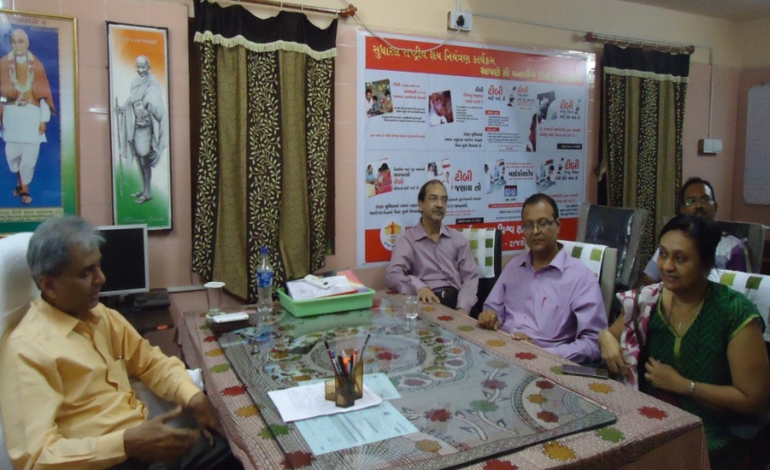
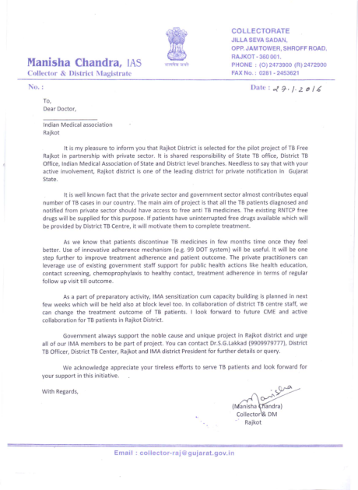
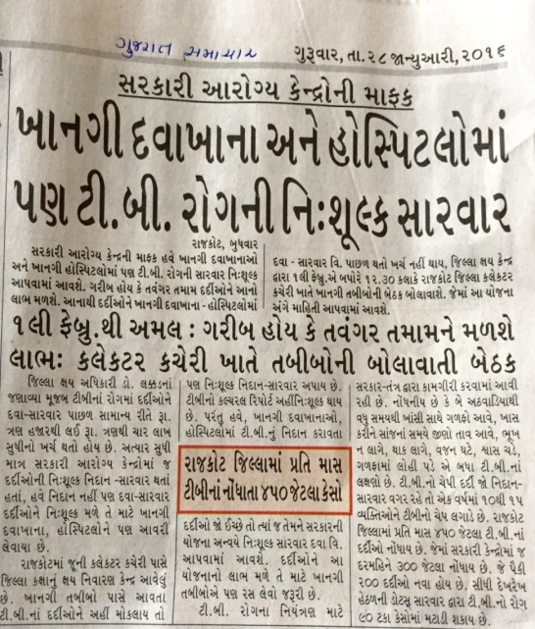
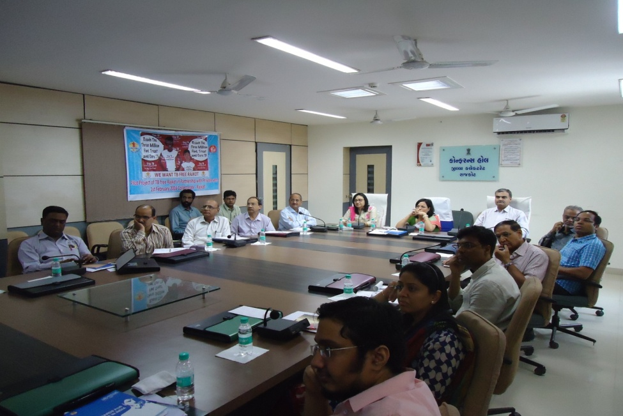
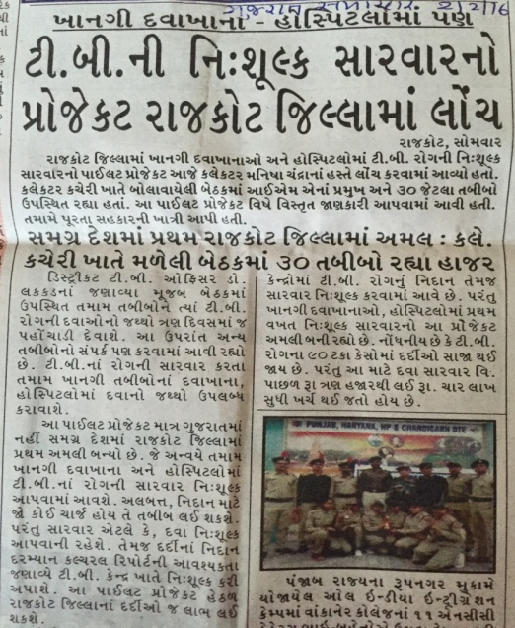
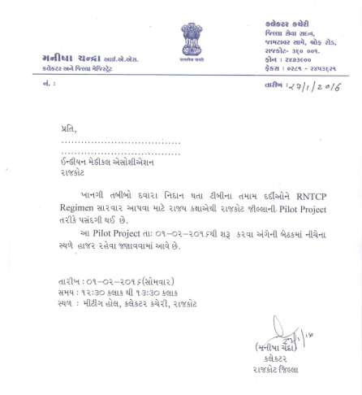
Preparatory activities - 99 DOTS
Advocacy meeting with district officials
Personal visit to practitioner
Letter to all PP from DM
Media coverage
Launch on 1st Feb’16 by
District collector Rajkot & IMA president
Invitation to IMA & NGO
Notes:
Preparation was began with advocacy about the intervention at all district level officials including DM, DDO and Chief District Health Officer. Lots of personal visit was carried out to sensitize private practitioners. Formal invitation was circulated to selected PPs for launch of project by District collector and IMA state president. This news was circulated in media to create wider awareness. One to one session with private practitioner was the main course of intervention to explain the model and involve them.

Slide 4

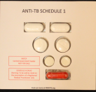

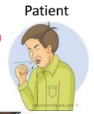






Model of intervention for empowering private patients
Counselling before treatment initiation
Free Monthly dose
8
2
Private practitioner
Presumptive TB case
1
3
5
4
TB notification
Free drugs
Public Health action
Private/ MOU / Public
Laboratory
9
Monthly supply as per requirement
District TB center
RNTCP staff
Notes:
Model of intervention is composed of providing government TB drug to the private practitioners to prevent delay in treatment initiation. When the presumptive TB case approached to private sector, practitioner will do the diagnosis of TB disease with the help of laboratory and radiology. Once the practitioner confirm TB diagnosis, he is suppose to notify patient details to TB center and patient will be offered government drugs wrapped in 99 DOTS blister. Patient is expected to take medicine at home. Practitioner will brief patient about the 99 DOTS and inform Project coordinator to explain further detail to the patient. RNTCP programme arrange the patient home visit at patient convenient time. Date of follow up visit is decided by treating practitioner.

Slide 5



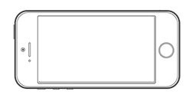
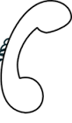
99 DOTs intervention- Toll free number
Daily reminder for missed dose
Daily / weekly reminder for missed dose
Server
Notes:
Now, I would like to brief how the mechanism of 99 DOTS works. You can see the blister of TB drug wrapped in 99 DOTs envelop. Once the patient take out tables from the blister, a hidden number will be appear from the back side of pill. Patient suppose to give a call on appeared number which is toll free number so even without balance also he can call to the number. Phone can be made from landline as well. Once the phone connected with server patient dose is registered with the system and phone gets disconnected after saying ‘Thank you’. Daily SMS generated by system for the patient if patient is not registered for that day dose. Similarly one massage is sent to the treatment observer on set frequency either daily or weekly. Treatment observer is expected to follow it up and ensure that day dose. Thus, system is able to generate, alert at the earliest possible time to take corrective action.

Slide 6
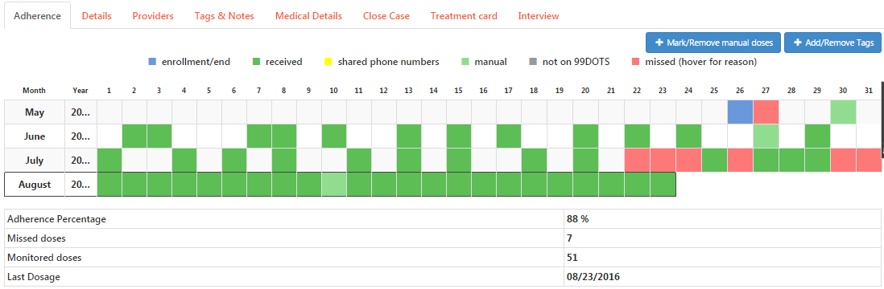
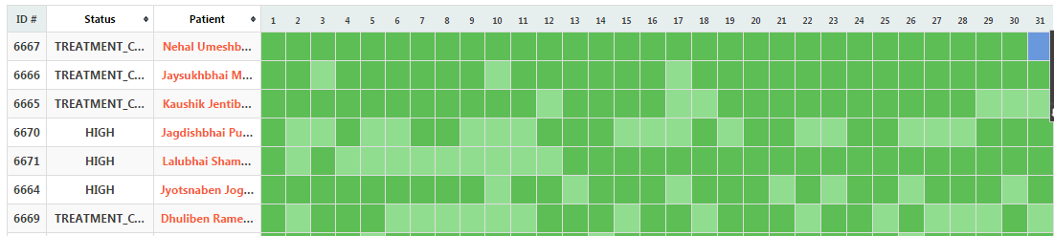
Dashboard – 99 DOTs
Patient wise detail
Daily log
Notes:
All such information is easily accessible in real time through dashboard of 99 DOTS website. Here each dose of all patient is recorded as colour coding for that date. Dark green colour is for the call received from the patient side while light green colour is where dose is verified by treatment observer and manually updated on website as dose consumed. However, missed doses will be seen as pink colour. White cell represents the day where patient are not expected to take medicine. Please keep in mind that patient expected to give call on alternate day during intensive phase of 2 to 3 months while daily during continuation phase of 4 months. Few more colour code is given to capture out of coverage area, adverse drug reaction and hospitalization. There are many more modules where you keep a patient details like note for reason of missed dose, HIV screening status, Diabetic status, follow up investigation status and many more. Due to time constrain I am unable to show you here.

Slide 7
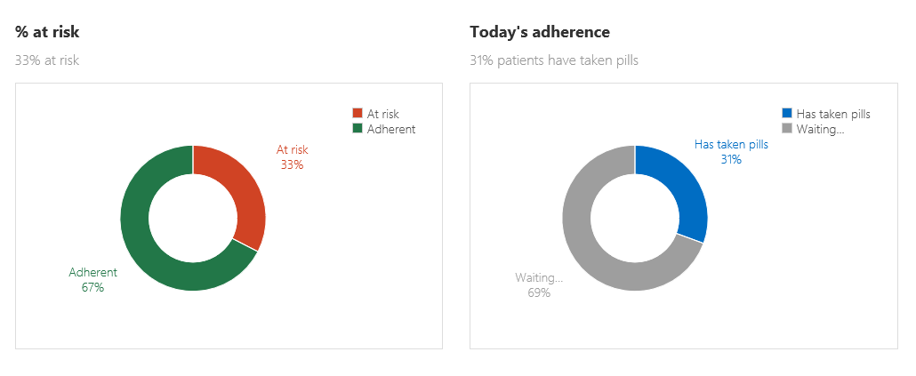
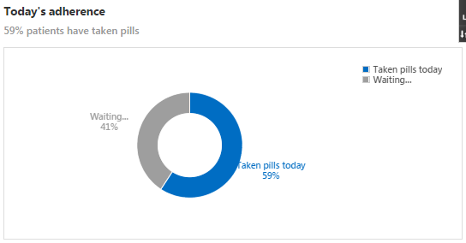
Dashboard 99 DOT
Adherence score Till 24/08/2016 | No. of call expected | No. of call made by patient | No. of doses manually updated by Health worker | No. of doses actually missed by patient (no drug and no call)
On treatment + treatment completed | 7419 | 6109 (82%) | 1073 (14%) | 237 (3%)
Treatment discontinued | 341 | 146 (43%) | 93 (27%) | 102 (30%)
Total | 7760 | 6255 (81%) | 1166 (15%) | 339 (4%)
Notes:
Summary of high risk patient, those who have missed more than 3 doses are seen on the dashboard to identify priority patient for focus intervention. Every day, cumulative treatment adherence is seen on dashboard.
If we calculate the proportion of patient missed the doses is hardly 3% including those who had missed due medical reasons. This holds true for those who are currently on treatment or completed their treatment course. While those who has already discontinued their treatment due to various reason including medical advice they shows poor compliance as expected. Out of total expected calls for due dose, more than 81% doses are reported by patients themselves while only 15% doses are updated by health worker after validation with the patient. We have observed that many times patient forgot to call the system even after drug consumption usually in initial days of treatment. One of the best advantage of this system is real time monitoring at every level.

Slide 8
Enrollment of Patient in project by 28 PPs
Status on 25/16 | Option 1 (Patient referred to Government for treatment) | Option 2 (patient initiated Govt. drugs with 99 DOT)
No. of patients enrolled (A) | 24 | 95
Out of A, no. of patient home visit carried out for Initial counselling | 24 | 95 (100%)
Out of A, no. of cases with known HIV status(B) | 22 | 91 (96%)
out of B, HIV positive | 00 | 01
Out of A, Tested for DM (RBS or U. sugar) (C ) | 22 | 92 (97%)
Out of C, found Diabetic | 00 | 02
Out of A, Pulmonary TB cases (D) | 17 | 62 (64%)
Out of D, under gone Sputum smear microscopy or CBNAAT | 17 | 42 (68%)
Out of D, Proportion of eligible patient tested for follow up sputum examination | 12 | 21
Notes:
Programme has provided two different options for treatment initiation to the involved practitioners. First option insist for the referral of TB patient to the RNTCP system for initiation of treatment. However, the field experience suggests, even though the practitioner refers the patient to the Government facility, patient refuses due to various reasons commonly due to objection against a system of physical DOTs. Such cases usually treated by prescribing medicines from the private sector which invariably increase out of pocket expenditure of patient. The second option of initiating RNTCP drugs directly by private practitioner and monitoring the treatment with ICT enabled mechanism which will help the practitioners to convince the patient to initiate government free drugs. Practitioner is also able to track his patient during the course which is really difficult in private sector otherwise. So, the second option works for Practitioner, patient and even for programme to offer additional services to the patient. Total enrolment till 25/08/16 under option 1 is 24 patient while 95 % enrolled under second option by currently active 28 practitioners. Moreover, programme is able to offer additional services like HIV screening, Diabetes screening and drug resistant screening. Significant number of patient underwent investigation for microbiological confirmation also. 21 pulmonary TB patient have been offered follow up sputum smear microscopy also.

Slide 9
Patient Treatment adherence status
Patient treatment status | Number of patient
Number of Patient registered (Till 25/08/2016) | 95
Current on treatment | 75 (79%)
Proportion of patient in Intensive phase (Initial 2 months) | 15
Proportion of patients in Continuation phase (more than 3 months) | 60
Treatment successfully completed | 07 (7%)
Treatment discontinued from 99 DOTs | 13 (14%)
Died | 00
Loss to follow up (treatment interrupted ) | 04
Loss to follow up (Switch to daily regimen) | 06
Loss to follow up (discontinued as per doctors advice) | 03
Notes:
If we look at the treatment adherence of enrolled 95 patient till 25th August, it reflects around 79% of them currently on treatment and 7% has completed their treatment successfully while 14% has discontinued their treatment due to various reason like change to daily regime at another private practitioner, discontinued as per practitioners advice or patient himself defaulted treatment.

Slide 10
Observation & recommendation
With 99DOTS
Confidence that drugs are taken
Currently
Private sector
Family DOTS
DOTS
99 DOT - ICT enable system helps in improving patient compliance in private sector especially through SMS reminder
Regular patients also missed to give call on toll free
Small part of practitioners are interested to see the patient compliance
Practitioner demands for daily regimen for their patients
Notes:
99 DOT improves confidence of provider for drug consumed by patient which is a very important but rarely observed in private sector. As per the feedback received from the patients, SMS reminder is one of the important activity which helps even a regular patient those who forgot to call after drug consumption. There are set of supportive mechanism for patient as well as for provider to improve the treatment outcome. It was observed that few proportion of private practitioners are not much interested in monitoring treatment personally, however they do not have any issue if programme plays that roll for their patients. There was a demand from the private practitioners for provision of daily regimen which expected to be available in next couple of years.

Slide 11
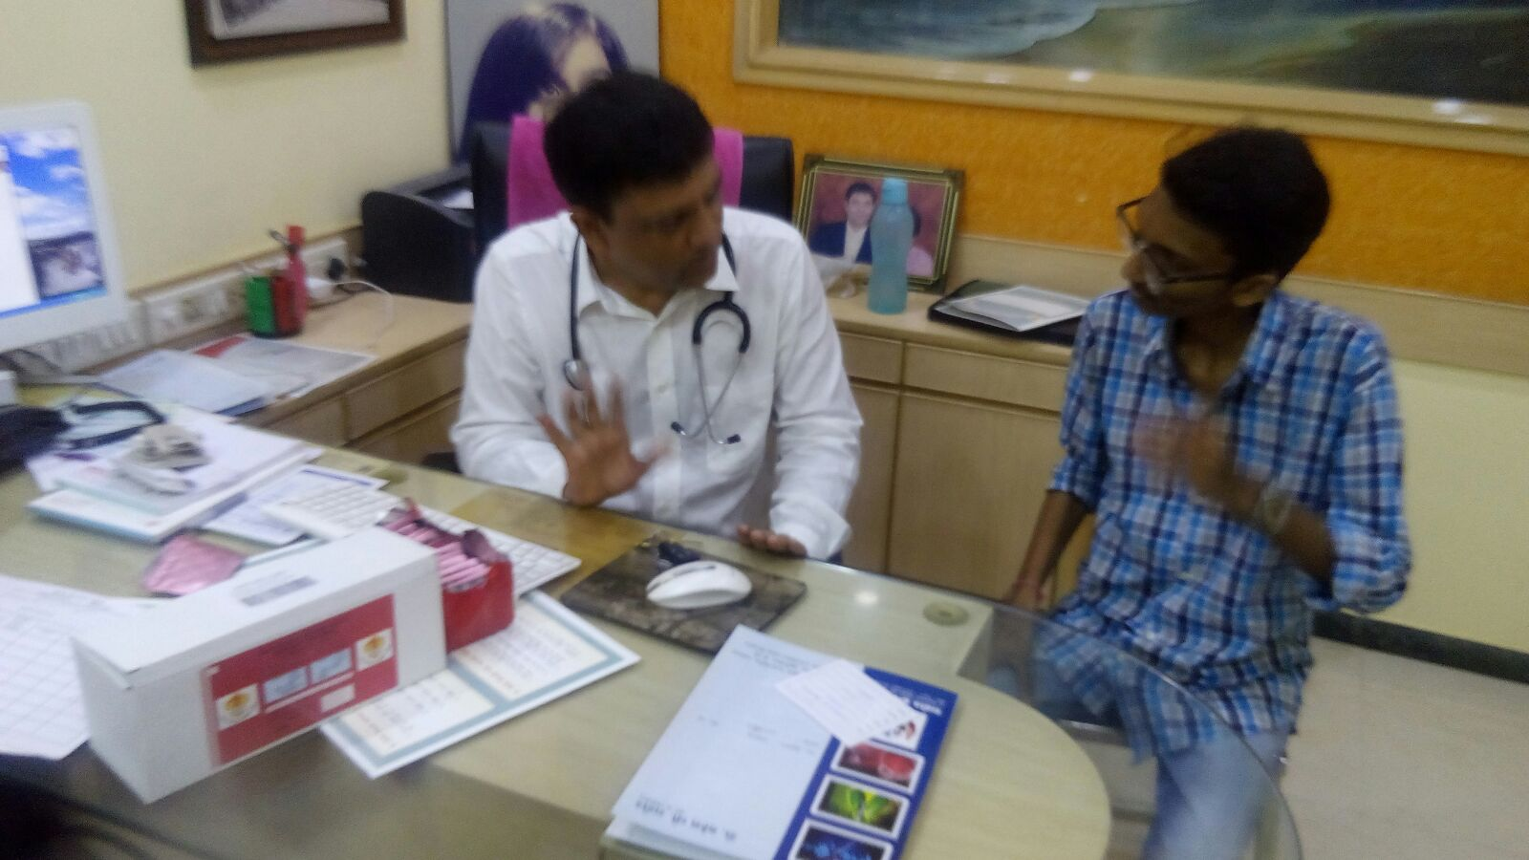
Acknowledgement: All involved Private practitioners, participants of study (Patients), 99 DOTs team and state team are acknowledge for their contribution
Thanks
Notes:
I would like to acknowledge all involved private practitioners, patients, 99 DOTs team and state RNTCP team for their contribution. Thank you

