Slide 1



IMPLEMENTATION OF NEW IHIP/IDSP, KARNATAKA
“ National Summit on ‘Good & Replicable Practices on Public Healthcare in India
16th -18th Nov 2019, Mahatma Mandir, Gandhi Nagar, Gujarat”
Dr Padma. M.R
Epidemiologist- State Surveillance Unit
Directorate of Health & Family Welfare Services
Karnataka
Mobile No. 9449843146 / 9448468054

Slide 2
Integrated Health Information Platform
Supports the e governance vision of the Ministry of Health
Integrates data from various sources to provide real-time information on human health from across India for decision-makers to take action
Reduces data and information fragmentation and provides a single operating platform of the health data and information of India.
Karnataka was one of the first states to adopt and implement the new IHIP/IDSP on 26 November 2018

Slide 3
Old and New IDSP portal
Old IDSP:
  Capture aggregate data only
  Paper-based data collection
  Not to link data from S, P and L forms
  Weekly surveillance
  Monitor only 13 health conditions
New IDSP:
  Capture disaggregate data of persons at all levels
  Link data from S, P L, EWS 1 and 2 forms
  Capture real-time or daily surveillance data
  Provide analysis on mobile and electronic devices
  Monitor more than 33+ health conditions
  Integrate with ongoing surveillance programs

Slide 4
Geospatial Information Platform
The Integrated Health Information Platform provides the ability to:
  integrate data sources from Public and Private sector facilities
  describe and analyze geographic variations in diseases in the context of demographic, environmental, behavioral, socioeconomic, genetic, and infectious risk factors
  interpret geographic correlations of persons with their socioeconomic and demographics attributes

Slide 5
New IDSP is a System of Systems
Architecture is based on eGovernance Data and Information Standards
A java-based programme
Ability to connect with eHospital Systems and the new Health Management Information System.
Ability to connect with public and private hospitals, laboratories, and research centers under one platform to exchange health data.
Notes:
Able to connect Electronic Medical records, HMIS by linking the API( Application programming Interface)

Slide 6
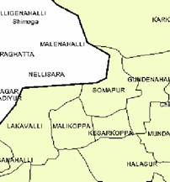
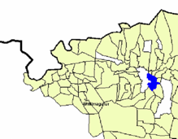
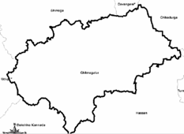
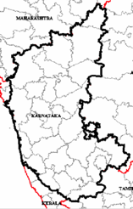
State
(36 States/UTs)
Conventional IDSP’s Data Collection Process - Karnataka
Weekly household
visits to collect data
Sub Center
Primary Health Center
(Auxiliary Nurse Midwife, or Male Health Worker)
Village
(655075)
One Consolidated “S” Form per Sub-center per week
Hand
deliver
Paper Forms
Laboratory Presence
Block PHC
or Community Health Center
(Medical Doctor + helper)
Sub-district
(6267)
One consolidated “P” form/PHC/week + “L” forms
B-PHC or CHC data collected from PHCs
Paper Forms
Hand
deliver
Laboratory Presence
Paper forms are converted to electronic data
District Surveillance Unit
(District Surveillance Officer,
Data Manager, Data Entry Operator)
District
(707)
Spreadsheets
Email/Web Entry
Laboratory Presence
State Surveillance Unit
(State Surveillance Officer,
Data Manager, Data Entry Operator)
Electronic data, kept in the form of XL sheets or on a DB / Portal
IDSP
Database
Spreadsheets
18/11/2019
IHIP implementation- Karnataka, 6th National Summit on "Good & Replicable Practices on Public Health care in India, Gujarat

Slide 7
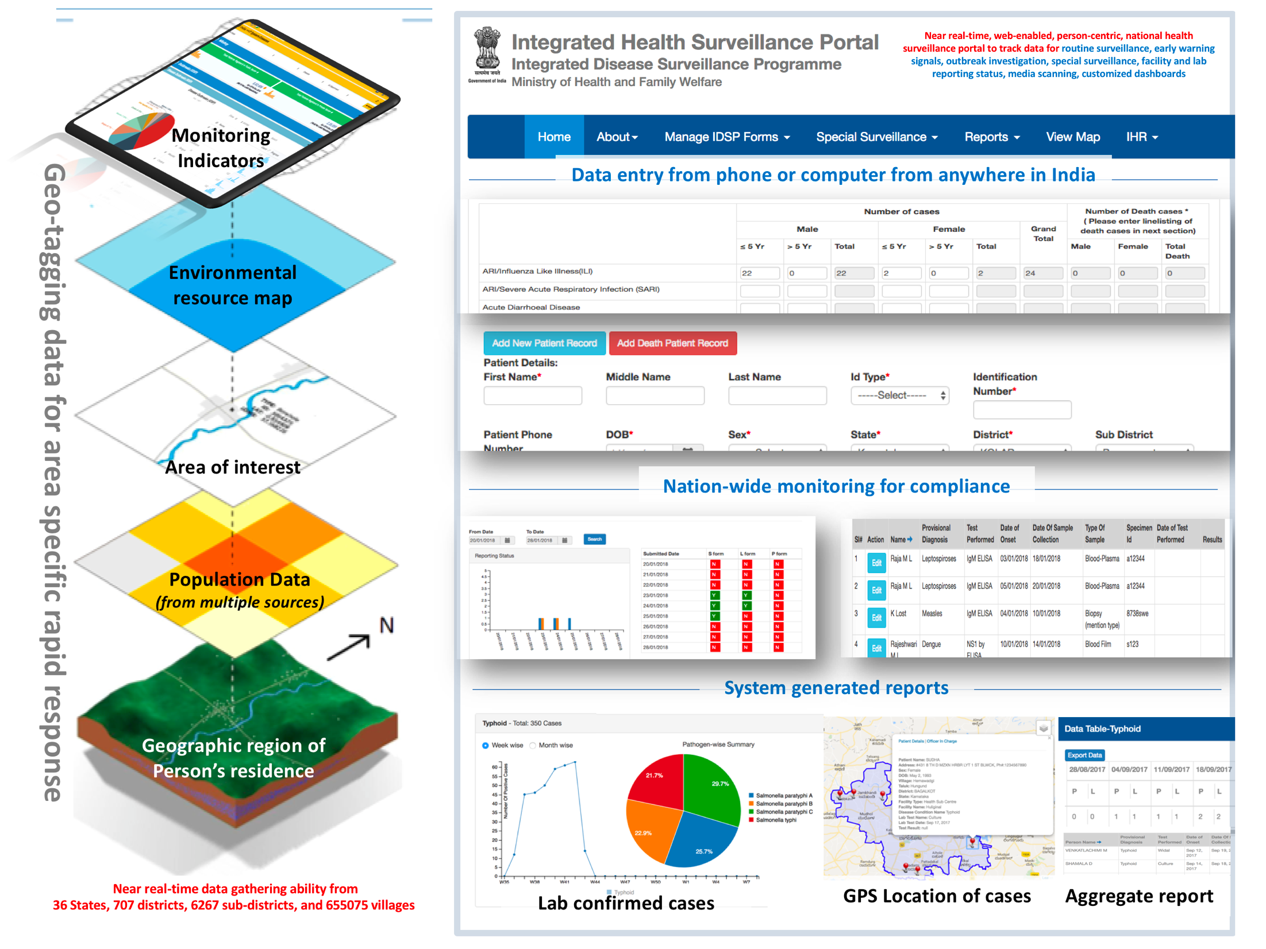

Real time data flow processes – New IDSP - Karnataka
Mobile/Tab reporting
Sub Center or Health Sub Center
Primary Health Center
Village
(655075)
Portal access
Mobile Reporting
Laboratory Presence
Block PHC
or Community Health Center
Sub
-district
(6267)
Broadband
Connectivity
Portal access
Mobile Reporting
District Surveillance Unit
Laboratory Presence
District
(707)
Broadband
Connectivity
Portal access
Mobile Reporting
State Surveillance Unit
Laboratory Presence
State
(36 States/UTs)
Broadband and Satellite-based Connectivity
Proposed System: Portal access allows reporting of all data from
DSU, CSU, SSU to CSU/IDSP in near real-time. Mobile reporting is both store and forward and near real-time. Data analytics and results will be accessible at all levels for action.
18/11/2019
IHIP implementation- Karnataka, 6th National Summit on "Good & Replicable Practices on Public Health care in India, Gujarat
7
Notes:
Off line entries are possible

Slide 8
Milestones of IHIP Implementation in Karnataka
Time Period | Activities
March 2018 | Pre-testing of IHIP in Hassan & Mysore district-
End March & Early April | Piloting of IHIP at Mysore & Hassan
3rd – 5th May 2018 | State presented the piloting findings at the National Review Meeting of IDSP, Lucknow
26th & 27th June 2018 | Hands on training on IHIP at New Delhi ( 5 members )
9th to 13th July 2018 | State level IHIP TOT workshop of ( 124 members) DSOs, Epidemiologists, Microbiologist, Data Managers
July 15th to end August 2018 | District level training- THO, MO, Pharmacist , lab technician ( 8092 trainees)
26th November 2018 | Soft launch of IHIP by GOI
19th Dec 2018 | ANMOL tablet distributed (7820)
Nov 18 to end of March 19 | Block level training of ANMs ( 9597 members)

Slide 9
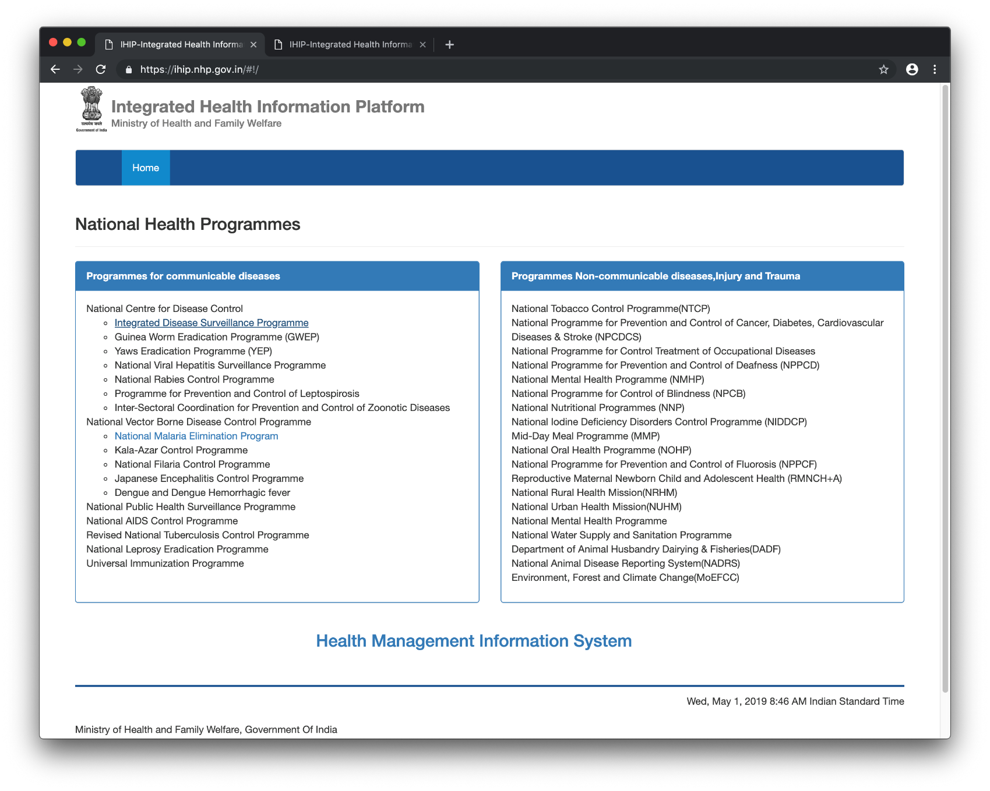
Notes:
Secured login – user controlled, cannot be viewed by others, Total no of users in Karnataka-

Slide 10
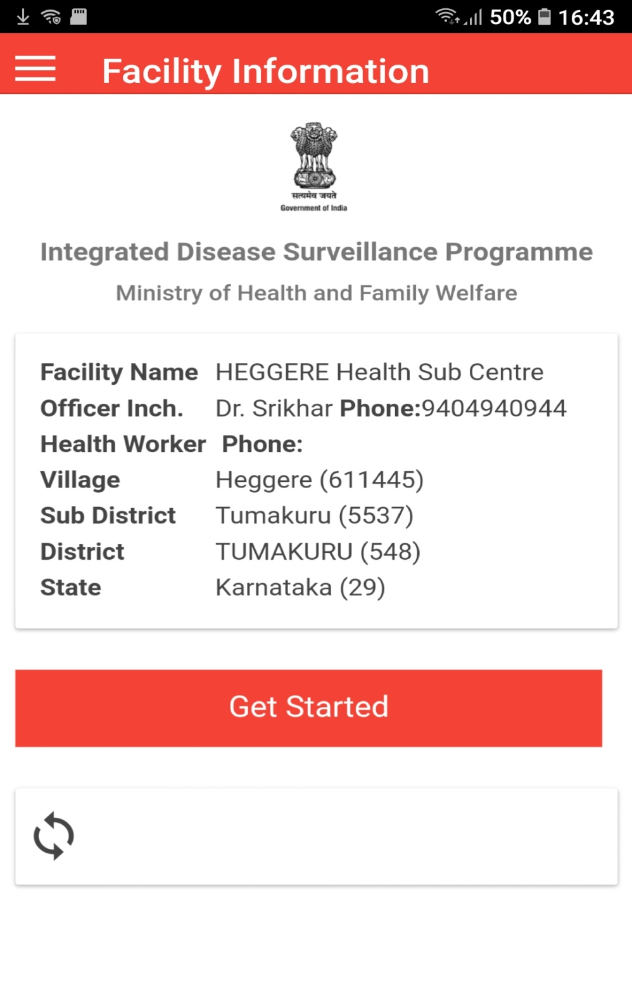
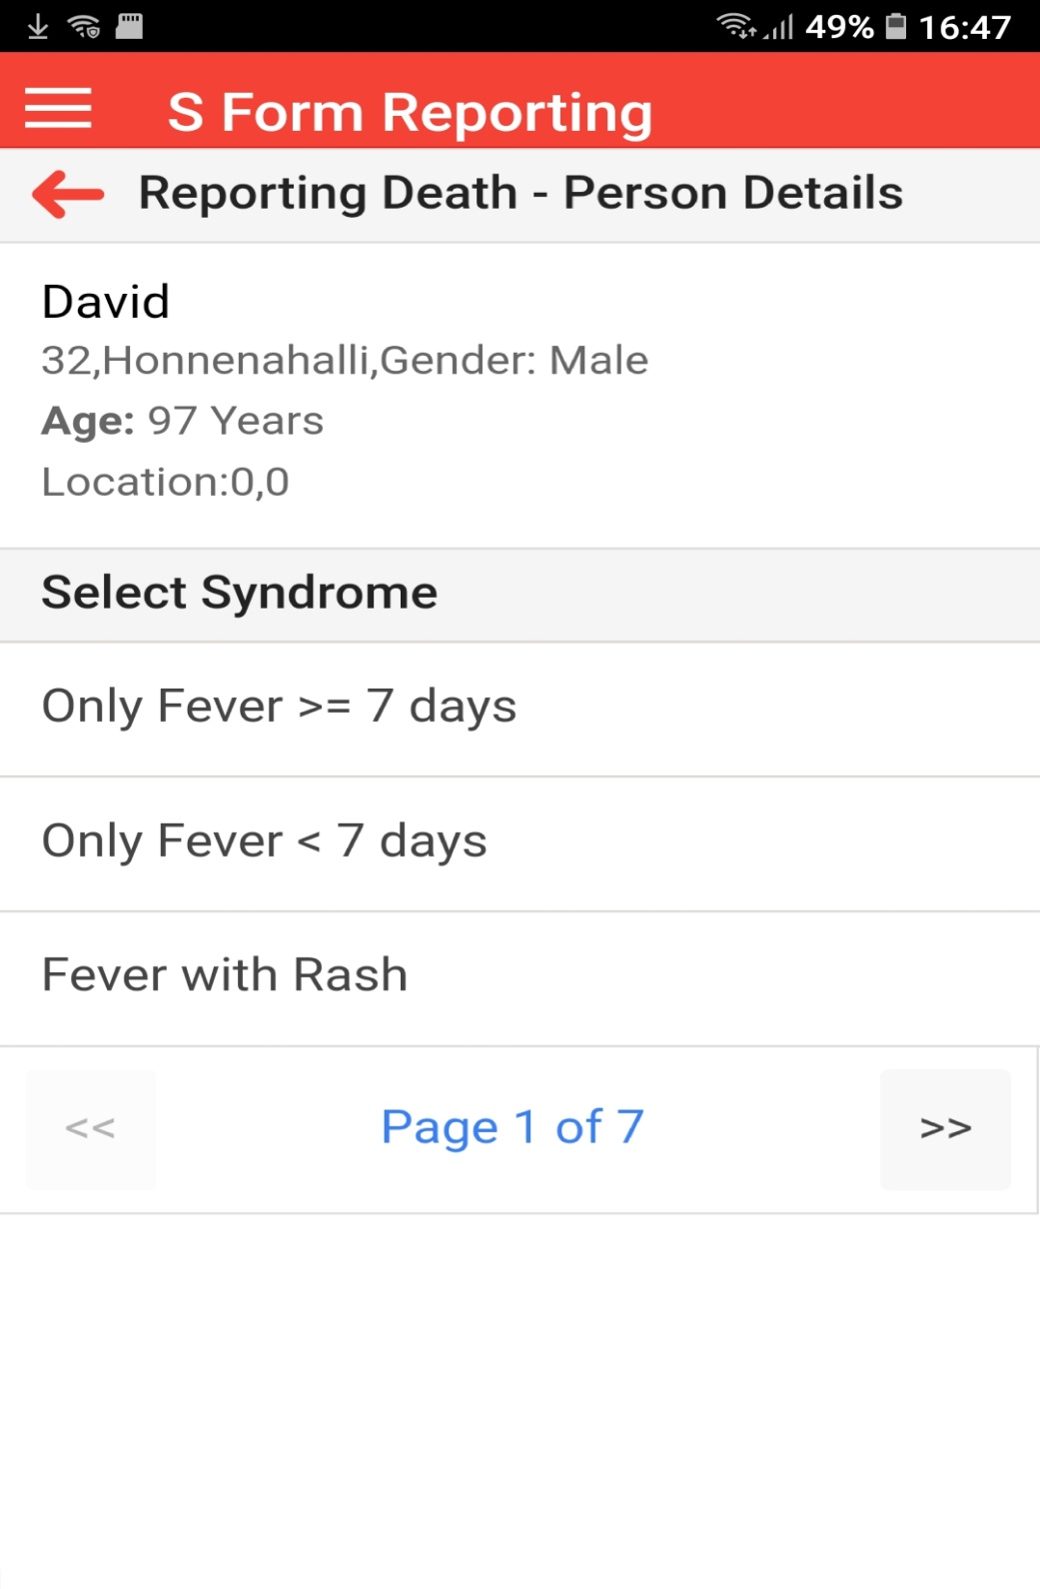
Mobile-based or Tablet-based data collection
for peripheral health workers(real-time or offline data collection abilities)

Slide 11
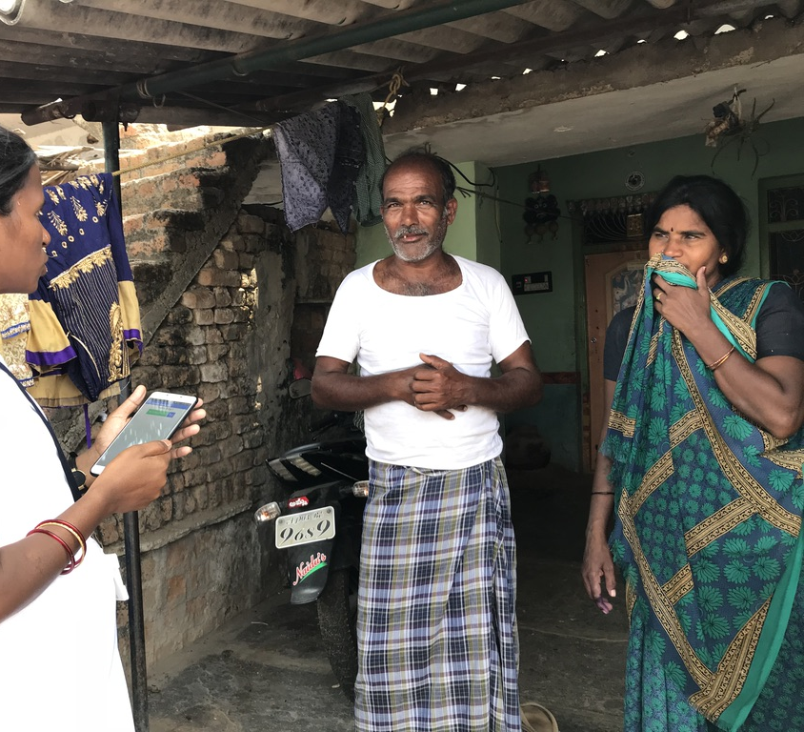
Syndromic Surveillance Data Collection on Mobile Platform
(from villages, rural and urban communities)
Notes:
Patient info being locked in to the system

Slide 12
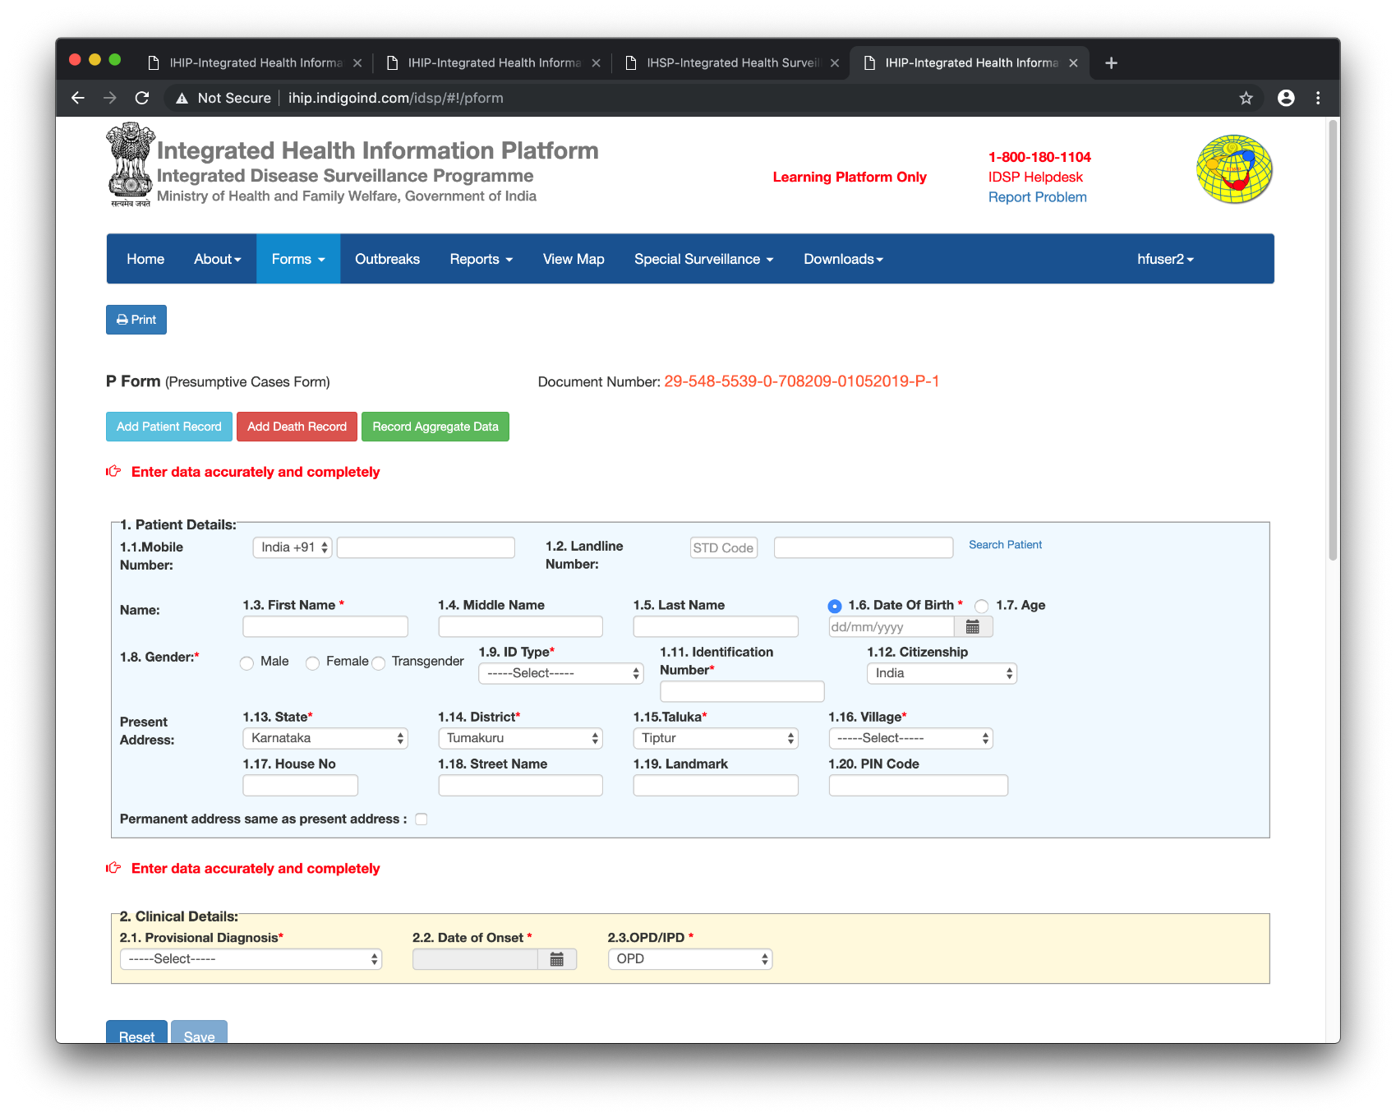
Desktop-based data entry at health facilities
(real-time or offline data collection abilities)

Slide 13
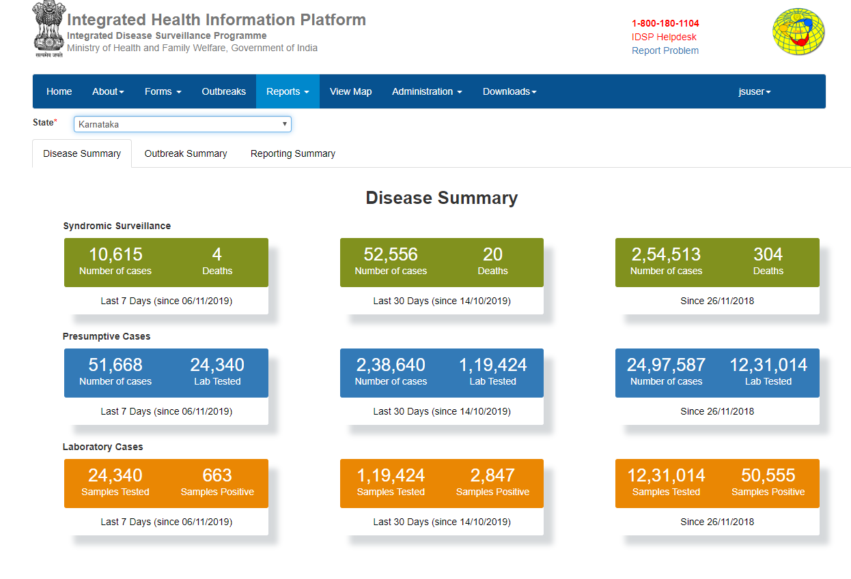
Disease summary Dashboard

Slide 14
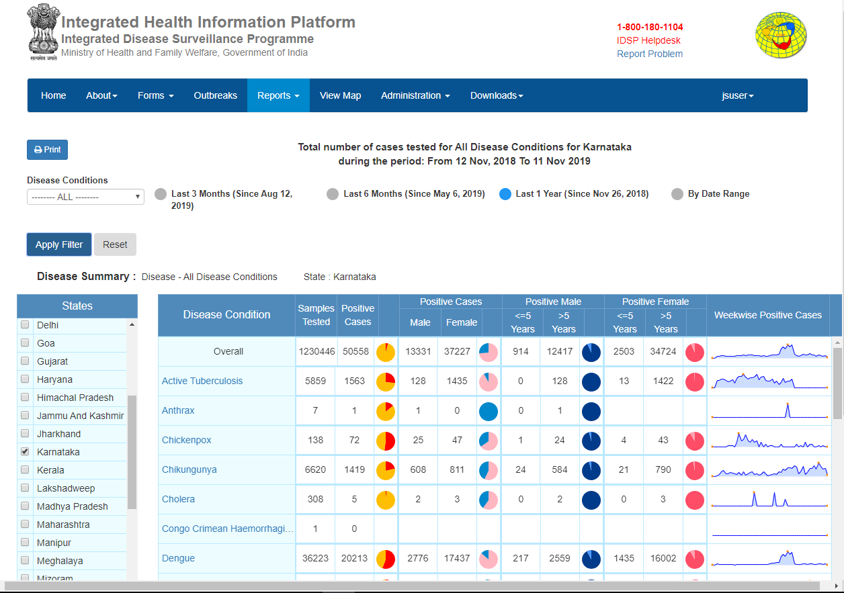
Real-time Lab confirmed cases of health conditions

Slide 15
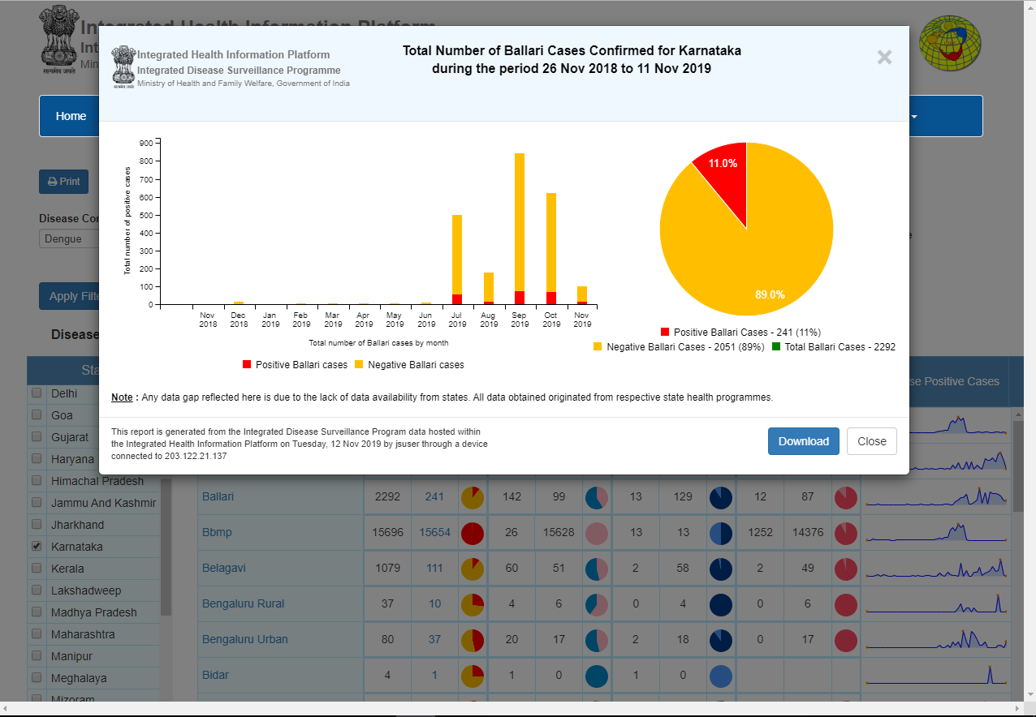
Summary downloadable real-time charts

Slide 16
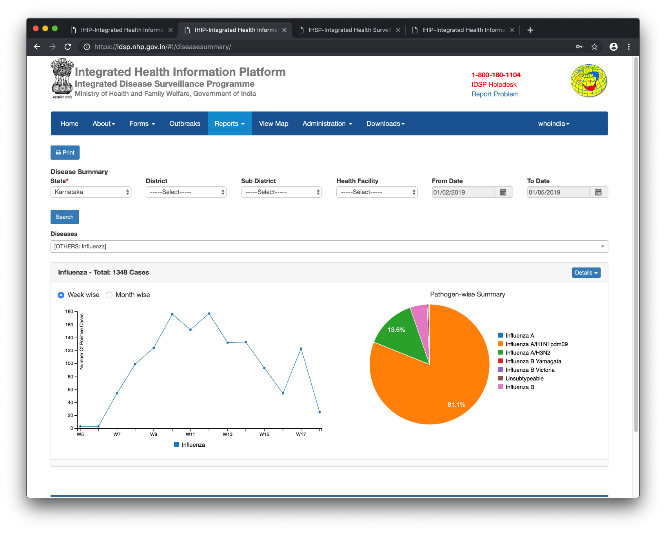
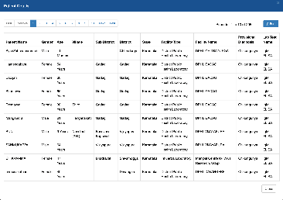
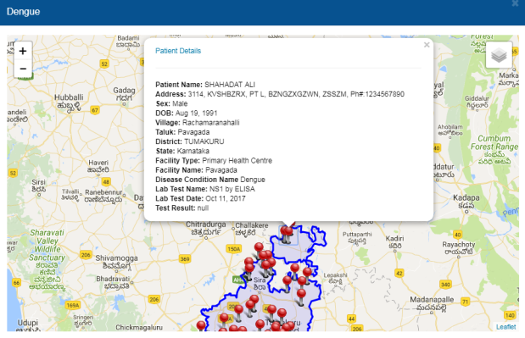

Real-time view of lab-confirmed cases of
And progression and daily/weekly monitoring of activity

Slide 17
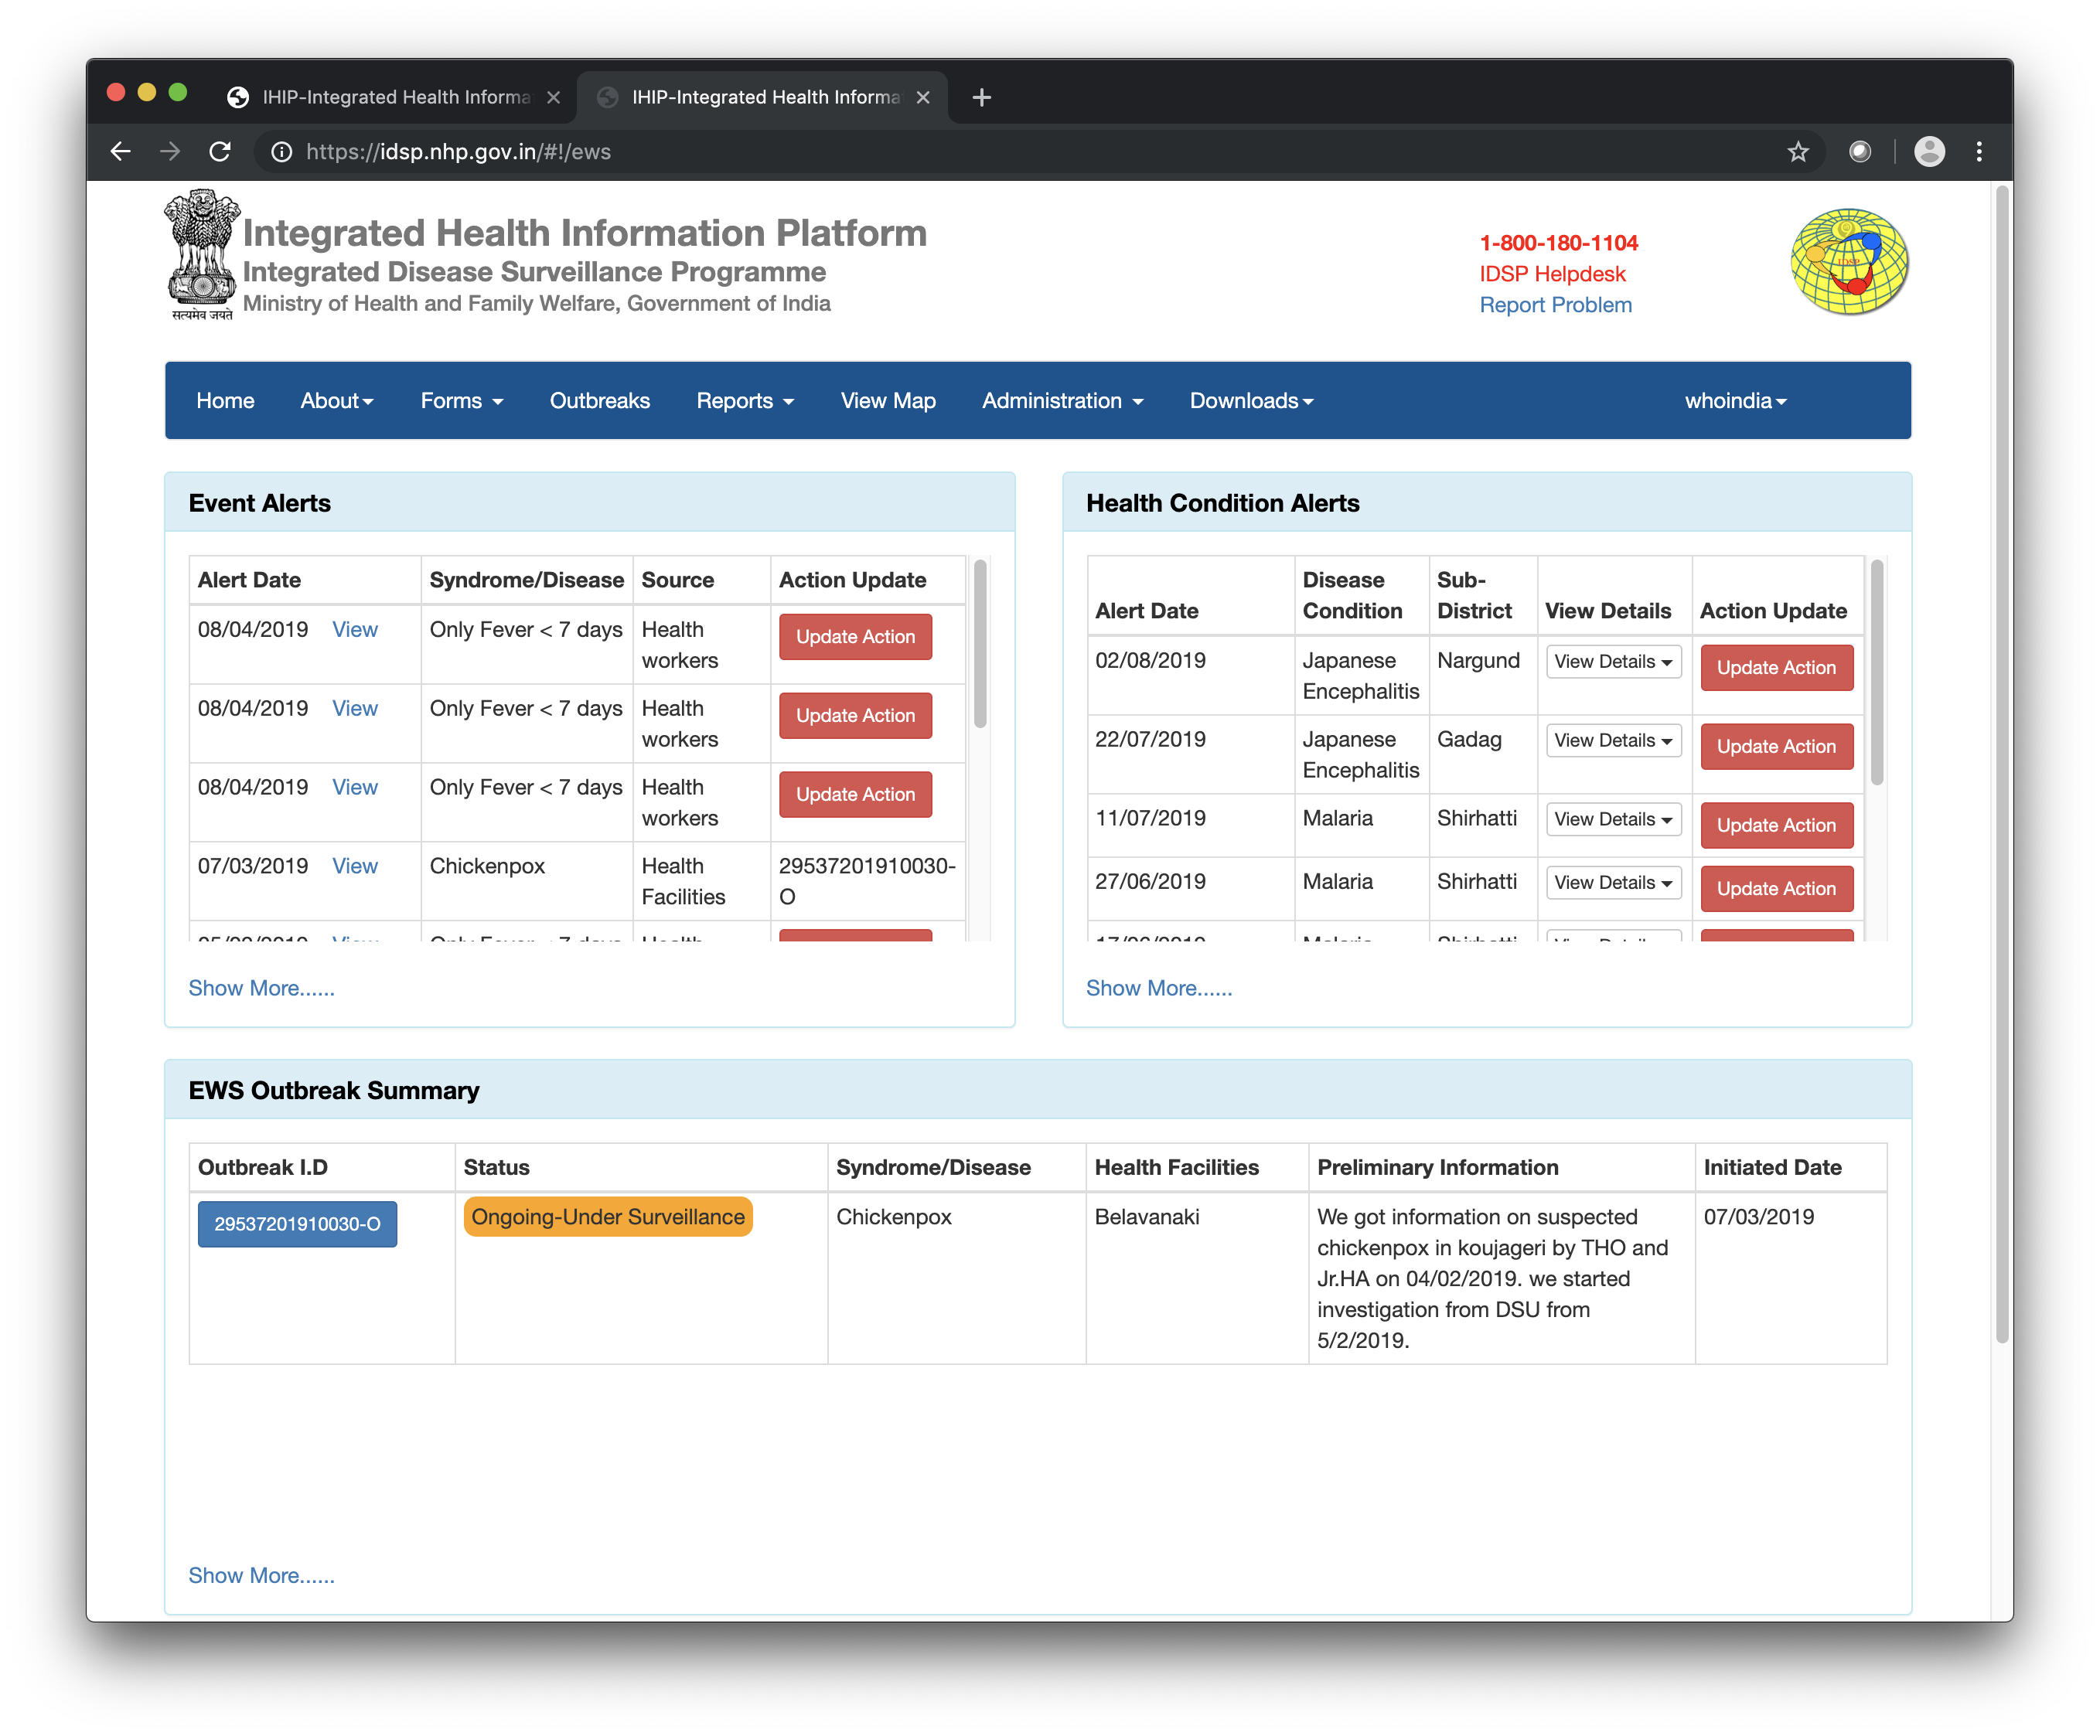
Real-time end-to-end management of outbreaks

Slide 18
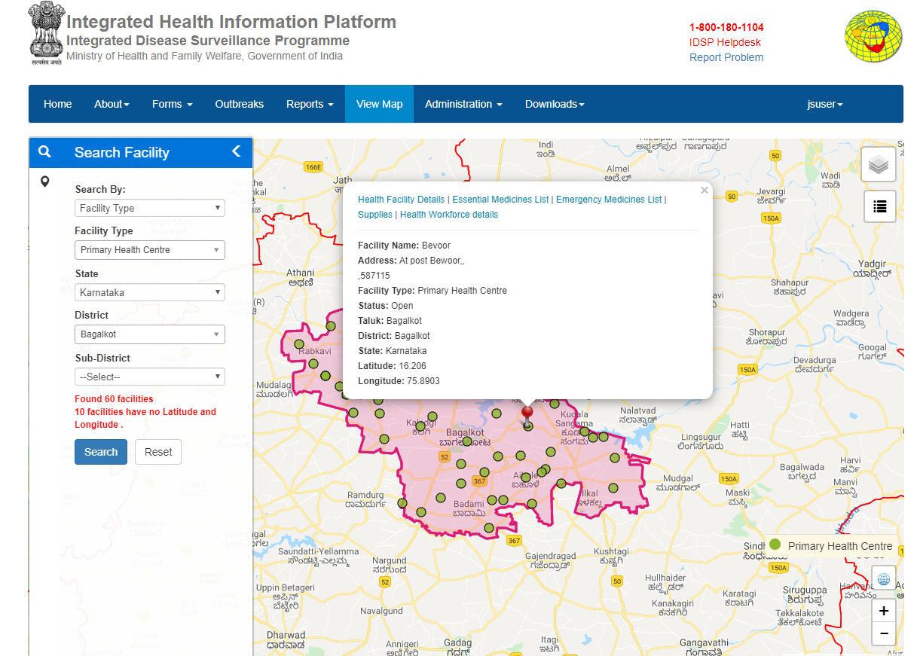
Manage health facilities along with the list of health workforce,
essential and emergency medicines and supplies within them.

Slide 19
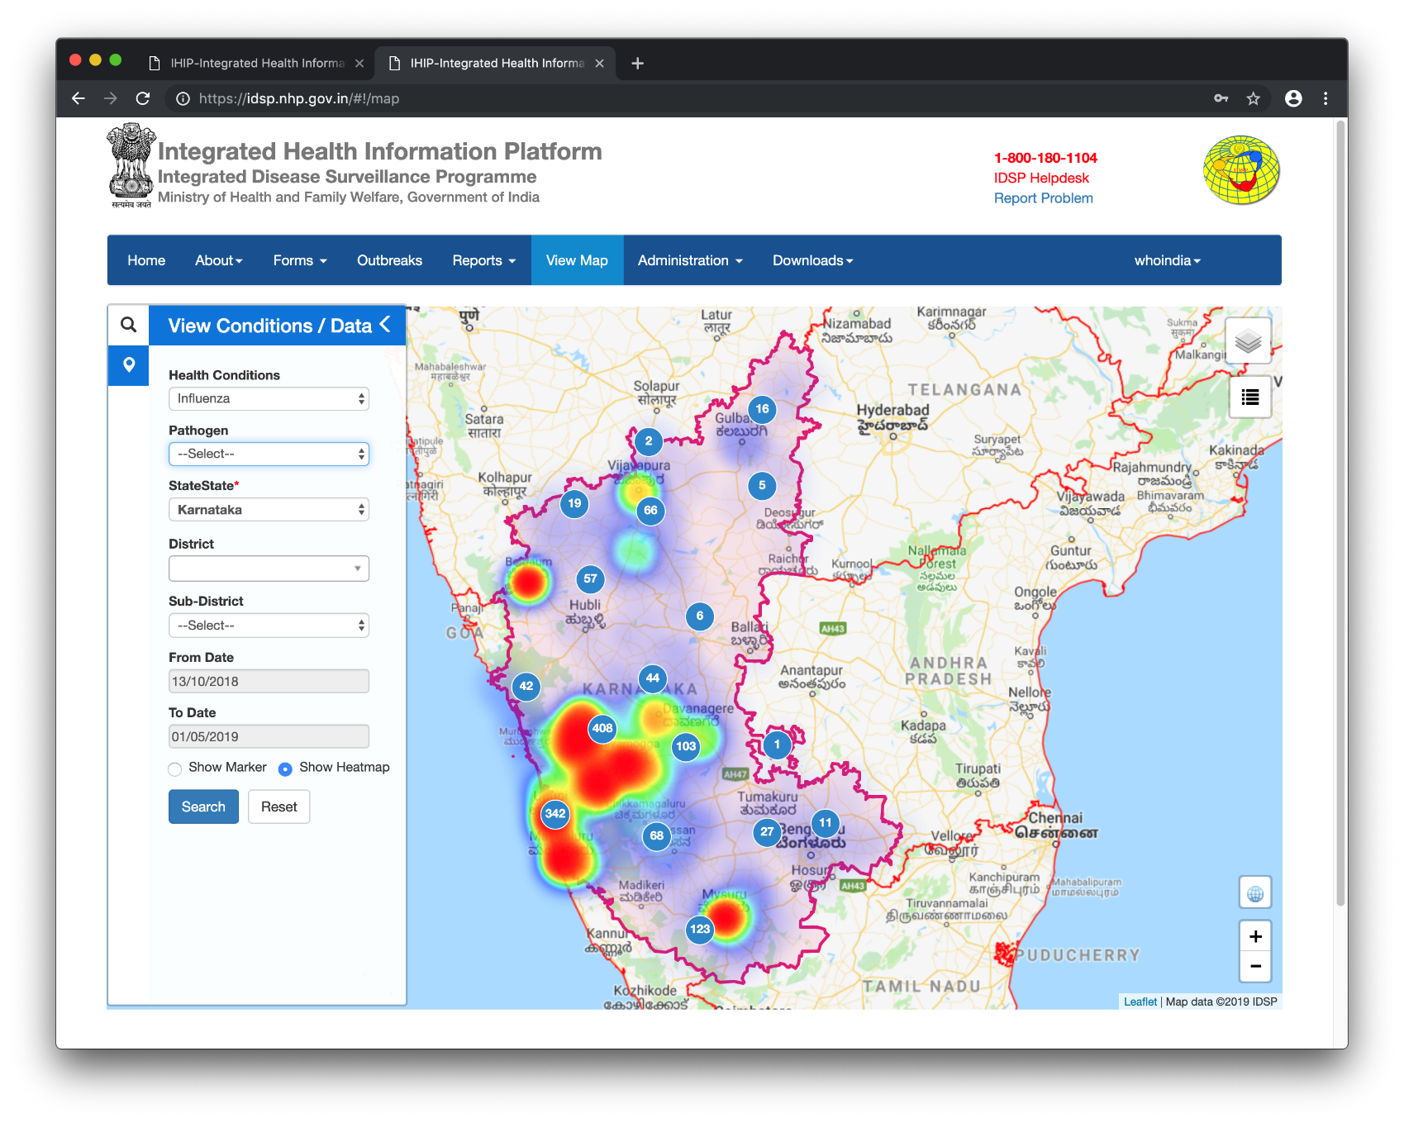
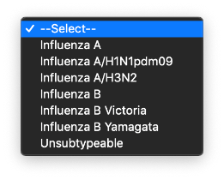
View heatmaps and distribution of lab-confirmed cases.

Slide 20
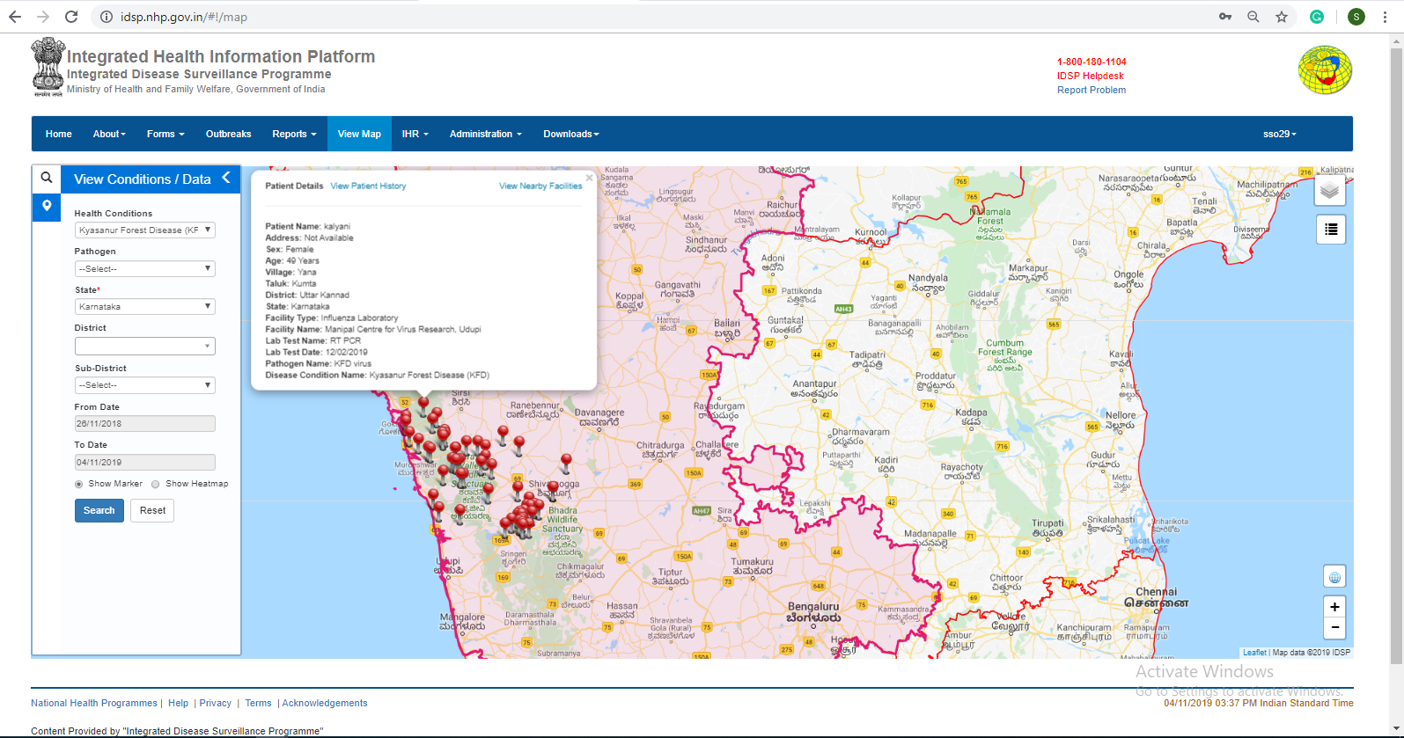
KFD Cases on GIS map

Slide 21
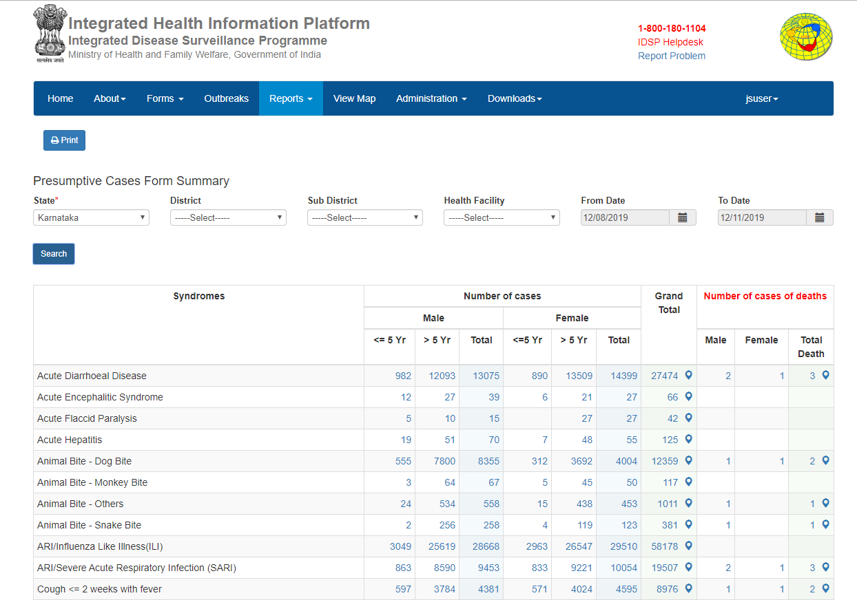
Presumptive cases summary
Hyperlinked to line list and view on map

Slide 22
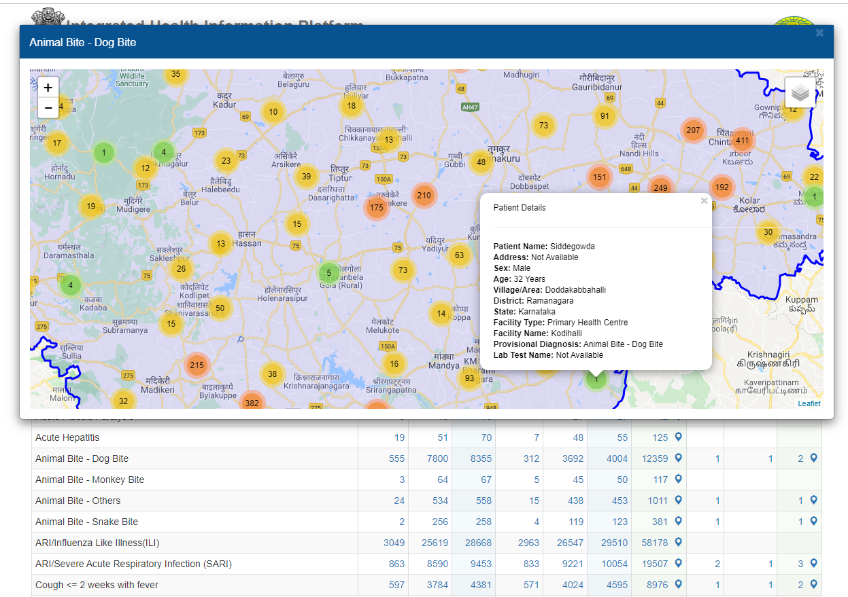
Presumptive cases - dog bites in Karnataka
Time place and person

Slide 23
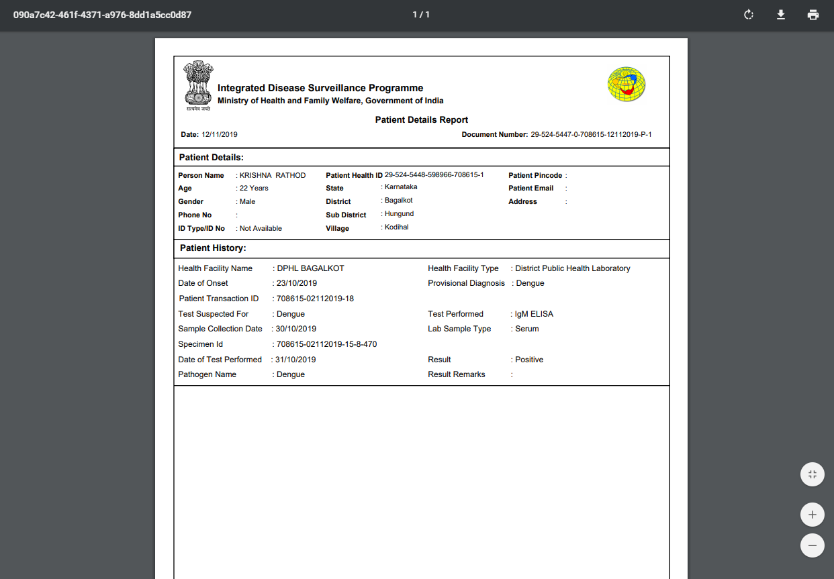
Patient case summaries – real time

Slide 24
Status of Integrated Health Information Platform (IHIP)
Reporting Units
S-form: 9844 |  | P-form: 2987 |  | L-form: 2952
Training pertaining to IHIP
 | S-form: |  | P-form: |  | L-form:
No of Districts: Covered | 30 |  | 30 |  | 30
No. of Participants: Trained | 9597 |  | 8092 |  | 8092

Slide 25
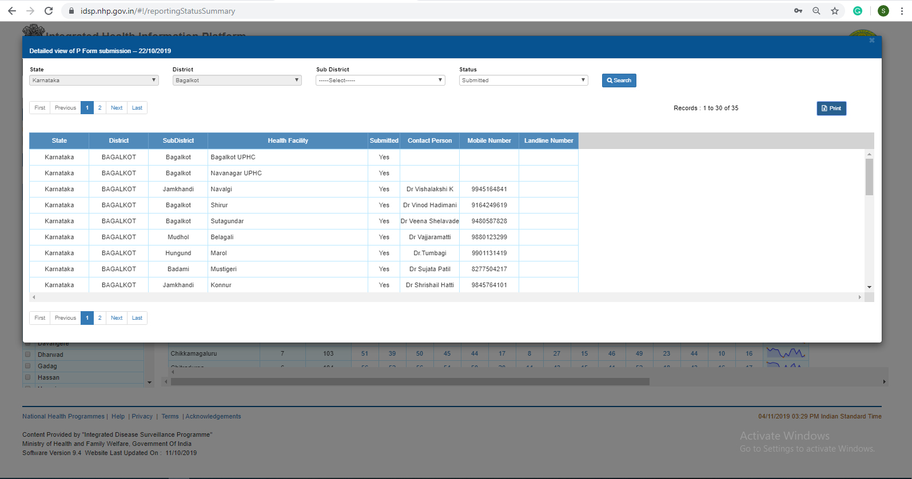
Report submission Status
Notes:
Same as the EMR- clinical , lab features, death records.. Every record has a document no

Slide 26
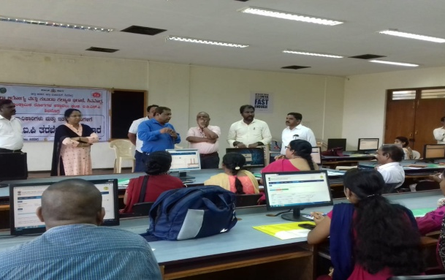

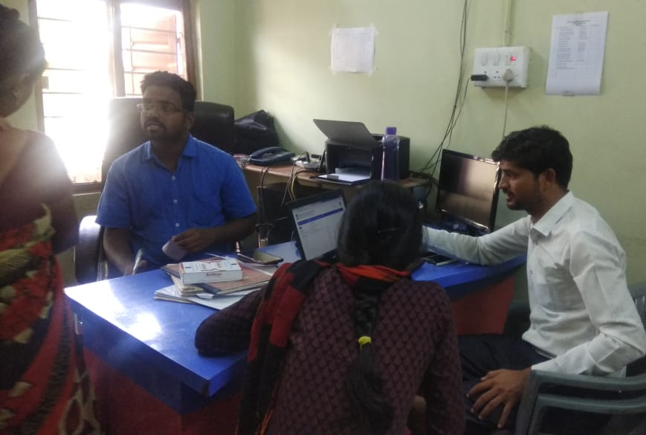
Innovation/Activities to improve the Quality and Quantity of IHIP reporting
Identified Block, District and State Nodal officers for IHIP to ensure IHIP implementation
Regular follow by State and District Teams
Use of applications like Helpdesk, email and Team-viewer to solve issues on-time and to provide suggestions

Slide 27
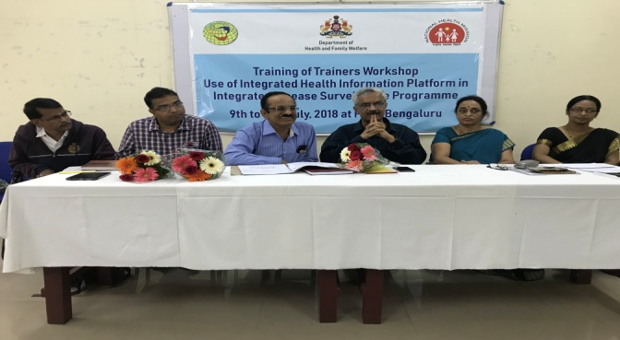
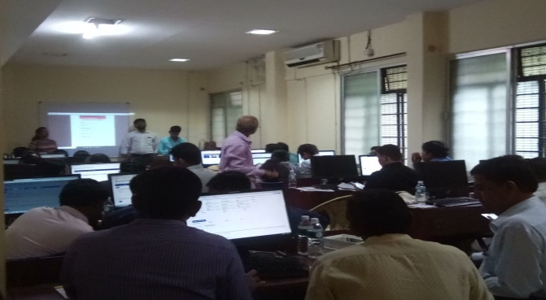
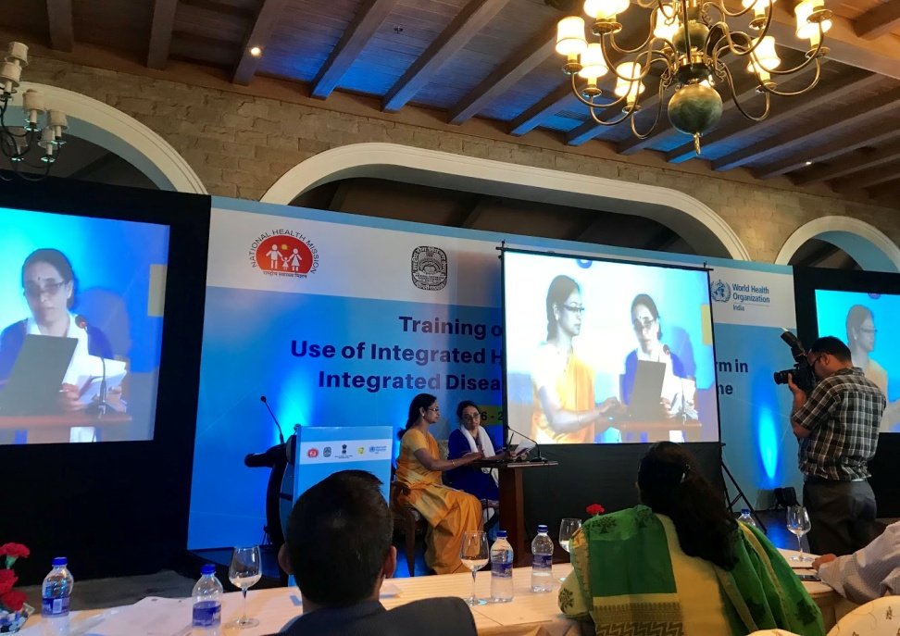
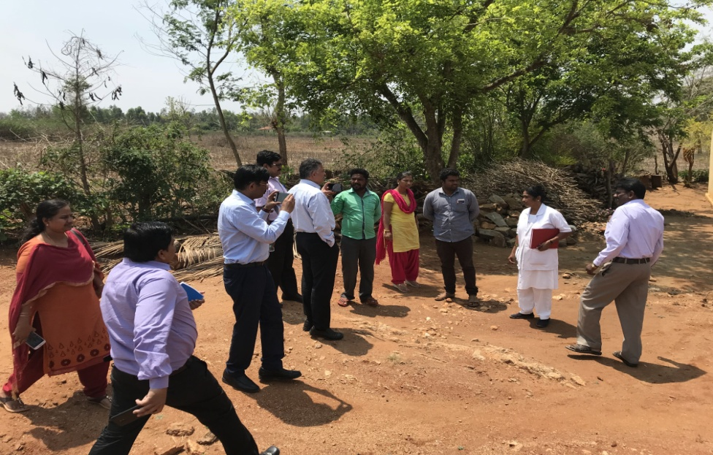
Key activities
Inauguration of State Level ToT workshop on IHIP State level ToT workshop on IHIP to District Teams
Presentation at New Delhi on the implementation Pre-testing of IHIP for IDSP in the Mysuru District
of IHIP in the Karnataka

Slide 28
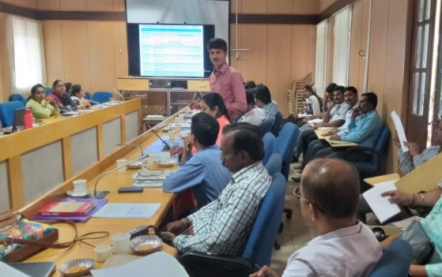
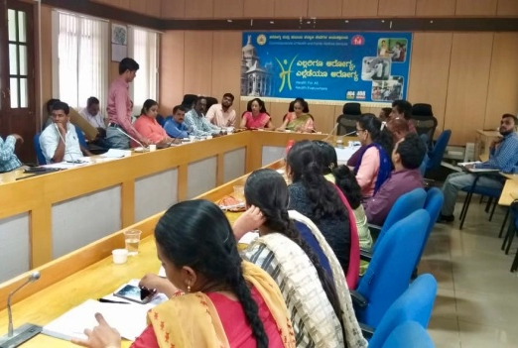
Innovation/Activities to improve the Quality and Quantity of IHIP reporting
Fortnightly/Monthly Monitoring of IHIP implementation at the Block level meetings
Dedicated involvement of SSU & DSU staffs in the Implementation of IHIP
State/District/Block level WhatsApp groups for immediate response and to ensure daily reporting
Regular visits to Health Facilities by Epidemiologists, Data Managers and identified Nodal Officers of IHIP
Link:https://idsp.nhp.gov.in/#!/

Slide 29
Take home message
GIS is the strength of IHIP with different features and real-time data for timely action.
User can customize the tool according to state specific requirements
The IHIP is a great tool for Surveillance activities of Communicable & Non communicable Diseases
Aids in decision making and allocation of resources
Acknowledgement:
NCDC-GoI, WHO (India & Geneva ), GoK

Slide 30


