Slide 1
India Hypertension Control (Management) Initiative
Dr Prabhdeep Kaur, Scientist E and Head of NCD Division, ICMR-NIE, Chennai
On Behalf of the Project Partners
Partners – ICMR, WHO, NPCDCS program, State Governments and Vital Strategies- Resolve to Save lives, USA

Slide 2
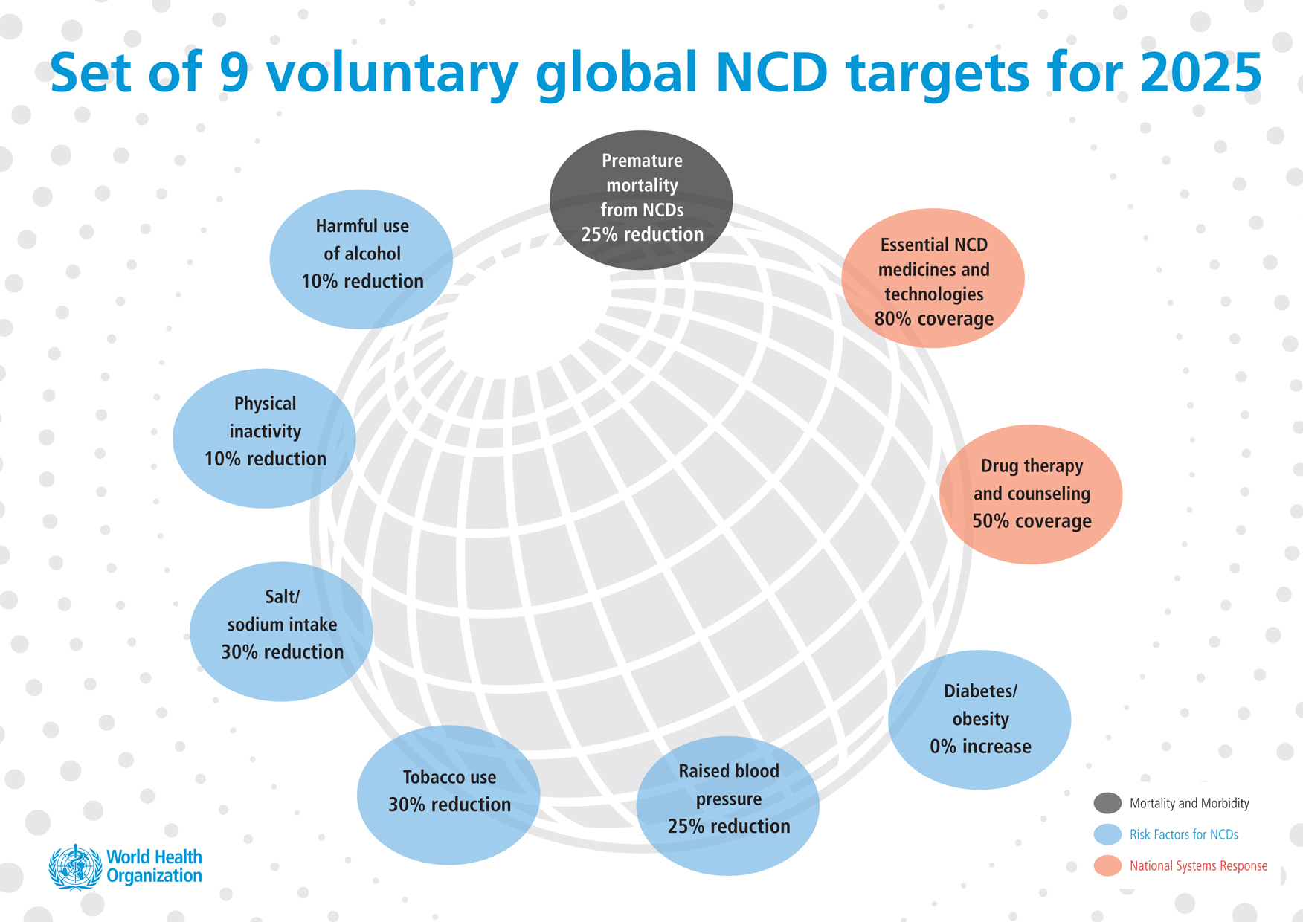

Slide 3
India – More People with HTN than Any Other Country
Top 30 countries, world, 2014
WHO. Global Status Report on noncommunicable diseases 2014.

Slide 4
Prevalence of hypertension in various Indian states : DLHS- 4 survey 2012-14

Slide 5
India Hypertension Control (management) Initiative – Multi-partner project
Aim: Increase the blood pressure control from 10% to 30% in the project districts in India by 2022
Strengthen the hypertension treatment component of NPCDCS (national program)
Strategies to improve treatment coverage and blood pressure control
  Standard treatment algorithm
  Capacity building at all levels
  Availability of protocol drugs
  Patient cohort monitoring – robust M&E
  Decentralization for BP measurement and drug dispensing at sub center level
Partners : ICMR, WHO, MoHFW, State Governments, Vital Strategies - RSTL
Hypertension patients : 200 million
Treatment 50 million (25%)
Blood pressure control - 20 million (10%)

Slide 6
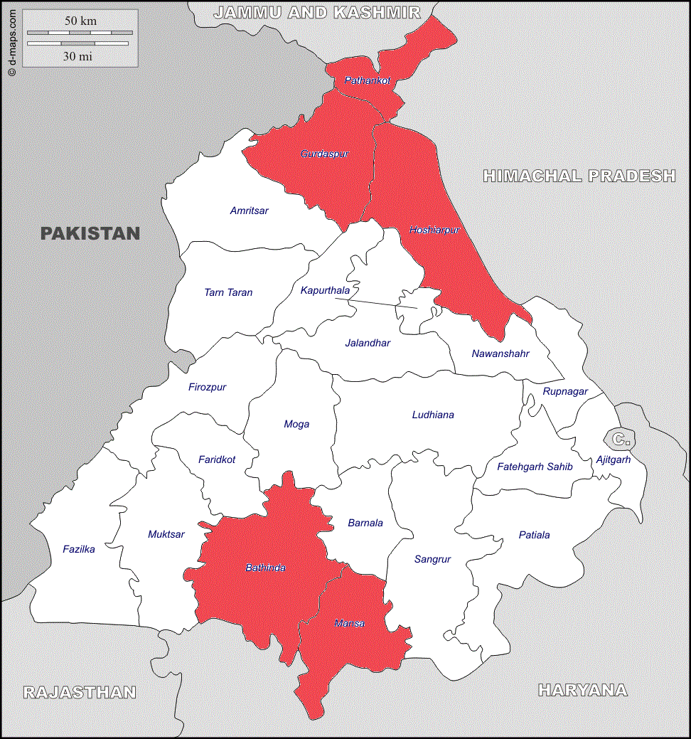
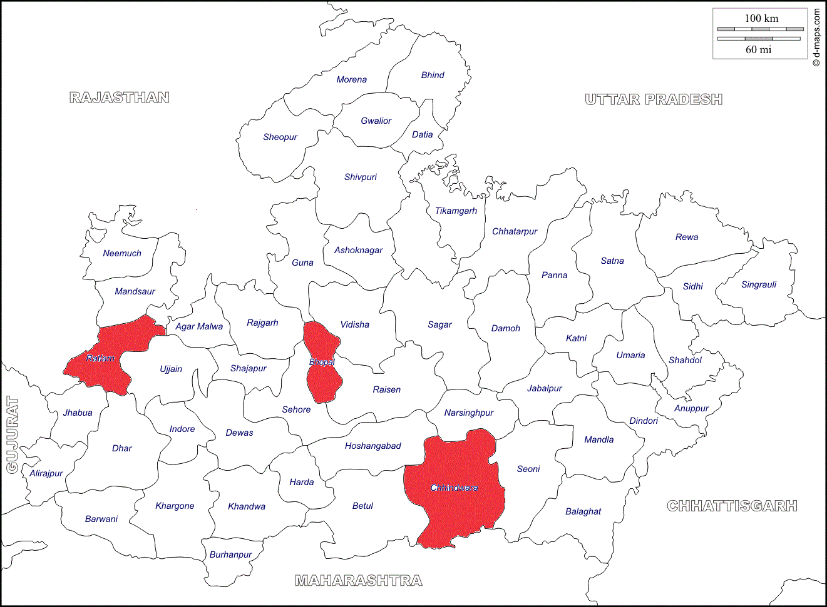
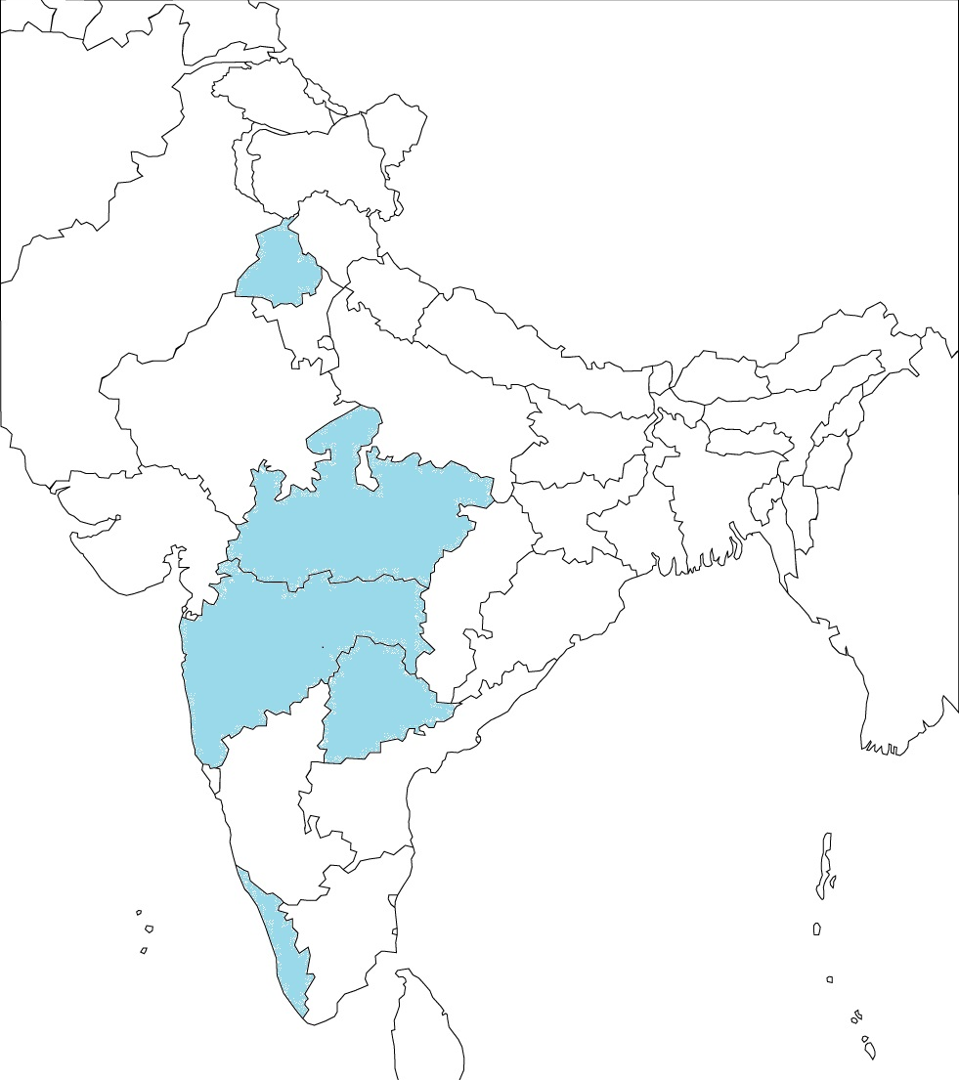
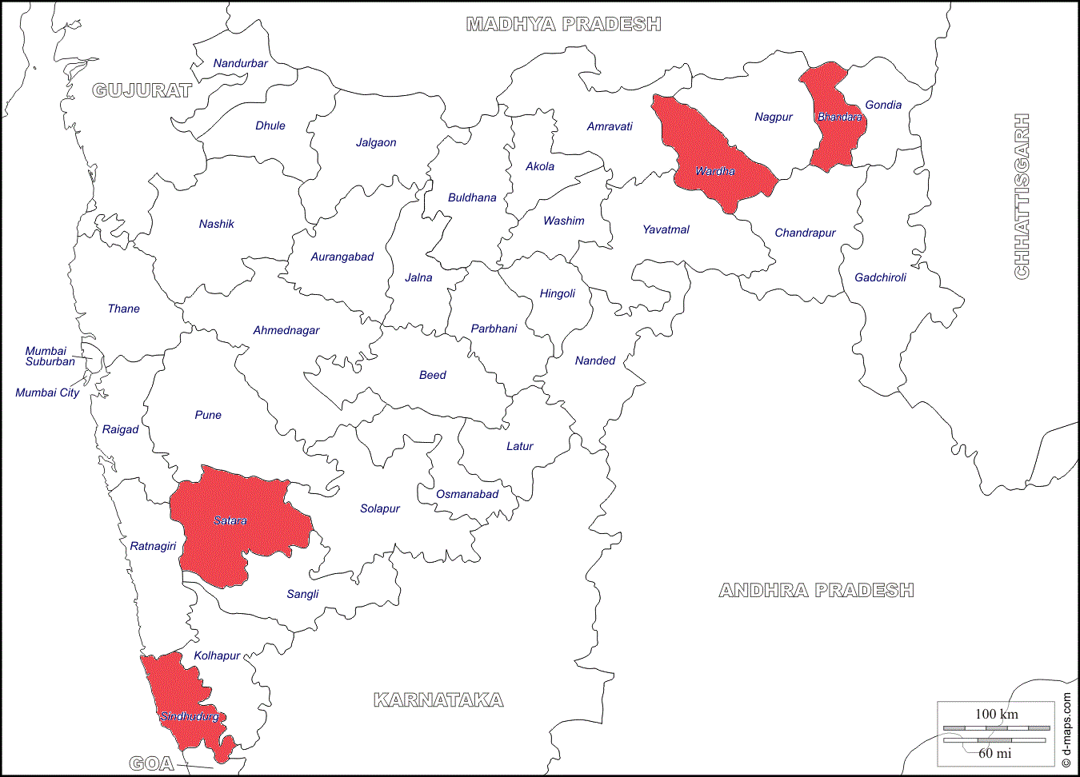
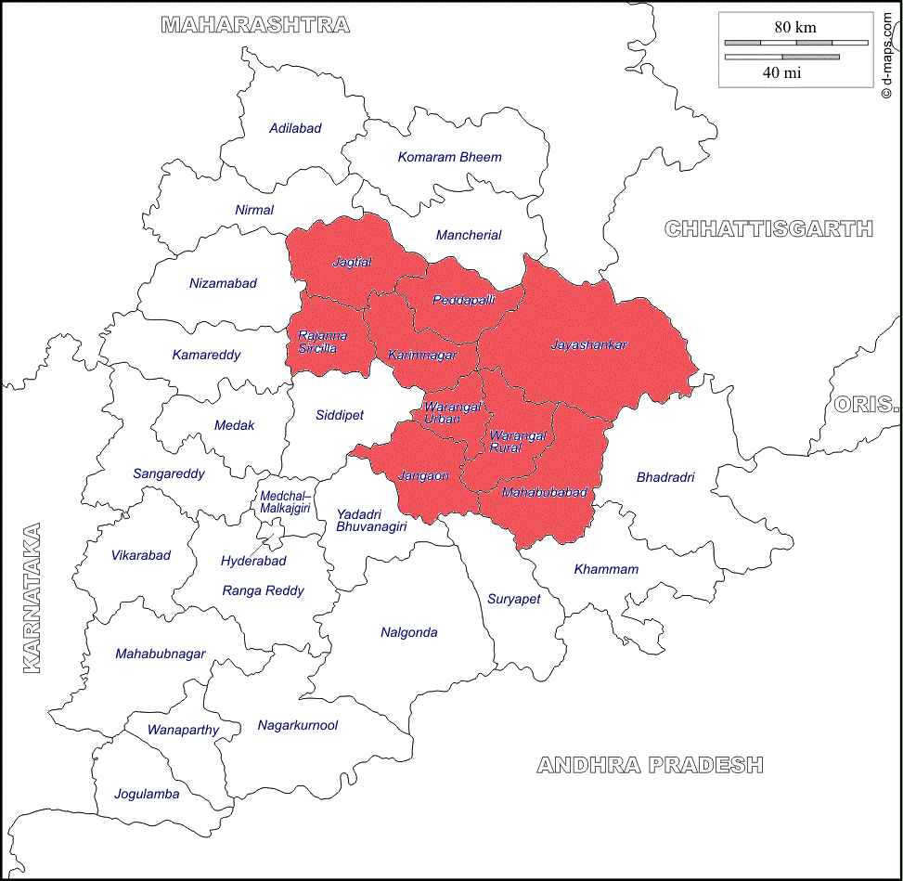
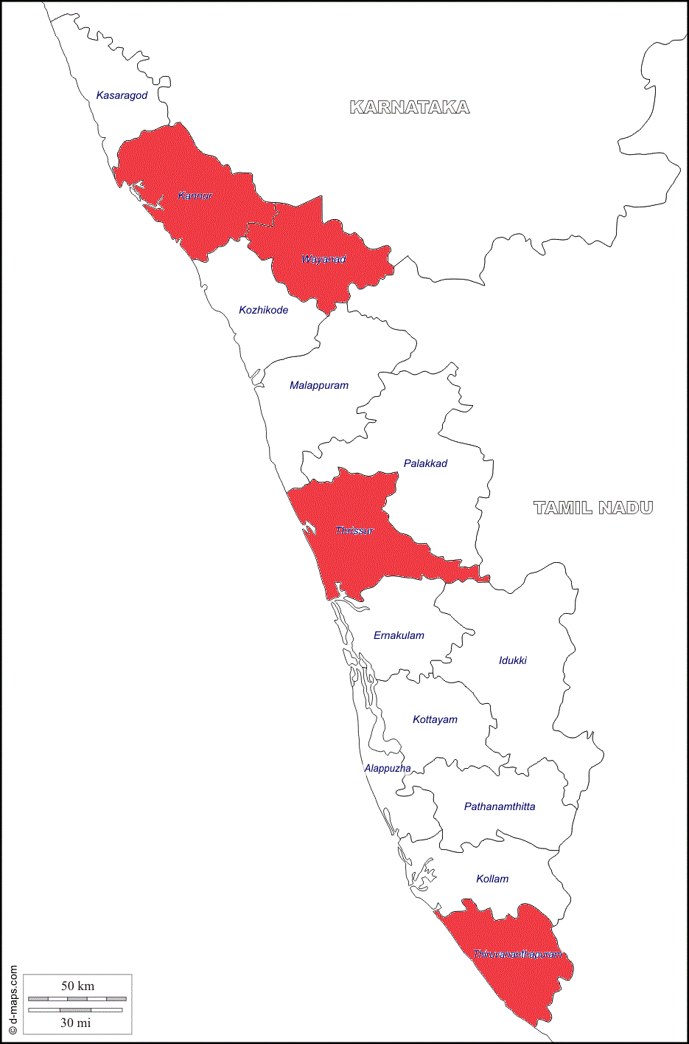
Project districts – 25 districts in five states
MP: Launched in three districts on 7th April
Punjab: Launched on 2nd Jan in five districts
Maharashtra: Consensus meeting and protocol finalised – To be launched in 4 districts
Kerala: Launched on 4th April in five districts
Telangana: Consensus meeting, state and dustrict level TOT done, to be initiated in 9 districts

Slide 7
Hypertension – Program and Status
Target of GOI: 25% reduction in the increased BP by 2025 (4 crore patients)
NPCDCS has established basic infrastructure of staffing (NCD officer at State level, medical officers and nurses, equipment, drugs, screening, etc.)
Focus on a select group of districts drawn from the 158 districts previously selected by GOI for population-based screening under NPCDCS
Follow-up of patients screened positive for HTN has been limited
Additional inputs required to increase the follow-up and control
Data available regarding number screened and detected ; monitoring and evaluation need to be strengthened to ensure quality and to capture the outcomes

Slide 8
Project -specific additional inputs
Additional manpower- in project districts to support training and monitoring
  Cardiovascular Health Officers: One per district ± one at state level
  Senior Treatment Supervisors: 1-2 per district (depending on number of health facilities)
Consensus workshops at the state level to finalise protocol
Train trainers at state level and support training at the district level
Facilitate streamlining of drug logistics and BP monitor procurements
Strengthen patient monitoring to improve BP control and to reduce drop outs
Encourage task shifting for easy access to follow up treatment
Implementation science to document impact
  Research to measure the change in blood pressure control in sample districts
  Rigorous data quality monitoring, quarterly analysis and feedback to states
  In depth data collection in a sample of health facilities

Slide 9
Sample protocol

Slide 10
Punjab, MP and Kerala – Patient Registrations
States | Name of Districts | Initiation of IHMI | Total number of registrations till 30 Sep 2018
Punjab | Gurdaspur | Jan-18 | 5,459
 | Pathankot | Jan-18 | 1,919
 | Hoshiarpur | Jan-18 | 8,191
 | Bathinda | Jan-18 | 3,050
 | Mansa | Jan-18 | 2,510
Total |  |  | 21,129
Madhya Pradesh | Bhopal | Apr-18 | 2,605
 | Chhindwara | Apr-18 | 4,606
 | Ratlam | Apr-18 | 2,228
Total |  |  | 9,439
 | Thiruvananthapuram | May-18 | 13,292
 | Kannur | Jun-18 | 22,745
 | Wayanad | Jun-18 | 4,428
 | Thrissur | Jun-18 | 18,112
Total |  |  | 58,577
Grand total |  |  | 89,145

Slide 11
Experience in first 6 months : Drugs and BP monitors
 | Achievement | Lessons learnt
Drug/dosage specific protocol | Protocol finalised in the State consensus meetings State experts/doctors from district hospitals/CHC - Drug specific protocols useful and simple | Possible to achieve consensus Acceptability and effectiveness to be determined
Availability of adequate drugs as per protocol | States willing for procurement as per protocols | Inadequate medicines due to lack of forecasting and delay in procurements
Blood pressure monitoring | Local procurement being done in many facilities after starting the project | Lack of good quality monitors in most facilities Many patients who enter health facilities do not get BP measured Recording of BP inaccurately

Slide 12
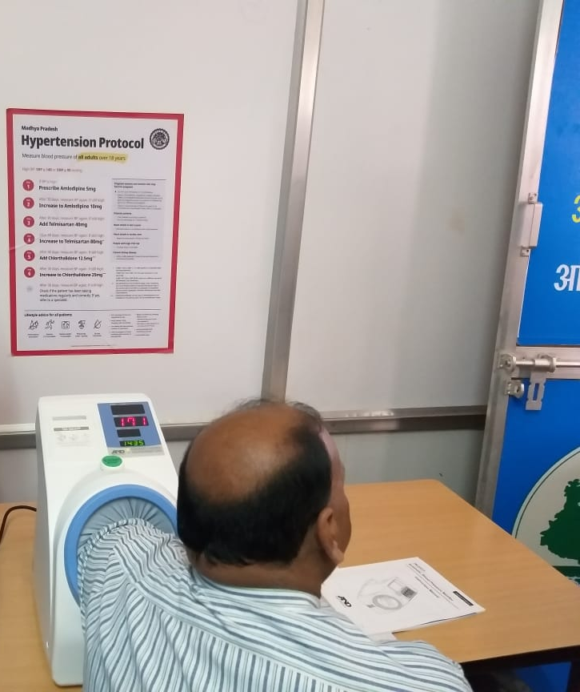
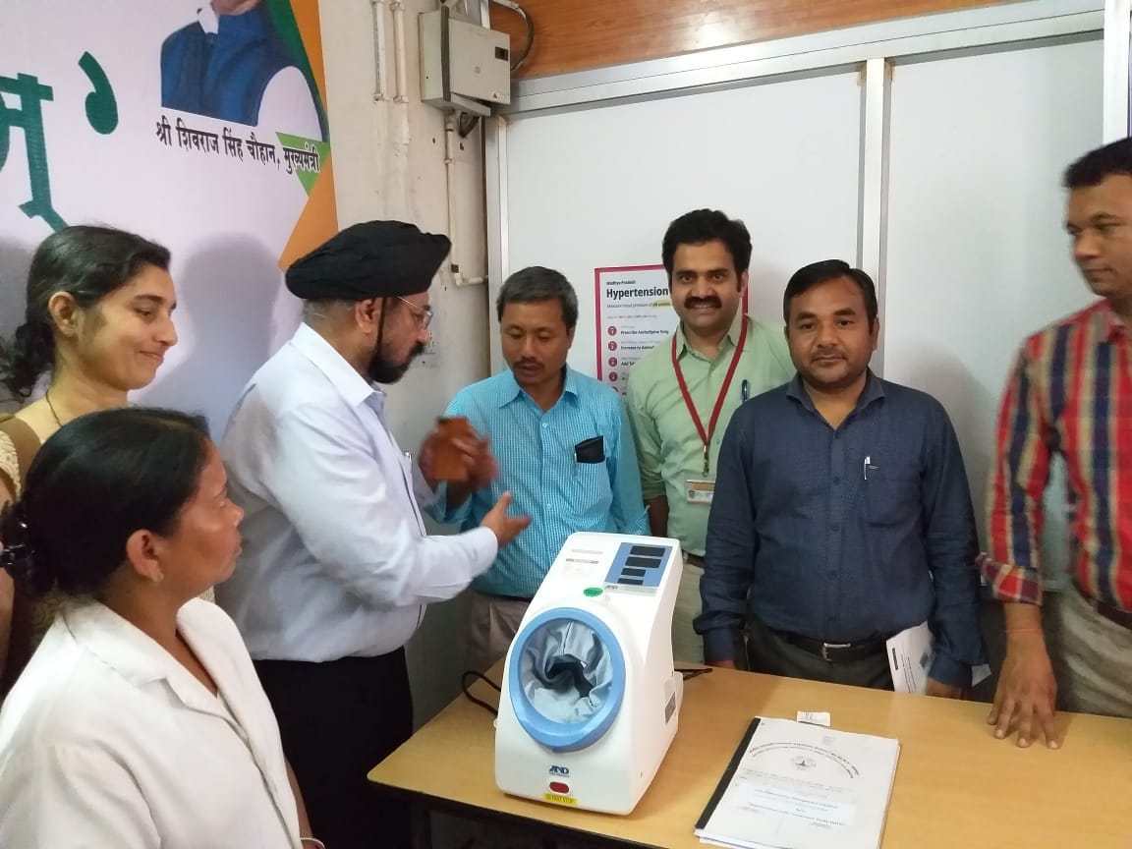
Arm in BP monitor at district and sub district hospitals

Slide 13
Human resources and service delivery
 | Achievement | Lessons learnt
Human resources in health facilities | NPCDCS staff available in majority of the district hospitals and CHC - played key role in operationalizing the program | NPCDCS staff either not recruited or diverted to other departments in many facilities No dedicated staff in PHC, heavy workload
Patient flow and team based care | Patient flow streamlined in some facilities to ensure all patients have BP checked and card entry made by nurse | Non-implementation of opportunistic screening in many NCD clinics Limited coordination between staff in NCD clinic and doctors – not all patients seen by NCD nurse
Patient-centered care | Order issued for 30-day prescription and implemented in most project districts | Decentralization to provide medicines at sub-center level for patients with controlled BP - yet to be operationalized

Slide 14
High prevalence poses a challenge –
Large number patients to be treated in a district
Average population of district – 2 million ,
Population above 30 years – 1 million
Number of hypertension patients who are aware after screening (70%)- 1,75,000
Number of patients seeking treatment in public sector (35%) – 62,000
Number of hypertension patients (25%) – 2,50,000

Slide 15
Monitoring and supervision
 | Achievement | Lessons learnt
Patient monitoring systems | Acceptance of tools by service providers – Patient card at the facility level and longitudinal (cohort) register High patient satisfaction | Need to develop systems for storage and retrieval of cards High rates of default (>60% in many centers) Non-involvement of ASHA and ANM for care
Overall monitoring and supervision | CVHO and STS visit all health facilities in rotation Feedback given to medical officer/district and state officials Better visibility of NCD program | Lack of ongoing field supervision under NPCDCS, therefore NCD activities not periodically reviewed in the districts Low priority in the state level reviews

Slide 16
Pre requisites for an effective hypertension management program
Protocol options at national level - 3 drugs for management in primary care
Procurement of protocol medications
Dedicated staff at facility level - District/CHC/PHC
Community based approaches involving health workers
Monitoring systems - cohort monitoring and mechanism to recall drop outs
Capacity building of all cadres
Supervision and reviews - Consultants / Treatment supervisors
Procurement of good quality BP monitors

Slide 17
What can be accomplished in LMIC :
Treatment and control of blood pressure, Thailand 2004-14

Slide 18
Way forward
Implementation Research from the initial 25 districts will help refine the strategies and document the effectiveness of best practices
Project scale up being considered to total of 100 districts
Aim to cover at least 2 districts per state
Strengthen the capacity of NCD cell at the state level to replicate the good practices in other districts
National and regional workshops will be planned with the states

