Slide 1


Jeevan Rekha
Viral Hepatitis Control Program in Haryana.

Slide 2

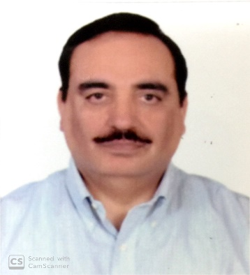
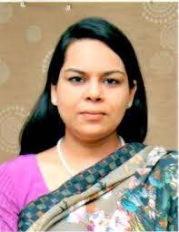



Rajeev Arora, IAS Additional Chief Secretary, Health Department, Government of Haryana, Chandigarh Phone: 0172-2706481
Amneet P. Kumar, IAS Mission Director, National Health Mission, Haryana, Panchkula Phone: 0172-2573922
Dr. Usha Gupta Director Health Services (NVHCP), Haryana, Panchkula Phone: 0172-2562414
Dr. Deepali Agarwal State Nodal Officer (NVHCP) Haryana, Panchkula

Slide 3
Jeevan Rekha- Viral Hepatitis Control Program in Haryana
In 2013 Program started in three Districts (Fatehabad, Kaithal and Jind) with initial state budget of Rs. 5.87 crores.
PGIMS Rohtak was the nodal center for treatment
-Free treatment to special category patients
-Subsidized rate treatment was available to other patients @ Rs. 1 lakh-2 lakh/patient for uncomplicated and complicated respectively.
In September 2017, Viral Load testing through PPP model.

Slide 4
Contd…..
-Program started in all Districts in 2017
-Nodal officers identified.
-Treatment made free for all patients.
On July 28th 2018 National Viral Hepatitis Control Programme launched by GOI and imbibed by the State.
Active screening was conducted from Oct. 2018-June 2019 in 8 high prevalent districts
All prisons given the status of Treatment Centres in Dec. 2018
Prisoner Screening started in all 19 prisons of Haryana in Dec. 2018.
Tele-callers facility established at SHQ to regularly follow-up with the patients during the active screening period.

Slide 5
Jeevan Rekha- Viral Hepatitis Control Program in Haryana
Generating awareness among people
Conducting screening in Hot Spots
Identifying the Hot spots
Linkage of positive patients with the health services
Follow-up with the patients
Ensuring availability of Drugs and testing facilities
Finding the areas contributing to maximum no. of patients
Using IEC activities to aware people in hot spots about causes of Hepatitis C.
Screen general population in Hot-spots for Hepatitis C.
Providing counselling to patients & provide them information to remove apprehensions.
Continuously monitoring drugs and partnering with empanelled agency for testing facilities.
Tele-caller facilities establishment at SHQ.

Slide 6

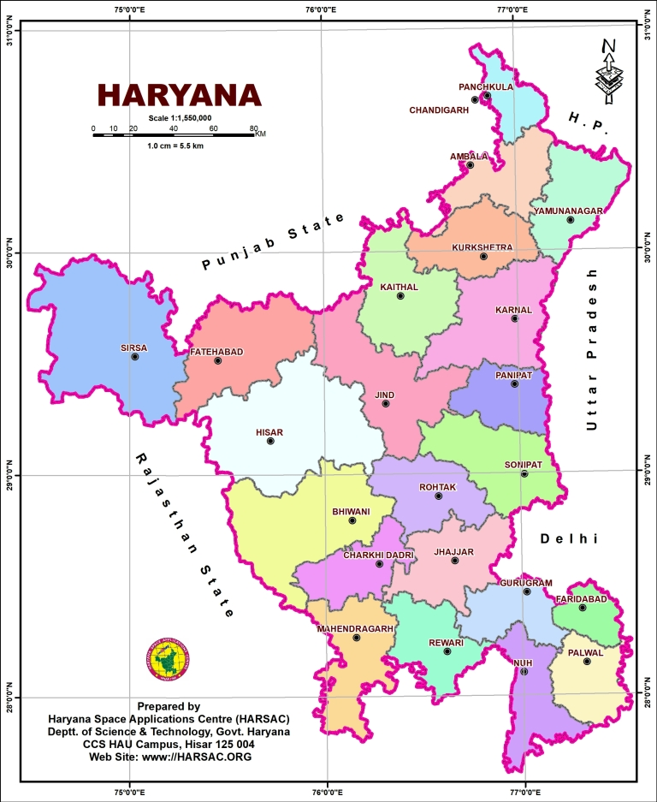
Identifying the Hot spots
The State was maintaining data of Hepatitis-C patients from the beginning of the treatment services at the level of Treatment Centre and Model Treatment Centre, in excel.
Geographic as well as treatment related details were recorded in the data.
The data identified eight high burden districts in the State.
High burden districts of Haryana are Fatehabad, Hisar, Jind, kaithal, Karnal, Panipat, Sonipat, Sirsa.
Districts on border between Punjab and Haryana on both sides had more prevalence due to increased I/V drug abuse.

Slide 7
Generating awareness among people
In order to prevent the spread of Hepatitis-C State conducted special awareness drives in these eight districts.
The general public also made aware about the causes of Hepatitis-C through display of hoardings, distribution of posters/ pamphlets etc.
People were made aware about free diagnosis as well as treatment provided by the State to all Haryana domicile patients.
Advertisements were given in newspapers to spread the awareness.

Slide 8
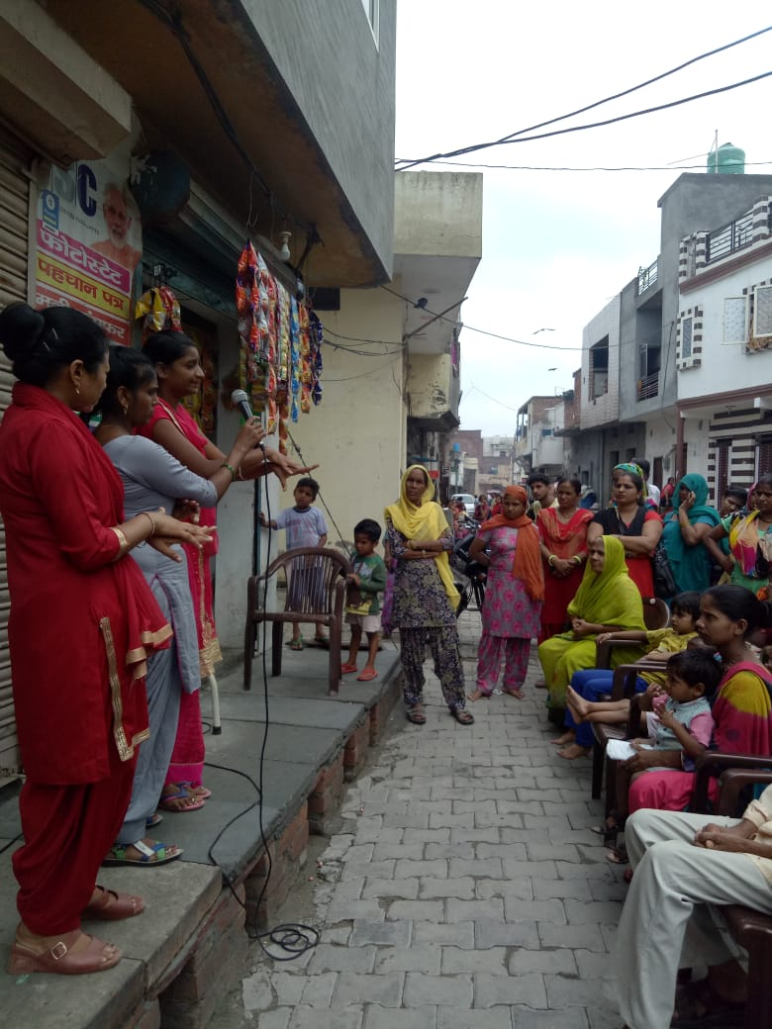
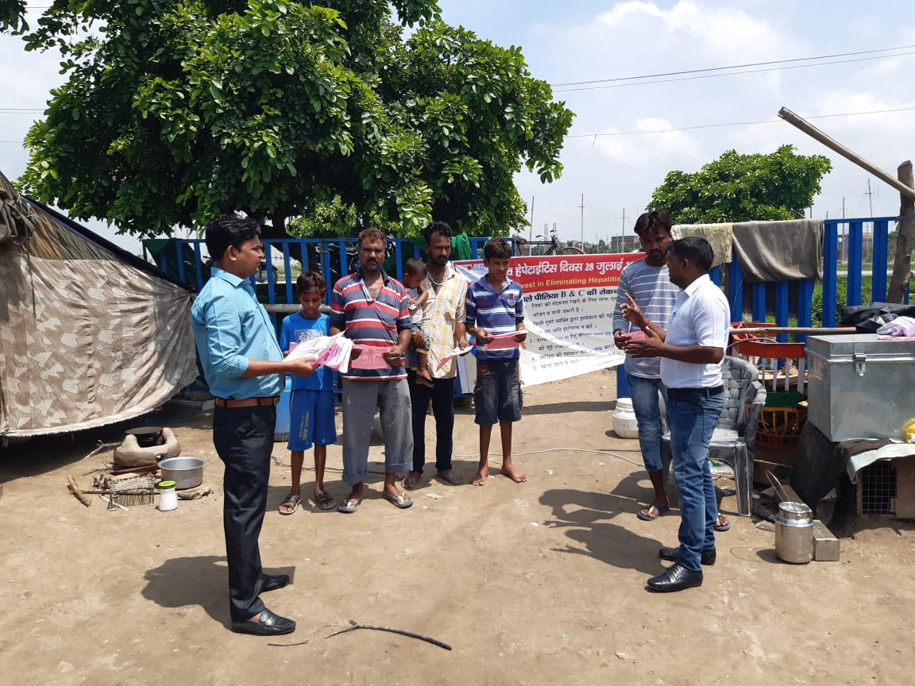
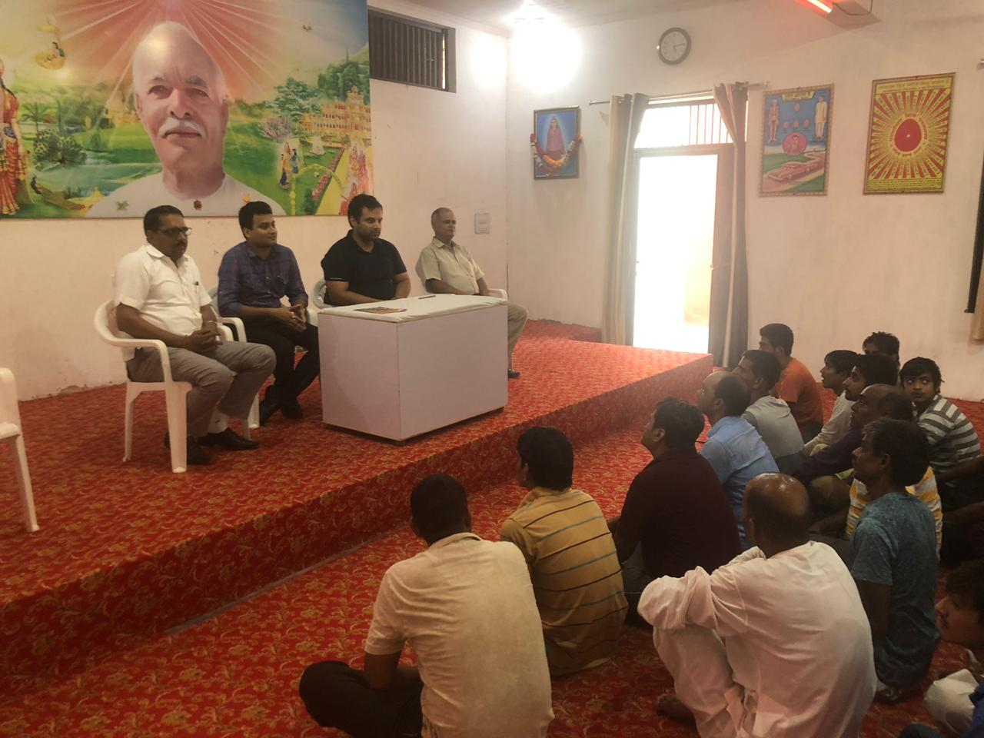
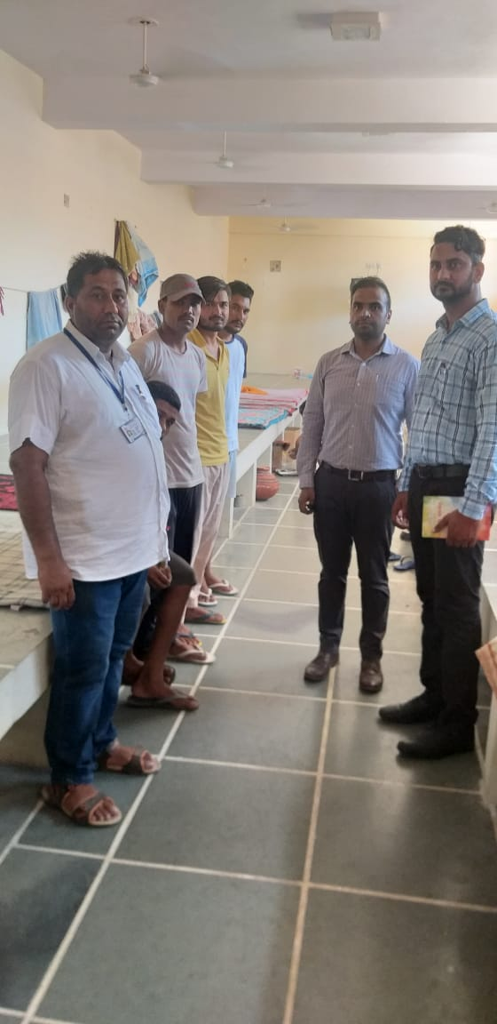
Awareness Camps/Nukkad Talks
Panipat
Urban Slums
Sonepat,
Bhiwani
Prison
Sirsa

Slide 9

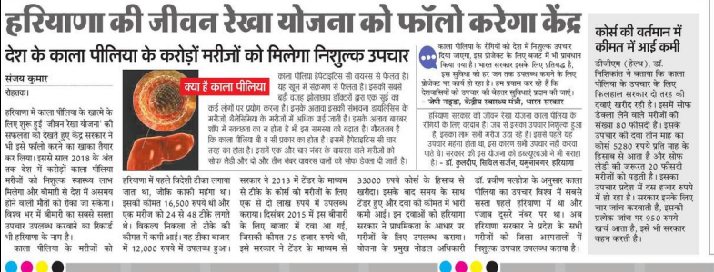
Jeevan Rekha- Makes a Mark

Slide 10
Conducting screening in Hot Spots
High prevalence in these eight districts alerted the State about the magnitude of the problem which needed to be quantified through research.
Hence, State, in August 2018, under the direction of DHS-NVHCP prepared a plan to start active screening drive in high burden districts.
Diagnostic services were provided through empanelment of lab.
Screening camps roster was prepared and active screening was conducted over a period of 9 months from Oct. 2018 to June 2019.

Slide 11
Ensuring linkage of positive identified patients with the health services
Active screening in high burden districts and prisons resulted in identifying approx. 4,470 Hepatitis C patients (through RDT)
Linkage of all patients to the health services was essential to progress towards the aim of Hepatitis-C free Haryana.
Counselling was provided to all patients about all aspects of the treatment
Their data such as name, address, contact etc. were recorded and used for follow-up later.
Confidentiality of the data was also ensured.

Slide 12
Follow-up with patients (Tele-Callers facility)
For follow-up of the patients the State set up Tele-callers facility at the State head quarter.
It facilitated monitoring of the patient from screening to the end of treatment for a period of 9 months between Oct. 2018 to June 2019.
Tele-callers were trained to provide counselling as well as clearing queries, apprehension of the patients.
It actually helped the State in linking patients with the health services.

Slide 13
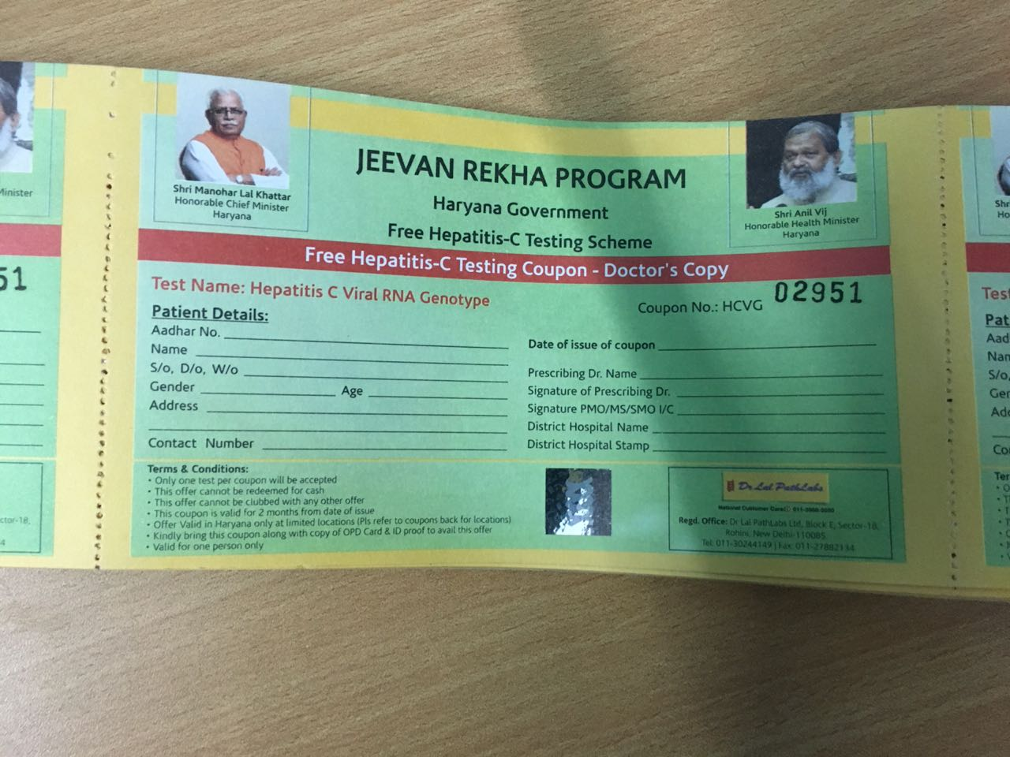
Ensuring availability of Drugs and testing facilities
Drug inventory monitored by Haryana Medical Services Corporation Limited through online drug portal.
It helped in preventing stock out situation.
Drugs Stock was maintained in 8 Drug warehouses of the State and districts were distributed considering their distance from the warehouses.
The State provided diagnosis facility through decentralized model via empanelment of laboratory services which helped in managing patient load for diagnostics as well as preventing unnecessary travel of patients.
Diagnostic Coupon

Slide 14
Program Outcome
The Active screening drive in high burden districts and prisons helped in quantifying the prevalence of Hepatitis C.
Prevalence data helped the State in framing further strategy to tackle the burden of the disease.
It proved the State’s ability to work in decentralized mode in collaboration with State partners.
It generated awareness among general population about Hepatitis C.
Finally, it expedited the progress of the State towards the goal of eliminating Hepatitis C.

Slide 15
Scalability of the Model
The program’s primary requirement is identification of Hotspots.
Once hotspots are identified on the basis of data efforts/resources can be deployed in those regions to reinforce currently running health services.
State has implemented this working model in High burden districts, prisons and ICTC centres and has planned further strategy for its implementation among other high risk groups such as:
  De-addiction centres.
  OST centres.
  Both for Hepatitis B&C.

Slide 16
Screening in Prisons
Prisoners are a high risk group for the Hepatitis C.
The State extended identification and screening working model to prisons.
Started screening for Hepatitis C in all 19 prisons of the State in Dec. 2018.
Out of total 19,500 prisoners 16,947 were screened during the period of Dec. 2018 to Sep. 2019
To avoid the movement of the prisoners, all prisons made into Treatment centres
Screening ,Confirmation and Treatment done in prison itself

Slide 17
Working Model in Prisons
Blood samples of all positive screened prisoners being taken in prison itself by Prison medical officials and sent to Lab for Viral load test
Blood sample of viral load confirmed patients is being taken in prisons & brought to TC for baseline investigations
Medical Officer of prison did screening regularly in prison itself
Based upon the results of investigation, drugs are being provided to prison medical officer.

Slide 18
Future Roadmap
Priorities for the State to meet the objectives of:
  Elimination of Hepatitis C from the State much before 2030.
  Reduce the mortality and morbidity associated with Hepatitis B&C
Launch of Hepatitis-B treatment services in the State.
Screening of prisoners for Hepatitis-B along with Hepatitis-C.
Screening of HIV patients in collaboration with ICTC centres for Hepatitis-B along with Hepatitis C.
Screening of High risk population for Hepatitis B&C in
    De-Addiction centres
    OST centres
    Other high risk groups.

Slide 19
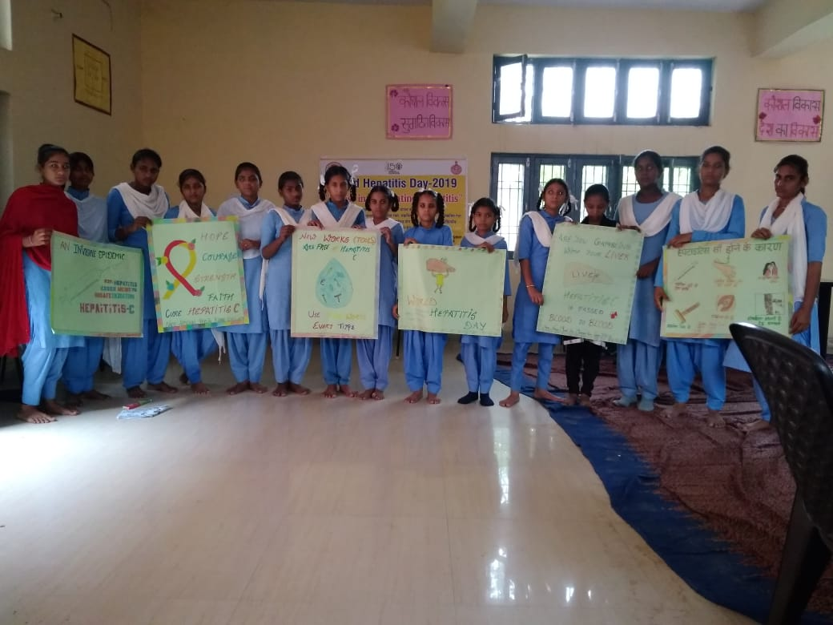
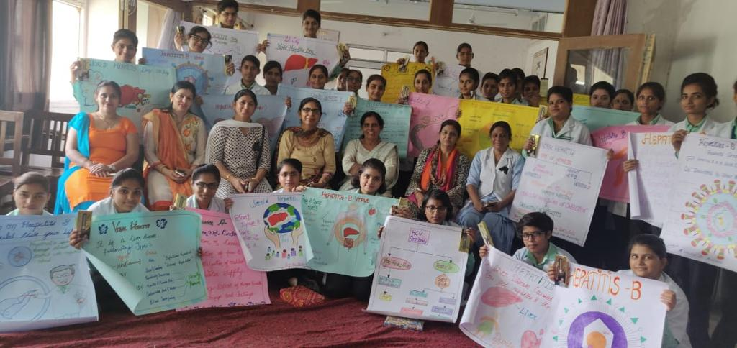
Poster making Competition at Schools
Sirsa
Hisar

Slide 20
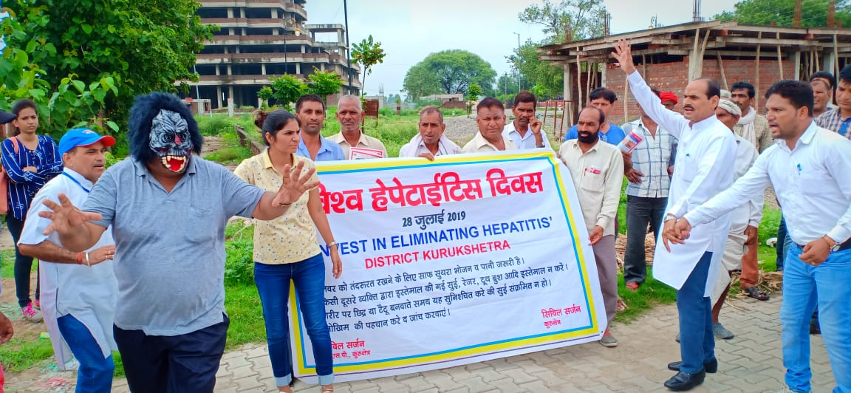
Nukkad Nataks
Kurukshetra
Panipat

Slide 21
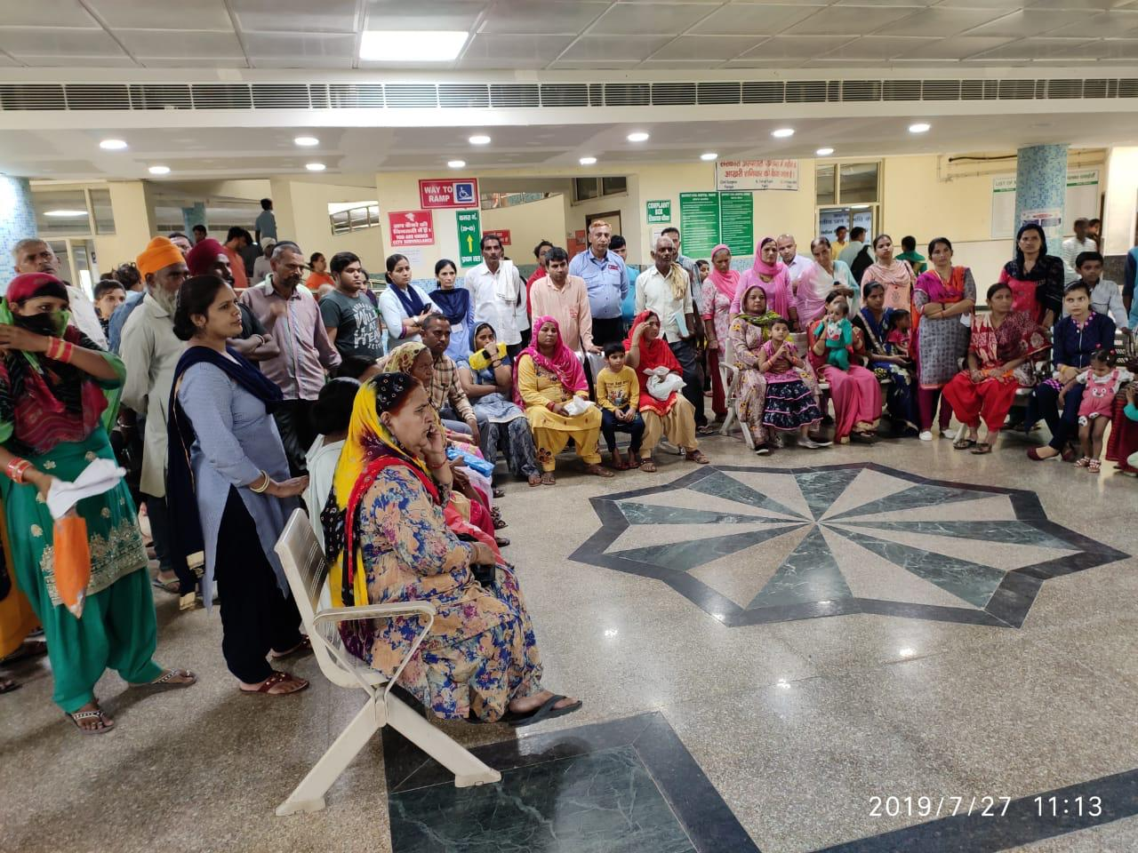
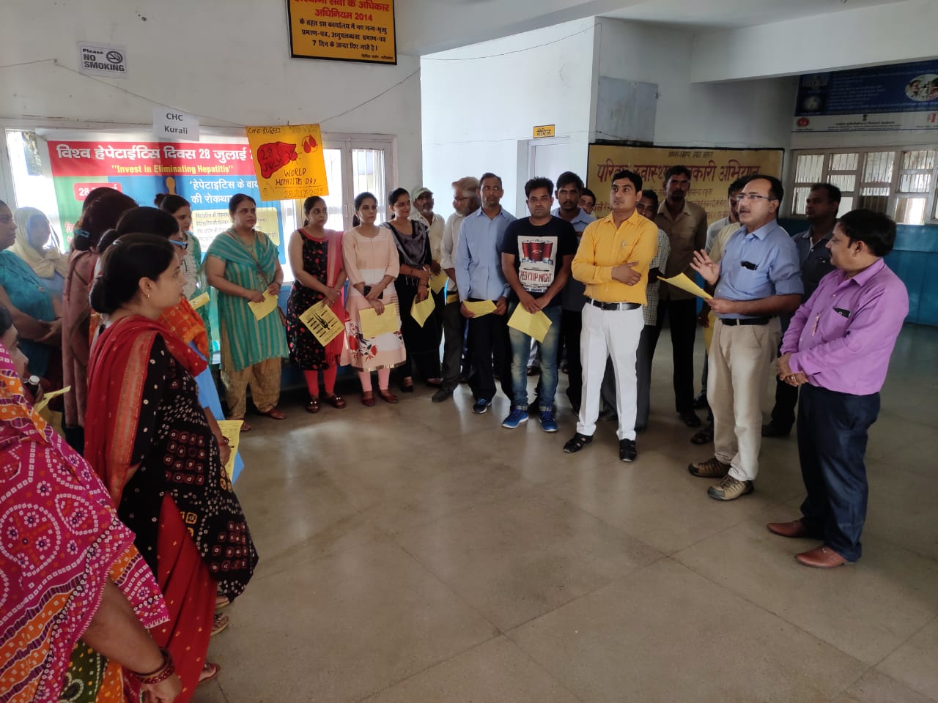
CHC and PHC level Awareness camps
Kaithal
Faridabad

Slide 22
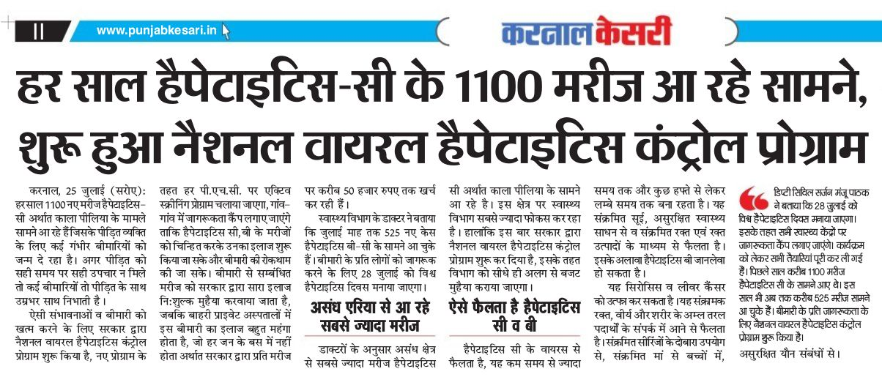
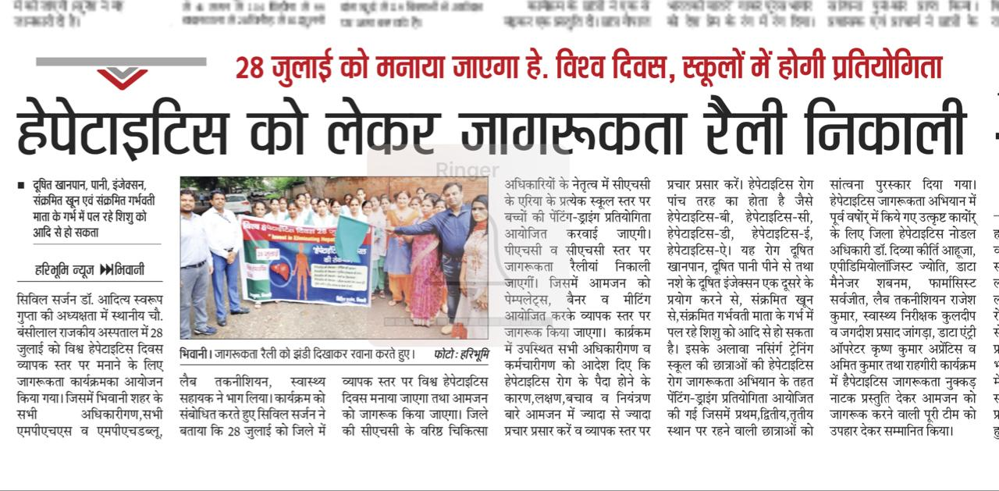
Newspaper advertisements
Karnal
Bhiwani

Slide 23
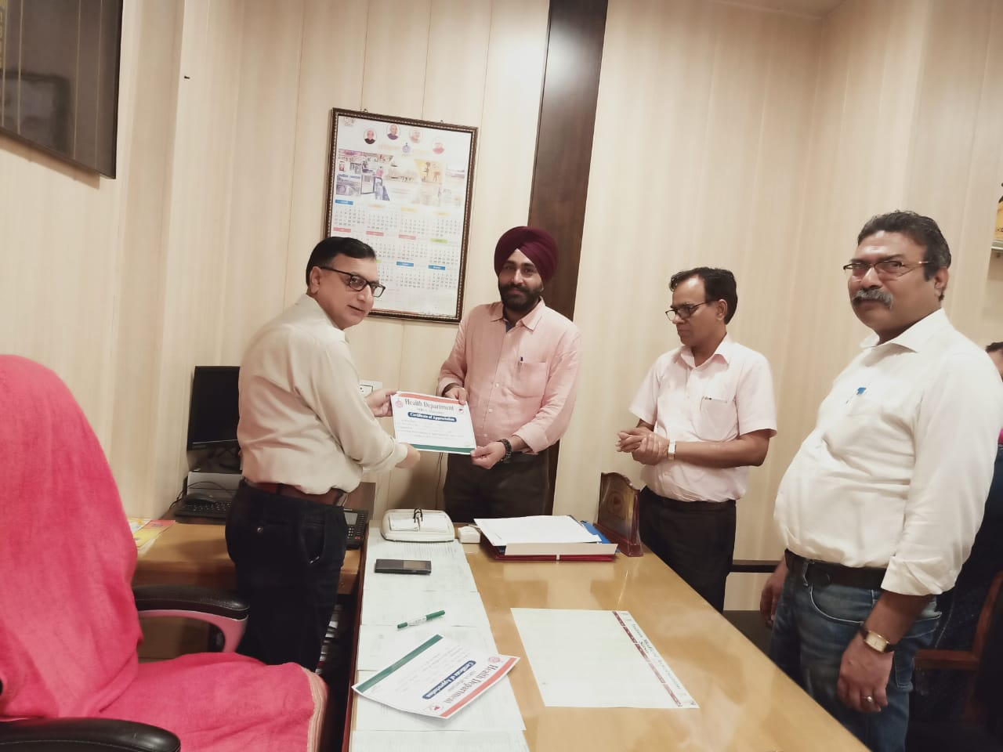
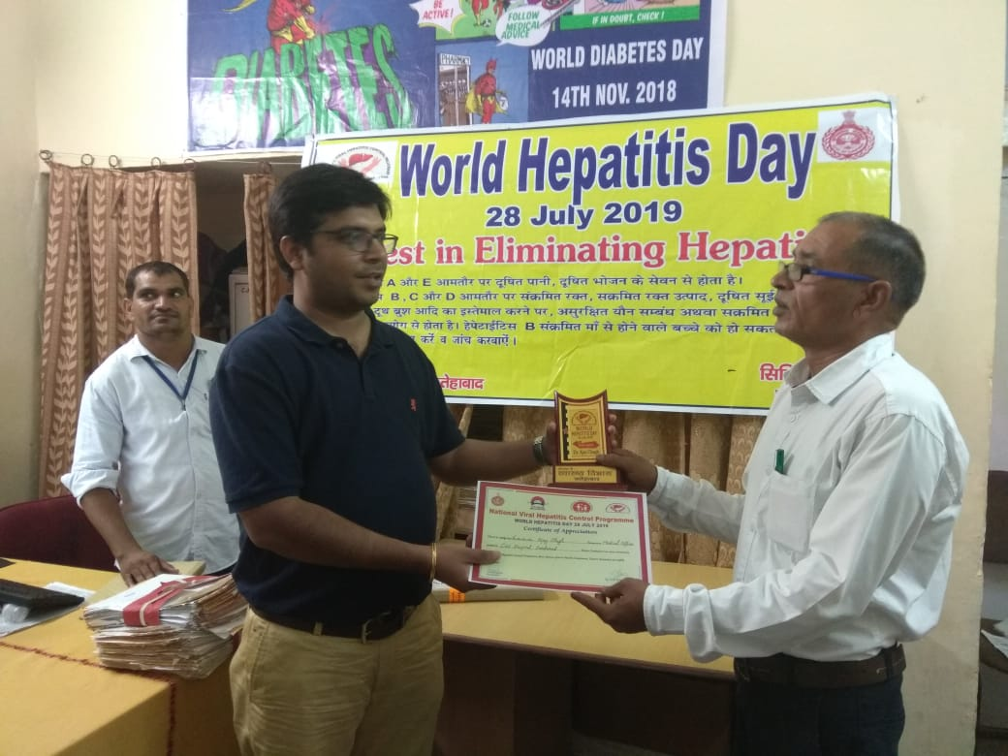
Appreciations to DNO’s
Dr. Satinder Dhanju, Sirsa
Dr. Ajay Chugh, Fatehabad

Slide 24
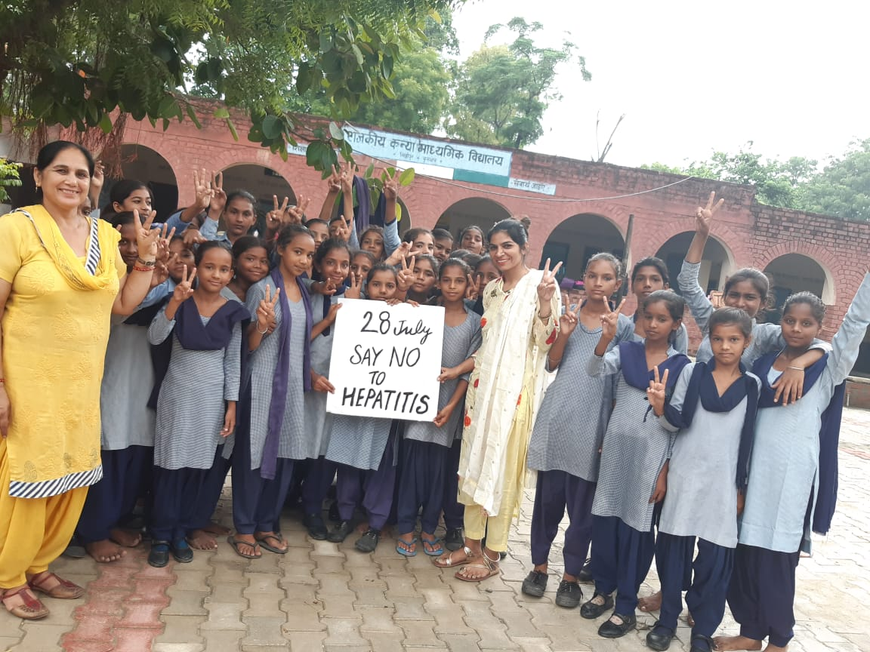
Thank You
We are committed to eliminate Hepatitis from Haryana much before 2030.

