Slide 1


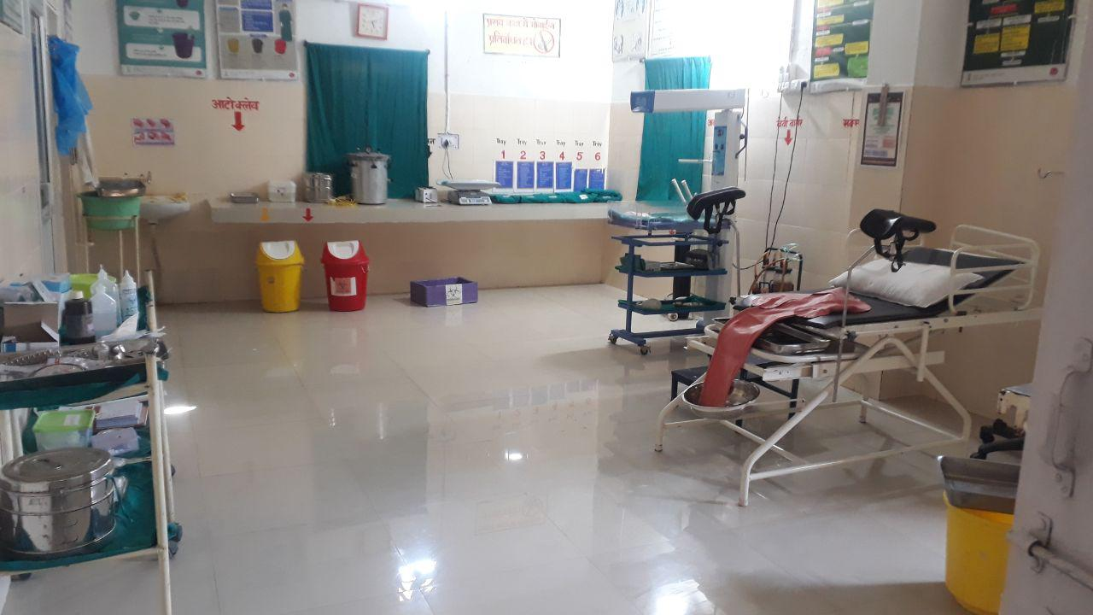

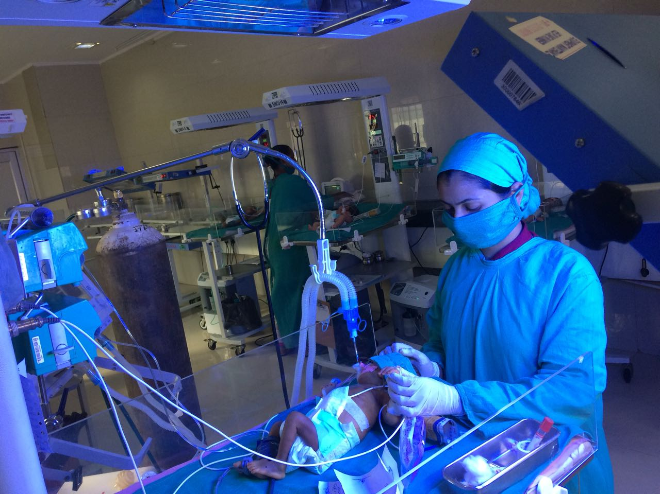
Innovations in Maternal and Child Health Care Services in Chhattisgarh
Department of Health & Family Welfare, Govt. of Chhattisgarh

Slide 2
A. Microbial Surveillance of
SNCU & Maternal Care Service

Slide 3
Problem Statement
% of Causes of Maternal Deaths in Chhattisgarh 2018-19
% of Causes of Neonatal Deaths in Chhattisgarh 2018-19
Sepsis 4th leading cause of Maternal death
Sepsis 3rd leading cause of death in Neonates

Slide 4
Objectives
Environmental Microbial surveillance of SNCU & Maternity Units
Profiling of various Nosocomial Infections (NIs) in SNCUs
Profiling of causative pathogens & their Antibiogram.
Prevailing Antibiotic Use Surveillance
Training of Staff posted in unit as per Infection Control protocols
Future Interventions to be planned & Executed accordingly to minimize morbidity & mortality

Slide 5
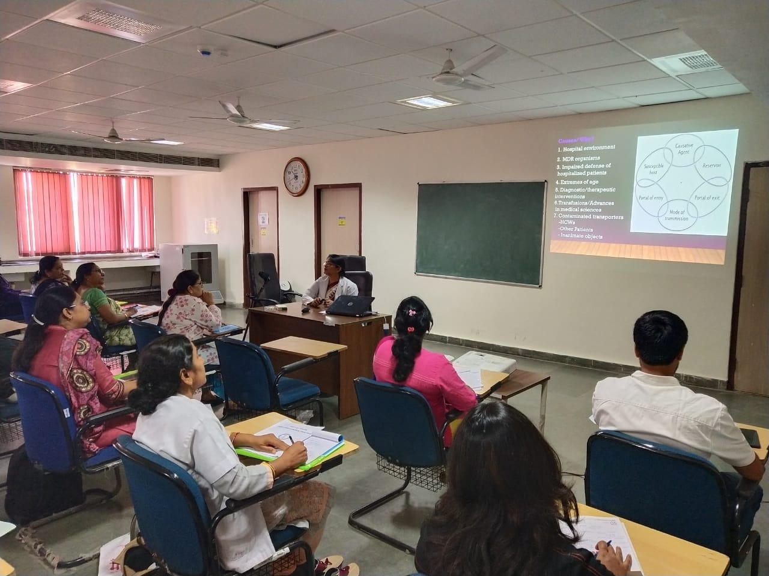
Phase I -Environmental microbial surveillance of SNCUs
Environmental microbial surveillance of SNCUs started in Feb 2017
Sensitization of staff regarding magnitude of Hospital Acquired infections (HAIs) in SNCUs & Training in ICP
Started in 13 SNCU with pre-defined collection sites
Training of Staff in Collection & transportation of sample
Empanelment of Runner
Samples were collected in pairs from the sites- pre and post cleaning to find out the efficacy of cleaning process
03 rounds of environmental surveillance were completed in 13 SNCUs
Results were shared immediately with the units to do the corrective measures
DHS/NHM
UNICEF
EKAM
AIIMS
Stakeholders

Slide 6
Environmental Sample Collection Sites
Sites in SNCU
Nursing Station
Phototherapy Hood, Warmer Basinet
Cradle Bar/Frame
Suction Tube, Suction Jar,
Oxygen Humidifier/Ventilator/C-Pap
Ambubag, Nebulizer Mask
Water Tap Handle, Door Handle, Medicine Trolley,
Infusion Pump, IV Stand, Oxygen Concentrator, Oxygen Hood
Procedure Trolley, Key Board Computer
Sites in Labour Room
IV stand
Oxygen bag and mask
Door handle
Delivery trolley
Labour Table
Infant weighing scale
Labour Room Warmer
Oxygen hood
Electrical Suction Machine and tubes
Nursing station

Slide 7
Process for Sample Collection, Report Generation of Environmental Surveillance
Sample Collection in swab
Report to facilities
Sample transport in cold box
Sample processing in AIIMS
Runner

Slide 8
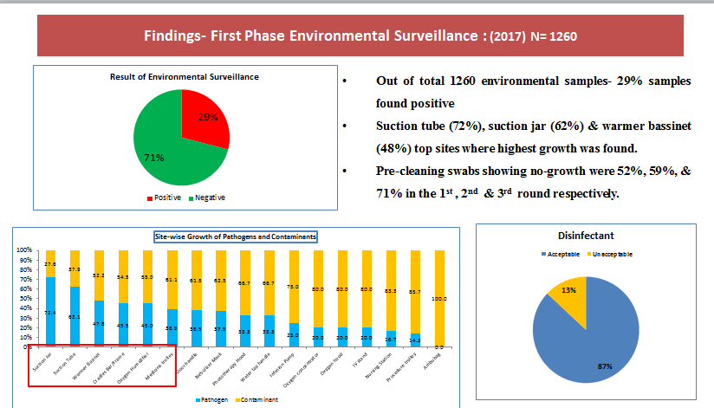

Slide 9
Common pathogens in environmental sample (%)

Slide 10
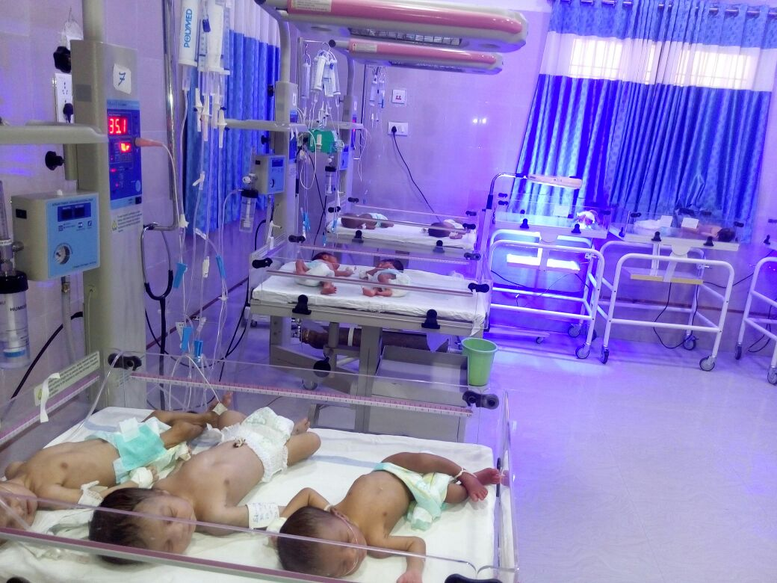
Interventions after phase -I
  Customised Infection Control Guidelines developed for each SNCU based on lab results& available resource
  Development of SOPs for cleaning & disinfection
  Training of all SNCU Staffs on cleaning process
  SOP for Use of disinfectant were provided
  Expansion of phase in blood surveillance
  Rational use of Antibiotics

Slide 11
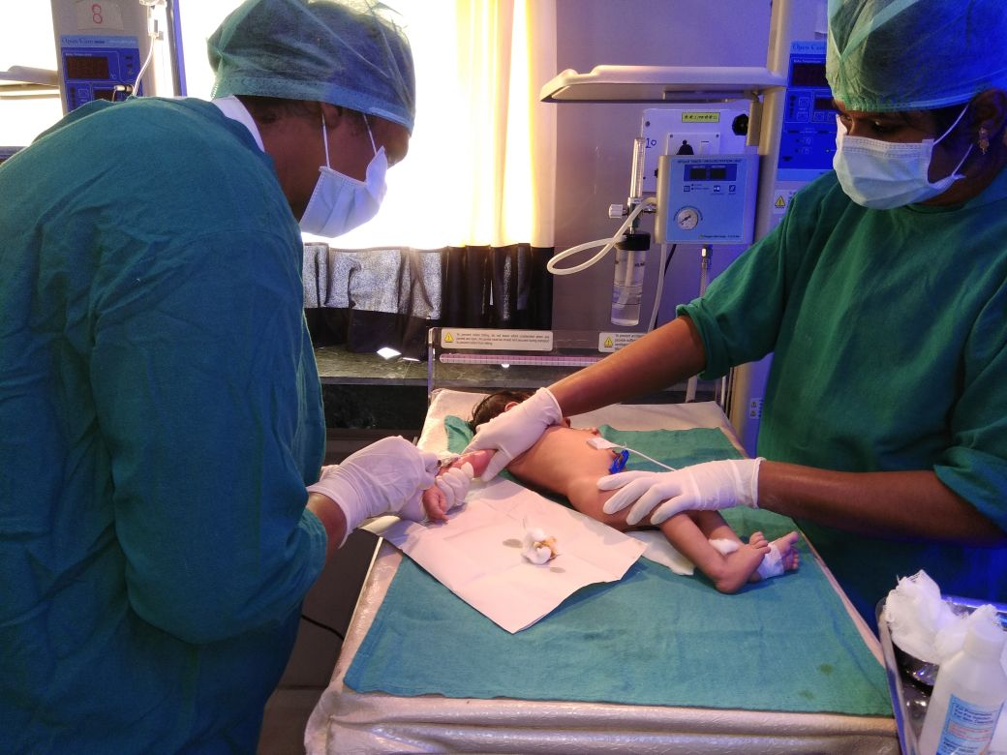
Phase-II Blood Surveillance
Blood sample surveillance started in October 2017 and is on-going since than
Blood samples of neonates suspected of sepsis has been taken
Samples were transported through private bus free of cost by runners to collection centre at AIIMS, Raipur

Slide 12
Process For Sample Collection & Report Generation of Blood Culture
Drawing of Blood sample
Sharing of reports with the units
Blood sample in bar coded bottle
Sample testing at AIIMS Raipur
Free Sample transportation by bus

Slide 13
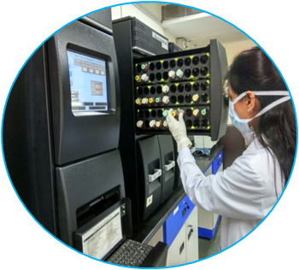
Phase-II Findings Blood Surveillance N=4043
Indicator | 2017 (Oct to Dec) | 2018 (Jan to Dec) | 2019 (Jan to Sept) | Total
Total No of SNCU | 13 | 17 | 23
Total no Samples | 73 | 1375 | 2595 | 4043
Total no of positive samples | 47 | 618 | 881 | 1546
% of samples positive | 64 | 45 | 34 | 47.6
Antibiotic use rate | 59.2 | 59.2 | 49.3

Slide 14
Pathogens found in blood culture Multi Drug Resistant pathogens

Slide 15
Interventions after Phase II
  Prescription of Antibiotics as per the sensitiveness as per the report provided by AIIMS
  Decrease in prescription of antibiotics for each and every cases.
  Profiling of the Nosocomial infections
  Tele consultation
  Supportive supervision by AIIMS faculty
  Quality Improvement cycle initiated
  Development of database for formation of antibiotic policy

Slide 16
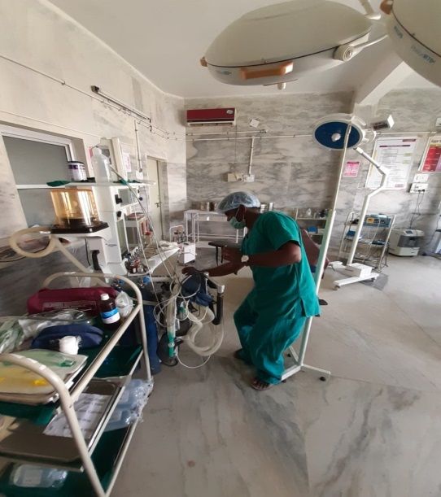
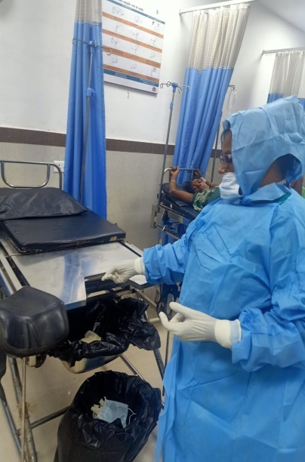
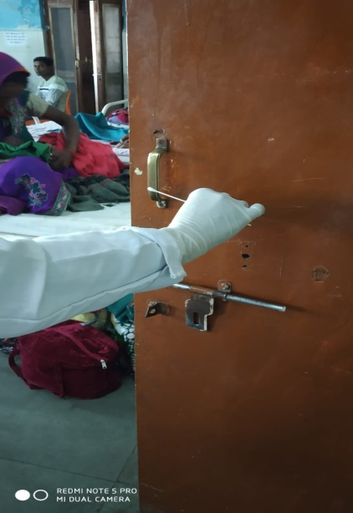
Phase-III Post Intervention Assessment & Expansion to Maternal Care Service
After successful completion of phase-II
Phase-III Environmental surveillance of SNCUs and Maternity units started in April 2019 in 23 district hospital starting with training of maternity units staff
First round of environmental surveillance completed in 23 districts.
Pre Intervention Environmental Surveillance of Labor room, OT & PNC Ward
Analysis of findings
Intervention planned accordingly
Post intervention impact assessment

Slide 17
Findings – Environmental Surveillance Phase III (2019 ongoing)
N=2080
Common organisms observed are
Staphylococcus aureus,
Methicillin Sensitive
Coagulase Negative
Staphylococcus
Klebsiella pneumonia.

Slide 18
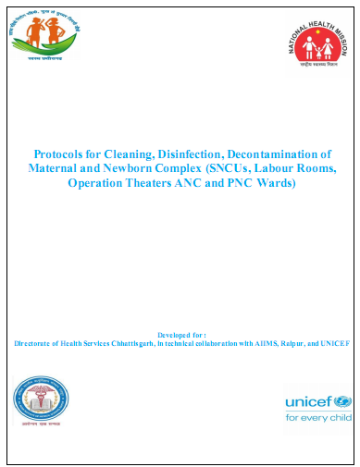
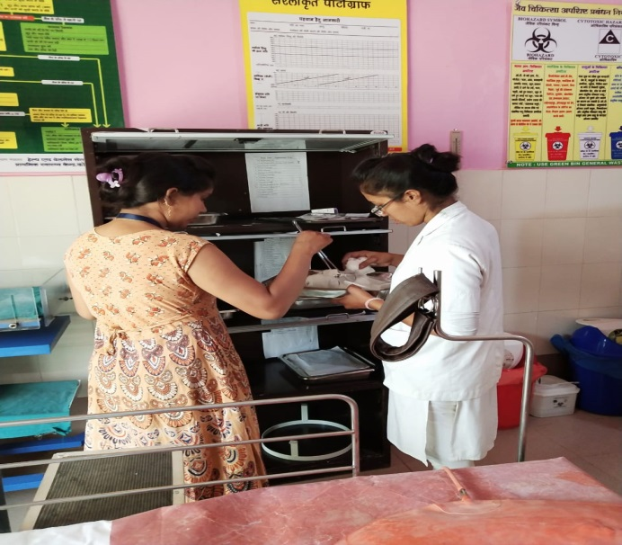
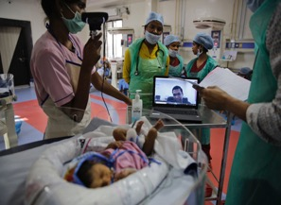
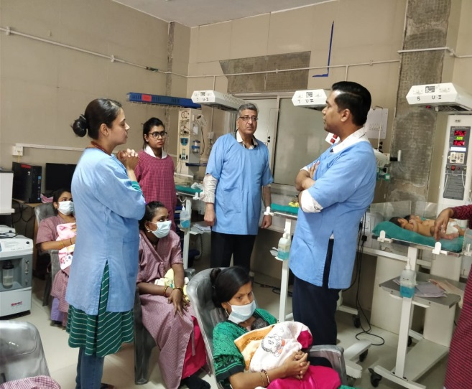
Interventions after phase -III
Microbial consortium committee formed at state level for review, intervention planning & regular follow-up
Development of SOPs for cleaning in Maternity Units in addition to SNCUs
Nurse mentoring program initiated
Handholding support to the facilities through quality circle team
Quality improvement cycle initiated in Maternity Units
Supportive supervision visit by AIIMS experts & lab strengthening in medical colleges
Special Focus on microbial Surveillance- Point of care quality improvement (POCQI)

Slide 19
Key Outcomes
Post intervention results have shown improvement.
Positive growths in the blood surveillance reducing from 2017 to 2019.
Antibiotic prescription rate has declined from 67% in 2016-17 to 57% in 2018-19 and Jan to September 49%.

Slide 20
Reduction in Pre & Post Cleaning growth
26 PT

Slide 21

Way Forward
  Preparation of customised antibiotic policy for the SNCUs
  Strengthening of Microbiology labs in the Medical colleges for handholding to nearby district & decreasing load in AIIMS
  Monitoring & Mentoring (M&M) units are being formed at state & district level for peripatetic training
  Incorporating infection control protocol training like Dakshata, LaQshya and Bemoc , FBNC training etc.

Slide 22
B. e- Kalyani

Slide 23



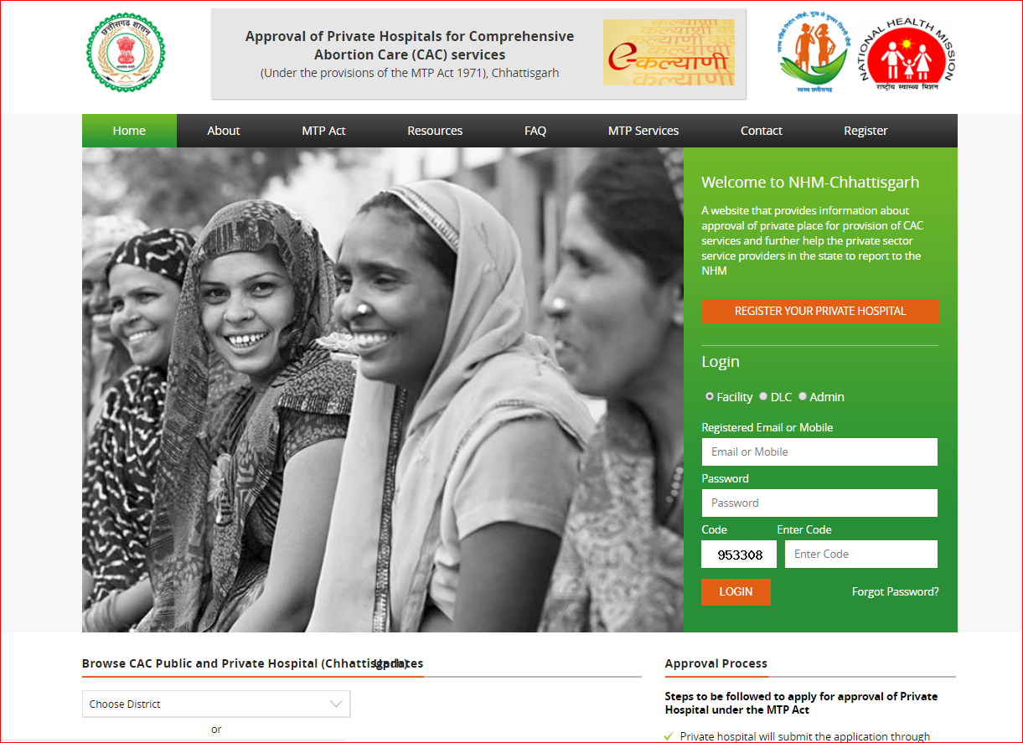
E- Kalyani
A Technology Based Solution to Strengthen Registration & Reporting of MTP Services in Private Sector in Chhattisgarh
http://cg.nic.in/ekalyani

Slide 24

Problem Statement
In India (8%) & Chhattisgarh (2%)unsafe abortion contributes to maternal deaths.
More than half of abortion services are offered by private sector
High pendency of applications for CAC
Problem on MTP reporting from private nursing home/hospitals.
Delay in approval of pvt. facilities by DLC

Slide 25

Need of Technology
Smooth and faster process required for application & approval
No centralised data of District Level Committee (DLC)approved private facilities
No centralised monitoring system for approval
Lack of reporting of MTP services by approved private facilities.
Limited access to information for private health facilities about process of application & approval

Slide 26
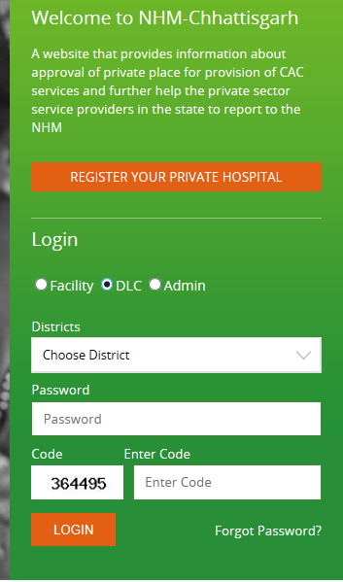
Module of Software
Web based online system with following modules
For private facilities
    Application
    Reporting
For DLC
    Review of application
    Approval
Admin
Centralised review and reporting
Public view
    Information about MTP Act
    District-wise information of public and private health facilities offering safe and legal abortion services
c

Slide 27
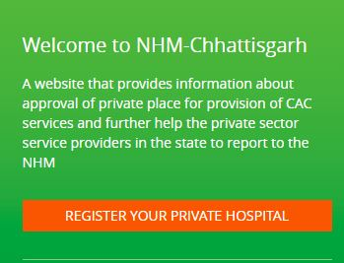


Application Process
Fill form A online
Submit printout of form A to CMHO’s office
Through registered mail ID & Password facility will report monthly MTP services data in form II.
Facility approved and Form B issued & upload form B by DLC.
DLC will review application, conduct site verification and approve or reject the application as per the MTP ACT 1971.
Facility owner will get SMS on registered mobile no. & password on registered Email ID
After approval you can get SMS & mail for your site approval.
Notes:
Inspection: A place approved under rule 5 may be inspected by the CMO, as often as may be necessary with a view to verify whether termination of pregnancies is being done under safe and hygienic conditions.
If the CMO has the reason to believe that there has been a death/ injury, of a pregnant woman in the place or that the termination of pregnancies is not being done done under safe and hygienic conditions, he can call for any information or may seize any article.
DLC members cannot conduct independent inspection, the inspection has to be conducted by CMO or authorized representative.
Suspension or cancellation of certificate of approval: : If the CMO after the inspection is satisfied that the facility is not being maintained properly and termination is not being conducted in safe and hygienic conditions, he/she shall report the same to the DLC giving detail of deficiencies and the DLC if satisfied, suspend or cancel the approval provided. However, DLC shall give an opportunity of making representation to the owner of the place before the certificate of cancellation is issued.
Where a certificate issued under rule 5 is cancelled, the owner of the place may improvements in the place and thereafter, he may make an application to the DLC for grant of approval under rule 5.
In the event of suspension of a certificate , of approval, the place shall not be deemed to be an approved place during the suspension for the purposes of termination of pregnancy from the date of communication of the order of such suspension.
Review:
The owner of a place, who is aggrieved by an order made under rule 7, may make an application for review of order to the Government within 60 days from the date of such order. Provided that Government may condone any delay in case it is satisfied that applicant was prevented by sufficient cause to make application within time.
The DLC, after giving the owner an opportunity of being heard, would confirm, modify or reserve the order for approval.
Form of consent: The consent referred to in sub-section (4) of section 3 shall be given in Form C.
Repeal and saving: The MTP Rules 1975, are hereby repealed except as respects things done or omitted to be done before such repeal.

Slide 28
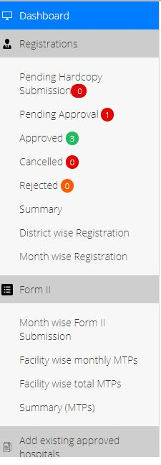
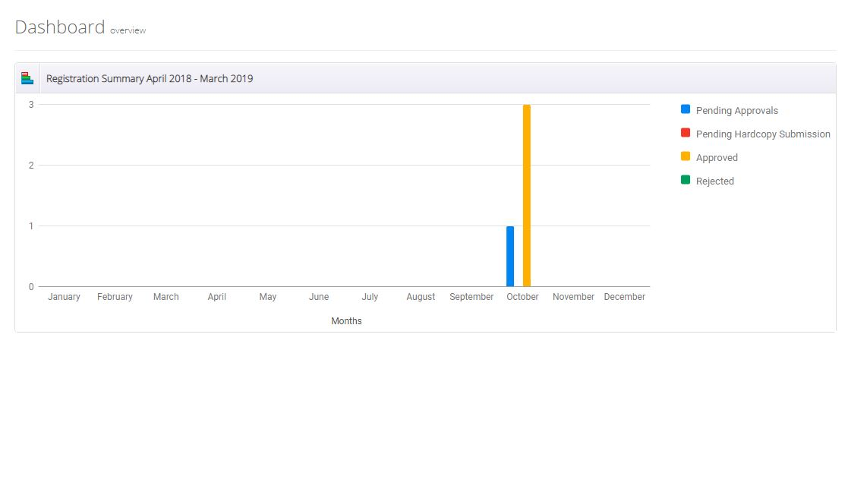
District Login (DLC)
Review pending applications
Review application, conduct site verification and approve or reject the application.
Upload form B.
Review facility wise reporting.
Alert defaulters.

Slide 29
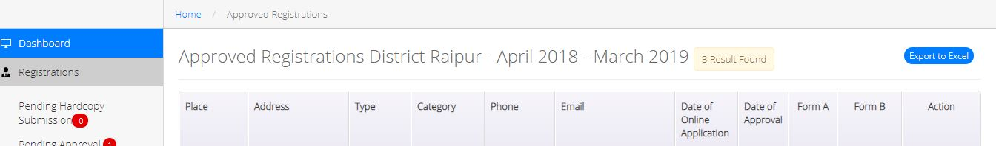
Approval by DLC
New applications
Login with DLC credentials
Review form A
Conduct facility visit
Recommend for approval/rejection
Approved then upload form B and inform applicant

Slide 30
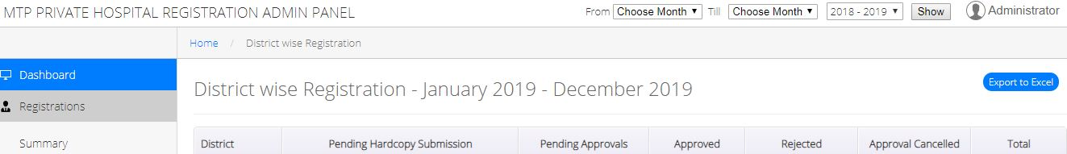
Admin
Review district-wise pending applications
Approval status and form B upload
MTP reporting status
Alert defaulters and uncovered districts
Update important information resources about MTP

Slide 31
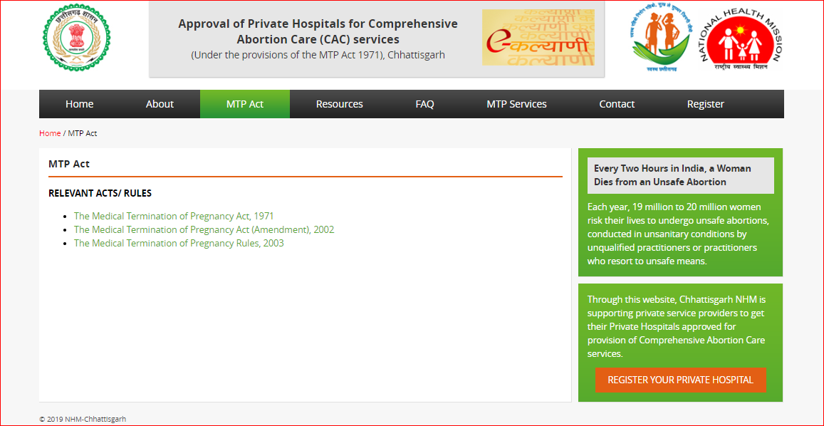
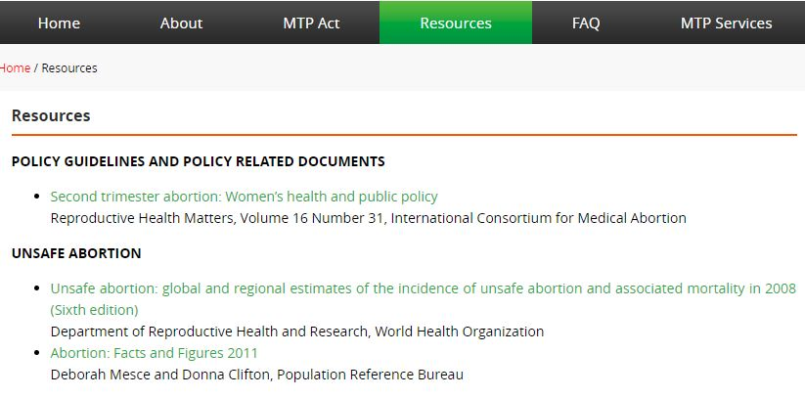
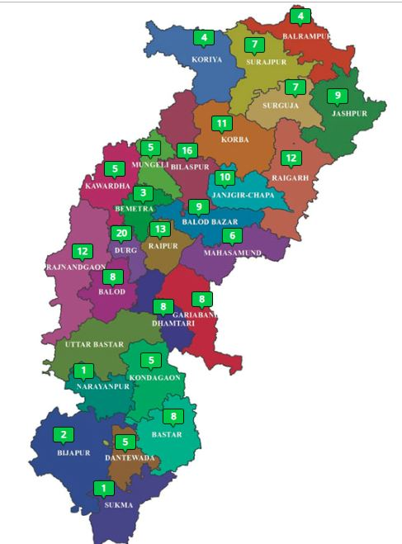
Public view
Free access login not required
Information about MTP Act
Resources and policy guidelines on CAC.

Slide 32
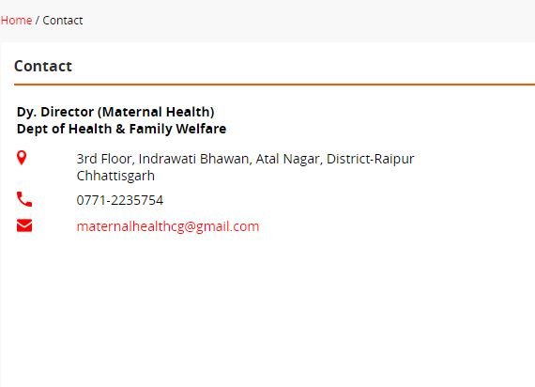
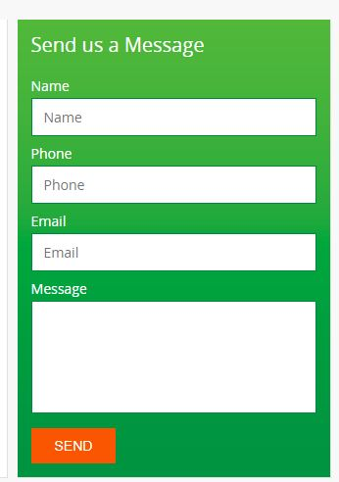
Feedback & Grievances Benefits of E-Kalyani
Monitoring system will improved.
Email & SMS system every level- form A submission, Form B uploaded, reminders for reporting each month.
Less paper work- online reporting.
Monitoring of form A submission date and time taken in approval process.
All information related to CAC available at webpage.
/ 104 health helpline

Slide 33
Current Status
Active District level committees- 27
Application received for CAC accreditation | Application review and issued certificates | Reporting started
121 | 72 | From 42 Pvt. centers

Slide 34

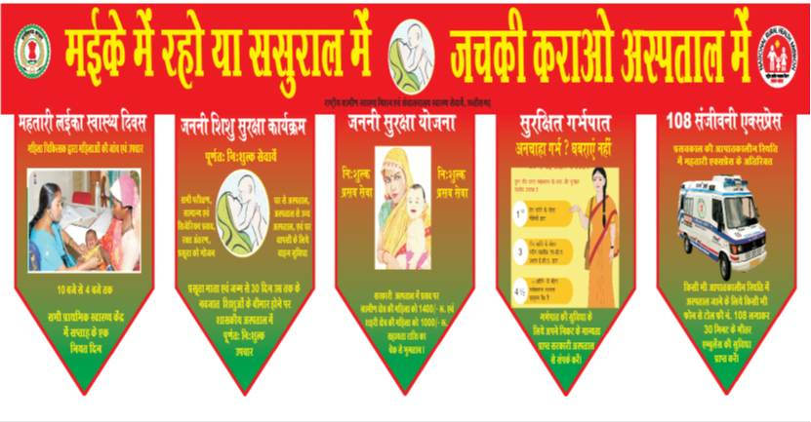
Way Forward
Incorporating reporting of reasons of MTP services
Linkage of private USG centre and MTP centre
Interactive Voice Response System to record women’s perception of quality of services received.

Slide 35
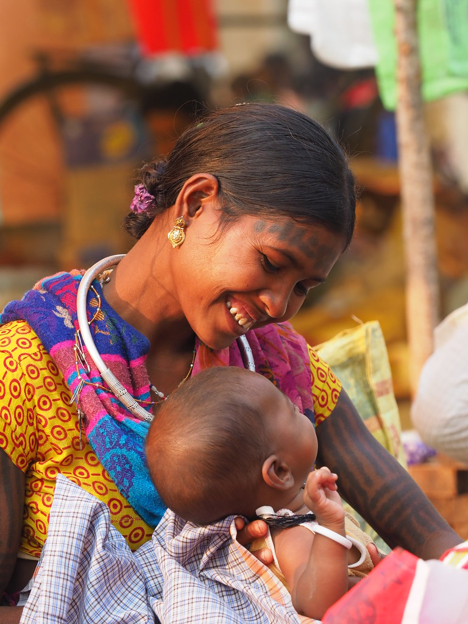
Thanks !

