Slide 1

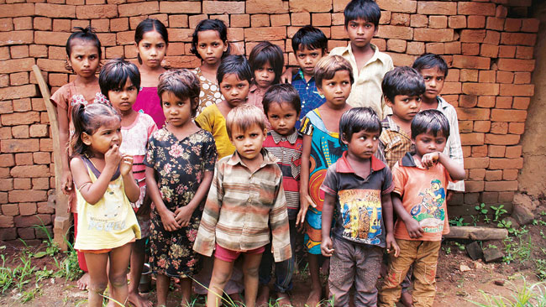
Integrated Approach to
Elimination of Grade II Disability due to Leprosy
U.T. of Dadra & Nagar Haveli
  S. Krishna Chaitanya,
  MD (NHM),
  Dadra & Nagar Haveli.

Slide 2
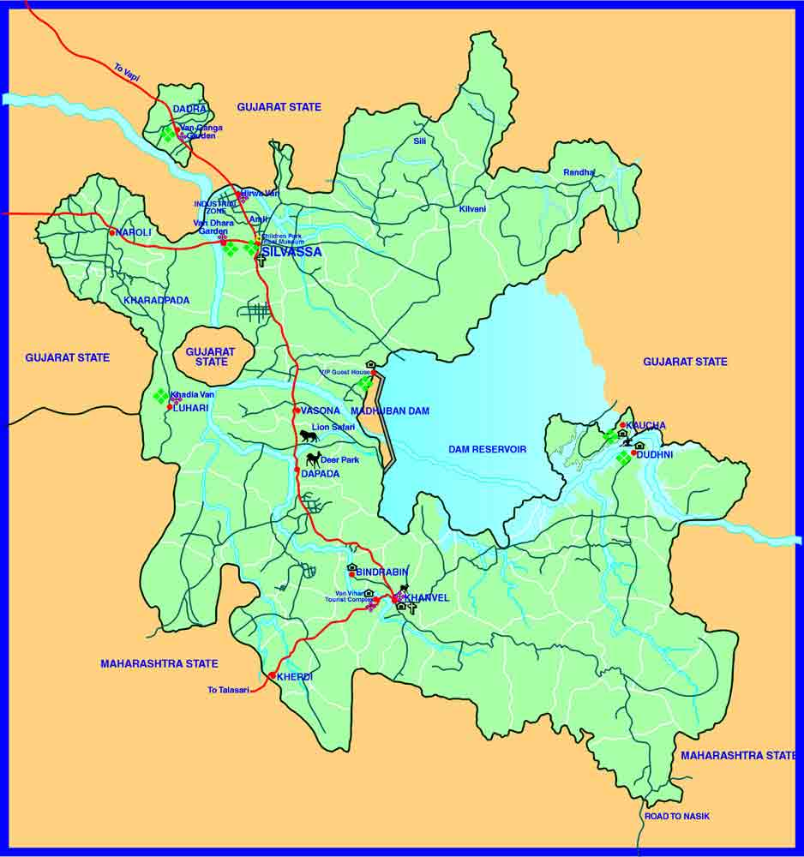
UT Area : 491 Sq. Km
Population : 424394
Male : 228505
Female : 195889
Tribal Pop. : 52%
Urban Pop. : 136376
Rural Pop. : 288018
Literacy Rate : 77.65
Sex Ratio : 943
DH : 01
SDH : 01
CHC : 02
PHC : 09
UHC : 02
Sub-centre : 71
Demographic Profile

Slide 3
Leprosy...
A chronic granulomatous disease caused by Mycobacterium Leprae causing intractable visible deformities primarily to limbs and face, loss of vision etc.
Oldest Disease Known to Man and the Most stigmatized disease in the Human history
The key factor behind stigma associated with Leprosy is the deformities/ grade II (visible) disabilities leading to permanent disfigurement.

Slide 4
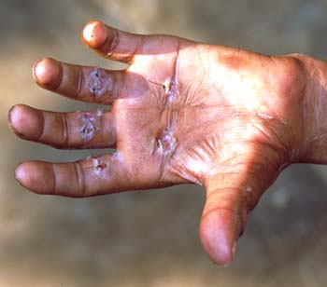
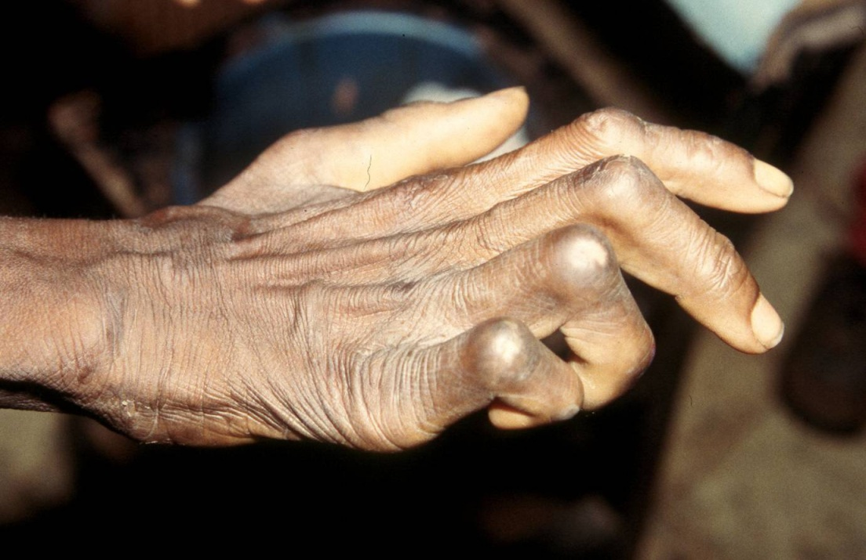
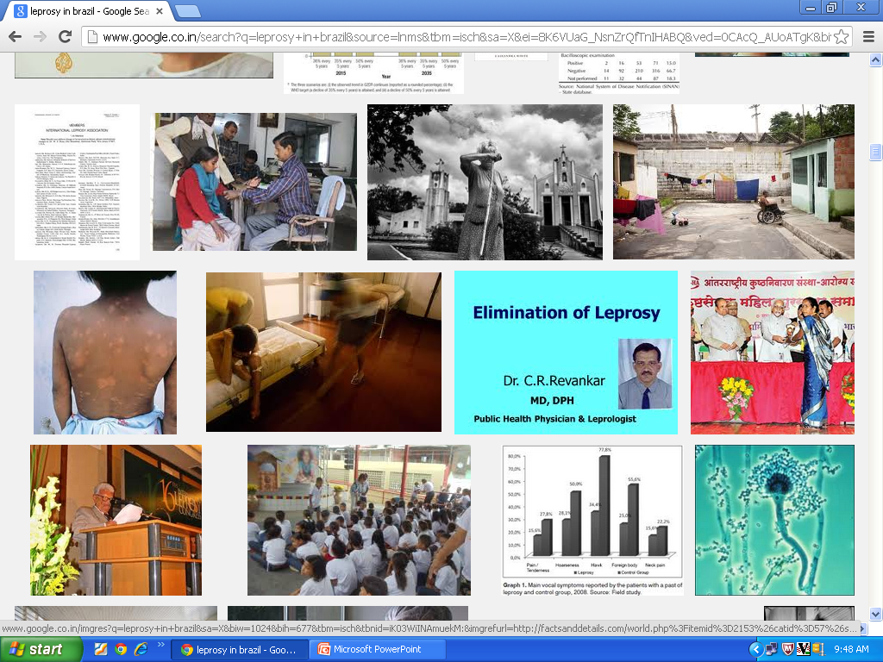
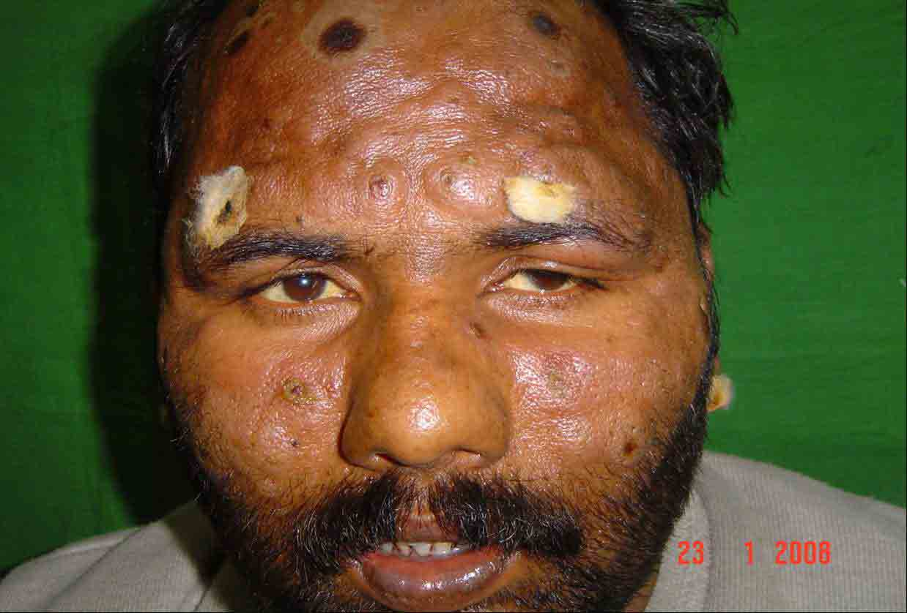
Deformities/Grade II Disabilities :Cause of Stigma

Slide 5
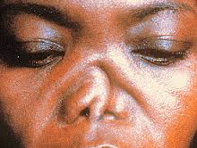
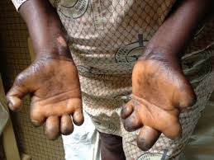
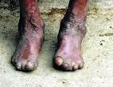
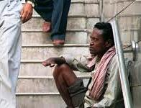

Slide 6
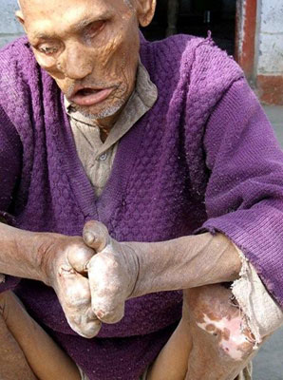
Definitely
we
need to
prevent
this !

Slide 7
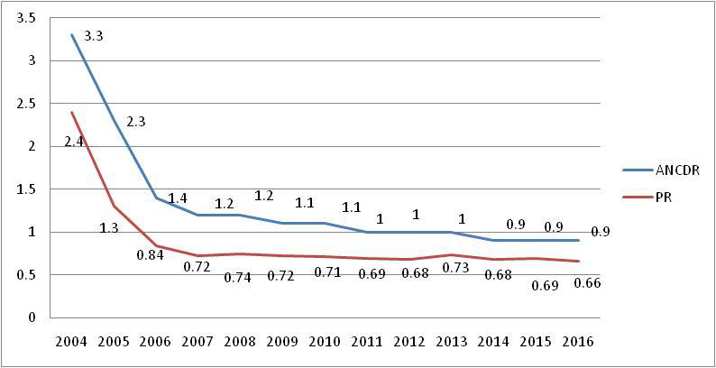
Leprosy in Dadra Nagar Haveli
INDIA
PR /10000
ANCDR/10000
D&NH
PR
ANCDR

Slide 8
Probable Reasons of High Endemicity
Environmental Conditions – Hot and Humid for most part of the year
Housing – Poorly ventilated, kachcha floorings & dark interiors (no windows)
Tribal population – Leprosy in DNH mostly in Tribals(98%)
Nutritional status/ Immunity/ Genetic predilection of Tribal Population in that area
Adjoining High endemic blocks – Gujarat & Maharashtra

Slide 9
Leprosy and NLEP in DNH
Disability Prevention, Management and Rehabilitation (DPMR) is an important component of NLEP
Started implementing all the components of DPMR under NLEP vigorously along with the steps to curb rising Prevalence Rate (PR) and Annual New Case Detection Rate (ANCDR)
Started organizing RCS camps regularly
Started Leprosy Post Exposure chemo Prophylaxis in March 2015

Slide 10
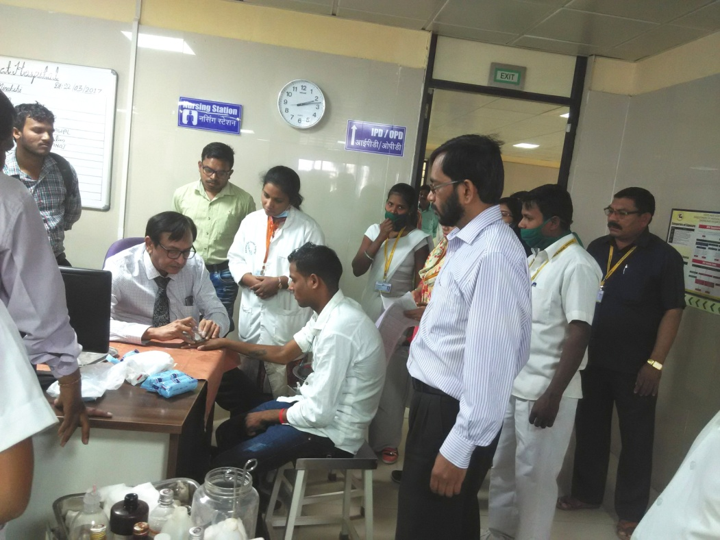
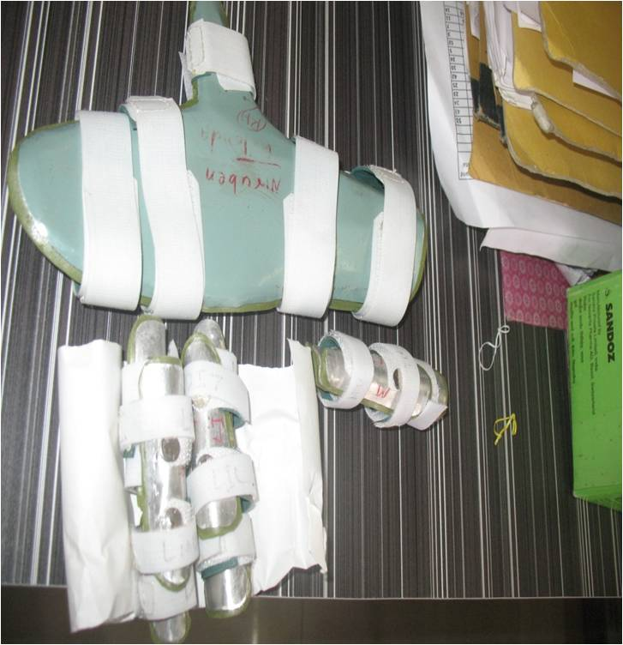
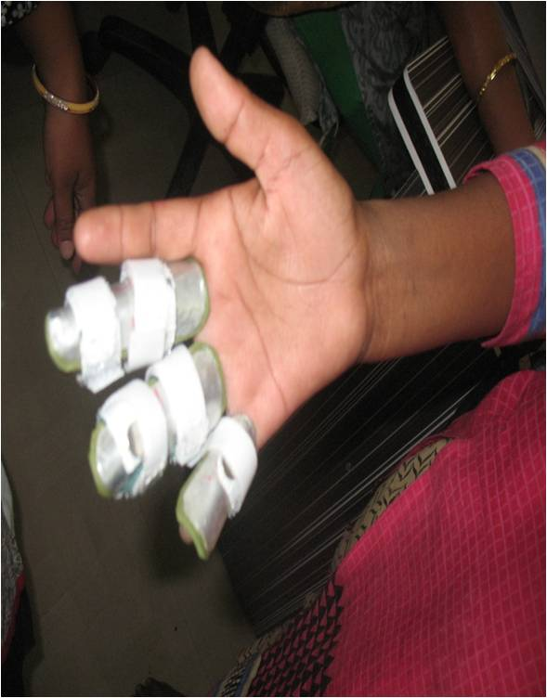
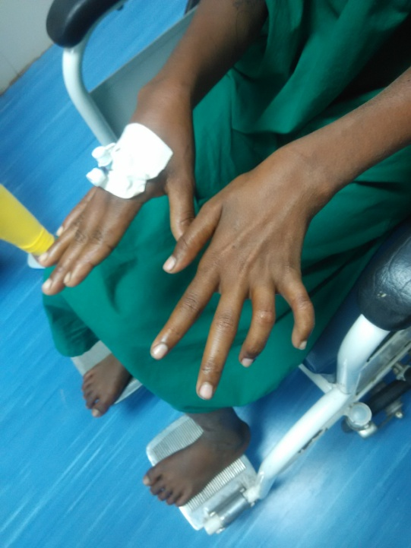
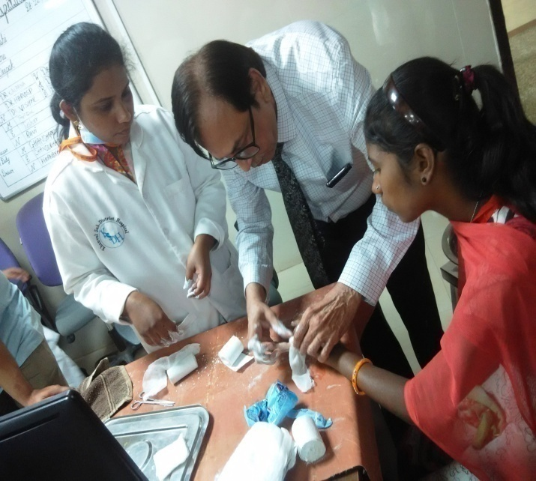
RCS Camp in DNH

Slide 11
Grade II Disability cases in DNH
In 2015-16, 8 cases of grade II disability were reported among new cases.(2 cases in 2014-15)
8 cases of G2D ( Grade II Disability) in a population of about 4.2 lakhs is alarming & indicated more hidden cases.
In 2016 -17, again 8 such cases were reported taking the grade II disability rate at the time of diagnosis from 1.88% in 2015-16 to 2.08% in 2016 -17.

Slide 12
Grade II Disability 2014-15 t0 2016-17

Slide 13
Situation Analysis & Intervention 2017-18
Findings & Issues identified –
Reconstructive Surgery (RCS) is not the true solution for Grade II Disability (G2D).
Pure neural cases were being missed by the heath staff including Medical Officers ( 3 such cases in a single year came with G2D)
Working population was being missed in the active case finding campaigns (Leprosy Case Detection Campaigns or Special Activity Plans) and coming out later with Grade II Disability and More males were diagnosed with G2D (67% in last 3 years)
Female proportion was much higher among new Leprosy cases( 60:40)

Slide 14
Situation Analysis & Intervention… (contd.)
Strategies adopted to curb Grade II disability (G2D) –
Detect Leprosy cases (including hidden cases) early – before development of any disability
Halt active transmission by early diagnosis & prompt treatment
Decrease Prevalence Rate & Annual New Case Detection Rate in the long term (3 – 5 yrs) because –
  More new cases More likelihood of G2D

Slide 15
What we started in 2017-18…
Three rounds of Active Case Finding Campaigns & one round of Focused Leprosy Campaign for early detection
Active Case Detection Survey twice by General Health Staff
Active search in evening hours (6 -8 PM) to screen working population
Sensitized and Trained all the Medial Officers, Supervisors, ANM, MPWs & ASHAs to screen households for sensory loss in addition to hypo-pigmented patch and visible deformity
Increased no. of households for contacts screening from 25 to 50 or more depending on adjoining population for every new case
Started contact tracing of PB cases also
Started follow up of Released From Treatment cases up to 5 years

Slide 16
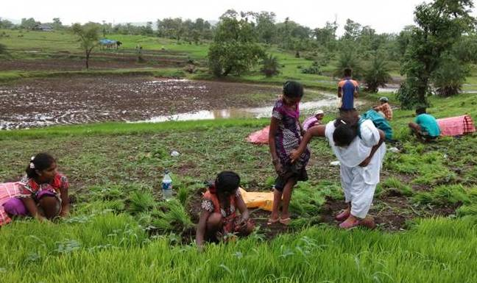
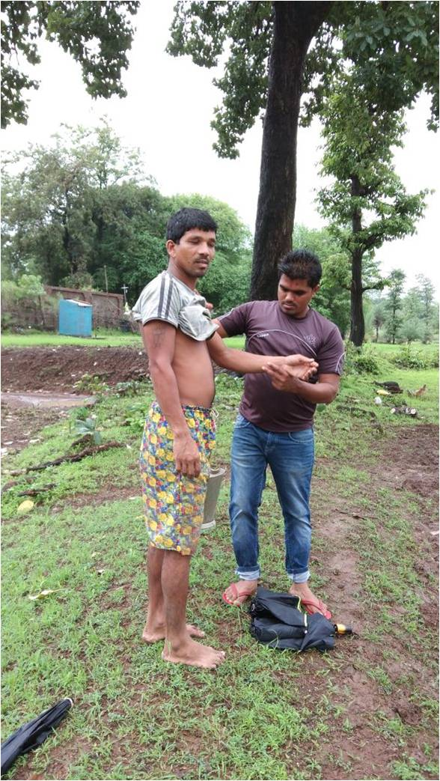
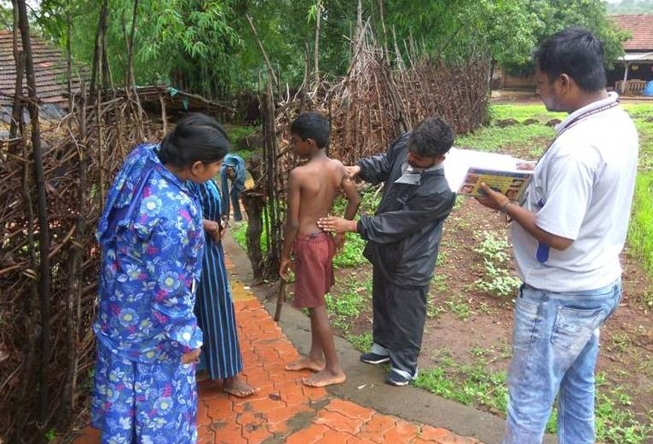
Active Case FInding

Slide 17
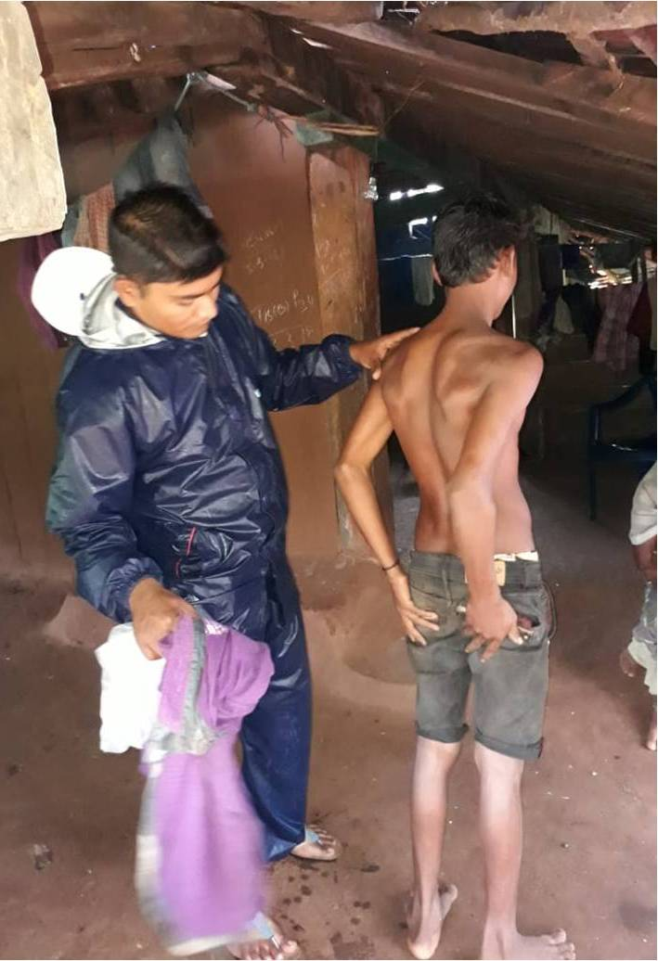
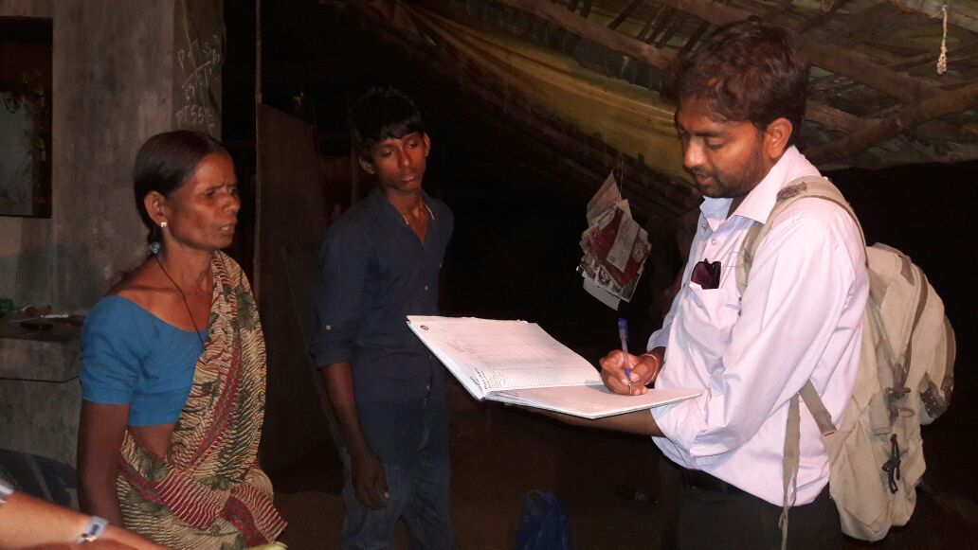
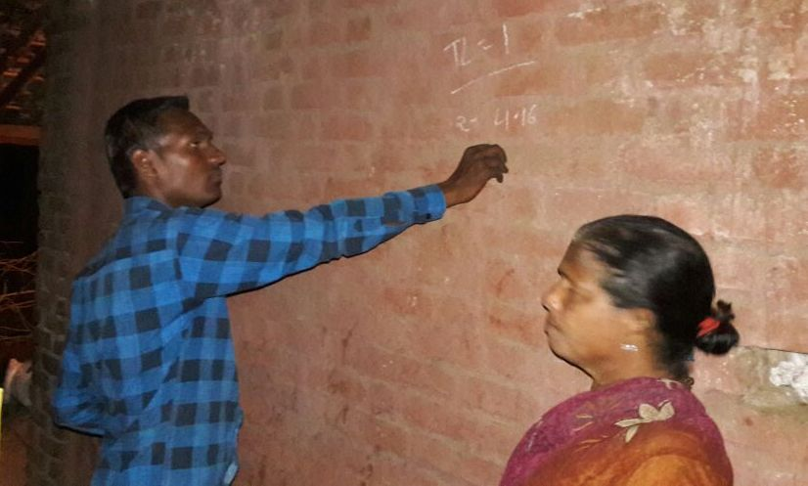
Active Case FInding

Slide 18
Also continued –
Reconstructive Surgery (RCS) camps & distribution of self care/Ulcer kits
Targeted need based IEC by NLEP staff
Capacity building of ASHA & general health staff twice a year
Investigation of all disability, MB & child cases – to identify the source of infection
Maintaining record of contact examination & Active search
( in registers)
Fortnightly Review & Strict Monitoring of Field Activities by State Program unit

Slide 19
Additional Support From…
Central Leprosy Division – DDG(Leprosy) visited DNH in 2015, 2017 & 2018.
Innovations from Central Leprosy Division –
DNH implemented all the innovations introduced into NLEP – LCDC (Leprosy Case Detection Campaign), FLC (Focused Leprosy Campaign), SLAC (Sparsh Leprosy Awareness Campaign) and ABSULS (ASHA Based Surveillance of Leprosy Suspects)

Slide 20
For 2018-19
The UT set its goal to ‘Zero Grade-II deformity due to Leprosy’ in contrast to the All India goal of grade-II disability <1 per million population set by MoHFW, Government of India to be achieved by 2nd Oct 2019.
Continued all the intensified activities undertaken during 2017-18 to prevent the occurrence of Grade-II disability.
In addition - Continuous active case finding approach was adopted & implemented particularly with the help of PMWs and local ANMs/MPWs in the high endemic pockets of the UT – per day target to each Field Staff for screening

Slide 21
Results...
A single case with Grade II disability was confirmed during 2017-18 and maximum reduction of percentage of Grade 2 disability was made possible.
Brought down the G2D at diagnosis from 2.08% in 2016-17 to 0.36% in the year 2017-18
2018-19 : Reached the target of “Zero Grade II Disability” due to Leprosy till now

Slide 22
Results... Graph of G2D

Slide 23
Not Only G2D....

Slide 24
Current Status
“Zero” grade-I and
“Zero” grade-II disability at diagnosis in the UT during this year
The UT of Dadra & Nagar Haveli is putting all its efforts to maintain this status of “Zero Grade-II disability due to Leprosy” and further continue the Intensive activity to reduce the Prevalence rate and Annual New case Detection rate towards elimination of Leprosy.

Slide 25
Thank You

