Slide 1
Integrated Health Information Platform and its adoption to Integrated Disease Surveillance Programme Prepared for NHM Best Practices Summit, Kaziranga, Assam National Centre for Disease Control Integrated Disease Surveillance Program New Delhi, India | 31 October 2018
Dr Pradeep Khasnobis Joint Director, IDSP, NCDC pradeep.khasnobis@gov.in
Dr Ramesh Krishnamurthy World Health Organization krishnamurthyr@who.int
Dr Pavana Murthy World Health Organization murthyp@who.int

Slide 2
Background on
Integrated Disease Surveillance Platform
(IHIP)

Slide 3
Parallel Electronic Surveillance Systems
Communicable Diseases
Integrated Disease Surveillance Program (IDSP)
National Vector-Borne Disease Control Program (NVBDCP)(NAMIS)
Revised National TB Control Program (RNTCP) (Nischay)
National AIDS Control Program (NACP)
National Public Health Surveillance Program (NPSP)
National Leprosy Eradication Program (NLEP) (Nikusht)
Non-Communicable Diseases
National Program for Prevention & Control of Cancer, Diabetes, Cardio Vascular Diseases and Stroke (NPCDCS)
National Mental Health Programme
National Program for Control of Blindness
Trauma and Injury Surveillance

Slide 4
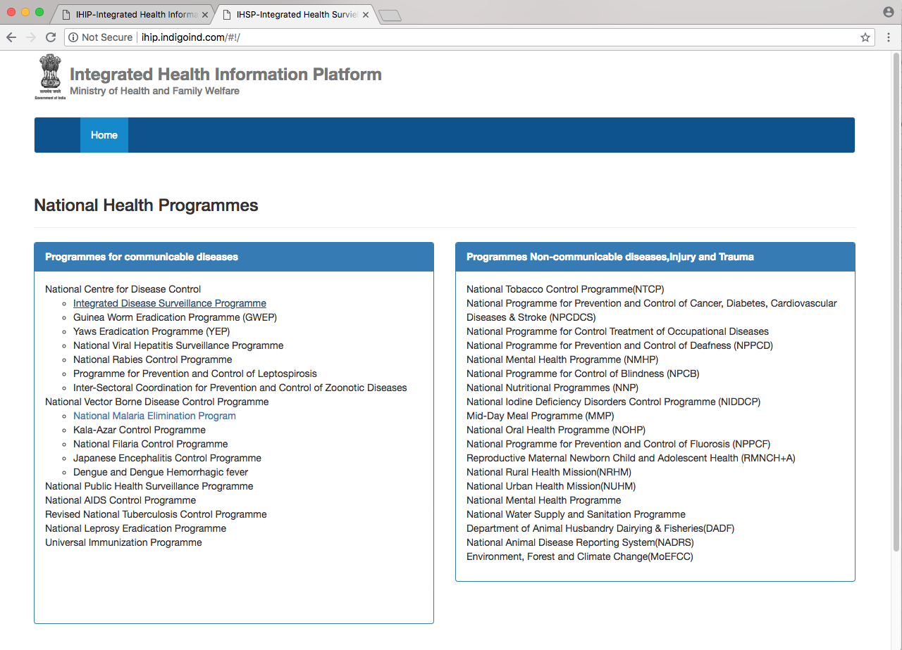
Access to Program Specific Health through IHIP)

Slide 5
Geospatial Epidemiology and Health Surveillance
Key Feature of IHIP
The IHIP platform will provide the ability to:
describe and analyze geographic variations in diseases in the context of demographic, environmental, behavioral, socioeconomic, genetic, and infectious risk factors
interpret geographic correlations of persons with their socioeconomic and demographics attributes
conduct public health surveillance in the context of One Health

Slide 6
Essential features of IHIP-IDSP
Mandate- Strengthening of disease surveillance system for epidemic prone diseases to detect and respond to disease outbreaks
IHIP is engineered for IDSP to:
Collect disaggregate public health surveillance data at all levels
Monitor more than 33+ health conditions
Link real-time case-based surveillance, clinical data, lab data, and public health emergency data in a single platform
Provide analysis on mobile and electronic devices
Integrate with other ongoing state-specific surveillance programs
States own and control the IDSP data, stored at BSNL virtual cloud services

Slide 7
Integrated Health Surveillance Platform is designed
to obtain real-time information on ongoing public health issues
ahead of newspapers and media

Slide 8
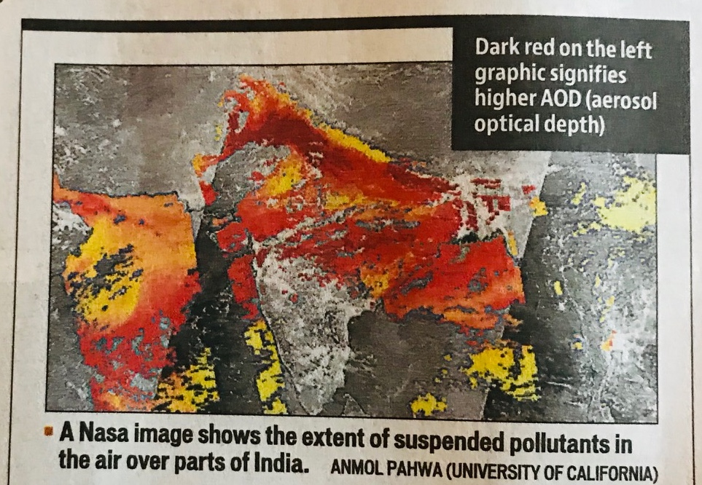
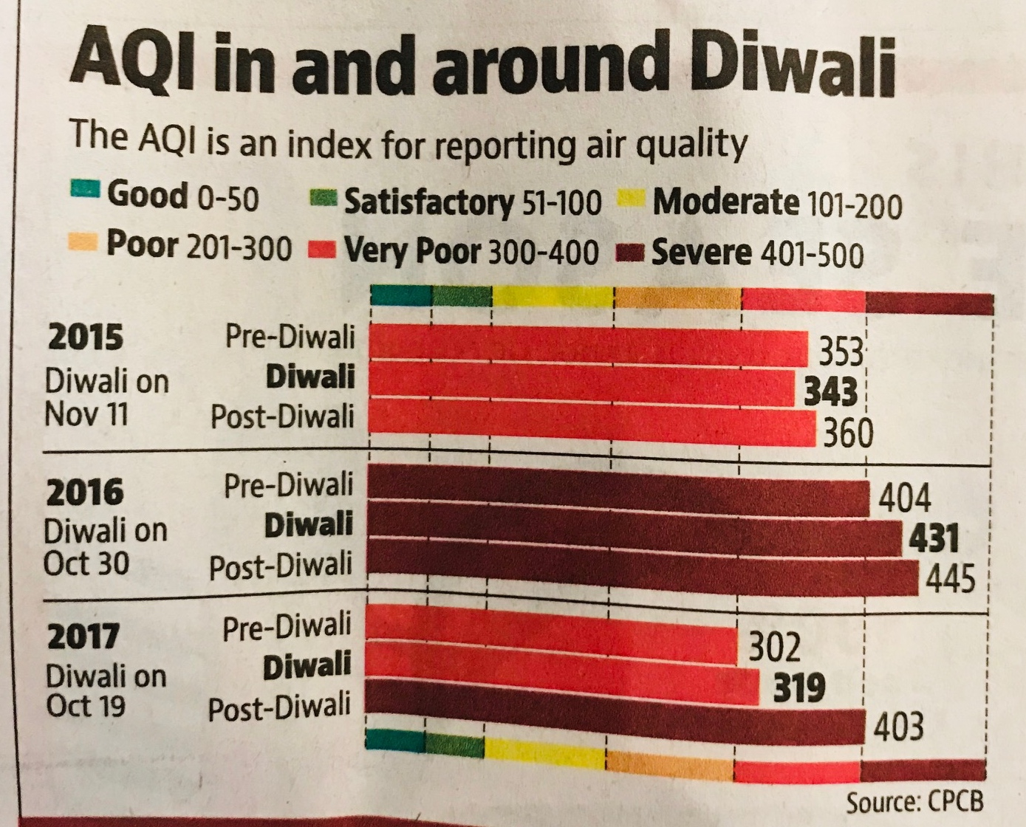
Integrated Health Surveillance Platform is designed
to obtain real-time information on
environmental health issues, accidents, injuries and NCDs

Slide 9
Public Health Dataflow in
India’s Geographic Context

Slide 10
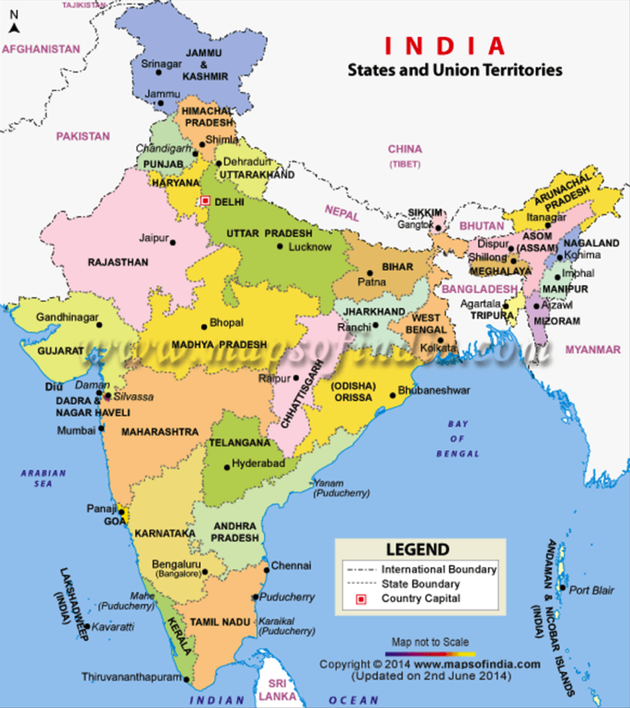
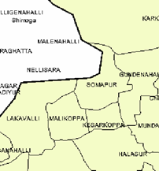
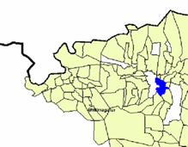
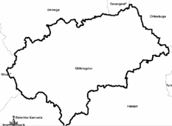
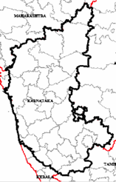
State (36 States/UTs)
Public Health Dataflow in India’s Geographic Context
Village
(655075)
Sub-district (6267)
District (707)

Slide 11
Public Health Dataflow in India’s Geographic Context
Mobile reporting
Sub Center or Health Sub Center
Primary Health Center
Village
(655075)
Portal access
Mobile Reporting
Laboratory Presence
Block PHC or Community Health Center
Sub-district (6267)
Broadband
Connectivity
Portal access
Mobile Reporting
Laboratory Presence
District Surveillance Unit
District (707)
Broadband
Connectivity
Portal access
Mobile Reporting
State Surveillance Unit
Laboratory Presence
PH-EOC
State (36 States/UTs)
Broadband and Satellite-based Connectivity
24-HOUR CALL CENTER
Proposed System: Portal access allows reporting of all data from
DSU, CSU, SSU to CSU/IDSP in near real-time. Mobile reporting is both store and forward and near real-time. Data analytics and results will be accessible at all levels for action.

Slide 12
States need Integrated Health Information Platform
to connect data from multitude of sources for monitoring of
human health and animal health in the context of environment

Slide 13
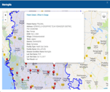
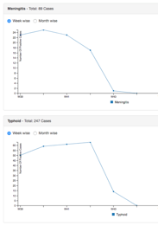
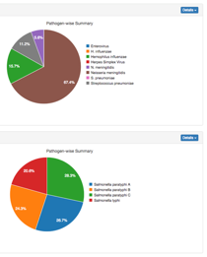
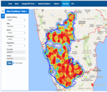
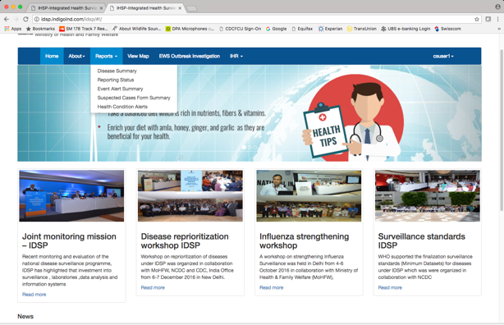
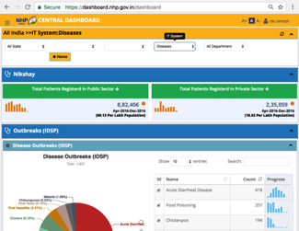
IDSP Data-linked Information System
(simplified view)
Example of Program Specific Health Data from MoHFW entities
Revised National TB Control Program (RNTCP)
National Vector Born Disease Control Program (NVBDCP)
National AIDS Control Program (NACP)
National Leprosy Eradication Program (NLEP)
Health Management Information System (HMIS)
Emergency Medical Relief (EMR)
International Health and Point of Entry (IH & PoE)
Example of Program Specific Health Data Non- MoHFW GoI entities
National Animal Disease Reporting System (NADRS)
Geospatial Data from National Informatics Center (NIC)
Civil Registration System (CRS)
Public Assets (Airport, Seaport, Transportation datasets)
IDSP Dashboard
(secure access to all reporting units)
IDSP Reporting Platform
(secure access to all reporting units)
Data integration
Data distribution
(Selected number of indicators
made available to NHP Dashboard)
NHP Dashboard
Platform access provided to all registered public and private reporting entities and contributing MoHFW Programs
Data Input
Data Process
Data Output

Slide 14
Integration: Linking Data and Information System*
S Form
Data
P Form
Data
L Form
Data
Syndromic Data
Clinical Data
Laboratory Data
PRIMARY SOURCE
PRIMARY SOURCE
PRIMARY SOURCE
Integrated
Surveillance
Data Record
EWS 1 EWS 2
Media Alerts
Data
24-hour
Call Center Data
Early Warning Data
Media and Rumor Data
Call Center Data
PRIMARY SOURCE
SECONDARY SOURCE
SECONDARY SOURCE
Facility NIN
Geocoded PIN
Reporting Unit ID
Reporting Person ID
Person Aadhar
(for line listing)
CRS + HMIS
Data
Other
Program-specific
Data
Geospatial and
RS Data +
GIS Database
SECONDARY SOURCE
SECONDARY SOURCE
SECONDARY SOURCE
*Based on eGovernance Standards, Surveillance Standards and Minimum Data Set

Slide 15
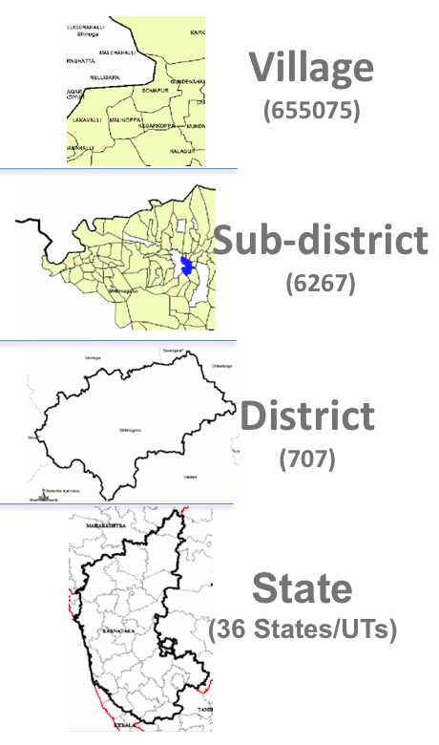
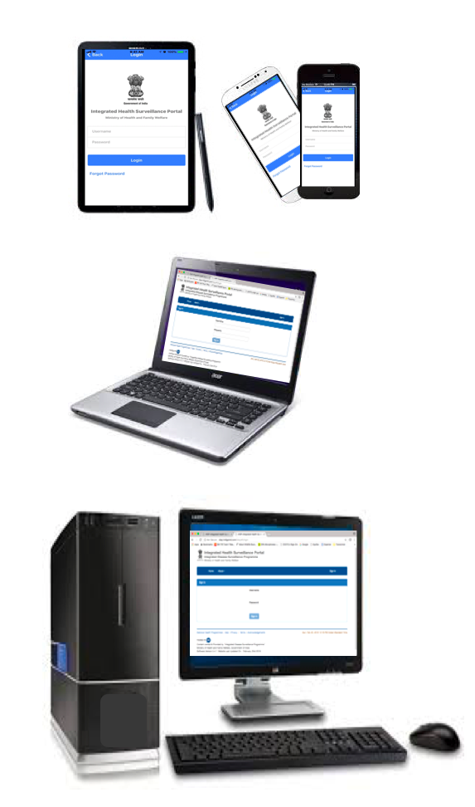
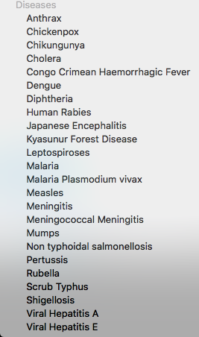
India’s Integrated Health Information Architecture
…..
NCDs
Other
CDs
IDSP
Secure
Access
Local Government
Registry
Health
Facility
Registry
RRT
Registry
Line Listing Registry
Web-enabled Software interface
Geospatial
Imagery
Data
Case Definition
Registry
International
Health
Photo and Image Registry
Near real-time feedback
eGovernance Standards for
Interoperability
Geospatial
Boundary
Data
Diseases & Pathogens
Registry
User Registry
SOP Document
Registry
Earth Observation Data
ICD-10
Registry
Patient Registry
Population Registry
Synchronize
NHPS
Data warehouse
Health Information
Exchange
Integrated Health Information Platform
Linking Surveillance Data Records
Facility NIN; Geocoded PIN; Reporting Unit ID; Reporting Person ID; Person Aadhar or other IDs

Slide 16
Functional Integrated Health Information Platform
Sample screenshots

Slide 17
Access to Program Specific Health through IHIP)

Slide 18
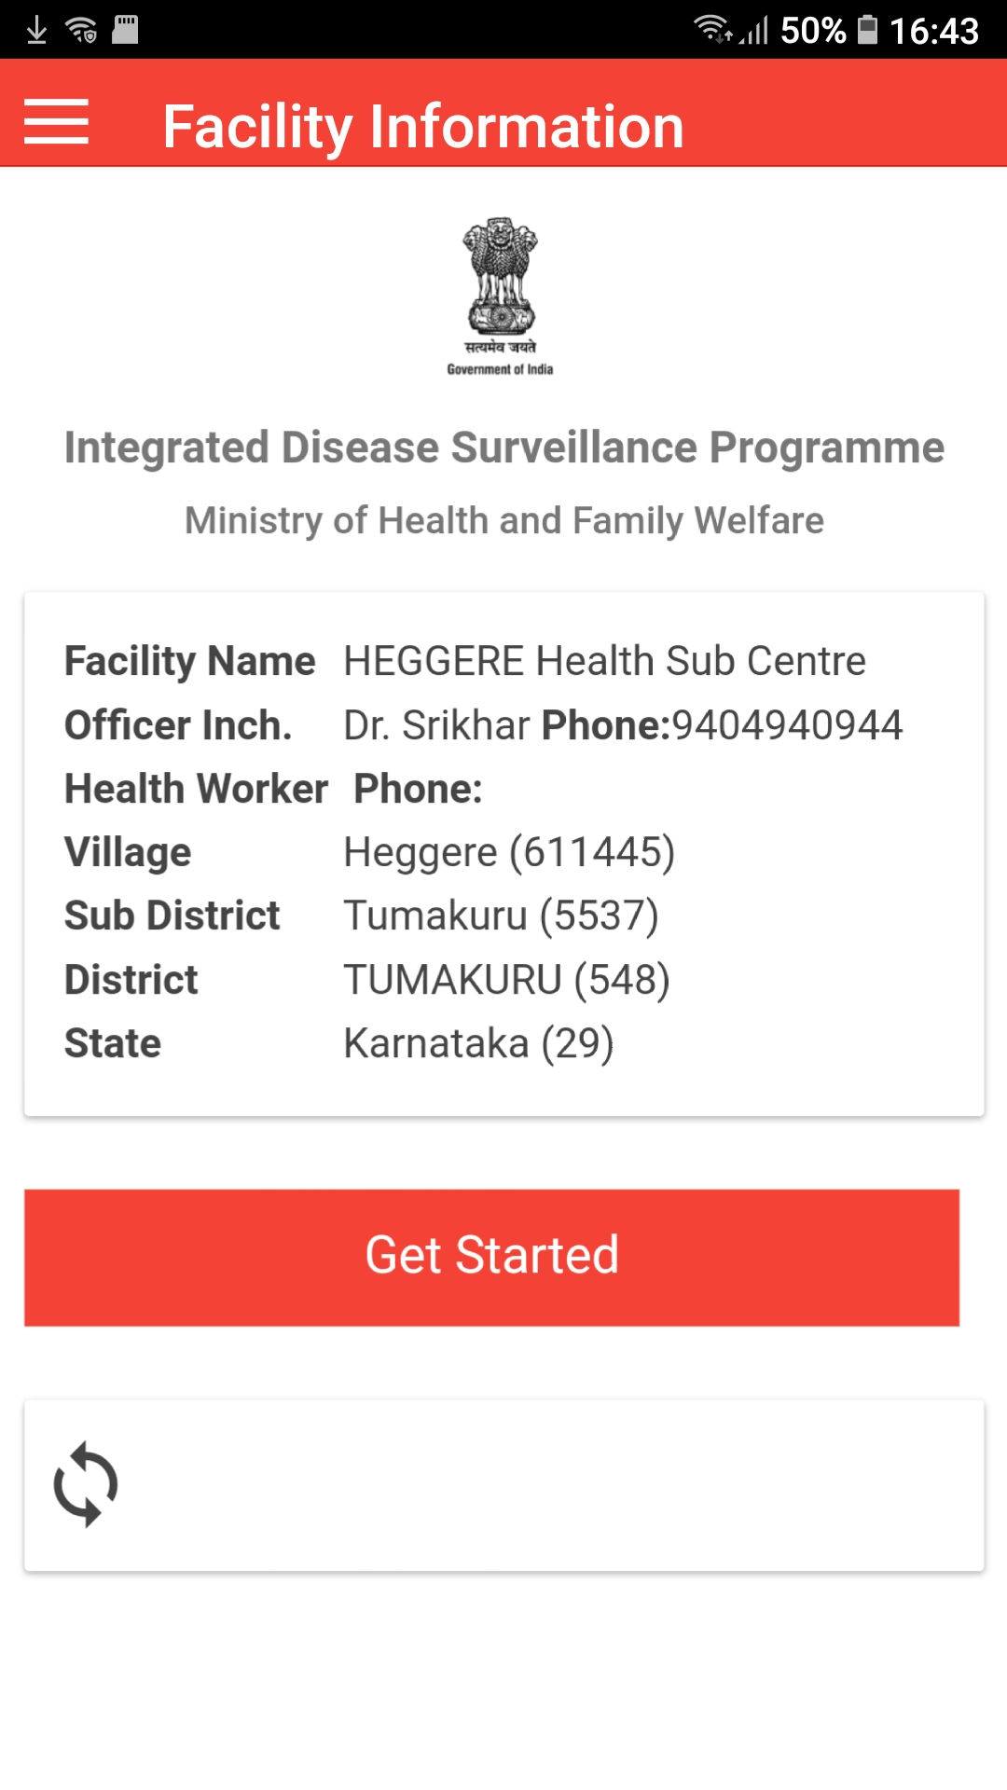
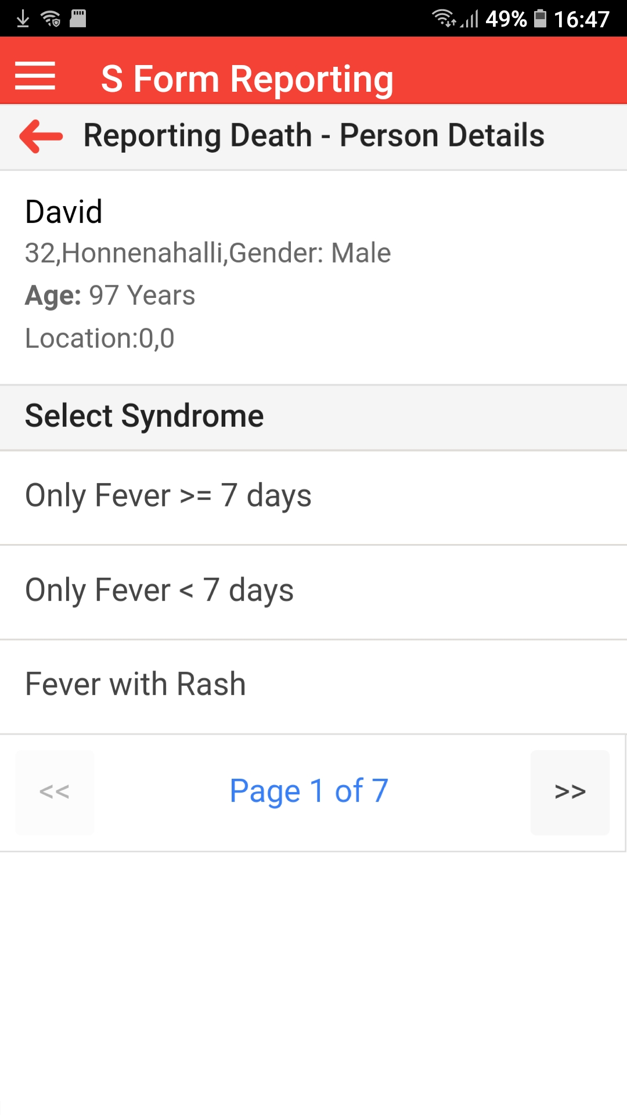
Mobile-based or Tablet-based data collection
for peripheral health workers
(real-time or offline data collection abilities)

Slide 19
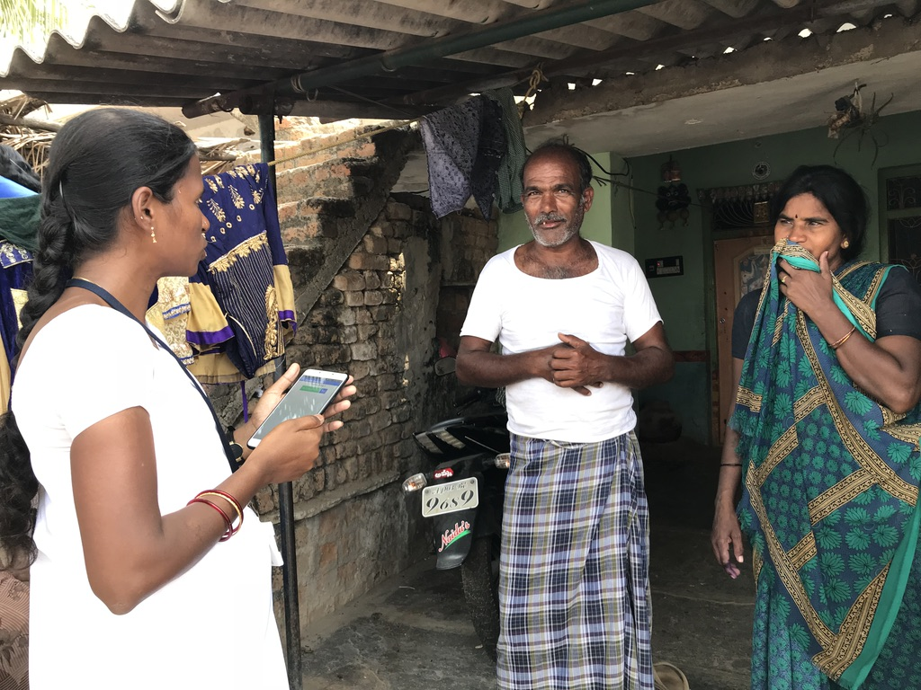
Syndromic Surveillance Data Collection on Mobile Platform
(from villages, rural and urban communities)

Slide 20
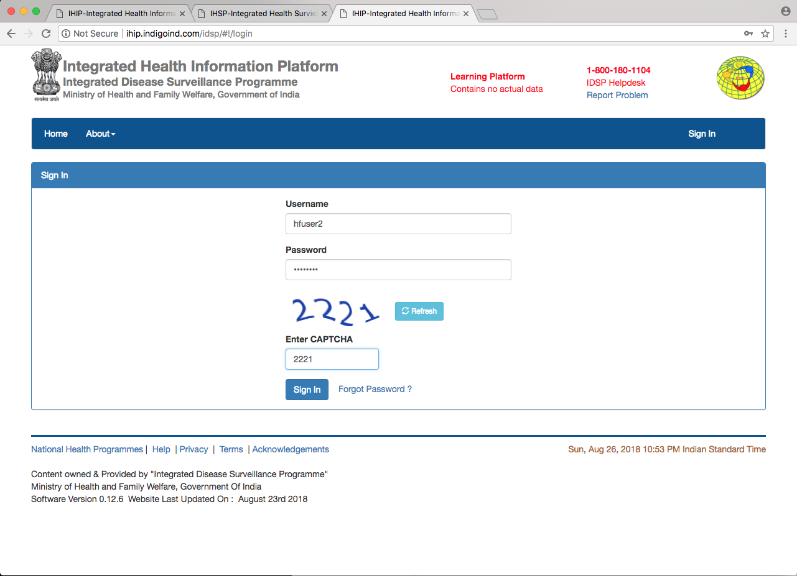
Desktop-based data entry at health facilities
(real-time or offline data collection abilities)

Slide 21
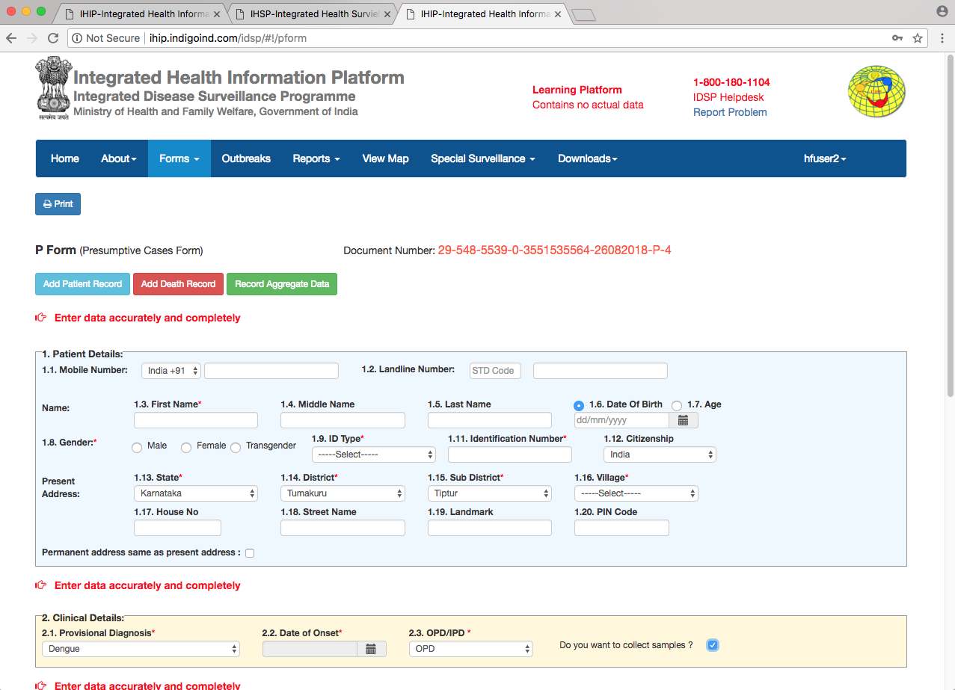
Desktop-based data entry at health facilities
(real-time or offline data collection abilities)

Slide 22
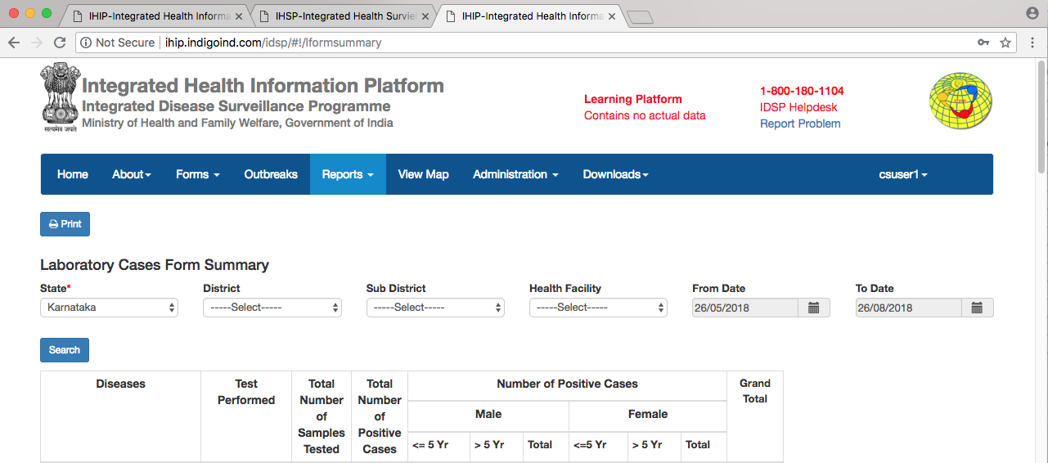
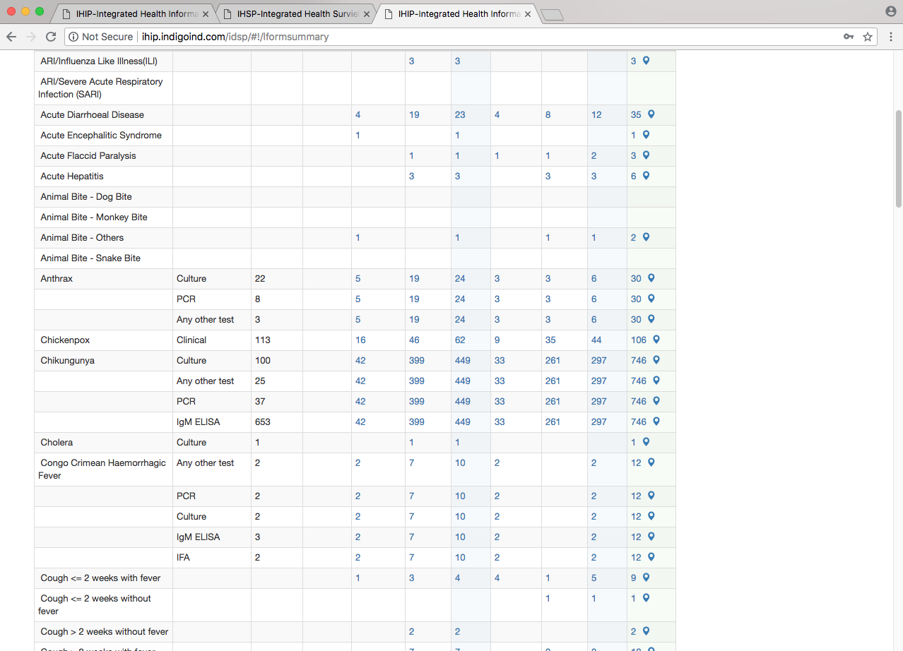
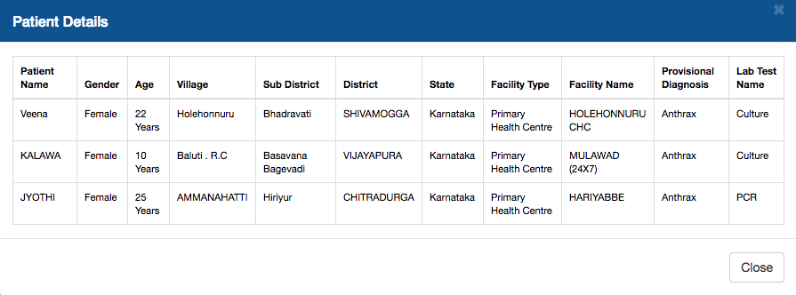
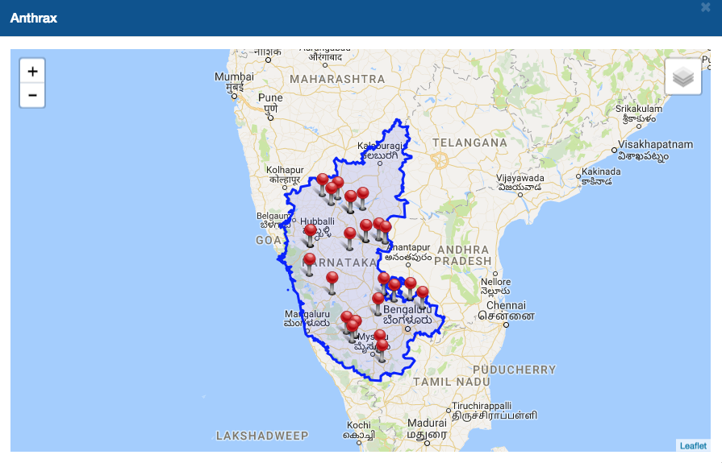
Realtime view of the lab sample tested and confirmed cases and their geographic attributes

Slide 23
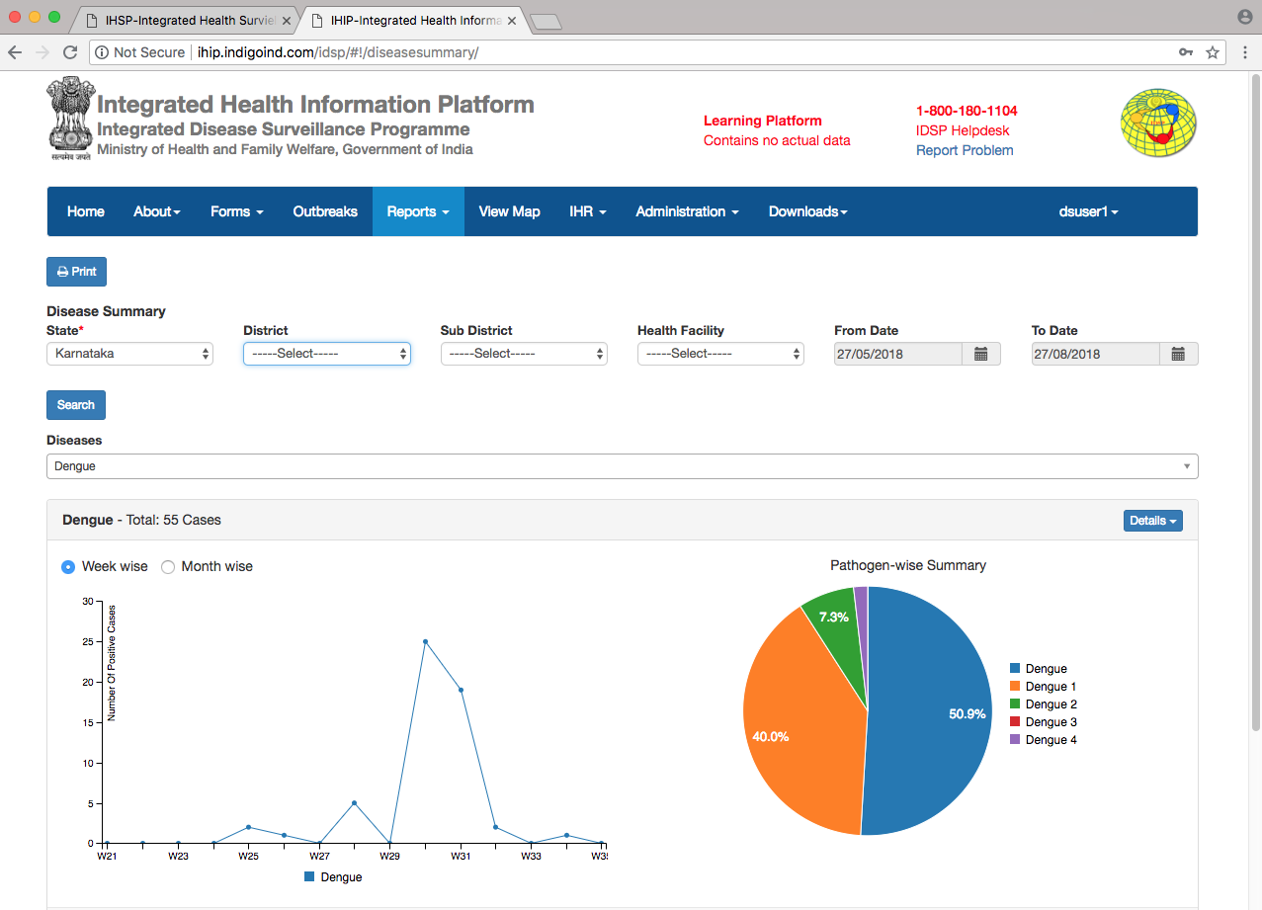
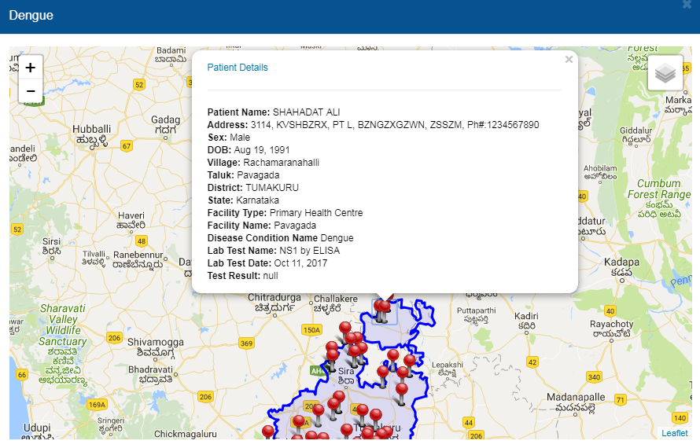
Real-time view of lab-confirmed cases of
And progression and daily/weekly monitoring of activity

Slide 24
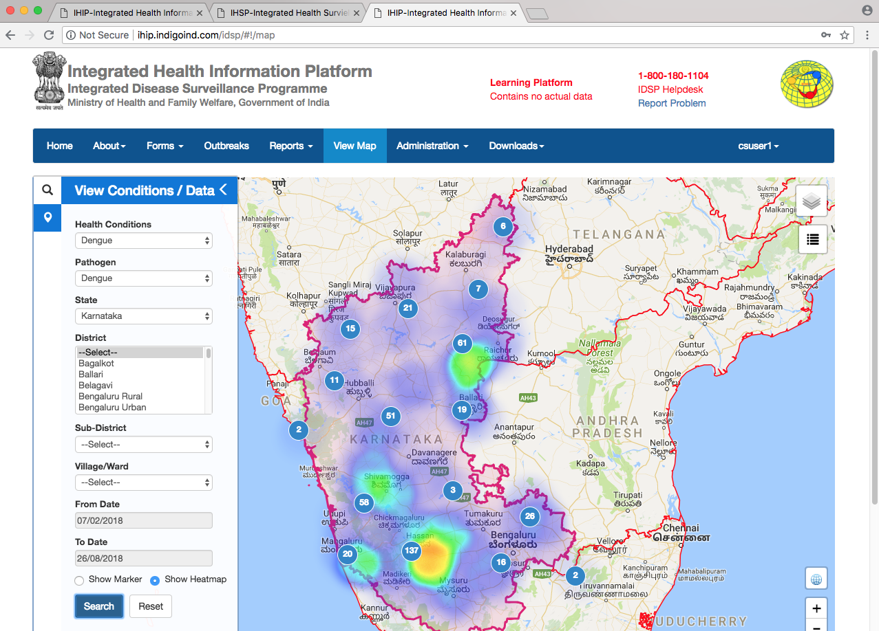
View heatmaps and distribution of lab-confirmed cases.

Slide 25
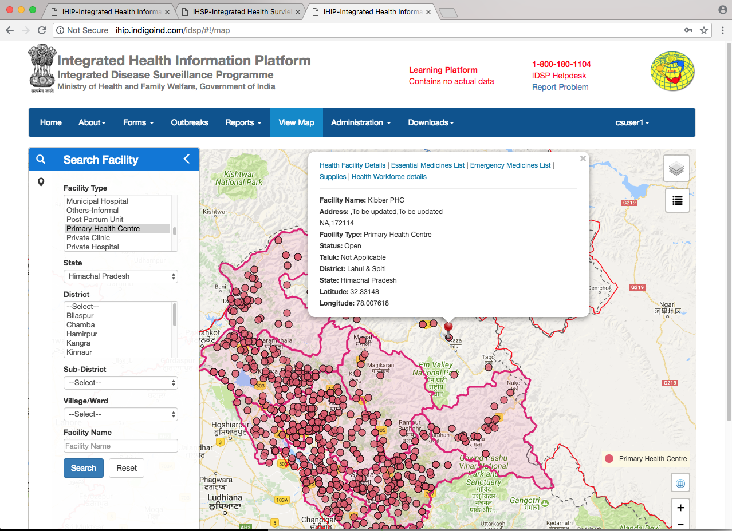
Manage health facilities along with the list of health workforce, essential and emergency medicines and supplies within them.

Slide 26
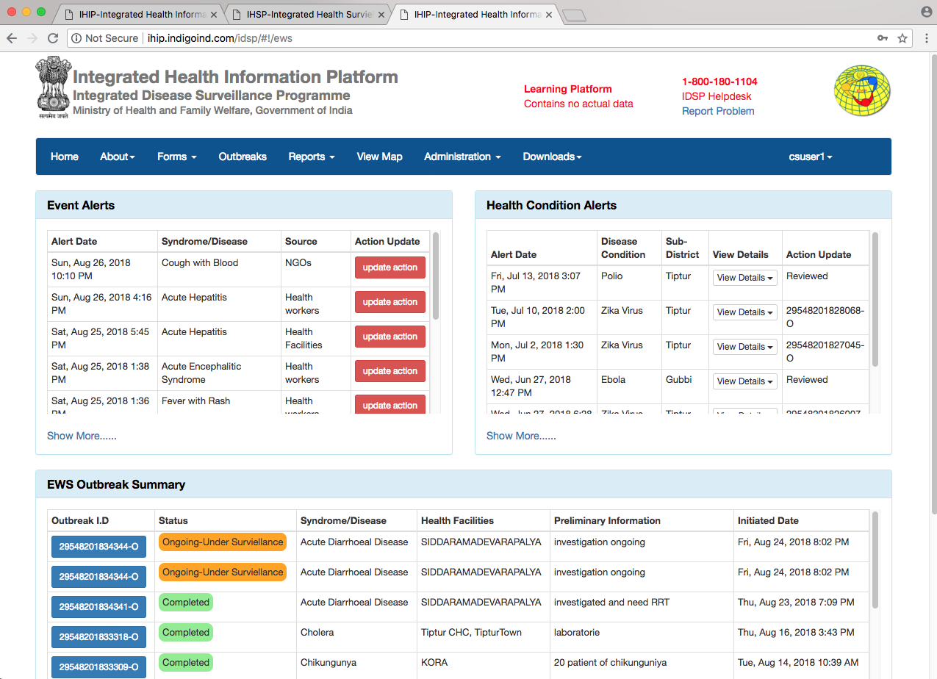
Provides a dashboard of all ongoing events,
health condition alerts and disease outbreaks

Slide 27
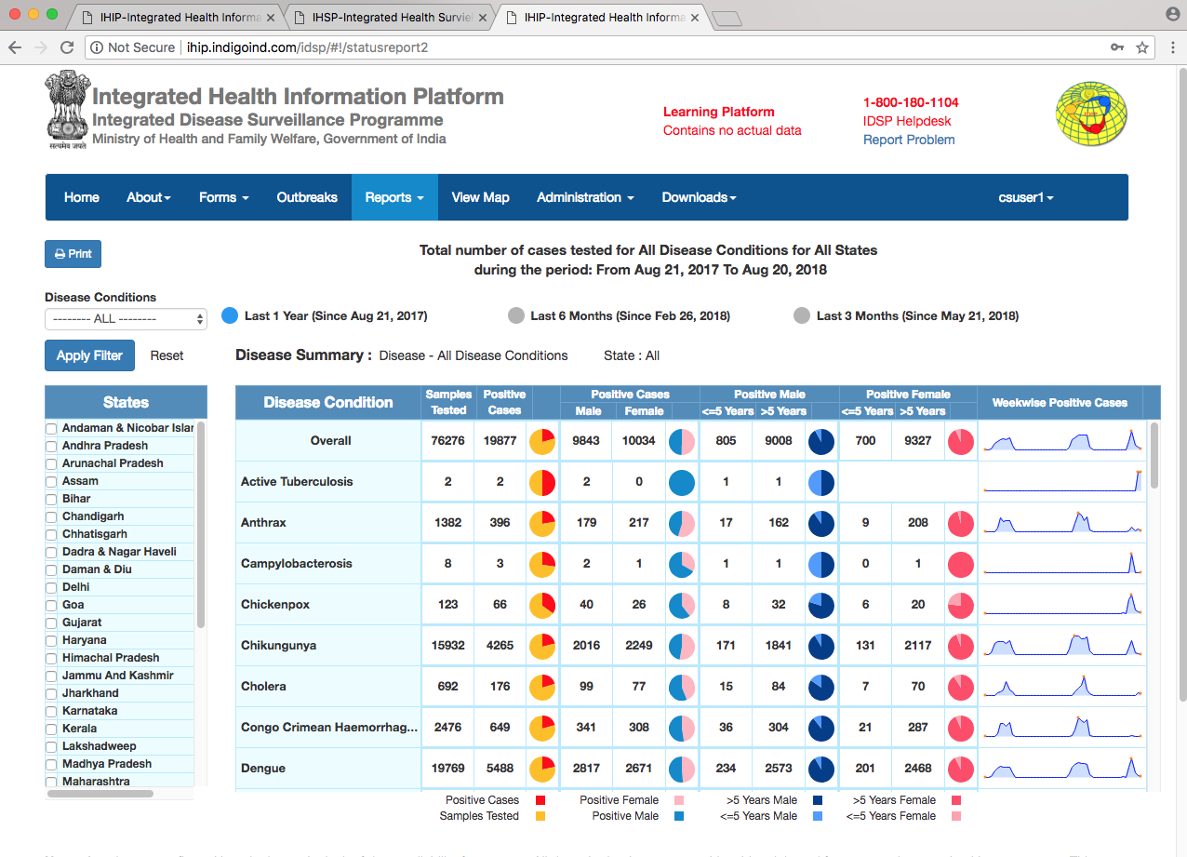
Provides comprehensive dashboard of all activities for decision-makers

Slide 28
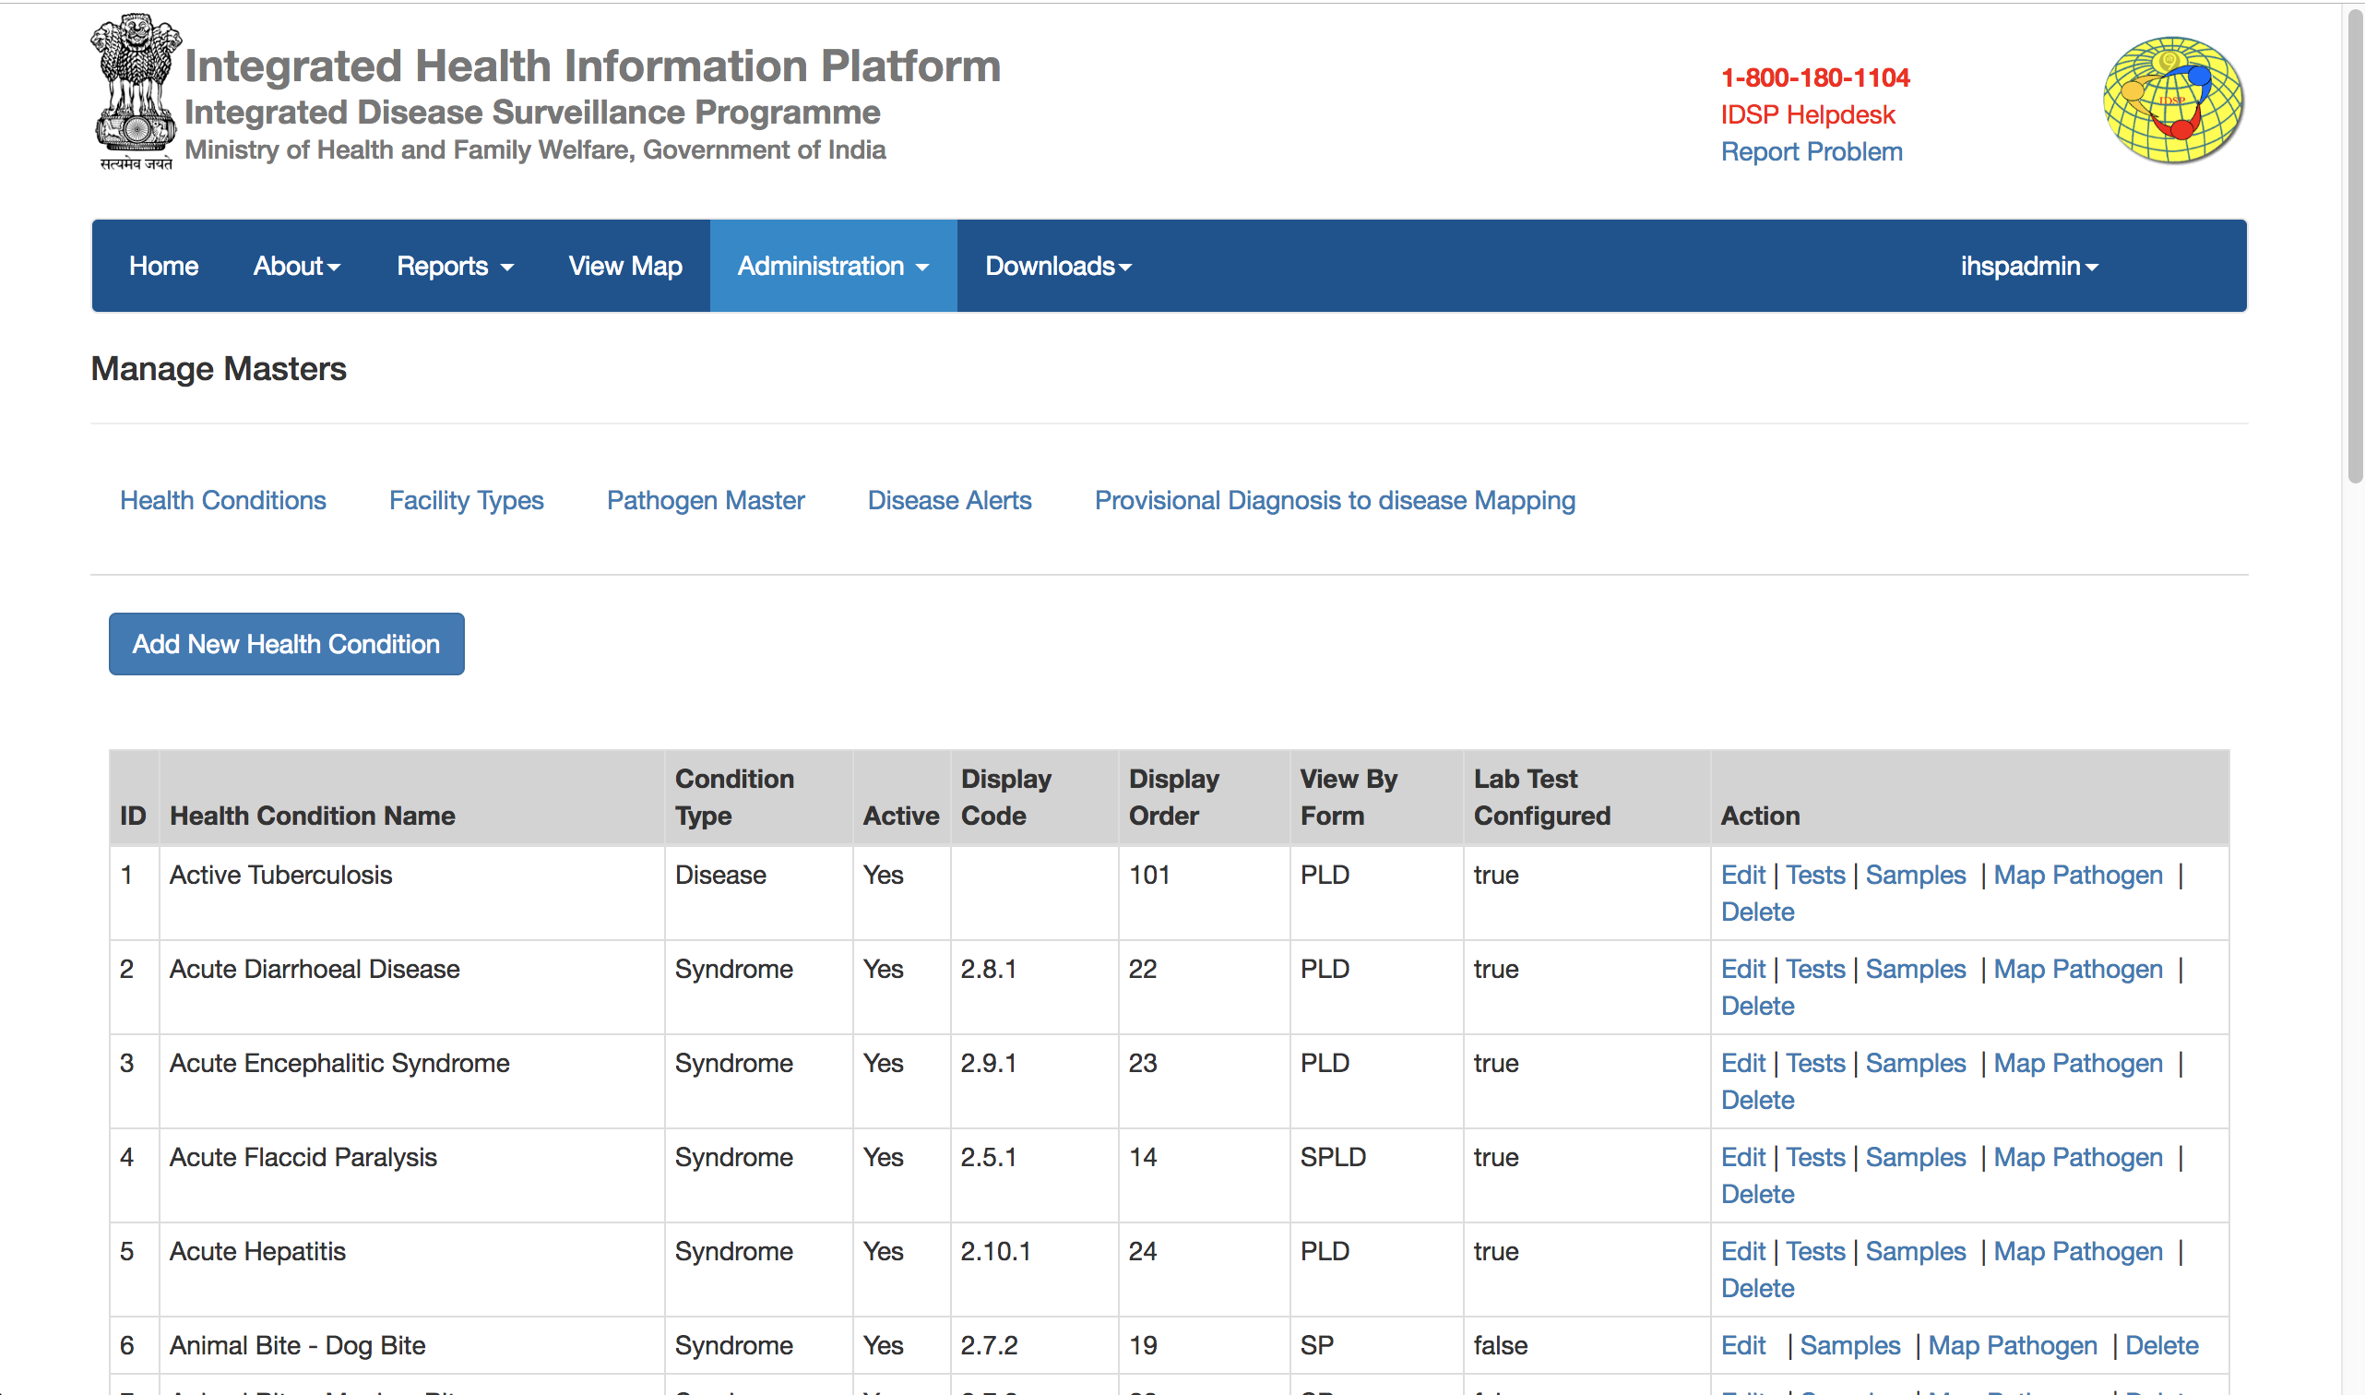
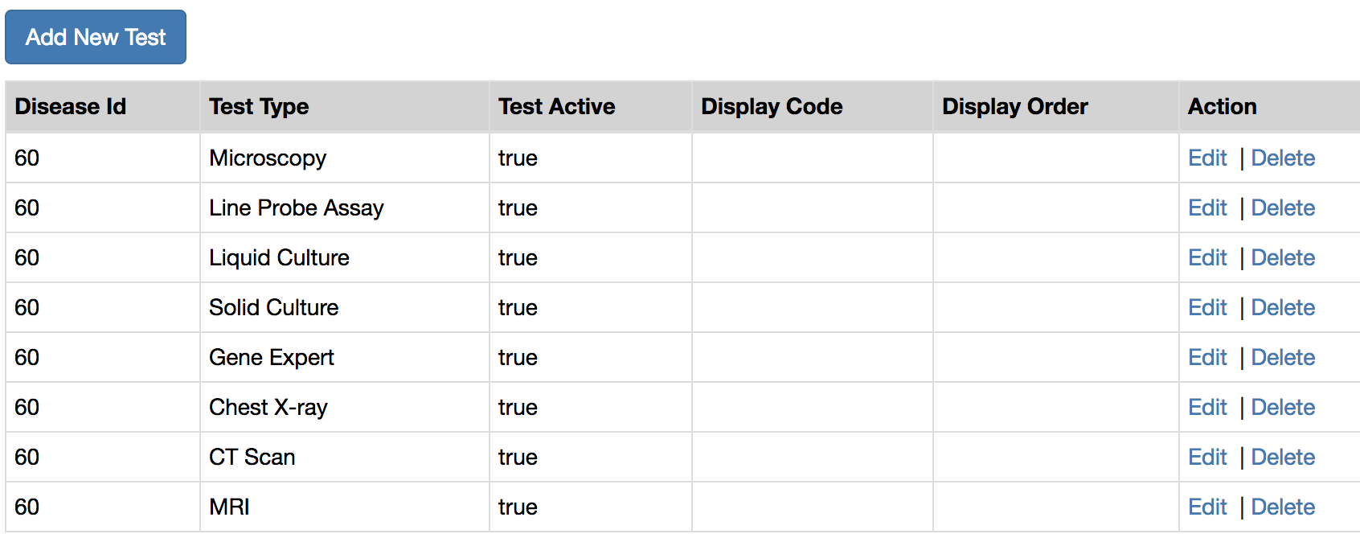
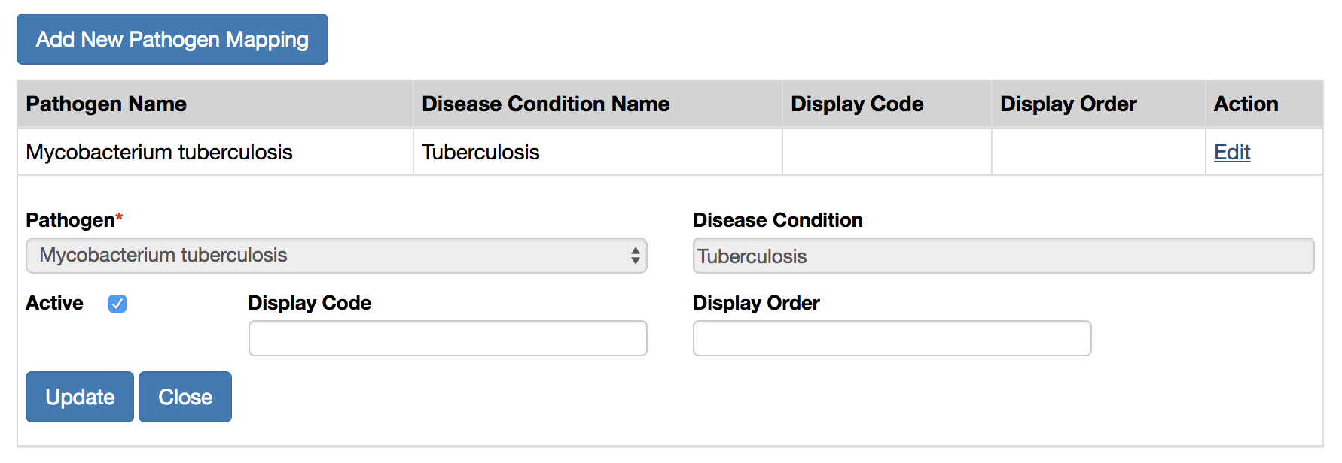
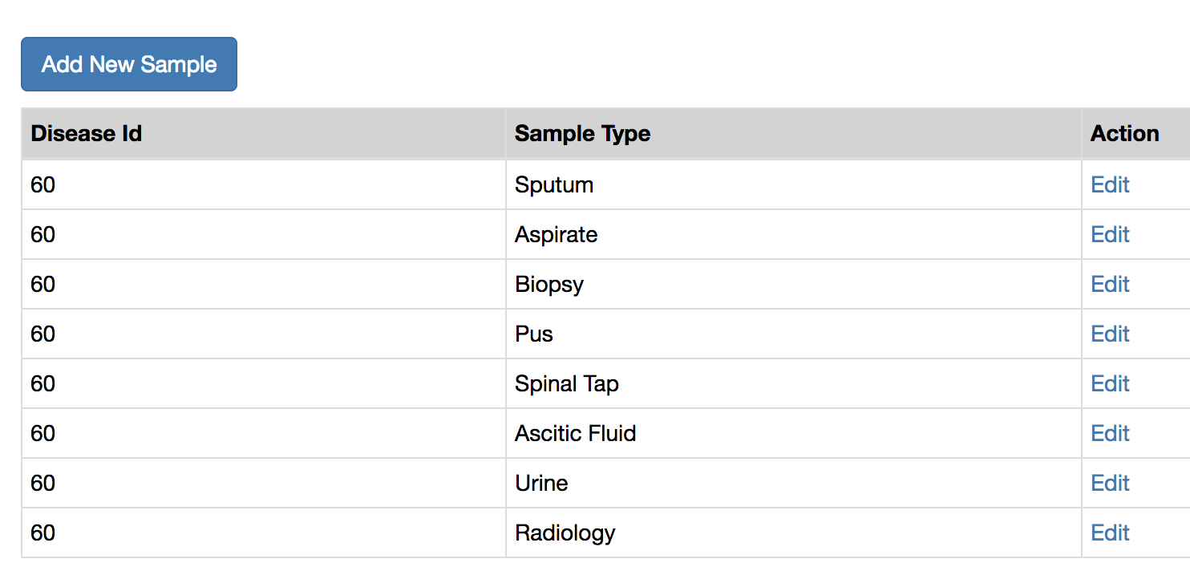
Powerful features to edit forms for real-time deployment nationwide during emergencies and outbreaks

Slide 29
Other Essential Features of
Integrated Health Information Platform

Slide 30
NASA 2013
Integration of On-demand Satellite Imagery and Ground-based Environmental Observation data

Slide 31
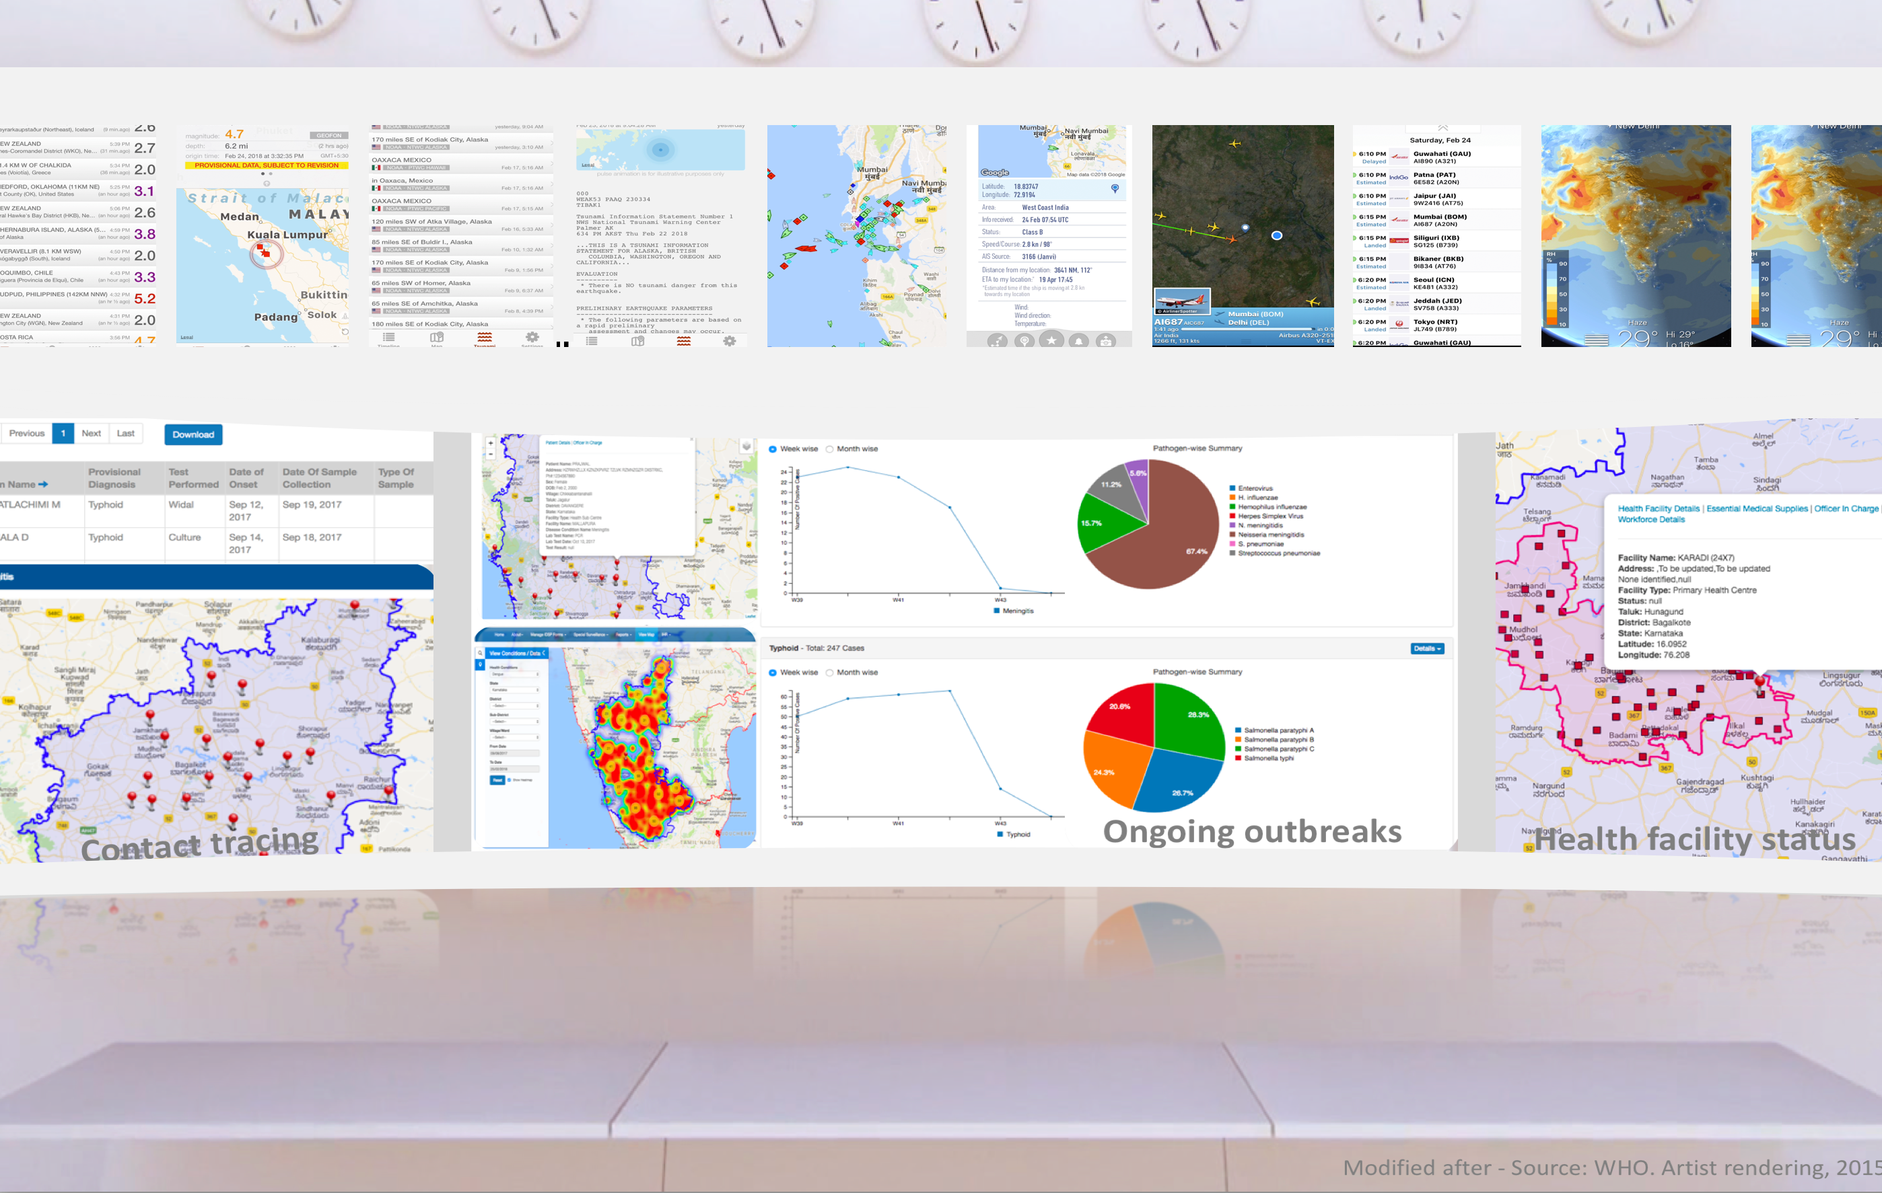
MoHFW Integrated Health Surveillance Dashboard
Strategic Health Operations Center

Slide 32
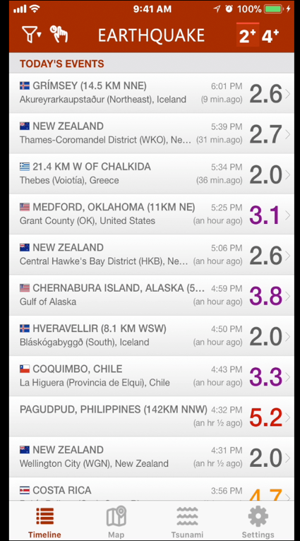
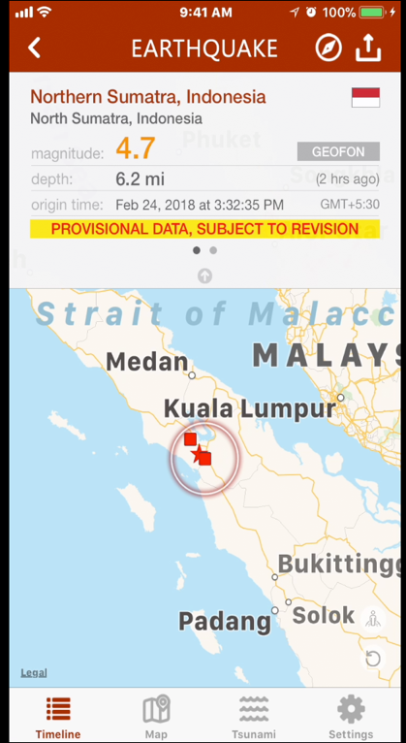
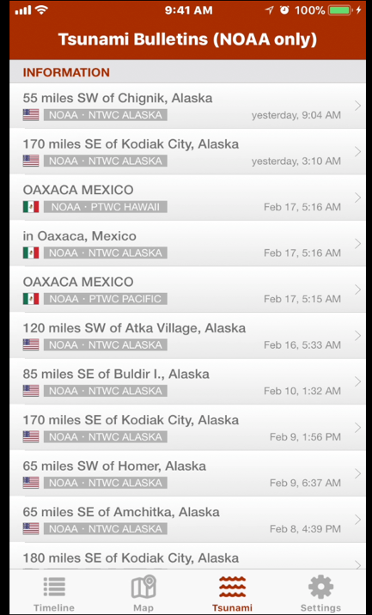
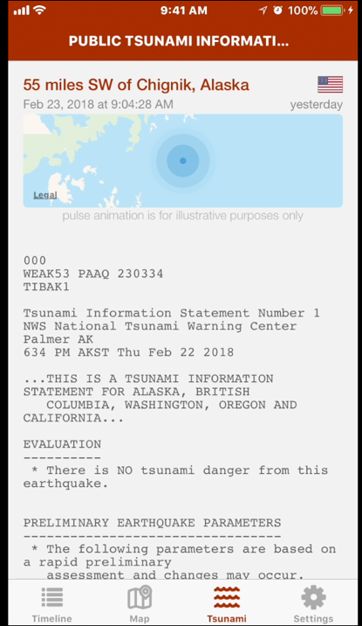
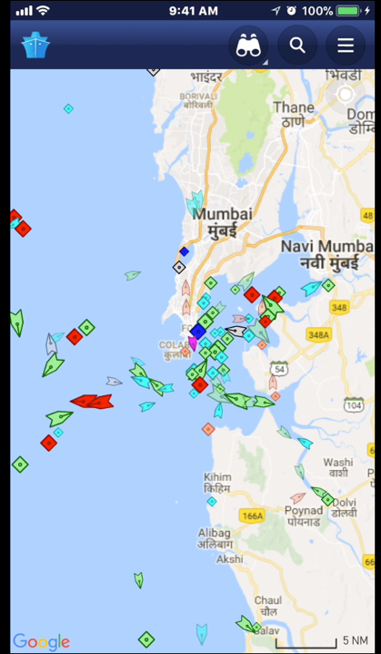
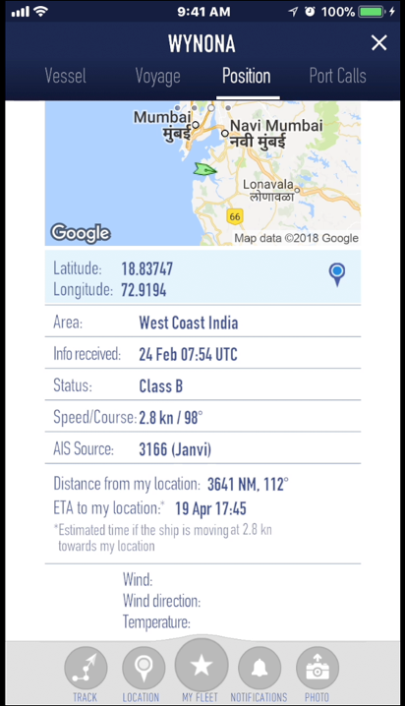
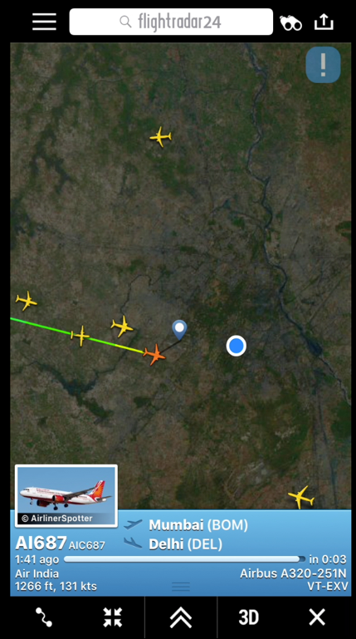
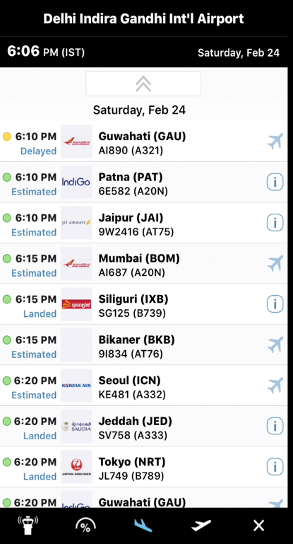
Dashboard A - Public Health Emergency Monitoring
Dashboard B – Integration of Airports, Seaports, Land Boarder Crossing Data

Slide 33
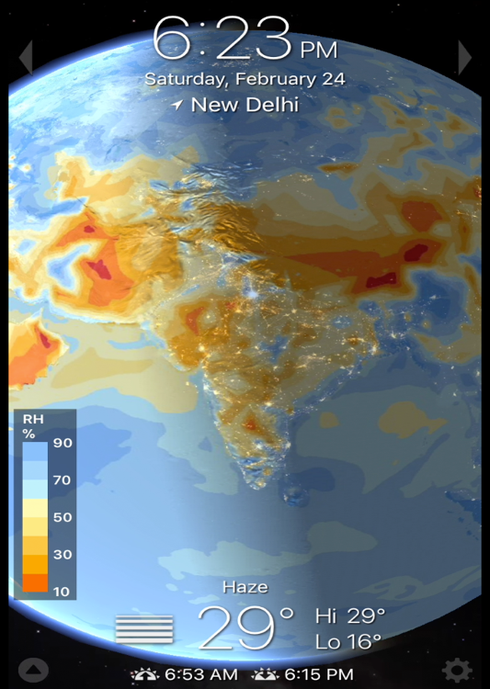
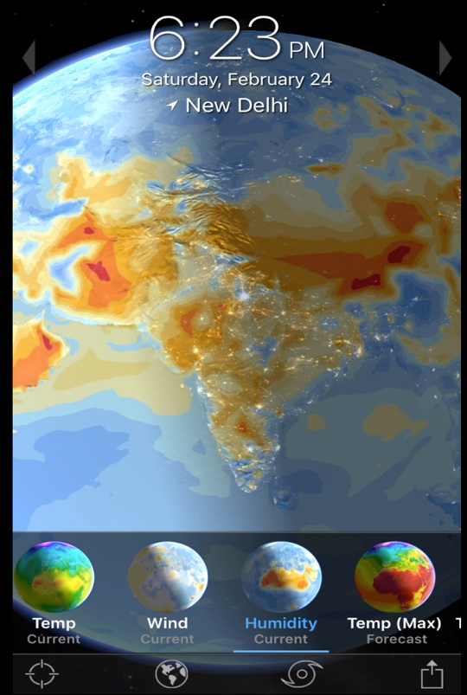
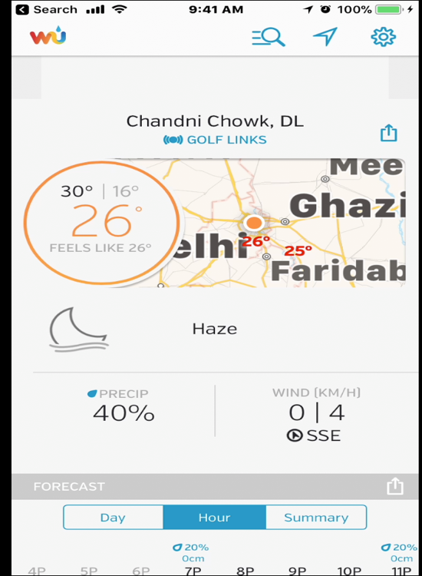
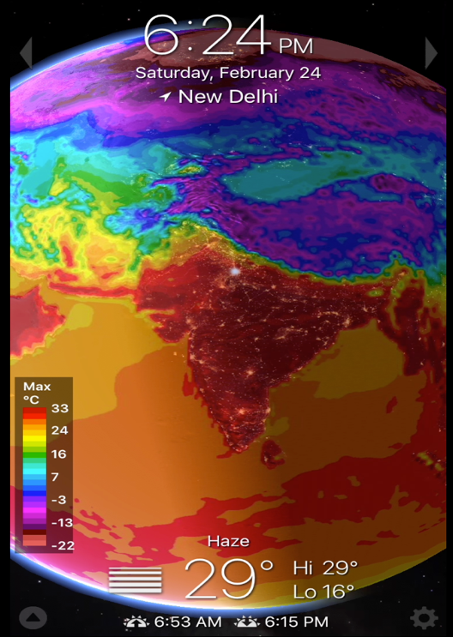
To be configured
To be configured
Dashboard C - Public Health Environment Monitoring
To be configured
To be configured
Dashboard D – To be configured

Slide 34
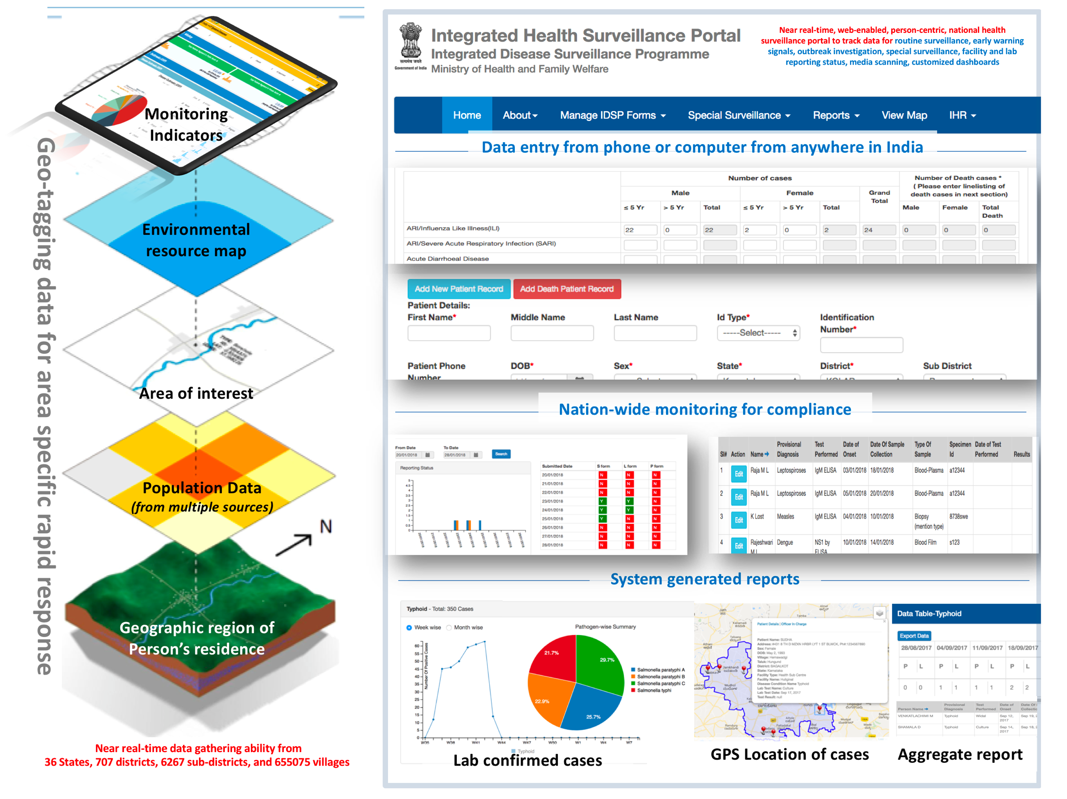

Slide 35
IHIP Training & Roll Out (proposed)
State | Training | Roll Out
Karnataka | State & District Completed | Post 7th November
Himachal Pradesh
Andhra Pradesh
Odisha (17 districts)
Uttar Pradesh | State & selected district Level Completed
Telangana | State Level Completed District level started
Kerala | 21st -23rd November

Slide 36
Thank you
For further information
Dr Ramesh Krishnamurthy, KrishnamurthyR@who.int
Senior Advisor, Health Metrics and Measurement Cluster
WHO Headquarters, Switzerland
Dr Pavana Murthy, MurthyP@who.int
National Professional Officer
WHO Country Office, India

