Slide 1



A LIFE SAVING INNOVATION:
INTEGRATION OF 108 EMRI AMBULANCES
WITH TAMIL NADU ACCIDENT AND EMERGENCY CARE INITIATIVE(TAEI)
Dr.Darez Ahamed, IAS
Commissioner of Trauma care
Mission Director – NHM Tamil Nadu

Slide 2
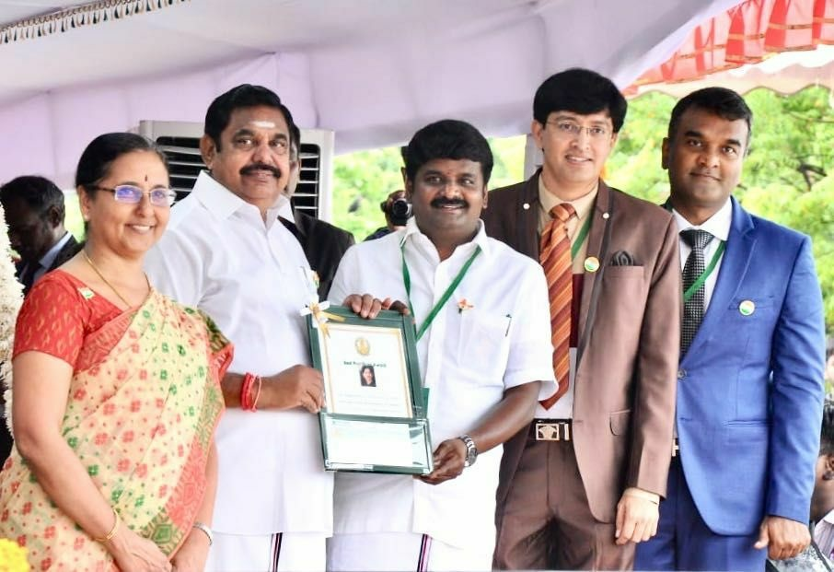
Independence Day award (2018) from Hon’ble CM for TAEI

Slide 3
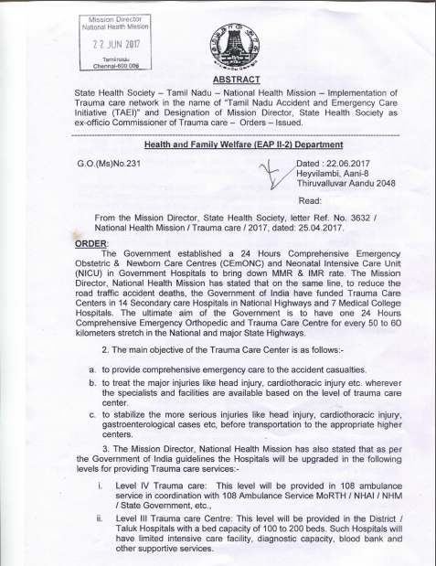
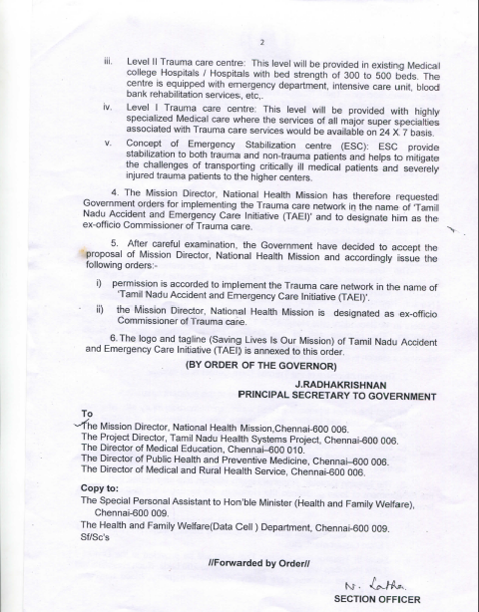
MD NHM designated as the Commissioner of Trauma Care vide
G.O. (Ms) No. 231 dated 22.06.2017

Slide 4
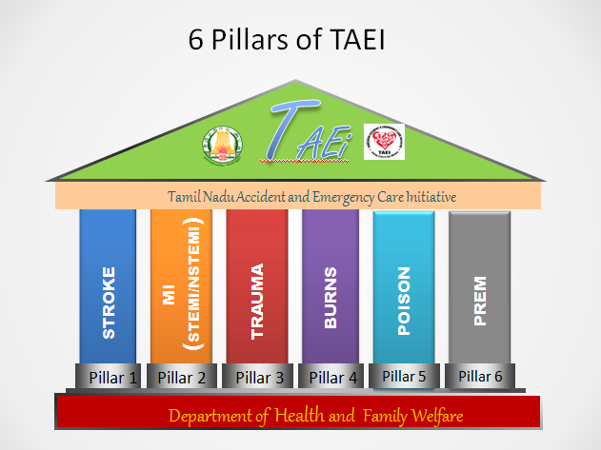
Tamil Nadu Accident & Emergency Care Initiative (TAEI)

Slide 5
State TAEI Governance Committee
District Programme Unit
Chairmanship under
District Collector
District Trauma Care Nodal Officer
Joint Director (DM&RHS)
Hospital Trauma Care Nodal Officer (HTNO) of Respective Trauma Care Centres
Name of The Official | Designation
Principal Secretary, Health & Family Welfare Department | Chairperson
Mission Director NHM, and Commissioner of Trauma care | Member Secretary
Director of Medical Education | Member
Director of Medical and Rural Health Services | Member
Director of Public Health and Preventive Medicine | Member
Commissioner of Trauma Care (PD TNHSP) | Member
MD, TN Medical Supplies Corporation ltd | Member
Director of Trauma Care ( Level-1 facility @ Chennai) | Member
State Head 108 Ambulance services | Member
Head, CMCHIS Scheme | Member
President, IMA, Private Hospitals network | Member
Representation from Police, Road Transport, Highways Departments | Member

Slide 6
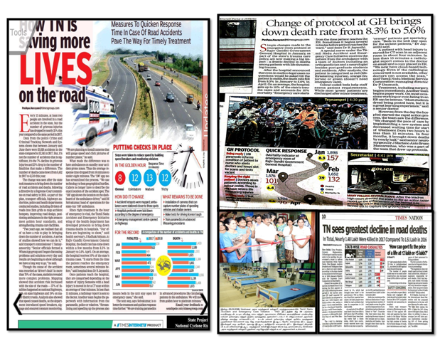
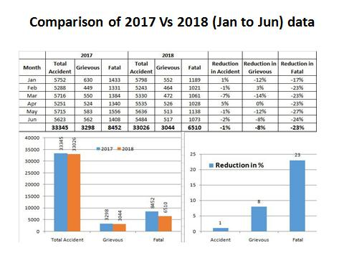

Slide 7
One Year Data from 75 TAEI hospitals
Oct 2017 to Sep 2018
S.No | Particulars | Oct 2017 - Sep 2018
1 | Total Trauma | 474778
2 | Total Admitted | 277974
3 | Total RTA | 189478
4 | Total Fall | 169404
5 | Total Assault | 115896
6 | Total Head injury | 94310
7 | Total Surgery | 137804
8 | CT Done | 95561
9 | Blood Transfusion | 12522
10 | Refered out | 32611
11 | Brought by 108 | 147296
12 | Ift 108 | 31799
13 | Brought dead | 6161
14 | RTA DIED | 2669
15 | Self Harm (2Months ) | 15853
16 | Hospitals | 75

Slide 8
TAEI Android App
Consolidated at 6 pm daily
Particulars | OCT 25th | OCT 26th | OCT 27th | OCT 28th
Total Trauma | 1295 | 1348 | 1425 | 1650
Total Admitted | 682 | 671 | 784 | 954
Total RTA | 489 | 473 | 550 | 702
Total Fall | 534 | 473 | 568 | 600
Total Assault | 272 | 309 | 307 | 348
Total Head injury | 291 | 248 | 275 | 305
Total Surgery | 510 | 487 | 437 | 512
CT Done | 339 | 341 | 337 | 338
Blood Transfusion | 30 | 37 | 29 | 42
Refered out | 89 | 90 | 91 | 143
Brought by 108 | 460 | 564 | 546 | 588
Ift 108 | 148 | 113 | 121 | 158
Brought dead | 18 | 27 | 20 | 26
RTA died at Hospital | 6 | 3 | 3 | 6
Self Harm (75) | 257 | 254 | 261 | 318
Hospitals (75) | 75 | 75 | 75 | 75

Slide 9
Mortality in Trauma Reduced from 8.27 to 3.28 %
RGGGH-MMC Chennai
 | Total Cases | Death | %
January '18 | 1898 | 157 | 8.27
February '18 | 1652 | 132 | 7.99
March '18 | 1576 | 101 | 6.4
April '18 | 1706 | 96 | 5.62
May '18 | 1818 | 87 | 4.78
June '18 | 1608 | 88 | 5.47
July '18 | 1656 | 81 | 4.89
August '18 | 1676 | 55 | 3.28

Slide 10
Mortality in Other Conditions Reduced by 3 %
RGGGH-MMC Chennai
 | Total Cases | Death | %ge
January '18 | 4133 | 228 | 5.51
February '18 | 4976 | 168 | 3.37
March '18 | 4747 | 160 | 3.37
April '18 | 4742 | 154 | 3.24
May '18 | 4937 | 155 | 3.13
June '18 | 4650 | 133 | 2.86
July ,18 | 4558 | 124 | 2.72
August '18 | 5251 | 189 | 3.59

Slide 11
PRE HOSPITAL Innovations
GIS mapping of Accidents to find the hotspot
Dynamic Allocation of Ambulances based on GIS Mapping
108 Global Position transmitter App(Lat & Long of caller location)
Pilot navigation app to reach the Scene
Introduction of Advanced Paramedics in the field
Pre- Arrival Intimation to 75 TAEI centers to expedite the reception and resuscitation

Slide 12
HOSPITAL Innovations
Pre Arrival Intimation at 75 Centres
Trauma Reception (Triage Codes Red Yellow Green )
Creation of Resuscitation Bay
Time Stamped Management
Point of Care Testing at ER
Linkages with Multidisciplinary Units
Multi Disciplinary Critical Care Unit
Nurse Driven Model
TAEC Protocols
Capacity Building (Training)
Formation of Emergency Department
Rehabilitation starts From the Day of Admission

Slide 13
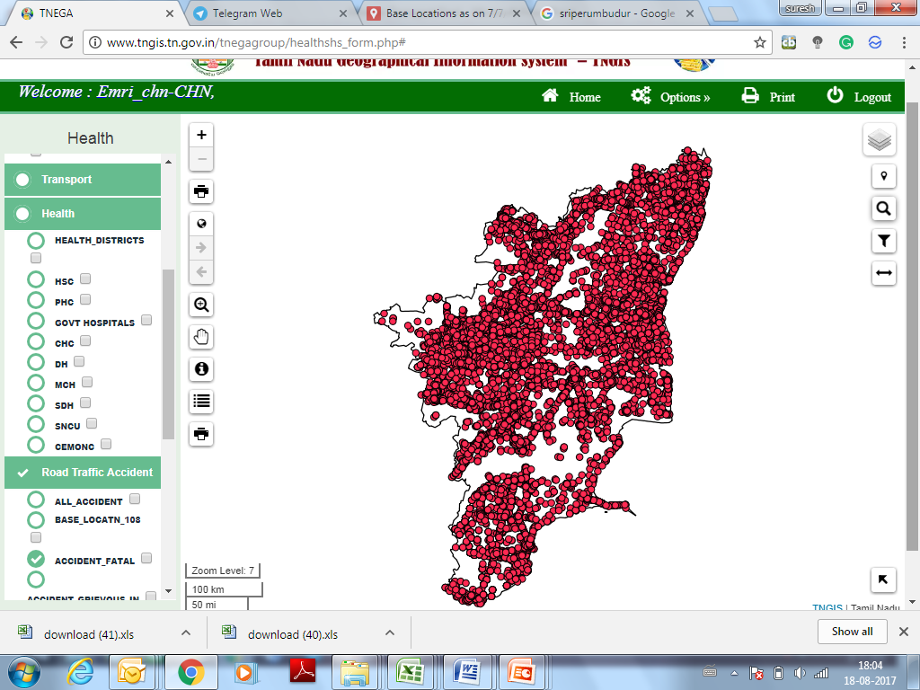
GIS Mapping to find Top 100 Accident Grid in the state (4 km²)
S.NO | DISTRICT | GRID ID | Accident Count
1 | Tiruppur | 13629 | 169
2 | Tiruvallur | 33199 | 168
3 | Cuddalore | 24000 | 149
4 | Cuddalore | 23999 | 141
5 | Kancheepuram | 33114 | 114
6 | Tirunelveli | 421 | 113
7 | Tiruvallur | 33200 | 109
8 | Tiruchirapalli | 14357 | 107
9 | Tiruvallur | 33116 | 104
10 | Kancheepuram | 33032 | 102
11 | Kancheepuram | 33115 | 101
12 | Tiruvallur | 33198 | 91
13 | Tirunelveli | 2178 | 90
14 | Tiruchirapalli | 14525 | 86
15 | Chennai | 33201 | 85
16 | Chennai | 32942 | 84
17 | Kancheepuram | 33031 | 80
18 | Tirunelveli | 2295 | 77
19 | Tirunelveli | 1969 | 76
20 | Erode | 19634 | 73
21 | Tiruchirapalli | 14863 | 73
22 | Tirunelveli | 2745 | 71
23 | Coimbatore | 12934 | 68
24 | Ramanathapuram | 5084 | 68
25 | Salem | 23086 | 68

Slide 14
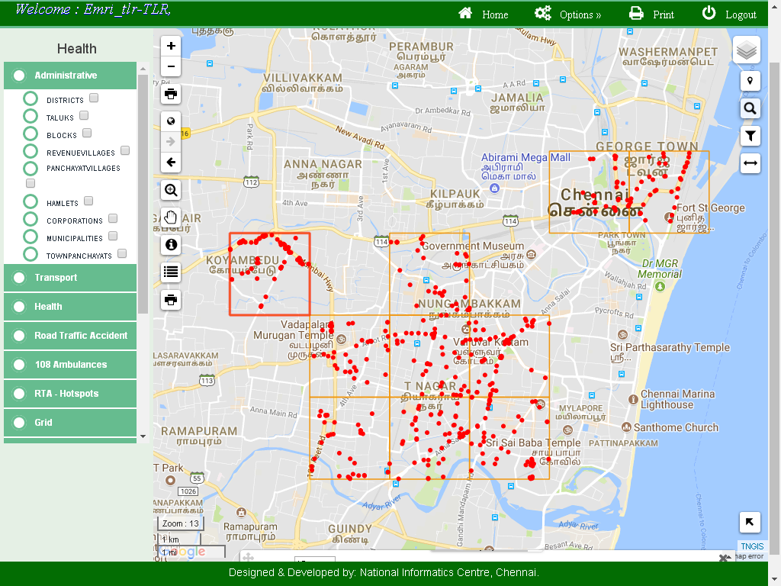
S No | Grid Id | Fatal / GI | Roads
1 | 33201 | 85 | GWT Road(SH),Inner Ring Road(SH)
2 | 33121 | 60 | GST Road(SH),(ODR)
3 | 33120 | 51 | (ODR)
4 | 33037 | 50 | GST Road(SH),(ODR)
5 | 33119 | 48 | Inner Ring Road(SH),(ODR)
6 | 33281 | 48 | GNT Road(SH),GWT Road(SH),(ODR)
7 | 33036 | 47 | GST Road(SH),(ODR)
8 | 33282 | 40 | GWT Road(SH),(ODR)
9 | 33035 | 36 | Inner Ring Road(SH)
10 | 33203 | 36 | GWT Road(SH),(ODR)

Slide 15
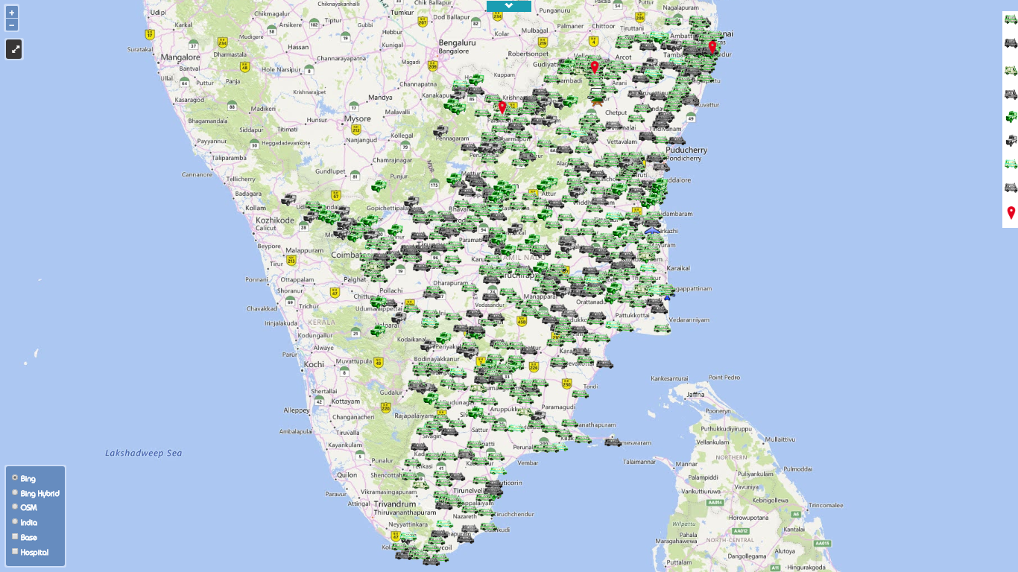
Real time tracking of Ambulances and dynamic case assignment based on the GPS

Slide 16
Ambulances Reach 4 Minutes Earlier after Changing the Location
District | Before Intervention | After Intervention
Krishnagiri | 00:16:35 | 00:13:50
Kancheepuram | 00:19:40 | 00:16:13
Villupuram | 00:15:24 | 00:14:06
Vellore | 00:14:51 | 00:14:03

Slide 17
Ambulances Reach More People after Changing the Location
District | Before Intervention | After Intervention
Krishnagiri | 207 | 282
Kancheepuram | 266 | 365
Villupuram | 243 | 319
Vellore | 241 | 299

Slide 18
State Level Impact after
Re-Deployment based on Accident density analysis

Slide 19
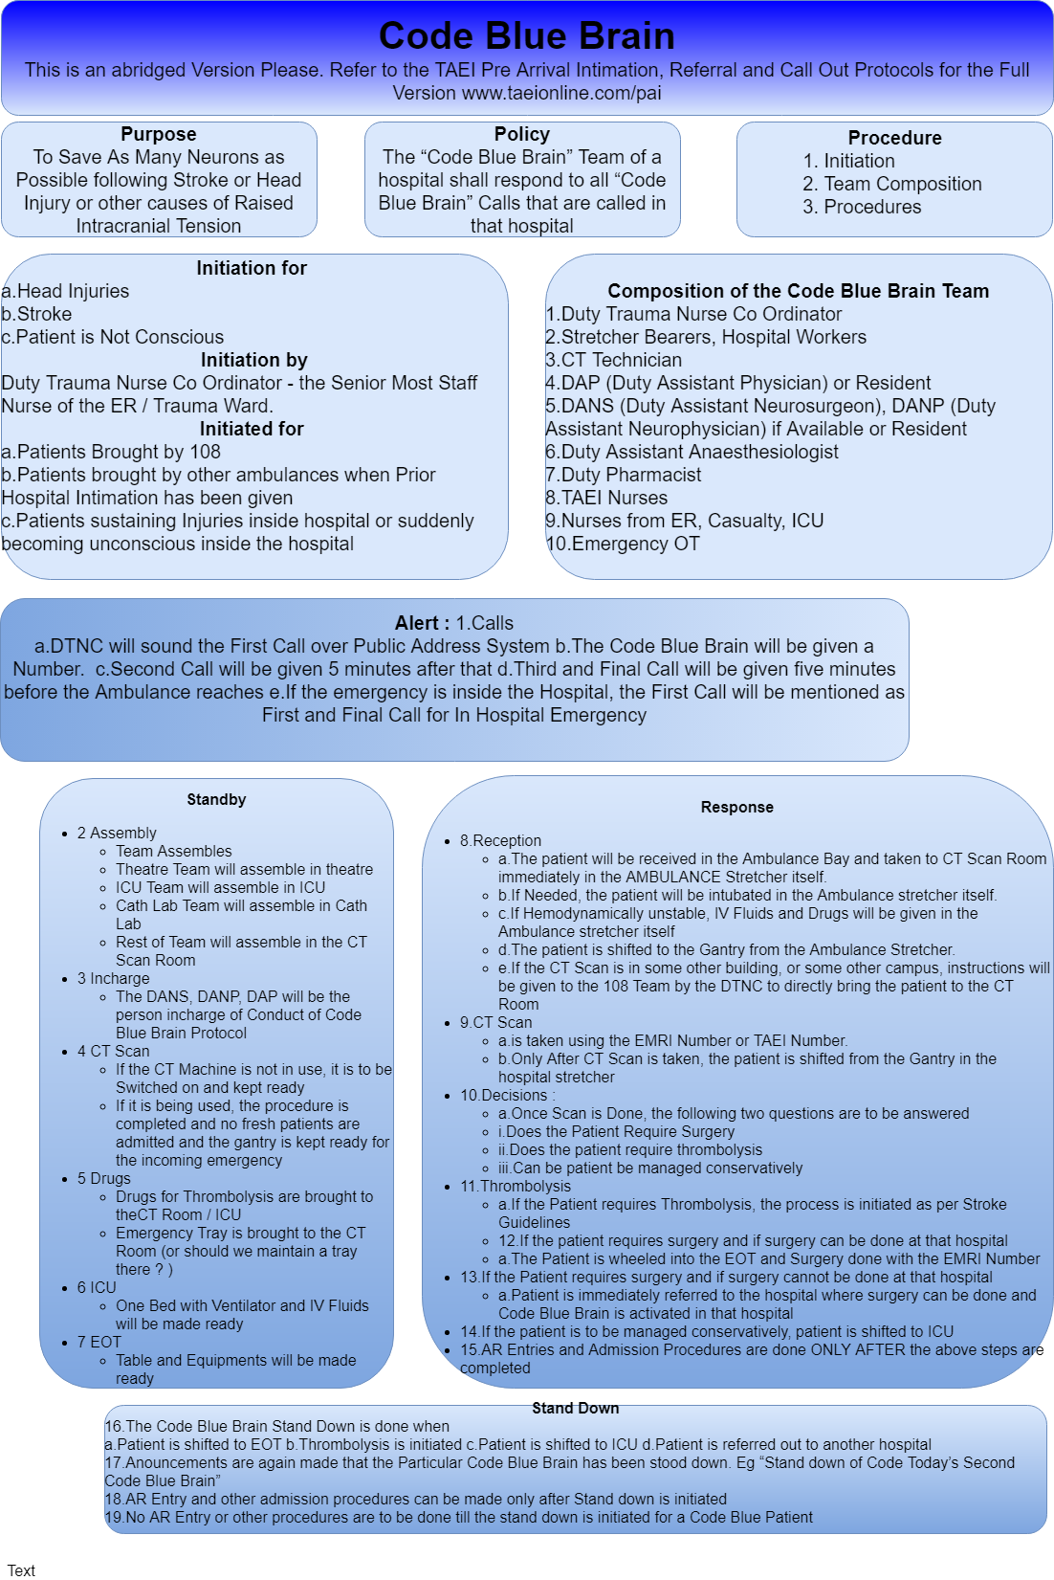
Hospital Emergency Callout Codes in response to Information from Ambulance
1. Code Blue Brain
2. Code Blue Heart
3. Code Blue Abdomen
4. Code Blue Poison
5. Code Blue Burns

Slide 20
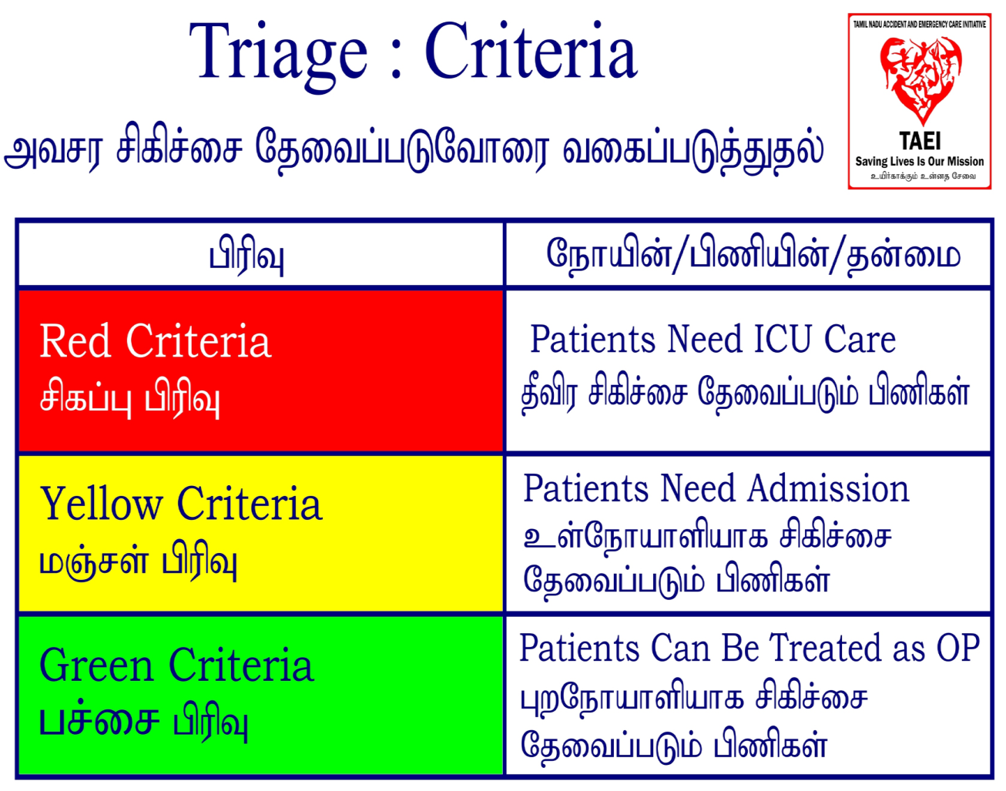

Triage into Red, Yellow, Green Categories

Slide 21
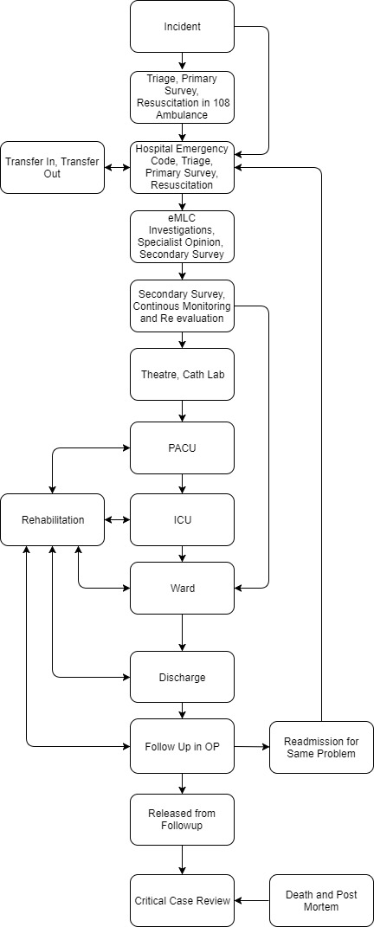

Slide 24
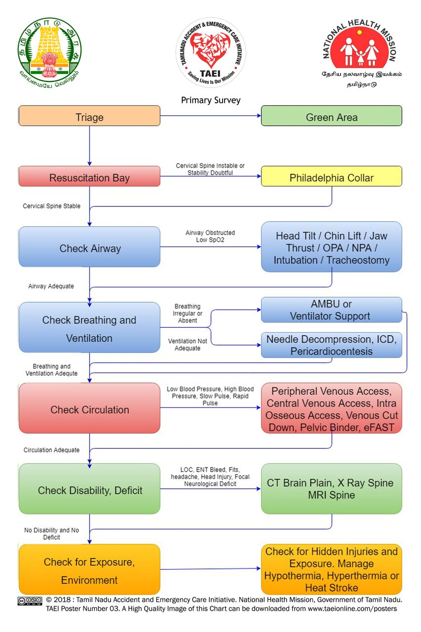

Slide 28

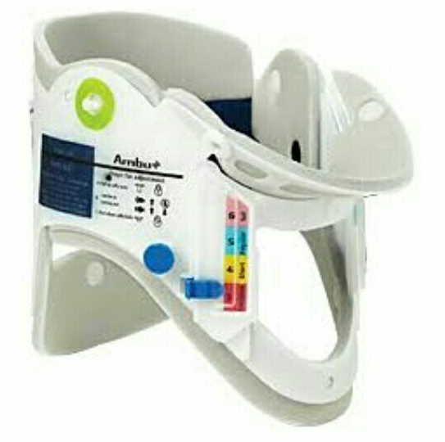
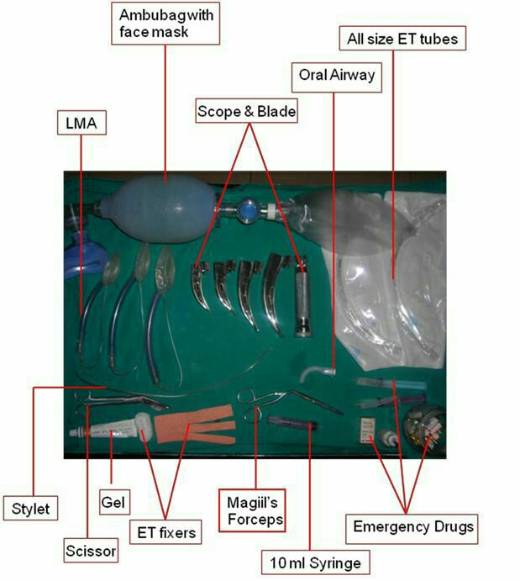
Resuscitation Bay where Red and Yellow Patients are received
Primary Survey and Resuscitation Go Hand in Hand
Airway with C spine stabilisation
Breathing
Circulation
Disability
Environment

Slide 29
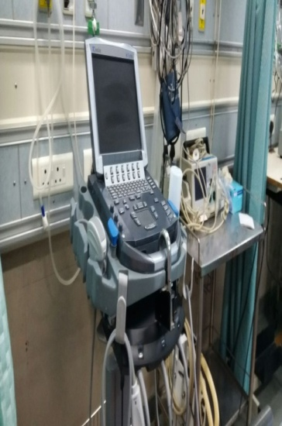
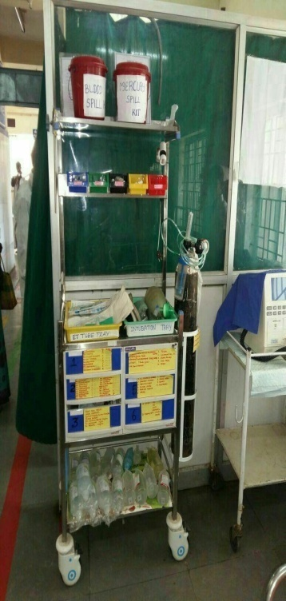
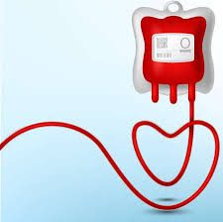
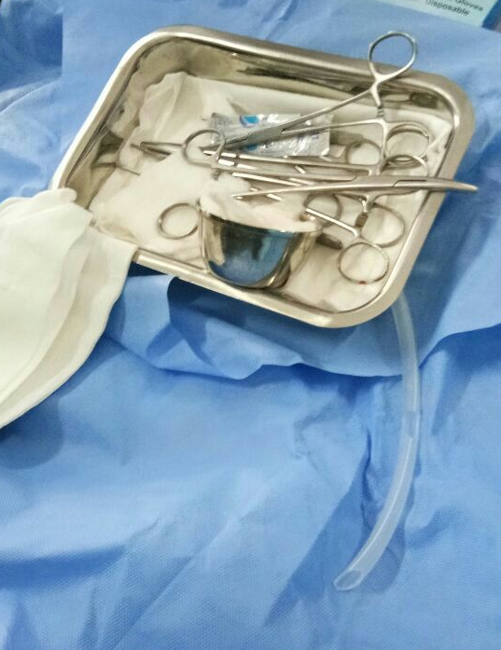

Slide 30
 | Stage | Description | Time
1 | Triage | Red, Yellow or Green | 2 minutes
2 | Primary Survey | Check ABCDE | 2+2 minutes
3 | Resuscitation | Manage ABCDE | 8 minutes
4 | Investigations | eFAST, Mobile X - Ray, Investigations, CT, Thrombolysis(if needed) | 15 minutes
5 | AR Entry | Medico Legal Formalities | 30 minutes
6 | Secondary Survey | Detailed Examination | 45 minutes
7 | Specialist opinion | Complete opinion from all Specialists | 120 minutes
8 | Monitoring & Re-evaluation | Spinal Stabilisation (if necessary) & Continuous post resuscitation monitoring and evaluation | 180 minutes
9 | Shifting of Patient | Shift Patient from ER to Respective Departments | 360 minutes

Slide 31
10 Second Quick Primary Survey
2 Questions + 1 Instruction
  Name ?
  What happened?
  Lift Both Legs, Move Both Arms.
If Patient Answers Both + Moves All 4 limbs
  Airway is Patent
  There is Sufficient air reserve to permit speech
  There is Sufficient perfusion
  Sensorium is Clear
  No Neurological Deficit

Slide 32
Emergency Room
Emergency Operation Theatre / Cath Lab
Post Anaesthetic Care Unit
Multi Disciplinary Critical Care Unit
Intensive Care Unit
Wards
EMERGENCY DEPARTMENT
Trauma Care Centre

Slide 33
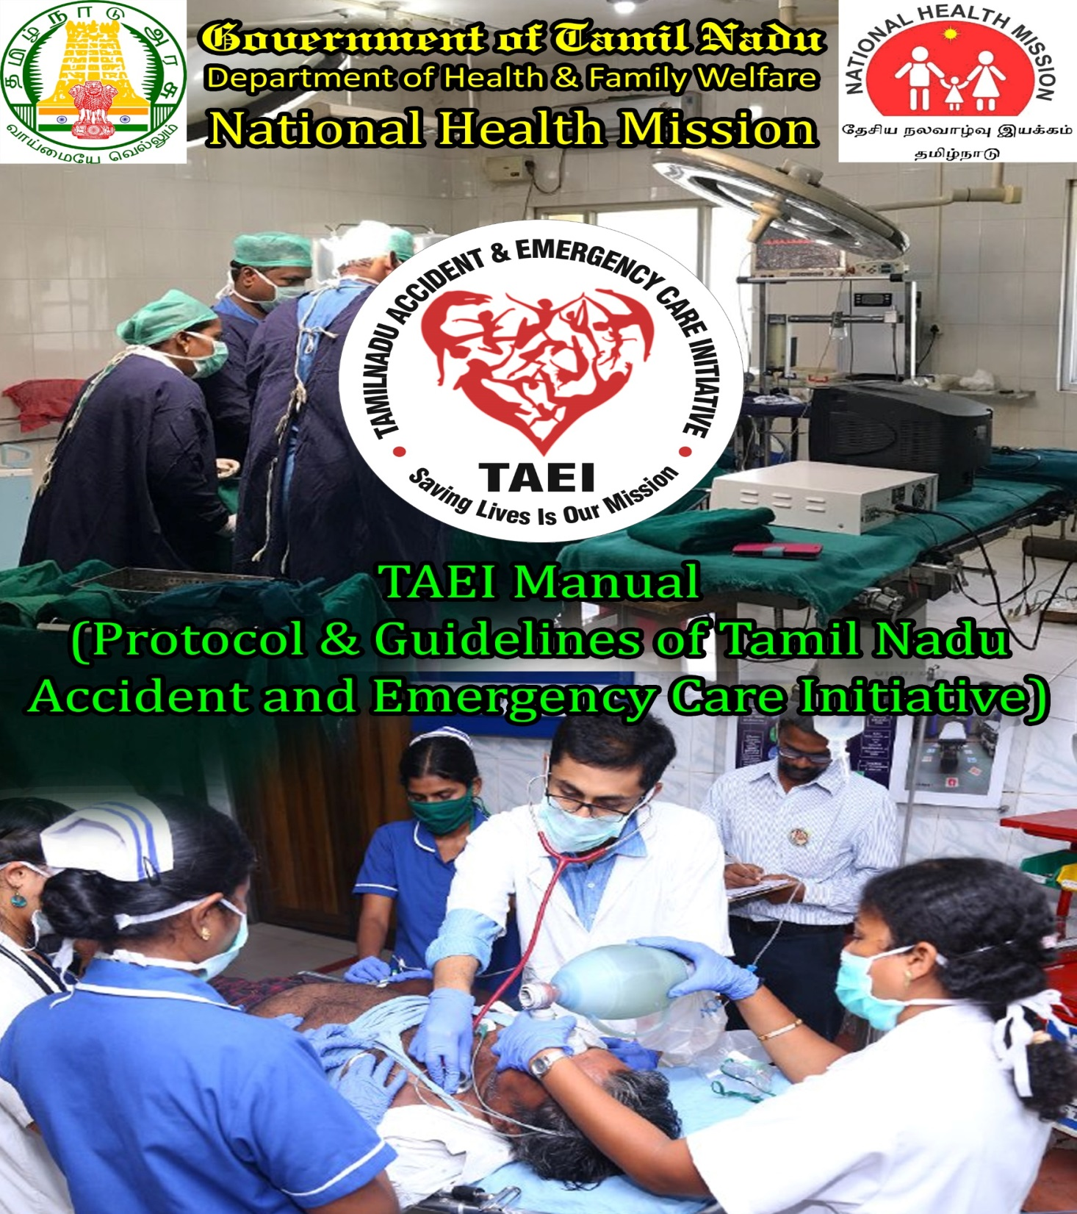
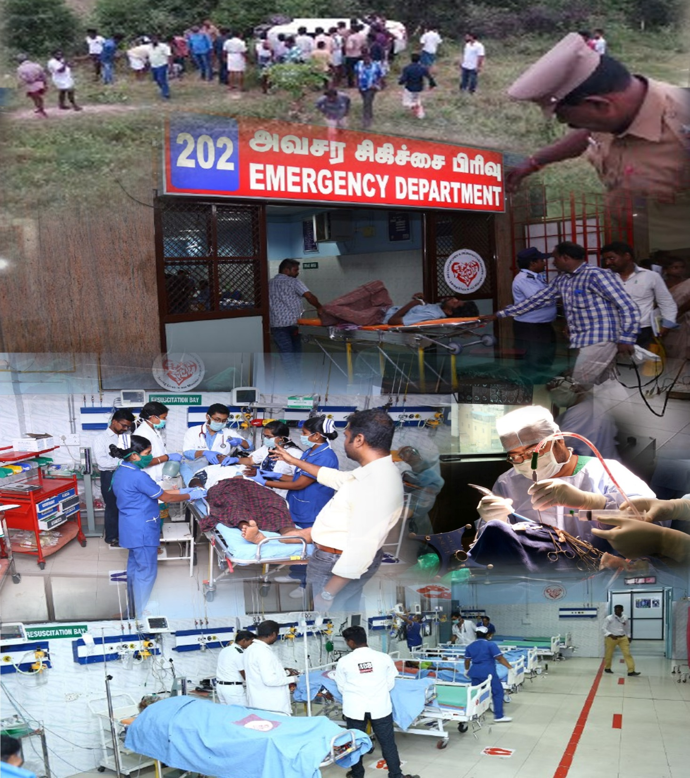

Slide 34
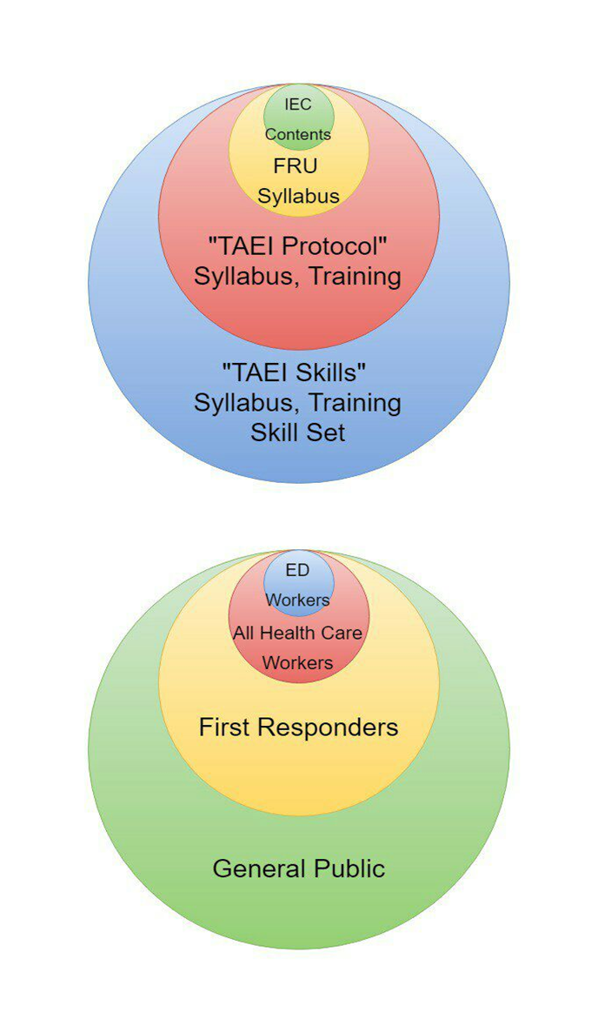
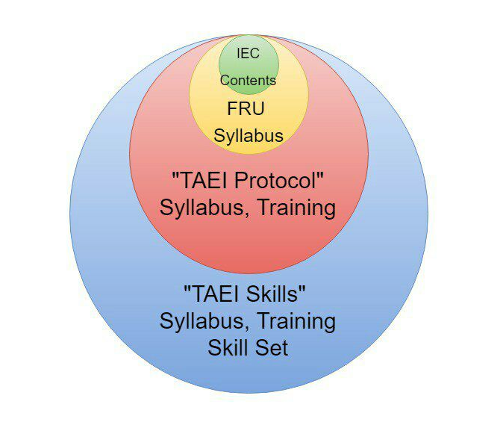
4 Stages of Capacity Building

Slide 35
Mail rchpcni@tn.nic.in
MD NHM Mobile 9443358888
Now lets attain Space Age Precision in saving human lives.
TAEI Manual (Policy & Protocols), Standard Operating Procedures, Training Manuals available for download at www.taeionline.com/book
Posters available for download at www.taeionline.com/posters

