Slide 1
INTEROPERABLE
ELECTRONIC HEALTH RECORDS (EHR)
31st Aug, 2016

Slide 2
A KEY COMPONENT OF DIGITAL INDIA PROJECT
HON’BLE PM LAUNCHED THE PROJECT – ORS (ONLINE REGISTRATION SYSTEM) ON 1ST JULY, 2015
QUOTE FROM HON’BLE PM’S THIS YEAR INDEPENCENCE DAY SPEECH

Slide 3
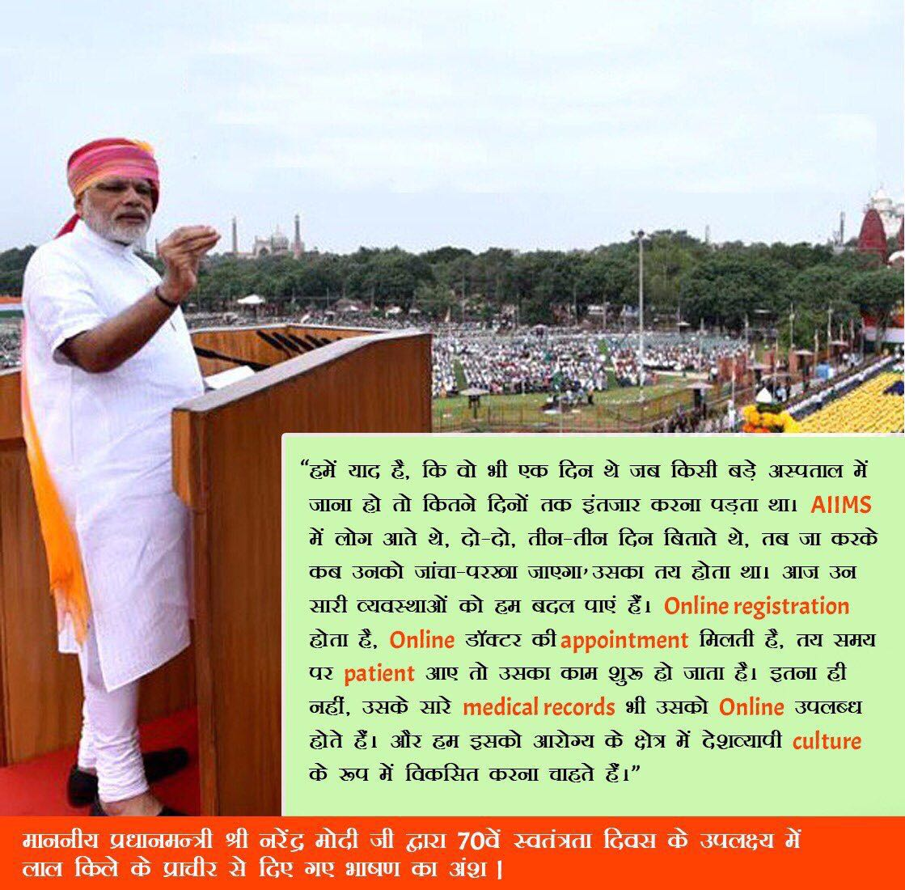
QUOTE FROM HON’BLE PM’S THIS YEAR INDEPENCENCE DAY SPEECH

Slide 4
COMPONENTS OF EHR
INTEGRATED HEALTH INFORMATION PLATFORM (IHIP) AND EXCHANGE- EOI ISSUED
EHR STANDARDS- NOTIFIED
UNIQUE NUMBER (NIN) FOR EACH HEALTH FACILITY
  ASSIGNED FOR ALL PUBLIC HEALTH FACILITIES (STATES TO VERIFY)
  PROVISION MADE FOR NIN FOR PVT. FACILITIES
PRIVACY ISSUE OF EHR
  NLS BANGALORE WORKING ON DRAFT LEGISLATION
HOSPITAL INFORMATION SYSTEMS FOR ALL HEALTH FACILITIES/ SYSTEMS

Slide 5
ECOSYSTEM CREATED BY NIC
CLOUD BASED eHOSPITAL APPLICATION
ROLLOUT AGENCIES EMPANELLED
NIC TO SUPPORT HOSTING OF APPLN ON CLOUD
  NIC TO TAKE CARE OF CLOUD INFRA AND APPLN MAINTENANCE
ORS MODULE FOR ONLINE CITIZEN SERVICES
  ONLINE REGISTRATION/ APPOINTMENTS
  ONLINE LAB REPORTS
  ALSO AVAILABLE ON MOBILE APP
  44 HOSPITALS ON BOARD
NICSI RATE CONTRACTS FOR LAN, HARDWARE

Slide 6
eHOSPITAL MODULES
Out Patient Department (OPD)
Online Registration System (ORS)
Admission Discharge & Transfer (IPD)
PRESENTLY AVAILABLE
ON CLOUD
Billing
Laboratory
eBloodBank
Pharmacy
Clinic
EXPECTED BY END OF SEPTEMBER
Lab Information System
Store & Inventory
Radiology
EXPECTED BY YEAR END
Dietary
Laundry

Slide 7
ACTION POINTS
FUNDING FOR COMPUTERIZATION UNDER NHM
IMPLEMENTATION OF HOSPITAL INFORMATION SYSTEM IN DISTRICT HOSPITALS & COMMUNITY HEALTH CENTRES
  PROCURING HEALTH FACILITY LEVEL IT INFRASTRUCTURE
  ENGAGING ROLL-OUT AGENCY
  ONBOARDING THE eHOSPITAL APPLICATION (http://ehospital.gov.in)
  (SUPPORT : ehospital@gov.in)
ADOPTION OF ORS IN HOSPITALS & MEDICAL COLLEGES

Slide 8
THANK YOU

