Slide 1
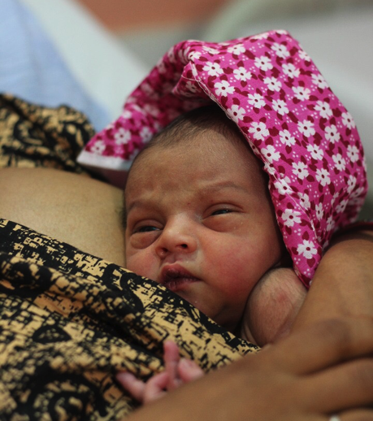
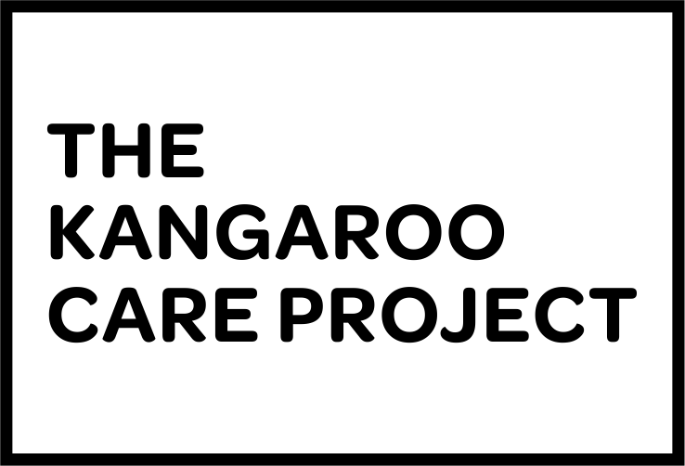


Shaping a health system that values every newborn life through Kangaroo Care
Alok Kumar, IAS
Mission Director
National Health Mission, UP
Dr. Vishwajeet Kumar
President & Principal Scientist
Community Empowerment Lab

Slide 2
70%
72%
A quarter of newborn deaths can be averted by universalising Kangaroo Care.
LOWER RISK OF
SEVERE ILLNESS
40%
LOWER RISK OF
HYPOTHERMIA
40%
HIGHER SURVIVAL
in < 2000g babies compared to
conventional incubator care
20%
LOWER REPEAT
HOSPITALISATION
HIGHER EXCLUSIVE
BREASTFEEDING
Most powerful intervention for reducing mortality in low birth weight infants.
One of the 3 priority facility-based interventions for small & sick newborns: INAP
Yet, less than 1% newborns globally receive Kangaroo Care.
Source: Conde-Agudelo A, Diaz-Rossello JL. Kangaroo mother care to reduce morbidity and mortality in low birthweight infants. Cochrane Database of Systematic Reviews 2016.
Notes:
Near universal coverage of KMC has the potential to avert at least 60,000 newborn deaths in UP alone.

Slide 3
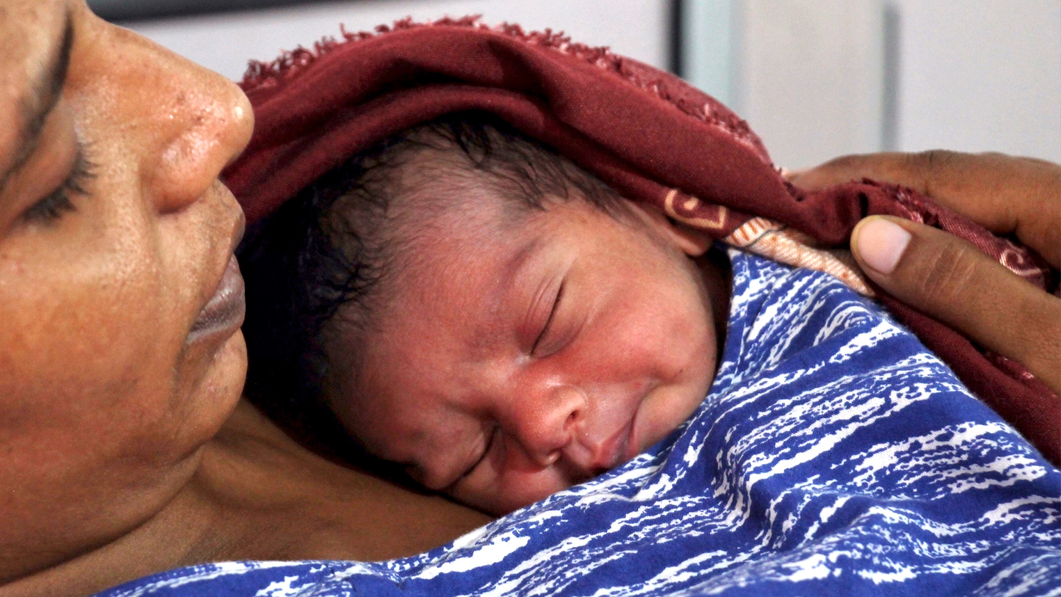
Shaping a health system that values every newborn life through Kangaroo Care.
THE KANGAROO CARE PROJECT

Slide 4
APPROACH.
Design an ecosystem that promotes the uptake of Kangaroo Care using principles of design thinking, systems dynamics and implementation science.
01
02
03
shared ownership.
co-design.
data-driven.
Expanding ownership to include stakeholders from the political, administrative, health system, civil society, media, industry and community systems. Creating common ground around Kangaroo Care.
Not a top-down imposed model. The entire design process involving understanding people, systems, processes; identifying opportunities and decision-making; action, review and feedback for improvement, is participatory involving all stakeholders.
Using data to understand the relationship between behaviors and outcomes, identify critical points of intervention, support decision-making and quality improvement.
04
05
06
empathy.
leverage.
changing norms.
The existing ‘empathy vacuum’ between the health system and communities leads to low health worker morale, disrespect and dissatisfaction amongst mothers & families. Filling this gap is critical to success.
Kangaroo Care is not a standalone intervention, and must be integrated & leveraged to strengthen the health system, nurture an environment of respectful care, and improve adoption of life-saving behaviors.
Norms are primary drivers of behaviors, both at facility and community levels. Changing norms requires designing an enabling environment to accelerate behavior change.

Slide 5
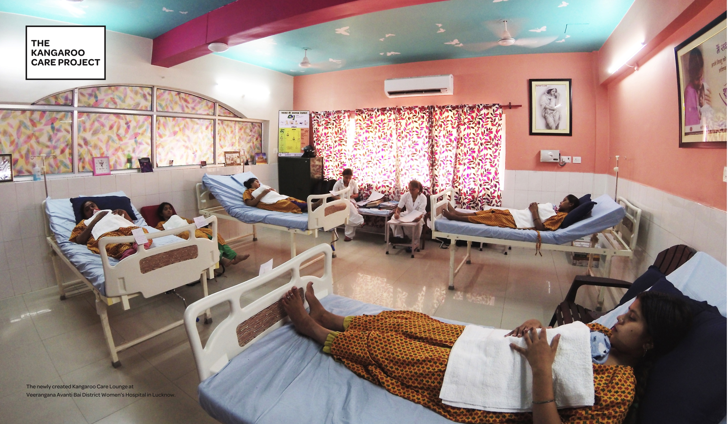

The Kangaroo Care lounge is at the heart of the facility-based ecosystem that fosters an environment of empathy, comfort and respectful care.

Slide 6
APPROACH.
Design an ecosystem that promotes the uptake of Kangaroo Care using principles of design thinking, systems dynamics and implementation science.
01
02
03
shared ownership.
co-design.
data-driven.
Expanding ownership to include stakeholders from the political, administrative, health system, civil society, media, industry and community systems. Creating common ground around Kangaroo Care.
Not a top-down imposed model. The entire design process involving understanding people, systems, processes; identifying opportunities and decision-making; action, review and feedback for improvement, is participatory involving all stakeholders.
Using data to understand the relationship between behaviors and outcomes, identify critical points of intervention, support decision-making and quality improvement.
04
05
06
empathy.
leverage.
changing norms.
The existing ‘empathy vacuum’ between the health system and communities leads to low health worker morale, disrespect and dissatisfaction amongst mothers & families. Filling this gap is critical to success.
Kangaroo Care is not a standalone intervention, and must be integrated & leveraged to strengthen the health system, nurture an environment of respectful care, and improve adoption of life-saving behaviors.
Norms are primary drivers of behaviors, both at facility and community levels. Changing norms requires designing an enabling environment to accelerate behavior change.

Slide 7
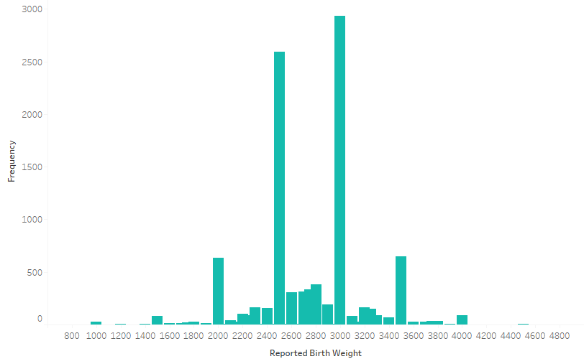
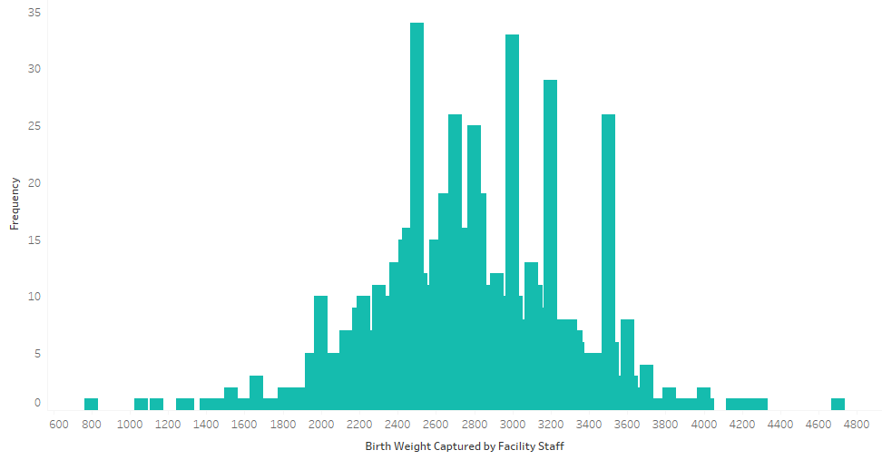
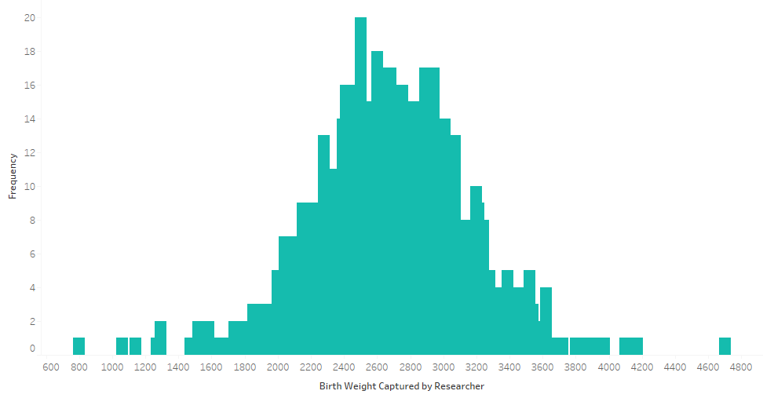
Accurate weighing is critical to the care of low birth weight babies.
DATA-DRIVEN PROCESS IMPROVEMENT.
Before
After
Actual
Birth Weight Distribution

Slide 8
APPROACH.
Design an ecosystem that promotes the uptake of Kangaroo Care using principles of design thinking, systems dynamics and implementation science.
01
02
03
shared ownership.
co-design.
data-driven.
Expanding ownership to include stakeholders from the political, administrative, health system, civil society, media, industry and community systems. Creating common ground around Kangaroo Care.
Not a top-down imposed model. The entire design process involving understanding people, systems, processes; identifying opportunities and decision-making; action, review and feedback for improvement, is participatory involving all stakeholders.
Using data to understand the relationship between behaviors and outcomes, identify critical points of intervention, support decision-making and quality improvement.
04
05
06
empathy.
leverage.
changing norms.
The existing ‘empathy vacuum’ between the health system and communities leads to low health worker morale, disrespect and dissatisfaction amongst mothers & families. Filling this gap is critical to success.
Kangaroo Care is not a standalone intervention, and must be integrated & leveraged to strengthen the health system, nurture an environment of respectful care, and improve adoption of life-saving behaviors.
Norms are primary drivers of behaviors, both at facility and community levels. Changing norms requires designing an enabling environment to accelerate behavior change.

Slide 9

AGRIMAAS.
Young female volunteers who are:
setting standards for respectful care
identifying the small but significant barriers to implementation, and catalyzing continuous quality improvement within facilities
playing a pivotal role in bridging the empathy gap within the health system staff and between the health system and families

Slide 10
APPROACH.
Design an ecosystem that promotes the uptake of Kangaroo Care using principles of design thinking, systems dynamics and implementation science.
01
02
03
shared ownership.
co-design.
data-driven.
Expanding ownership to include stakeholders from the political, administrative, health system, civil society, media, industry and community systems. Creating common ground around Kangaroo Care.
Not a top-down imposed model. The entire design process involving understanding people, systems, processes; identifying opportunities and decision-making; action, review and feedback for improvement, is participatory involving all stakeholders.
Using data to understand the relationship between behaviors and outcomes, identify critical points of intervention, support decision-making and quality improvement.
04
05
06
empathy.
leverage.
changing norms.
The existing ‘empathy vacuum’ between the health system and communities leads to low health worker morale, disrespect and dissatisfaction amongst mothers & families. Filling this gap is critical to success.
Kangaroo Care is not a standalone intervention, and must be integrated & leveraged to strengthen the health system, nurture an environment of respectful care, and improve adoption of life-saving behaviors.
Norms are primary drivers of behaviors, both at facility and community levels. Changing norms requires designing an enabling environment to accelerate behavior change.

Slide 11
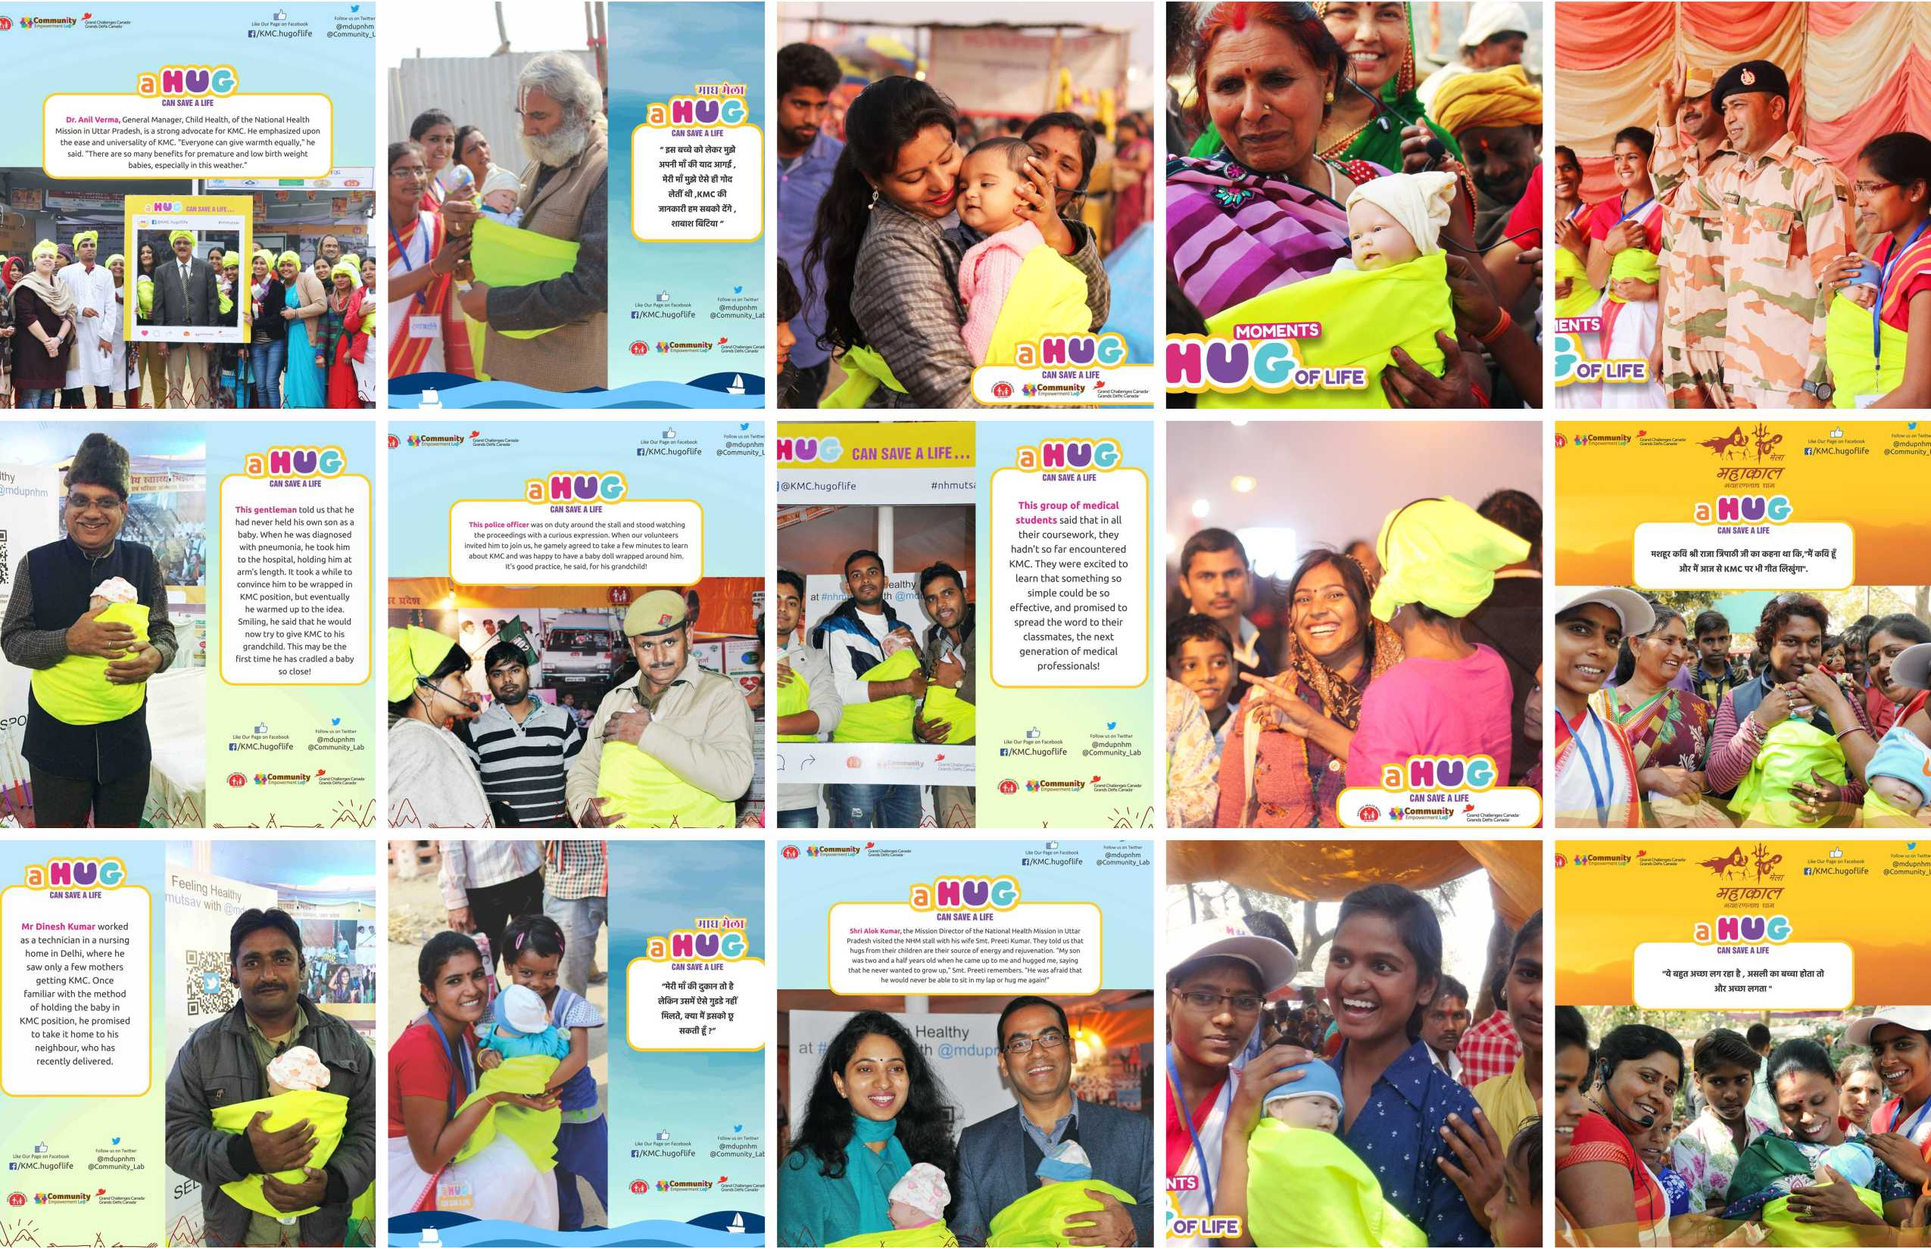
THE HUG OF LIFE CAMPAIGN.

Slide 12
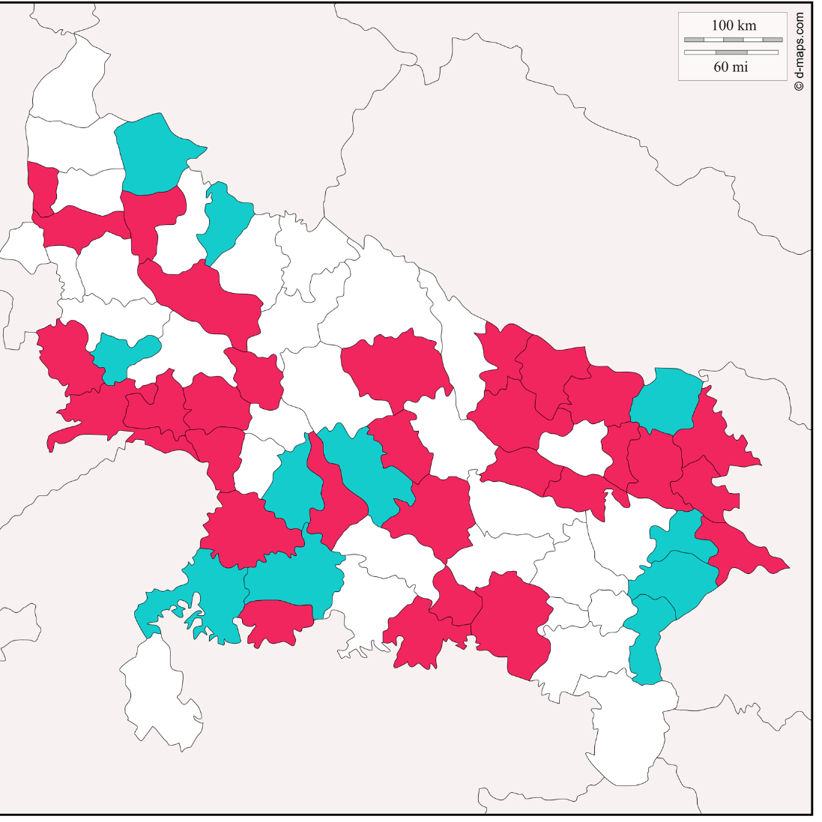
DASHBOARD.
Operational
Ready to launch
44
262
1394
10.4
No. of KMC facilities
No. of beds
No. of babies
initiated on KMC
Avg. hours of KMC per day

Slide 13
LESSONS LEARNT.
01
02
03
Empathy matters.
Small is BIG.
Community is key.
04
05
06
Make change step by step.
Impacts other behaviours.
Strengthens the health system.

Slide 14
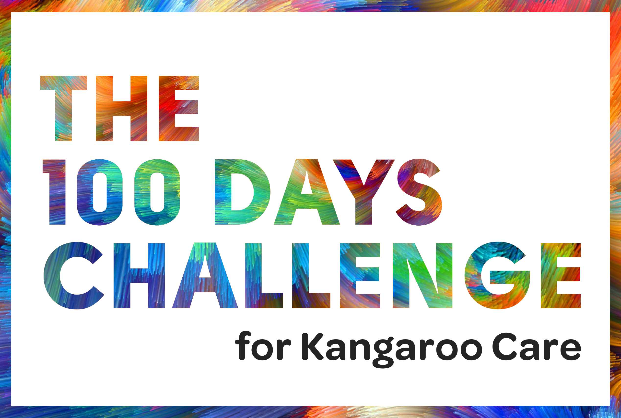
NEXT STEPS.
technology ecosystem.
e-learning platform.
developmental follow-up.
community-chc-district continuum.
the Kangaroo Care helpline.
to be integrated with the UP health helpline

Slide 15
a hug can save a life

