Slide 1

National Summit on Good and Replicable Practices And Innovations in Public Healthcare Systems, Khaziranga, Assam
KNOWLEDGE COMMAND CENTRE
Presented by
Smt. Dr. Poonam Malakondaiah, IAS
Special Chief Secretary
Health Medical & Family Welfare
Government of Andhra Pradesh
HM & FW Department, GoAP

Slide 2




Knowledge Command Center (KCC)
Knowledge Command Center: An Introduction
Knowledge command center (KCC) is the analytics wing for the Health, Medical and Family Welfare department, Government of Andhra Pradesh
Data from public health facilities and PPP programs are captured using IT system and the same is used
  To identify communicable disease incidence and non communicable disease prevalence
  To calculate the effectiveness, efficiency and quality of government health programs
  To monitor progress of districts and state on various health indicators and identifying areas that need additional focus
The data analysis then serves as an input to the government to make appropriate policy or administrative interventions
Knowledge Command Center
Government
Public Health Facilities

Slide 3

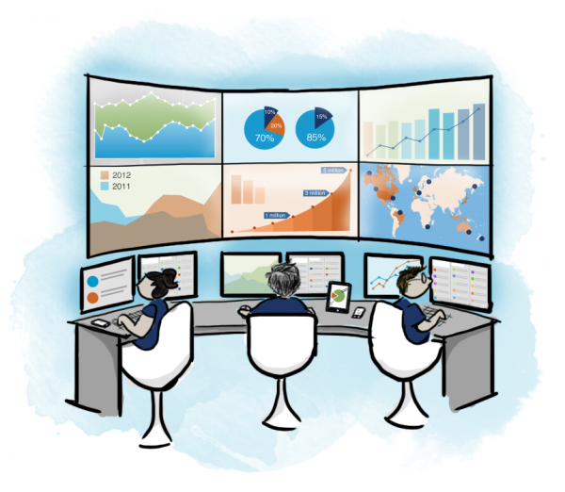
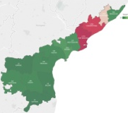









KCC: Program Flow
Health Department, GoAP
Processed data from KCC is used by the government to make necessary interventions. For example,
Knowledge Command Center
Communicable Disease Hotspots (Predicted & Actual): Govt. uses this data to ensure adequate supply of necessary drugs in the health facilities and to plan IRS and LLIN distribution across the state
Data of beneficiaries availing services from public health facilities
Non Communicable Disease Heatmaps:
Govt. uses this data to identify areas that need additional focus. For example, an area with higher occurrence of diabetes will need the PDS to stock brown rice
Program Efficiency Maps:
Govt. uses this data to identify areas that need additional focus from the service providers and government for better implementation of PPP health programs
Report Card on State Health Indicators:
Govt. uses this report card to monitor the overall progress of the state and districts on identified indicators and to identify gaps
Hospital Development Society (Rogi Kalayaan Samiti): Govt uses this analysis for close monitoring of the hospital conducting monthly HDS meetings
Data of beneficiaries availing services from health programs
Data is processed to provide meaningful inputs for the government to act on
Village/District and State Health Bulletin: Govt releases a monthly bulletin covering health initiatives, seasonal diseases in the respective geography
Notes:
Add HDS performance monitoring (Rogi kalyana Samiti)
Village/dist/state health bulletins released monthly

Slide 4
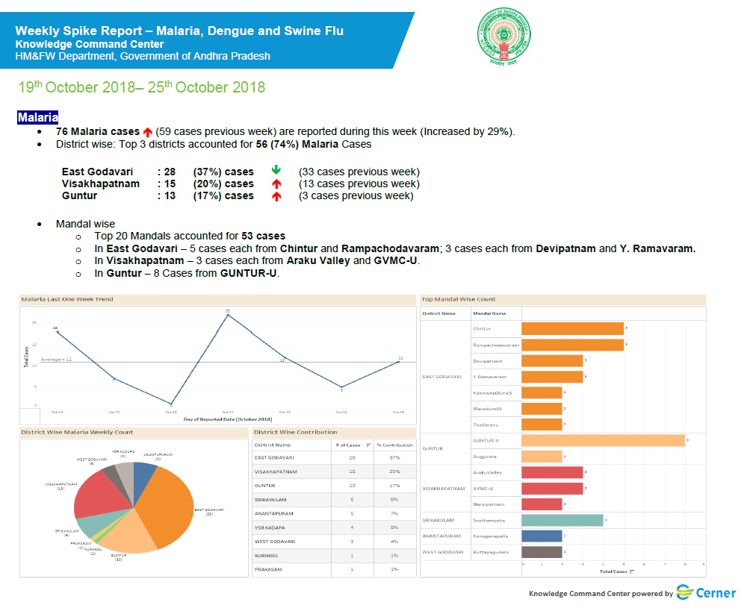
Disease Management – Communicable Diseases
Government of Andhra Pradesh is leveraging data and analytics helps to improve healthcare delivery for focused and timely action
Communicable Disease Spike Reports
Daily & weekly reports showing incidence of communicable diseases – Malaria, Dengue, Swine flu
SOS reported showing weekly trends in the incidence of communicable diseases
Predictive report showing the possible incidence of communicable diseases based on historical incidence data
These reports are shared through Kaizala so as to ensure that the concerned authorities are better equipped to handle the situation
Notes:
Slide 4a weekly spike report
4b Week on week spike report

Slide 5
Disease Management – Communicable Diseases (Weekly Trend Analysis)
Week on week comparison of Malaria Incidence in Andhra Pradesh
2017 vs 2018
Week on week comparison of Dengue Incidence in Andhra Pradesh
2017 vs 2018

Slide 6
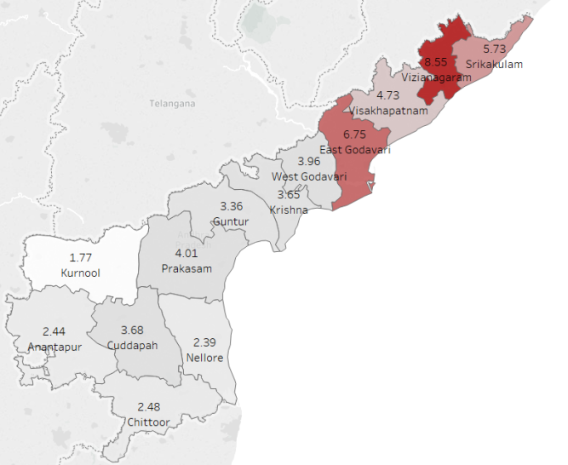
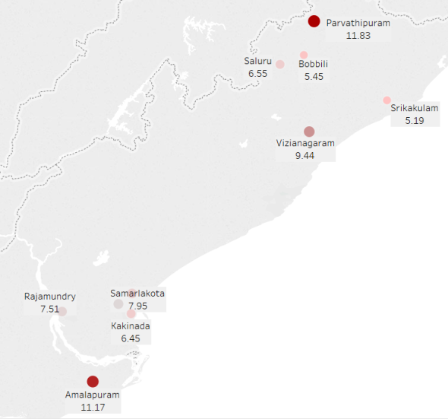
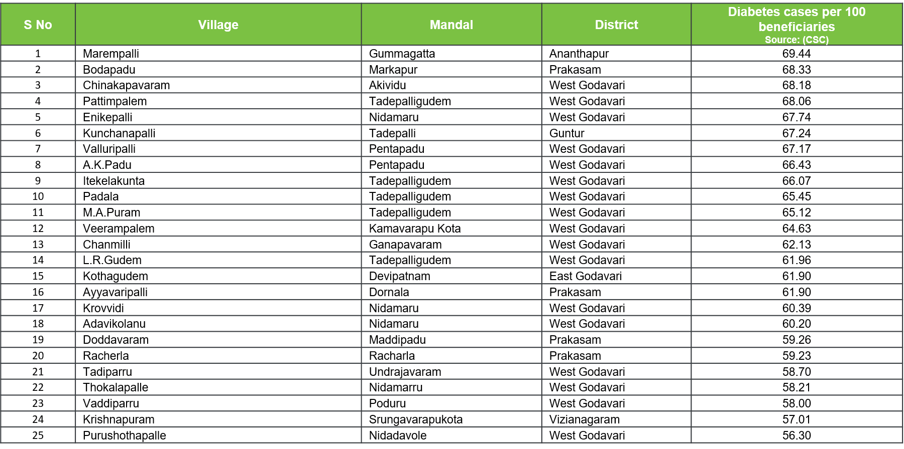
Disease Management – Non Communicable Diseases
Diseases in focus: Diabetes, Hypertension, Cardiovascular Disease, Arthritis, Asthma and Cancer
Prevalence of the above mentioned disease is calculated based on confirmed diagnosis recorded in various government health programs such as Chandranna Sanchara Chikitsa, Mukhyamantri Arogya Kendralu, NTR Vaidya Seva, NTR Vaidya Pariksha, MMHC
Districts, mandals and villages with highest prevalence of the mentioned diseases are identified for policy and administrative interventions
High risk districts, mandals and villages are also identified based on marker tests which helps the government take precautionary measures
Reported at district, Mandal, village/ municipality levels
District level maps
Mandal level maps
High Risk Villages/Wards
Incidence are across the districts is computed
Top 25 mandals across the state with highest prevalence are considered for Mandal level intervention
Top 50 villages with highest risk of disease prevalence across the state are considered for Village level intervention
Notes:
Slide 5
5a – diabetes
5b – htn

Slide 7
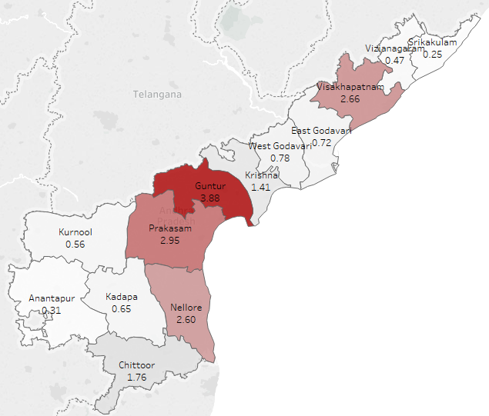
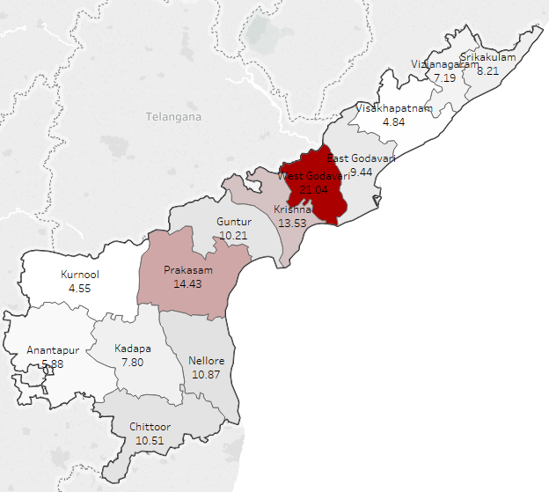
Disease Management – Non Communicable Diseases (Diabetes: State Profile)
Diabetes Profile Episodic (District Wise)*
Source: NTR VP
Diabetes Profile Longitudinal (District Wise)*
Source: CSC, eUPHC, MMHC
Guntur has the highest number of episodic cases followed by Prakasam and Visakhapatnam
West Godavari has registered the highest number of longitudinal diabetic cases with more than 21 cases per 100 beneficiaries, followed by Prakasam and Krishna
*Number of cases per 100 beneficiaries who utilized respective programs is taken

Slide 8
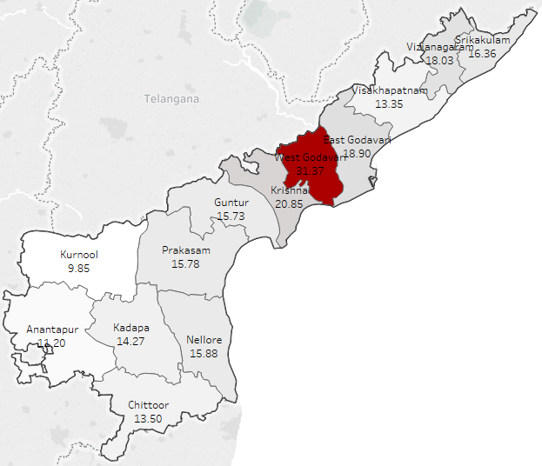
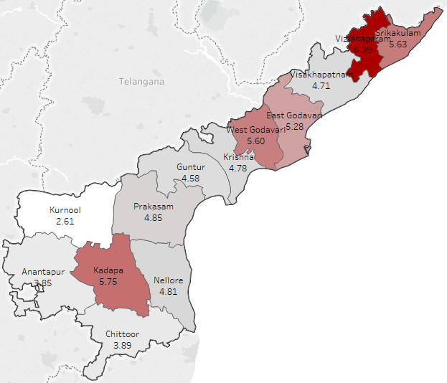
Disease Management – Non Communicable Diseases (Hypertension: State Profile)
Hypertension Profile Longitudinal (Rural)*
Source: CSC, MMHC
Hypertension Profile Longitudinal (Urban)*
Source: eUPHC
CSC and MMHC programs are considered for rural level heat maps
West Godavari has the highest number of longitudinal hypertension cases per 100 beneficiaries in rural areas
12 districts have more than 10 hypertension cases per 100 beneficiaries in rural areas
eUPHC program is considered for urban level heat maps
The northern districts have more number of longitudinal cases registered in the state compared to remaining districts in the state
*Number of cases per 100 beneficiaries who utilized respective programs is taken

Slide 9
Program Efficiency Mapping
Objective
To measure the effectiveness of programs of the health department every month
Methodology
Programs Covered
A set of 110 KPIs were identified across 19 programs post discussion with nodal officers
KPIs were designed based on 4 parameters: Coverage, Efficiency, Quality of Service and Cross Program Correlations
KPIs are calculated district wise and the districts are classified into 3 groups – districts that need improvement (blue), districts that have an average performance (yellow) and districts with good performance (green)
Program & Cross Program Aggregate scores are calculated and used for ranking of districts
The following programs are evaluated through program efficiency:
108 Services
Bio Medical Equipment Maintenance Service
Mobile Medical Units
CHC Sanitation
eUPHCs
Free Dailysis Program
HSMS
Master health check up
NTR Vaidya Seva
Approach
Coverage
Efficiency
Quality
Cross program correlations
Free Diagnostics Program
Free Teleradiology (CT Scan) Program
Free Teleradiology (X Ray) Program
RCH
Talli Bidda Express
Linen and Laundry Services
Mahaprasthanam
Tele Ophthalmology Program
Notes:
Slide 6a – Ashwin
6b - current
6c –
6d –

Slide 10
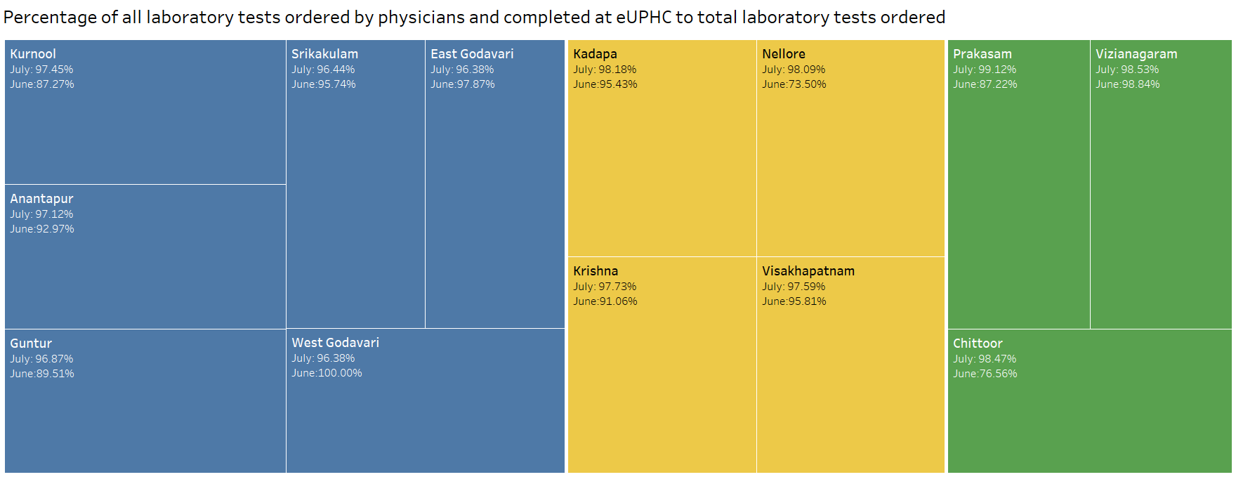
Program Efficiency Mapping: Impact
The performance of every district is monitored month on month for every public private partnership program. This along with timely administrative interventions have resulted in an increase in the overall efficiency of programs. The reports are computed on a program level and district level
Program Level Maps
District Level Maps
KPI level analysis on a monthly basis help identify the gap for service providers at district level
District Level Maps gives insight on the programs that are not meeting the targets in a district

Slide 11
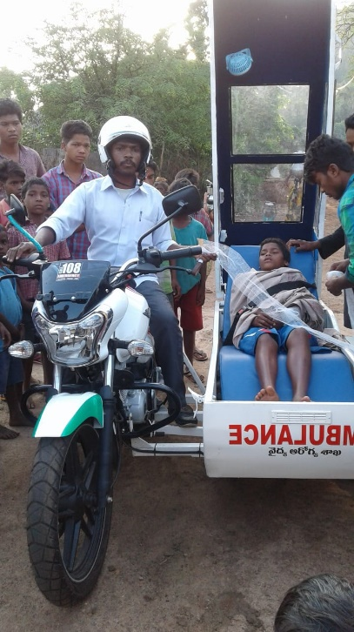
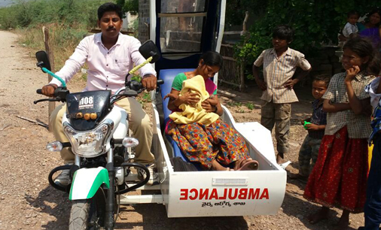
Feeder (Bike) Ambulance – 108 Service
Scope of the Program
Under Tribal Reform Yardstick (TRY) a novel initiative to shift the patients from remote and in-accessible ITDA areas to 108 ambulances was initiated with feeder Ambulances. These feeder ambulances intended to save the time to reach in shifting the patient to 108 ambulances and save the lives of the critical patients and pregnant women. The Pilot is trained in emergency health management techniques and to use the golden hour to save the patient life.
The total fleet 122 in 7 ITDA areas of Andhra Pradesh to supplement 43 ambulances (108) running in ITDA areas. These feeder ambulances were equipped with lifesaving drugs and surgical consumables and the details of services and monitoring of fleet movement shall be captured on real time.
Progress
8,760 cases have been transported using 108 Bike Services since its inception
A total of 1,19,450 km has been travelled by the 108 bikes
39% of the cases transported by the feeder ambulance are pregnancy related.

Slide 12



Report Card on State Health Indicators (ReSHI)
Report on State Health Indicators is a quarterly report to measure the overall health performance of the state and districts of Andhra Pradesh
ReSHI
Core Health Indicators (14)
Social Health Indicators (13)
Health Infrastructure Indicators (20)
Human Resource Indicators (22)
Health Financing Indicators (18)
Quality Service Indicators (13)
ReSHI is computed using on 100 KPIs, based on guidelines from NITI Aayog, UNDP and WHO. These 100 KPIs are classified into 6 baskets. ReSHI is a quarterly report computed district wise and state wide.
Methodology: A nodal officer is appointed for each of the indicator and the on filed data is aggregated at district level.
Usage: The indicators were measured on a quarterly basis and best performing and worst performing indicators were identified and shared with District Collectors. Continuous monitoring has helped the government to achieve improvement in the overall health of the state
Andhra Pradesh (State wide average % Change) | Overall Improvement in Health Indicators
Q2 (2018-19) Vs Q1 (2018-19) | 0.81%
Q1 (2018-19) Vs Q4 (2017-18) | 2.31%
Q4 (2017-18) Vs Q3 (2017-18) | 4.42%
Q3(2017-18) Vs Q2 (2017-18) | 2.68%
Q2(2017-18) Vs Q1 (2017-18) | 3.08%
Q1(2017-18) vs Q4 (2016-17) | -2.75%
Notes:
7a – Reshi (state)
11 – HDS
12 HB

Slide 13
Report Card on State Health Index (ReSHI) – Q on Q Basis
Sl No | Quarterly Health Report Card (% difference between Quarterly State Health Index) | Core Health Indicators (CHI): | Social Health Indicators (SHI): | Human Resource Indicators (HRI): | Health Infrastructure Indicators (HII): | Quality & Service Indicator (QSI) | Health Financing Indicators (HFI): | Average % Change in Each District
1 | East Godavari | 6.40% | -3.57% | -0.77% | 0.77% | 5.00% | 11.41% | 1.57%
2 | West Godavari | -5.80% | -3.90% | -4.80% | 0.00% | 2.80% | 4.60% | -2.34%
3 | Krishna | -3.19% | -0.36% | -0.98% | -0.13% | -1.76% | 1.68% | -1.28%
4 | Guntur | 14.50% | -0.07% | -0.65% | -1.24% | 8.12% | 0.01% | 4.13%
5 | Prakasam | -11.20% | -10.92% | -2.88% | 6.57% | 7.08% | 3.71% | -2.27%
6 | Sri Potti Sri Ramulu Nellore | -13.17% | -7.50% | 0.31% | 0.00% | 8.60% | 14.74% | -2.35%
7 | Srikakulam | -7.47% | 8.30% | -1.74% | 1.17% | 2.78% | 2.77% | 0.60%
8 | Vizianagaram | -18.46% | 0.53% | 0.47% | 0.38% | 16.38% | 15.61% | -0.14%
9 | Visakhapatnam | -8.09% | -1.66% | -1.39% | 3.74% | 6.74% | -0.11% | -0.13%
10 | Kurnool | 4.03% | -3.94% | 0.22% | 3.33% | 5.62% | -2.09% | 1.85%
11 | Chittoor | -3.43% | -8.65% | 0.11% | -0.33% | 0.22% | 1.44% | -2.41%
12 | YSR Kadapa | 4.24% | 1.14% | -0.68% | 0.00% | 2.89% | -3.10% | 1.52%
13 | Anantapur | -10.39% | 10.91% | -0.49% | 0.00% | 4.77% | 15.39% | 0.96%
 | Andhra Pradesh (State wide average % Change) Q1 (2018-19) Vs Q2 (2018-19) | -0.08% | -0.79% | -0.90% | 1.08% | 4.76% | -13.14% | 0.81%
For HFI, few KPIs are computed only at State level impacting the overall HFI score for the state. For example, change in Average number of days for transfer of funds from treasury to Department for Q1 vs Q2 is -105% leading to overall negative change in HFI for the state.

Slide 14
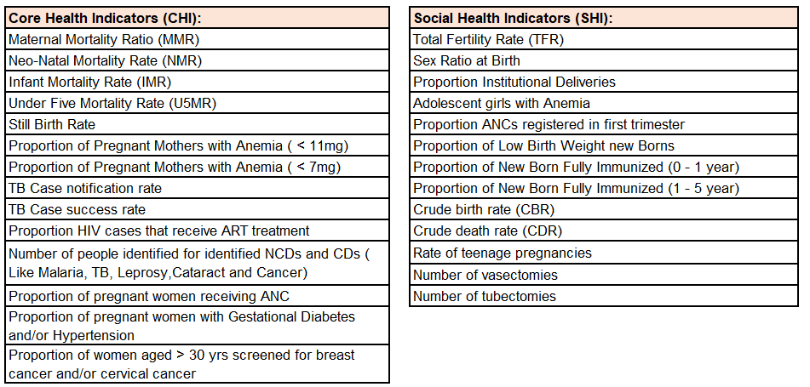
ReSHI: Report Card on State Health Index
Core Health Indicators and Social Health Indicators

Slide 15
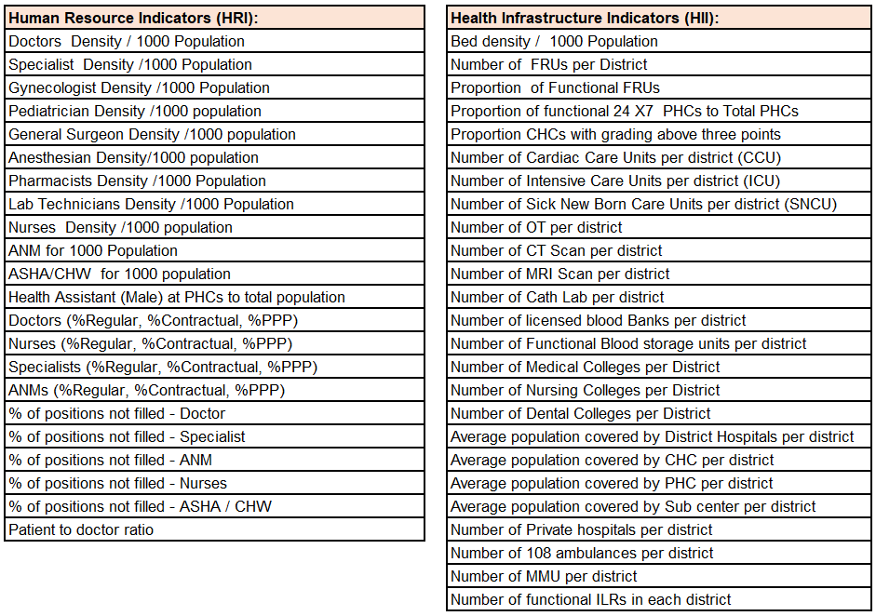
ReSHI: Report Card on State Health Index
Human Resource Indicators and Health Infrastructure Indicators

Slide 16
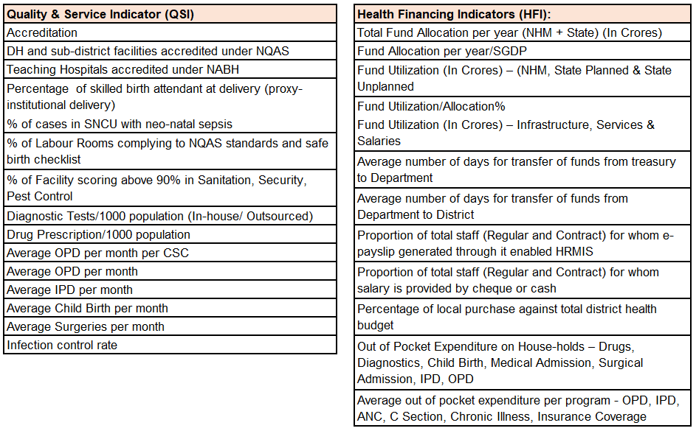
ReSHI: Report Card on State Health Index
Quality and Service Indicators and Health Financing Indicators

Slide 17
Institutions Conducting HDS Meetings in Q1 vs Q2 2018 (District-wise)
Hospital Development Society (Rogi Kalyana Samithi-RKS) Monitoring
District | Apr-18 | May-18 | Jun-18 | Jul-18 | Aug-18 | Sep-18
Anantapur | 80 (75%) | 97 (91%) | 101 (94%) | 107 (100%) | 106 (99%) | 104 (97%)
Chittoor | 12 (10%) | 54 (44%) | 84 (68%) | 120 (98%) | 119 (97%) | 119 (97%)
East Godavari | 100 (64%) | 155 (99%) | 151 (96%) | 155 (99%) | 156 (99%) | 156 (99%)
Guntur | 41 (38%) | 63 (58%) | 73 (67%) | 105 (96%) | 94 (86%) | 89 (82%)
Kadapa | 49 (54%) | 42 (46%) | 57 (63%) | 61 (67%) | 74 (81%) | 75 (82%)
Kurnool | 58 (53%) | 63 (57%) | 57 (52%) | 91 (83%) | 99 (90%) | 100 (91%)
Krishna | 100 (95%) | 100 (95%) | 101 (96%) | 101 (96%) | 93 (89%) | 103 (98%)
Nellore | 20 (22%) | 27 (29%) | 23 (25%) | 60 (65%) | 69 (74%) | 82 (88%)
Prakasam | 28 (26%) | 81 (75%) | 74 (69%) | 103 (95%) | 93 (86%) | 96 (89%)
Srikakulam | 46 (46%) | 71 (72%) | 74 (75%) | 82 (83%) | 78 (79%) | 73 (74%)
Vishakhapatnam | 25 (23%) | 61 (55%) | 72 (65%) | 100 (91%) | 93 (85%) | 75 (68%)
Vizianagaram | 13 (16%) | 54 (66%) | 66 (80%) | 78 (95%) | 82 (100%) | 82 (100%)
West Godavari | 109 (100%) | 109 (100%) | 109 (100%) | 108 (99%) | 109 (100%) | 109 (100%)
Andhra Pradesh | 681 (49%) | 977 (70%) | 1042 (74%) | 1271 (91%) | 1265 (90%) | 1263 (90%)
Vizianagaram and West Godavari have 100% centers conducting HDS meetings in the last 2 months.
Visakhapatnam has shown a decline trend in the total centers conducting HDS meetings in Q2, i.e, from 91% of centers in July 2018 to 68% of centers conducting HDS in September 2018. Similar trend is observed in Guntur, Prakasam, and Srikakulam.

Slide 18
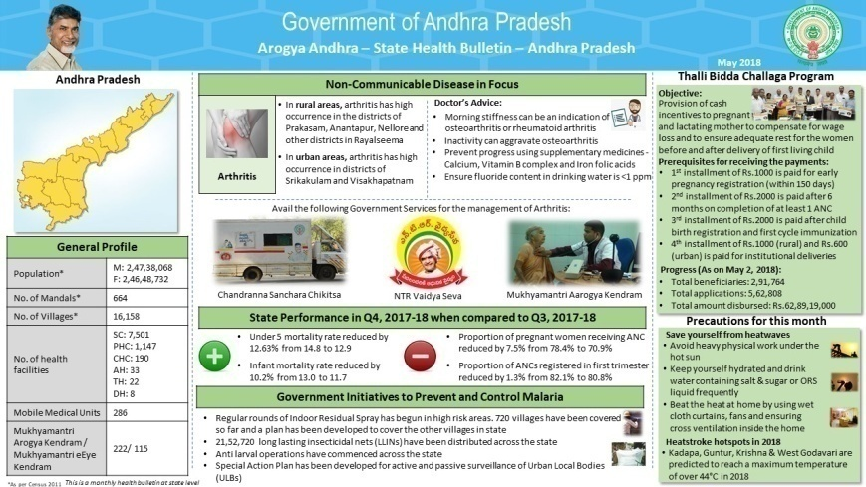
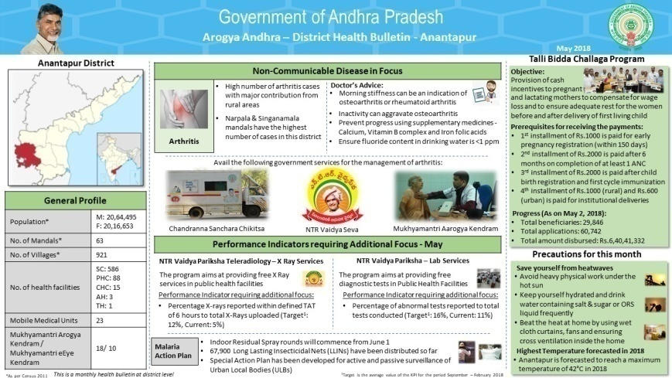
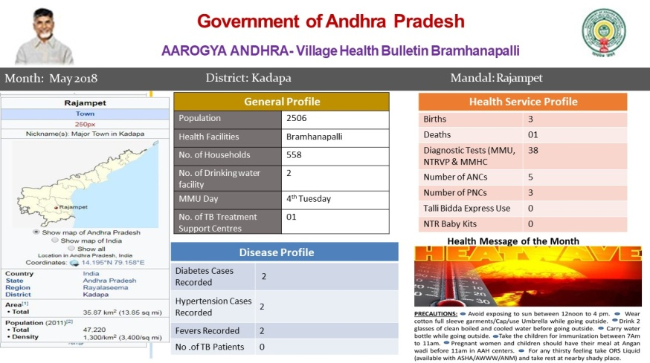
Health Bulletins: Key Features
State Health Bulletin
District Health Bulletin
Village Health Bulletin
Major sections of State Health Bulletin
Preventive and healthcare management measures of leading non-communicable disease in the state
Top 2 and Bottom 2 performing health care indicators in the state
Various government initiatives / schemes launched to improve the health of the state
Details on the healthcare programs and services available for public
Health tips on prevention of seasonal diseases
Major sections of District Health Bulletin
Preventive and healthcare management measures of leading non-communicable disease in that district
Health programs that need additional focus
Various government initiatives / schemes launched to improve the health of the state
Details on the healthcare programs and services available for public
Health tips on prevention of seasonal diseases
Major sections of Village Health Bulletin
Health facilities / centers and services available in the village
Disease profile of the village (Name of diseases and number of cases for each disease)
Health tips on prevention of seasonal disease

Slide 19
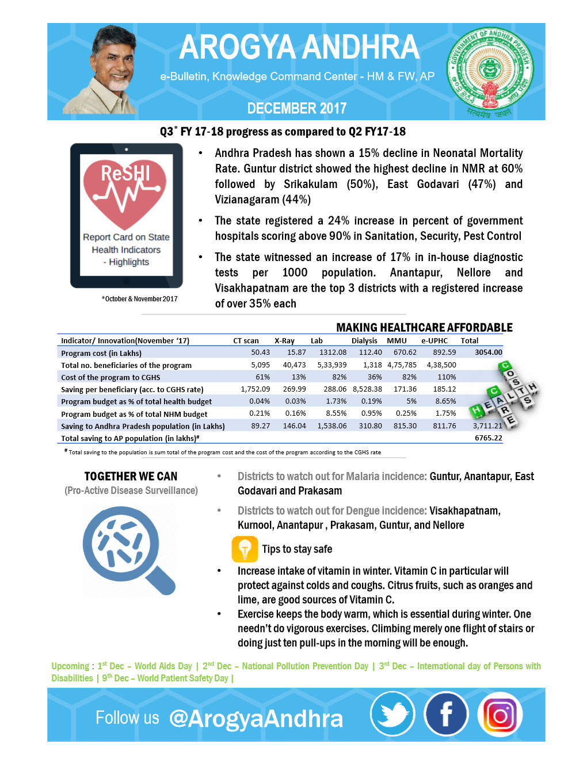
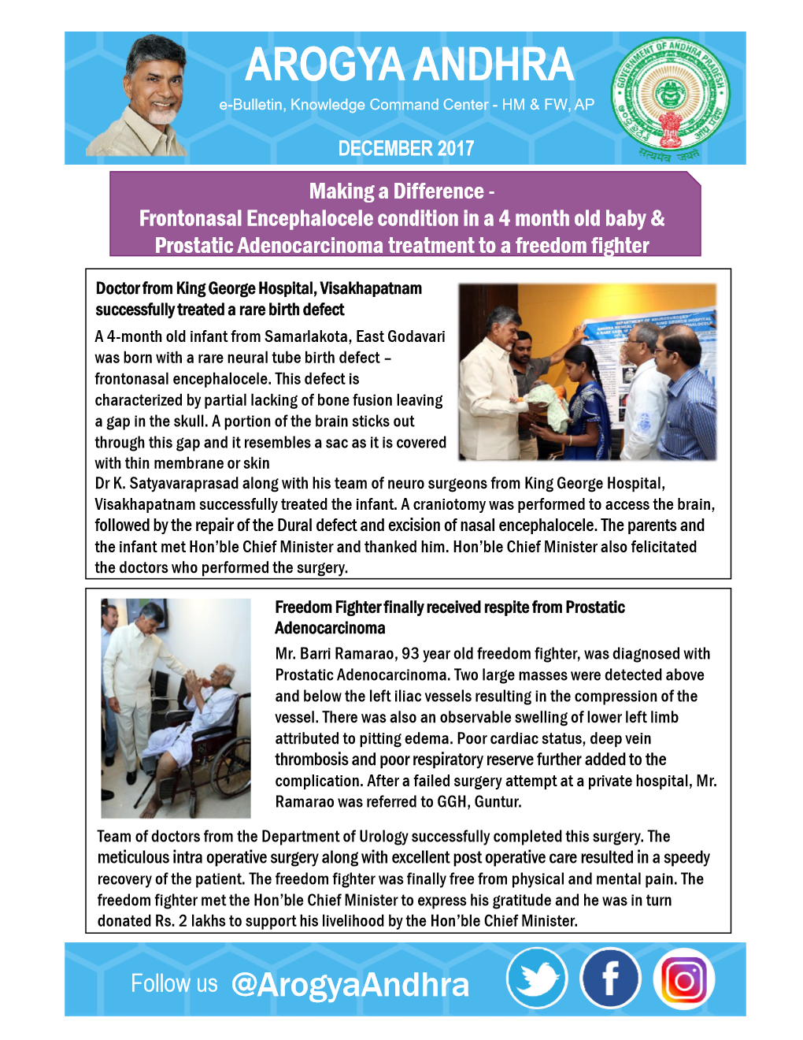
Social Media
Twitter & Facebook handles of the health department is managed by Knowledge Command Center
Social Media is leveraged to create awareness of government healthcare programs and to provide health tips to the population
An e-Bulletin is released and published in social media every month
Topics covered in eBulletin includes:
  General Health Indicators progress for the month
  Disease prevalence scenario in a non-panic language for the public
  Economic benefits of the program on society
  Major health days of the coming month
  Few touching case studies of good work of the department.
Notes:
14
15,16 Benefits, Challenges

Slide 20



Benefits of KCC
Better preparedness
Government/ health department is now able to take necessary precautions based on the data available which has in turn helped in better management of diseases especially malaria, dengue, swineflu and other non communicable diseases
Driving efficiency
The Government of Andhra Pradesh handles public private partnership programs and spend crores of money on these programs to ensure access to quality health services for the people
Data analytics of KCC is used by the government to measure the performance of programs on efficiency, effectiveness and quality which in turn helps the service providers and administrators to make interventions
Continuous Improvement
A set of 100 key indicators are monitored on a quarterly basis and areas that need additional focus are identified at the state and district levels with the help of data
The above analysis is then shared with the government which takes necessary administrative steps to improve the performance of the identified indicator

Slide 21
Challenges Faced
Streamlining of data captured across various public private partnership health programs and government health facilities
Management of multiple stakeholders – public government healthcare officials and private health players
Integration of data from multiple data sources
Best Practices
Leveraging on data and technology to drive efficiencies in the delivery of healthcare services for the people of Andhra Pradesh
Making administrative / policy interventions as per the need of that particular district
Monitoring and improving the effectiveness and efficiency of health programs
Identifying gaps and focus areas to improve the overall health of the state through continuous monitoring of the data

Slide 22
Arogya Andhra
Quality Efficiency Accountability
Thank You

