Slide 1



Linkage of PICME(MCTS) & CRS
(Pregnancy & Infant Cohort Monitoring & Evaluation 2.0) Software (MCTS Portal) And
Civil Registration System Software
Presented By
Dr.Darez Ahamed, I.A.S.,
Mission Director, NHM TN
COMMISIONER OF MATERNAL & CHILD HEALTH TAMIL NADU

Slide 2
Reports available in New CRS PICME/MCTS Software
(* indicates that Data is AVAILABLE ONLY IN PICME 2.0)
S.No | Indicators |  | April-September
 |  |  | 2015-16 | 2016-17 | 2017-18 | 2018-19
1 | Total AN Registration |  | 523648 | 514931 | 320428 | 579004
2 | Early AN Registration |  | 3629 (0.7%) | 4152 (0.8%) | 50326 | 510409
3 | Teenage Pregnancy |  | 3457 | 4684 | 6770 | 16072
4 | Abortion Entry | Total Abortion | 18186 | 18461 | 7243 | 25367
 |  | First Trimester Abortion | 6925 | 7064 | 3438 | 14955
 |  | Second Trimester Abortion | 11228 | 11325 | 3742 | 10401
5 | Visitor Mother Entry |  | * | * | 241 | 142479
6 | Total Pre Registration |  | * | * | 1417 | 58439
7 | Govt. Institutional Delivery Entry |  | * | * | 18 | 225645
8 | Birth Certificate through CRS Linkage (Jan'18-Sep'18 | Total Birth Registered with RCH ID | * | * | * | 520390
 |  | Total Birth Registered with Pre Registration ID | * | * | * | 69941

Slide 3
Why the need for a revamped MCTS/PICME
7% Higher order birth contributed 30% of MMR
Migrant / Visitor mother contributes more than 1/3rd of MMR
5% of deliveries happen in above 30 mothers contributes 25% of MMR ( Elderly primi and infertility treatment)
To capture all second trimester abortion to prevent feticide.
State MMR target of 25 by 2023 needed a significant shift in strategy since 65% deliveries in government (SRS-HMIS :67 in 2016)
Get accurate data on teenage pregnancy and identify social high risk mothers.

Slide 4
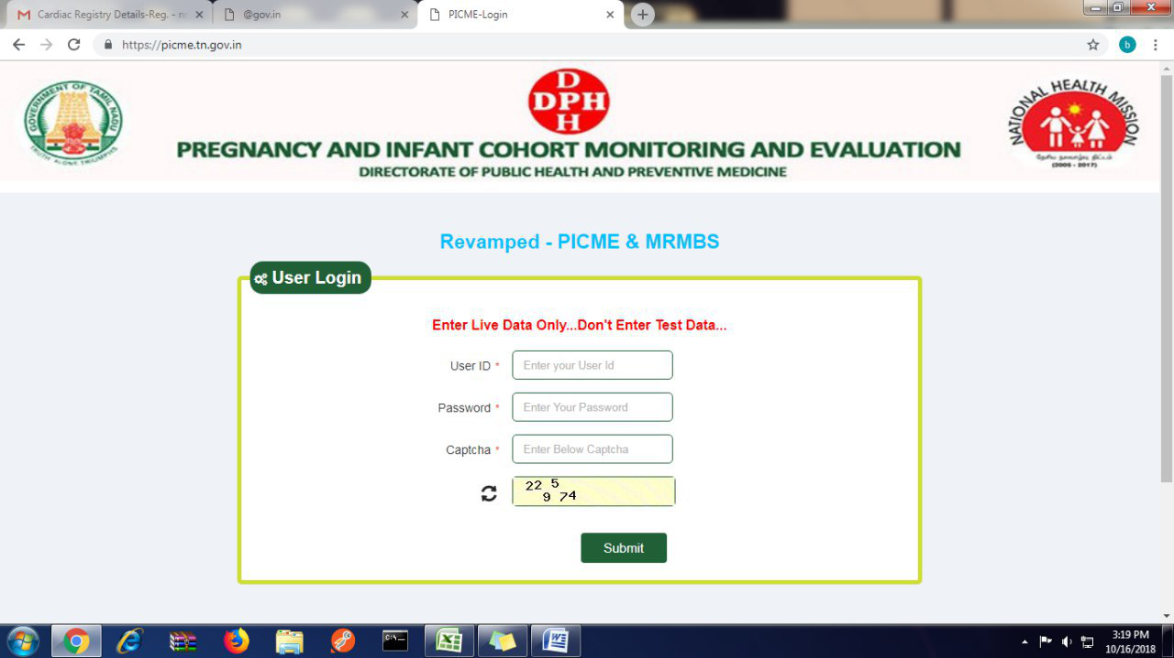

Slide 5
Project Objective: Universal MCH CARE
All Eligible couples to avail Maternal & Child health services.
To register all Antenatal mothers including teenage pregnancy to render/ensure all the Antenatal and Postnatal services.
To implement effective PCPNDT Act by having vigilant audit on Second Trimester abortions
To track visitor and migrant antenatal mothers
To register all infants and to ensure routine immunization in time. (Birth Cohort)
Overall objective is to reduce IMR and MMR.
To ensure 100% registration of all live births, still births through linkage of PICME Software with CRS software including private institutions.

Slide 6
Project Description
PICME/MCTS data will serve as Mother & Child registry for the State of Tamilnadu.
The Unique RCH ID from PICME/MCTS software is essential to obtain Birth certificate
This software has been linked to Civil Registration System Software to issue free birth certificates at delivery points.
Effective Civil Registration Software linkage has ensured that all private deliveries are also entered in the Maternal Child Tracking System portal
Auto updation of birth and death in State resident Data Hub from CRS software.

Slide 7
Project Description
Provision for pre registration by mothers through CSC /102/ Online
Aadhaar Authentication
Visitor mother registration
Institutional Delivery entry has been made mandatory.
All Migrant mothers i.e mothers from other States and Mothers who are Non Residents of India are also being captured.

Slide 8
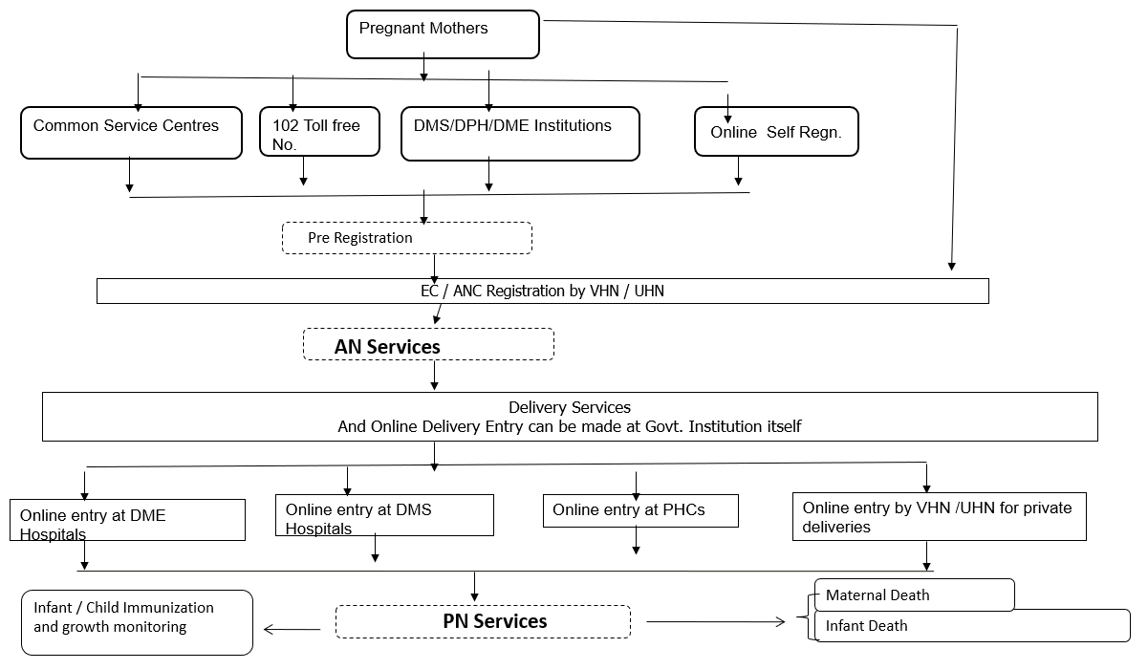
Revamped PICME 2.0 Workflow

Slide 9
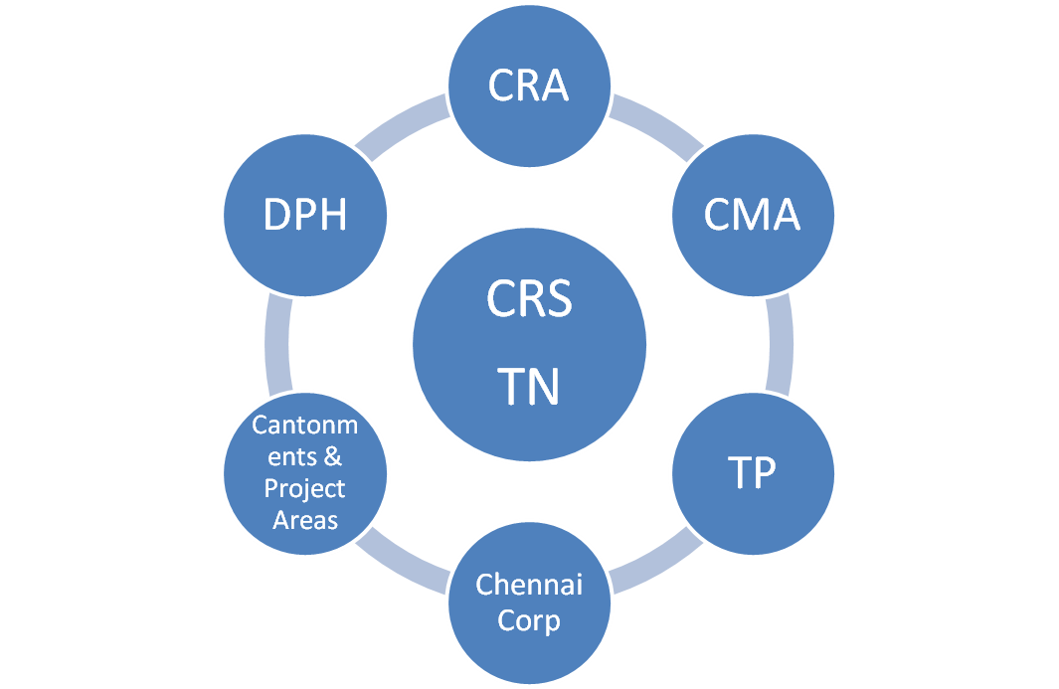
Usage of CRS Software as per
G.O (Ms) No.351 H&FW Dated :09.10.2017
All Line Departments use the software
  CRA-Commissioner of Revenue Administration
  CMA- Commissioner of Municipal Administration
  DPH-Director of Public Health & Preventive Medicine
  TP- Directorate of Town Panchayat

Slide 10
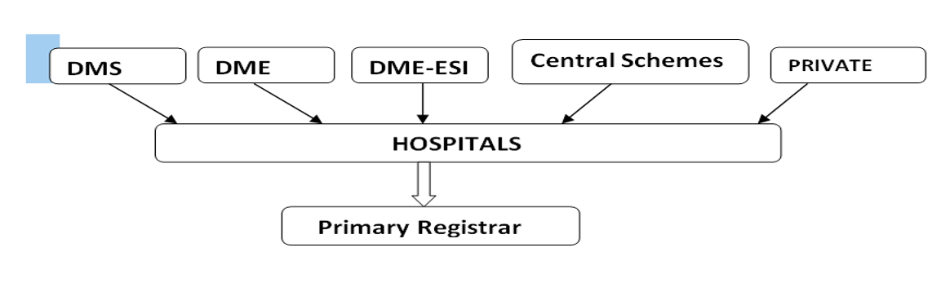
All HospiTALS USE THE SOFTware

Slide 11
DELIVERABLES
Reduction in MMR( 2 years comparison-Apr to Aug 18)
Continuous monitoring of High Risk AN mothers has decreased MMR of Tamil Nadu to 52.61 ( Apr 18-Aug 18) when compared to the previous year (73.52 in Apr 17- Aug 17) per 1 lakh Live Births
 | Maternal Death Line List April’18-Aug'18 | Maternal Death Line List April’17-Aug'17 | MMR = MD/LB *100000
 |  |  | Till Aug'18 | Till Aug'17
Tamil Nadu | 200 | 332 | 52.61 | 73.52

Slide 12
FINANCIAL IMPLICATIONS
S.No. | Name of the Activity | Number required | Period | Approx Cost (in Rs.)
1 | Salary Component for PICME Software Development | 05 Developers | 01 year | 18,00,000
2 | SMS Integration to CDAC SMS Gateway | 30 Lakh SMS | 01 year | 3,10,500
3 | Laptops | 05 No. | - | 2,36,000
4 | Server-High end | 02 No. | - | 18,00,000
5 | CRS Software Development | 01 No. | - | 30,00,000
6 | Biometric Devices for Health facilities and registration units (Rs 2000/Device) (Under Process) | 19900 |  | 3,98,00,000
 | TOTAL |  |  | Rs. 4,69,46,500

Slide 13
Highlights of the Initiative
Real time Monitoring of Maternal and Child health activities.
Provision for Pre registration through common service centers /102/institutions/online self registration.
Aadhar authentication and unique RCH ID made valid throughout the State
Uniform Civil Registration software in all 16,259 Birth and Death registration units
Free online birth and death certificate issued at delivery points
Visitor mother registration made mandatory and visitor mother tracking made real time.

Slide 14
Highlights of the Initiative
Cardiac Registry of AN mothers has been included in the software
Migrant mother tracking is also possible
SMS in local language to mothers regarding high risk symptoms, due for AN visit, Immunization due etc
Government Institutional delivery entry made mandatory
Effective Civil Registration Software linkage to ensure that all private deliveries are also entered in the Maternal Child Tracking System portal.
Linked with Conditional Cash Transfer System

Slide 15
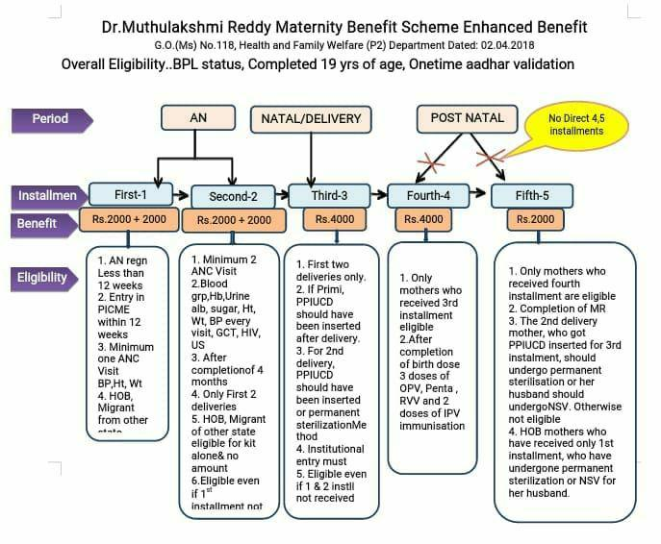
Conditional Cash Transfer Scheme

Slide 16
TAKE HOME MESSAGES
PICME – CRS Linkage ensures 100 % Maternal Care and 100 % Birth Registration
Easy to Implement and Easy to Sustain
Helps us Monitor Female Foeticide, Surrogate Mothers etc

Slide 17
way forward
Replicability & scalability : Easy to adapt in all settings
Way forward:
e - signature in all birth and death registration units
linkage of CRS software with MCCD software
10% reduction in MMR every year

Slide 18
THANK YOU

