Slide 1
Mahila Arogya Samitis (MAS) Experience in Rajasthan
Rajan Vishal, IAS
Additional MD, NHM & Special Secretary ,Medical & Health, Rajasthan

Slide 2
NUHM Rajasthan Framework
Population – 686.21 lakh
Urban Population – 170.81 lakh
Urban slum Population – 23.32 Lakh
Health Services for
Urban Poor & Vulnerable Population
Comprehensive Primary Healthcare
Urban PHCs (245)
Urban CHCs (13)
MMU (4)
Health Kiosk (36)
Outreach Camps
(under UPHCs)
UHNDs
(Under AWCs)
Community Processes
Urban ASHA (4636)
&
MAS (4708)

Slide 3
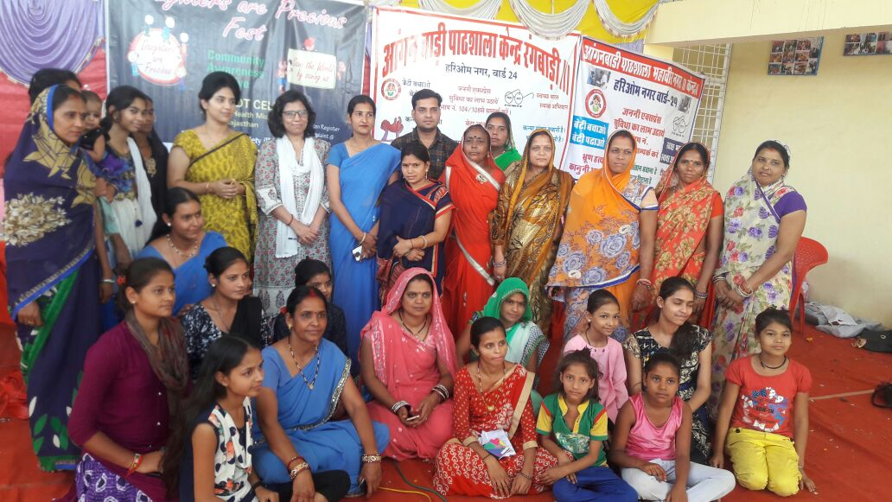
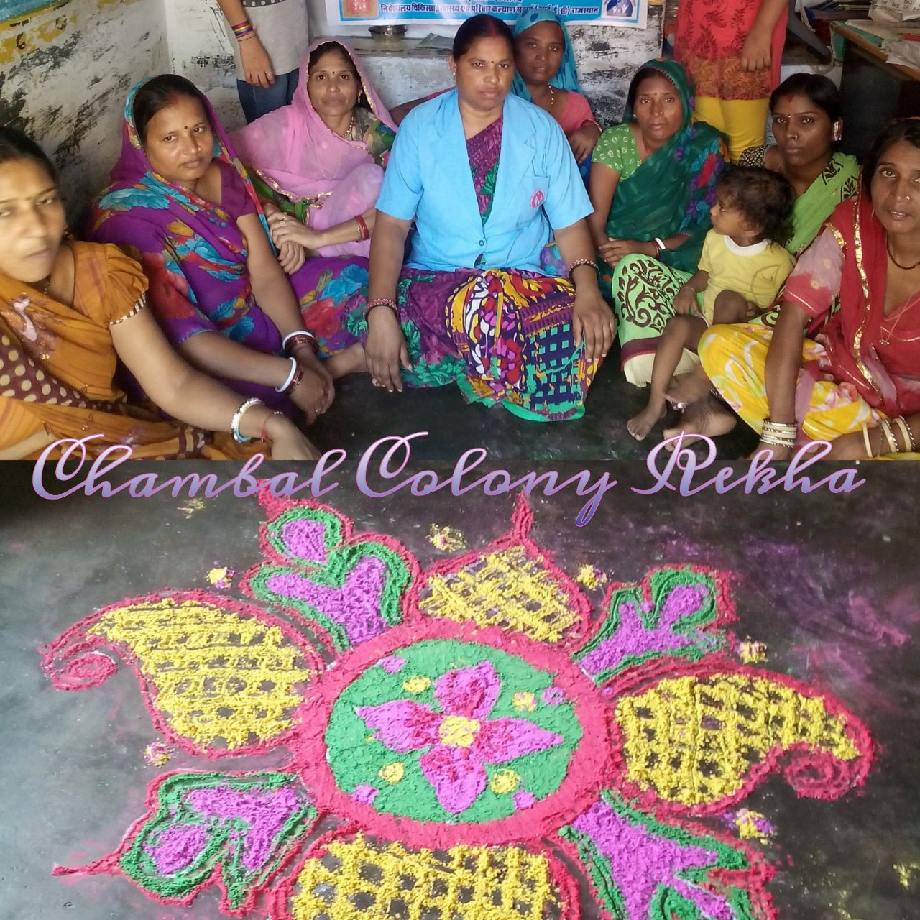
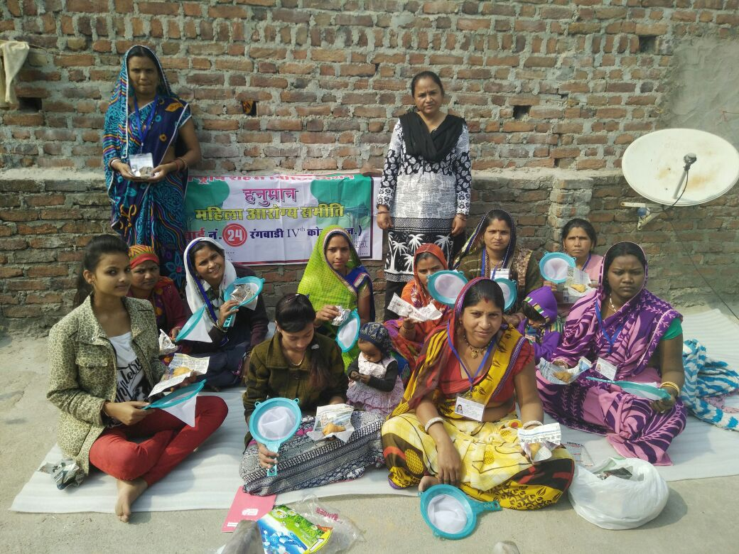
Mahila Arogya Samitis

Slide 4
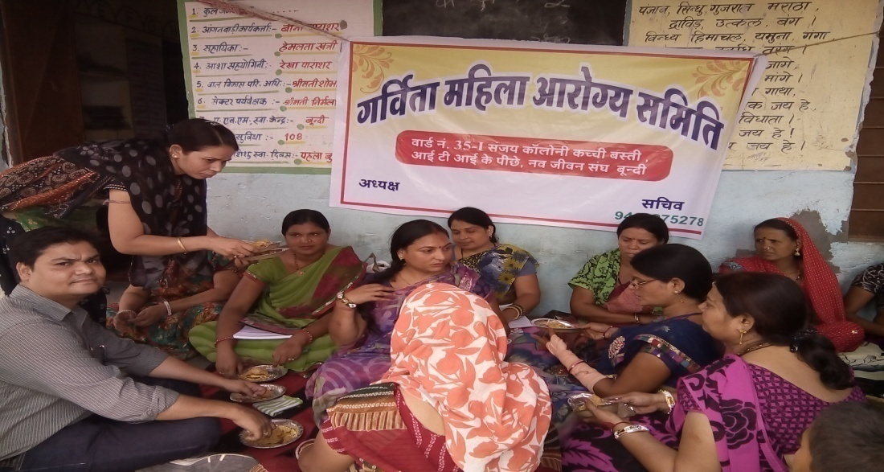
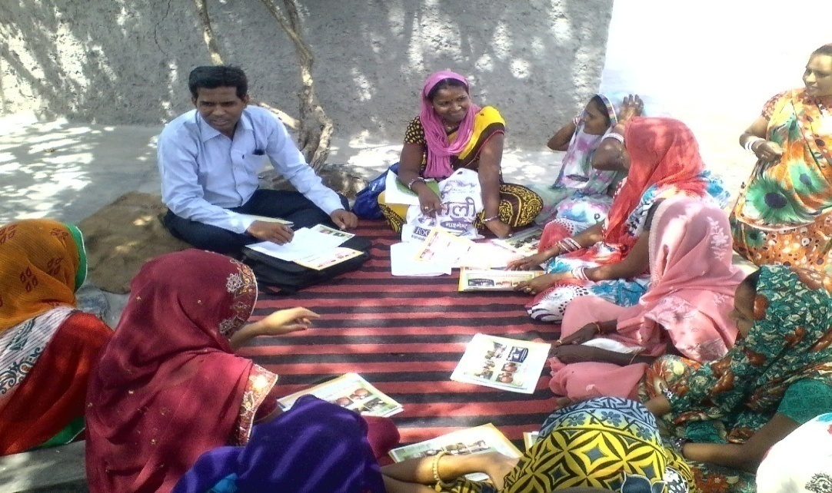
Status of MAS in Rajasthan
S.No | Particular | Target | Achievement
1 | No of MAS | 4708 | 4708
2 | No of MAS Members (Approx) | - | 48500
3 | No of MAS Bank Account | 4708 | 4708
4 | Orientation of MAS on NUHM | 4708 | 4708

Slide 5
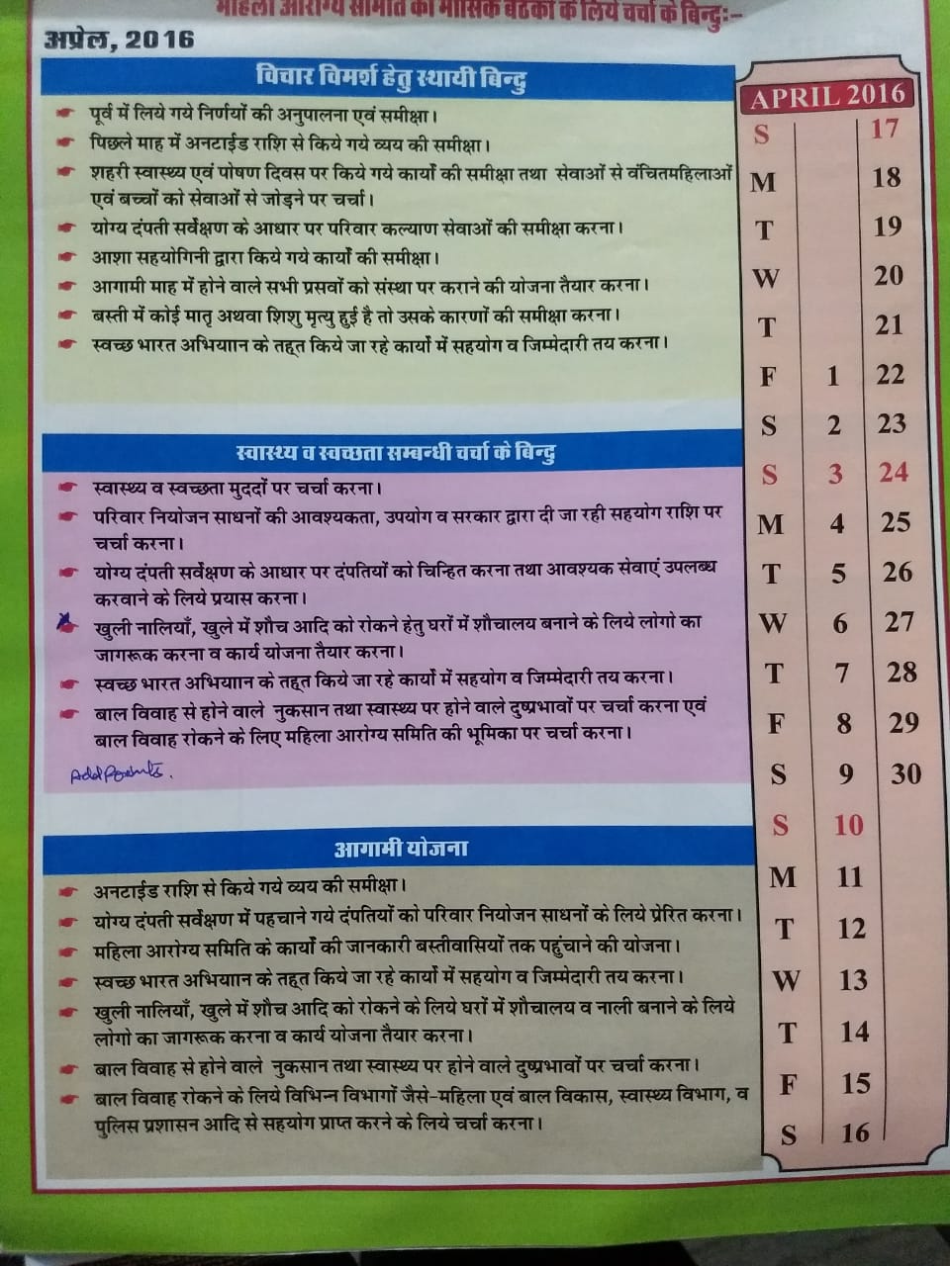
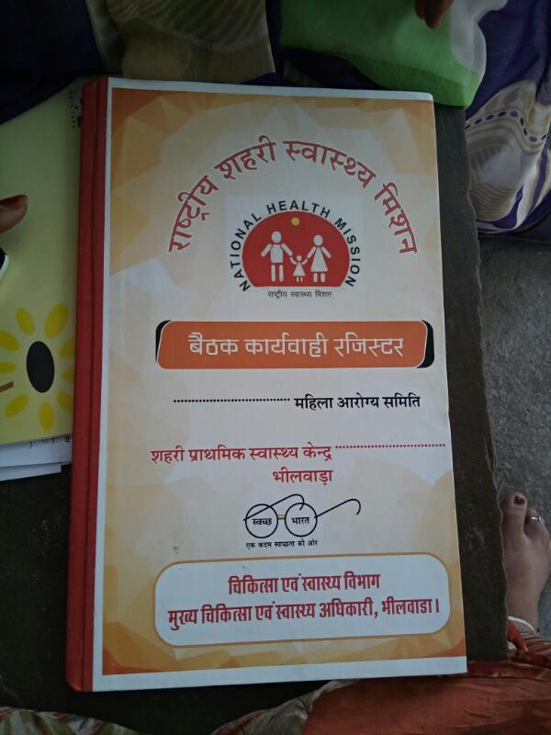
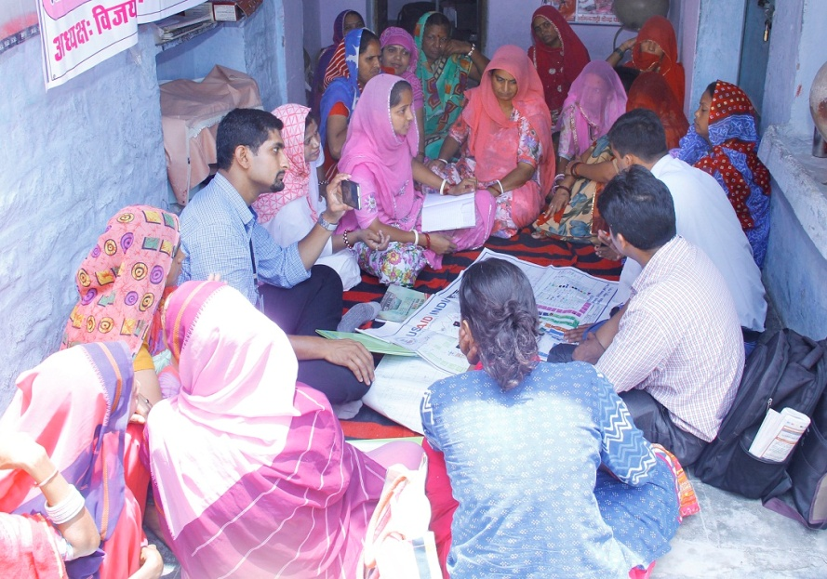
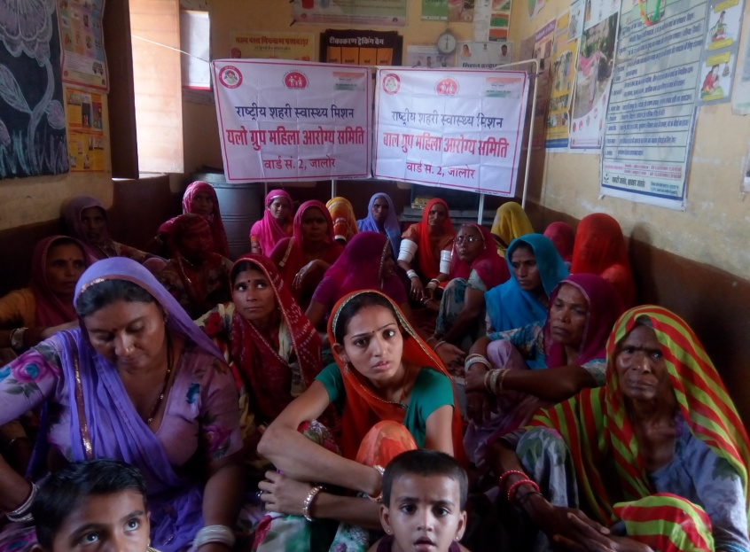
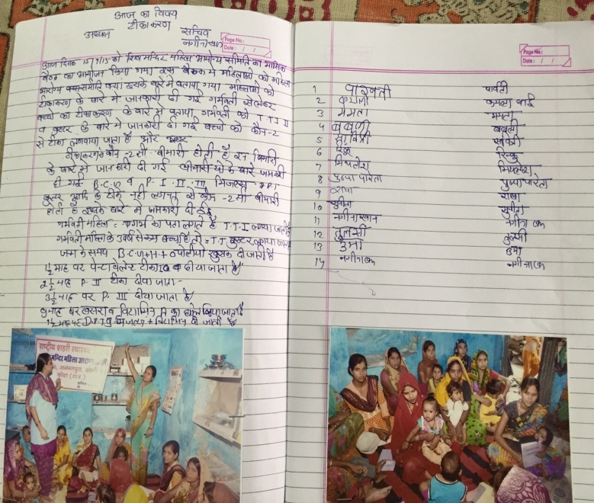
Salient Features of MAS in Rajasthan
Regular monthly meetings and active participation
Regular recording and updation of minutes of monthly meeting
Supportive supervision of MAS by PHM
Regular capacity buidling of MAS in monthly meetings by PHM as per MAS calendar
Regular payment of MAS meeting incentive to Urban ASHA
Active participation of MAS in all health related activities of the Govt., NGOs, private organizations etc like: RCH activities, Health program/schemes, Health education, Sanitation, Pulse Polio Drive etc.

Slide 6
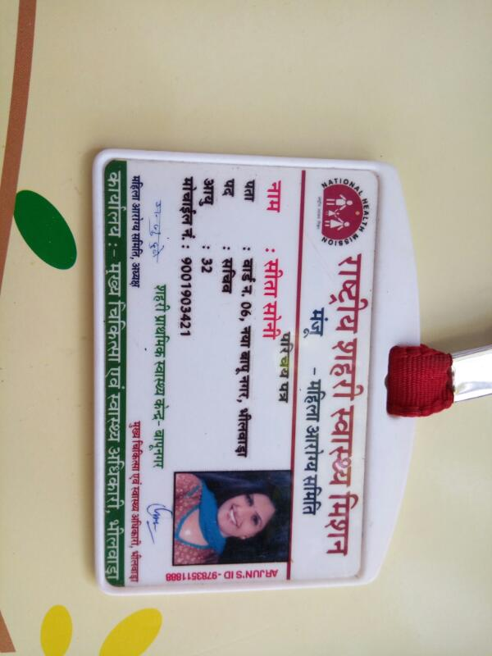
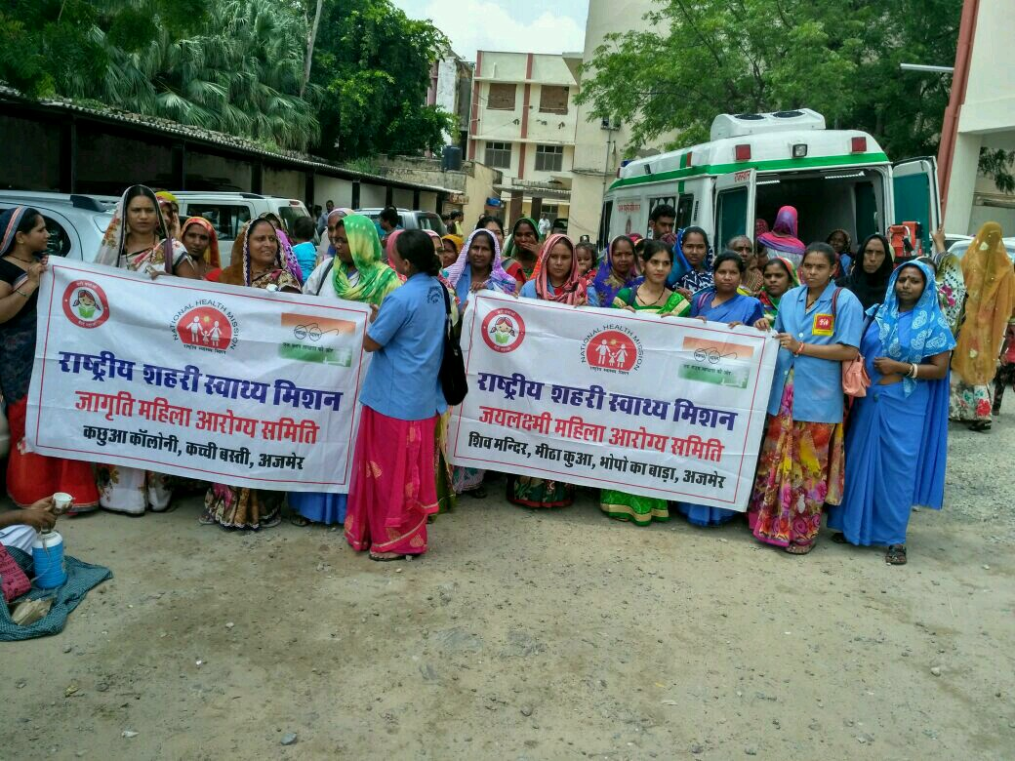
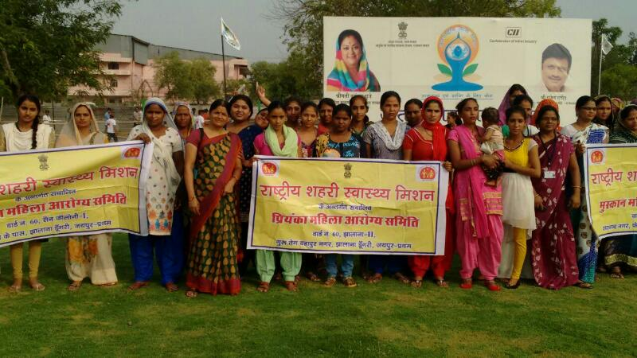
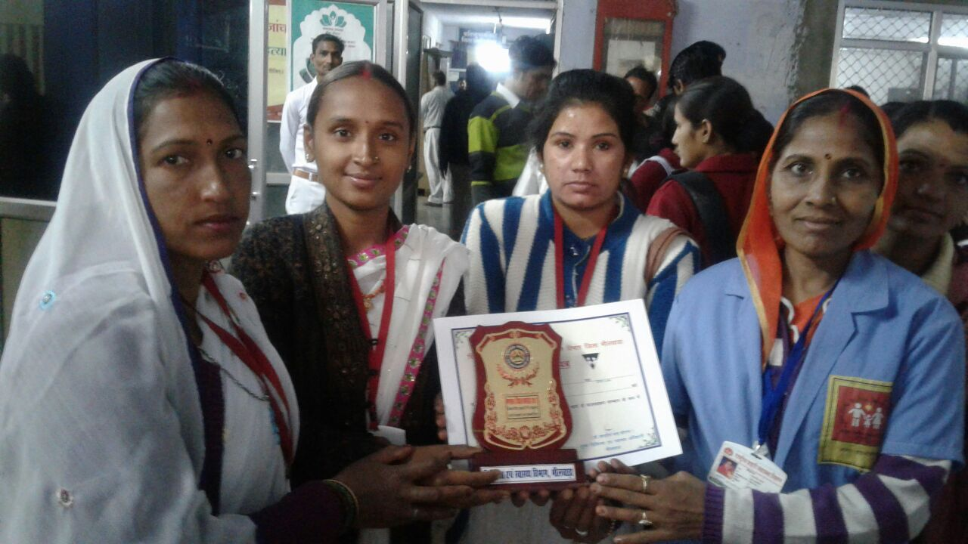
Key Interventions for Strengthening MAS
Photo ID cards to MAS
Award distribution to Best MAS in district level events
Participation of MAS in distt/state level events like “Yoga Day’’
Participation of MAS members in monthly meetings at UPHC level

Slide 7
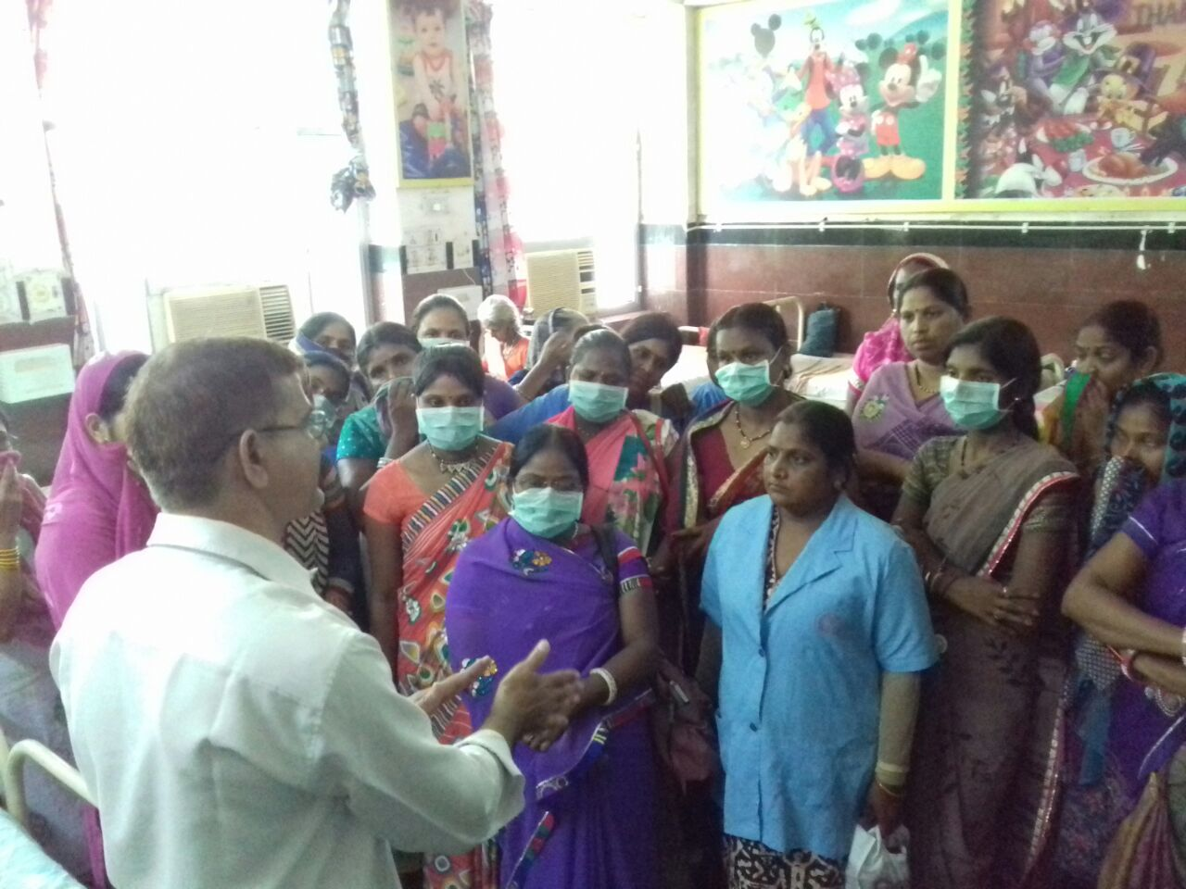
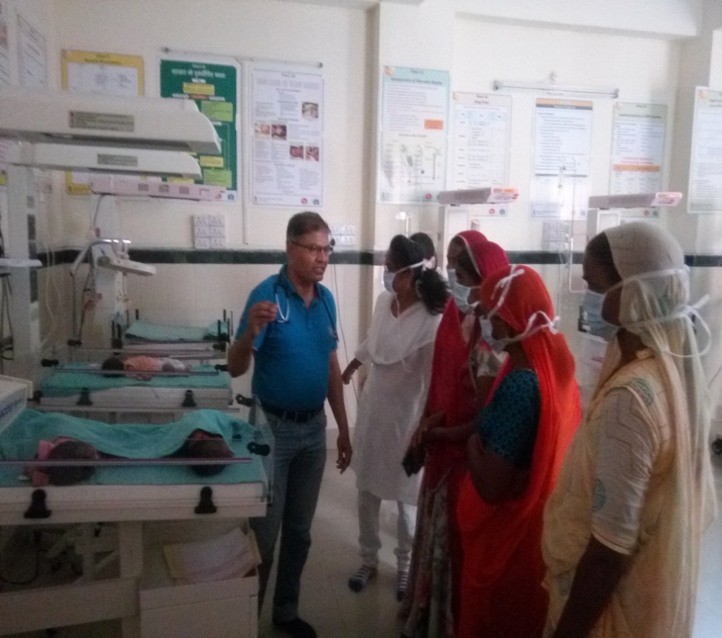
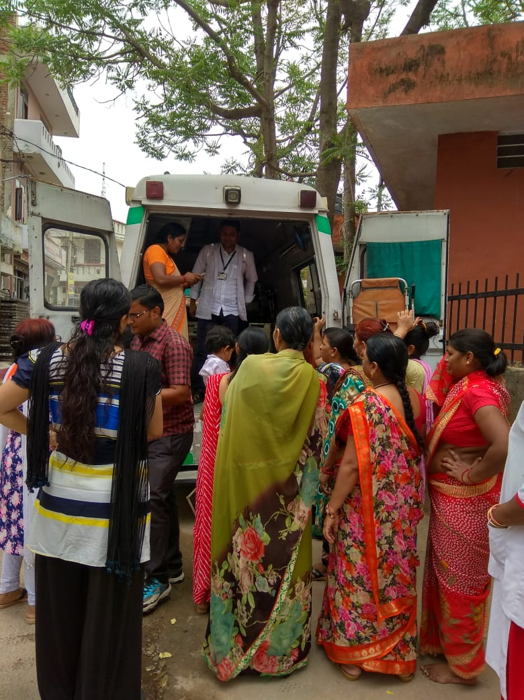
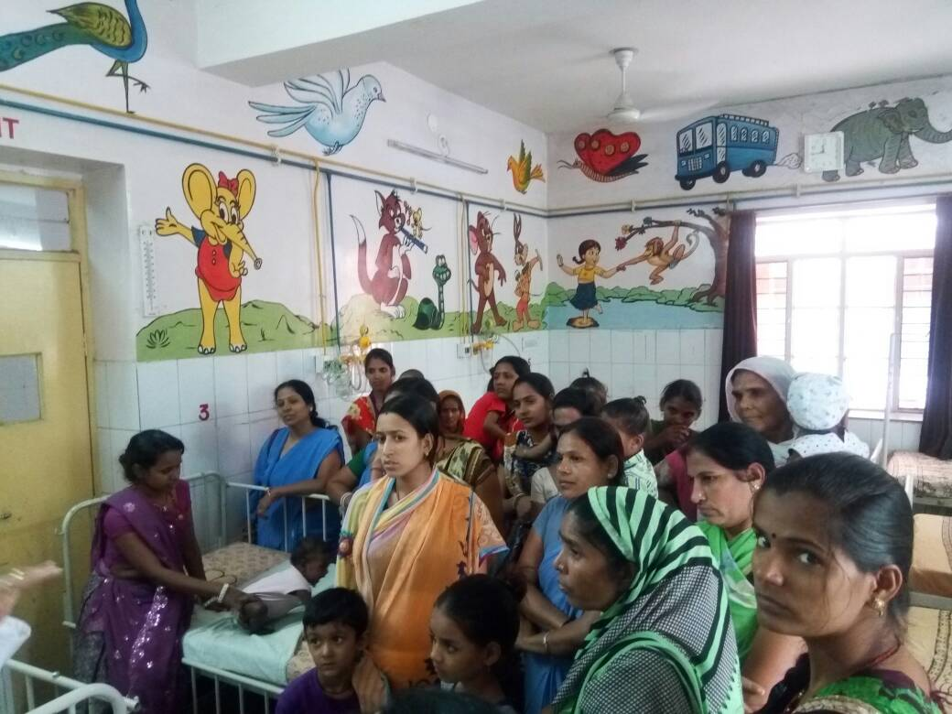
Exposure visits of MAS members to SNCU, MTC of District Hospital & 108 ambulance
To create awareness on availability of health services in their district
MAS members reaction :
’’ Sarkari asptal me itni achhi suvidha uplabdh hai hume pata hi nahi tha’’

Slide 8
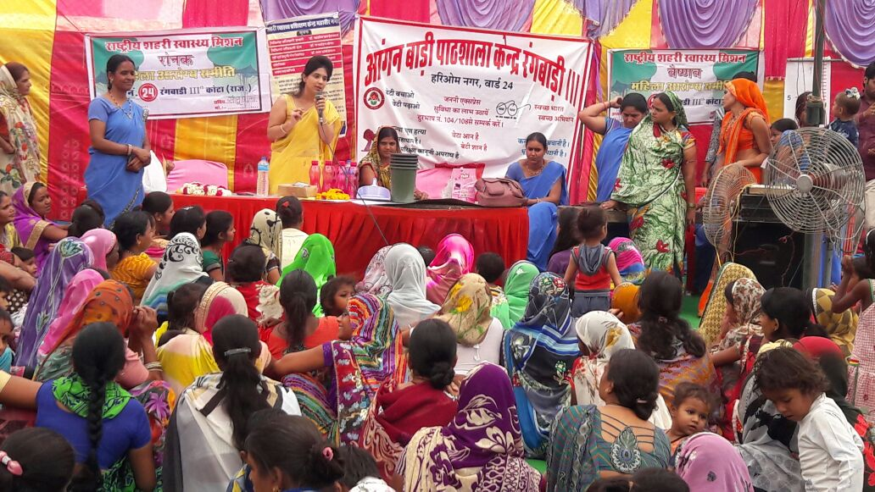
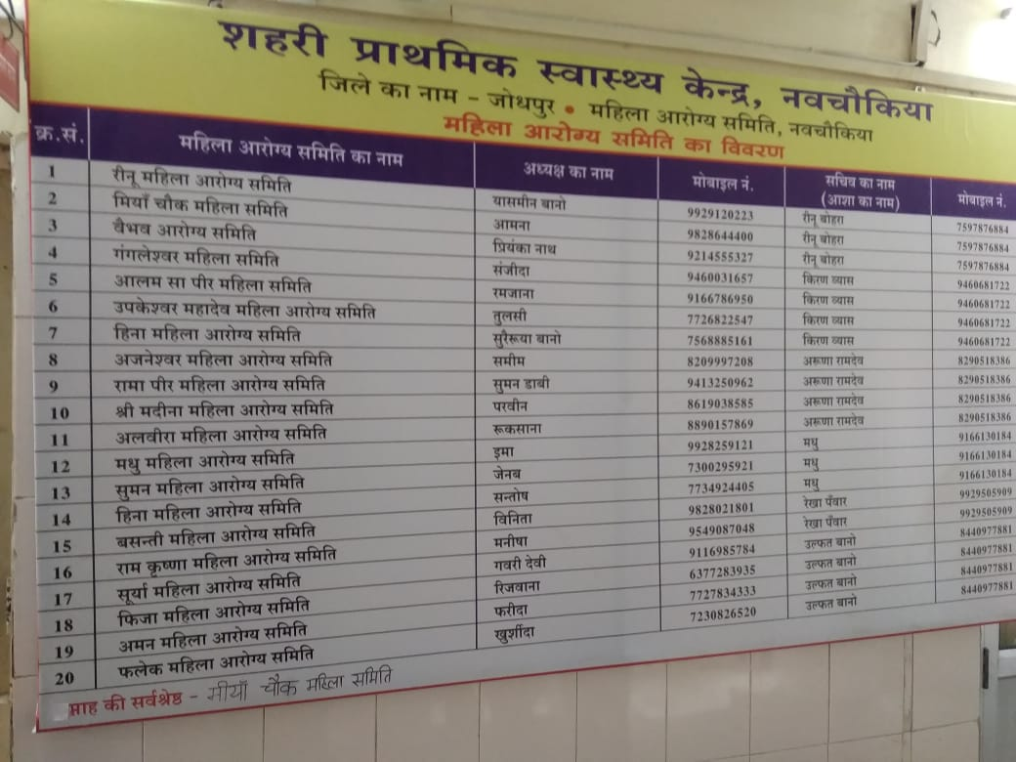
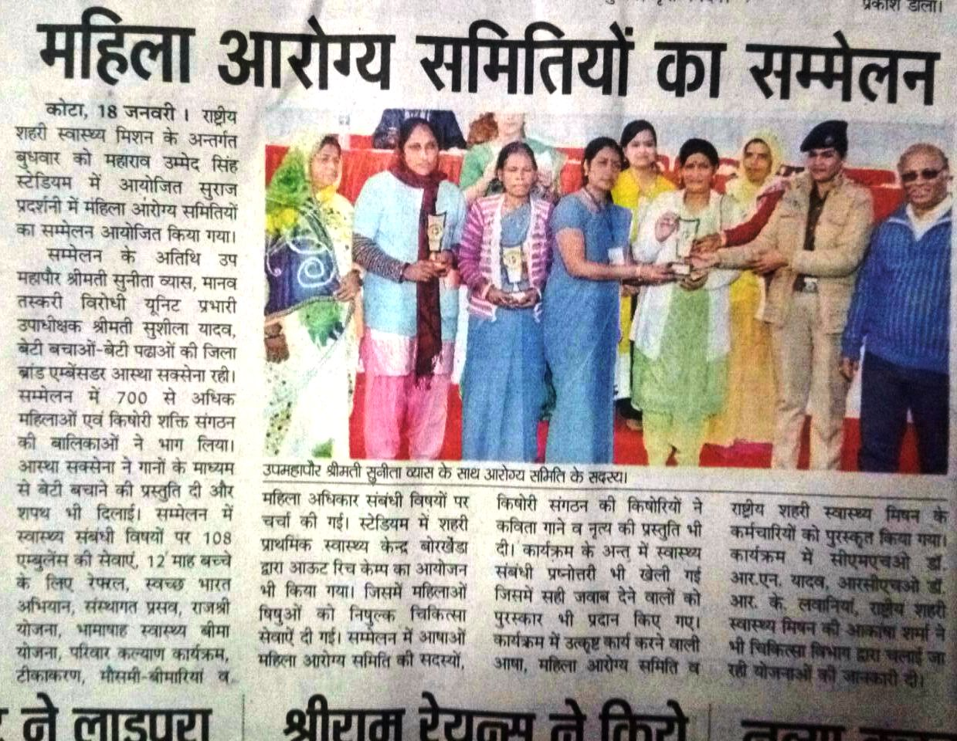
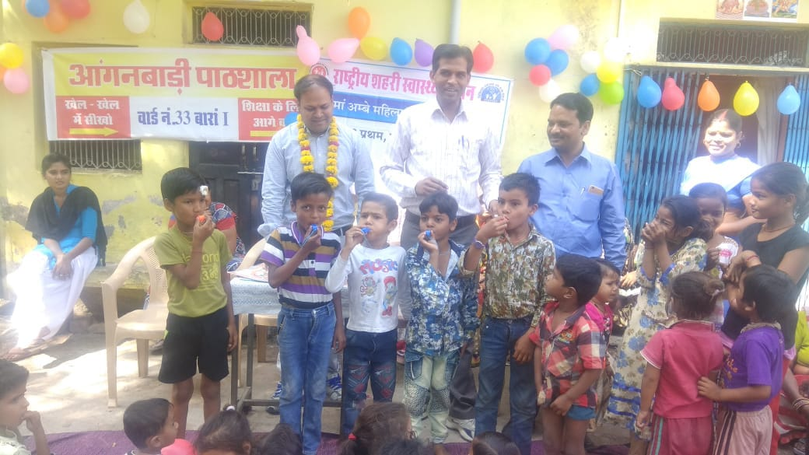
MAS Sammelan at District level to recognize efforts of MAS
Display of contact details of Chairperson of MAS groups on UPHC Notice board . It gave ‘’Recognition’’ to members in community
Event Celebration with MAS members like - Birthdays
MAS members reaction ‘’ NUHM dwara diye gaye sammaan se samaaj me hamari pehchan bani hai’’

Slide 9
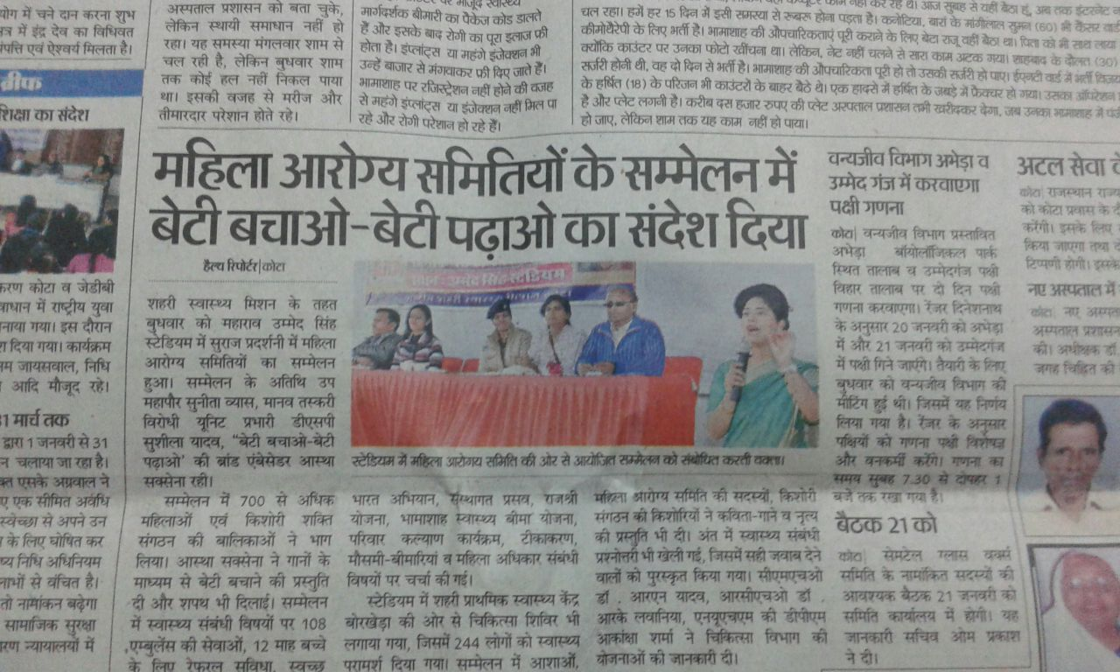
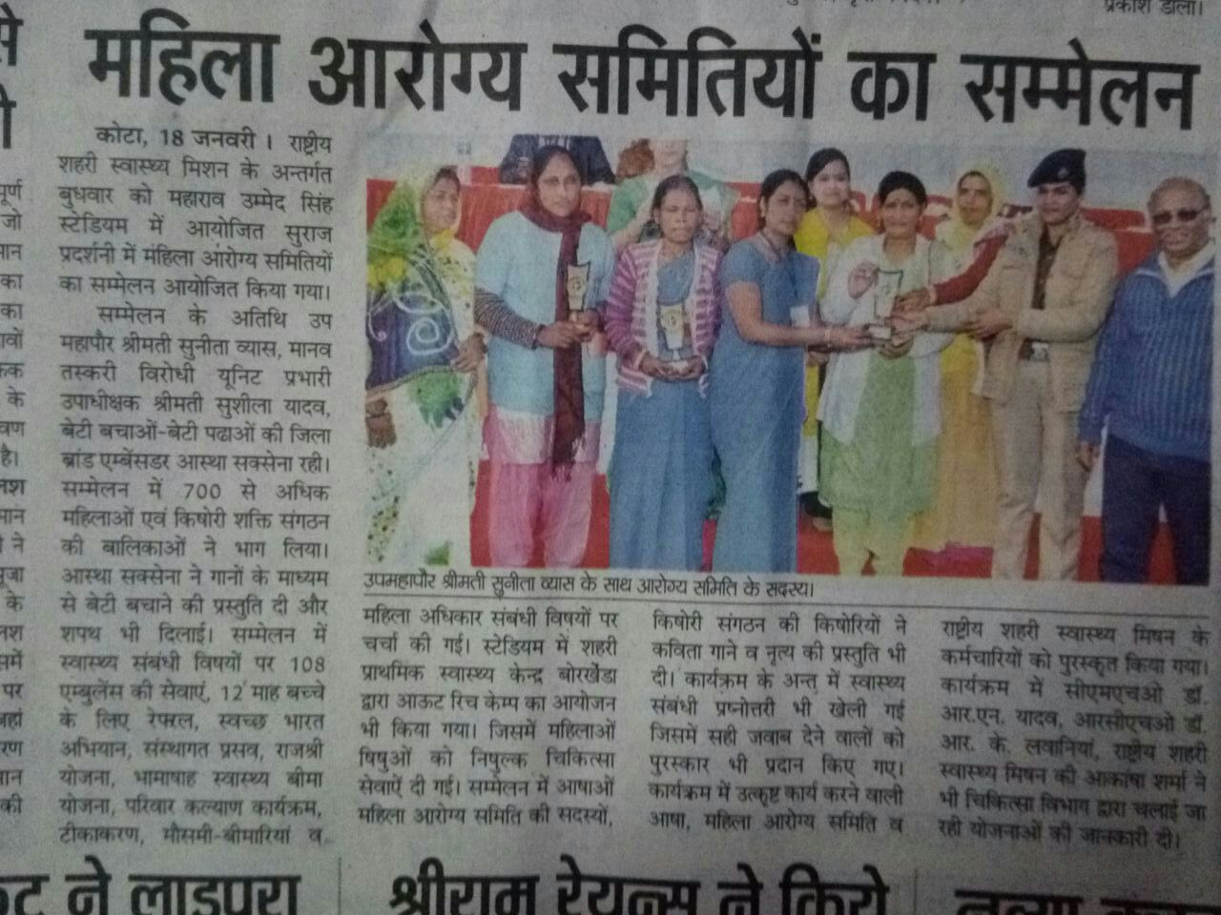
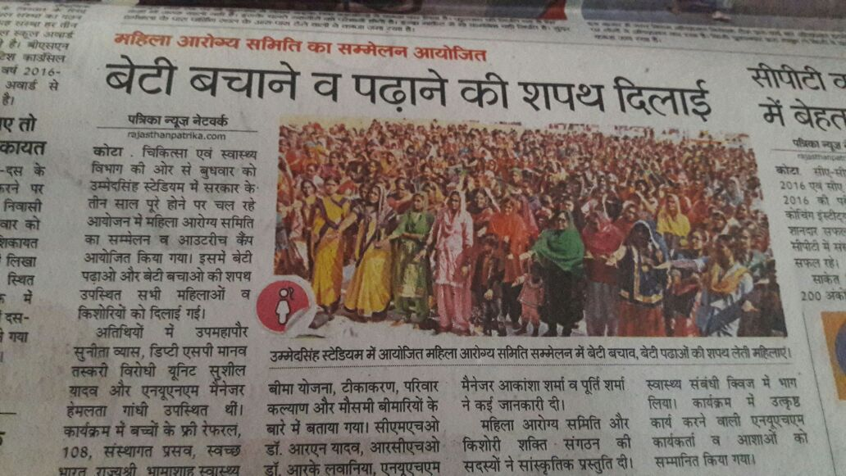
MAS SAMMELAN PRESS COVERAGE

Slide 10
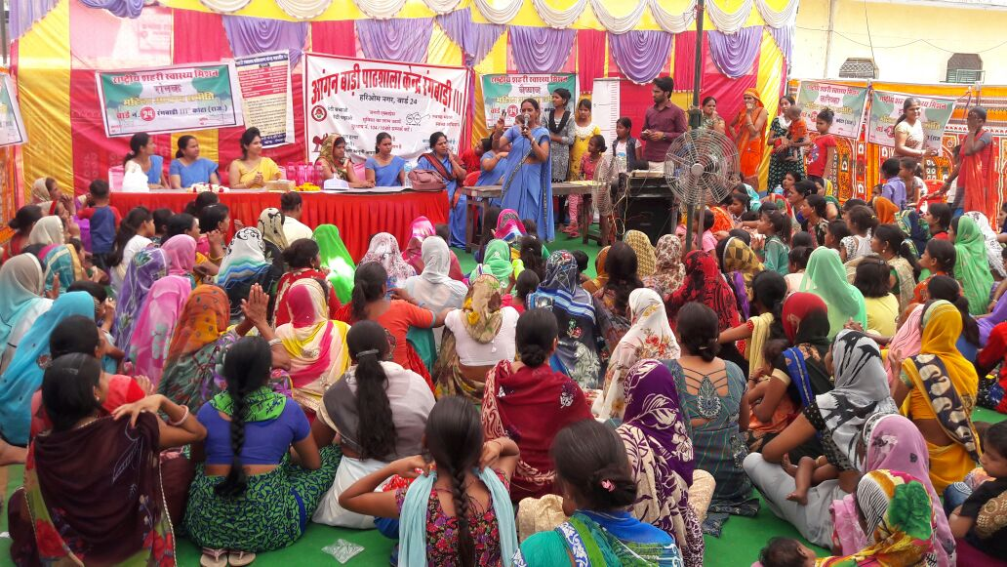
MAS in Kota City of Rajasthan

Slide 11
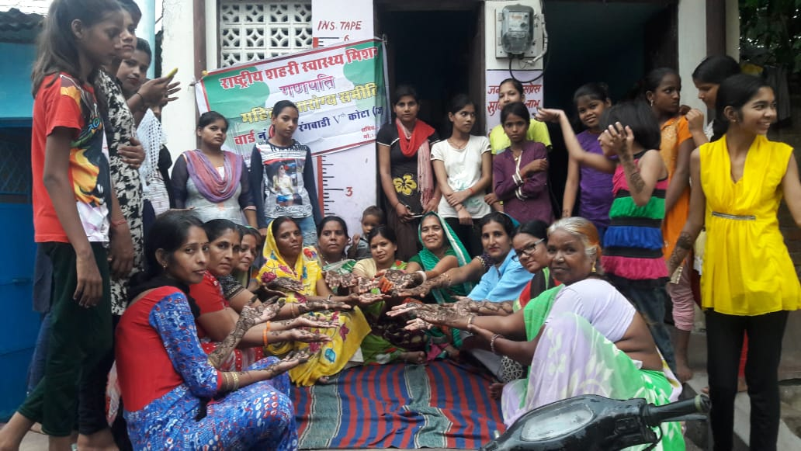
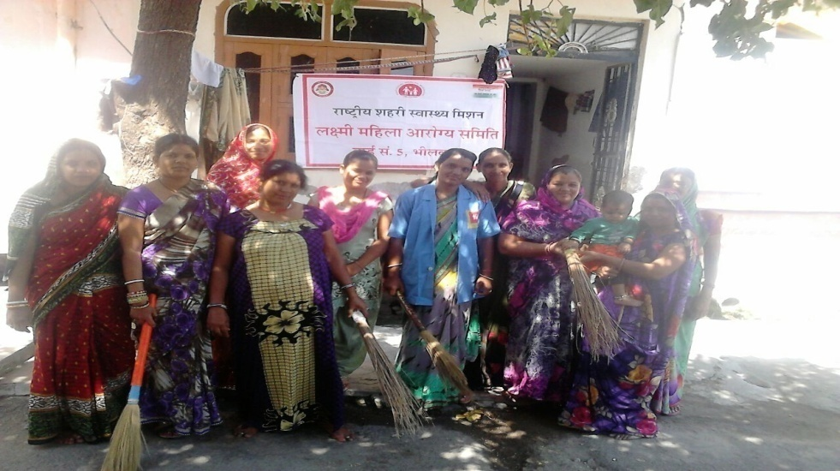
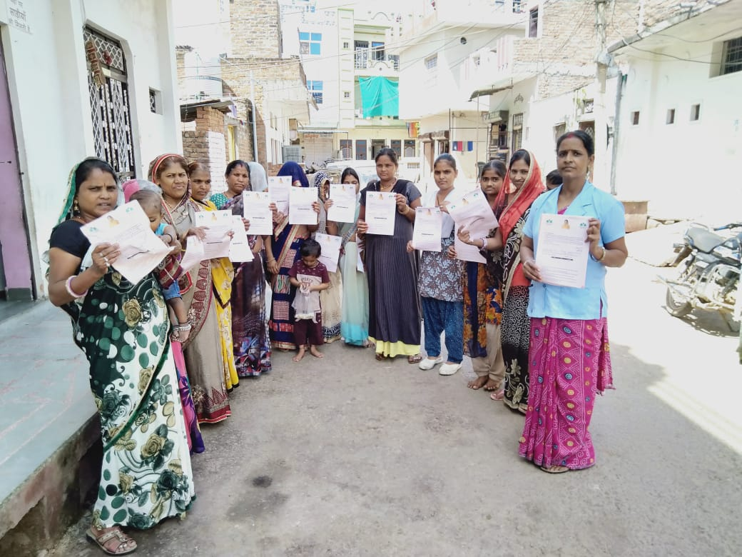
Key Activities of MAS in Kota City
Team Building activities
  Slogan writing competition
  Cooking competition (Healthy Snacks Competition)
  Mehandi designing competition
Community Level Awareness
  Street Play ‘’Nukkad Natak’’ focused on RCH & Sanitation activities
  Health Education & Counseling to beneficiaries
  Awareness on ‘’ Beti Bacho-Beti Padao’’
Sanitation & Hygiene Practices
  Toilet Construction, SWACHTA TOLIES, Community Monitoring, Hand Washing, Waste Management etc
Community Mobilization
  Mobilization of beneficiaries during UHND, Outreach sessions

Slide 12
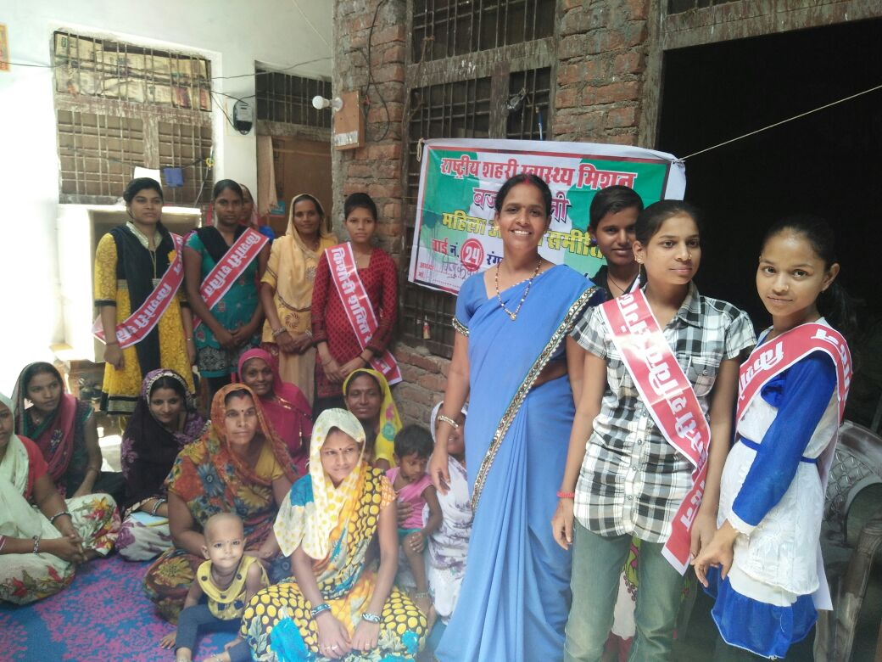
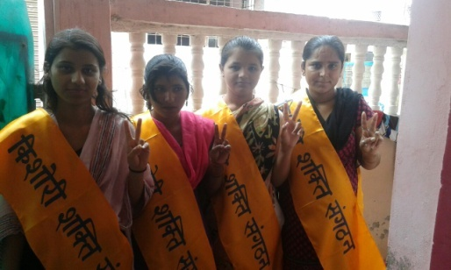
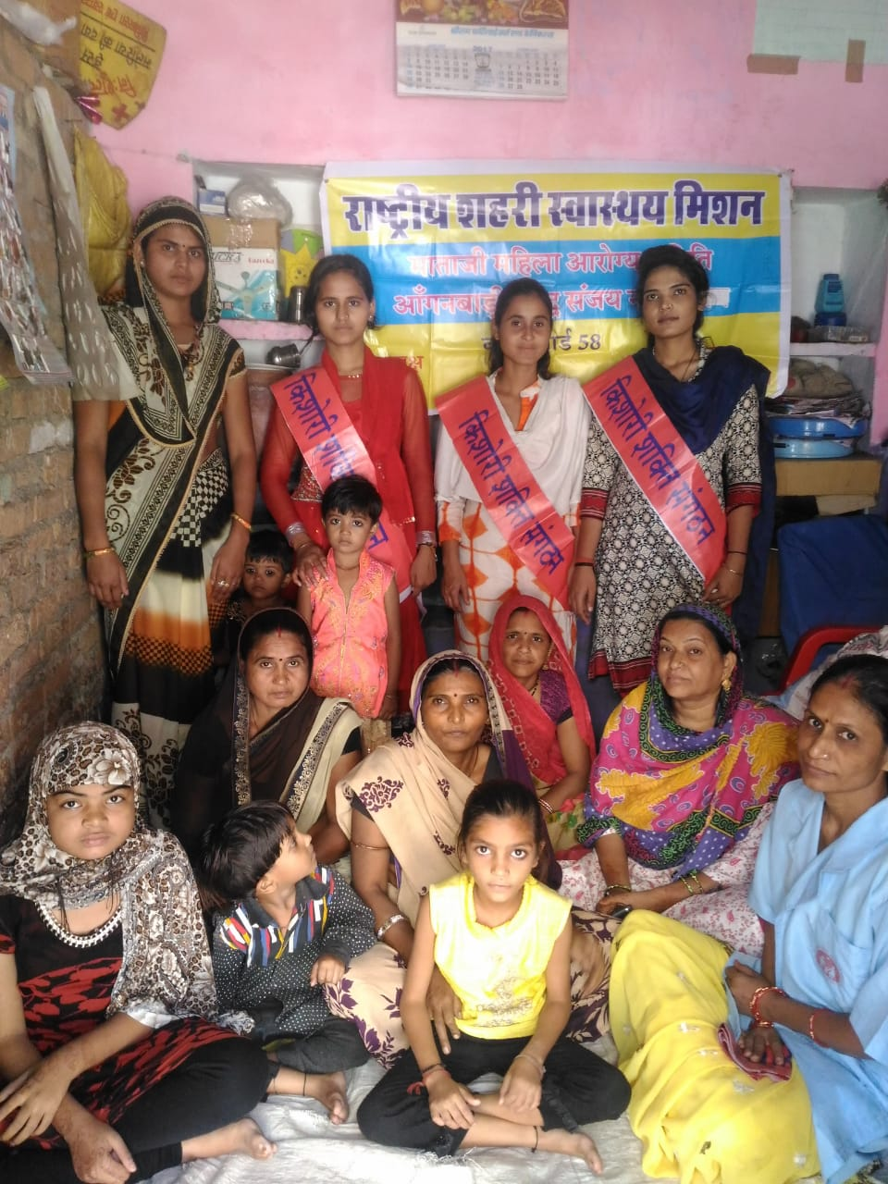
Innovative Interventions
‘’KISHORI SHAKTI SANGHTHAN’’
Group of 4-5 girls (Aged between 12-18 yrs) are linked to each MAS group named as ‘’Kishori Shakti Sanghthan (KSS) ’’.
These girls actively participate in MAS meetings and field level activities of MAS.
They give regular updates on distribution of iron tablets in schools, Mid day meal status, Sanitation status in school to ASHA & MAS. Based upon their feedback PHMs work with concerned school for improvements.
They motivate other girls of community for attending school and spread awareness on Menstrual Hygiene etc.
Resultantly, attendance of girls in school has increased along with improved awareness on health & related issues

Slide 13
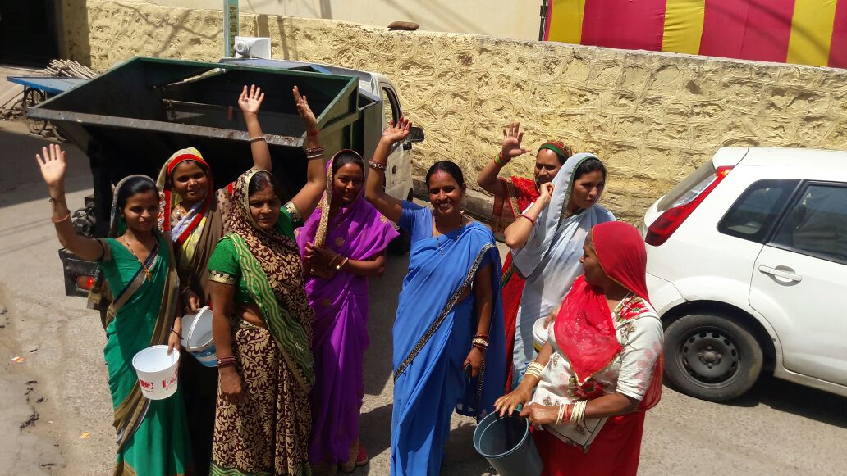
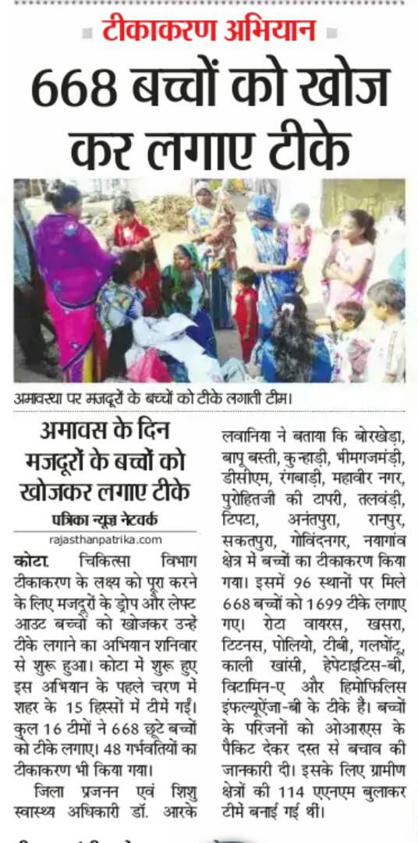
‘’SPECIAL AMAVASYA DRIVE’’
To immunize children of labour community, Kota city has introduced ‘’SPECIAL AMAVASYA DRIVE’’
As labourers do no not go for work on AMAVASYA (New Moon Day), it is best time to immunize their children
MAS members play an important role in spreading awareness among community and mobilizing beneficiaries to the immunization sites.

Slide 14
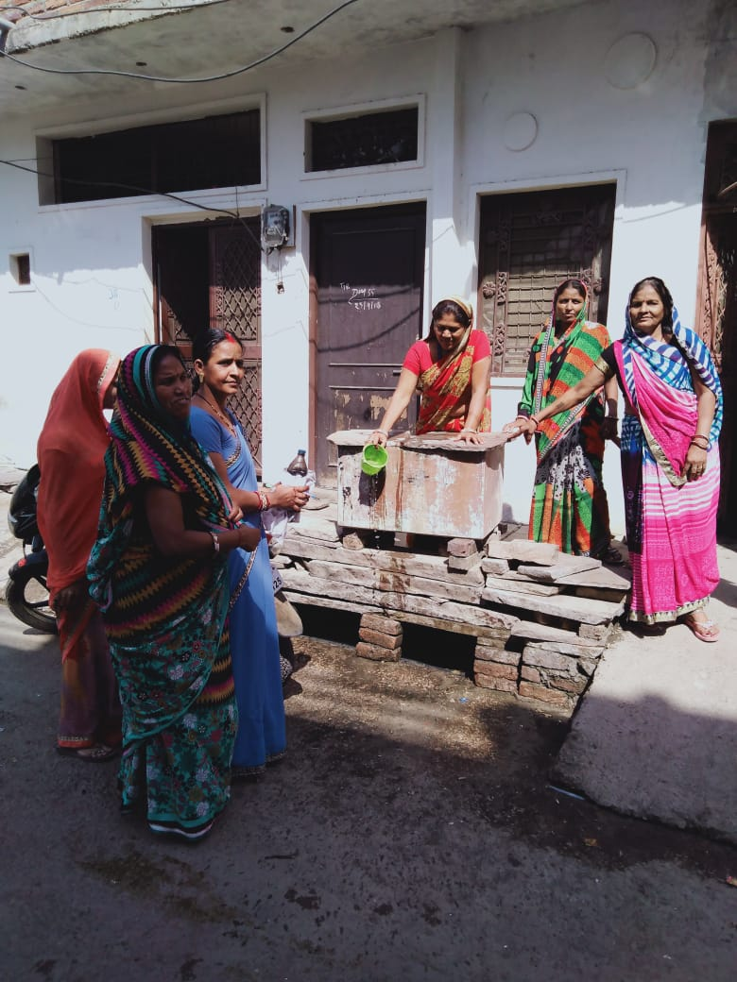
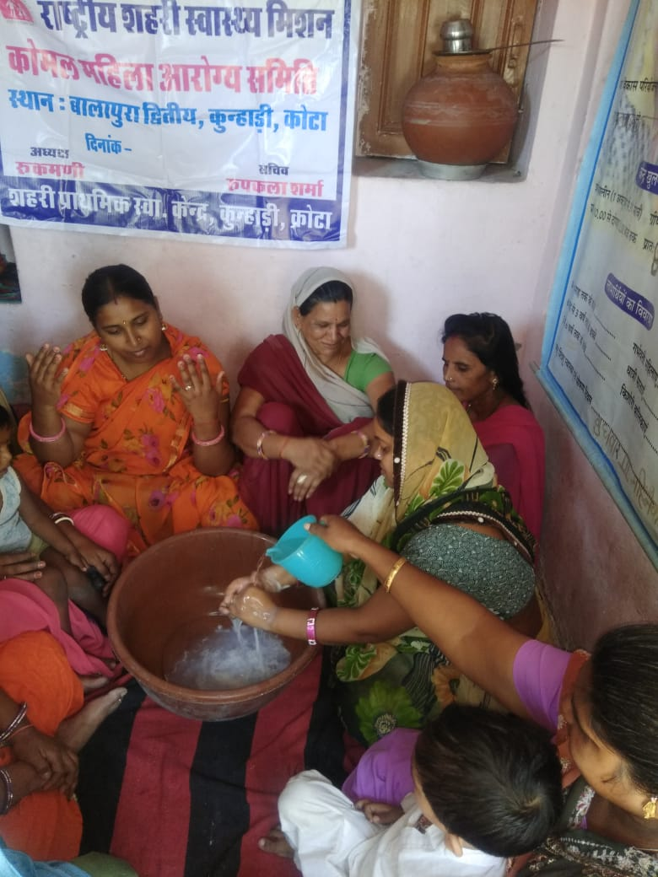
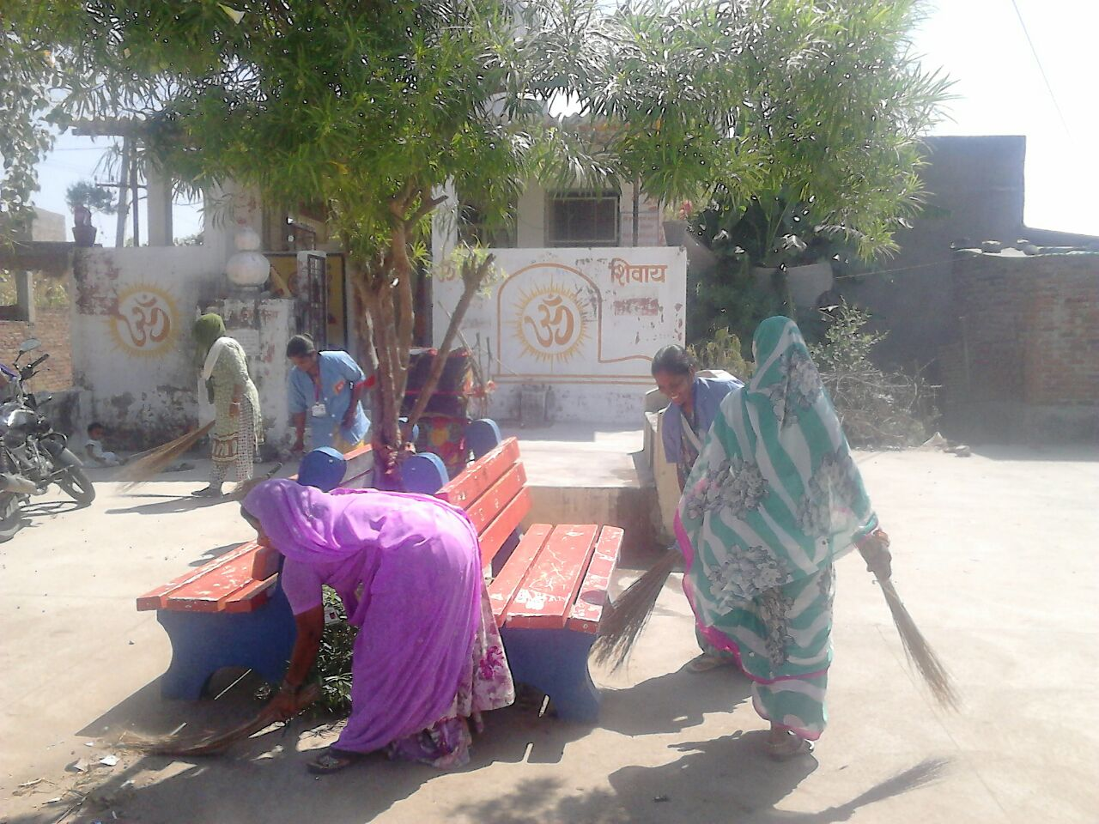
‘’SWACHHTA TOLIES’’
Group of 5-6 MAS members from every MAS have formed a sub-group named as “Swachhta Toli’’, to create awareness on sanitation .
These groups visit open defecation prone areas on every Saturday morning to create awareness on sanitation & hygiene.
They promote use of individual/community household toilets.
‘’SWACHTA TOLIES ‘’ have been instrumental in making slum areas ‘open defecation free’ and are now working for its sustainability.
These groups are promoting other activities also like - anti larval activities, hand washing practices etc.

Slide 15
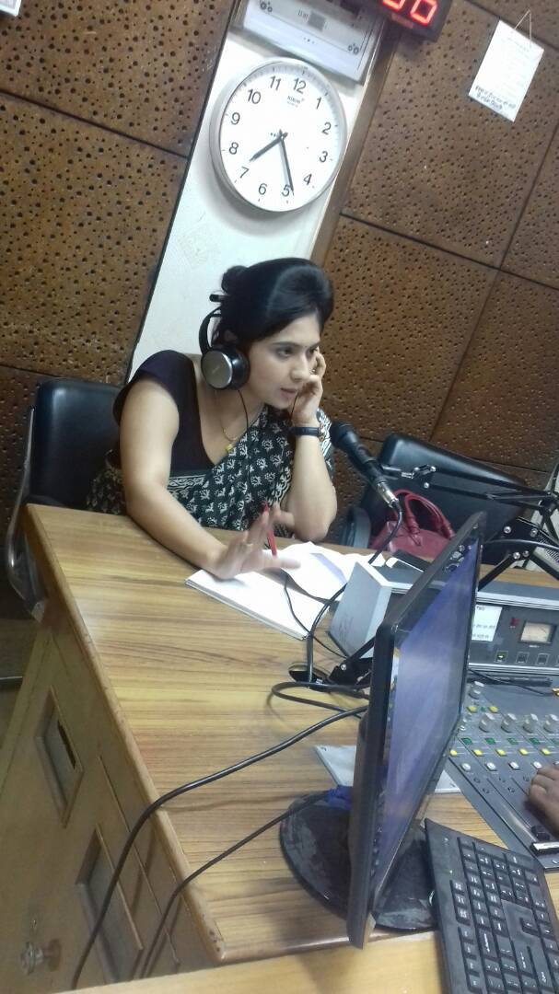
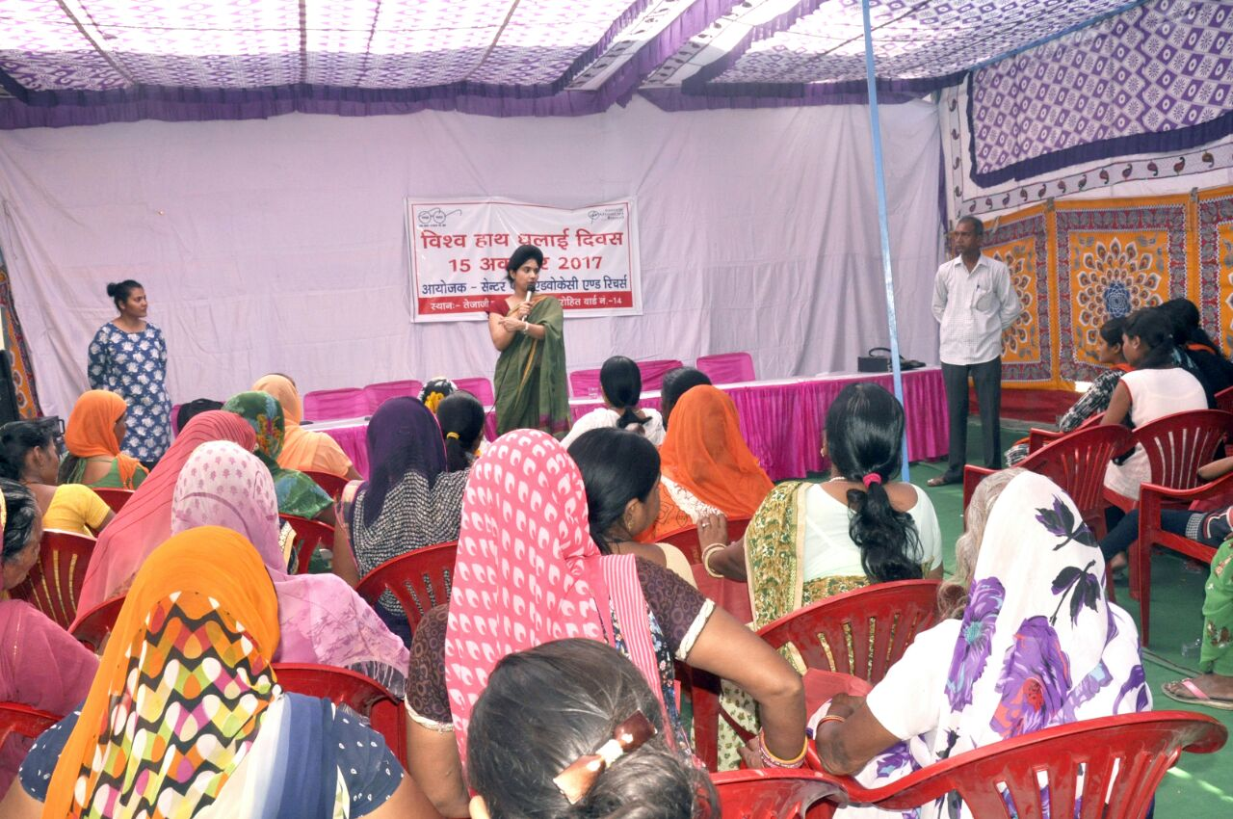
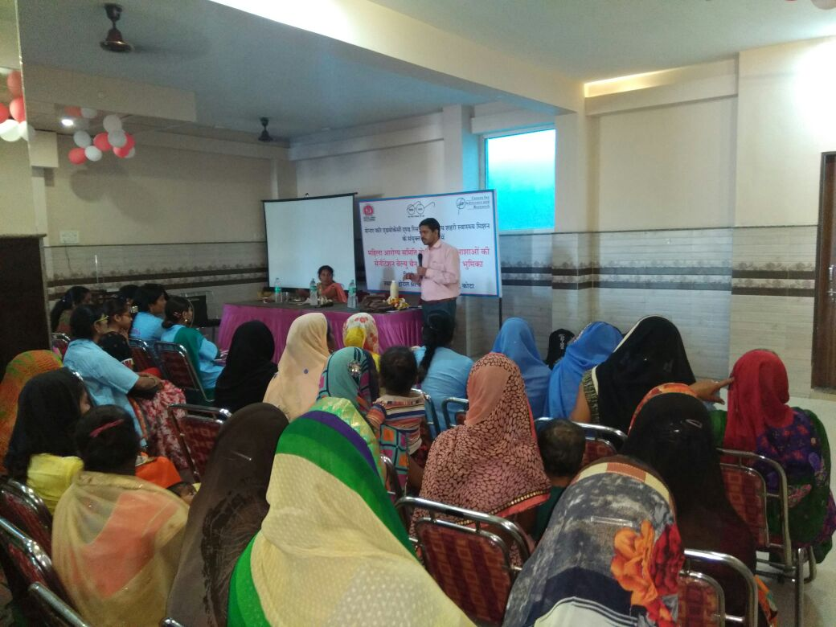
MAS & NGOs Collaboration
NUHM has conducted vocational training for MAS members for livelihood opportunities like - Toilet construction, waste management, environmental friendly (cloth) sanitary napkin making, compost making and stitching with the support of various NGOs like C-FAR, JCI and Swasthya Sewa Sansthan etc.
In collaboration with NGOs, NUHM has conducted radio talk shows, workshops on breastfeeding practices and Nutrition etc for MAS members.

Slide 16
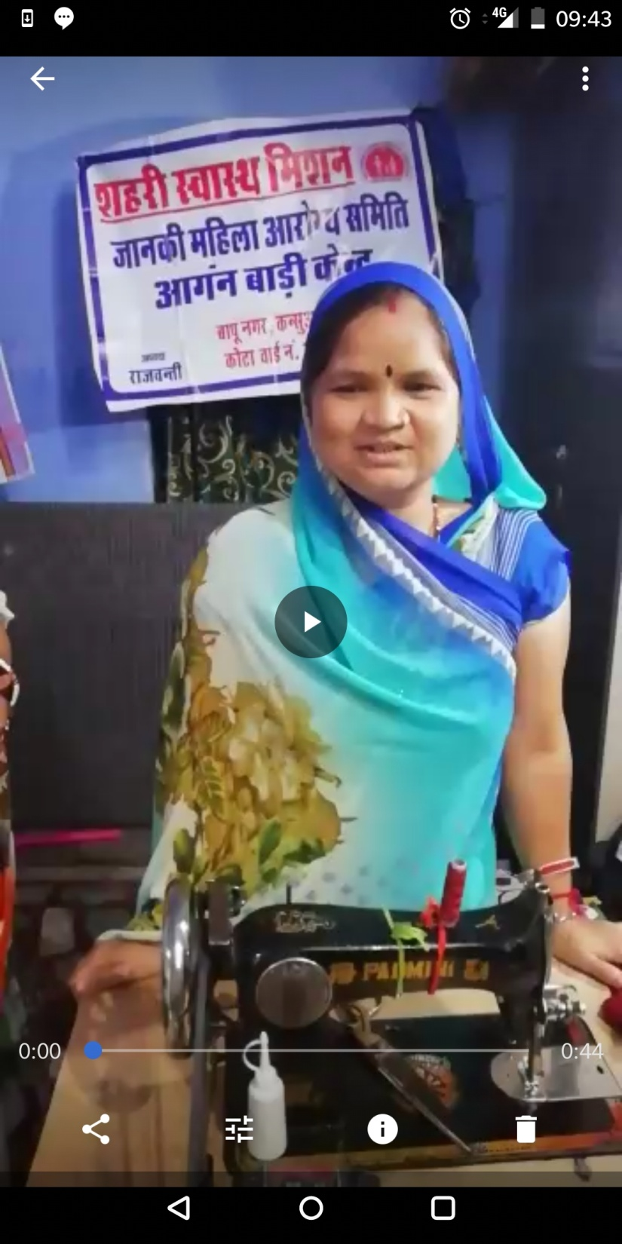
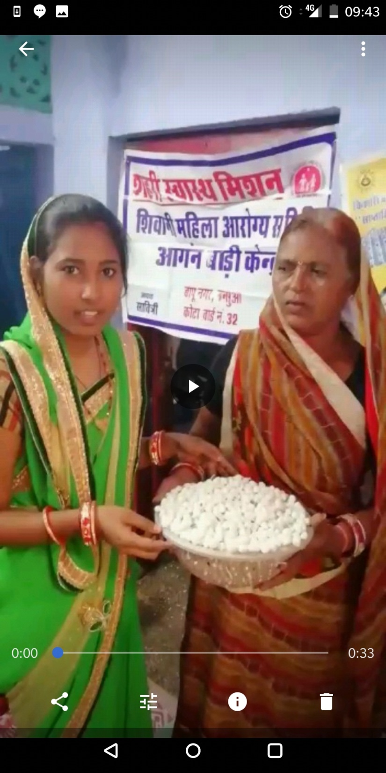
After vocational training, many MAS members have got employed in local factories, manufacturing units etc.
MAS members are selling home made products like compost, pooja items etc in local fairs, local community & local shopkeepers etc.

Slide 17
Overall Impact of MAS Intervention
MAS became tool of women empowerment (financial independence, social recognition, strengthened demand for health needs etc.)
MAS facilitated the service delivery of front line workers i.e. ASHA, ANM and AWW.
Increased awareness on Health & Sanitation in community as MAS members worked as a change agent in community
Behavioral changes in community
Reach of health services broadened and uptake of public health services has increased
Increased community participation in implementation of health programs.
Community participation in monitoring and planning.

Slide 18
Lessons learnt/ take-aways
Factors attributed to the success of MAS :
  Willingness and concern of administration
  Coordinated efforts of all front line workers
  Synergetic convergence with other line departments like ICDS, ULBs etc.
  Social recognition of MAS and its members
  Active involvement of community ensured through trainings & orientations and continuous hand-holding
  Effective supervision of field activities by NUHM staff
  Effective collaboration with NGOs and civil society bodies
  Potent use of effective IEC
  Effective utilization of untied fund

Slide 19


The key is to ignite the community through effective engagement
and
involving beneficiaries in planning and delivery of health services.

