Slide 1



Malaria Mukt Bastar Abhiyan
State-Chhattisgarh

Slide 2
Malaria Situation

Slide 3
Malaria Situation 2019 :- Country Vs State Vs Bastar division
Country/ State/Division | Population(in Lac) | Malaria positive cases | Annual Parasite Incidence(API)
India | 13376.17 | 334685 | 0.25
Chhattisgarh | 306.18 | 60458 | 1.97
Bastar Division | 34.98 | 45903 | 13.12
Chhattisgarh contributes 2.29% Population & 18% Malaria Cases of the Country . Bastar division contributes 11.42% Population & 76% Malaria Cases of the State.

Slide 4
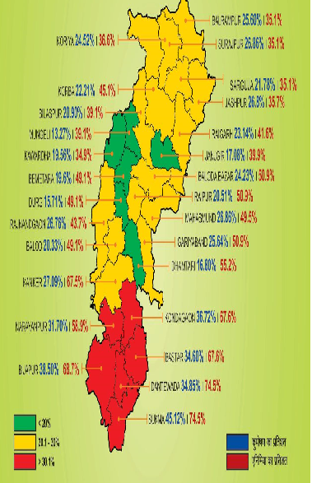
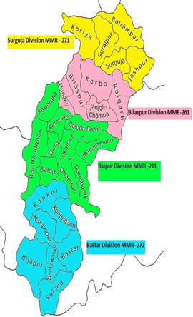
Why in Bastar ??
High API
High Malnutrition & Anaemia
High Maternal Death

Slide 5
Strategies Adopted ( Active Mass Screening)
Need for Active Screening :
Asymptomatic carriers not diagnosed by routine surveillance.
Afebrile carriers contain Malaria gametocytes which act as transmission pool for the community
Malnourished children with asymptomatic malaria
Malaria infection among pregnant mother may have grave repercussions.
To reduce parasite load in the community through Early detection and complete treatment
Malnutrition increases susceptibility to infection while episodes of infection precipitate nutritional deficiency (Mal-Mal theory)
High endemic blocks of Bastar division identified for Active mass screening.

Slide 6
Malaria Mukt Bastar / Chhattisgarh Abhiyan
1st , 2nd & 3rd Phase
AIM of the Activity:-
To reduce morbidity & mortality due to malaria in the State & especially in tribal predominant high endemic blocks with special focus on pregnant women, lactating mother and under 5 yr children.
To reduce parasite load in the community in high endemic pockets by diagnosing symptomatic and asymptomatic (afebrile) malaria cases to ensure complete treatment.
Selected high endemic blocks of Bastar division under 7 aspirational districts in 1st phase during Jan-Feb 2020

Slide 7
Why in Jan- Feb : As per last 3 yrs data , 3 peaks reported in districts of Bastar division in the month of July, Nov. & Jan.

Slide 8
Phase wise -Intervention
Particulars | Phase-1 | Phase-2 | Phase-3
Time Frame | Jan-Feb 2020 | Jun-July 2020 | Dec 20-Jan 21
Division | Bastar Div | Bastar Div | Bastar & Sarguja Div
Blocks | 26 | 30 | 55
Malaria Positive cases | 64646 | 30076 | 9534 (in process)
Test positivity rate | 4.6% | 1.27% | 1.10%
Asymptomatic cases | 57.04% | 59.75% | 56%
Pregnant women detected positive | 6.5% | 1.9% | 1.6%

Slide 9
Methodology of Activities under Mass Screening
Diagnosis of Malaria by Survey Team by RD test (Door to Door )
During 2nd & 3rd phase of abhiyan, survey team members are instructed to follow the COVID-19 guideline by using Mask, gloves & sanitizer.
Nail Marking , Wall stencil, IEC, use of LLIN, Recording , Collection of Empty blister, Source reduction
Result: Positive for Malaria
Pv (CQ + PQ)
Pf (ACT+ PQ)
Mix infection
(ACT + PQ)
Result: Microscopy result found Negative
Result: Positive for Malaria
Pv (CQ + PQ)
Pf (ACT+ PQ)
Mix infection
(ACT + PQ)
Result: Negative for Malaria X
Complicated cases will be referred to CHC by 108 ambulance
Intake of Food before taking drug
After one month of treatment Follow up of Each malaria positive cases by examining blood slide to know whether the parasite is destroy or still exist
Complete Treatment by Mitanin in supervision of RHO
Case follow up by Supervisor at SHC level in 7 & 14 days

Slide 10
Activities Conducted during Abhiyan
Door to door visited by the survey team to achieve 100% coverage of the targeted population.
Test, Treat and Track approach was followed
Provide local food to the Malaria positive cases by the survey team to avoid drug intake in empty stomach.
Wall sticker/stencils pasted outside the surveyed houses to identify the house and left-out persons.
Treatment card issued to all Malaria Positive cases for ensuring complete treatment and verification during case follow up.

Slide 11
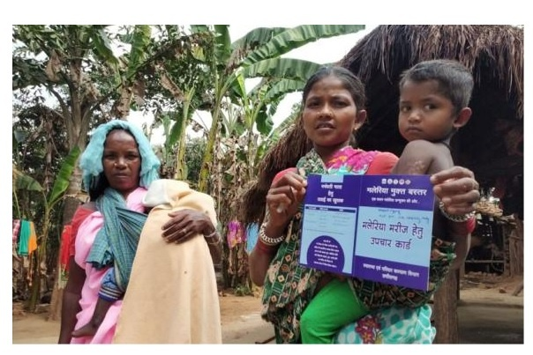
Initiatives Taken
Sticker, Treatment Card & Referral Card used during Abhiyan

Slide 12
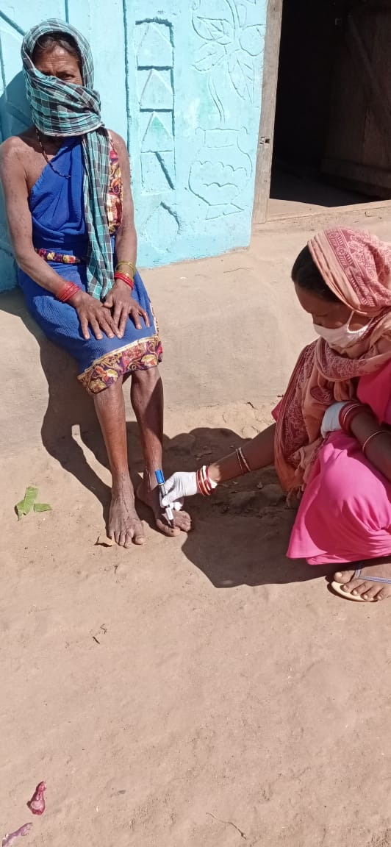
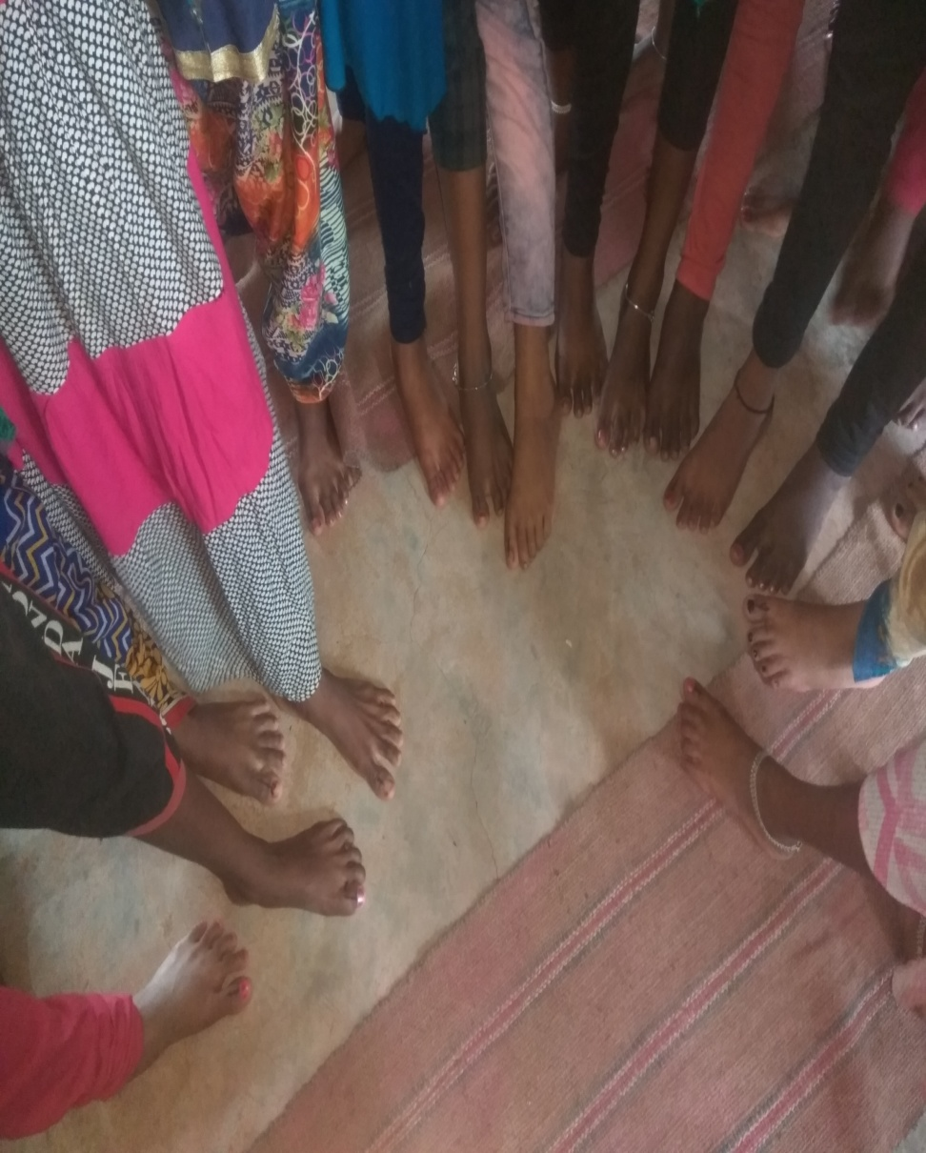
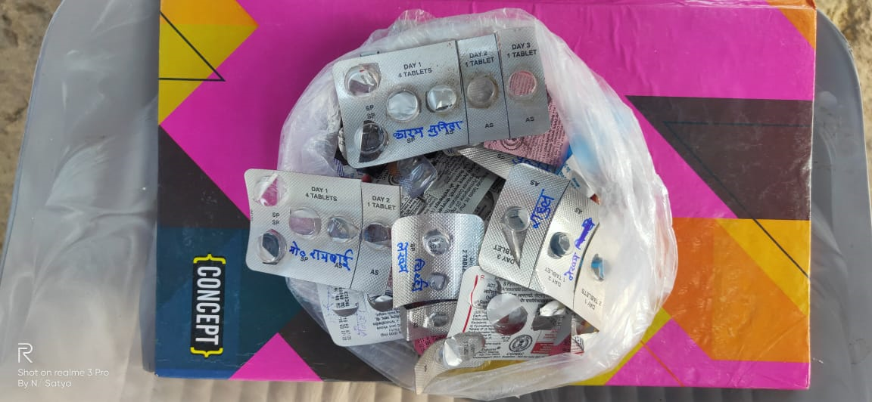
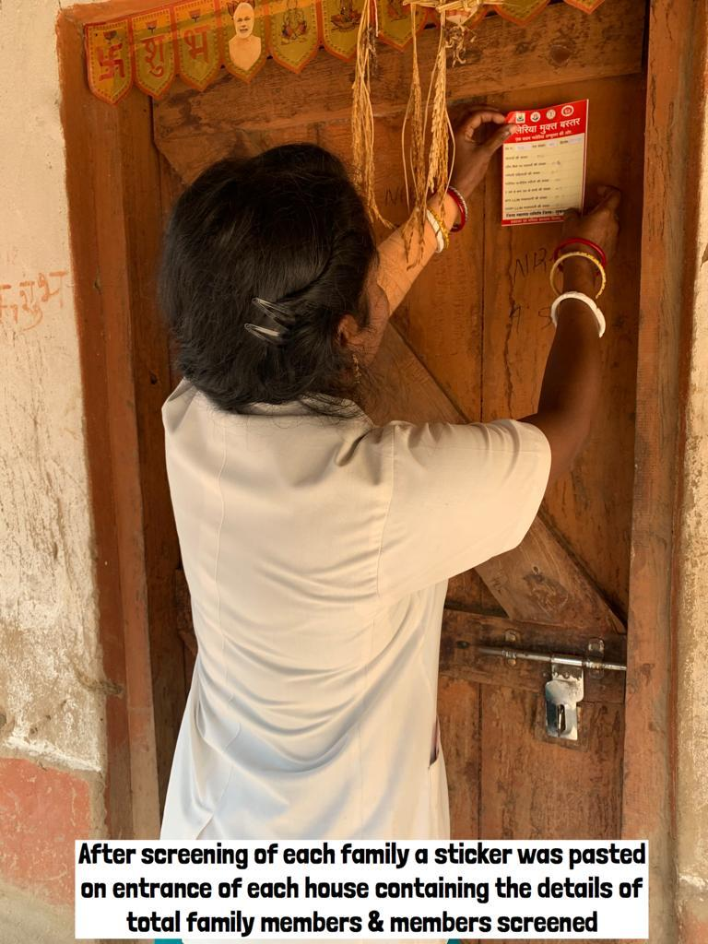
Initiatives taken
Toe marking(Nail marking) to identify the persons tested for Malaria. | Toe marking(Nail marking) to identify the persons tested for Malaria.
Collection of empty Blister Packs to ensure complete treatment

Slide 13
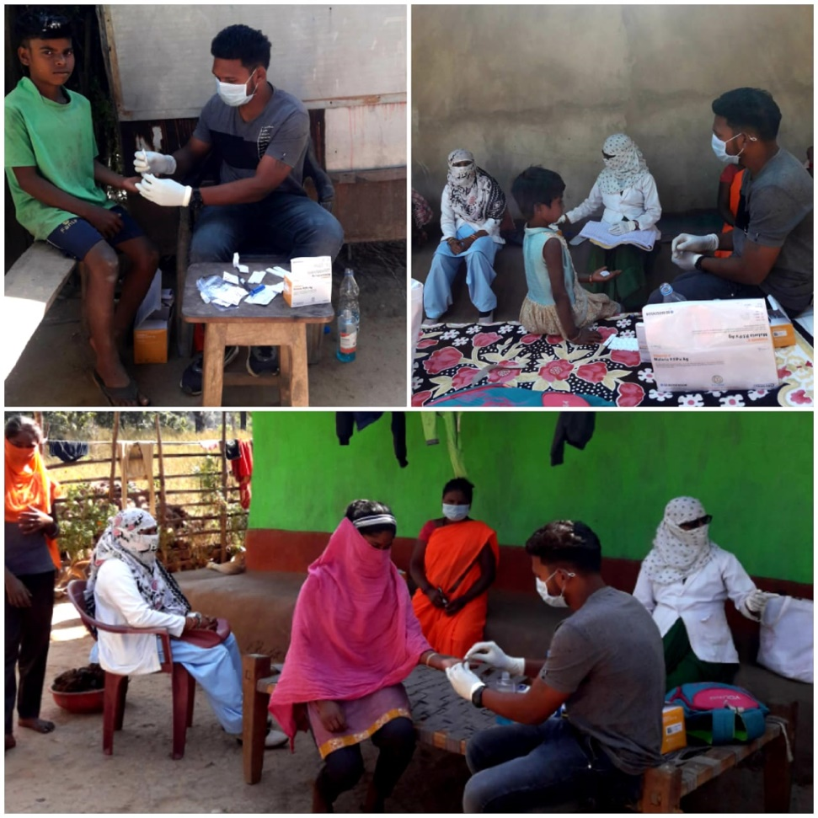
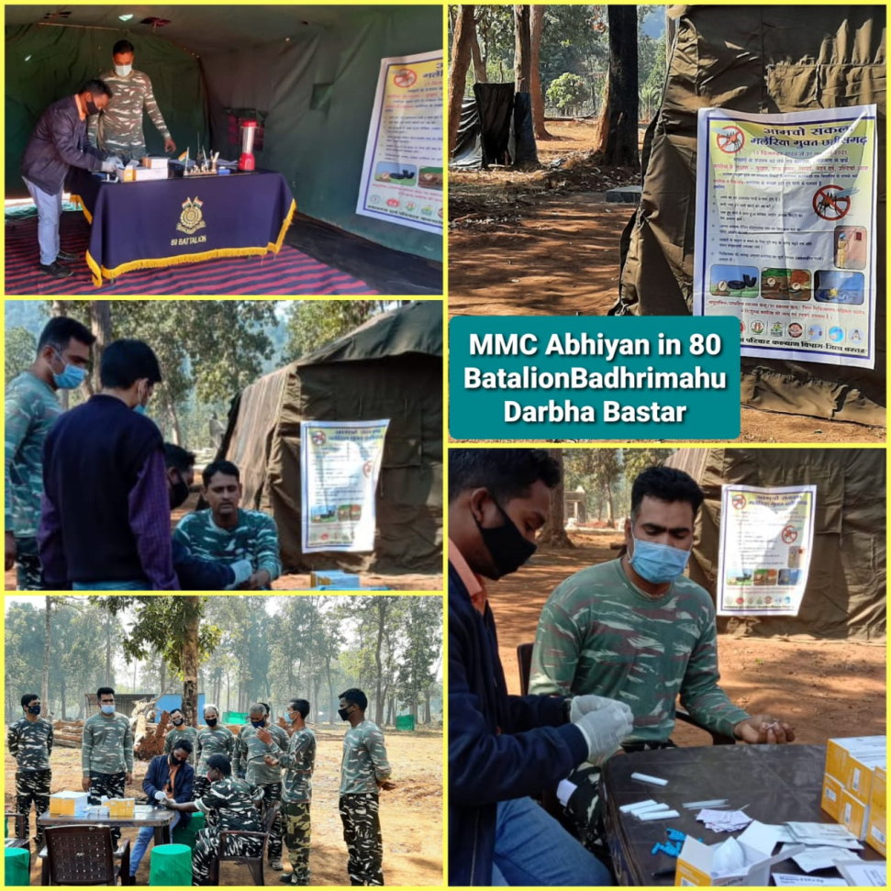
Initiatives Taken
Following Covid Appropriate Behaviour while survey
Survey in Paramilitary force camps

Slide 14
Activities Conducted during Abhiyan
Referrals slip for severe and complicated cases.
Follow up slide preparation after one month of treatment completion and examination to ensure parasite elimination.
Surveillance in Haat-Bazaar by organizing health camps and effective IEC
Source reduction activities (Larvivorous Gambusia fish) during door to door survey.
LLIN monitoring during door to door survey.
Whistling/ ringing of bell in the evening by Mitanin for community awareness for using LLIN.
Inter sectoral coordination with different departments like CGMSC, WCD, NCDC, Paramilitary Education, Forest etc.
Entomological surveillance in coordination with NCDC.
Data collection by using google sheet.

Slide 15
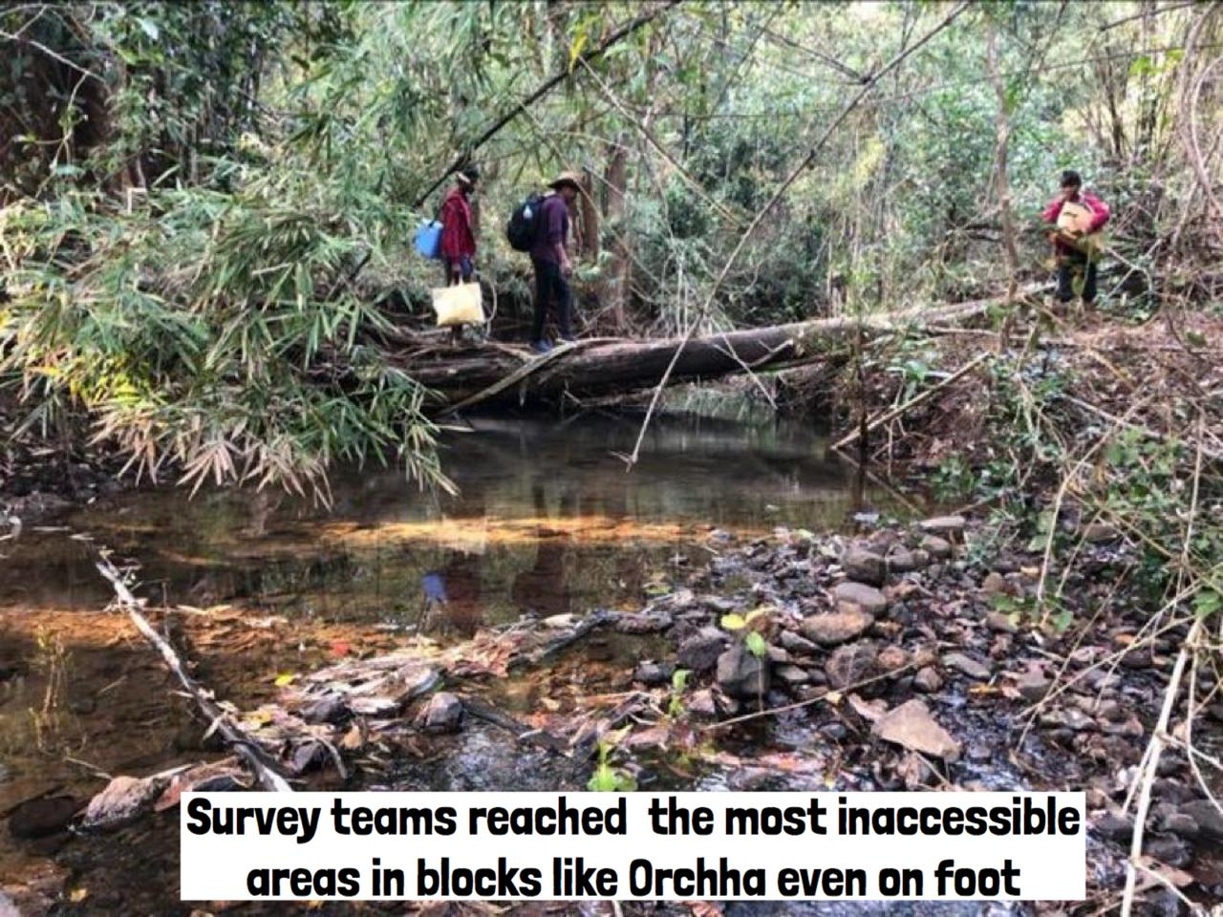
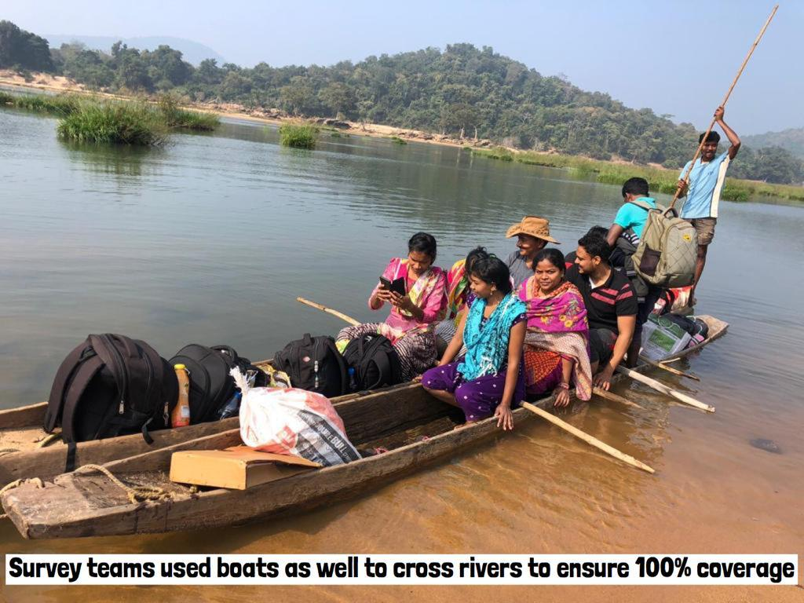
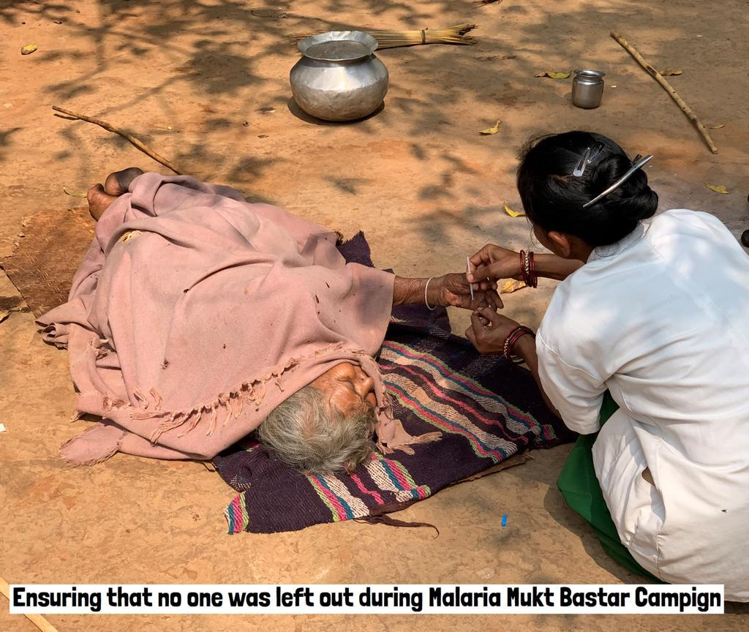
Initiative taken for hard to reach population

Slide 16
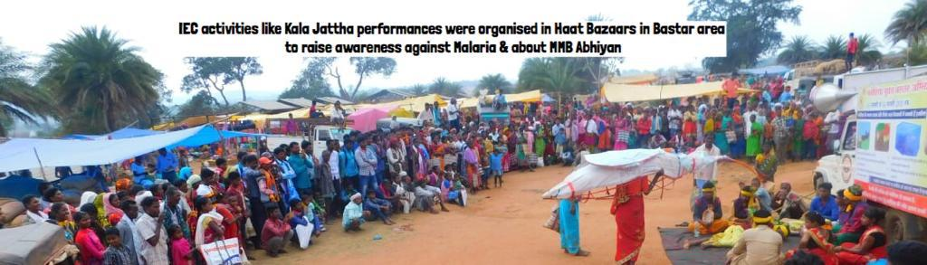
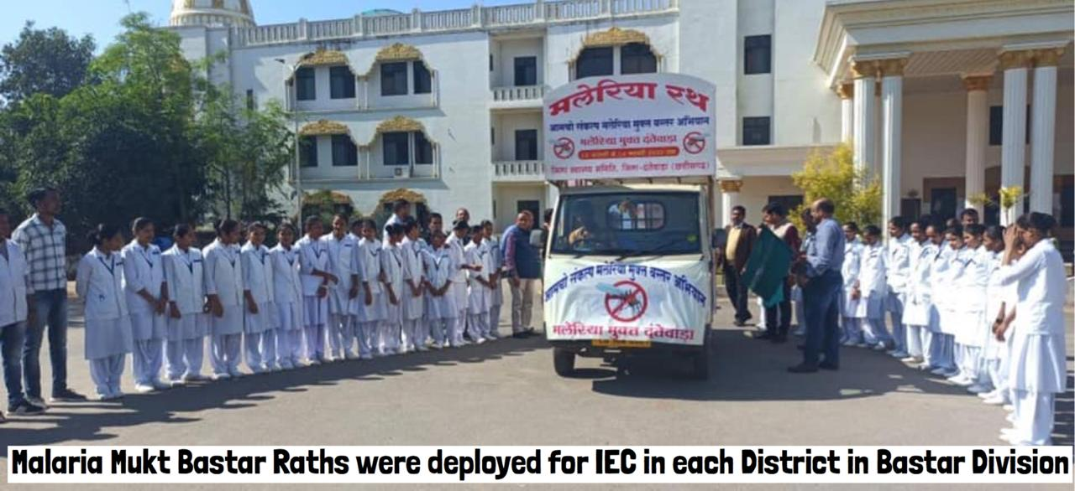
Effective IEC

Slide 17
Coordination with other Govt departments for effective implementation
Departments | Responsibilities
Woman & Child Development | Reporting during survey, nail marking, wall stencil, Health Education at AWW Centre , Use of LLIN by Pregnant Woman & under 5 children,
Education | Motivate children for use of LLIN , regular health check up and cleanliness of surroundings and checking water containers for mosquito breeding , Mass Screening at Ashram and Potacabin
Public Health & Engineering(PHED) | Proper drainage near Tube well, Restoration of leaking taps, Repair of leakages in supply pipes to prevent water pools, mosquito proofing water Harvesting system
Panchayat & Rural Development | Cooperation in implementation of ongoing malaria programme activities like mass screening, LLIN use, source reduction, facilitating community participation in implementing programme activities, SHGs

Slide 18
Coordination with other Govt departments for effective implementation
Departments | Responsibilities
Forest Department | Source reduction, motivation of staffs for health check up & motivation for use of LLIN
Tribal Department | Sensitisation of Ashram school children on prevention and control of malaria, community mobilisation for acceptance of vector control measure and case management services by health workers
Fishery | Production, supply & Implementation of larvivorous fish (Gambusia) and trained community for its use

Slide 19
Achievements of 1st & 2nd Phase of the Abhiyan
S.No | Particular | 1st round | 2nd round
1 | Period of Abhiyan | Jan-Feb 2020 | June-July 2020
2 | Block Covered | 16 Complete & 10 Partially | 30 Blocks
3 | SHC Covered | 431 | 757
4 | Village Covered | 1857 | 3226
5 | House Hold Covered | 289357 | 490402
6 | Survey Team | 1562 | 2804
7 | No. of Persons in the survey Team | 8749 | 5608
8 | Population covered (in Lakh) | 14.06 | 23.75
9 | Malaria Positive cases | 64646 | 30076
10 | Treatment Completed | 64646 | 30076
11 | Test Positivity Rate | 4.60% | 1.27%

Slide 20
Achievements of 1st & 2nd Phase of the Abhiyan
S.No. | Particular | 1st round | 2nd round
12 | Pregnant Woman Tested | 13355 | 16181
13 | Pregnant Woman found Malaria Positive | 870 (6.51%) | 308 (1.90%)
14 | Asymptomatic Malaria Cases | 36874 (57.04%) | 17970 (59.75%)
15 | symptomatic Malaria Cases | 27772(42.96%) | 12106 (40.25%)
16 | No. of Schools Covered | 3778 | 0
17 | No. of Ashrams Covered | 501 | 0
18 | No. of Hostels Covered | 156 | 0
19 | No. of Pota cabins Covered | 76 | 0
20 | No. of Paramilitary Camps covered | 169 | 189

Slide 21
Third Party Evaluation of Phase 1
A third party evaluation was conducted by UNICEF (independent agency) & SHRC (State Health Resource Centre).
It is observed that 91.30% population coverage during abhiyan.
95% malaria positive cases were given complete treatment as per GoI guideline.

Slide 22
Malaria Mukt Chhattisgarh Abhiyan
Dt.15.12.2020 to 30.01.2021
3rd Phase of Abhiyan started in Bastar division & 1st round of abhiyan in Surguja division on 15th December 2020.
S.No. | Target | Bastar Division | Surguja Division | Total
1 | Population | 1174153 | 391361 | 1565514
2 | House Holds | 243128 | 90826 | 333954
3 | District | 7 districts | 5 Districts | 12 District
4 | Block | 29 | 26 | 55
5 | Sub Health Centre | 527 | 170 | 697
6 | Village | 1908 | 391 | 2299
7 | No. of Survey Team | 1388 | 785 | 2173
8 | Survey Team Member | 5578 | 1634 | 7212

Slide 23
Malaria Mukt Chhattisgarh Abhiyan-3rd Phase
Dt.15.12.2020 to 04.01.2021
S.No. | Achievement | Bastar division | Surguja Division | Total
9 | No. of houses visited | 140579 | 51043 | 191622
10 | No. of Persons tested | 656695 | 211652 | 868347
11 | Malaria Positive cases | 9518 | 16 | 9534
12 | % of Malaria Positive cases | 1.45% | 0.01% | 1.10%
13 | Symptomatic cases | 4179 (43.9%) | 13 (81.3%) | 4192 (44%)
14 | Asymptomatic cases | 5339 (56.1%) | 3 (18.8%) | 5342 (56%)
15 | Pregnant Woman Tested | 4612 | 1275 | 5887
16 | Pregnant Woman found Malaria Positive | 94 (2.04%) | 1 (0.08%) | 95 (1.6%)

Slide 24
Malaria Mukt Chhattisgarh Abhiyan-3rd Phase
Dt.15.12.2020 to 03.01.2021
S.No. | Achievement | Bastar division | Surguja Division | Total
17 | % of Adult Male found Malaria Positive | 20.0% | 18.8% | 20.0%
18 | % of Adult Female found Malaria Positive | 23.6% | 62.4% | 23.7%
19 | % of Children below 14 yr found Malaria positive | 56.4% | 18.8% | 56.4%
20 | LLIN used in no. of houses | 140303 | 50687 | 190990
21 | No. of Persons found with COVID symptoms | 44 | 77 | 121

Slide 25
Impact

Slide 26
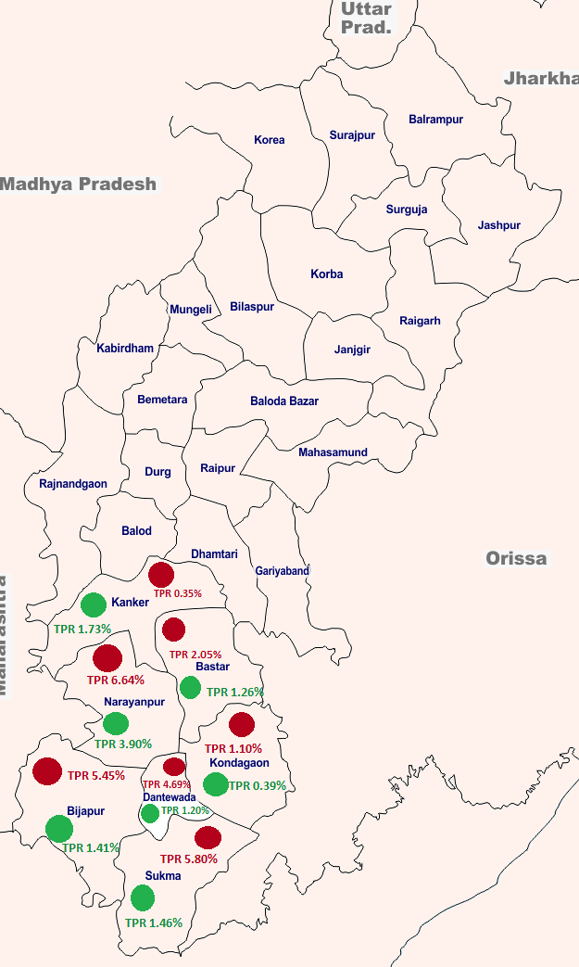
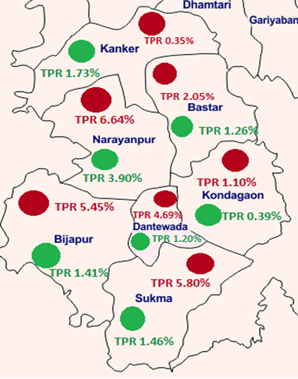
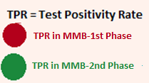
Decline in Test Positivity Rate
Test Positivity Rate during 1st Phase of MMB (Jan-Feb’20) was 4.6%. It declined to 1.27% in 2nd phase of MMB (June-July’20).

Slide 27
Reduction of Malaria cases in 2020 (after abhiyan ) in transmission season.

Slide 28
District wise Decrease of Malaria Positive cases November 2019 & 2020 | District wise Increase /Decrease of Malaria Positive cases
S.No. | District | 2019 | 2020 | % Decline
1 | Sukma | 913 | 303 | -66.81
2 | Kanker | 337 | 147 | -56.38
3 | Dantewada | 1353 | 665 | -50.85
4 | Narayanpur | 445 | 231 | -48.09
5 | Bijapur | 1407 | 773 | -45.06
6 | Bastar | 466 | 259 | -44.42
7 | Kondagaon | 351 | 318 | -9.40
State Total | State Total | 5272 | 2696 | -48.86
All districts showed decline in malaria positive cases.

Slide 29
Thank You

