Slide 1




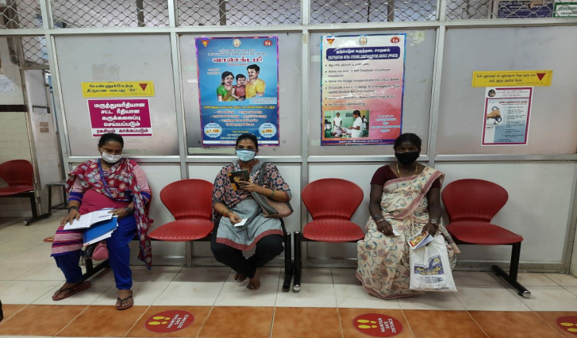
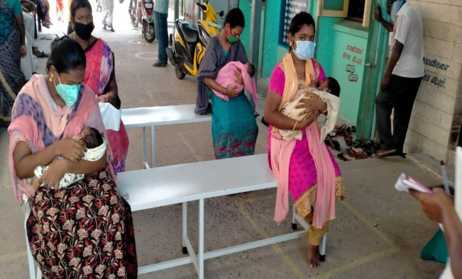
National Summit on
Good and Replicable Practices – 2020
Management of High Risk
Antenatal Mothers
during Covid Pandemic
Dr.J.Radhakrishnan, IAS,
Principal Secretary to Government
Health and Family Welfare Department
Govt. of Tamil Nadu

Slide 2
Rationale
The COVID-19 pandemic and subsequent lockdown measures has placed unprecedented demands on our health system, especially among pregnant women.
Innovative measures to manage the prevailing situation was quintessential for delivering quality AN care to address the following barriers:
  Accessibility: Physical (due to lockdown)
  Affordability: financial (due to unemployment, stressed financial services) and
  Social factors (fear of getting infected when seeking services and stigma).
TN has come up with many innovative strategies, which were based on standard protocols, quality driven and suited to the local context.

Slide 3
Programme Description
All pregnant mothers were identified as ‘ High Risk’.
Line list of all Antenatal mothers were obtained from Pregnancy and Infant Cohort Monitoring and Evaluation (PICME / RCH portal) and are categorized as Low Risk, Moderate Risk and High Risk ANCs.
District wise line list of 7.29 Lakh mothers with Expected Date of Delivery (EDD) for the period March 24th 2020 to Dec 31st 2020 obtained from PICME Software and shared to the districts/ Chief District Obstetrician for ready reference
The dash board has colour categorization for Mothers as detailed below
    Green
    Yellow
    Red
User Id and password created for the Mentor Obstetrician, who looks after a block in each district, the Chief District Obstetrician who is in charge of the whole district
SAFE
MODERATE RISK
HIGH RISK

Slide 4
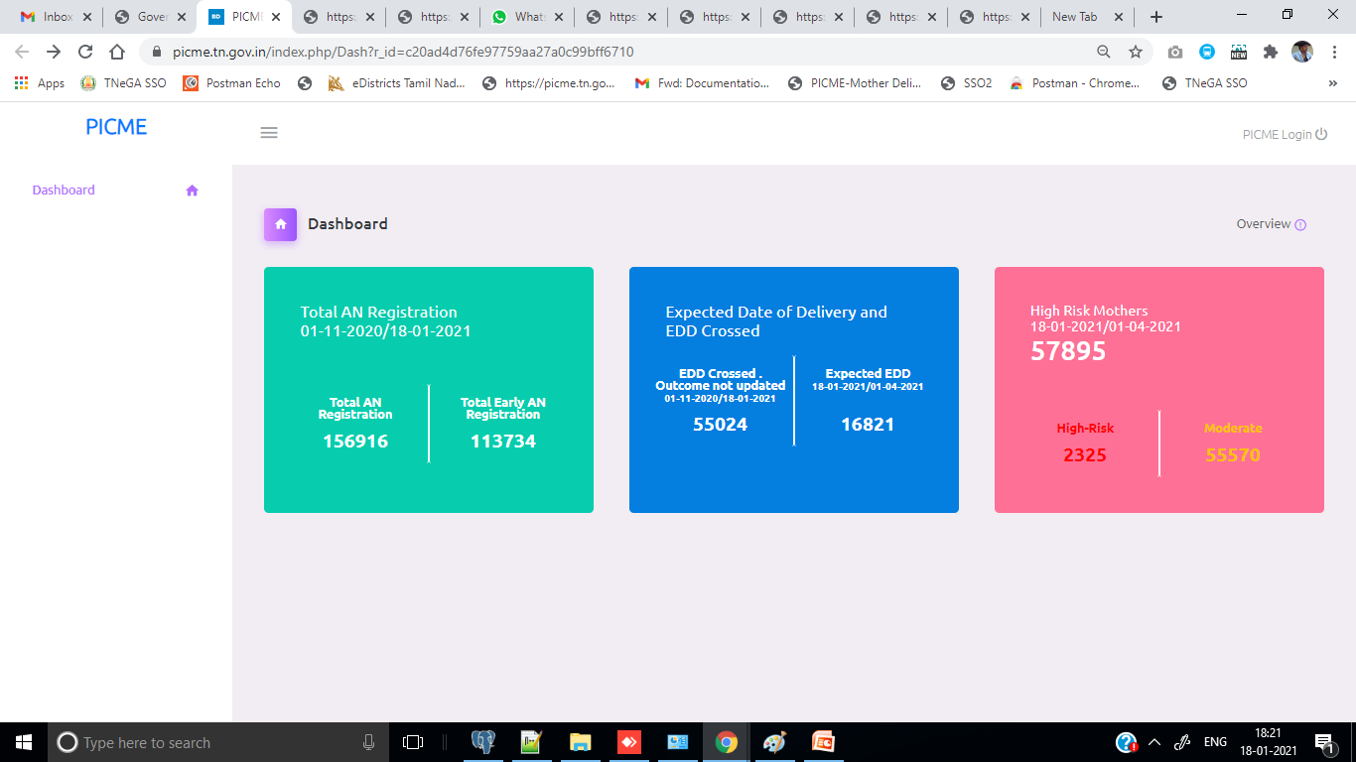
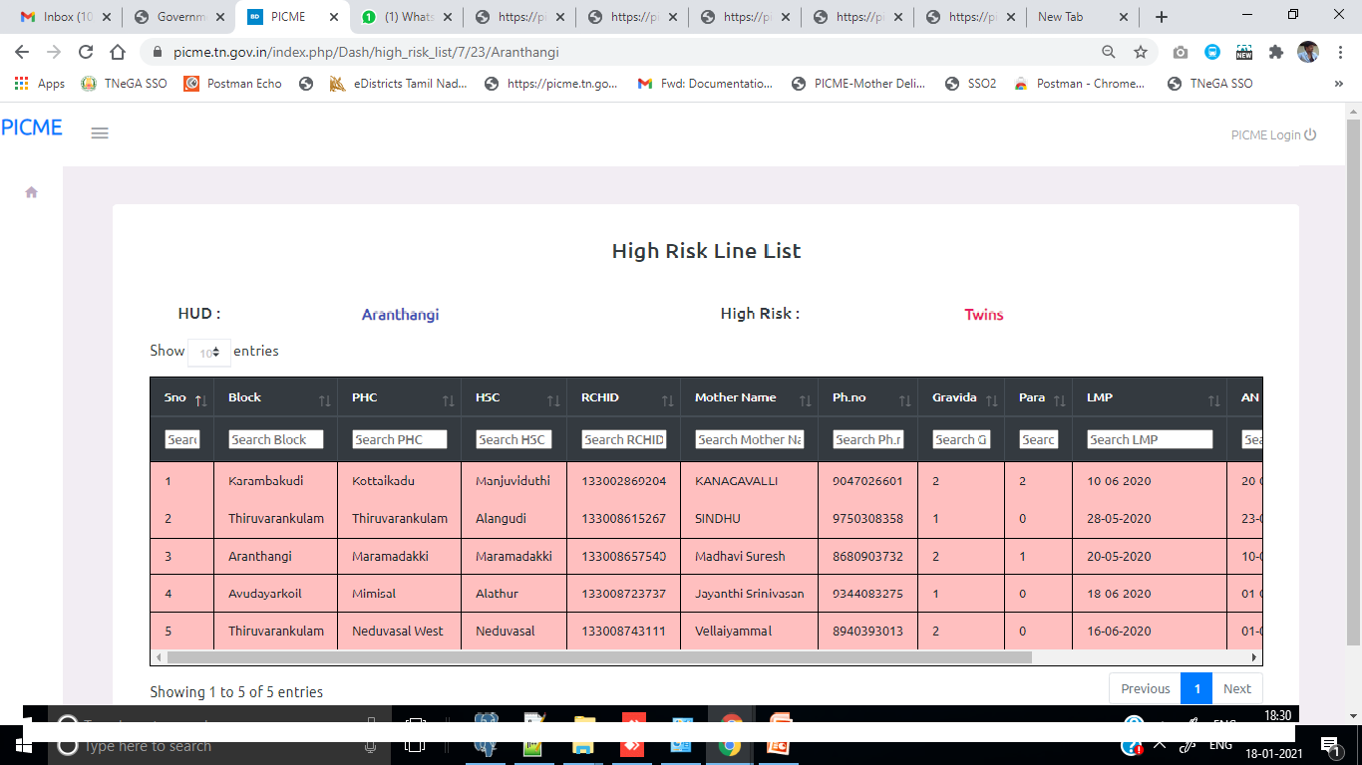
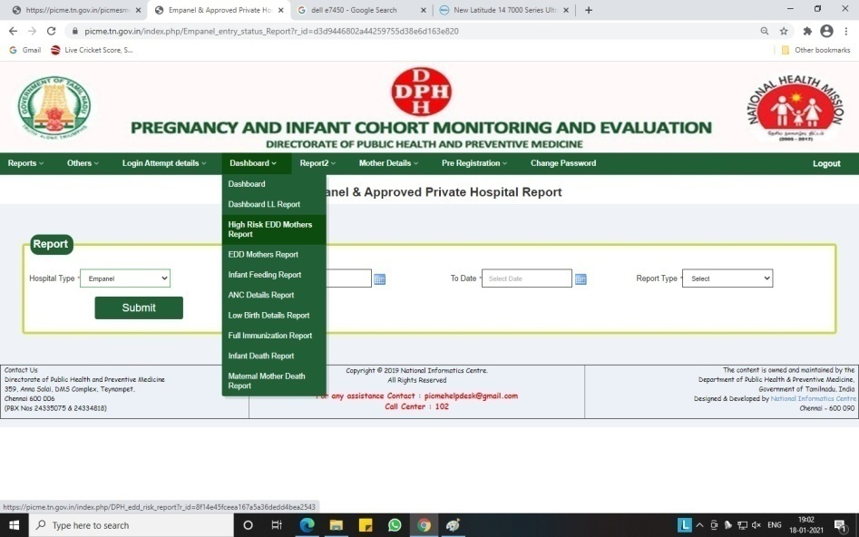
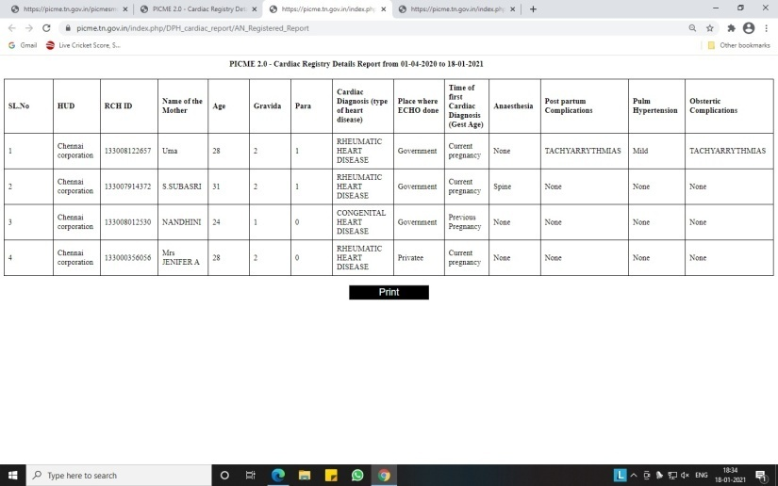
Dashboard

Slide 5
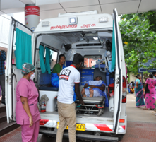
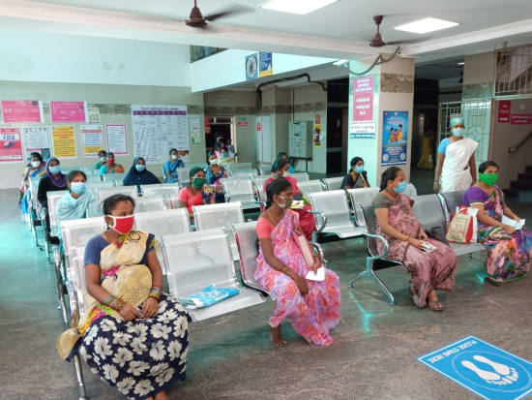
Care for High Risk Antenatal Mothers
Micro-plan worked out at all levels for tracking of Mothers – Mentor OG, Block MO, PHC MO, VHN for follow up
High Risk Mothers with EDD during the lock down period followed by 104 /102 - PICME cell
WhatsApp groups were created within each blocks in the district
The High Risk mothers were mobilised to the nearest CEmONC centre for Antenatal Care via 108 Ambulance
The CEmONC centres were ensured for Birth Preparedness and Complication Readiness.

Slide 6
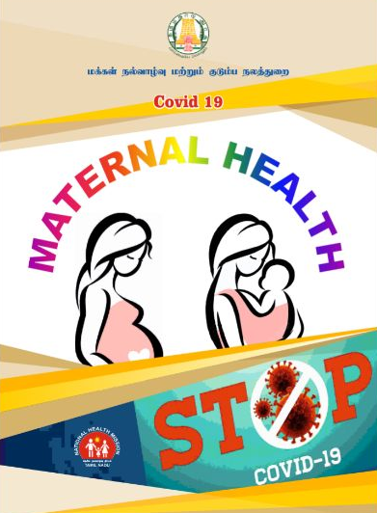
Institutional Strengthening for managing COVID suspect and positive mothers.
All L3 facilities were COVID Designated Hospitals and another block in the hospital was made available for providing Maternal Health services to COVID suspect and COVID positive mothers.
Standard Operating Protocol were created and ensured to follow the protocols for rationale use of PPE, universal precautions and for Donning and Doffing.
The private nursing homes were also instructed to manage COVID suspected positive patients and periodically monitored for their preparedness.

Slide 7
Modus Operandi
Antenatal Mother (Line listed from PICME / RCH Portal)
Covid Negative
ANC and Delivery in PHC / CHC / FRU
ANC and Delivery in CEmONC Centre
Covid Positive & Covid Suspect
Low Risk
ANC and Delivery in CEmONC Centre
Covid Negative
ANC and Delivery in CEmONC Centre
Covid Suspect
ANC and Delivery in CEmONC Centre
Covid Positive
High Risk
Dropped back by Government / JSSK Vehicles
Followed up with home visits / telephonic enquiry

Slide 8
Mentoring
Chief District Obstetrician
from MCH / DHQ
District Head Quarters Hospitals
Block PHC
Additional PHC
Sub District Hospitals
Block PHC
Additional PHC

Slide 9
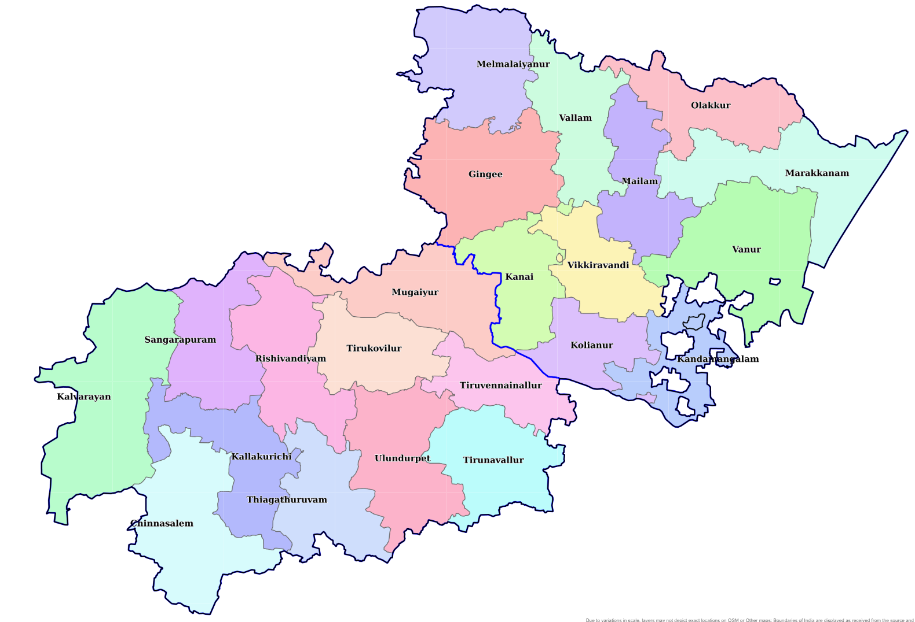
Villupuram HUD & Kallakurichi HUD

Slide 10
S.No | Name of the Block | Mentor Obstetrician
 |  | Name | Work Station
1 | Gingee | 1.Dr. K.Rajalakshmi , AS | Gingee SDH
 |  | 2.Dr.S.Suganya , AS | Gingee SDH
 |  | 3.Dr.Saveetha AS | Gingee SDH
2 | Kanai | 4.Dr. Sasi Reka AS | Vilupuram MCH
 |  | 5.Dr.Rajeshwari Associate Prof | Villupuram MCH
3 | Kandamangalam | 6.Dr.Thangamani Associate Prof | Villupuram MCH
4 | Koliyanur | 7.Dr.Viva priya Associate Prof | Villupuram MCH
5 | Marakanam | 8.Dr.Ramya AP | Villupuram MCH
 |  | 9.Dr. Nithya Priyadarshini AP | Villupuram MCH
 |  | 10.Dr.Muralishree AS | Tindivanam GH
S.No | Name of the Block | Mentor Obstetrician
 |  | Name | Work Station
12 | Chinnaselam | 26.Dr.Naveena AS | Kallakurichi DHQ
 |  | 27.Dr.Madumitha AS | Kallakurichi DHQ
13 | Kallakurichi | 28.Dr. M. Porchelvi,CCS | Kallakurichi DHQ
 |  | 29.Dr.Jovitha Deepthi AS | Kallakurichi DHQ
14 | Kalrayan Hils | 30.Dr.Sujatha AS | Kallakurichi DHQ
 |  | 31.Dr. Anitha AS | Kallakurichi DHQ
15 | Mugaiyur | 32.Dr.Shanthi .P AP | Villupuram SDH
 |  | 33.Dr. Suganya AS | Gengee GH
16 | Rishivandhiyam | 34.Dr. Shanmugapriya AS | Tirukovilore GH
 |  | 35.Dr.Ayesha AS | Tirukovilore GH
17 | Sankarapuram | 36.Dr.S. Induja , AS | Sankarapuram
18 | T.V.Nallur | 37.Dr. Abirami AP | Villupuram MCH
 |  | 38.Dr. Sindu AS | Villupuram GH
19 | Thiagadurgam | 39.Dr. Deepa Darshini AS | Ulundurpet GH
 |  | 40.Dr. Naveena shree AS | Ulundurpet GH
6 | Melmalaiyanur | 11.Dr. Vinodha AP | Villupuram MCH
 |  | 12.Dr.Oviya AP | Villupuram MCH
 |  | 13.Dr.Deepika AS | Gingee SDH
7 | Milam | 14.Dr.S.Santhakumari , CCS | Tindivanam SDH
 |  | 15.Dr.Poorna devi AP | Villupuram MCH
8 | Olakkur | 16.Dr.Gomathi AP | Villupuram MCH
 |  | 17.Dr.Kanimozhi AP | Villupuram MCH
 |  | 18.Dr.Renji AS | Tindivanam GH
9 | Vallam | 19.Dr.Divya AP | Villupuram MCH
 |  | 20.Dr.Thamilaselvi AS | Tindivanam GH
10 | Vanur | 21.Dr.Nithya AP | Villupuram MCH
 |  | 22.Dr.Sowmya AP | Villupuram MCH
 |  | 23.Dr.Neraja AP | Villupuram MCH
11 | Vikkiravandi | 24.Dr.S.Shanthi, CCS | Villupuram SDH
 |  | 25.Dr.Kavitha AP | Villupuram MCH
20 | Thirukoilur | 41.Dr. Alamelu CS | Thirukoiyulore SDH
 |  | 42.Dr. Kalaiarasi AS | Thirukoiyulore SDH
21 | Thirunavalur | 43.Dr..Narmada AS | Ulundurpet SDH
 |  | 44.Dr. Rajalakshmi AS | Ulundurpet SDH
 |  | 45.Dr. Sathya AP | Villupuram MCH
22 | Ulundurpet | 46.Dr. M.Hilarina Joshita Nalini CCS | Ulundurpet SDH
 |  | 47.Dr. Kanmani AS | Villupuram MCH

Slide 11
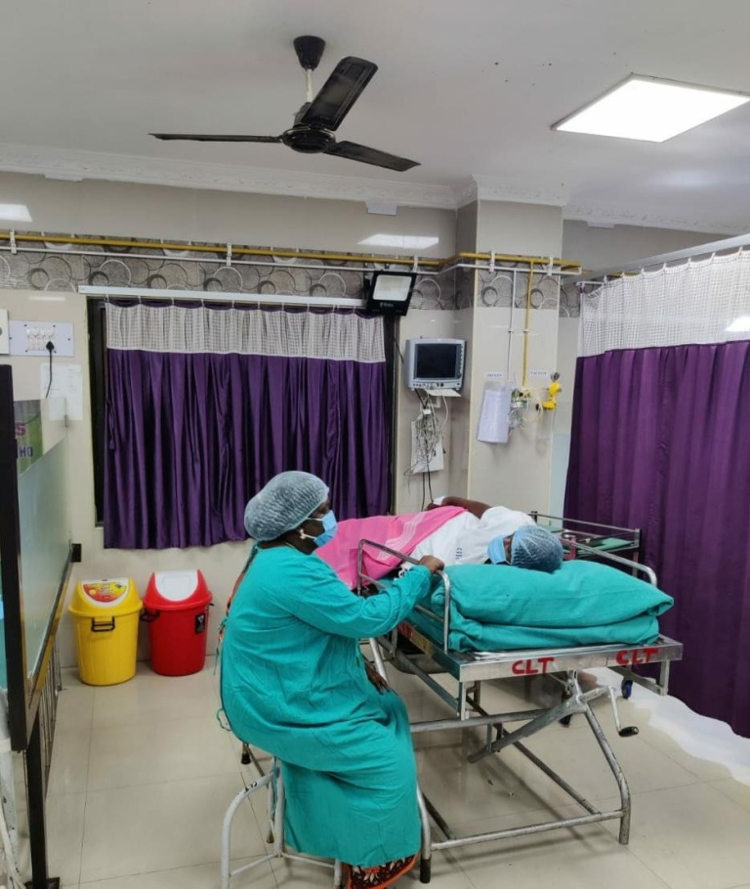
Intrapartum Care
Mother and birth companion were provided with mask
Obstetric examination and monitoring as per standard obstetric practices & protocols for High Risk pregnancy
Induction of labour and Caesarean section were done, when medically justified and based on Maternal and Foetal condition
Progress of labour was monitored by real time partograph
Mode of birth was individualised, based on Obstetric indication

Slide 12
Postnatal Care
Mothers were monitored by Safe Birth Checklist (SBC) in addition to the monitoring of the High risk conditions as required
Counselling and psychological support were offered to mothers recovering from acute illness/isolated from infant
Postpartum family planning services were available to all the beneficiaries
The Postnatal mothers and new born were followed up in their homes by ANMs / ASHAs by home visits and telephonic enquiry.
They are counselled about nutritious diet, adequate hydration, Iron and Calcium supplementation, exclusive breast feeding for the baby and enquired about any COVID symptoms and danger symptoms for the mother and baby.

Slide 13
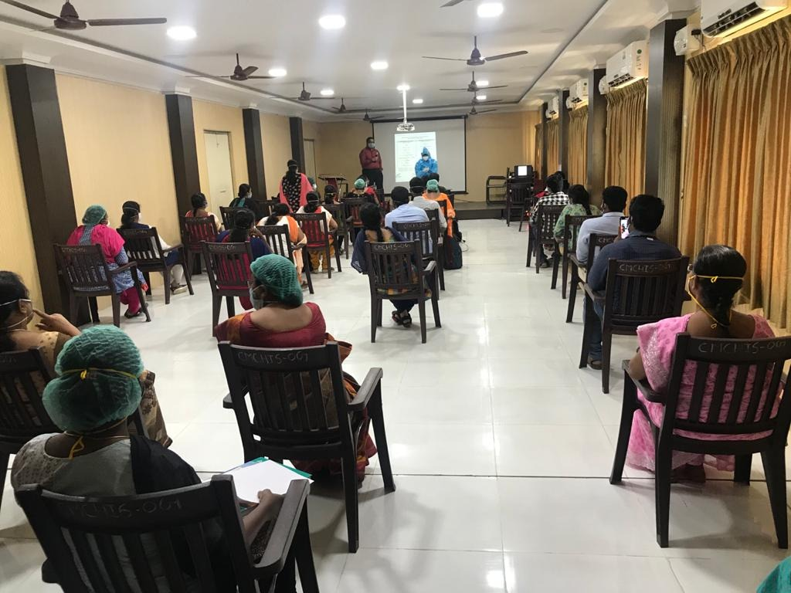
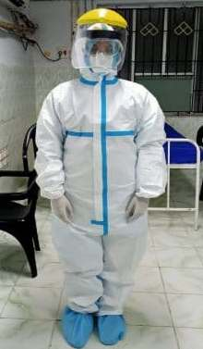
Teach, Train and Transform
The Hospital Infection Control Committee (HICC) was activated for preventive and responding to Health Care Associated Infections (HAI) among Health Care Workers.
Mock drill exercises were conducted
  for better preparedness during Antenatal Care and delivery at all Health Care Facilities.

Slide 14
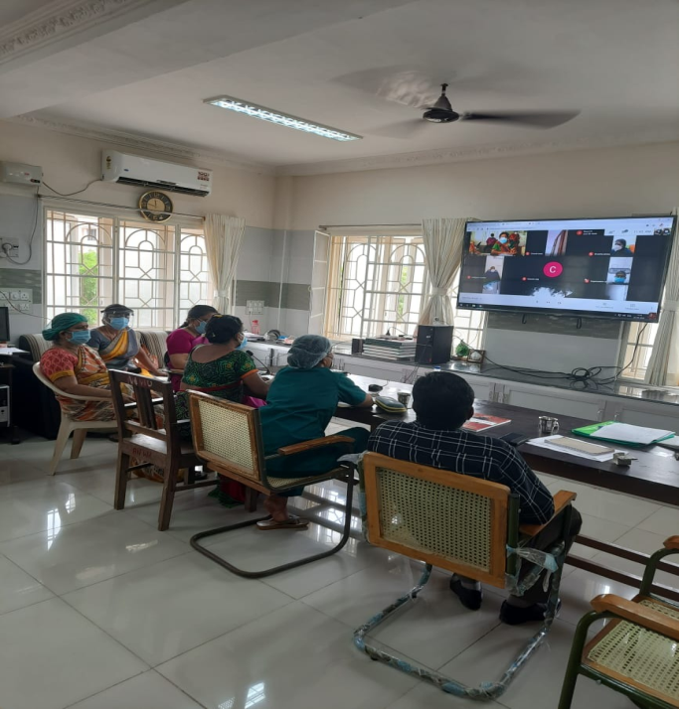

Teach, Train and Transform
Virtual Mentoring and Real Mentoring done by the designated Obstetricians.
Obstetricians were pooled into the Telemedicine – E-sanjeevaniOPD and public awareness was promoted to prevent unnecessary travel and exposure of the pregnant women.

Slide 15
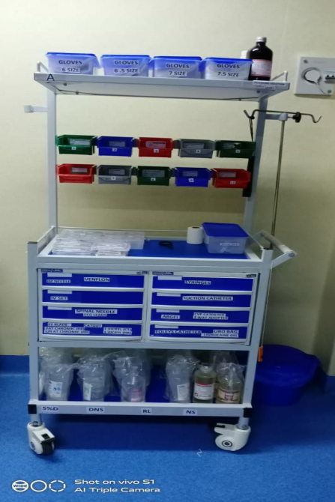
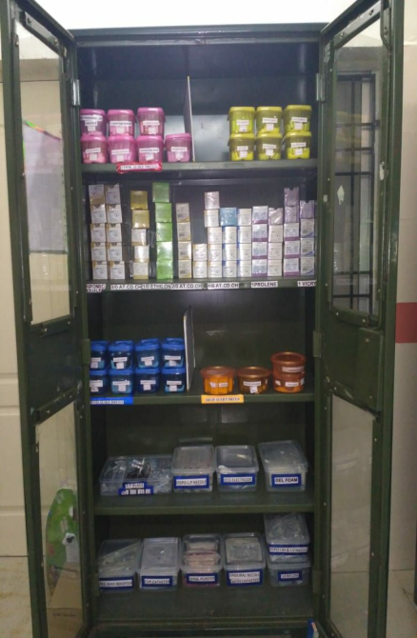
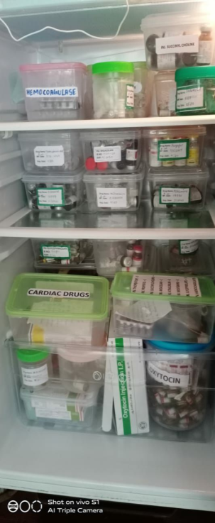
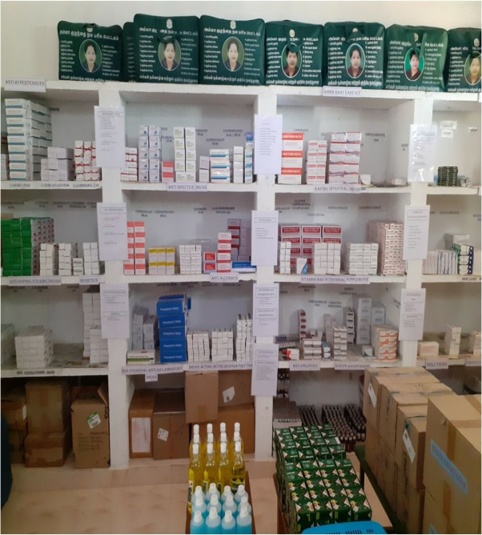
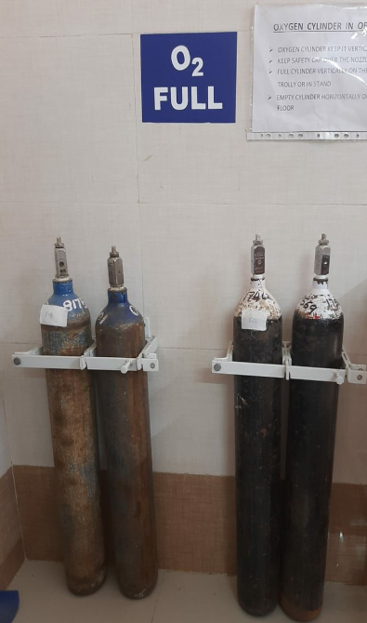
Teach, Train and Transform
Uninterrupted supply of Blood, Oxygen, Drugs , Reagents and Consumables including PPE were ensured for nil stock outs through TNMSCs / TANSACs

Slide 16
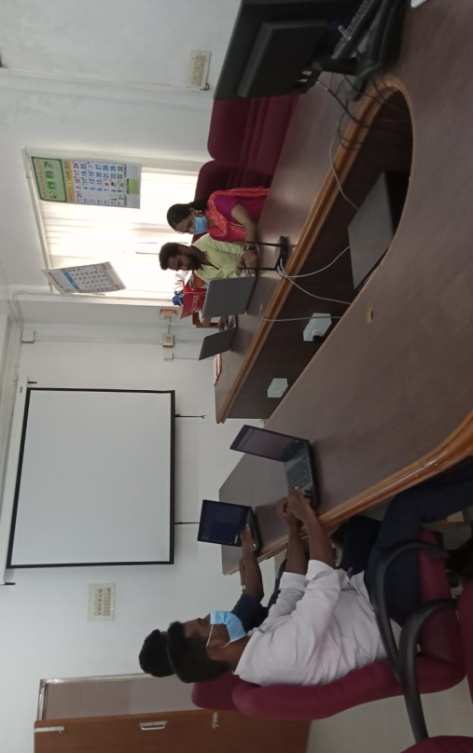
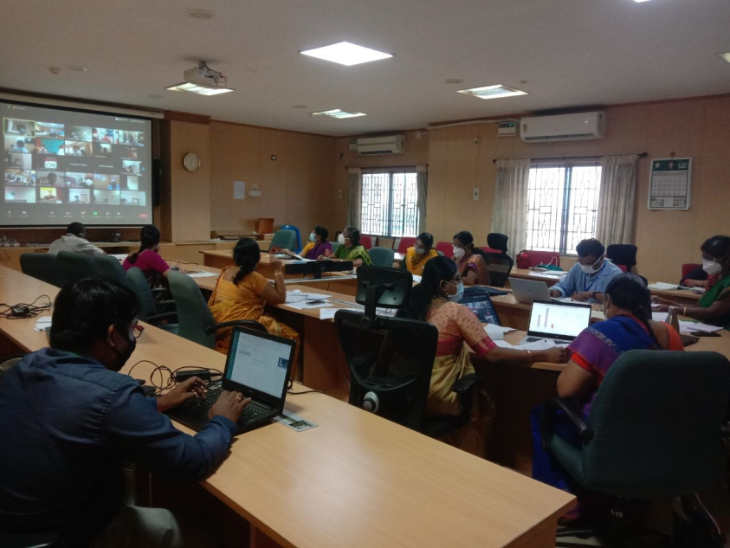
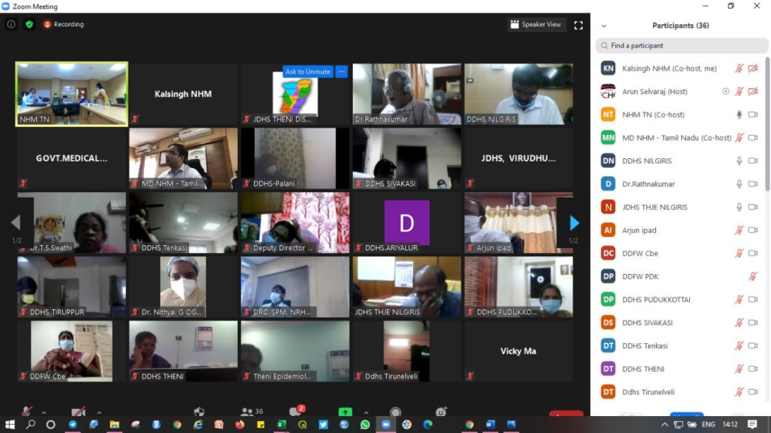
Teach, Train and Transform

Slide 17











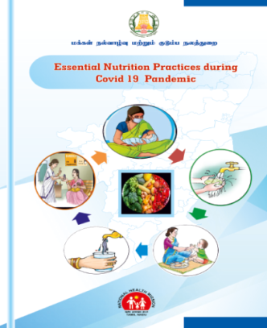
Information - Education and Communication
1. Kidney disease
on Dialysis
2. Cancer
3. Hypertension
4. Diabetes
5. Cardio Vascular Disease
6. Maternal Health
7. Child Comorbidities
9. TB /COPD / Asthma
10. HIV and Comorbidities
8. Mental Health
11. Geriatric Care
12. Nutrition

Slide 18
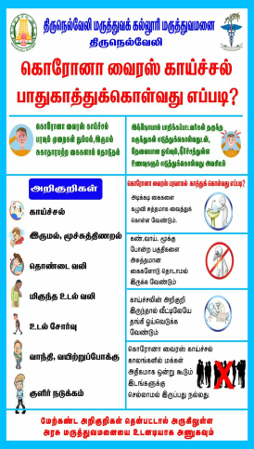
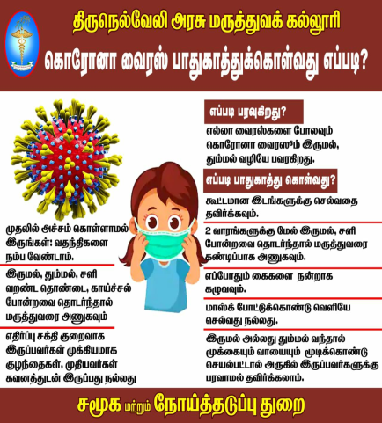

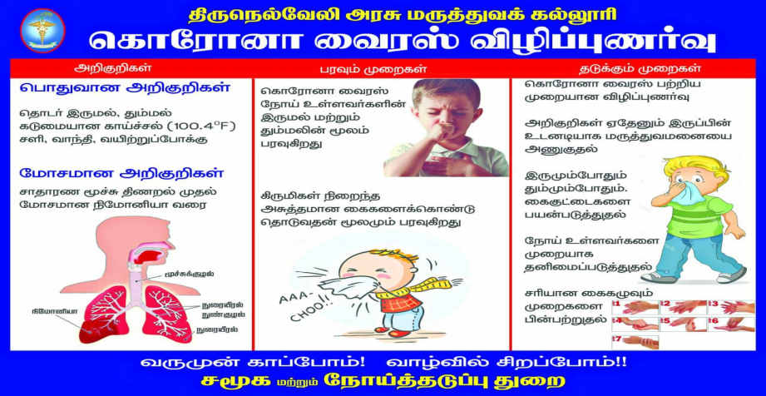

Information -Education and Communication
IEC were disseminated through print, word of mouth and social media regarding the availability of free pickup and drop back services.
COVID Designated Hospitals, availability of toll free numbers like 108 , 104 and 102 for any emergency were reinforced and displayed prominently in all Public Health Facilities.

Slide 19
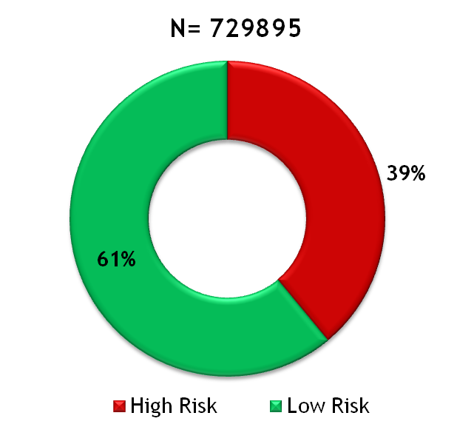

Outcome (April-2020 to Dec-2020)
281966 (39%) Mothers with High Risk factors identified out of the EDD – Expected date of delivery (N)
Out of 281966 HR mothers , 149442 (53%) Mothers with High Risk factors delivered Normally and 132525 (47%) Mothers delivered through LSCS
234 (0.08 %) Mothers with High Risk were lost

Slide 20
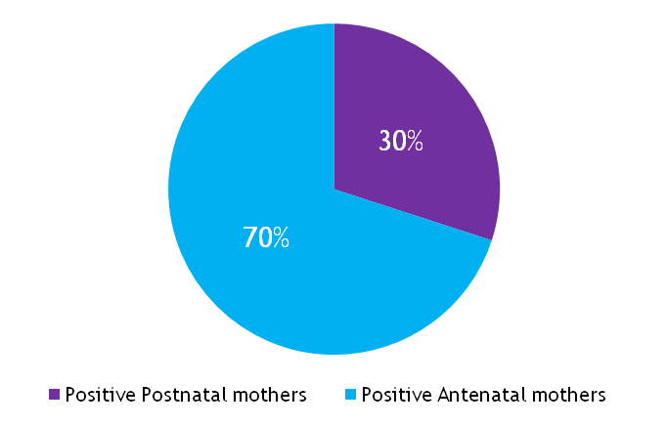
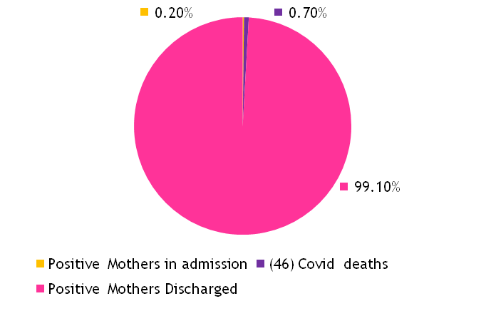
Outcome (April 2020 - December 2020)
6460 Mothers Positive for COVID as on 31st December 2020
N=6460
N=6460

Slide 21
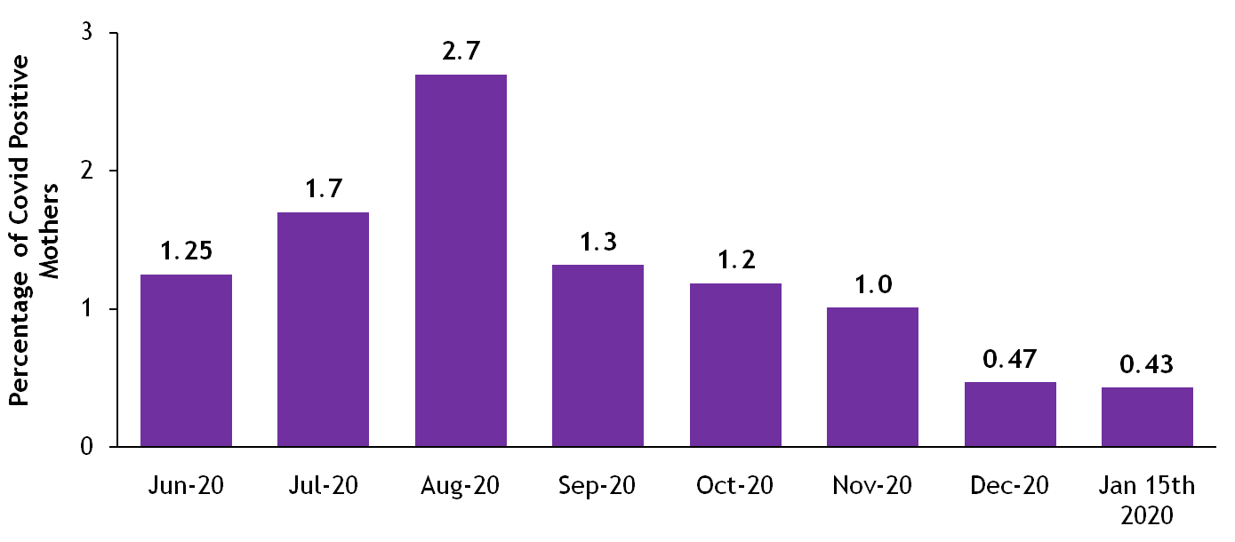
Covid Positivity Rate (%) among Mother tested
(July 2020 to Jan 2021)

Slide 22
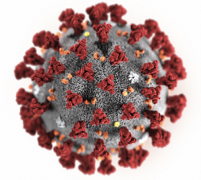


Covid-19 Positive Mothers
Total Covid Positive Mother
6460
4544 Covid Positive AN Mother
1916 Covid Positive PN Mother
31 Mothers had Abortion
0.68 %
849 mothers delivered through LSCS
44 %
1021 Mothers delivered Normally
54 %
46 mother died due to Covid
2%

Slide 23
Challenges
Creating Community awareness via multimedia platforms eg. (TV, Radio, and Social Media) on the importance of
  seeking care from skilled providers in public health facilities
  how and when to access maternity services
  use of recommended IPC practices and safe care seeking
  information about transport facilities and
Creating Public confidence
  their well being and safety are assured
  service is guaranteed with Zero Expense
  with adequate infection prevention in all public health facilities.
Strengthening of all public health facilities
  in terms of knowledge, attitude and skills
  about the quality care available with zero tolerance for denial of services

Slide 24
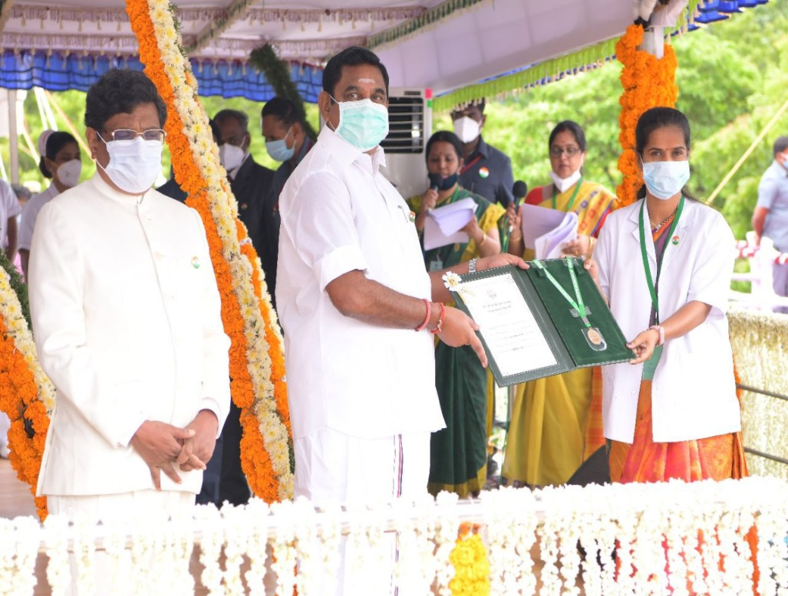
Felicitation by the Government
Dr.Uma Maheswari, Obstetrician
from Government Medical College Hospital, Virudunagar was felicitated for handling maximum number of High Risk mothers including Covid Positive Mothers during Covid Pandemic by Honble Chief Minister of Tamil Nadu

Slide 25
Summary of Lessons
Priority is workforce safety
Training in Barrier Precaution and Hygiene practices
Psychological stress and burnout of Health Care Workers is common
Provide emotional support , encouragement and appreciation
Provision of frequent updates and training
Special provision of meals to boost morale ; Laundry services for used scrubs ; comfortable quarantine stay .
Care of workers who may have medical conditions

Slide 26
THANK YOU

