Slide 1
Mera Aspataal
Gujarat experience
Dr. U B Gandhi
Assistant Director (medical services)
Health & Family Welfare Department, Gujarat

Slide 2
Overview of the presentation
Mera Aspataal Application
Roll out plan in Gujarat
Timeline and process of roll out
Current Status
Patient Feedbacks analysis
Challenges
Way Forward

Slide 3
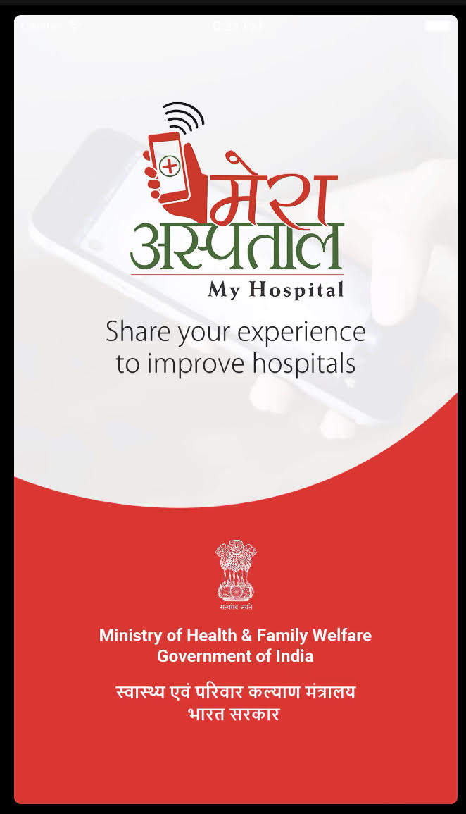
Mera Aspataal Application
MoHFW initiative to capture patient feedback
Launched in 2016
Works through SMS, Call, Mobile App or Web
Feedback compiled, analysed and disseminated to improve quality of care at public and private institutions

Slide 4










Feedback collection flow
Patient
Hospital
Registration Counter
Doctor Room
Patient
1. Entry
2. Exit
4b. Patient visits mobile app/web portal
3. Upload
Patient Data
7. Online Access/
Reporting
National
NIC Cloud
4a. Target Patient through SMS & OBD
State
6
District
5b. Patient Response (Mobile App & Web Portal)
Dashboard
Web Server
Facility
5a. Patient Response (OBD & SMS)

Slide 5
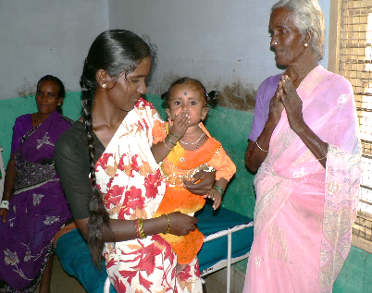



Patient feedback questionnaire outline
Greeting Message
Q0 (Overall Rating)
Very Satisfied
Satisfied
Not Satisfied
Q1 (service/s dissatisfied with)
Staff Behaviour
Cleanliness
Treatment Cost
Quality of Care
Others
Q2
Q3
Q4
Q5
Q6

Slide 6
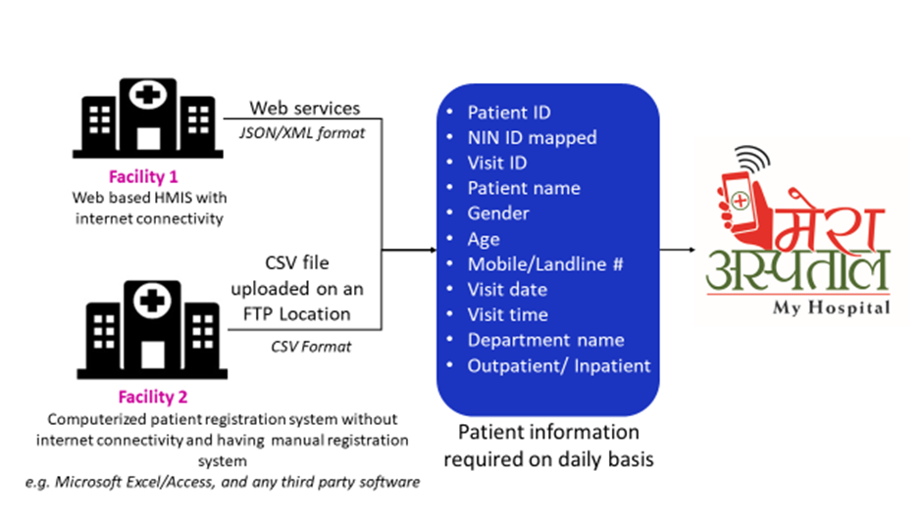
Integrating health facility with Mera Aspataal Application

Slide 7
Roll out plan of Mera Aspataal in Gujarat
Total 3029 facilities were selected for inclusion in to Mera Aspataal program.
Medical College - 20
District Hospital - 25
Sub District Hospital -36
Community Health Centre - 363
Primary Health centre -1474
UHC -321
Ayushman Bharat empanelled private hospitals -790

Slide 8
IEC Material Development in Vernacular Language

Slide 9
Timeline & process of Roll out
2016
National Launch
2016 Sept.
State level orientation
2017
Jan
Phase – I
Inclusion of MCH, DH
2017 Mar
First Feedback Received
2018 Aug
District Level Training
2018 Oct
IEC development for demand generation
2019
Jan
Phase – II
Phase – III
2019 May
AB empaneled pvt Hospital
SDH, CHC, U/PHC

Slide 10
Current status of implementation
Sr | Type of Facility | Total | Enrolled | Percentage
1 | Medical College Hospital | 20 | 20 | 100%
2 | District Hospital | 25 | 25 | 100%
3 | Sub District Hospital | 36 | 30 | 83%
4 | Community Health Centre | 363 | 267 | 74%
5 | Primary Health Centre | 1474 | 1131 | 77%
6 | Urban Primary Health Centre | 321 | 258 | 80%
7 | Ayushman Bharat Empanelled private Hospitals | 790 | 161 | 20%
 | Total | 3029 | 1892 | 63%

Slide 11
Patient Feedback
(1,43,109)

Slide 12
Satisfaction level among beneficiaries (n-1,43,109)
Other
Cost
Cleanliness

Slide 13
Challenges
Huge number of facilities to be enrolled for the program including Private health care facilities
Creation on NIN ID for private health care facilities
Limited technical resources at state and at field level and lack of dedicated staff for the program
Awareness generation among beneficiaries for feedback
Application related issues such as uploading CSV files in offline mode

Slide 14
Addressing the challenges
Dedicated training cum orientation program for DQAMO, RPCs, CPCs & DPCs
Involvement of district data manager for technical support
Efforts to generate National Identification Number (NIN) for public and private health care facilities
Empowering state IT team to lead the initiative
Weekly performance review at state level by Principal Secretary and Commissioner of Health.

Slide 15
Way forward
On Boarding of all health care facilities on Mera Aspataal
Awareness generation among patients to provide their valuable feedback
Timely feedback sharing with facility level team and monitoring corrective actions initiated
Incorporation of Mera Aspataal feedback for the private facility under Ayushman Bharat Yojana

Slide 16
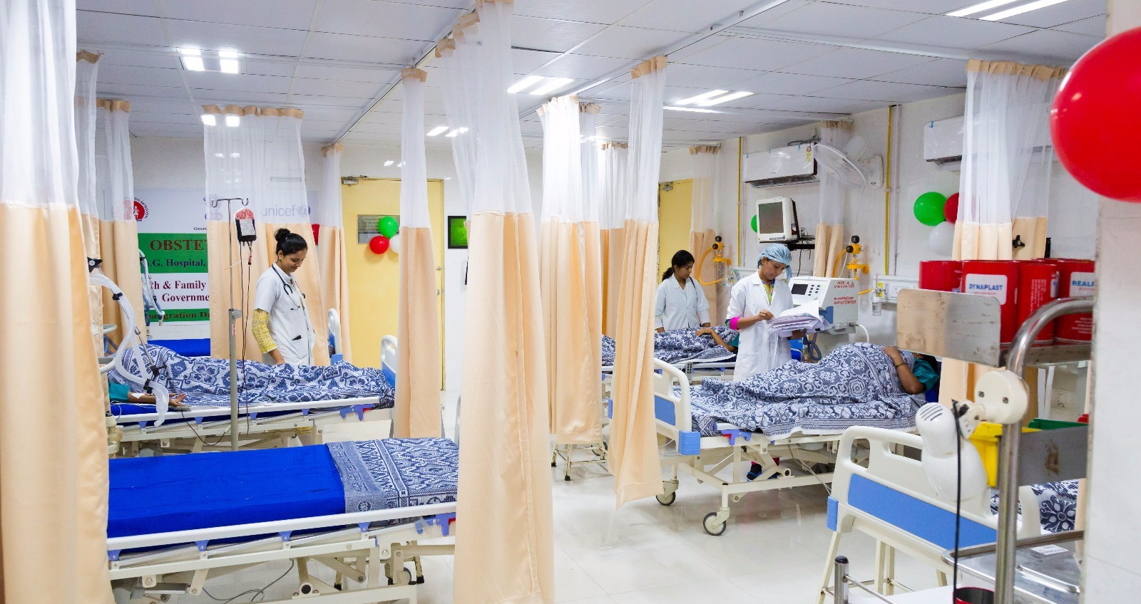
Ensuring Health and Wellbeing for all at all ages . . .

