Slide 1
Model Urban Primary Healthcare Project, Nagpur
Supported by
TATA TRUSTS
5th National Summit
Good & Replicable Practices and Innovations in Public Healthcare Systems
November 1, 2018
Kaziranga, Assam

Slide 2
Health care ecosystem in Nagpur - Supply Side
Existing structures
Required as per norms in NUHM
3
Tertiary care hospital
2 UCHC
Indoor hospital
Diagnostics
3
2
50 Urban Primary Health Center
26 Urban Primary Health Center
Allopathy dispensary
AYUSH
7
18
Corporation established in 1951
Population 25,00,000
10 Administrative zones
Layers of administrative operations

Slide 3
Problem statements

Slide 4
Possible steps

Slide 5
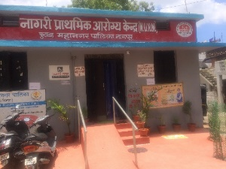
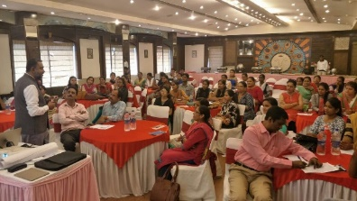
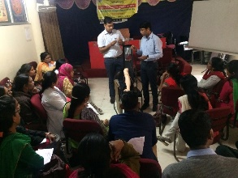
Our goals and objectives
Demonstrate “Model Urban Primary Health centre” network catering to “primary health care needs of Urban poor.”
Objective
To upgrade infrastructure of UPHCs
To use technology to provide protocol based care, create appropriate referral, supply chain and support services
To improve quality of services
Aug 18
Initiation of laboratory
Reinforcement on use of IT
July 17
Scoping study
Dec 17 MoU
Infrastructure upgradation
IT practice environment
Broad work plans identification
Facility wise appraisal on clinical and non clinical work
IT enabled systems trainings and customization
Warehouse management
June 17
Hon. CM office suggestion
Jan 18 Governing council
June 18
GoLive in 8 clinics

Slide 6
Process realignment and Quality Enhancement
Central Laboratory
Infrastructure upgradation
Model UPHC
Supply Chain Management
Capacity building
Technology Platform

Slide 7
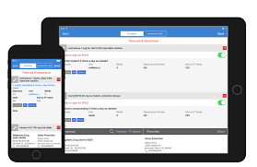
Process realignment
1
3
4
EHR
T/t protocol
ICD 10
Lab report back to EHR
1
2
Community EHR
Referral and follow up
warehouse
Unique Patient ID enabled registration & access to all UPHCs
Nationally recognized treatment protocol
Central diagnostic laboratory ®
Enhanced access to relevant and essential drugs
Targeted IEC through AV aids
Efficient Inventory Management

Slide 8
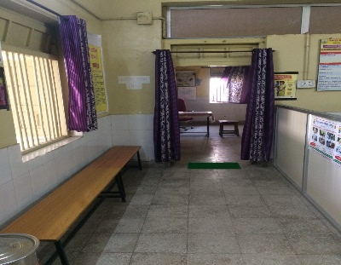
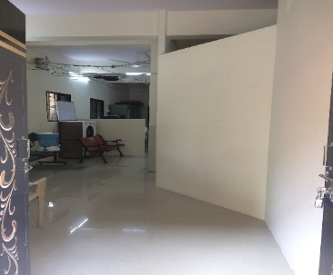
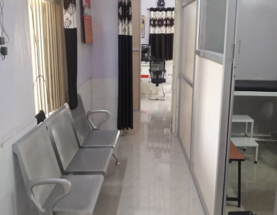
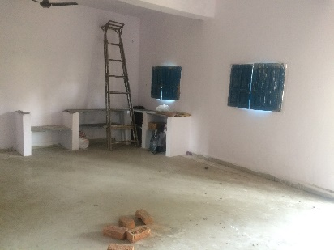
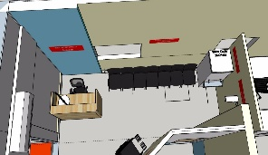
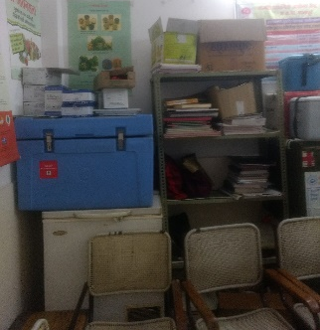
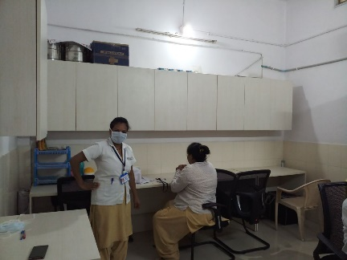
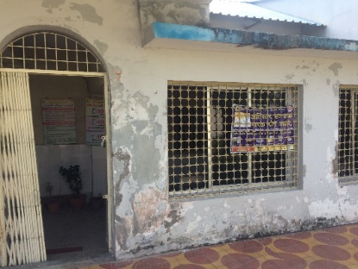
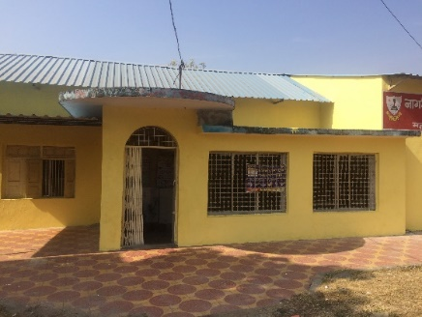
Infrastructure
2
Our approach
Use of funds for facilities
Complemented by Tata Trusts
Architect consultations
Uniformity
Results
Fast tracking momentum to NQAS and Kayakalp
Assistance to local government to gain visibility in kayakalp, NABH
Aesthetically pleasing environment for staff & patients
Standardization of signages, IEC
Efficient use of space
Better working conditions
Clean & welcoming
Why? Our outlook toward the community needed a change. Consistent services and infrastructure were the first stepping stone.

Slide 9
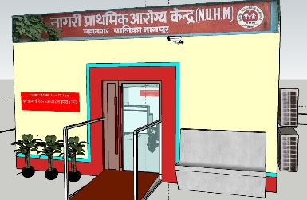
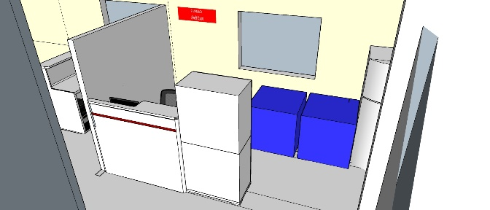
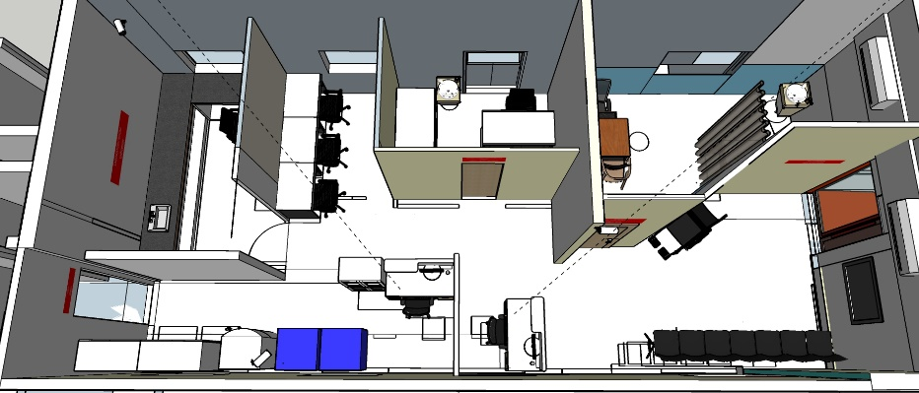
Infrastructure – how was this done?
2
Detailed technical report
Planning with architect input and teams in UPHC
Infrastructure mapping and requirement gathering
Rest of interior – Tata Trusts
BOQ for civil work – NMC
Notes:
Flow correction,
Instrument location identification,
Uniformity in color coding,
Appropriate bilingual signage’s fixed in all service stations for easy navigation of the patient’s movements within the UPHC,
Aesthetically pleasing furniture’s (this is improving the patient experience, comfort and overall satisfaction, and may even increase UPHC staff productivity.)
CCTV camera installation
LED TV installation (This LED TV is used for spreading awareness about hygiene practices, information about national health programs and others)

Slide 10
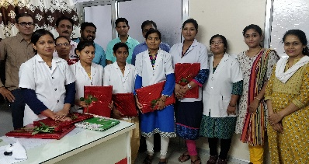
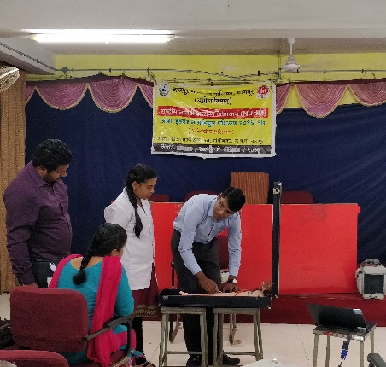
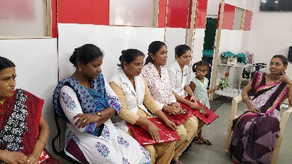
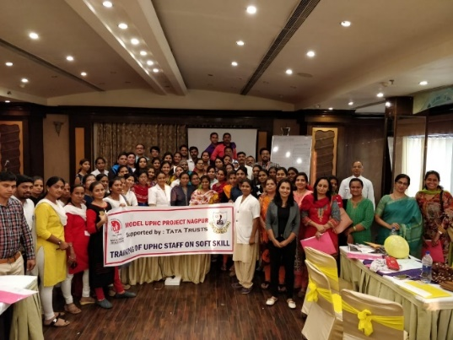
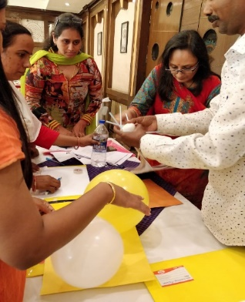
Capacity Building
3
Change Management
Using IT inputs
Our approach
Evolving models for better communications
Efforts to bring in adherence to protocol
Need based trainings for layering in other activities
Results
Early signs of behavior change
staff compliance on quality guidelines and quality practices
Soft skills
Clinical protocol
Laboratory trainings
International Nurse Day celebration
Training of laboratory technicians on phlebotomy techniques
Quality assurance
Data Analytics
State NHM inputs
Training of UPHC staff on soft skill
Continued connect
NUHM competence matrix
What else? It has started elevating the motivation level. Structured methods to understand this are underway.

Slide 11
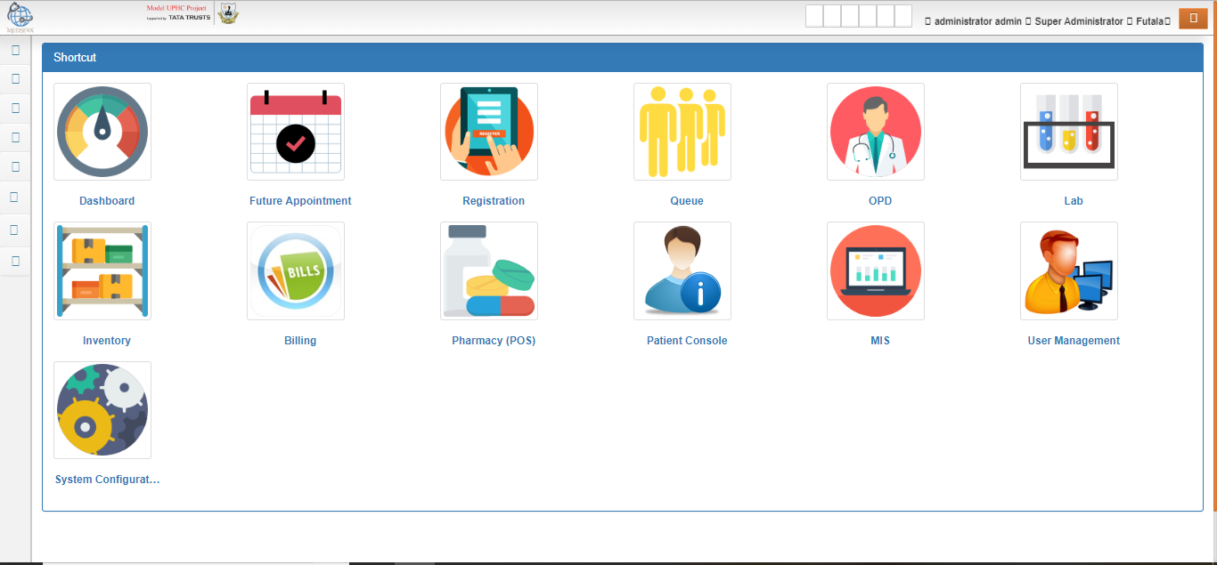
IT platform / E.H.R.
4
Our approach
Use of nimble and user friendly application
Co-develop the configuration with clinical teams for better ownership
Results
Substantial compliance (60 %) by all 8 UPHC team
Data / Line report of more than 32000 patients available to administration for scrutiny
Slow yet steady movement towards paperless clinics
Single platform for clinical, laboratory, inventory and administrative purposes
Why? Our outlook toward the community needed a change. Consistent services and infrastructure were the first stepping stone.

Slide 12
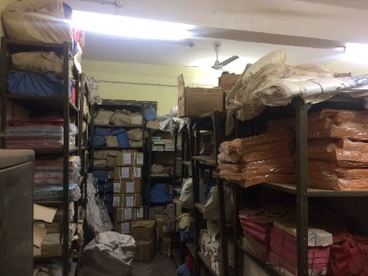
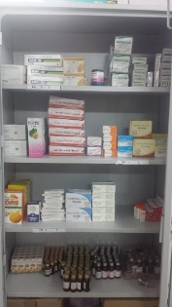
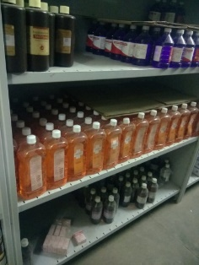
Supply chain management
4
Good store practices
Our approach
Online indenting and supply tracking
Training on use of basic guidelines
Upgradation of warehouse and measure to protect inventory
Results
Implemented : standard drug storage guidelines
Digitization / web based : indenting + inventory management + transfer through single platform
Pharmacy in UPHC monitored
Hand holding
Hardware and training
Real time inventory status tracking
Basic inputs of contemporary racks
NMC – civil work
Tata Trusts – IT and interiors

Slide 13
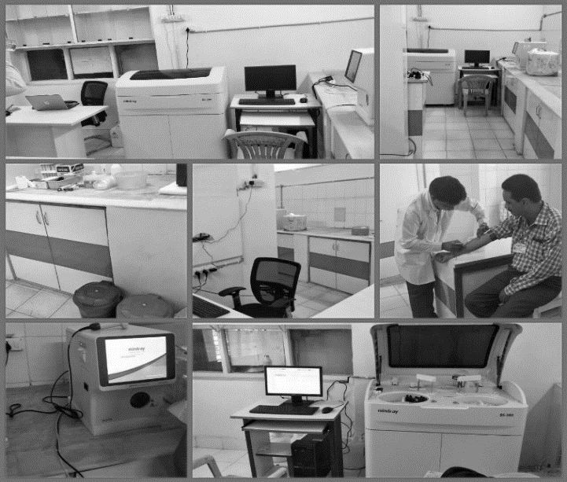
Central laboratory
5
Our approach
Hub and Spoke Model for operations
Reagent rental model for cost containing
Results
Availability of high frequency diagnostics in primary set up
TAT of 48 hours targeted – 24 hours
Good models for biochemistry and hematology investigations
Why? Our outlook toward the community needed a change. Consistent services and infrastructure were the first stepping stone.

Slide 14
Quality Assurance with NHM
SOP for all major process
5 S training to all staff
Appreciation & recognition of good performing UPHC staff in quarterly review meeting in presence of Additional NMC commissioner.
SOP and guidelines of procedures have been prepared
Infrastructure and process realignment is done according to NQAS, KAYAKALP and NABH guidelines
Biomedical waste management contract of each UPHC with “Super hygiene” agency
Quarterly pest control activity in UPHCs
Compulsory immunization of staff to prevent from hospital induced infection
On monthly basis feedback from patients is collected and analysed to improve quality continuously
Demarcated breast feeding corner
Promotion of hand hygiene, sanitation and hospital upkeep
Labelling of racks and proper drug storage centrally as well as each UPHC level
Area mapping of UPHC on google map
Internal assessment: 4 UPHCs scored more than 70% and nominated for state level external assessment

Slide 15
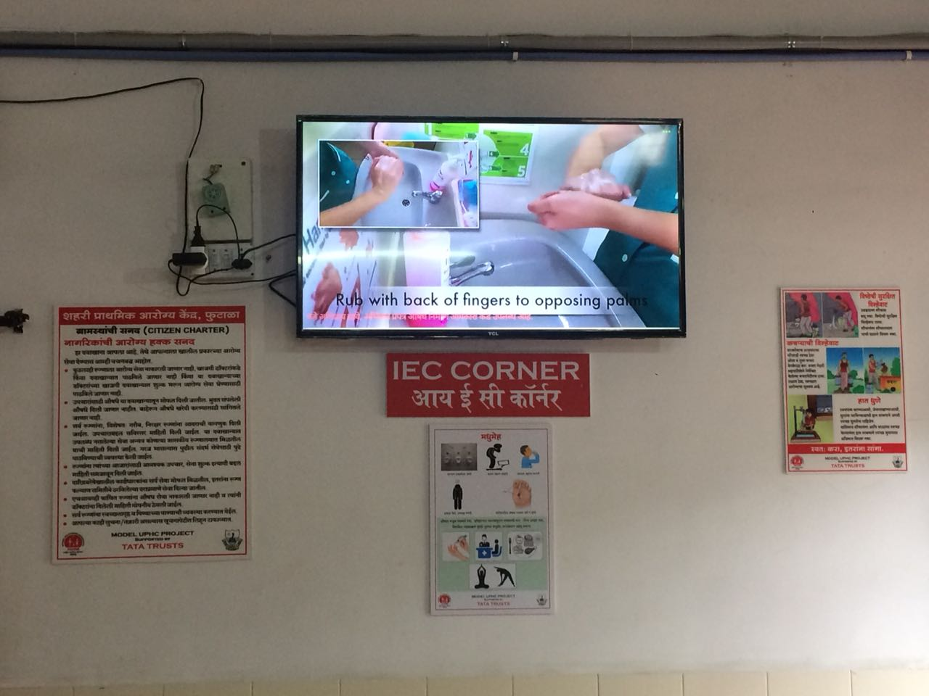
Photos
Digital Signage
Rs. 30,000 capital cost
Rs. 500 annual subscription
Results
Targeted IEC possible
Content push from the central location
Way ahead
Understand its effectiveness through feedback
Could get free on open source

Slide 16
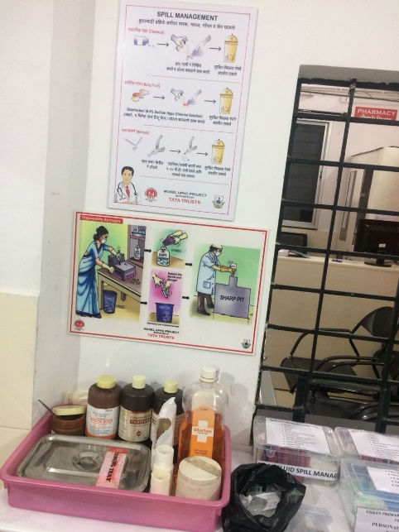
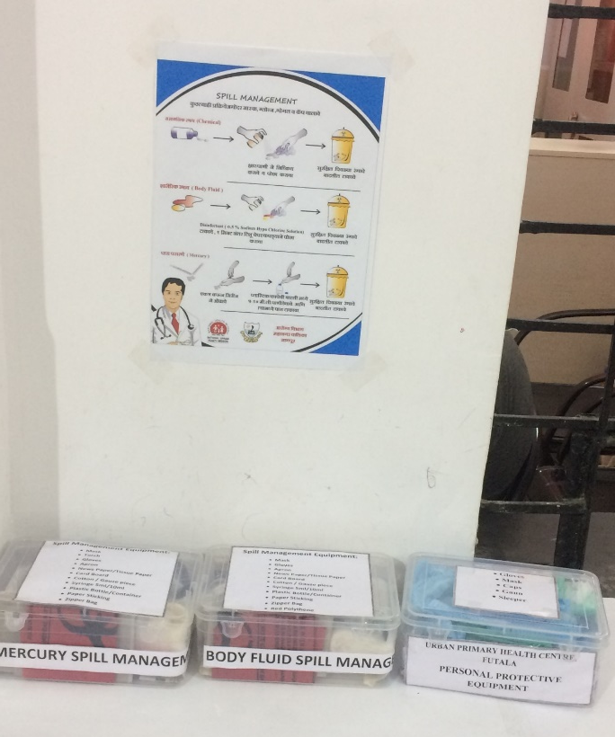
Photos
Protocols
Amongst several protocol
Spill management

Slide 17
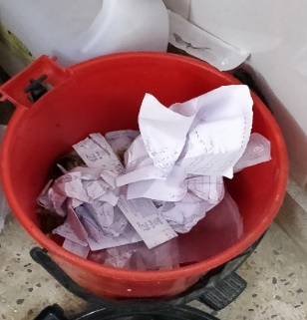
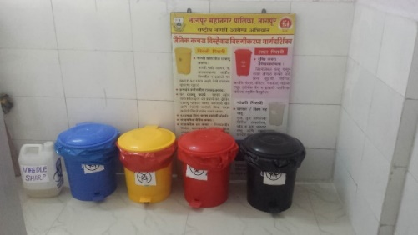
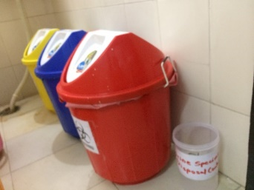
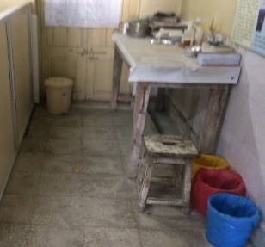
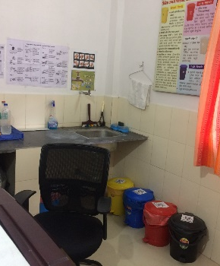
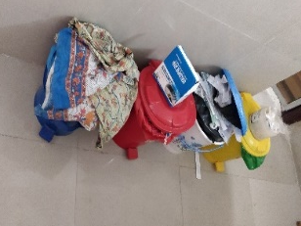
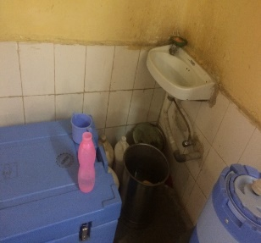
Photos
Simple activation of routine guidelines
BMW streamlining from UPHC level to contractor
Hand wash stations

Slide 18
Trend of average footfall per day per UPHC
Average footfall increased by 75% & availability of doctor in OPD hours increased by 85% in all 8 UPHCs (compare with June 18 & Sep 18 figures).
Shantinagar & Futala UPHC per day average footfall is above 60 for Sep 2018
Indora & Futala per day average footfall is above 50
Except Kapilnagar & Diptisignal, all other UPHCs average footfall is above 40
Average footfall per day per UPHC has increased from 26 to 46, if we compare last four month trend

Slide 19
PROJECT SUSTAINABILITY, EXIT POLICY AND REPLICATION
Project Implementation shifting to PMU (Project Management Unit) of Nagpur Corporation, activities will be sustained by the NMC & NUHM city program management team.
How we will ensure quality practices in long run ? Regular prescription audits, patient satisfaction index
These interventions in Model UPHC Project will bring about a positive behavioural change in care providers. Service during engagement will be uninterrupted, available, credible & desirable.
Involvement of community leaders including Corporation elected body. This is expected to give a positive change in attitude & behaviour of care providers, along with focus of the government/ administration towards patient centric services.
Over the period of time, confidence will be build among the citizens, with appropriate & timely referrals, citizens will get improved access to high level of care, if required.
As a result of above actions, not only citizen, but also the care providers of Nagpur city will demand continuation of same high standards of primary health care services.

Slide 20
Way Forward
At each UPHC level:
Community Based survey
ARSH clinic
Breast feeding corner
Telemedicine (all UPHC work as spoke and NUHM City Program Management Unit will work as Hub)
ASHA & MAS involvement for increase in utilisation of UPHC services
Develop UPHC as TB centre by increasing number of DMC

Slide 21
Supplementary slides

Slide 22
CENTRAL LABORATORY ®
Distribution of current sample load
Overview of data
 | Aug-18 | Sep-18 | Total
Number of Direct beneficiaries | 875 | 1117 | 1992
Number of Revenue generated through central Laboratory | 45315 | 76270 | 121585
Number of tests performed at central laboratory | 994 | 1771 | 2765
Total Number of sample received in Central laboratory is 2765
CBC is the highly availed service from Central Lab
Sugar test comprises of 22 percent of total
43 percentage of tests are of Biochemistry and 57 belongs to Haematology
Biochemistry Analyser and services are under utilised
Notes:
Signage >> visibility
Interior >> Tata Ethos
Housekeeping >> hygiene
External >> visibility

Slide 23
Trend of average footfall per day per UPHC
Total 24973 patients were registered till Sep 2018
Total 7808 patients were registered in Sep 18.
Compare with Aug, 8 % increase in patient count in Sep 18.
More than 1000 footfall recorded in a month of Sep in Indora, Zingabai Takli & Futala.
Out of total 8 UPHCs – Kapilnagar UPHC has recorded comparatively less footfall.

Slide 24
Age wise distribution of patients
Out of total patients registered 20% patients are in age group of 19 to 30 years and followed by 18% patients are in age group of 31 to 45 years, 15% patients are in age group of 45 to 60 years age group.

Slide 25
Gender wise distribution of patients Trend of New & Follow up consultation
Out of total registered patients 56% are female and 44% are male.
Majority of consultation were new consultation. This is system biased figures- at the time registration if staff clicked on first visit though patient has came on follow up visit then EMR data will capture as new visit

Slide 26
Top 5 Diseases
ICD Code 10 | Description | Number of cases | % out of total case sheet filled (n=6402)
J06.9 | Acute upper respiratory infection, unspecified | 2840 | 44
M79.1 | Myalgia | 802 | 13
B34.9 | Common viral fever | 641 | 10
K52.9 | Acute Gastro Enteritis | 310 | 5
K29.0 | Acute gastritis | 186 | 3
44% patients diagnosed with Acute Upper respiratory tract infection
Currently NCDs patients are not visiting UPHC because of unavailability of Anti Diabetic & Anti Hypertensive medicine

Slide 27
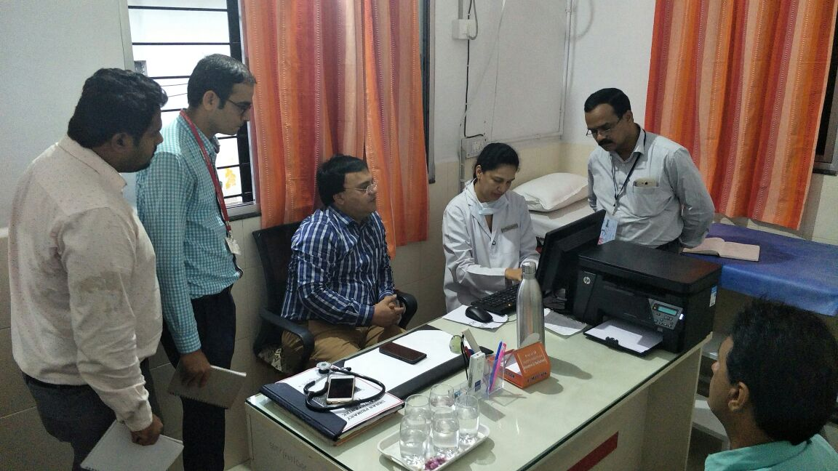
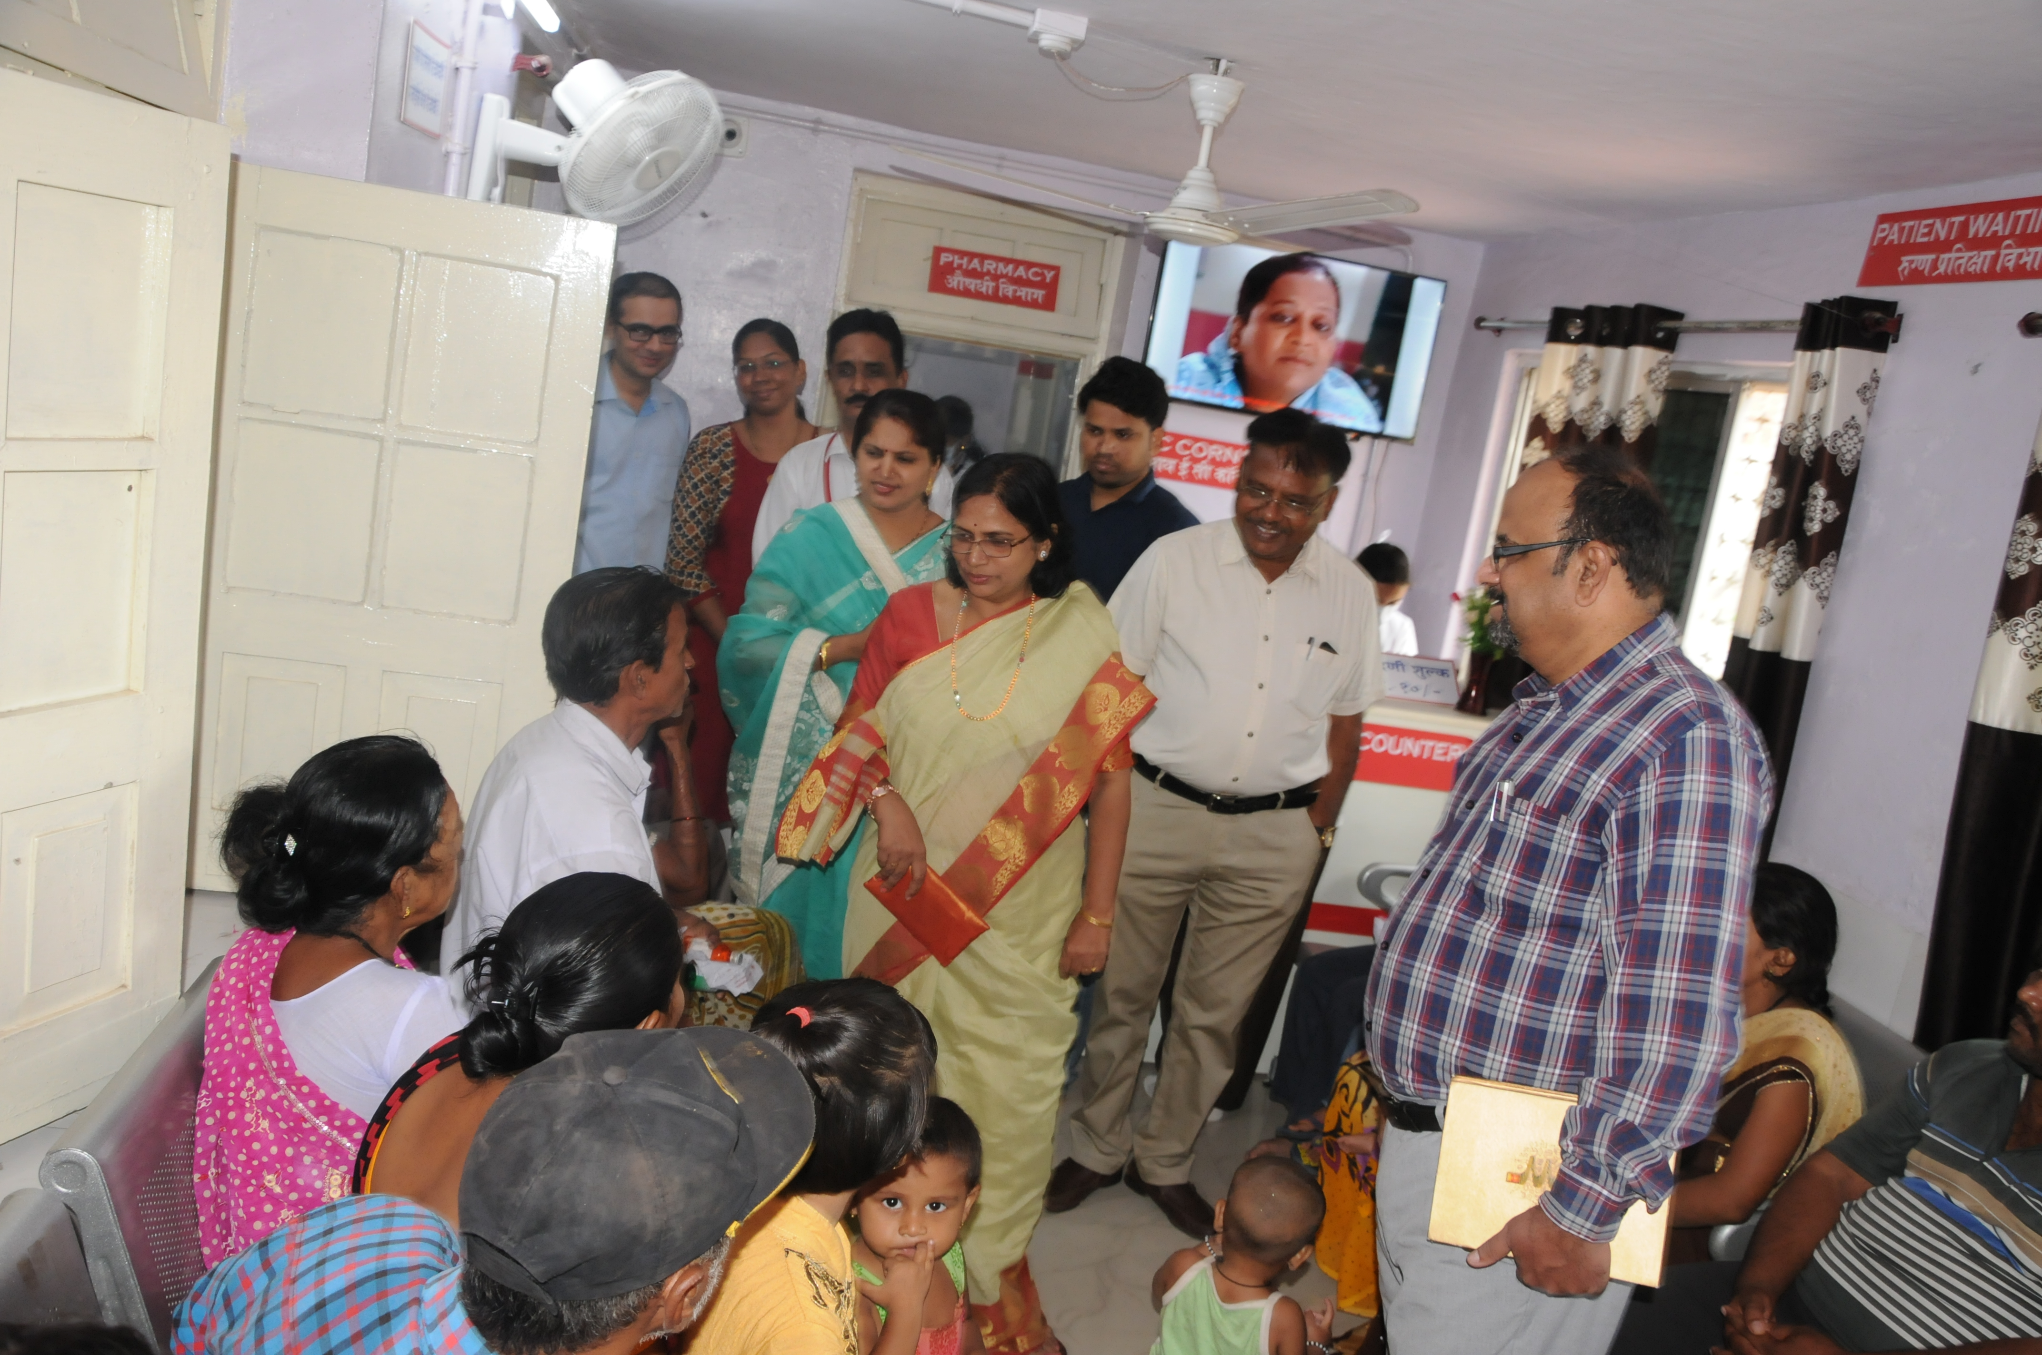
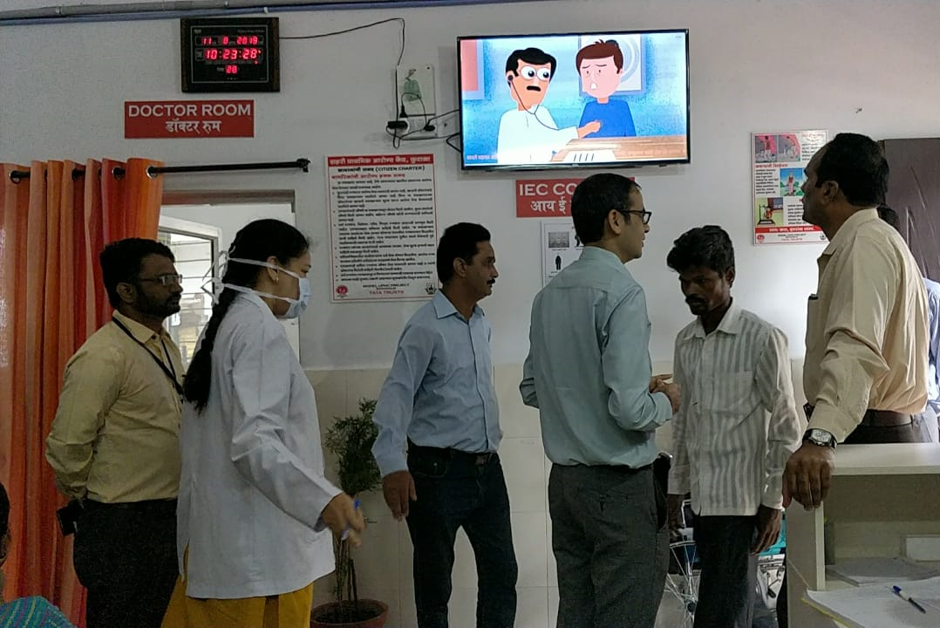
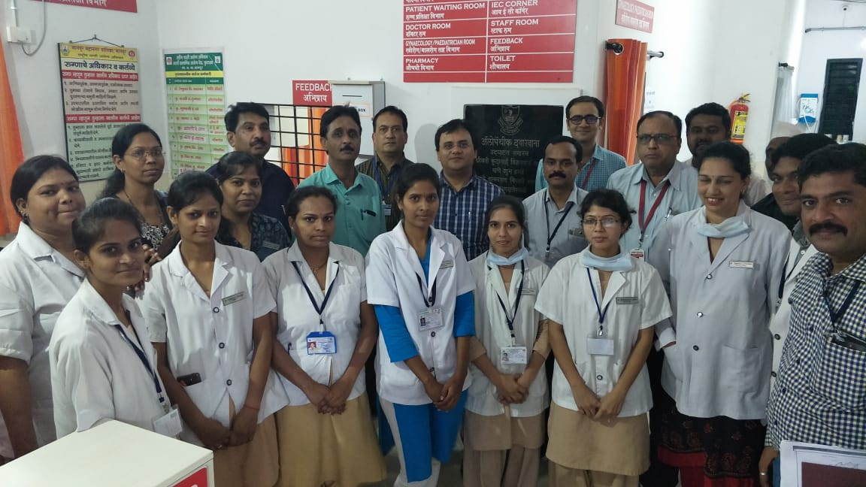
Glimpse of Dignitaries visit to UPHCs
Honourable NMC Mayor visited Indora UPHC and interacted with patients
Honourable Commissioner & MD NHM visited Futala UPHC and PMU team has given him detailed overview about work done
Honourable NMC Commissioner visited Futala UPHC and PMU team has given him detailed overview about work done

