Slide 1

NIPAH..
A story from Kerala
…..Team Kerala

Slide 2


Slide 3
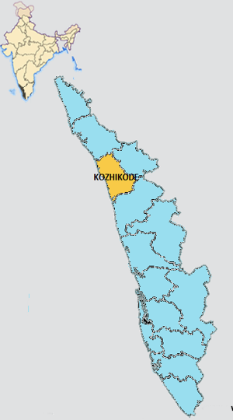




KOZHIKODE DISTRICT
Population
3,089,543

Slide 4


The alert : May 17th 2018
Two sources
MLA
Treating physician
District and State Health Authorities

Slide 5

Verification
17 May 2018: District Medical Officer verified
One world one health: Veterinary
Forest
Entomology
18 May 2018: Laborotary confirms Nipah Virus
Confirmation

Slide 6
Public Health Response
immediate ,intermediate and extended
18 May 2018 – State and District public health services in action
  Responsibilities assigned
  Oversight committee formed
  Monitoring and control measures
  Established contact tracing
19 May 2018 -9pm – Hon. Health Minister of Kerala reviews the situation on site and address people through media

Slide 7
20 May 2018: 19:43 hrs
National Institute of Virology, Pune-reconfirms
Official declaration
Nipah outbreak

Slide 8
Public Health Response immediate
Emergency operation Centre (EOC/ Control room) – NIPAH CELL
Director of Health Services posted as incident commander
Multidisciplinary approach – District administration
21 May 2018
Central team arrives to
support outbreak management

Slide 9
EOC (NIPAH Cell) Activities
Single window system
Infrastructure & Logistics management
Training of Health Care workers
Case definition & Management Protocols
Transportation and Funeral guidelines
Contact tracing & Home Quarantine
Call centre for public
Daily Activity review and Press release
Other important activities

Slide 10
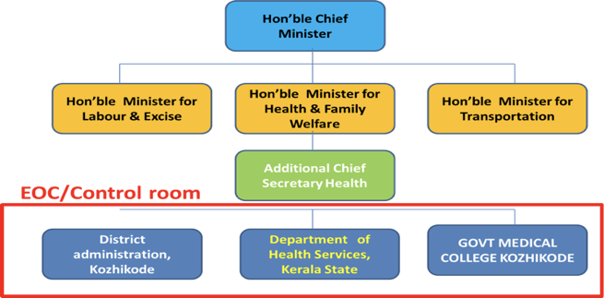
Mission Director

Slide 11
Infrastructure & Logistics management
Isolation facility in tertiary care hospital
Transformed a block with 100 rooms into isolation facility
Three floors to three levels

Slide 12
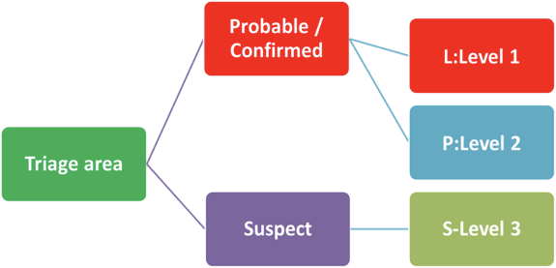
ISOLATION FACILITY

Slide 13

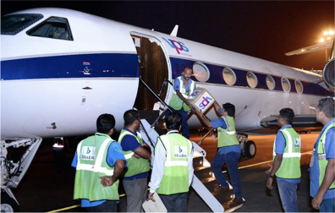
LOGISTICS
N95 masks , PPE s and other essential equipments made available through public and private sector participation.

Slide 14
Enhanced laboratory
supported surveillance
Established enhanced lab supported surveillance of
Acute Encephalitis cases
Severe Acute respiratory Infection (SARI)
Acute Respiratory Distress ARDS) cases
MCVR supports
Sample collection,packing and transportation guidelines finalised
Report within 24 hours

Slide 15

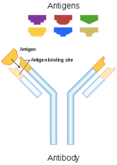
Drug management
M 102.4

Slide 16
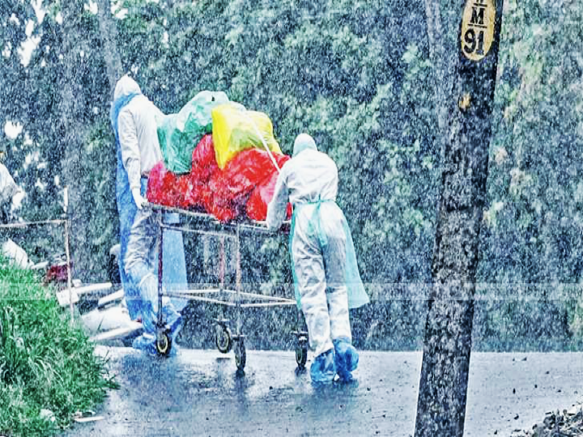
Waste
Disposal

Slide 17
Trainings and
sensitisations
Continuous process
All health staff in private and public system in the district
Professional organisations
Policy makers
Media persons

Slide 18
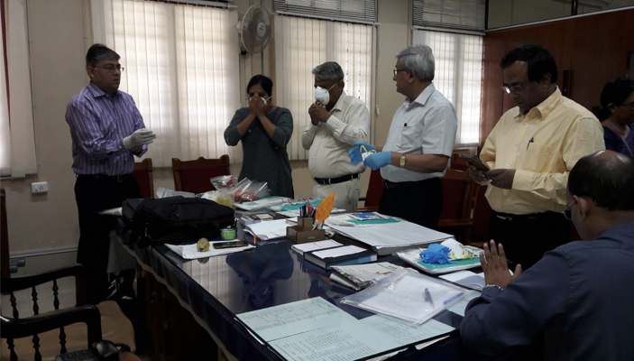
Training of Health Care workers

Slide 19
Case definition &
Management Protocols
Ebola protocols
Modified
Finalised and circulated

Slide 20
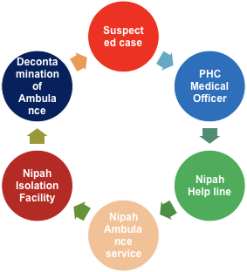
Transportation
guidelines

Slide 21
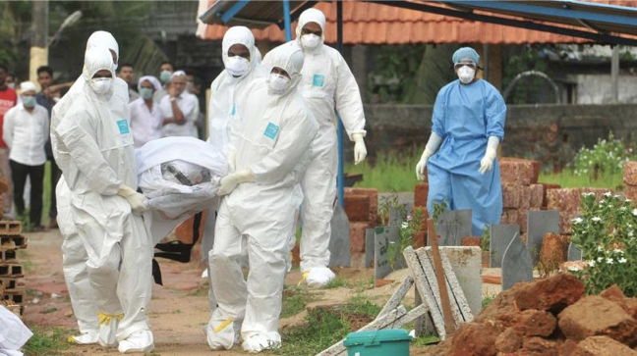
Funeral protocols

Slide 22
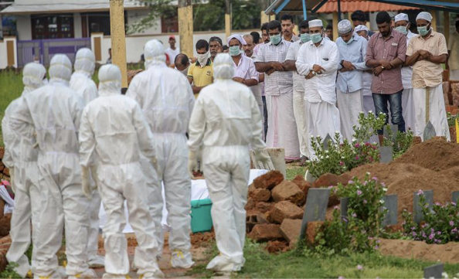

Slide 23
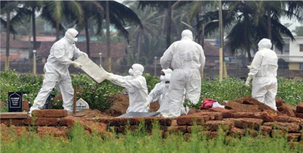
Safe Burial Practices
Sensitive to cultural practices
Cremation (Burning)
Deep burial

Slide 24

Contact tracing & Home Quarantine

Slide 25
Enhanced contact tracing
Preparation of extended contact list
Asymptomatic contacts advised home quarantine for 21 days
Health status checked through daily phone calls / field staff
Call centre for public
Symptomatic contacts transferred to isolation facility

Slide 26
Number of contacts under surveillance

Slide 27
Type of contacts under surveillance

Slide 28
Daily Activity review and Press release
Risk communication activities-JIC
Chaired by Hon’ble Ministers / ACS/SMD/DHS / District Collector
- Attended by State and Central team
Objective review- 12 parameters with predefined format.
Review of other major challenges faced and formulate action plans
Daily press briefing and bulletins-STARCC principle

Slide 29
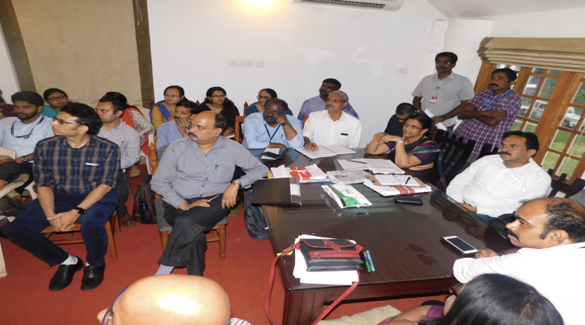
Daily review meeting

Slide 30
Social Media Management
Daily monitoring
Countering misinformation campaign
25 cases were registered and 10 persons arrested
Used to disseminate health department authorized IEC

Slide 31
Extended activities
Mental Health support
Public support system
Research activities
- Sero surveillance
- Case control

Slide 32
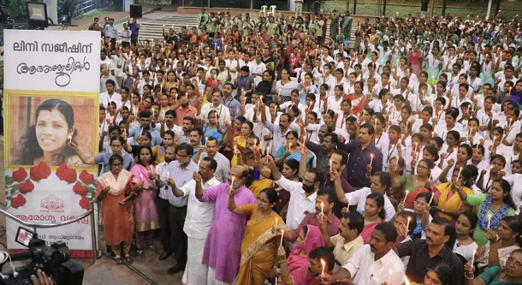
We lost our dear colleague to the deadly virus

Slide 33
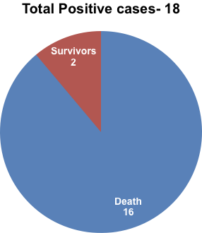
Total NIPAH cases
& their Outcome

Slide 34
Conclusion
Prompt public health action
Strong political and administrative commitment
Excellent team work by District administration & Health department
National level support
Private Participation
Planning, Coordination and Action
Continued follow up and vigilance

Slide 35
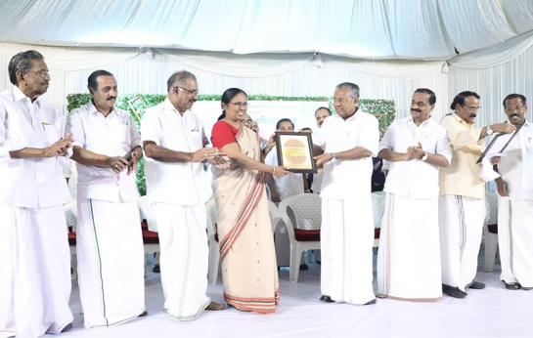
July 1 st 2018 End of Nipah Outbreak

Slide 36

…Thank you

