Slide 1
NATIONAL LEPROSY ERADICATION PROGRAMME-MADHYA PRADESH
“TRIALOGUE”
Nurturing Community Participation
Dr K.L.Bhandarkar

Slide 2
What is Trialogue
Trialogue is a social action strategy based on mutual respect, trust and sharing
Key stake holders – Patient, Provider and People.
Aims at changing community attitude and behavior
Initiates active participation of the 3 Ps.

Slide 3
THE CONCEPT
Patient /
Person
LEPROSY
Social &
Public Health
PROBLEM
Providers of Health Services
People Around Having Concern

Slide 4
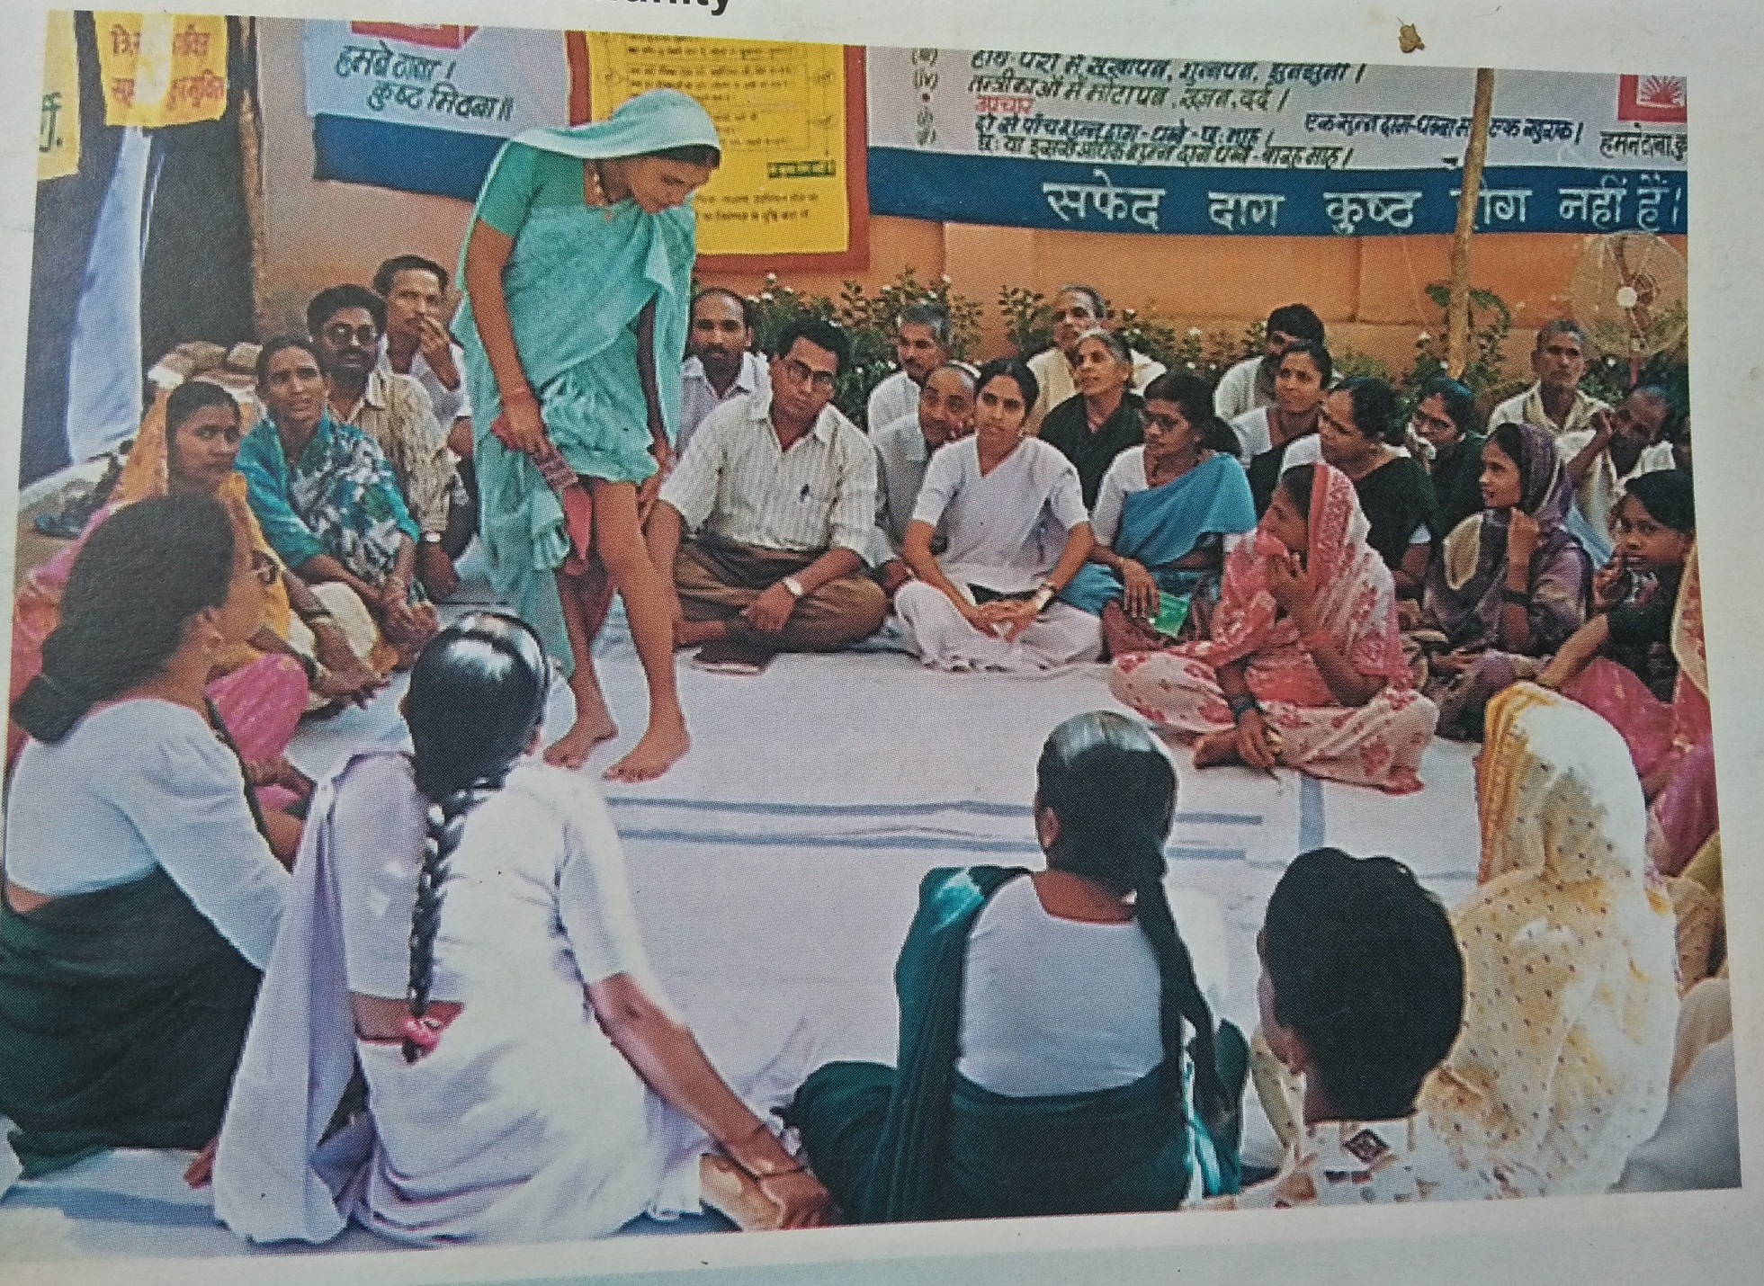

Slide 5
Problem Statement
Refusal to the accept the diagnosis.
Gender discrimination
Behaviour and Attitude of community towards the affected person.

Slide 6
ISSUES ADDRESSED
Medical :-
    About its cure, change in status of disease and reaction
Social
    Myths,Misconception, Stigma, Discrimination
Economical
    Inability to perform work
    Losing job
    Responsibility of the family
Psychological
    Feels discarded
    Inability to perform normal pursuits
    Marriage/divorce

Slide 7
ACTIVITIES IN 2016-17
Total camps organized - 129
Affected persons participated - 3323
PRI Members - 170
Service providers – 440
Organization involved – Gayatri Mission, Rotary & Lions club, Scout and Guide, Local NGOs, Local TV channels & LEPRA society

Slide 8
ACTIVITIES IN 2016-17 cont..
Stakeholders | No. of participants
Persons affected by Leprosy | 3323
PRI members | 170
Service Providers | 440

Slide 9
METHODOLOGY
“Mixed Group Residential Care and Concern Camp”
Open Discussion on medico-social and psychological dimensions

Slide 10
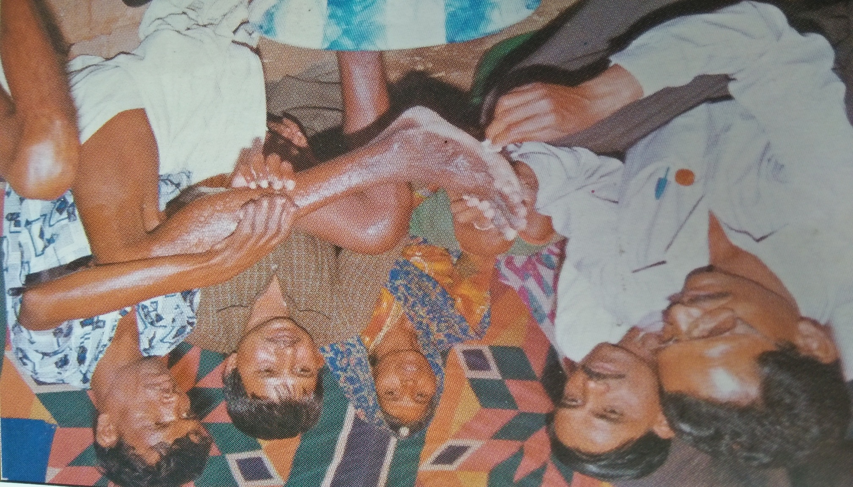
Mixed group residential care and concern camp
(Khargone- December 2016)

Slide 11
OUTCOME
Removal of perceived fear of infectivity
De-mystification of diseases
De-stigmatization of leprosy
Powerful way of spreading message of “sure-cure”
Promotion of Community based rehabilitation and Prevention of De-habilitation.
Community witnesses and participants learn self care procedure.
Openness for diagnosis and treatment

Slide 12
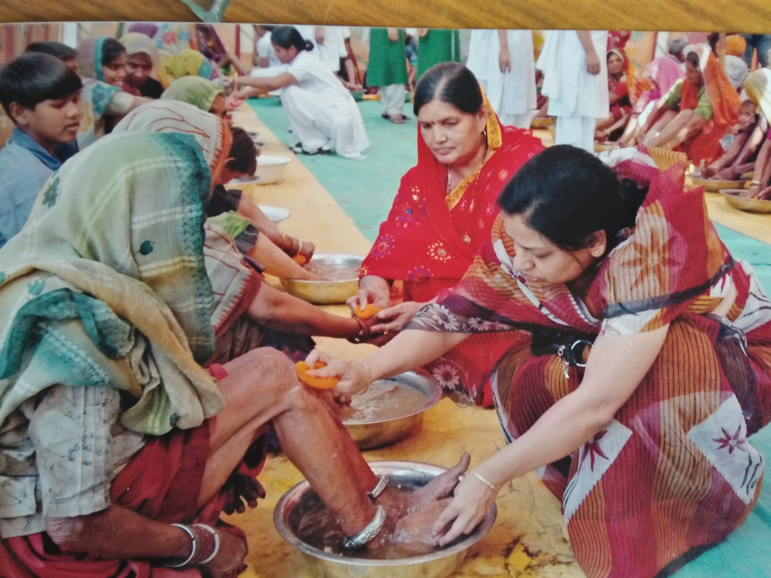
Chairman District Zila Panchayat, District Jabalpur

Slide 13
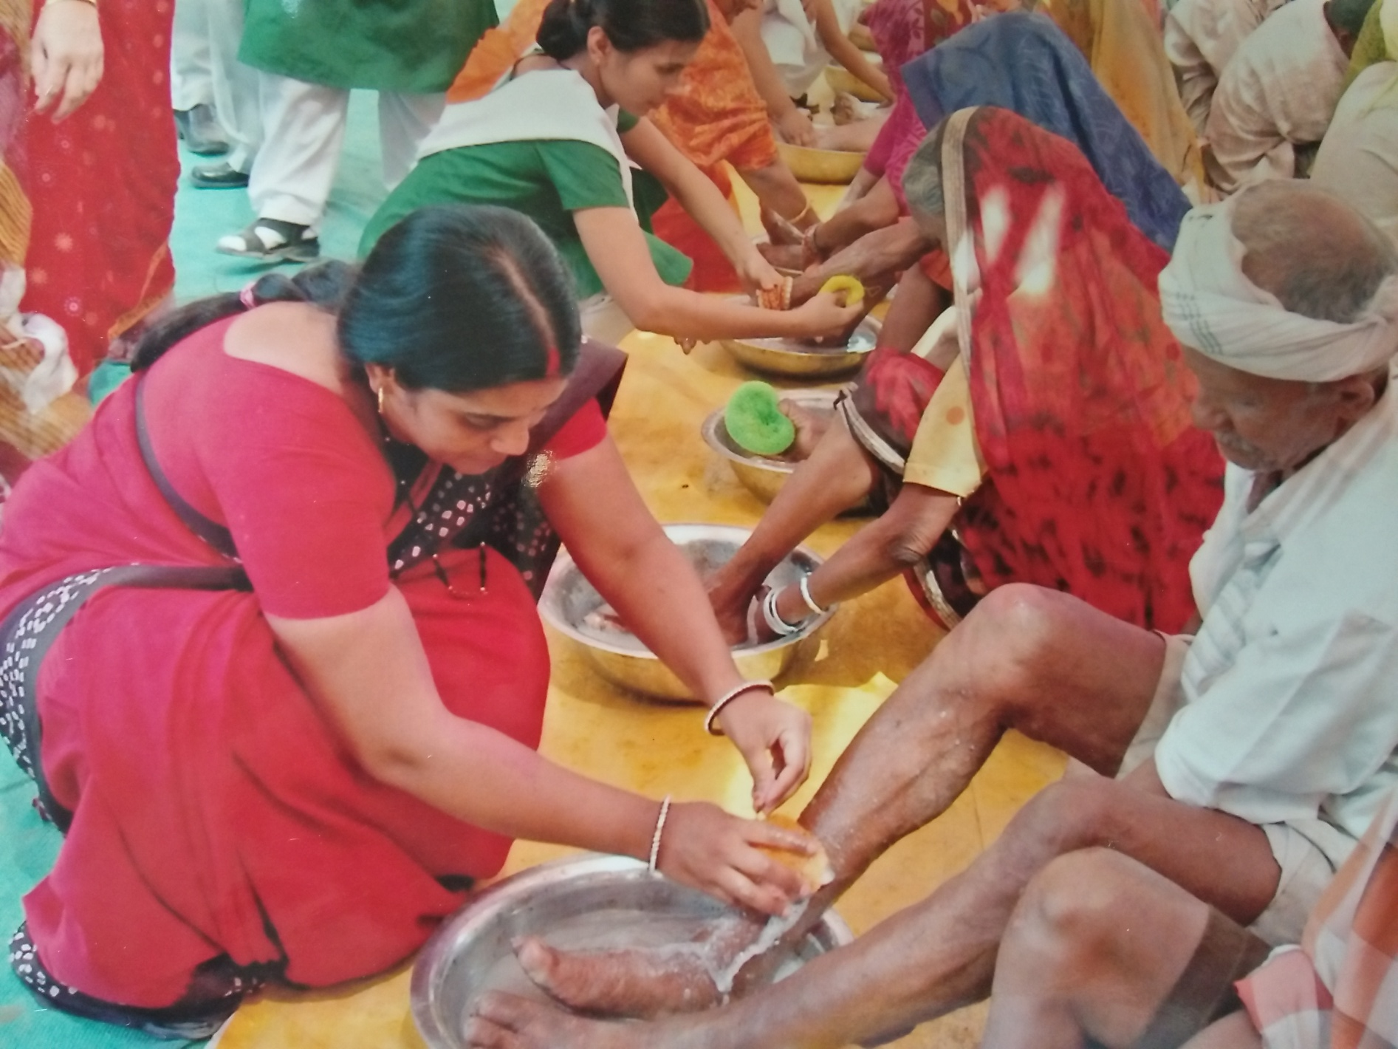
Chairman Rotary Club, District Jabalpur

Slide 14
FEW SUCCESS STORIES
Asha Sharma from Chichli, Narsinghpur Prevented from committing suicide
Radha Bai from Sendhwa in Barwani district was return back to her husband’s home
Leprosy colony in Sehore district was closed down
Ayurvedic doctor started daily dressing of his mother in Omkareshwar, Khandwa district
Additional Collector of Khargone district sat with Leprosy affected and took her lunch
Collector of Indore himself dressed a foul smelling ulcer
Professor and Head of the department of Orthopedics operated Leprosy deformity in his major O.T after counseling.

Slide 15
FEW SUCCESS STORIES cont..
CMHO of Chhindwara allow to carry out RCS camp in his major O.T. after trialogue
A meeting for establishing leprosy colony in Shajapur was turned down after trialogue
In Khethia village Barwani district the community refused for opening a new leprosy colony
Holy (the festival of colours) was organized at Kaloo Baba’s (case with deformity & ulcer) home after trialogue
Principal Secretary, Commissioner health and Director Health after a meeting at Leprosy colony Bhopal got sensitized after looking at the sufferings of Leprosy affected and added additional activity in the State Annual Action Plan for 2013-14

Slide 16
Trialogue
Aims to establish leprosy as a
common ailment
“THE REAL GOAL”
Thanks

