Slide 1



7th National Summit on “Good & Replicable Practices and
Innovations in Public Healthcare Systems”
National Tele-consultation Services in Tamil Nadu
(eSanjeevaniOPD)
Dr. J. Radhakrishnan., IAS
Principal Secretary to Government
Health and Family Welfare Department
Government of Tamil Nadu

Slide 2
eSanjeevani OPD
A citizen-centric initiative for uninterrupted services during Covid-19 pandemic
An online OPD (patient to doctor) integrated telemedicine solutions
Launched by Government of India on 13th April’ 2020 across the country
Government of Tamil Nadu implemented on 13th May’ 2020
At present - more than 1100 registered doctors available across the state
Till date, Tamil Nadu completed more than 3,50,000 consultations

Slide 3
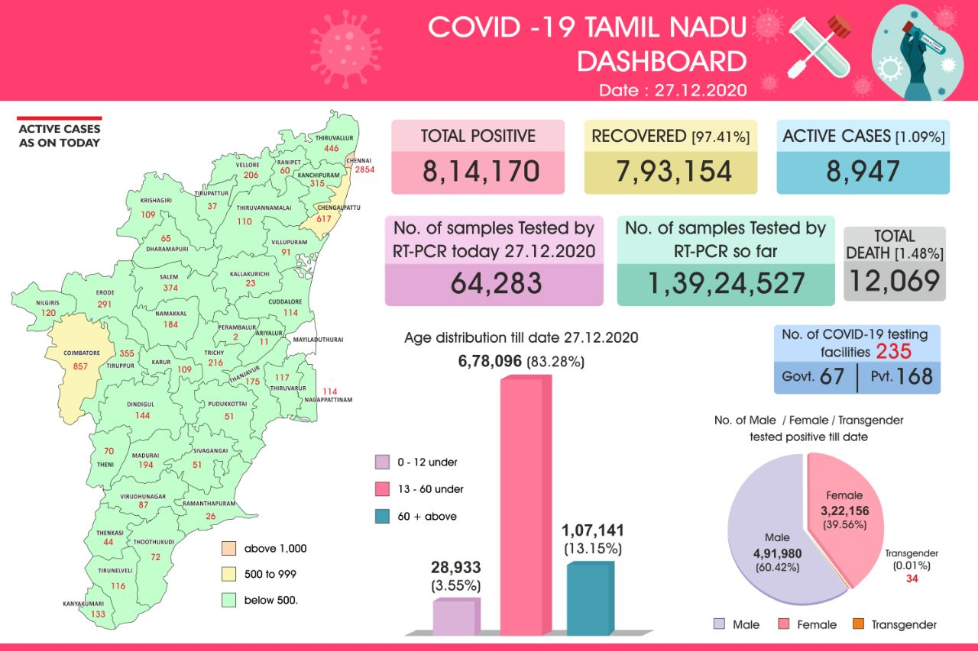

Slide 4
Epidemiological Curve :Total Cases-Discharge-Death

Slide 5
Inputs
Human Resources
Infrastructure & equipment
Drug Supply Chain
Capacity Building
Information, Education and Communication

Slide 6
Human Resources
State Level Team : Overall implementation of the program
District Officials and Second level Medical Officers : Facility Level Coordination
Field staff like Staff Nurses, VHNs and Self Help groups for reaching general public
At present, more than 1100 registered doctors (including specialists like obstetricians, ART MOs and TB MOs) available for providing consultations

Slide 7
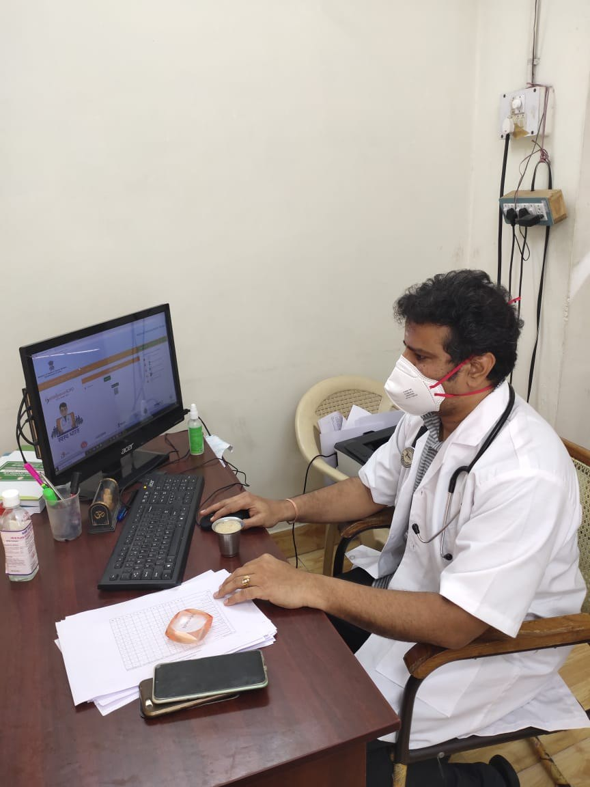
Infrastructure & Equipment
Ensured an ambient environment with exclusive room, devices and internet facility for teleconsulting doctors to provide consultations
Provided the hardware and software requirements to the doctors as recommended by CDAC, Mohali
  Desktop/Laptop with camera
  Wi-Fi/Fiber net connection
  Headphone with microphone
Requested district administration to send a proposal, if additional support necessary

Slide 8
Capacity Building
Virtual training programs conducted at various level
Initial orientation and program outline by CDAC, Mohali for
  2nd level medical officers
  Master trainers & other eSanjeevani OPD doctors
State Level Training for district officials & field staffs on awareness creation
District Level Training for all field staffs
Training to HWC 2nd VHN for multiple registration
Training to General Public for App installation and utilization

Slide 9
Drug Supply Chain
Suitable instructions to Government Health facilities including PHCs, HSCs to provide drugs for ePrescription generated via eSanjeevaniOPD
All Private Pharmacies providing drugs for eSanjeevaniOPD ePrescriptions : through Department of Drugs Control Administration

Slide 10
Information, Education & Communication
Hon’ble CM paid special attention and inaugurated the program
News through print media
    Frequent press release by Hon’ble Health Minister
    Press release by collectors at District level
Videos through news & you tube channels
Messages in social media
Pamphlet/leaflet/OPD Tickets/Wall posters/Banners/Miking

Slide 11

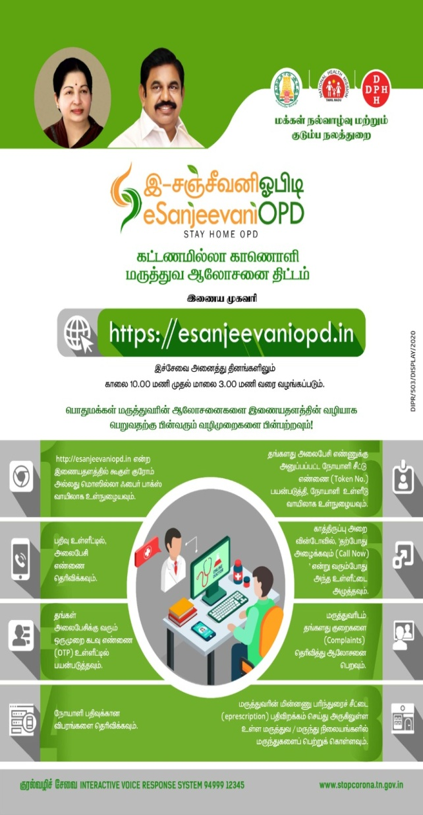
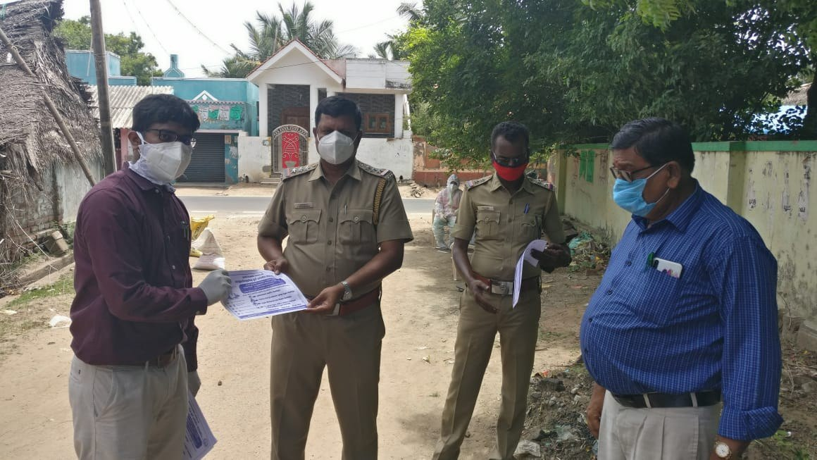
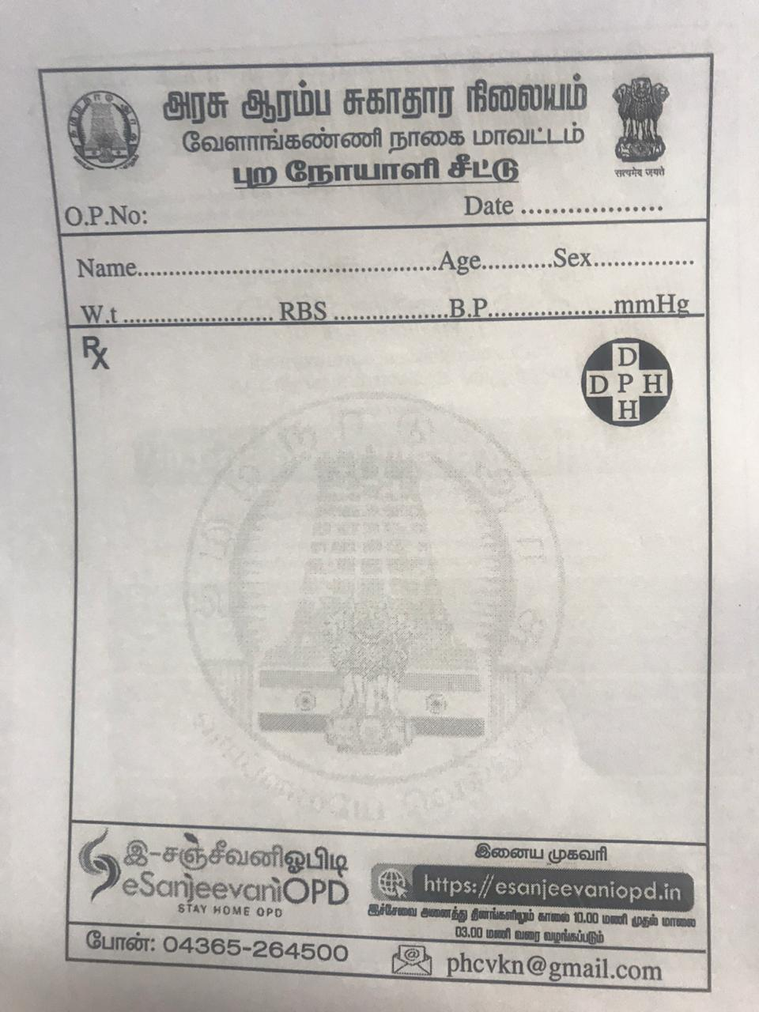
Pamphlets/leaflets/OPD Tickets

Slide 12
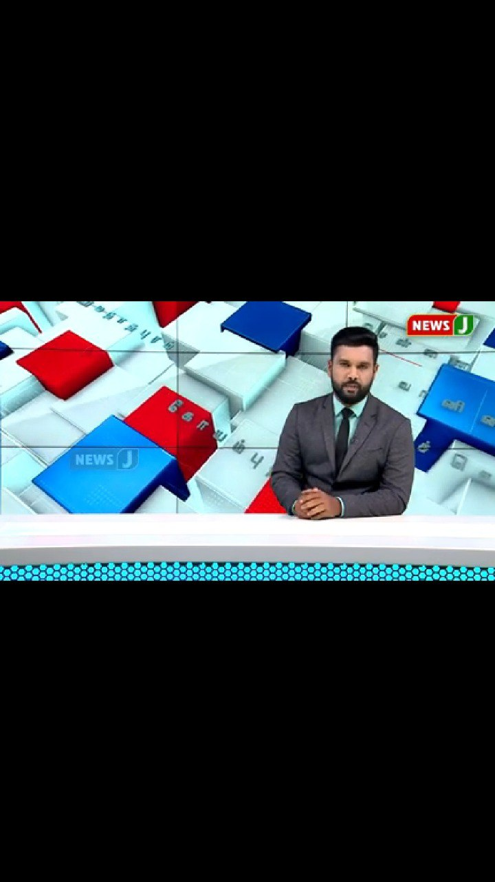
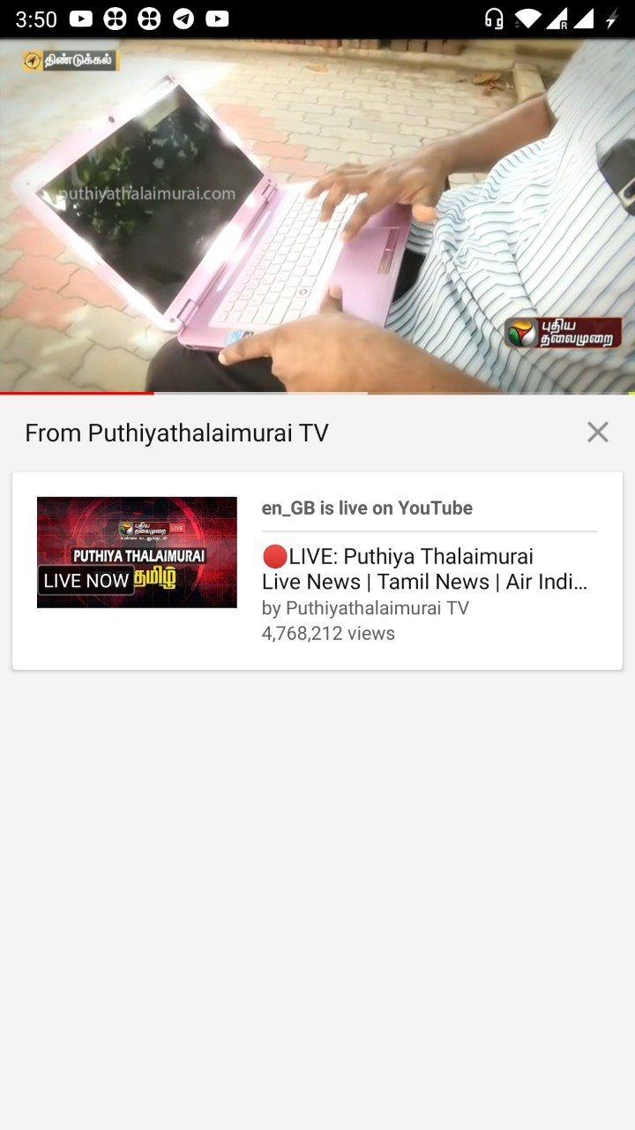
Videos through news & you tube channels

Slide 13
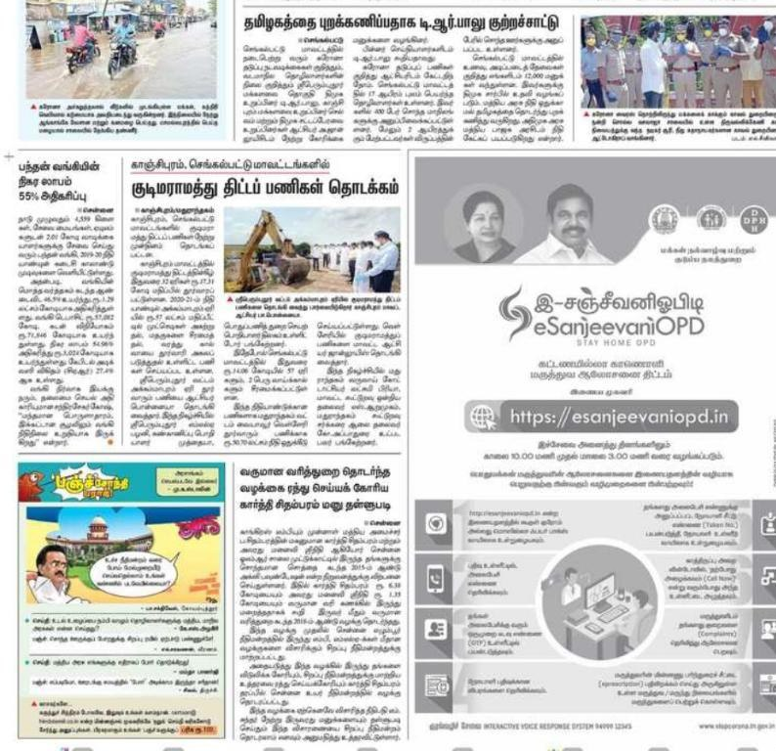
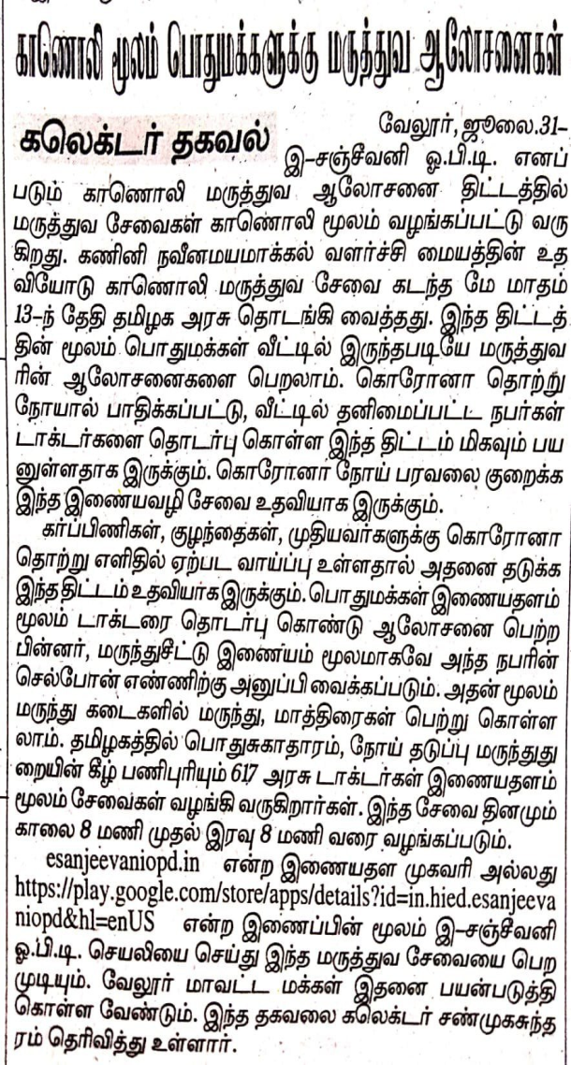
News through leading print media in local language at state and district level

Slide 14
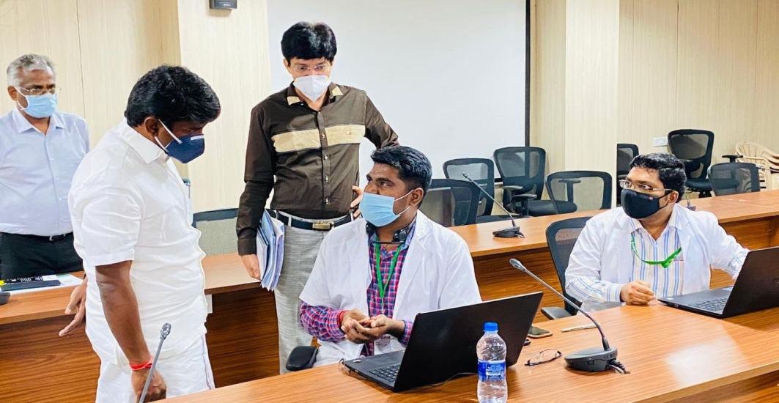
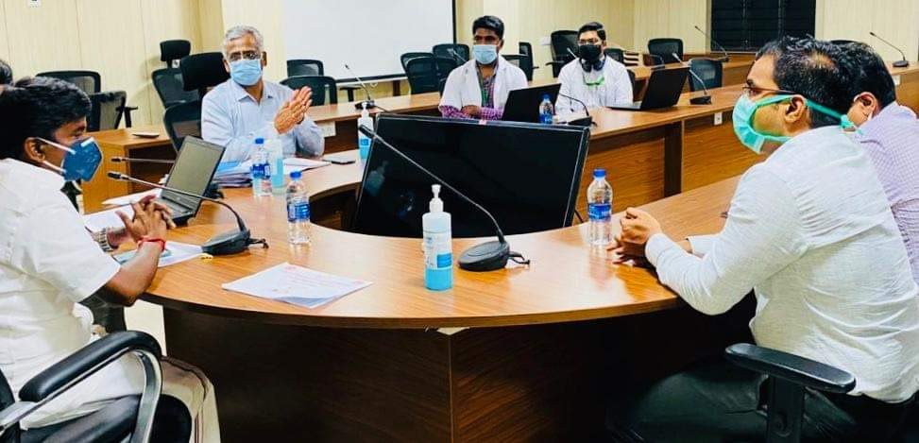
Process
Trained district officials, Medical officers and field staffs
Implementation monitored at various levels including state, district and block level by appropriate authorities
Management Information System (MIS)
  Daily district wise eSanjeevani OPD performance review with key conclusions and recommendation : to all district collectors, health officials by O/o NHM, TN
  MIS : Helped in creating awareness on the status of the program implementation to the administrators and field staffs for planning on improvement
Short term evaluation done for assessing quality of consultations & to understand technical challenges

Slide 15
Outputs
Tamil Nadu conducted more than 3,50,000 consultations till date
19/38 districts in Tamil Nadu have crossed more than 5000 consultations
COVID symptomatic patients identified and shifted to facility for further care
Increased High risk AN mothers followed up
NCD patents/TB/PLWHIV follow up
Introduction of AYUSH OPD

Slide 16
Outcome
Improved accessibility to quality health care
Improved outreach of the specialist services to the rural people
Reduction in the service delivery time
Creation and transmission of Electronic Health Record (EHR)
Timely access to the right clinician resulting in cost reduction
Creation of database for disease patterns
Reduced burden on Secondary and Tertiary Healthcare System

Slide 17
Month-wise Consultations

Slide 18
Age wise consultations

Slide 19
District wise Consultations

Slide 20
Common conditions- Counselled/treated/referred

Slide 21
Key Challenges
Inadequate Internet connectivity in remote areas
Technical Errors during peak OPD hours reducing patients interest
Establishing linkage with private pharmacies, labs and other follow up services

Slide 22
Future plans
Including other Specialists, Super specialists and Dental, AYUSH doctors
Integration with Ayushman Bharat HWCs- MLHP facilitated consultations for needy patients with specialists
Linking 133 Hubs, HMIS, Outreach camps, pharmacy, Lab services(EDSS), Emergency care system with eSanjeevaniOPD for rapid response when required
Integration of Tele-medicine and Tele-mentoring services
Developing SOP for integrating tele-consultation services by Hub and Spoke model

Slide 23
Thank you

