Slide 1



Operationalizing Mental Health Clinics at District Hospital
Dr. Manish Singh
Deputy Director Mental Health
National Health Mission Bhopal.

Slide 2
Problem Statement:
Mental illness now recognized as an important Non Communicable Disorder (NCD), on the lines of cardiovascular disease, diabetes, cancer, cerebrovascular disease.
WHO estimates that at any given time 10% of global population suffers from some form of mental illness.
Estimates suggest that by 2020, depression, the most common mental disorder.
In MP the prevalence rate of mental disorder are 13.9%

Slide 3
Mental Disorders Prevalence and Treatment Gap
Data source : NMHS 2015-16

Slide 4
National Mental Health Program
National Mental Health Program started in 1982.
The District Mental Health Program (DMHP) was launched under NMHP in the year 1996.
  In MP DMHP program start on 1997-98.
  In 2017-18 DMHP program sanctioned in 30 district.

Slide 5
Approach adopted by MP
Integration of mental health care services
Utilization of the existing infrastructure
Task-oriented Training to the existing staff.
Mental health services with the existing community development program

Slide 6

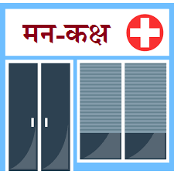
Infrastructure & Human Recourse …
District Hospital
DMHP District
1 Psychiatric / MO & 1 Clinical Psychologist (NHM).
Dedicated Posted Trained Staff Nurse*.
Psychiatric / Trained Medical Officer* Provide Treatment
Dedicated Posted Trained Staff Nurse*.
Trained Medical Officer* Provide Treatment
* Regular cadre State Health department

Slide 7
Training
1
District Level Orientation
2.
1 Month Training of MO & 14 Days Training Staff Nurse in Mental Health
3
2 Days MO & 6 Days SN orientation for Management of Mental Health Program
13 Psychotropic medicines incorporated in EDL of Madhya Pradesh which is available free of cost in all clinics.
Various record keeping & reporting formats (Screening Record Register, Case Record Register, Follow up Record Register, MH GAP Mater Chart, Case Booklet Sheet, Referral Slips, Treatment & Follow up Card &Monthly Reporting formats etc). Developed in close coordination with State Government Officials & other technical experts.
Supportive supervision by State.

Slide 8
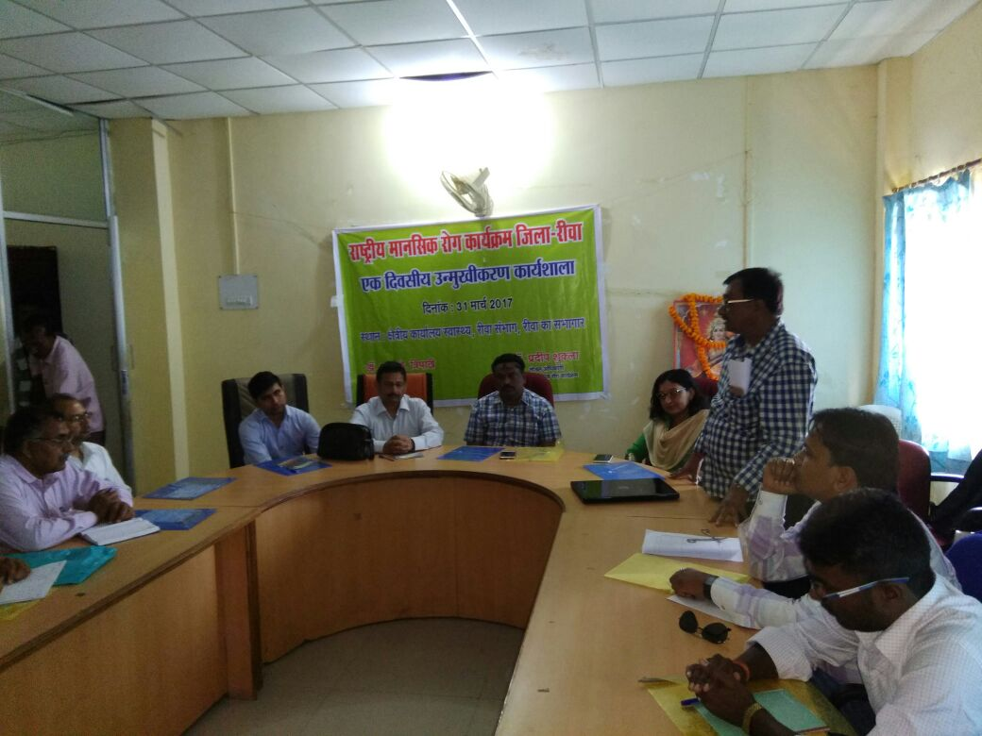
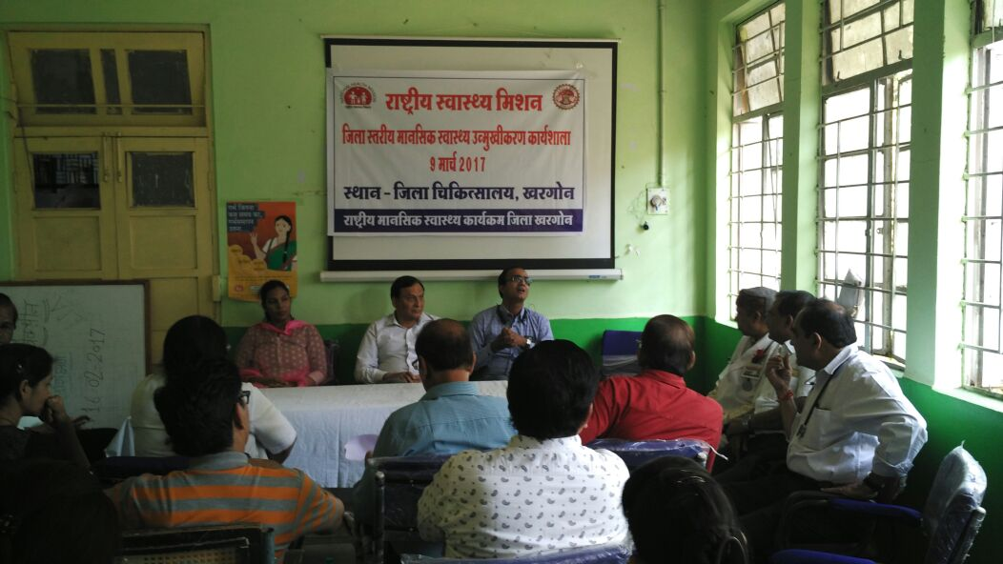
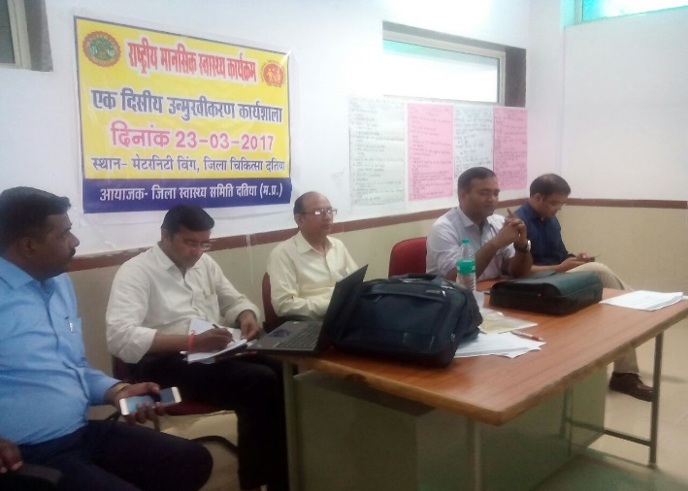
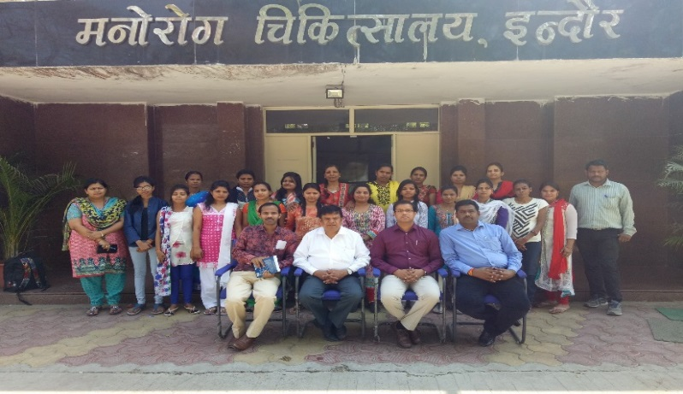
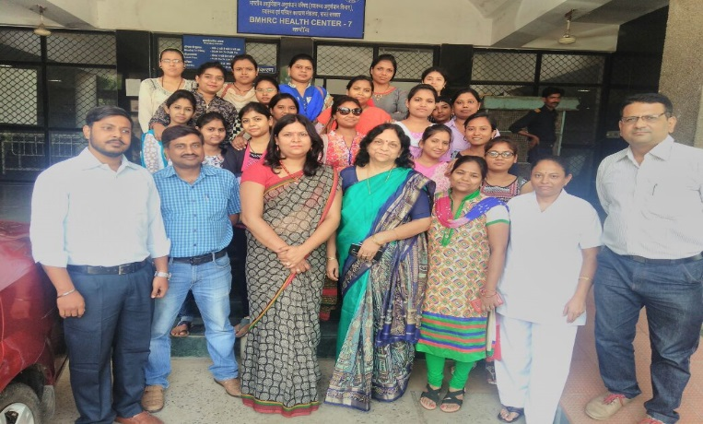
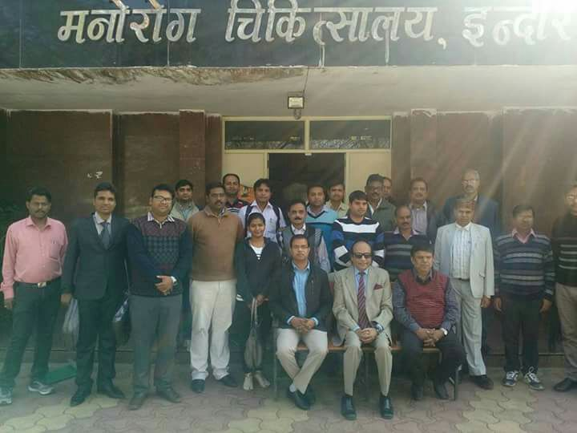
Results
District level Orientation Program in all District Hospitals.
Total 64 Medical officers & 150 staff Nurses from 51 Districts are trained in Mental Health training (One Month and Two weeks duration).

Slide 9
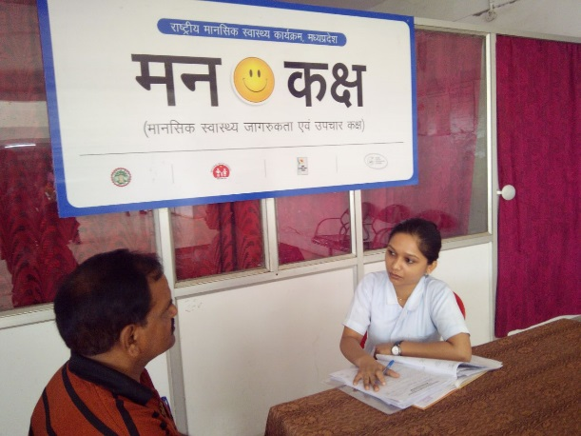
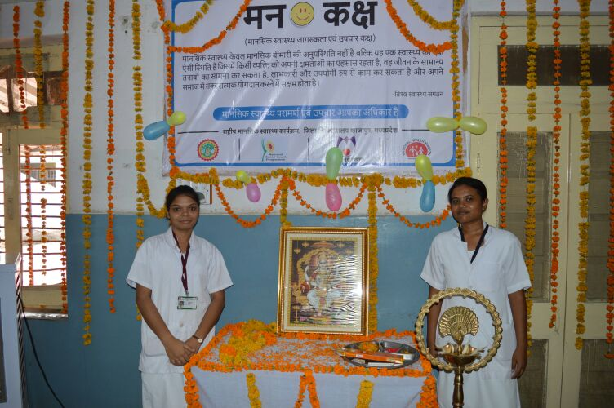
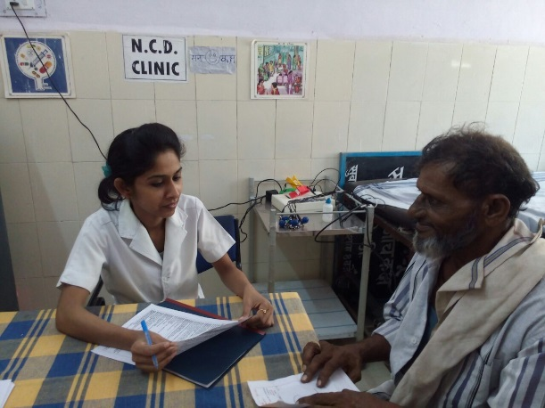
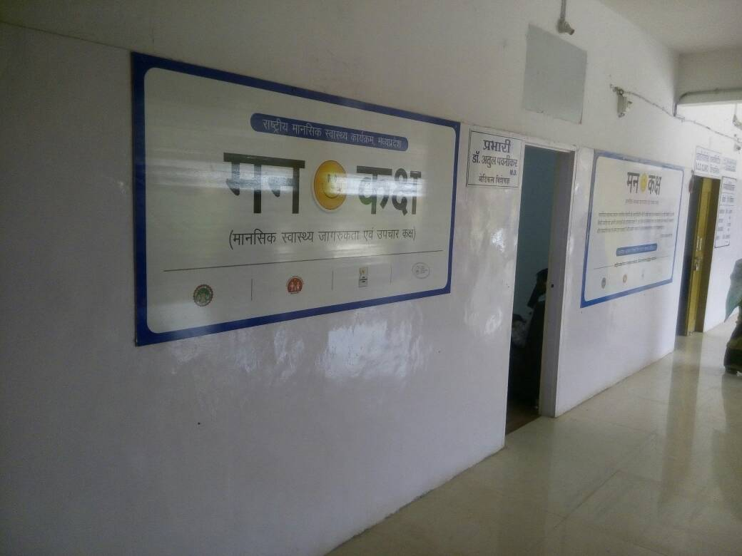
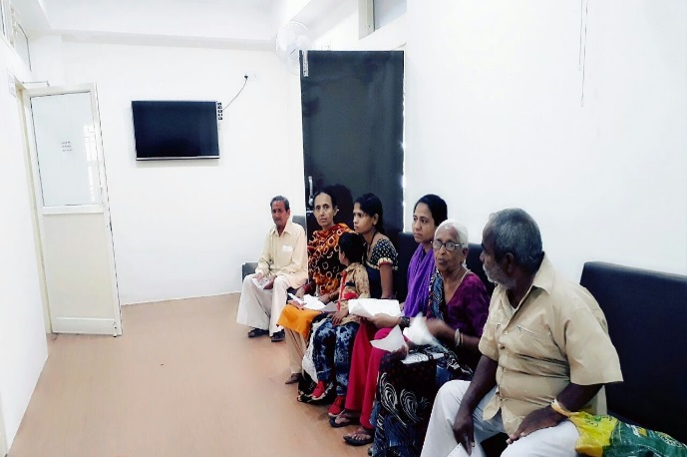
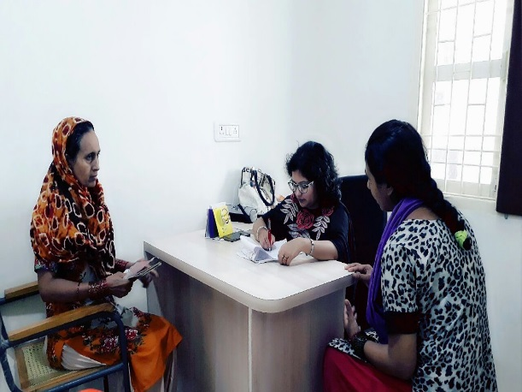
Results
Operationalized Mental Health clinic “MannKaksha” in all 51 District Hospitals with trained staff.
Establishment of Counselling centre at 7 District Hospitals and 3 Medical colleges (2016-17).

Slide 10
Result -
Nearly 46322 cases have been screen in “MannKaksh” out of which approximately 21151 cases are being found positive and are on pharmacological and psychosocial management.(Data Year 2016-17)

Slide 11

THANK YOU

