Slide 1
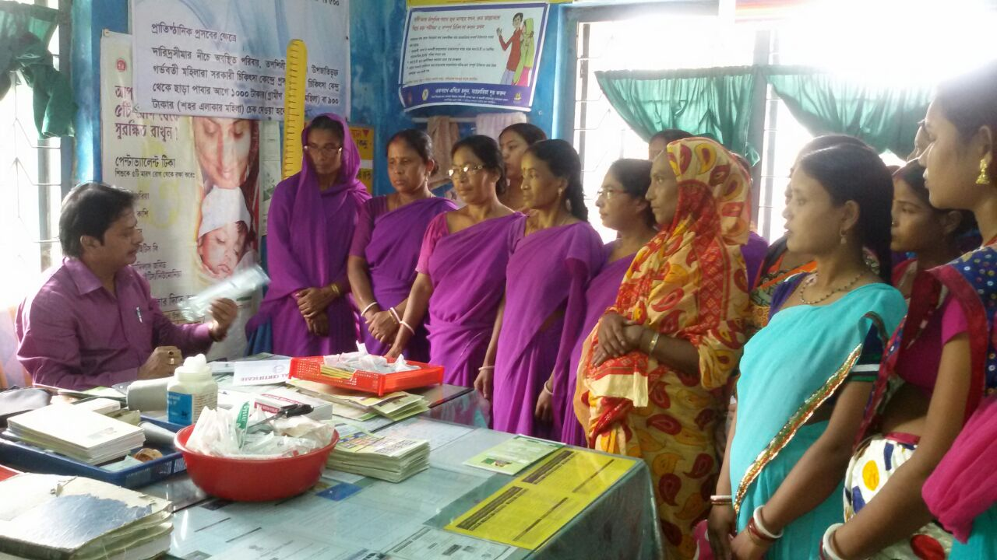
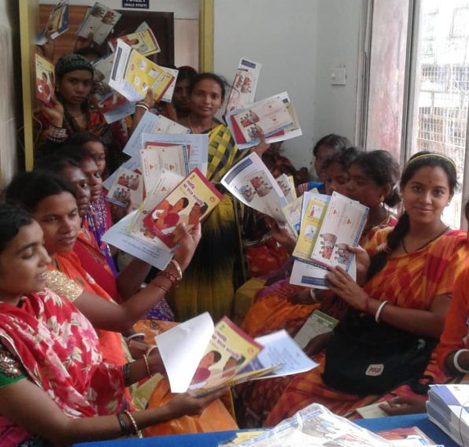
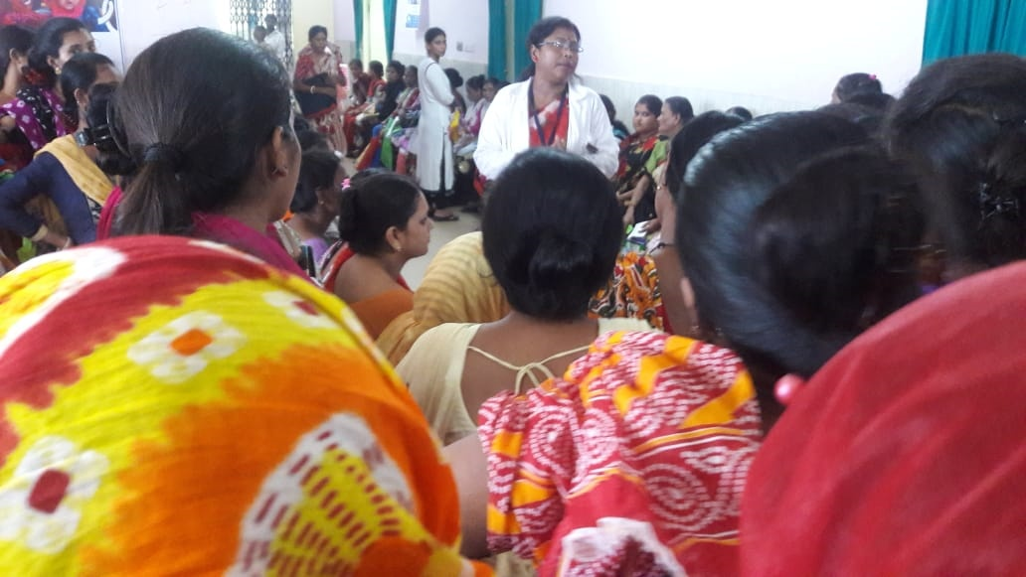
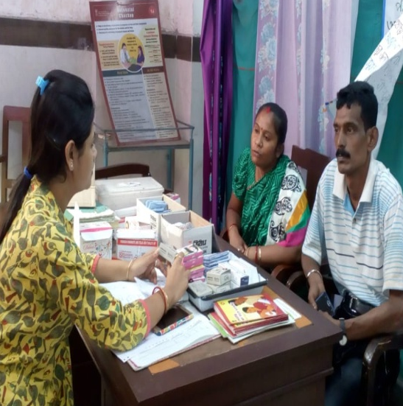
OPTIMAL CONTRACEPTIVE METHOD-MIX
(WEST BENGAL)
By:
Dr. Ajoy Kumar Chakraborty
DHS, West Bengal

Slide 2
State has achieved
Replacement Level Fertility of 2.1 decade back
Current TFR = 1.6
(3rd lowest in the country)

Slide 3

The question is
Do we still need Family Planning ??!!

Slide 4
We Realized that
Access to contraceptive choices is essential to protect reproductive & sexual rights of couples.
The pattern of contraceptive use and range of services provided are important indicators in this regard
Access to Family Planning services is imperative in improving women’s chances of surviving pregnancy and childbirth even after reaching the replacement level TFR.
The next substantial gain in MMR and IMR would come from investment in Family Planning
Reproductive health is critical to advancing overall health and socioeconomic development

Slide 5
Challenges
Challenges were result of
Fourth Largest Population
High MMR
High Abortion/Still birth Rates (5.2%-NFHS III)
High LBW (22.9%-NFHS III)
High teenage fertility (25.3%-NFHS III)
High use of traditional methods
(21.3%-NFHS III)
Skewed contraceptive method mix
Low use of contraceptive use in post-pregnancy period

Slide 6
State’s Concerted efforts
Emphasis on all available contraceptives
Focus on Birth spacing
Ensuring quality of training & services
Tapping post pregnancy period
Improving demand for sterilization services
Ensuring method continuation

Slide 7
Focus on Birth Spacing
We Focussed on counseling, increasing access and ensuring uninterrupted supply of contraceptives till the last mile to provide wider choices
Addressed misconceptions regarding IUCD locally
Conducted special drives to operationalize non performing Sub-centers to provide Interval IUCD
Installed Condom boxes in all health facilities for increasing access and male participation in FP
WB is one of the first non “Ensuring Spacing of Birth” scheme states to seek assistance under NHM for implementing this scheme

Slide 8
Emphasis on available basket of choices
We contribute to a relatively much higher share in all of the spacing methods.
Combined oral contraceptive share is 23%, PPIUCD is 17% and PAIUCD is 13% which are the highest in the entire country.
Antara and Chhaya have been recently introduced and rapidly holding ground
West Bengal reports 3rd highest male sterilizations in the country

Slide 9
Tapping post pregnancy period
98% institutional deliveries (81% of which are at public institutes), provided an opportunity for expanding post partum FP services.

Slide 10
Tapping post pregnancy period
A rapid scale up of PPIUCD services from less than 1% (2013-14) to nearly 40% at present.
The state now leads in PPIUCD acceptance rate in the country

Slide 11
Ensuring Method Continuation through quality services
Strong counseling and good quality of services ensure acceptance among the people.
West Bengal has one of the lowest discontinuation rate for IUCD.
Discontinuation rates for OCPs and condoms is substantially low.

Slide 12
Improving Sterilization Demand
Emphasis given on improving postpartum and post abortion sterilization services
Stabilized fixed day approach for sterilization in all blocks throughout the State.
Special drives on NSV in high focus areas through group counseling and recognizing top performing service providers

Slide 13
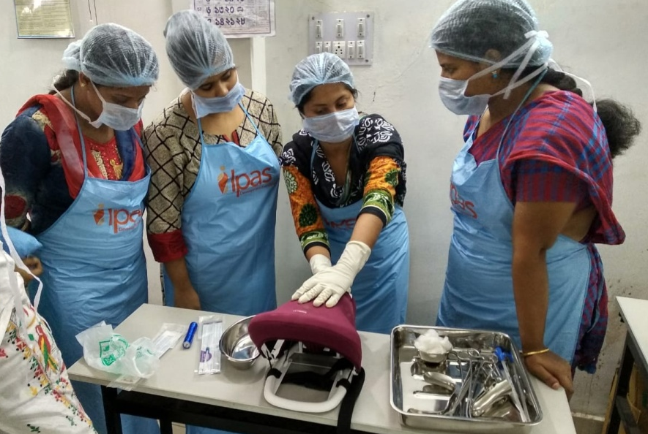
Ensuring Quality of Training
Involved Medical Colleges in introduction of PPIUCD, post abortion IUCD (PAIUCD) and thereby built a strong foundation for training.
Similar mechanism followed for introduction of newer contraceptives
Capacity of Medical Officers and frontline workers improved for counseling and addressing side effects.
Linkage between Medical College and other facilities strengthened through training partnership and hand holding.

Slide 14
Program rejuvenation
Addressing skewed method mix- Previously, emphasis was largely on sterilization methods
The state effected a paradigm shift wherein focus was given to available array of contraceptive choices.
The share of spacing methods increased by 30% (NFHS I to NFHS IV)

Slide 15
Emphasis on the Choice-
(A balanced method mix)
Analysis of the NFHS-4 data shows a balanced method mix in West Bengal for both limiting as well as spacing methods

Slide 16
With continued focus on FP
mCPR of the state has increased from 49.9% to 57% (NFHS III to NFHS IV) (14.2% increase) (one of the largest increase in the country).
The Teenage fertility rate has declined from 25.3% (NFHS III) to 18% (NFHS IV) (29% decline)
The traditional methods usage has declined from 21.3% to 13.9% (NFHS 3 to NFHS 4) (35% decline)
Improvement in pregnancy outcomes- the incidence of low birth weight has declined from 22.9% (NFHS III) TO 16.7% (NFHS IV) (27% Decline)

Slide 17
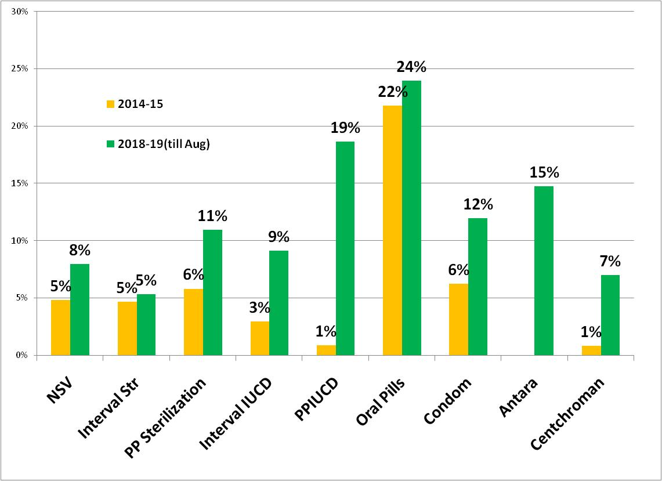
Improving the acceptance
With the emphasis on quality training, intensive counselling and increasing accessibility with uninterrupted supply, we have increased the share in all the component in FP services during last 3 years (2014-15 to 2018-19 till Aug)
Share of FP Methods in India, 2014-15 to 18-19 (till Aug)

Slide 18
The focus on FP services resulted in yielding rich dividends:
The state, each year is able to avert:
  46 lakh unintended pregnancies,
  1.53 lakh unsafe abortions
  1500 maternal deaths*
* (Source: Track 20)
We hope that with continued focus on FP we would be able to achieve MMR and IMR targets quicker than envisaged.

Slide 19


Thanks

