Slide 1

4th NATIONAL SUMMIT ON
BEST PRACTICES & INNOVATIONS -NHM
TRANSTAN & ORGAN DONATION ACTIVITIES
IN TAMILNADU

Slide 2
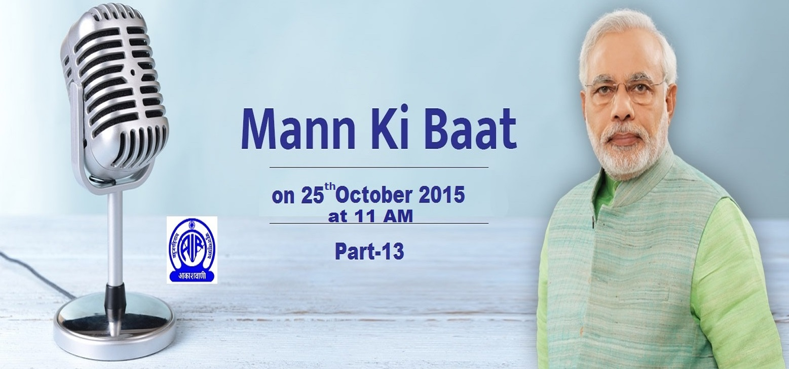
HON’BLE PRIME MINISTER LAUDS TAMIL NADU'S ORGAN DONATION PROGRAMME
Hon’ble Prime Minister SHRI.NARENDRA MODI has commended Tamilnadu for its Organ Donation Programme saying the state has done “extremely well” and a Role Model to other states in the13th edition of his
‘Mann Ki Batt’- Programme which was broadcast on 25th October 2015.

Slide 4
Villivakkam was called Kidney Village

Slide 5
Steps Taken
2007 March : One Day Workshop with Four Working Groups:
  Cadaver organ donation
  Cadaver organ transplantation
  Coordinating Organization for organ sharing
  Live donation and transplantation
33 recommendations for follow up action.
The participants felt that there were many grey areas in the Transplantation of Human Organs Act.
In particular, no guidelines on who will get the donated cadaver organ

Slide 6
Government Orders Were Issued
Declaration of brain death made mandatory
Procedure for declaration of Brain Death
Authorization Committee Procedures
Procedure to be adopted for Cadaver transplant by the Government and Private Hospitals
Responsibilities of Transplant centers in hospital
Post-mortem examination in medico legal cases – Procedure prescribed
Non Transplant Organ Retrieval Centres were registered.

Slide 7
Tamil Nadu Network for Organ Sharing
Initiatives for forming “Tamil Nadu Network for Organ Sharing” and maintaining a common online waitlist for all potential recipients in all hospitals.
Common Waiting List (Blood Group based) visible to all stakeholders.
Allocation based on the Waiting List.
Priority based on well defined criteria
Green Corridor for transport of organs

Slide 8
NUMBER OF DONORS

Slide 9
ORGAN DONATION - OVERALL AND 2017 PERFOMANCE TILL JUNE
STATISTICS
OCTOBER - 2008 TO JUNE - 2017
STATISTICS
JANUARY TO JUNE - 2017
DONOR | 994
Heart | 320
Lungs | 173
Liver | 935
Kidneys | 1801
Pancreas | 17
Small Bowel | 2
Major Organs | 3248
Heart Valve | 727
Corneas | 1517
Skin | 63
Blood Vessels | 2
Spine Bone & Disc Tissue | 2
TOTAL | 5559
DONOR | 89
Heart | 46
Lungs | 33
Liver | 77
Kidneys | 146
Pancreas | 3
Small Bowel | 0
Major Organs | 305
Heart Valve | 15
Corneas | 134
Skin | 10
Blood Vessels | 0
Spine Bone & Disc Tissue | 2
TOTAL | 466

Slide 10
DONORS PER MILLION PER YEAR

Slide 11
DONORS AND TRANSPLANTED ORGANS
IN GOVERNMENT HOSPITALS-TAMIL NADU
(OCTOBER 2008 -- June 2017)
 | Rajiv Gandhi Govt. General Hospital | STANLEY Medical College | Madurai Rajaji Hospital | Kilpauk Medical college | TNGMSSH | Tirunelveli Medical College & Hospital
DONORS | 108 | 54 | 1 | Nil | Nil | Nil
KIDNEY | 204 | 118 | 2 | 10 | Nil | 1
LIVER | Nil | 63 | Nil | Nil | Nil | Nil
HEART | 6 | Nil | Nil | Nil | 1 | Nil
CORNEAS | 162 | 94 | 2 | Nil | Nil | Nil
HEART VALVES | 70 | 44 | Nil | Nil | Nil | Nil
SKIN | 5 | 9 | Nil | Nil | Nil | Nil

Slide 12
TRANSTAN
Transplant Authority of Tamil Nadu was started in December 2014 by the Government with the Hon’ble Chief Minister as Chair Person and 20 other members including Hon’ble Ministers for Health and Finance, Secretary for Health & Family welfare and various Secretaries of the Government as its General body.
TRANSTAN coordinates and supervises the entire range of transplant activities including Live transplants, Cadaver transplants and tissue transplants.

Slide 13
FUNCTIONS
Assists patients with organ and tissue failure related health problems.
Regulates distribution of organs in a transparent manner.
Assists the State & Central Governments in the formulation of policies, procedures, establishment of regulatory frameworks for all kinds of organ & tissue transplantation.
Aids in Networking all stake holders in organ and tissue transplantation.
Streamlining all procedures related to Cadaver and Living Organ Transplantation.
Helps hospitals to identify brain stem death and proceed further.
Maintains an online waitlist registry.
Liaison with Police in providing Green Corridor for transporting organs.
Liaison with neighboring States in organ sharing.
Helps in compiling a state and regional database.
Ensures protocol development, research, data analysis, outcome monitoring and knowledge dissemination.

Slide 14
POLICY MAKING / IMPLEMENTATION /
MONITORING HOSPITALS
Holds consultative meeting with all member hospitals to frame new guidelines or when issues arise which needs to be sorted.
Ensures organs are distributed in a fair and transparent manner as per the waitlist and guidelines in force.
Encourages new hospitals to join the program by providing advice and assistance.
Ensures all deceased donor transplants are done only in registered hospitals holding valid licence.
Ensures that Identification / Certification / Retrieval are carried out as per established protocols.
Collect deceased donor data’s / live data from hospitals.

Slide 15
ACHIEVEMENTS
TAMIL NADU IS THE FIRST STATE IN THE COUNTRY :
To start a programme exclusively for organ transplant, streamline organ distribution and clarify Medical legal procedures.
To issue Government Orders to clarify grey areas of the Transplantation of Human Organ (THO) Act.
To make certification of brain stem death mandatory.
To expand the pool of Forensic specialists (Allowing even specialist from private sector to perform Post Mortem for this purpose)
To provide Green Corridor for organ transport.
To undertake many complex transplants like pancreas & kidney, liver & kidney, heart & lung etc.

Slide 16
TRANSTAN AS ROTTO
Regional Centres to support Transplant programs in neighbouring States and Tamil Nadu is the ROTTO for the entire Southern Region.
Promotes the establishment of programs in other States with financial support from Centre and co-ordinate entire range of transplant activities including live transplants.
To assist Central Government efforts to network different States, to collect data and analyse and to improve end result
Monitoring and surveillance of transplantation activities in the region and organising training programs / workshops.
Dissemination of information, Technical guidance and support.

Slide 17
TRANSPLANT HOSPITALS
REGISTERED WITH TRANSTAN
No. of Registered Transplant Hospital | 78
Kidney | 72
Liver | 25
Heart | 23
Lung | 18
Pancreas & Multi Visceral Organs | 11
Hand | 3
Skin | 4

Slide 18
ACTIVITIES

Slide 19
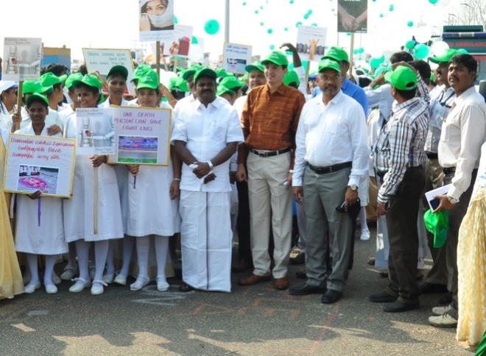
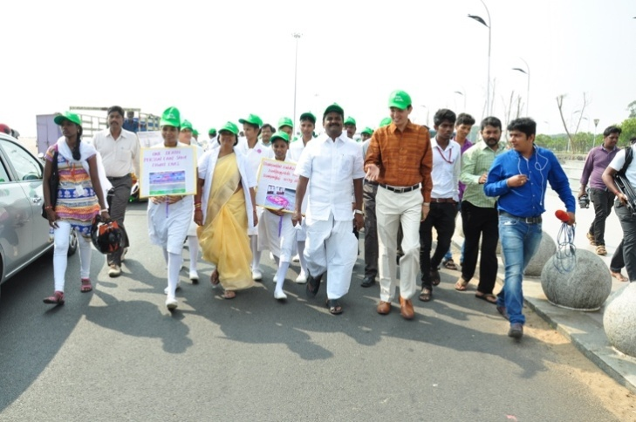
ORGAN DONATION WEEK – AWARNESS RALLY
A rally in Marina was organised as part of the Indian Organ Donation Week, on 25/11/16. Dr.C.Vijaya Baskar M.B.B.S, B.L., Hon’ble Minister of Health & Family Welfare, Dr.J.Radhakrishnan I.A.S., Principal Secretary to Govt, Health & Family Welfare, Shri P.W.C.Davidar I.A.S, Additional Chief Secretary / Chairman TUFIDCO, Director of Medical Education, Deans of City Medical Colleges and various dignitaries from Private Hospitals and Paramedical Staffs participated.

Slide 20
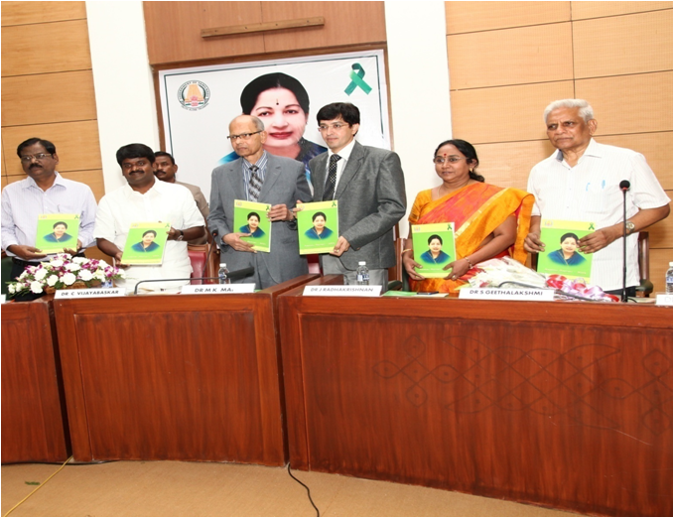
FIRST ORATION 27TH JUNE 2014 ‘WHAT CAN A DEVELOPING COUNTRY DO TO REDUCE CHRONIC KIDNEY DISEASES’ BY DR. M.K.MANI

Slide 21
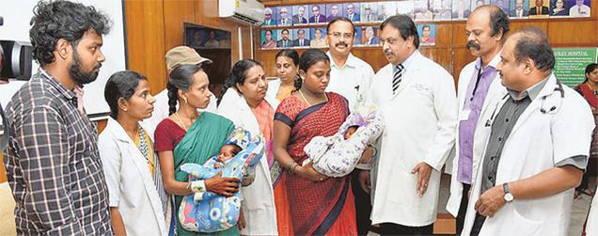
Heart & Kidney Transplanted ladies who delivered children in
Govt. Stanley Hospital, Chennai.

Slide 22
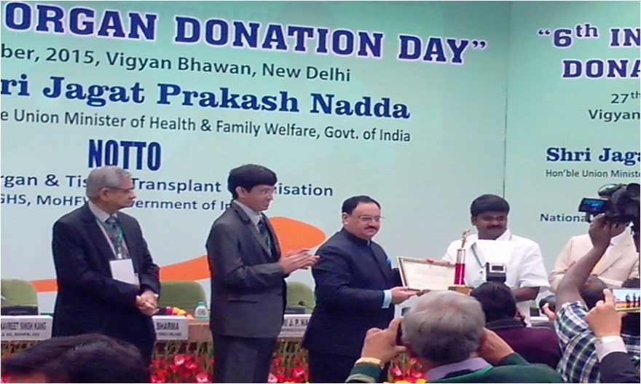
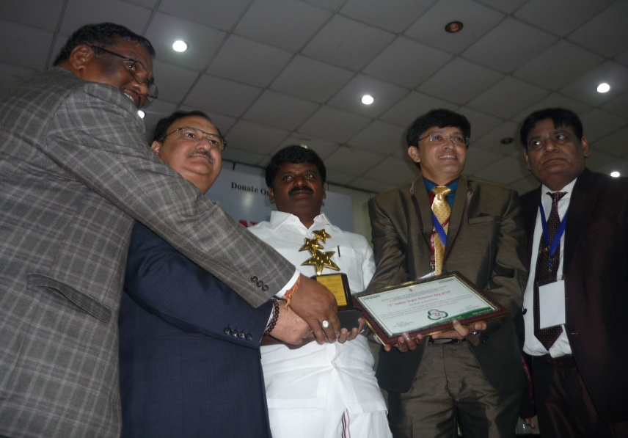
NATIONAL AWARD IN ORGAN DONATION 2016
TAMILNADU THE BEST PERFORMING STATE
Tamil Nadu was selected by NOTTO as “ THE BEST PERFORMING STATE” in transplantation in the country.
The Award was received by Dr. C. Vijaya Baskar M.B.B.S, B.L., Hon’ble Minister of Health & Family Welfare and Dr. J. Radhakrishnan I.A.S., Principal Secretary to Govt. Health & Family Welfare Department on 30th November 2016.

Slide 23
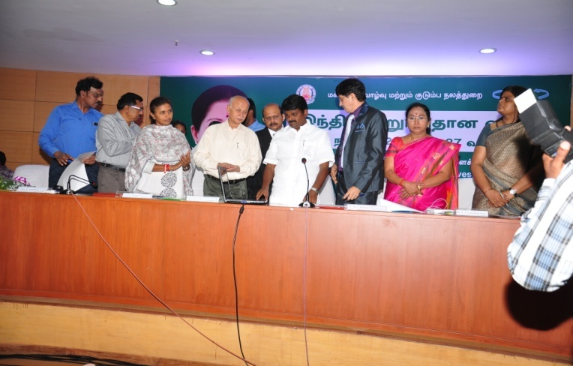
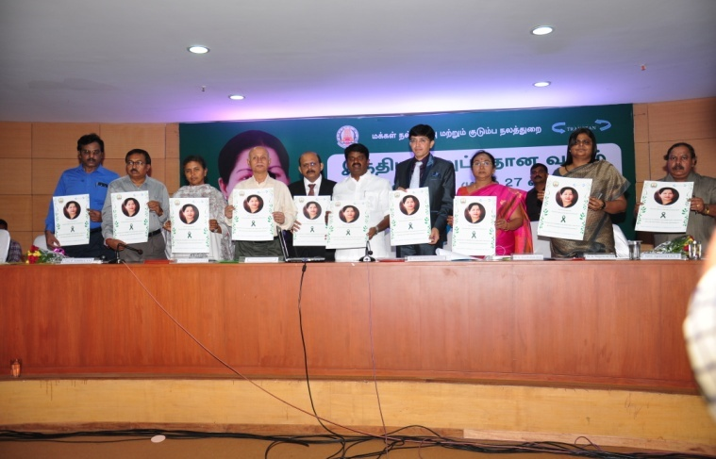
LAUNCHING OF TRANSTAN WEBSITE OF TRANSPLANT REGISTRY
Dr. C. Vijaya Baskar M.B.B.S, B.L., Hon’ble Minister of Health & Family Welfare and,
Dr. J. Radhakrishnan I.A.S., Principal Secretary to Govt, Health & Family Welfare Department along with other Senior Government Officials launched the TRANSTAN website on 25/11/2016.

Slide 24
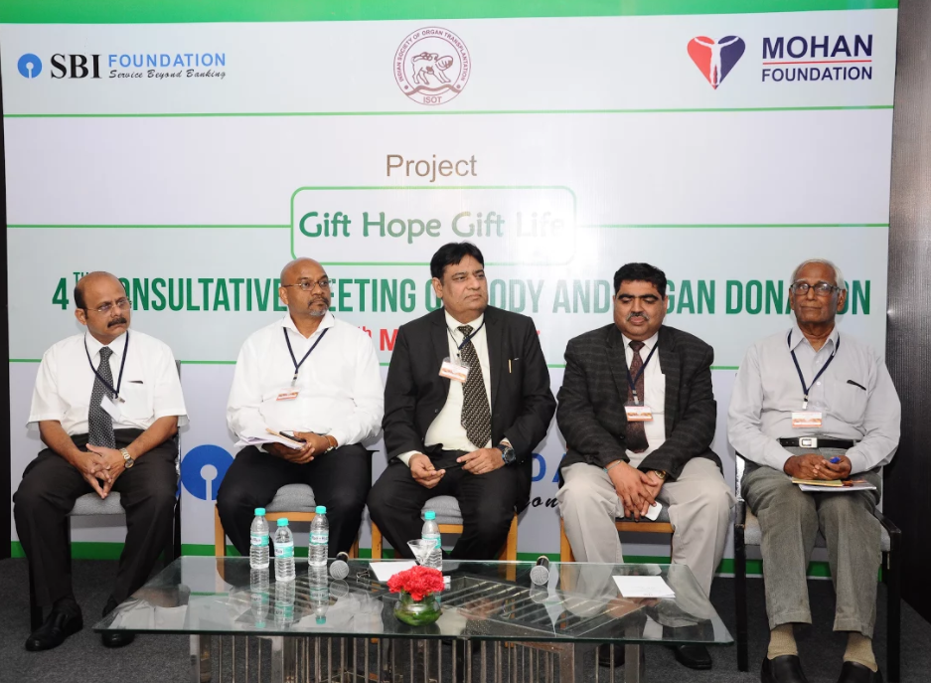
DISCUSSION ON ADOPTION OF TRANSPLANTATION ACT & RULES
Discussion on the adoption of Transplantation of Human Organ Act 2011 & Rules 2014 was held on 16.03.2017 at Park Hotel Chennai. Dr. Anil Kumar, Additional Deputy Director General of Health Services, Dr. Vimal Bhandari, Director NOTTO, Shri. P. W. C. Davidar I.A.S., Advisor Transplant, Dr. P. Balaji Member Secretary TRANSTAN, Dr. Sunil Shroff, Managing Trustee MOHAN Foundation, Mr. C. E. Karunakaran, Trustee NNOS Foundation participated.

Slide 25
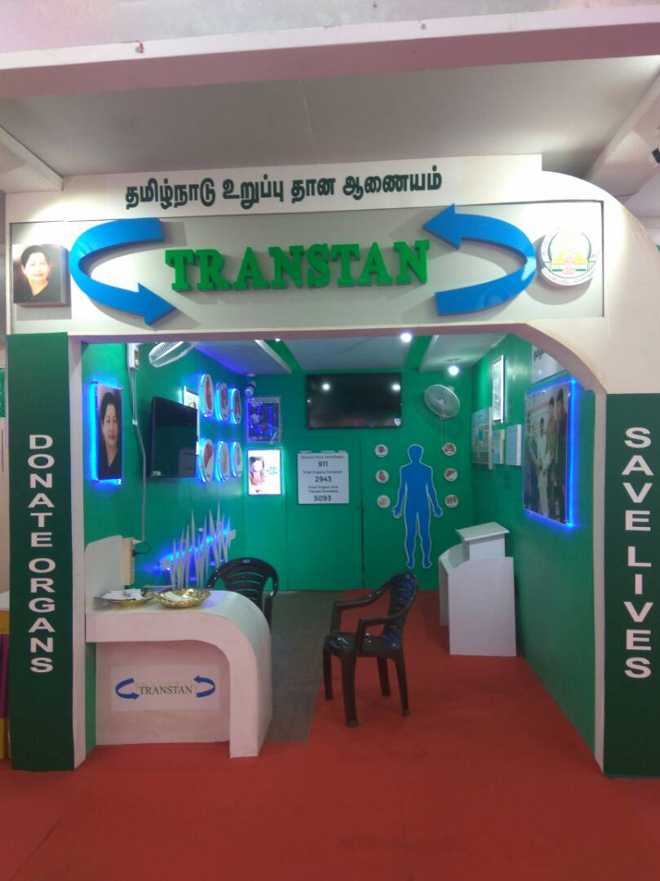
AWARNESS STALL OF TRANSTAN
TRANSTAN had put up a stall at 43rd India Tourist & Industrial Fair 2017 at Island Grounds for carrying out awareness to promote deceased donor organ donations and maintained it for 90 days. It created awareness among the general public who had visited the stall and was also judged by the committee as one of the best stalls.

Slide 26
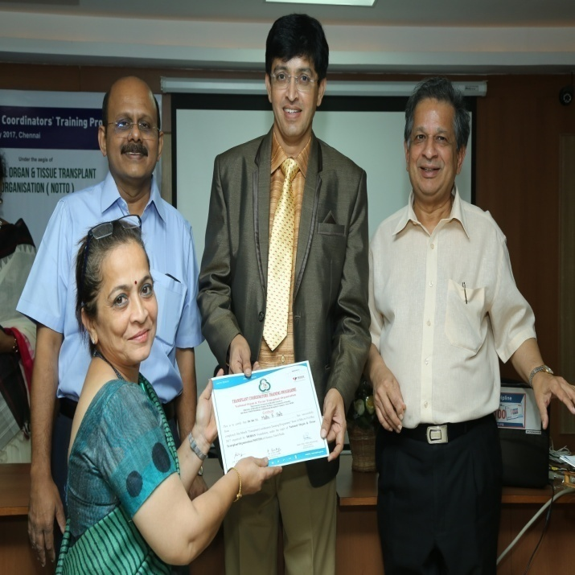
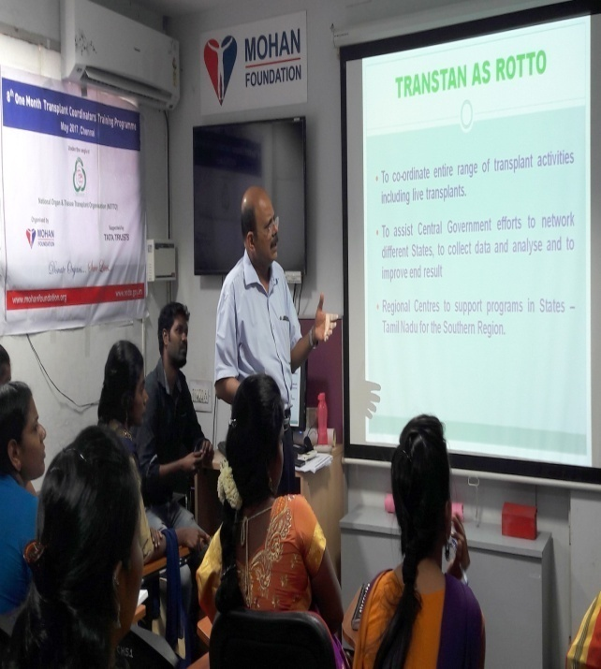
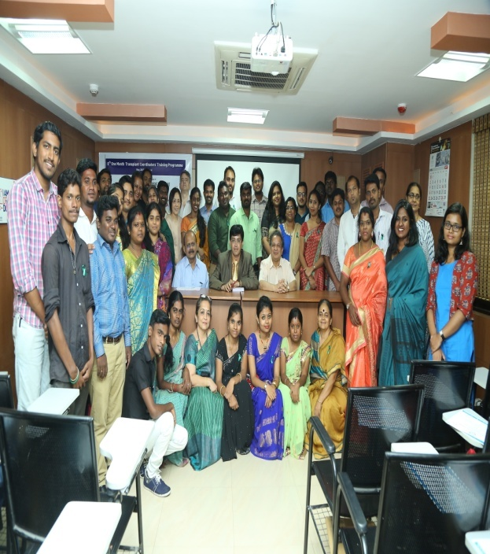
TRANSPLANT COORDINATORS TRAINING PROGRAMME
Dr.J.Radhakrishnan I.A.S., Principal Secretary to Govt, Health & Family Welfare distributing the transplant coordinator training certificates along with Dr. Sunil Shroff, Managing Trustee MOHAN Foundation and Dr. P. Balaji, Member Secretary TRANSTAN who is also delivering a lecture for the Transplant coordinators.

Slide 27
REASONS FOR SUCCESS OF TRANSPLANTATION IN TAMILNADU
Detailed consultation with stakeholders
Continuous consultation and always evolving
Participatory Executive Committee / General Body.
Transparent functioning with all details in website.
Perceived Fairness and Trust
Flexibility built into the System – Act, Rules, G.Os, Guidelines, Convener
Discretion.
TRANSTAN office nudges, rather than commands
Strong support from Government / NGO / Senior officials

Slide 29
Thank You

