Slide 1
PPIUCD Programme Implementation:
A success story from
West Bengal
Dr Ajoy Kumar Chakraborty
State Family Welfare Officer
Govt. Of West Bengal

Slide 2
Background And Objective
The State of West Bengal has reached the Population Replacement Level long back. Current TFR (1.6)¹ is one of the lowest in the country
But the contraceptive choice by the Couple is not appropriate
Out of mCPR of 57% in the State² NSV(0.1%) and IUCD (1.2%) rank among the lowest
OCP (20%) is the most popular spacing method despite contraindications and long-term side effects.
Therefore, state decided to promote IUCD with an objective to achieve at least 15% prevalence by the year 2020 and reduce OCP dependency
¹ SRS 2015; ²NFHS-4

Slide 3
Methodology
We performed a retrospective data review on Coverage of IUCD &PPUCD against Institutional Delivery
Field visit conducted during 2015-16 for gap assessment in implementation of IUCD & PPIUCD
Meetings conducted at all levels with key stake holders
  Providers (Gynaecologists, Staff Nurses, ANMs), ASHAs
  Community members, antenatal mothers and couples as potential acceptors
Gaps identified in both the Supply side(Providers) as well as demand side (Potential acceptors for PPIUCD)
GOI programme guidelines and protocols were adhered to
Monitoring and supportive supervision was strengthened at all levels to improve the program performance

Slide 4
Results: Gap Identification
Short-comings found in terms of involvement, knowledge and skills on the part of clinical service providers
The motivation of the gynaecologists, MO’s & trained GNMs for PPIUCD were low
The involvement of RMNCH+A counsellors was minimal
ANMs and ASHAs had limited understanding of side effects and its management
Logistics support like PPIUCD forceps and training mannequins were not adequate
Irregular disbursement of incentive especially for IUCD and PPIUCD resulted in low motivation among service delivery staff
Community had limited information specially on IUCD and various myths associated with it

Slide 5
Intervention: Strengthening Supply Side
Motivated Gynaecologists from each district and Medical colleges were selected
We trained and motivated them for PPIUCD. They further conducted quality trainings for the MO and GNM at high delivery case load facilities
During trainings emphasis was given on counselling & obtaining consent from the beneficiary
All the 47 counsellors posted at Medical colleges, districts hospital and SDH were trained In order to improve PPIUCD insertions in high case load hospitals
The state procured the mannequins, Kelly’s forceps; GOI ensured continuous supply for increased IUCD demand

Slide 6
Intervention: Scaling up supply & Community Demand
Supportive supervision and monitoring was strengthened and incentive disbursement was regularised
The programme at the next level was rolled-out at the CHC level
ANMs were uniformly trained at Block level by Video conferencing from state to handle minor side effects and ensure quality follow up
Follow up sessions focused on counselling for adherence and community acceptance of IUCD
ASHAs were trained on IPC to address misconceptions prevailing about the method
Counselling for PPIUCD during all antennal visits was emphasized

Slide 7
Follow up for Sustainability
Feedback was given to all stake holders on regular basis to boost their motivation
Some districts started improving performance; their successful strategies were shared with others and healthy competition was initiated
Both IUCD and PPIUCD performance were improved substantially over a period of two years
IUCD increased from 1.37 lakh during 14-15 to 1.76 and in 15-16 Rs.2.07 lakh in 16-17
PPIUCD insertions experienced a boost from 5,800 to 27,000 and to 1.94 lakh during the corresponding period

Slide 8
Performance of Interval IUCD and PPIUCD in Public Sector of West Bengal over last 5 years

Slide 9
Discussion: The Key Intervention
The gap assessment was the Key to understand the scenario and planning for appropriate action
Addressing the Providers Gap
  The highest quality of training was ensured by involving Medical Colleges. Initially only one Medical College, gradually involved seven more
  Identifying the motivated Gynaecologists of the District Hospitals quickly disseminate ownership
  Linkage between Medical College, Dist Hospital and CHC strengthened through training partnership and hand holding support established

Slide 10
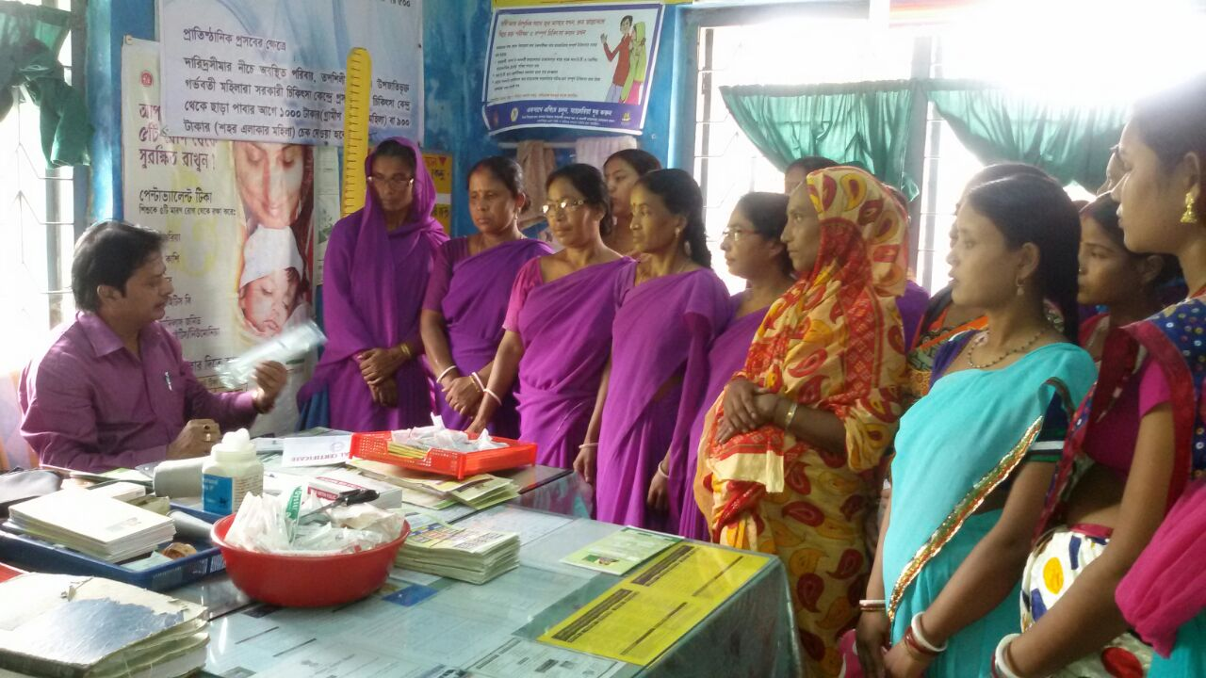
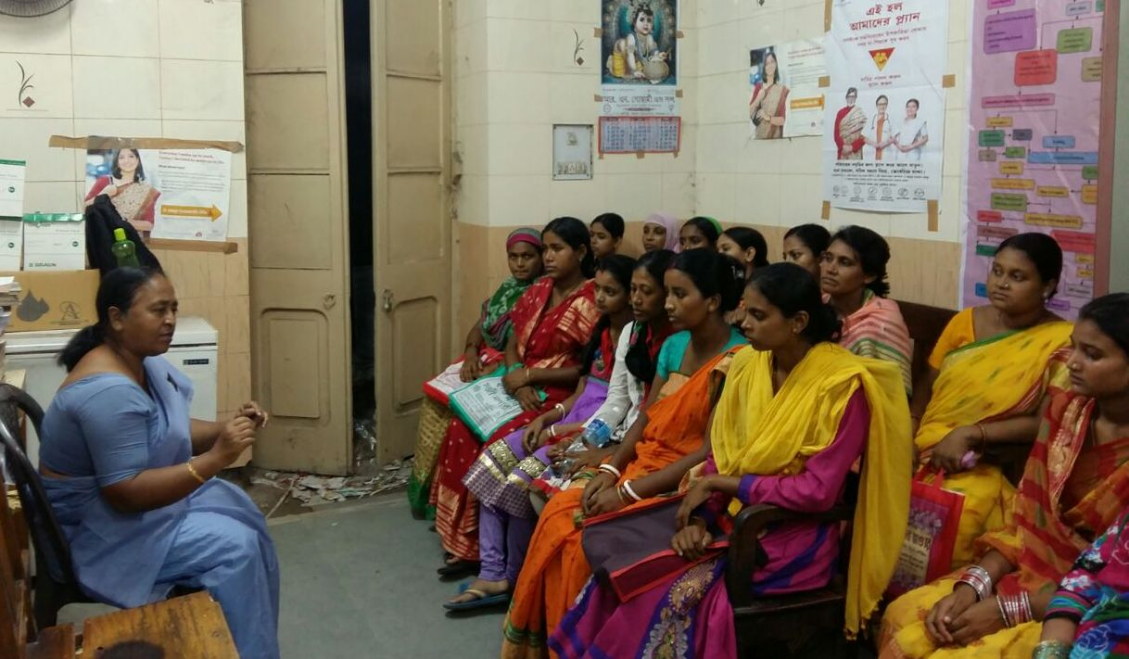
Discussion: The Key Intervention
Addressing the Demand Gap
  Quality follow ups by ANMs build confidence of the community
  Intensive counselling by ASHAs helped community specially the antenatal mothers to adopt correct choice and dispelling myths and wrong perception associated with IUCD
Addressing the Logistic Gap
  Uninterrupted logistics supply was ensured through intensified supply chain management
  Mannequins and PPIUCD forceps were procured and distributed adequately for training and service

Slide 11
Discussion: The Key Intervention
Addressing the Motivation Gap
  The individual performances were monitored and regular reviews at State, District and Block levels helped to identify gaps for correction and keeping up motivation levels of all stakeholders including administrators
  Districts were appreciated and performers were rewarded to create a healthy and competitive environment
  Fund disbursement was regularised through monitoring to keep the ASHA and the providers upbeat

Slide 12
Discussion: The Limitation
Involvement of the Districts
  Three districts and four Medical Colleges are lagging behind, special focus initiated this year

Slide 13
Conclusion : Achievement of the Objective
The success achieved following the GOI programme Guideline
With successful implementation of the PPIUCD in the State, an ambitious performance is expected to cover 3.5 lakh PPIUCD in addition to over 2 lakh interval IUCD in the 17-18 FY
Maintaining that performance in the subsequent years will add about 4.7 lakh new accepters per year
This will help to increase the pool of IUCD accepter by 18 lakh over next four years to achieve the objective of 15% IUCD prevalence among 1.65 crore couple of the State by the year 2020.

Slide 14
Conclusion: Scalability
The GOI Programme guideline is sufficiently designed to achieve the desired objective
Gap identification, appropriate planning and intervention are the key activities
Monitoring, uninterrupted supply, recognition of good work and creation of healthy environment are the key for sustainability

