Slide 1

Paying For Performances(P4P) Odisha Initiatives

Slide 2
Background
This system was introduced in 2008-09 & continuously improving since then with introduction various initiatives.
P4P propels higher performance in a cyclical process & a key strategy for improving capacity of HRH.
It is applicable for both Clinical & Programme management HR.
P4P system for PMU is exclusively focused of this Discussion
Milestones
2005-06
PMU Inducted
2008-09
P4P System introduced
2014-15
P4P System Strengthened

Slide 3






Comprehensive Package of P4P System
Rationalisation of HR
Blended Payment System
Performance Ranking & Grading
Incentives /Disincentives
Career Progression
Welfare Measures

Slide 4
Rationalisation of HR
Prior to 2014-15 there were more than 13 slabs of Hierarchy with many variations in remuneration.
All the positions were brought under seven slabs which were designed with distinct levels of qualification, experience, responsibility and level of posting.
All the newly created positions are also fitted in into this structure
State level HR Committee headed by MD decides such placement of positions in respective Slabs.

Slide 5
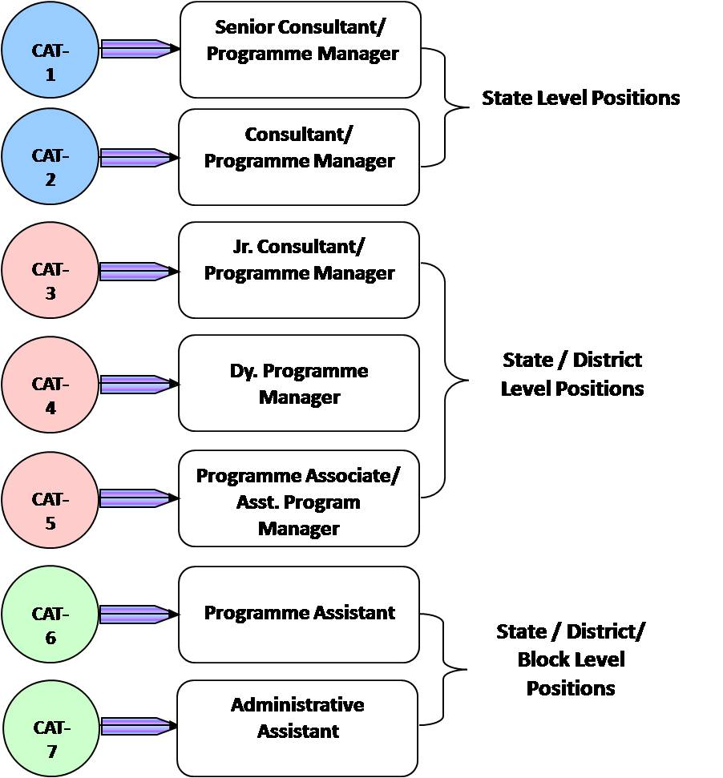
Rationalisation of HR
Hierarchical Structure- Seven (7) defined slabs.
All the manpower of parallel programmes (including DCP & NCD) were brought under this structure.

Slide 6
Blended Payment System
Base Remuneration
PI (Variable)
20%
+Annual Increment
PI (Fixed)
5%
+Performance Incentive (PI)
Remuneration
75%
= Total Remuneration

Slide 7
Performance Incentive under Blended Payment System
Fixed Performance Incentive
Extent of incentive : 5% of total Remuneration
Eligibility Criteria : At least 5 years experience in the system & secured score very good & above in three terms.
Variable Incentive
Extent of incentive : 20% of total Remuneration
Eligibility Criteria: Individual Performance assessment Report

Slide 8
Performance Appraisal
Assessment Parameters :
New PAR Format of 100 marks with CPI introduced.
  Subjective Assessment carries 30 Marks
  PIP linked CPI 70 marks.
Core Performance Indicators (CPI) for each position defined.
CPIs are PIP linked Objectively verifiable indicators
Means of Verification for each CPI identified (HMIS, FMR & other reporting)
Assessment Authority :
PAR flows through defined 3 layer reporting structure (Reporting, Reviewing, Accepting Authority).
The State Contract Renewal Committee and District Contract Renewal Committee act as grievance redressal forums.
Subjective Assessment Indicators on Management Traits
30%
70%
Objectively Verifiable Indicators

Slide 9
CPI – Examples
PERFORMANCE INDICATOR | TARGET | Highest Score | Means of Verification | Scoring Criteria
% of contractual staff whose contracts were renewed in time |  | 4 | Self certification and co-signed by CDMO | 4 = 80% & above contract renewed in time 3 = 60 to 79% contract renewed in time 2 = 50 to 59% contract renewed in time 1 = Below 50% contract renewed in time 0 = Below 30% contract renewed in time
% of funds released to blocks (as per plan) in less than 15 days of receipt |  | 4 | Fund distribution statement approved by CDMO | 4 = 80% & above funds released in time 3 = 60 to 79% funds released in time 2 = 50 to 59% funds released in time 1 = Below 50% funds released in time 0 = Below 30% funds released in time
Total expenditure against approval |  | 4 | FMR | 4 = Variance from target by up to 10% 3 = Variance from target by up to 15% 2 = Variance from target by up to 20% 1 = Variance from target by more than 20% 0 = Variance from target by more than 30%
Percentage of PIP activities with no expenditure (for RCH, NRHM and immunization section) |  | 4 | FMR | 4 = Variance from target by up to 10% (e.g. Q1 achievement lagged by 3%) 3 = Variance from target by up to 15% 2 = Variance from target by up to 20% 1 = Variance from target by up to 25%
% expenditure in untied fund (RKS, GKS and sub center) against receipt |  | 3 | FMR | 3 = Variance from target by up to 10% 2 = Variance from target by up to 15% 1 = Variance from target by up to 20% 0 = Variance from target by more than 25%
% of block paid ASHA incentive by 10th of every month |  | 3 | PFMS report | 3 = 80 % & above block ASHA paid incentive in time 2 = 60 to 79% block ASHA paid incentive in time 1 = 50 to 59% block ASHA paid incentive in time 0 = Below 50% blocks ASHA paid incentive in time.
Utilization of construction fund against release |  | 3 | FMR | 3 = Variance from target by up to 10% 2 = Variance from target by up to 20% 1 = Variance from target by more than 30%
% of facilities qualified for 3 star rating |  | 3 | HMIS star rating report | 3 = 50% facilities qualified 2 = 40 to 49% facilities qualified 1 = Below 39 to 30% facilities qualified
Total |  | 70

Slide 10
Performance Based Contract Management
Outstanding
(> 80%)
Very Good
(70-79%)
Good
(60-69%)
Average
(50-59%)
Poor
(< 50%)
Action:
Contract renewal/ Annual hike / Full PI (20% of the base remuneration)
Action:
Contract renewal/ Annual hike / 15% PI
Action:
Contract renewal/ Annual hike / No PI
Action:
Performance kept under observation for a period of 3 months/No Annual hike / No PI.
Action:
Non renewal of contract.

Slide 11
Career Progression
In house Recruitment
Opportunity for vertical growth
Retention of experienced and better performing staff
State level committee decides on the positions to be opened up for entry of existing employees through in house recruitment
Sponsorship for Courses for Capacity Building –PGDHQM & MPH

Slide 12
Welfare Measures
Incentive Package Under NHM Employees Welfare Fund
NHM Employees Welfare Fund
Funding from NHM availed
Nominal contributions collected from all employees under NHM for augmenting corpus fund.
Committee constituted at SPMU to examine & recommend payment.
Difficult Area Allowance
Annual Health Checkup of Employees above 40 years
Death/ Permanent Disability
Rs. 3 lakhs
Max Rs. 6 Lakhs*
Partial Disability between (61%-80%)
Rs. 2.5 Lakhs
Partial Disability between (40%-60%)
Rs. 2 Lakhs
Reimbursement of Medical Expenses
Up to Rs.3 lakhs

Slide 13
Way Forward
Regularisation of Paramedics.
Seniority Allowances – 1% of base remuneration of employee for each completed full term of contractual services of 11 months.(Source of fund- State Budget )
EPF for all employees under NHM with employees contribution limiting up to Rs.15,000/- per month
Induction of management personnel under Public Health Cadre
Online submission of PAR

Slide 14
Thank You

