Slide 1
Human Resources in NHM
Appraisals and Rationalisation
National Health Mission
Madhya Pradesh

Slide 2
Contents
Human Resources in NHM
Need for Appraisals and Rationalisation
Appraisal Process – Procedure
Rationalisation – An overview
Challenges
Benefits and Future Planning

Slide 3
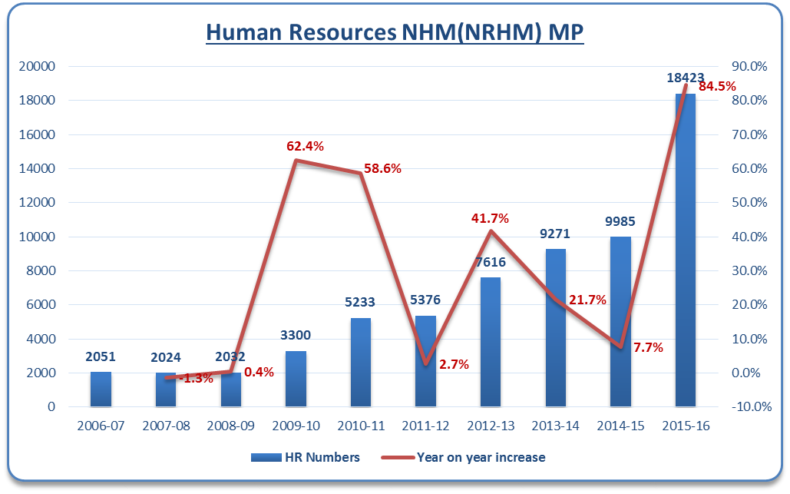
No of Human Resources – A phenomenal increase
DDC
NUHM
PMU
RBSK

Slide 4
Need for Revamping Appraisal Process
Process so far
  Subjective
  Informal
  Not Goal Oriented
  Not linked with incentives
Not Time bound
No clarity to field level supervisors

Slide 5
Need for Rationalisation
Example 1: Multiple Counsellors
Example 2: Lab Technicians – Too many
Citizen
FP Counsellor
ICTC Counsellor
Breast Feeding Counsellor
ARSH Counsellor
STI Counsellor
ICTC – 10
HIV Test
8AM to 1 PM
RNTCP – 20
Sputum
8AM to 1 PM
Malaria – 10-200
Slide
8AM to 1 PM
SNCU – 10
All
8AM to 1 PM
Regular – 100-150
All
??
Unable to provide 24 X 7 services
Similar anomalies in Data Entry Operators, Accounting staff, Staff Nurses etc.

Slide 6
Appraisal – Planning and Procedure
Appraisal Parameters
  Performance
    Measurable Parameters like HMIS, Registers, Logs etc.
    50% weightage
  Assessment of Relevant Knowledge
    Staff Nurse – Hb Estimation, BP measurement etc.
    Accountant - Tally, Excel etc.
    Written test and/or Skill Test
    50% weightage
Good | Average | Poor
65 and above | 64 to 55 | 54 and below
Contract Renewal – 1 year | 3 Month Conditional Notice to improve performance | Termination

Slide 7
Appraisal – Planning and Procedure
March 2016
State level briefing
Preparation of criteria and skill test checklist
April - May 2016
Teams – Constitution, Training
Appraisal and contract renewal of Technical Staff
June 2016
Apprailsal and Contract Renewal of Managerial Staff
Second Phase Appraisals
July 2016
Aug 2016
Appeals – Division level
Appeals – State Level
Final Contract renewals

Slide 8
Appraisal Teams
Cadre | Team Members | Total Team
ANMs | DHO-1, DPHN, BMO, Nursing Tutor/Nursing sister/ staff nurse | 51
Lab Technicians | Pathologist/ MO Lab In-Charge, BMO, Senior LT | 51
Pharmacists | Store I/C MO/BMO, Pharmacist grade-1, Store I/C pharmacist/Senior pharmacist | 51
DPMU Units (DPM,DAM,DCM,etc) | Director, NHM Director, Finance, NHM Dy. Director, NHM SIO | 1 team per cadre, appraisals scheduled in batches over 2 days
State Level Consultants | Director, NHM Executive Director, SHSRC Dy. Directors – of various Programs | 1 team
Staff of one district appraised by teams from a different district.

Slide 9
The Numbers – Technical Staff
Cadre | Total | Appraised | Contract Renewal for 1 year | Conditional Contract Renewal for 3 months | No Contract Renewal
ANMs | 5252 | 5110 | 4185 | 865 | 60
Staff Nurses | 1934 | 1849 | 1573 | 258 | 18
RBSK MOs | 935 | 930 | 816 | 83 | 1
Pharmacists | 1273 | 1227 | 1161 | 66 | 0
Lab Techs | 616 | 510 | 582 | 27 | 1
FDs | 260 | 257 | 224 | 32 | 1
DEOs | 1580 | 1570 | 1400 | 145 | 10
Total | 11850 | 11453 | 9941 | 1476 | 91

Slide 10
The Numbers – Managerial/MO/Consultant
Cadre | Total | Appraised | Contract Renewal for 1 year | Conditional Contract Renewal for 3 months | No Contract Renewal
Block Cadres | 737 | 667 | 513 | 122 | 32
District Cadres | 309 | 289 | 199 | 79 | 11
State Consultants | 125 | 124 | 104 | 17 | 3
Medical officers | 86 | 78 | 60 | 16 | 2
DEIC Staff | 87 | 87 | 80 | 7 | 0
National program | 325 | 318 | 296 | 21 | 1
PGMO OBS/GYN & Aneas | 31 | 22 | 19 | 2 | 1
LMOs | 41 | 32 | 21 | 11 | 0
Total | 1741 | 1617 | 1292 | 275 | 50

Slide 11
HR Rationalisation - Objectives
Optimum utilisation of existing cadres
Elimination of redundant or sub-optimal positions
  Divisional Cadres
Retention of trained manpower from terminated cadres by way of redeployment
  Bemonc Accountants
Multi-tasking and Integrated services approach
  Swasthya Samwad Kendra
Upgrading/Downgrading of positions based on skill and need
  Dist Nutrition Consultant, Div Comm Mobiliser to Dist Comm Mobiliser

Slide 12
Rationalisation - Redeployment
Name of the Cadre | Redeployed As
Divisional Staff | RMNCH+A Coordinators, APM (UH), State level vacancies
District Nutrition Consultant, Counselors – BFC, FP, AH | Woman Health Counselors, FDs
Div Community Mobilisers | District Community Mobiiser
BeMonc Accountants & FLA - Malaria | Accountants- DH, DAAs, BAMs
Redeployment based on qualifications, experience & appraisal scores
200 out of 450 redeployed.

Slide 13
Challenges
Process Acceptance.
Maintaining uniformity across the State.
Designing of Appraisal Formats.
Timely completion.
Litigations

Slide 14
Benefits of Appraisals and Rationalisation
Goal based approach
Transparency and objectivity in appraisal
Uniformity across the state
Performance based incentives
Better contract management
Optimum utilisation of funds
We now really know who is posted where and what he/she is doing

Slide 15
Benefits of Appraisals and Rationalisation
Total Savings ~ Rs 140 crore
  Almost equivalent to 75% of Annual Medicine Procurement Budget of MP
  More than 300% of NUHM Flexipool
  More than 100% of NDCP and NCD Felxipool combned

Slide 16
No adverse affect on services provided
Indicators | 2015-2016* | 2016-2017*
Total reported live births | 414,519 | 418,962
New Borns Breast Fed within 1 hour | 390,915 | 396,673
IPD | 1,373,447 | 1,452,593
OPD | 15,107,344 | 15,309,485
* HMIS Data : Period – April - July

Slide 17
Way Forward
Appraisals an integral part of HR policy (policy declared)
Alignment with HRMIS(under development)
Responsibility Matrix for each position (posted on NHM MP webpage)
Time Bound Appraisals and and performance based incentives
Activities | Nov-16 | Dec-16 | Jan-17 | Feb-17 | Mar-17
Process Orientation Divisional RJD's
Trainings Appraisal Teams
Sharing Of Appraisal Schedules
Appraisals Technical Staff
Appraisals Management Staff
Appeals
Contract Renewal

Slide 18
Thank you

