Slide 1
Person Centric Care through shared Leadership
A model from Banka, Bihar
East
Champaran
Gopalganj
iMadhubani
Saran
Vaishali
Begusarai
Nalanda
Banka
Kaimur
Munger
November 2019

Slide 2
The District Hospital in Banka is catering to 2.5 million population and was facing many challenges
Banka district hospital is the CEmONC centre for a population of more than 2.5 million of 11 blocks in a geographic area of 3020 sq. km.
Key Challenges :
1.Unavailability of assured services especially C-Section (Low C-section rate-1.02%)
2. Most cases were referred to higher facilities at night
3. Disease centric health care not person centric
4. High out of pocket expenditure
5. Low staff accountability and sub-optimal utilization of HR
6.Patient safety in low priority

Slide 3
Continuous Quality Improvement Program was initiated at the District Hospital to cater to some of these challenges
Hospital Leadership and frontline workers participated in Continuous Quality Improvement (CQI) from February 2018 to May 2019
Key Objectives:
  Enhance empathy and sensitivity of service providers to ensure person centric services
  Improve ability to oversee quality and safety in hospital leadership in patient care specific to mothers and newborn
  Develop and improve understanding of Quality Improvement principles and tools
  Lead data driven quality improvement activities
  Effectively coach and engage all hospital staff for No cost and effective health services
  Optimal utilization of available resources including HR, supplies, fund, etc. for person centred healthcare and generate high client satisfaction

Slide 4
The key work areas were identified to cater to some of these challenges through shared leadership at multiple levels and improved leadership behaviors
Continuous capability building of human resource for leadership
Generating staff motivation (intrinsic and extrinsic)
Bringing a culture of transparency
Optimal resource utilization
A
B
C
D

Slide 5
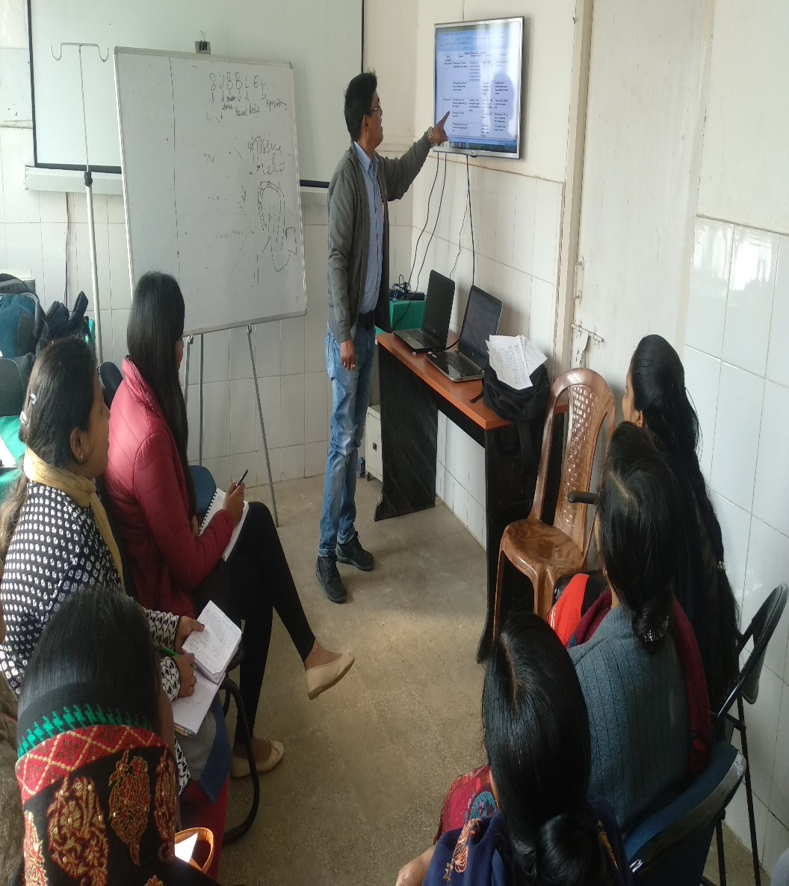
A. Continuous capability building of human resource for leadership
  Leadership Workshop for commitment and accountability from district health leadership.
  Improvement Coach Workshops to enable hospital superintendent and managers to give better coaching and mentoring support to service providers.
  Learning sessions Hospital staff participated in learning sessions for clinical training, data analysis, progress review, cross learning, experience sharing, etc. to achieve their aims.

Slide 6
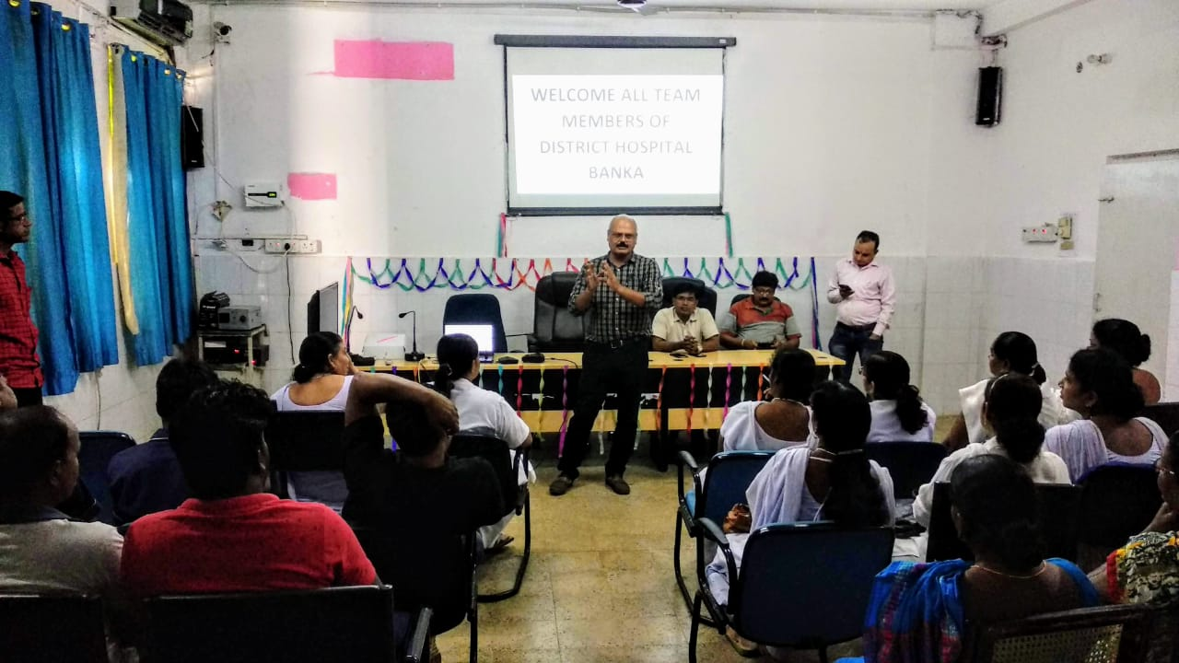
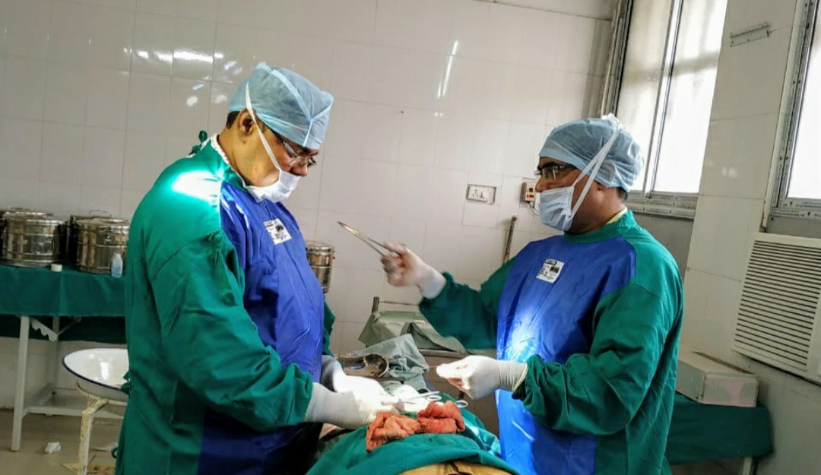
A. Continuous capability building of human resource for leadership
  Regular interaction and engagement with staff for person centric care
  Leadership allowed hospital staff to test change ideas in infrastructure redesigning
  Demonstration by doing wherein Deputy Superintendent of district hospital underwent EmOC training and started conducting emergency C-section
  Improved communication between departments like Labour Room, Operation Theatre and Sick New Born Care Unit resulted in service improvement

Slide 7
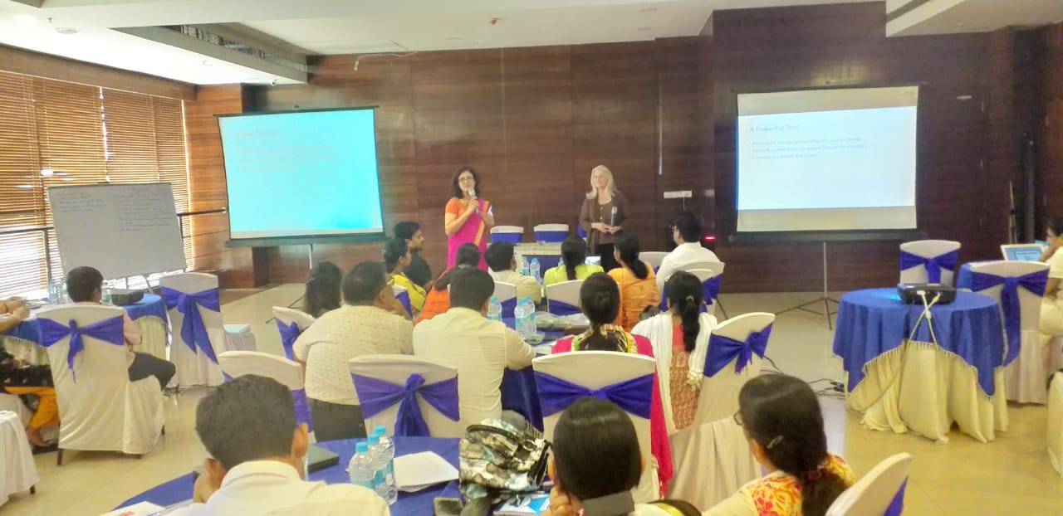
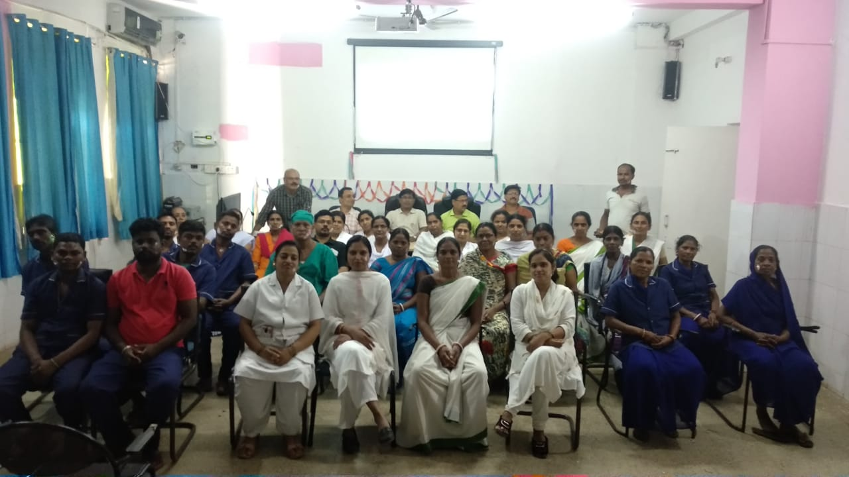
B. Generating staff motivation (intrinsic and extrinsic)
Story Telling
Informal bonding
Sharing of real stories with staff on harm caused to patients due to clinical errors, malpractices and complications during learning sessions
Helped in producing intrinsic motivation among staff for a better performance and connect with patients emotionally
Informal bonding of hospital leadership and all other staff over Tea helped in generating intrinsic motivation for teamwork

Slide 8
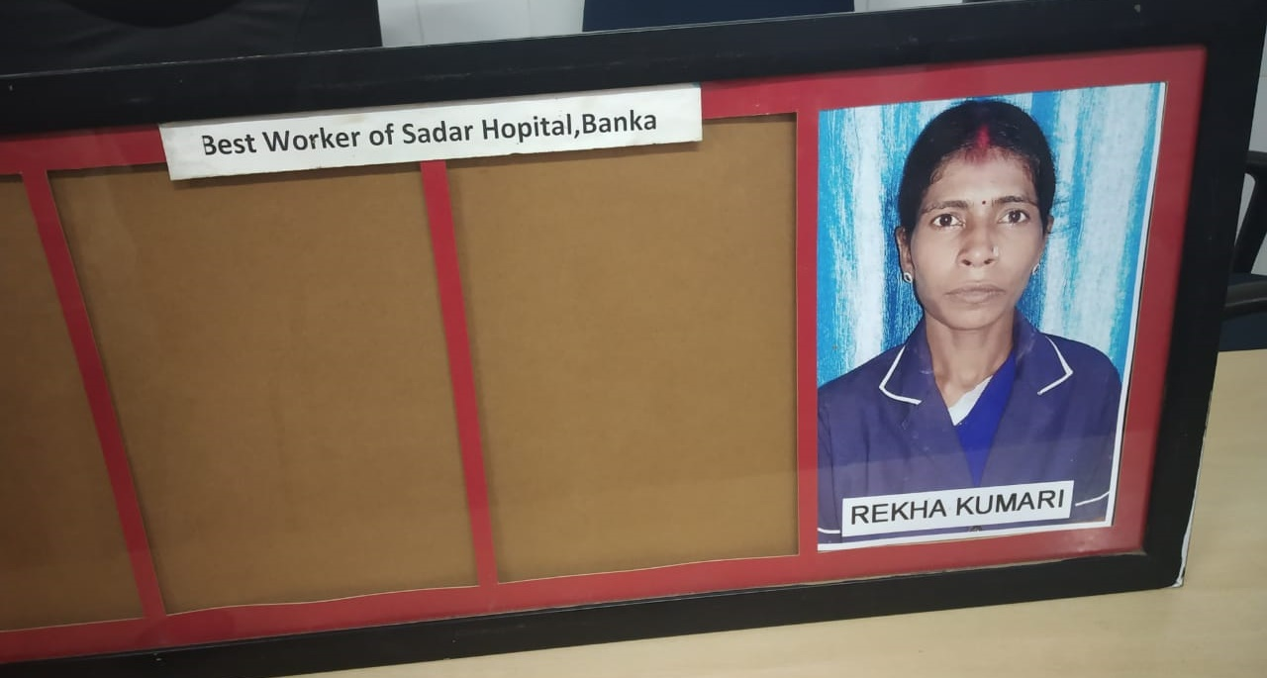
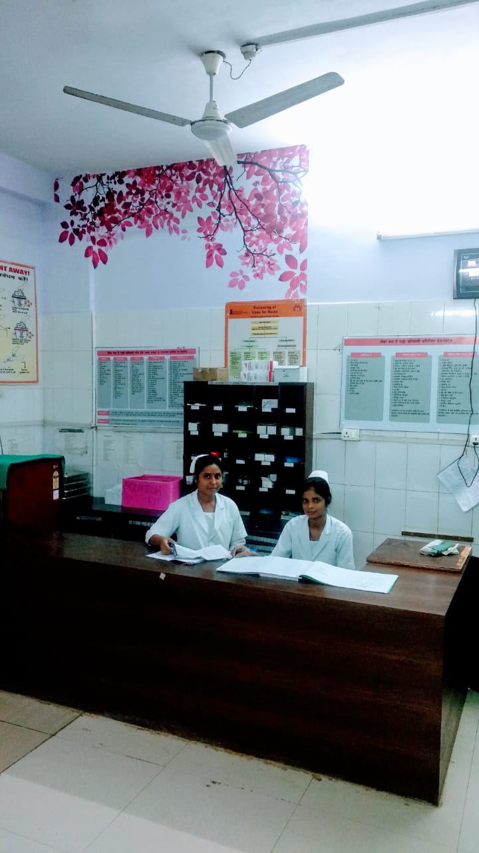
B. Generating staff motivation (intrinsic and extrinsic)
Identification and felicitation of champions
Suitable and enabling work environment for staff
To make staff feel proud about their work, Best Performer of the month award was given from hospital leadership
Transparent duty rosters, procurement of required instrument, supplies & consumables and proactive resolution of issues and grievances

Slide 9
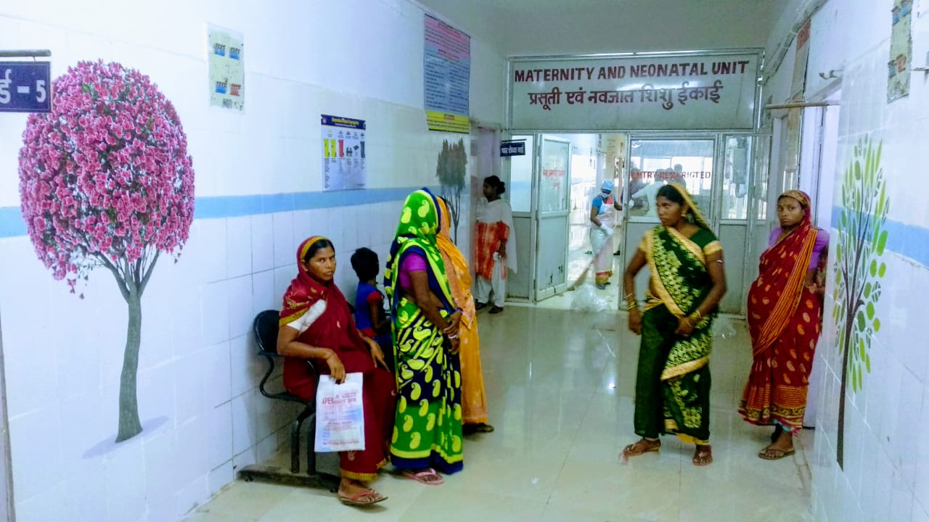
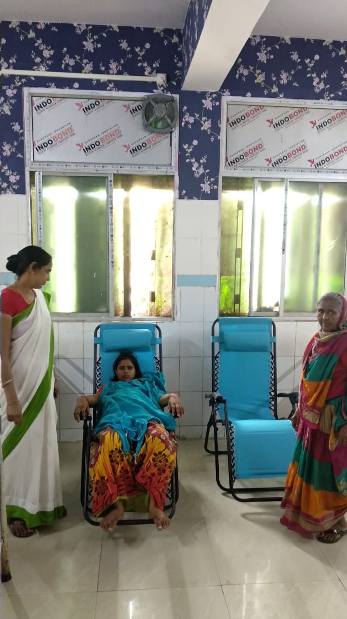
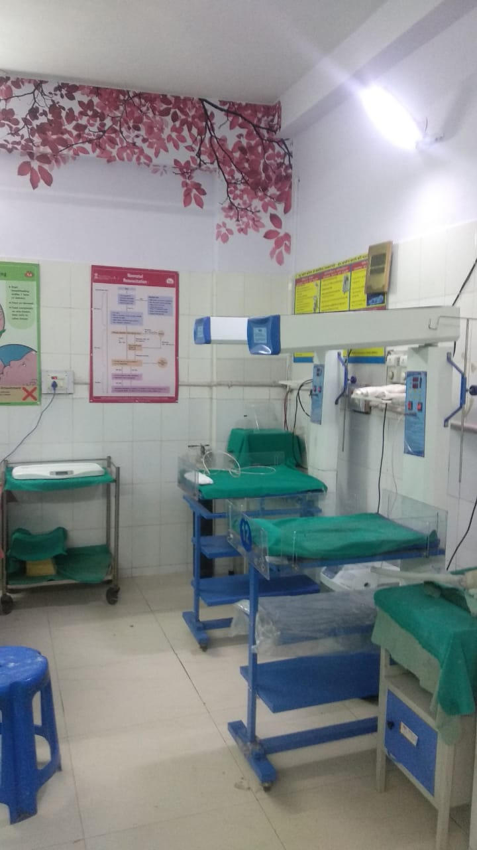
B. Generating staff motivation (intrinsic and extrinsic)
Suitable and friendly environment for mothers and families
Hospital Leadership was providing user friendly environment to mothers and families by beautiful wall painting in Maternity wing
Music & information on patient rights played on Audio Visual system
Key messages for mothers and families are played on TV in waiting area

Slide 10
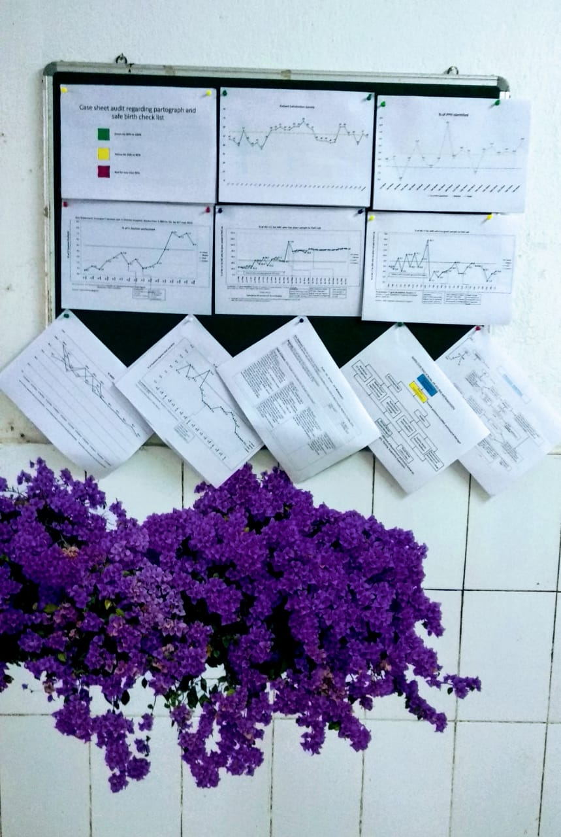
C. Bringing a culture of transparency
Transparency
Posting quality results for all to see
Sharing both good and bad patient stories
Require transparency about results, progress, aims & defects

Slide 11
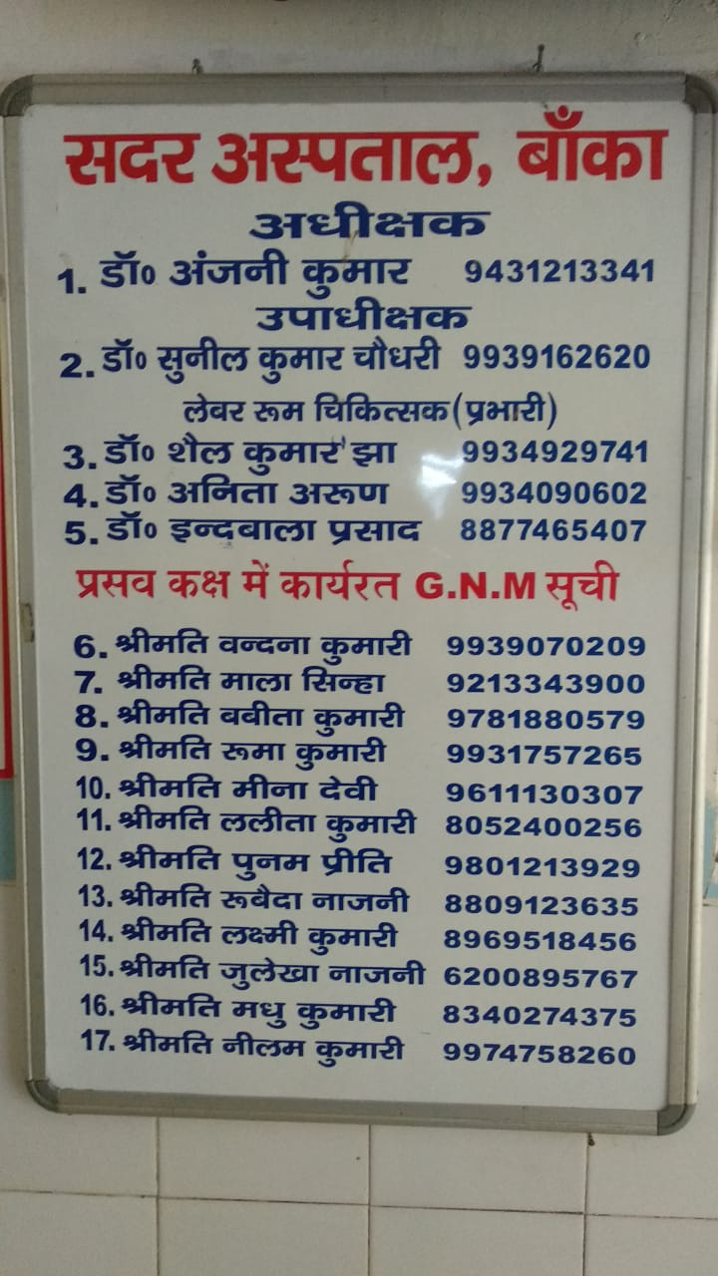
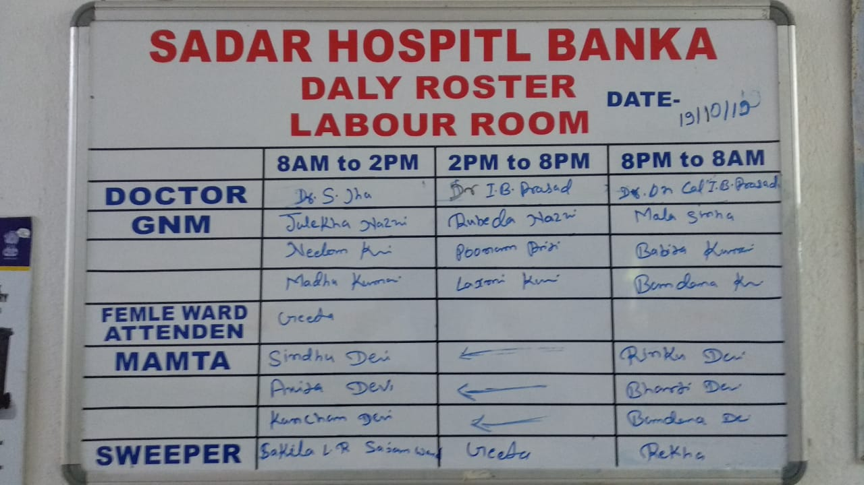
D. Optimal resource utilization
Duty Roster for all staff: Duty rosters for all staff prepared and publicly displayed for transparent and timely rotation of duty
Collaboration with other CEmONC centers: To deal with shortage of skilled HR, specialists from district Hospital visited nearby CEmONC centers located in peripheries and vice versa.
CEmONC: Comprehensive Emergency Obstetric and New Born Care

Slide 12
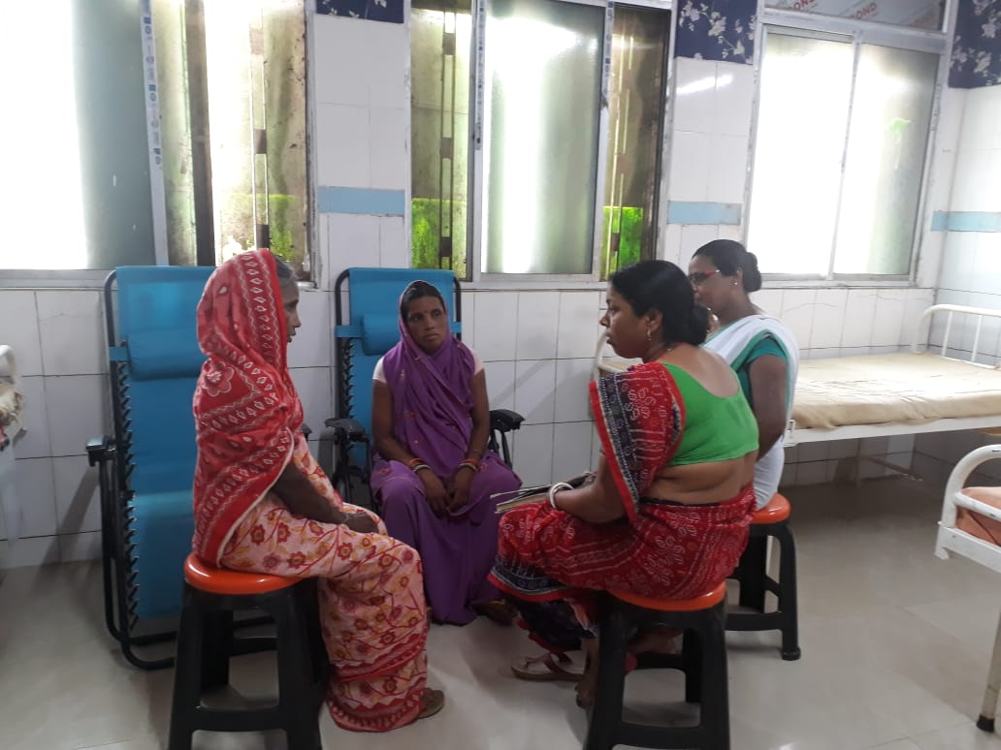
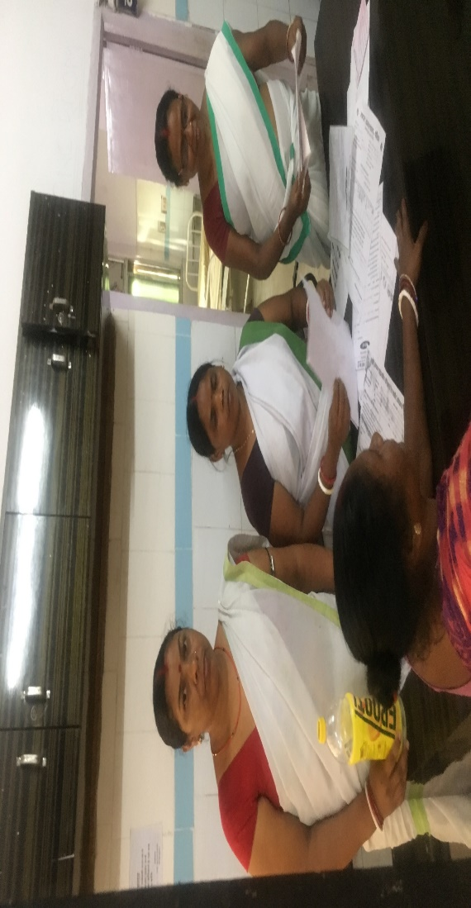
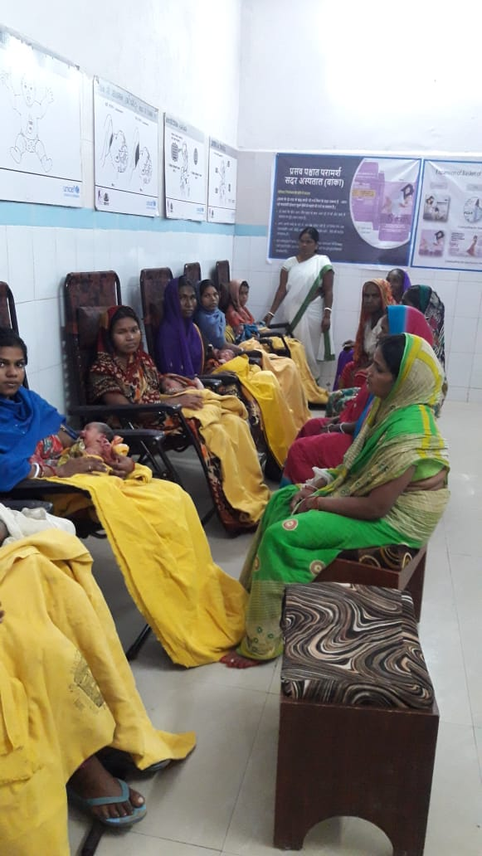
Optimal Resource Utilization
  Task shifting:
  i. Mamtas are trained to support in crowd management, counselling of birth companions and mothers about oxytocin abuse and postnatal counselling of mothers on breast feeding, nutrition,, etc.
  ii. Nurses trained to assist doctors during Caesarean section in operation theatres in absence of OT assistant.
Notes:
C. Transparent data driven discussion and public display of data:
i. Data system was strengthened with daily records, monthly summary & regular team review of key labor room data elements and indicators.
ii. In quality improvement meetings the staff participated, discussed transparently and started looking at key performance indicators like maternal complication identification and management, emergency caesarian section, blood transfusion, leave against medical advice, absconds, referrals and deaths, etc. The team tried to bring improvement in these indicators.
iii. Practice of public displaying of outcomes and key performance indicators started to generate higher degree of providers’ accountability.
iv. Regular review of data & progress in weekly and fortnightly QI meetings and clinical discussion and encouragement by leadership had motivated quality circle members to achieve their improvement aims.
v. Regular updates about CQI work were given to district and state health leadership for their support and ownership.

Slide 13
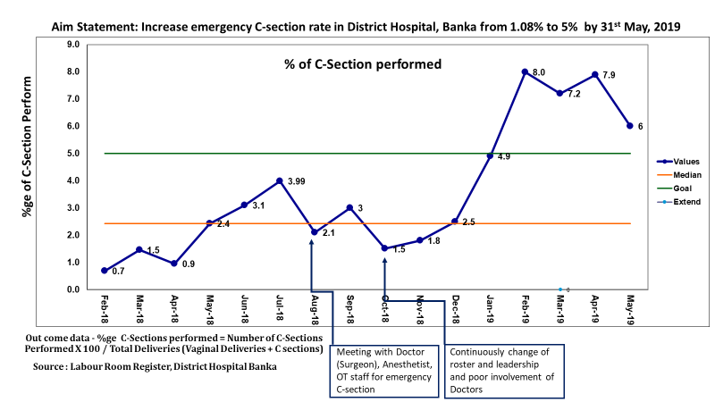
This led to noticeable improvements in the outcomes
Key Outcomes:
  Identification and reporting of maternal complications like Post-partum hemorrhage and pregnancy induced hypertension, etc. improved from 12.9% to 19.2%
  74% of complications were managed and discharged with 21% referrals and 5% LAMA(May-18 to Jun-19).
  Recording and reporting of outcome of maternal complications like managed & discharged, Referral and LAMA improved.
  Emergency C-section rate increased from a base line median of 1% (April-2017 to April-2018) to a median of 3.1% (May-2018 to May-2019)

Slide 14
The lessons learnt will act as stepping stones for the future success
Leadership of Banka district hospital clearly demonstrated five High-impact health leadership behaviours :
  Consistent focus on person and patient centric healthcare
  Genuine presence and support of leadership in hospital staff engagement
  Relentless focus on mission vision for quality improvement
  Transparency in data, defects and results for patient safety
  Encourage and practice system thinking and collaboration beyond departments and hierarchies of staff
We can keep motivation high, improve their performance, behavior and overall work culture even in a resource constraint setting through improved leadership, continuous support, training and sensitization of staff on the Human Psyche and Humane Aspects of Change

Slide 15
THANKS
“A good physician treats the disease, while a great physician treats the patient who has the disease”- William Osler
Acceptance, Attitude and Readiness of Hospital Leadership to test different change ideas can make things happen…

