Slide 1



Piloting an Antenatal Care-based Gestational Diabetes Mellitus Screening and management approach in Hoshangabad district, Madhya Pradesh
National Health Mission, Dept. of Public Health & Family Welfare Govt. of Madhya Pradesh
Dr.Archana Mishra
Deputy Director Maternal Health
NHM Madhya Pradesh

Slide 2
Need for Gestational Diabetes Mellitus screening
High Maternal mortality ratio (221-SRS 2011-13) and neonatal mortality ratio (35- SRS 2014).
GDM is associated with higher prevalence of maternal, Foetal and Neonatal morbidity and mortality.
Globally 1in 10 pregnancies is associated with diabetes; 90% of which are GDM.
High Prevalence of GDM in India (14.3%), estimated to increase to 20%.
High prevalence impaired glucose tolerance (> 140 mg/dl) - 5.8 % (NFHS-4).
40% of GDM positive women develop Type II diabetes in near future.
Notes:
Maternal Complications
Polyhydramnios, Pre-eclampsia, Prolonged labour, Obstructed labour, Caesarean section, Uterine atony, Postpartum haemorrhage, Infection, Type II diabetes
Fetal Complications Spontaneous abortion, Intra-uterine death, Stillbirth, Congenital malformation, Shoulder dystocia, Birth injuries, Neonatal hypoglycaemia,
Infant respiratory distress syndrome

Slide 3
Strategic Initiative
Goal :
To demonstrate operationalization of an integrated ANC-based GDM screening and management approach in Hoshangabad district Madhya Pradesh.
Objectives:
Introduce universal GDM screening by OGTT in accordance with the new national guidelines
Appropriate referral, treatment and follow-up support for GDM positive
Robust data management system with feedback mechanism.
Community awareness for GDM
Government of MP with technical assistance from Jhpiego, supported by Educational Grant from Novo-Nordisk implemented the project

Slide 4
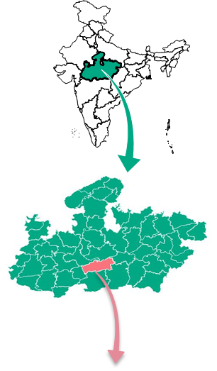
District Profile - Hoshangabad
Total population (Census 2011) : 12.94 lakh
MMR (AHS 2012-13): 218
IMR (AHS 2012-13): 59
Reported pregnancies (2015-16): 22,424
Coverage : 175 Facilities
District hospital | 1
Sub-District Hospital | 1
Community Health Centers | 7
Primary Health Centres | 14
Sub-health Centres | 152
Community Outreach | 1500 sessions in 975 villages

Slide 5
Project Approach
Facility assessment for service readiness
conducted in 26 facilities
Capacity building-competency based training
MO, SN, FD & counsellor
ANM, LT, LHV & supervisor
ASHA & ASHA Sahyogi
Resource material development for training
Training manuals
Facilitators guide
Job aids
Client booklet
System strengthening for GDM service delivery
Recording & reporting
Supervision & monitoring
First year Jan16-Jan17
Second year Jan17-Mar-17
Constitution of Technical Advisory group (TAG)

Slide 6
Facility readiness assessment-gaps (n-26, Jan-Mar 2016)
15 (58%) facilities were testing pregnant women for random blood sugar.
Only 3 of the 15 facilities (12%) were carrying out the blood sugar tests in all ANCs.
Only 3 (11%) facilities tested both mother & new born for blood sugar post partum
OGTT was not performed in any facility.
75 gm glucose pouches were not available
Service providers and field workers not trained in GDM protocols.
No follow-up mechanism for women with GDM
No data recording system for GDM

Slide 7
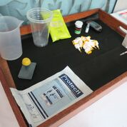
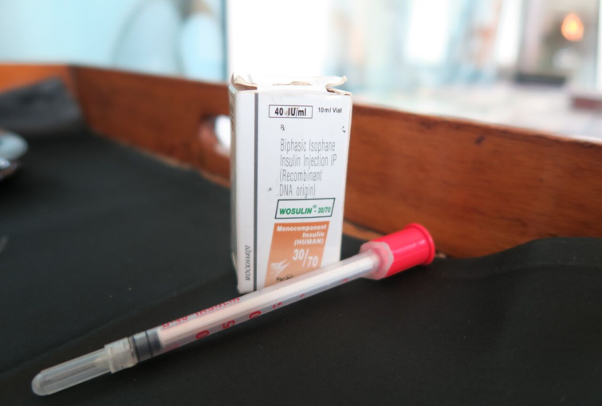
Ensuring availability of essential supplies
Capacity building
1. Glucose pouches: 75g/100g pouches procured & supplied up to the SHC level.
2. Glucometer strips calibration fluid: supplied up to SHC.
-
3. Glucometer: Procured and supplied as per National guidelines.
1 glucometer /ANM,
2 glucometers /L2 level health centre
3 glucometers/ L3 level centre.
4 Lancets, measuring mug, disposable glasses, spoons provided at all testing sites
Cadre | # Trained
ASHA | 1079
ASHA supervisor | 89
ANM and supervisor | 216
Staff nurse | 98
Doctor | 52
Lab technician | 30
Facility level counselors (NRC) | 10
Total | 1574
Notes:
ASHA-1 day training
ANM, LT, SN, MO- 2 days
Feeding demonstrator- 1 day

Slide 8
Total OGTT at Facility and VHND
Facility level :-
Total ANC Registered- 7020
GDM Screened / Positive - 4177 (59%) /291(7%)
Outreach level :-
Total ANC Registered- 18500
GDM Screened / Positive – 9289 (50%)/ 586 (6%)
Notes:
In total ANC all those women who were tested for GDM I are also included. Program is also launched in phasic manner.
There is overlapping of ANC in facility and VHND.

Slide 9
Results
June 2016 to March 2017
13466/25520 (53%) ANC clients have been screened for GDM
877/13466 (7%) PW have been diagnosed with GDM
415/877 (48%) women with GDM started on Medical Nutrition Therapy (MNT)
8 out of 877 (1%) women started on insulin therapy
264 GDM positive women delivered
17/264 (6%) GDM positive women who delivered, developed complications
Program was implemented in Phased manner
Commencement of testing and management in 2 blocks (June 16).
All 8 blocks started testing and management in January -17.

Slide 10
Challenges and learnings
Beneficiary Level
Noncompliance of clients to GDM testing in ANC & PNC
Follow up visits of GDM positive women is a concern
Availability of diet as prescribed in MNT
Service Provider Level
Outreach ANM is not focused on routine ANC care
BMI and BMR calorie calculation difficult for ANMs
MNT compliance poor due to inadequate counseling
Medical officers not confident in insulin initiation
Recording and reporting : Missing in RCH Portal and ANMOL
Under reporting of screening results to avoid follow up
Limited recording and reporting of maternal and fetal complications at facility level
Linkage with NCD clinic at DH and followup of newborn by Paediatrician
Notes:
Revision in National guidelines based on project learning's- Insulin pens vs Insulin vial, Oral anti-diabetic drugs

Slide 11
Cost effectiveness vs Scaling up of the programme
Financial Implications
Recommendations
Normal ANC requiring two tests-Rs 57 (2 glucose pouches 19 x 2= Rs 38, lancet-2 x 2=Rs 4, Glucometer strips Rs 6 x 2= Rs12, Disposable Glass & spoon-Rs 3
GDM Positive clients on MNT requiring 18 follow ups -Rs 182 per client (Glucose pouch not required)
GDM positive client on Insulin requiring 18 follow ups: Rs 1310 (Insulin-6 vials & 180 Insulin Syringes)
Cost of glucometer & training not included :
Total training cost -15 lakh
Cost of glucometer – 2 lakh
Decision regarding universal screening of GDM Vs High risk through OGTT : Urine dipstick can be considered
Techno - managerial support is required
Strengthen linkages between Maternal health, Child health and NCD program
Incorporation of GDM in RCH portal, ANMOL software, ANC registers
Involvement of DoWCD in dietary counseling
Notes:
Revision in National guidelines based on project learning's- Insulin pens vs Insulin vial, Oral anti-diabetic drugs

Slide 12
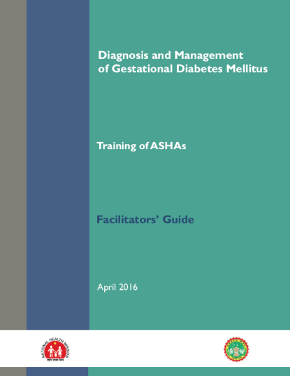
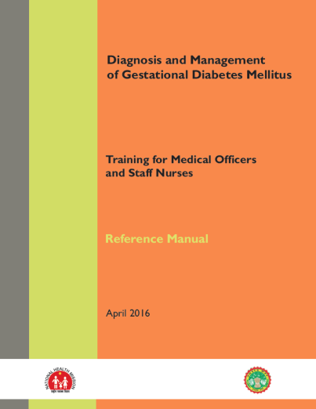
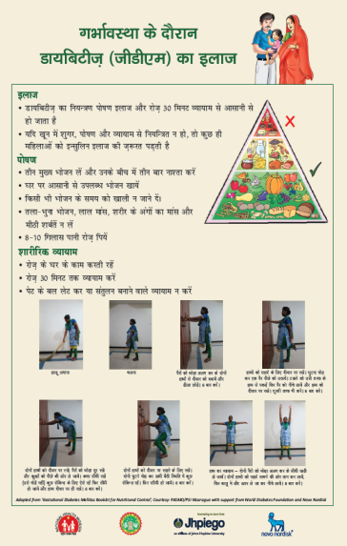
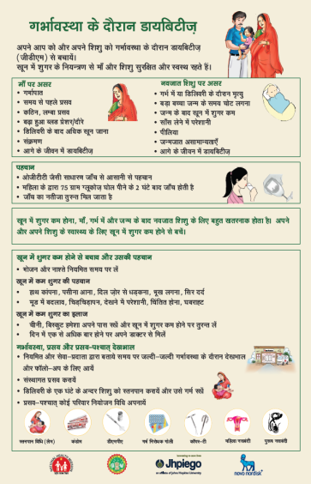
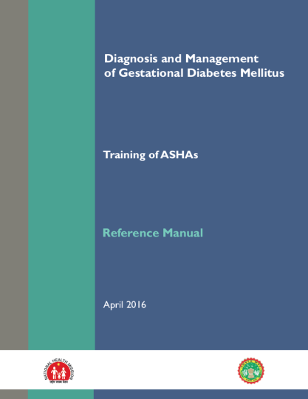
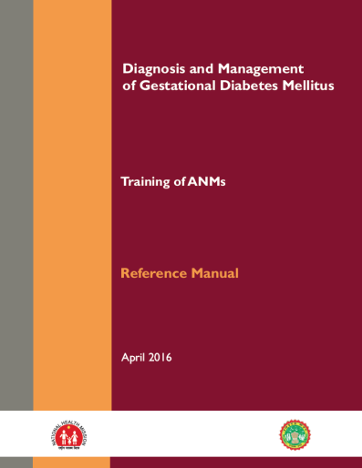
Thank You
Reference Manual & Facilitators guide, job aids for Doctors, ANM & ASHA

