Slide 1
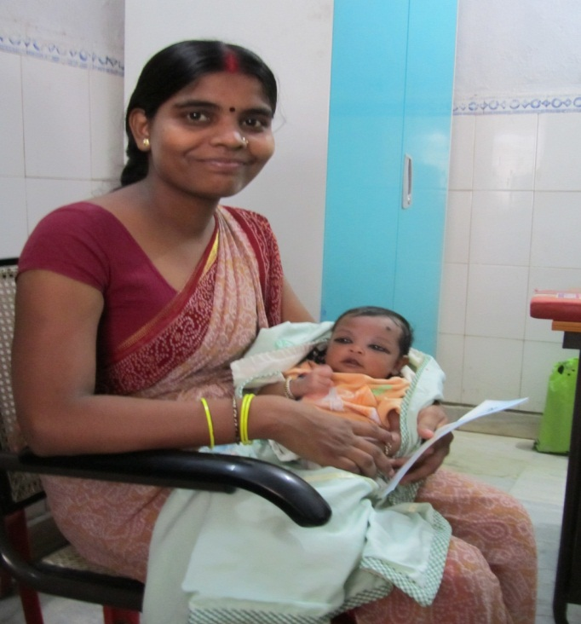
Public financial management system Health module 30 Aug 2016, tirupati

Slide 2
features of PFMS Health Module
All NHM payments including ASHA payments can be made
Developed as a part of PFMS within existing PFMS software environment & infrastructure
SMS notifications to beneficiaries on payment approval in the system
Integration with MCTS to register and validate Mother’s records
Aadhaar numbers can be used for registration of beneficiaries & payments (ABPS)
PFMS Health Module leverages PFMS Bank Integration to make DBT payments to beneficiaries on more than 110+ banks
Leverages PFMS Bank Account Validation Module to verify beneficiary accounts. Payments can be made from any bank to any bank, including new upcoming banks.

Slide 3
Features of PFMS Health Module
Single login id which allows existing PFMS users to access PFMS Health Module
Automated calculation of benefits based on pre-configured NHM approved rules
Incentive & PPP payments available for configuration for any new state through a configurable admin module
Maker - Checker process configurable up to 5 approval levels for better accountability (if required)
Simple admin module to configure rules for any new state.
System is maintained by PFMS & NIC with servers in Delhi and Hyderabad

Slide 4
PFMS (basic) vs. PFMS health module
PFMS (BASIC) | PFMS (HEALTH MODULE)
Manual Entry of payment amount for each Beneficiary | Calculate payment amount based on pre-configured rules for each beneficiary
No notification to beneficiary | SMS notification to beneficiary
Event details not captured | Event details captured as per requirement for audit trail
Standard reports | Multiple data point capture for rich analytics, reports and metrics including BI
Payments possible against all listed FMRs once configured by PFMS | Payments possible against all listed FMRs once configured by SHS. More authority to states.
Traditional fixed User Interface | Modern, lightweight & responsive UI

Slide 5
Work-Flow (in PFMs and PFMs Health module)
Record events & tag beneficiaries in PFMS HM
Review & approve the event records for payment
Generate reports and track progress based on collected metrics
Payment Channels
PPA
DSC
CINB
Step 1
MCTS -> PFMS
Update Beneficiary Record
Beneficiary Validated Data
MCTS
PFMS
Data Entry
Record events, beneficiaries and submits data
Approval
Bulk approval
Management
Reports
Detailed record verification
Dashboard
Payment Rejection
Analytics

Slide 6
WORKFLOW – beneficiary registration in pfms
Step 1
MCTS records pushed into PFMS (selected fields only)
Step 2
Agency data operator selects the beneficiaries from MCTS – PFMS master to import into Agency.
Step 3
Beneficiaries are mapped with agency.
Step 5
Step 4
Agency Operator verifies / updates beneficiary data and enters bank account information.
Bank account information validated by bank and sent to PFMS.
Step 6
Agency operator accepts bank validation or returns original bank details and submits
Step 7
Agency approver approves beneficiary
Outcome
Beneficiary available for PFMS DBT OR PFMS HM Event Recording

Slide 7
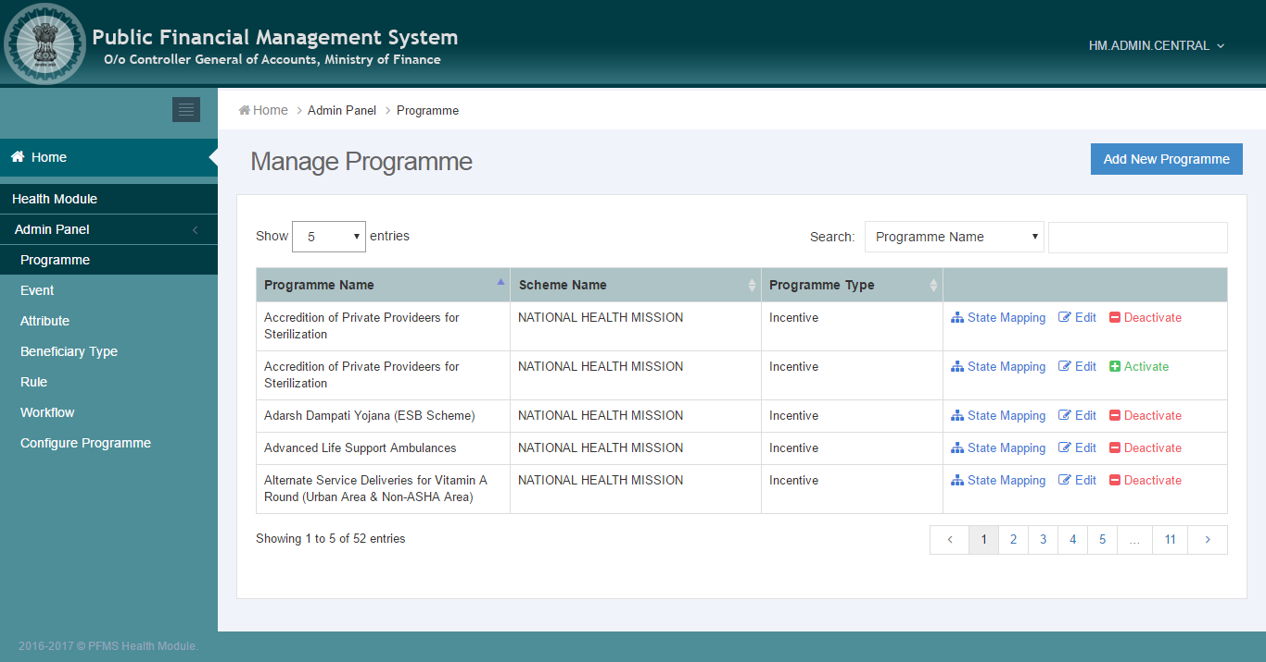
ADMIN CONFIGURATION
Full UI Based Configuration
First time users can configure without vendor support
Fast & Expressive UI
Configurable Payment Rules with review feature
Manageable by multiple users with full audit trail

Slide 8
Event recording and approval process
EVENT RECORDING | EVENT APPROVAL
Configuration of all approved NHM programmes Simplistic UI to aid in fast data entry Automated calculation of benefits based on latest rules Preview of payment details prior to submission Facilitates both bulk & per record entry | Read Only view to review & approve event records for payments Simplistic UI requiring minimal training Bulk approval support Preview of summarized & full beneficiary payment details Rejection of event records allowed with remarks and audit

Slide 9
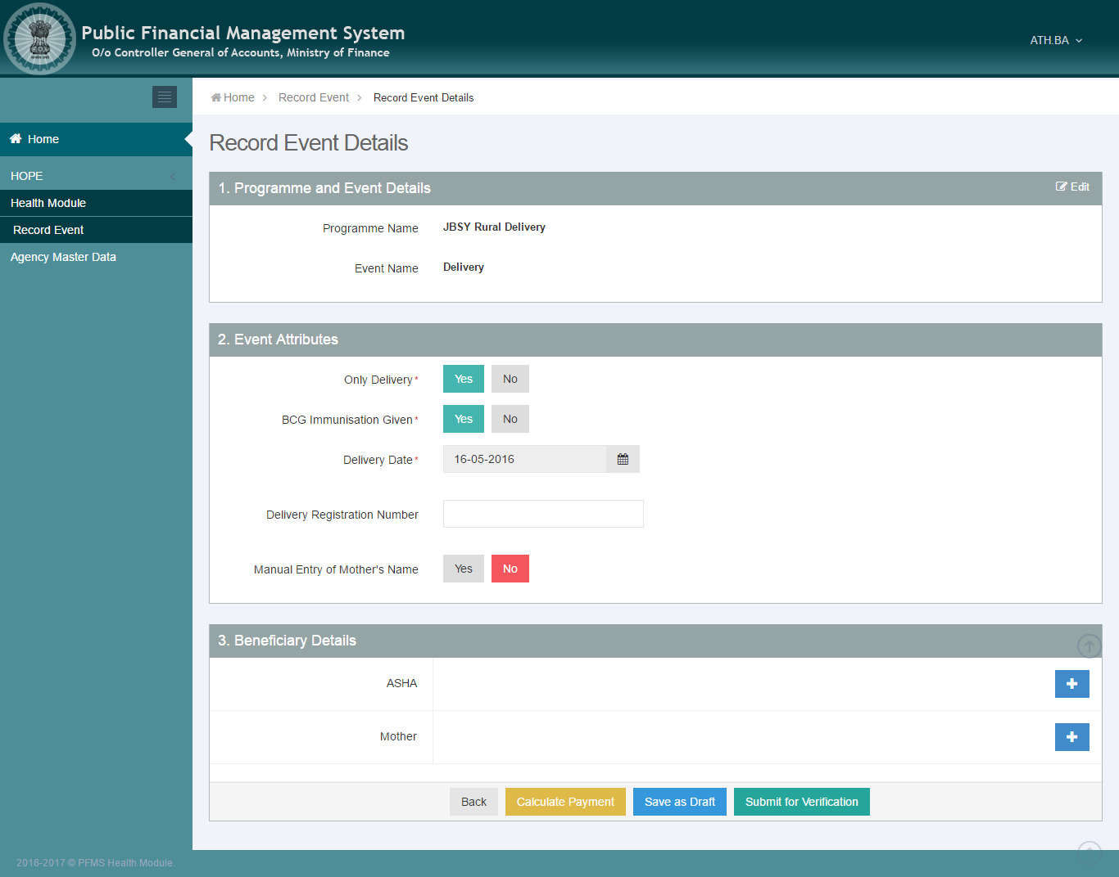
JBSY RURAL DELIVERY EVENT RECORDING UI

Slide 10
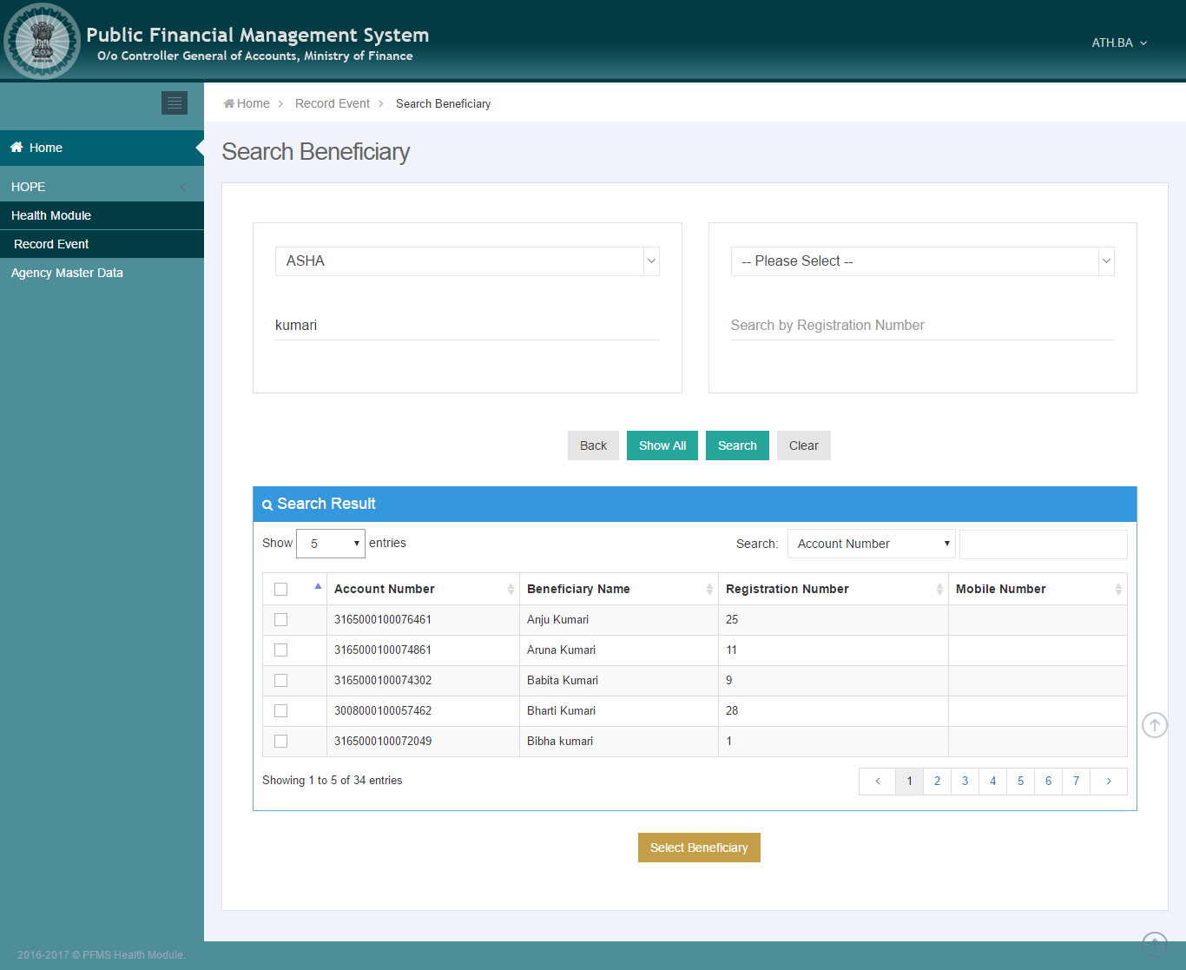
EVENT RECORDING – Beneficiary search UI

Slide 11
Analytics and Reporting - 1
Following widgets are currently available in the Dashboard and Reports, and more are being added:
Fund Status
PMU can view information regarding the allocation & utilization of funds for beneficiary payments
Transaction Processing
PMU can view information regarding the processing of events for selected beneficiary types for the selected FY
Bank Payment Ageing
PMU can view information on ageing of an event to understand time taken between event processing and receiving payments
Details can be viewed programme & beneficiary wise
Performance can be monitored
Availability of relevant information within PFMS database is a critical requirement for this widget

Slide 12
Analytics and Reporting - 2
PFMS System Access
PMU can monitor user access for PFMS Health Module
Assess end user performance
Payment Ageing
PMU can view information regarding the number of records approved & paid to the beneficiaries
State Ranking
PMU can view ranking of states based on their fund utilization, system usage and event approval timings
It will help assess performance at a national level and aid in decision making
The record level detail will be available for analysis

Slide 13
MOBILE APPS
Low Bandwidth Consumption
Android based for Mass Accessibility
Ease of Use
Seamless Data Capture & Approval Process
Minimal Training Required for Operation
Event Recording
Mother Registration through MCTS
Event Recording for Specific Activities
Event Approval
Click through Navigation for MOIC
Faster than web
ASHA Empowerment
Seamless Data Entry Process
Unprecedented Mobility
Bulk Approval

Slide 14
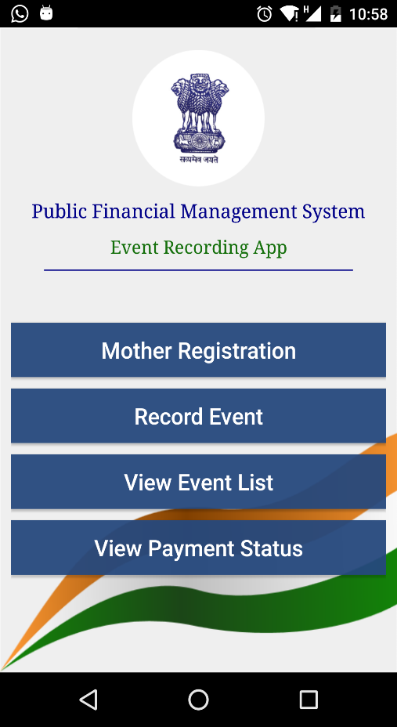
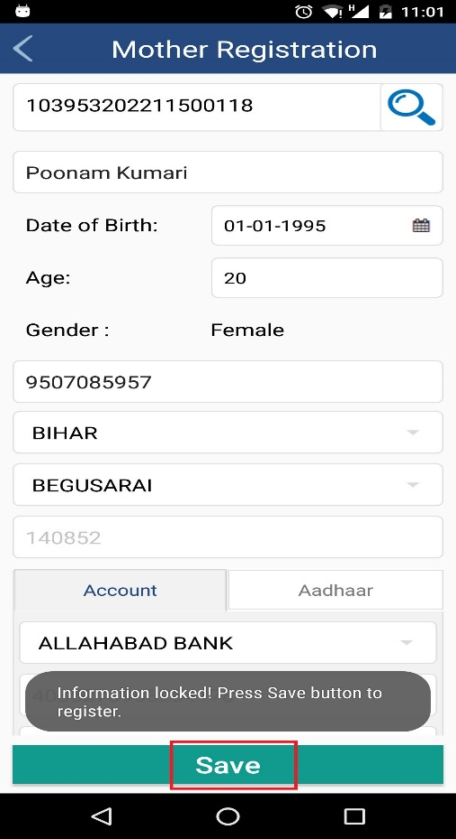
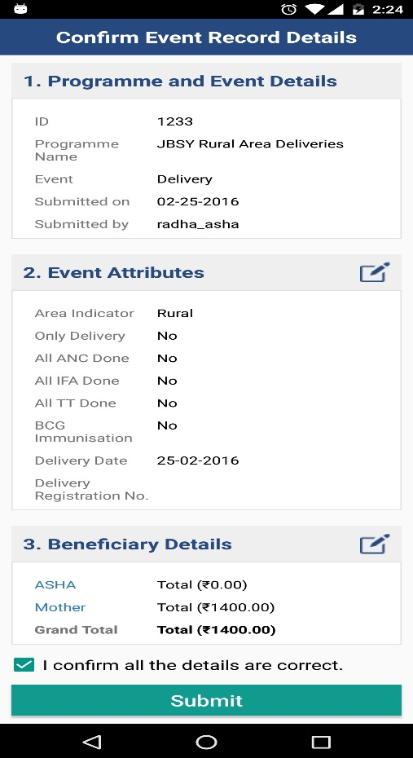
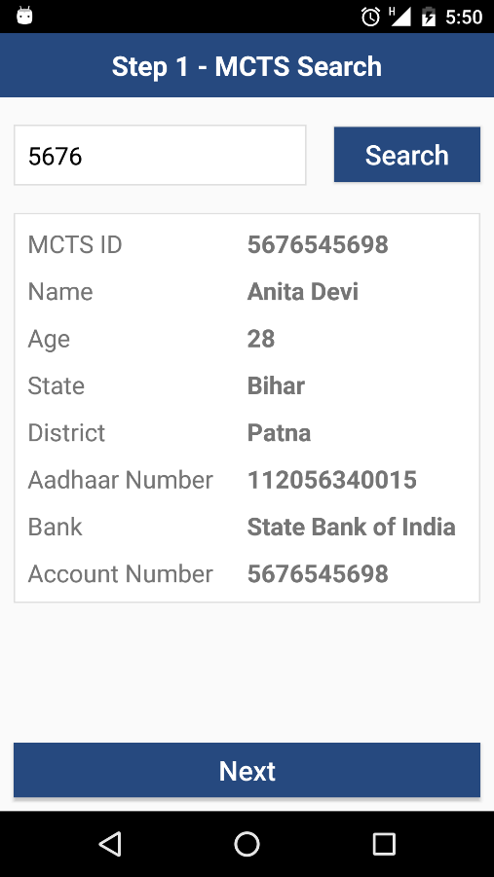
Event Recording APP ui

Slide 15
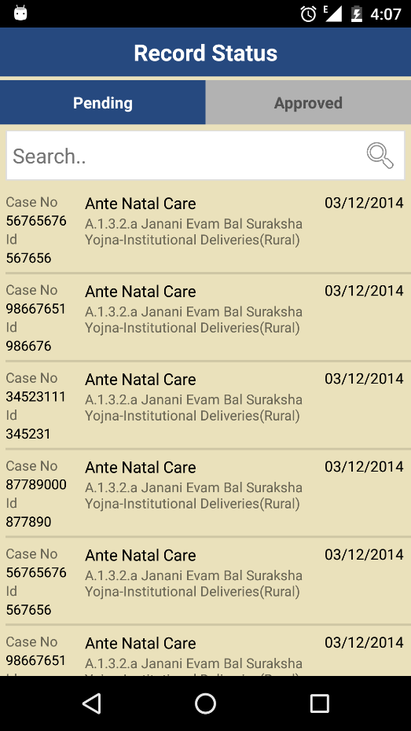
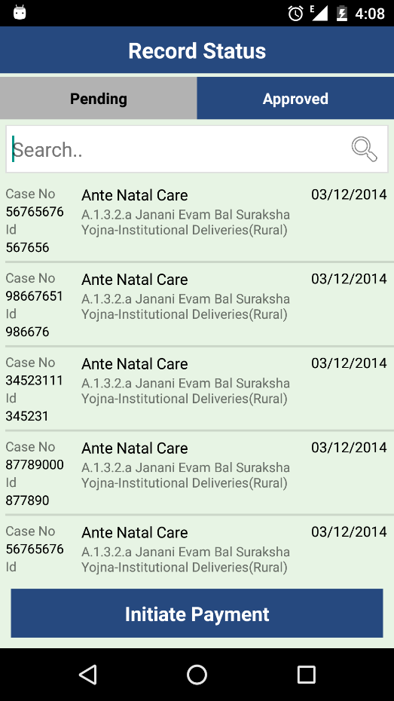
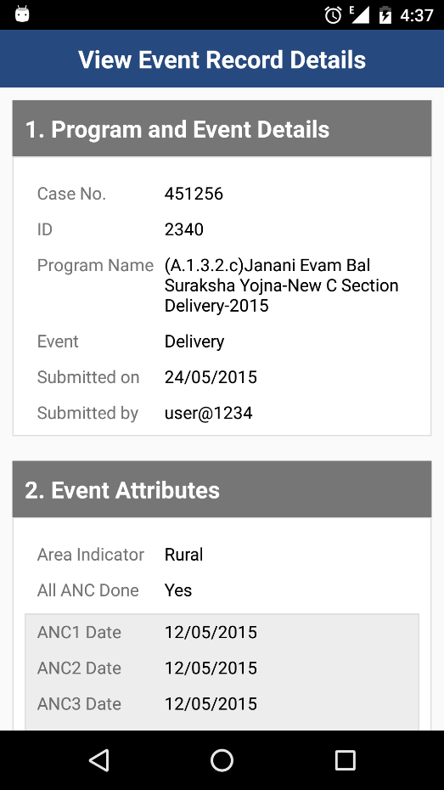
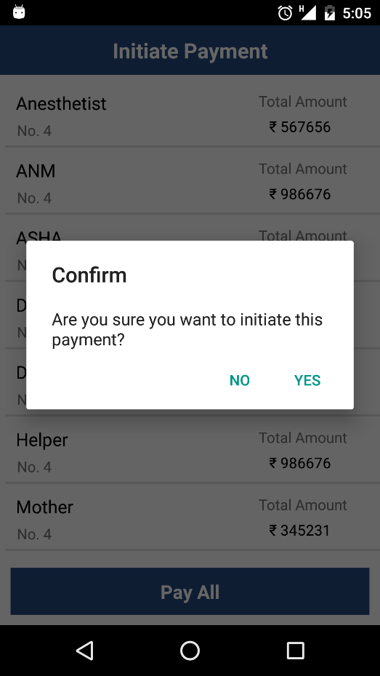
Event approval APP ui

Slide 16
Configured Programs in HM with FMR Codes
Sl No | Programme Name | Beneficiary Type/Group | New FMR Code (2017)
1 | Adarsh Dampati Yojana (ESB Scheme) | ASHA | B.1.1.3.3.2
 |  | ASHA | B.1.1.3.3.3
2 | Alternate Service Deliveries for Vitamin A Round (Urban Area & Non-ASHA Area) | ASHA | B.1.1.3.2.8
3 | ASHA Divas | ASHA | B.1.1.3.6.6.a
4 | Family Planning - Female Sterilization | Motivator/ASHA / Anesthetist/Assisting MO/ Citizen / Nurse/ANM / OT Technician/Helper / Surgeon / Clerk | A.3.1.3
5 | Family Planning - Female Sterilization PPS | Motivator/ASHA / Anesthetist/Assisting MO/ Citizen / Nurse/ANM / OT Technician/Helper / Surgeon / Clerk | A.3.1.3
6 | Family Planning - Male Sterilization | Motivator/ASHA / Anesthetist/Assisting MO/ Citizen / Nurse/ANM / OT Technician/Helper / Surgeon / Clerk | A.3.1.4
7 | Family Planning - PPIUCD Services - Insertion | ASHA / Medical Officer/SN/ANH/LHV | B.1.1.3.3.1
8 | Full Immunization | Health Worker | C.5
9 | Home Based New Born Care | ASHA | A.2.3
10 | Janani Evam Bal Suraksha Yojana for Home Deliveries | Mother | A.1.3.b

Slide 17
Configured Programs in HM with FMR Codes
Sl No | Programme Name | Beneficiary Type/Group | New FMR Code (2017)
11 | Janani Evam Bal Suraksha Yojana Institutional C Section Delivery | ASHA / Anesthetist/Assisting MO / Doctor / Mother / Paramedic / RKS | A.1.3.4
12 | Janani Evam Bal Suraksha Yojana Institutional Deliveries for Rural Area | ASHA / Mother | A.1.3.4
13 | Janani Evam Bal Suraksha Yojana Institutional Deliveries for Urban Area | ASHA / Mother | A.1.3.4
14 | Maternal Death Review | Health Worker / District Verifier / Citizen | A.1.4
15 | National Deworming Day | ASHA | B1.1.3.6.9
16 | National Leprosy Eradication Programme (NLEP) - Disability Prevention and Medical Rehabilitation | Patient | G.2
17 | National Leprosy Eradication Programme (NLEP) - Special Search Programme (ASHA Incentive) | ASHA | G.1.3
18 | NIDDCP | ASHA | D.6
19 | NLEP - Services in Urban Areas in High Endemic Districts | Doctor | G.1.2
20 | NLEP - Services in Urban Areas in High Endemic Districts | Doctor | G.1.2

Slide 18
Configured Programs in HM with FMR Codes
Sl No | Programme Name | Beneficiary Type/Group | New FMR Code (2017)
21 | NLEP Special Search - Sensitization of ASHA | Doctor / Non-Medical Assistant / Non-Medical Supervisor / ASHA / Block Community Mobilizer | G.1.3.i
22 | NVBDCP - Acute Encephalitis Syndrome (AES)/ Japanese Encephalitis (JE) | Health Worker | F.1.3.13
23 | NVBDCP - Dengue/Chikungunya - Community Sensitization | ASHA | F.1.3.k
24 | NVBDCP - Kala Azar - Loss of Wages for KA Patient | Patient | F.4
25 | NVBDCP - Lymphatic Filariasis (LF) - Mass Drug Administration (MDA) | Volunteer | F.1.4
26 | NVBDCP - Lymphatic Filariasis (LF) - Mass Drug Administration (MDA) | Supervisor | F.1.4
27 | NVBDCP - Lymphatic Filiaris - One Time Line Listing of Lymphodema & Hydrocele Cases in Non Endemic Districts | ASHA
28 | NVBDCP - Malaria | Health Worker | F.1.1.b
29 | Pulse Polio Campaign | Supervisor / Vaccinator | C.6
30 | RKSK - Mobility Support | ARSH Counsellors | A.4.1.5

Slide 19
Configured Programs in HM with FMR Codes
Sl No | Programme Name | Beneficiary Type/Group | New FMR Code (2017)
31 | RKSK - Support to Peer Educator | ASHA | B.1.1.3.4.1
32 | RKSK -Mobilizing Adolosecents for AHD | ASHA | B.1.1.3.4.2
33 | RNTCP - DOTS | Patient | H.3
34 | RNTCP - DOTS | Volunteer | H.3
35 | Routine Immunisation | ASHA | C.1.h
36 | Routine Immunisation - Alternate Vaccine Delivery | ASHA | C.1.i
37 | Routine Immunisation - Alternate Vaccine Delivery | ASHA | C.1.j
38 | Routine Immunization - Focus on Slums and Underserved Urban Areas | ANM/Hired Vaccinator | C.1.G
39 | Routine Immunization - Quarterly Review Meetings | ASHA
40 | Updating Data through USSD | ANM | B.15.3.2.14.3

Slide 20
Thank You

Slide 21
Annexure – Technical Details
Frameworks & Products Used
MVC 5 | HTML5 Responsive Design
WCF SoA - 3 tier (Web/Business/DB) | Bootstrap Layout Architecture for UI
.NET 4.5.1 | Android Studio with JDK8
SQL Server 2008 R2 | Custom Business Intelligence Tool leveraging OLAP
3rd Normalization Form
RESTful Services
Token based Authorization

Slide 22
Annexure - Architectural diagram

