Slide 1

Universal Access to TB Care -
Through Private Sector Involvement under RNTCP, Maharashtra.
5thNational Summit on Good & Replicable Practices and
Innovations in Public Healthcare Systems, KAZIRANGA, ASSAM

Slide 2
INTERVENTION 1
‘Empanelment of private X-ray’ - a tool for augmenting TB diagnosis in Mumbai, Maharashtra
INTERVENTION 2
‘Private Sector Engagement - Towards End TB’ through Innovative Private Provider Support Agency (PPSA) in Mumbai, Maharashtra
INTERVENTION 3
Access to free Fixed Drug Combination to TB patients seeking care in private sector through Nagpur Municipal Corporation’s (MH) efforts

Slide 3

Characteristic of these innovations
Recognising the prominent role played by Private Practitioners in TB care and need of involvement of Private sector in TB Programme, Government of Maharashtra undertook innovative interventions for private sector engagement.
a.
they are supported through NHM resources
b.
undertaken by existing health system
c.
significant, quantifiable and replicable results are achieved through these interventions
Outline of the Project

Slide 4

INTERVENTION 1
  ‘Empanelment of private X-ray’ - a tool for augmenting TB diagnosis in Mumbai, Maharashtra

Slide 5
Intervention 1:
‘Empanelment of private X-ray’ - A tool for augmenting TB diagnosis in Mumbai, Maharashtra
National Strategic Plan of Government of India for Tuberculosis depicts ‘Detect’ as one of the Strategic Pillar to ensure early diagnosis and treatment towards goal of ‘End TB – 2025’.
Objectives
1. Provision of ‘Upfront Free Chest X-ray’ along with sputum microscopy for all presumptive TB cases in public and private sectors
2. Decentralization of X-ray services by utilizing private X-ray facilities to reduce the drop outs for TB diagnosis
3. To reduce the ‘out-of-pocket expenditure’ amongst patients in private sector
Presumptive TB Cases
Revised Pulmonary TB
Diagnostic Algorithm
(TOG-2016)
policy of Upfront Chest X-ray
Sputum Microscopy

Slide 6




Intervention
This activity has been initiated since February 2018 in private sector and May 2018 onwards in public sector.
NGOs have been selected through a tender process as per NHM/RNTCP guidelines to operationalise the ‘Empanelment of X-ray facilities for presumptive TB cases amongst both public and private sector patients.
Target is outsourcing 60000 presumptive TB patients to private X-ray facilities out of 1.5 lakh persons examined for TB every year in Mumbai.

Slide 7




Process
Sensitised Public + Private Practitioner
Patient receive X Ray Voucher from public/ private doctors
Patient redeem X –ray voucher at the nearest X Ray Lab which are reimbursed by NGO after validation
All doctors (public and private sector) are sensitised and vouchers are kept at their clinic which are given to patients by doctors after consultation.
Patients redeem the voucher at the nearest X-ray clinic which are reimbursed by the NGO after validation.
Patients receive free quality diagnostics nearest to their residence

Slide 8
Results & Conclusion
February to August 2018
presumptive TB Cases ‘outsourced private facility
From February to August 2018 - Total 30,174 presumptive TB Cases from both public and private sector received free chest X-ray through ‘outsourced private facility’.
7,347/30,174 (24%) of patients’ chest X-rays have found to be abnormal.
2,015 (27%) have been diagnosed with TB and put on treatment amongst those with abnormal X-ray.
Outsourcing of X-rays has been found to be improving the accessibility of patients for X-rays thus reducing dropouts and ‘out-of-pocket’ expenditure and augmenting early diagnosis of TB.
30,174
(27%) have been diagnosed TB and put on treatment amongst those with Abnormal X-ray
7,347
(24%) of patients’ chest X-rays have found to be abnormal
2,015

Slide 9

INTERVENTION 2
  ‘Private Sector Engagement - Towards End TB’ through Innovative Private Provider Support Agency (PPSA) in Mumbai, Maharashtra

Slide 10

Intervention 2
‘Private Sector Engagement -Towards End TB’ through Innovative Private Provider Support Agency (PPSA) in Mumbai, Maharashtra
The National Strategic Plan (NSP) for TB has put forward a goal to end TB in India by 2025 -- five year ahead of the targets set by Sustainable Development Goals (SDGs).
It is estimated that about 50% of TB patients seek care from private sector in Maharashtra.
Hence, this intervention was undertaken to provide comprehensive diagnostic and treatment services of TB to patients through private sector.

Slide 11

Objectives
Free chest X - ray for presumptive TB cases
Free CBNAAT testing from public sector
Free daily regimen (Govt. Fixed Dose Combination) for Drug-Sensitive TB (DST) cases along with adherence monitoring through Nikshay
FDC supply through FDA approved retail chemists
Linking of drug-resistant TB patients to public sector for free second-line anti -TB drugs under RNTCP
1
2
3
4
5

Slide 12


Intervention
Following institutes are involved for Private sector engagement
Nursing Homes/Hospitals- 385
Formal Private Doctors-273
Informal Private Providers-1584
X ray Labs -177, Retail Chemist-198
Innovative scheme- PPSA (Private Provider Support Agency) was approved under National Urban Health Mission.
Private Provider Support Agency is identified as interface agency to engage the private sector.
NGOs working as PPSA
Maharashtra Janvikas Kendra
ALERT INDIA

Slide 13








PPSA Model for Integration Under NUHM & RNTCP
Gene Expert/
CBNAAT
Treatment/FDC
Chest X-ray voucher
Linkage to RNTCP
Nikshay
Notification
Treatment adherence
Counselling

Slide 14
PPSA performance from February to July 2018
CBNAAT through Public Sector
A | B | C | D
No. of pts. whose CBNAAT is done | Out of A), No. of pts. who are 'Rifampicin Sensitive' and notified | Out of A), No. of pts. who are 'Rifampicin Resistant' * | No of pts. Notified (clinically Diagnosed)
12515 | 3143 (25%) | 955 (7.6 %) | 1056 (12.5%)
X-ray done -5014/20006 (25%) were found to be Abnormal X- ray
Notification (Drug Sensitive Patients) | Direct Notification (Drug Sensitive Patients) | Total Notification
E | G | H
(B+D) |  | (E+G)
4199 (46.2%) | 4889 | 9088 (Govt. FDC-4925)

Slide 15
Conclusion
2018 (till July 2018)
RNTCP Maharashtra continues to provide quality free diagnostic and treatment services to even private sector TB patients through PPSA.
PPSA would be further enhancing the capacity to extend services to all Private Providers to reach out to all TB Patients in Mumbai as a step towards ‘TB Free Mumbai’.
418/Lakh
Total TB Notification for Mumbai
180/Lakh
TB Notification from private sector

Slide 16
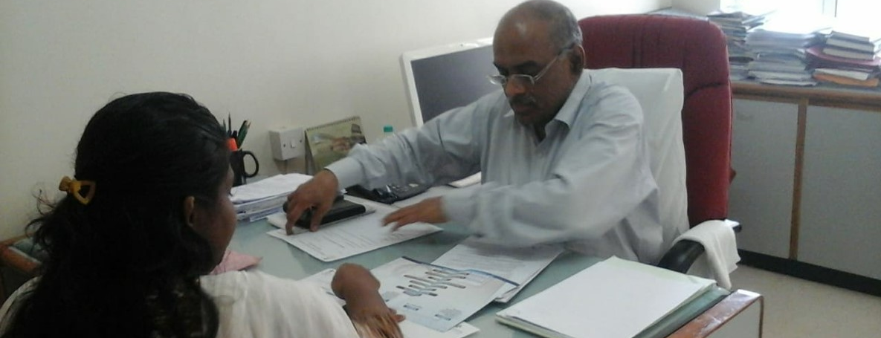
One-to-one sensitization of private doctors

Slide 17

INTERVENTION 3
  Access to free Fixed Drug Combination to TB patients seeking care in private sector through Nagpur Municipal Corporation’s (MH) efforts

Slide 18
Intervention 3:
Access to free Fixed Drug Combination to TB patients seeking care in private sector through Nagpur Municipal Corporation’s (MH) efforts
UATBC activities by the NGO
a.
b.
Facilitate notification of TB cases diagnosed and treated in private sector.
c.
Allow public sector to provide free diagnostic, treatment and extend public health services such as counseling, drug-susceptibility testing, contact investigation, ADR Support
d.
Ensure treatment completion and improved treatment adherence of TB patients in private sector
To ensure access to quality assured free TB Services to all the TB patients irrespective of source of care and thus reduce out-of-pocket expenditure to TB patients in private sector.
INTERVENTION
To further enhance the coverage and quality of care, Nagpur Municipal Corporation involved NGO (Disha Foundation) under RNTCP NGO PP Partnership scheme as interface agency between Public and Private Sector in April 2017.

Slide 19

Mechanism for augmenting uptake of Free FDCs in private sector
These Free FDCs are pre-fitted with ICT supported (99 DOTS) adherence tracking mechanism which acts as value proposition to PP’s for prescribing Free FDCs as it provides daily adherence log for their patients.
Conducting strategic IEC for generating demand among public for free FDCs.
NGO support for
1.Managing supply of free FDCs in private sector
2. Specimen transportation to CBNAAT/C&DST labs for improving microbiological confirmation.
NGO field officers distribute FDCs supplied by the government to the engaged PPs and chemists.
FDCs are further made available to private sector TB patients via PPs and chemists without disturbing their health seeking behaviour.

Slide 20
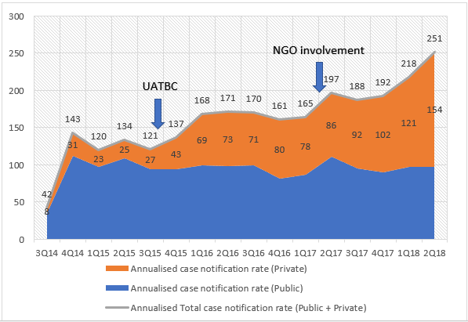
Outcome I
Sr. No. | Particulars | Total no.
1 | Agency Registered | PPs | 472
 |  | Pharmacy | 140
2 | Active Agency | PPs | 247
 |  | Pharmacy | 56
3 | Total Beneficiary | 5303
Private sector involvement status
Impact on TB case notification in Nagpur Municipal Corporation

Slide 21
Outcome II
Period | Total | Type of Medicine
 |  | Private Drugs | RNTCP FDC
2016 | 1342 | 1342 | 0
1Q 17 | 368 | 368 | 0
2Q 17 | 395 | 395 | 0
3Q 17 | 572 | 541 | 31 (5%)
4Q 17 | 608 | 520 | 88 (14%)
1Q 18 | 775 | 611 | 164 (21%)
2Q 18 | 986 | 615 | 371 (37%)
July 18 | 257 | 106 | 151 (59%)
From April-17 to July -18 | Specimen Transported | TB detected among tested | Rif Resistant | No of Rif Resistant Cases referred to RNTCP
Total | 2489 | 465 | 74 | 11
Beneficiary Trend for free Anti-TB Medicines through PPs/private chemist
Specimen transportation

Slide 22
Results and conclusion
40%
80%
UDST offered to ~40% notified private sector patients
Public health action (telephonic + home visit) provided to 95% of notified private sector patients residing in Nagpur corporation area
Strategic investment for involvement of some public-private interface agency for augmenting service delivery in private sector may be a cost-effective intervention considering a challenge of TB elimination

Slide 23
Plan
Maharashtra intends to expand these Private sector engagement initiatives in rest of the state.
Drug resistant TB services will also be provided to patients in private sector.
टीबी हारेगा! देश जितेगा!!
State intends to end TB by
2025 as per National Strategic Plan under the guidance of Government of India

Slide 24

THANK YOU!

