Slide 1



Rashtriya Kishor Swasthya Karyakram (RKSK) ADVOCACY CAMPAIGN
P. Bakshi, IAS
Secretary, Health & Family Welfare
Cum Mission Director, NHM , Government of Meghalaya

Slide 2
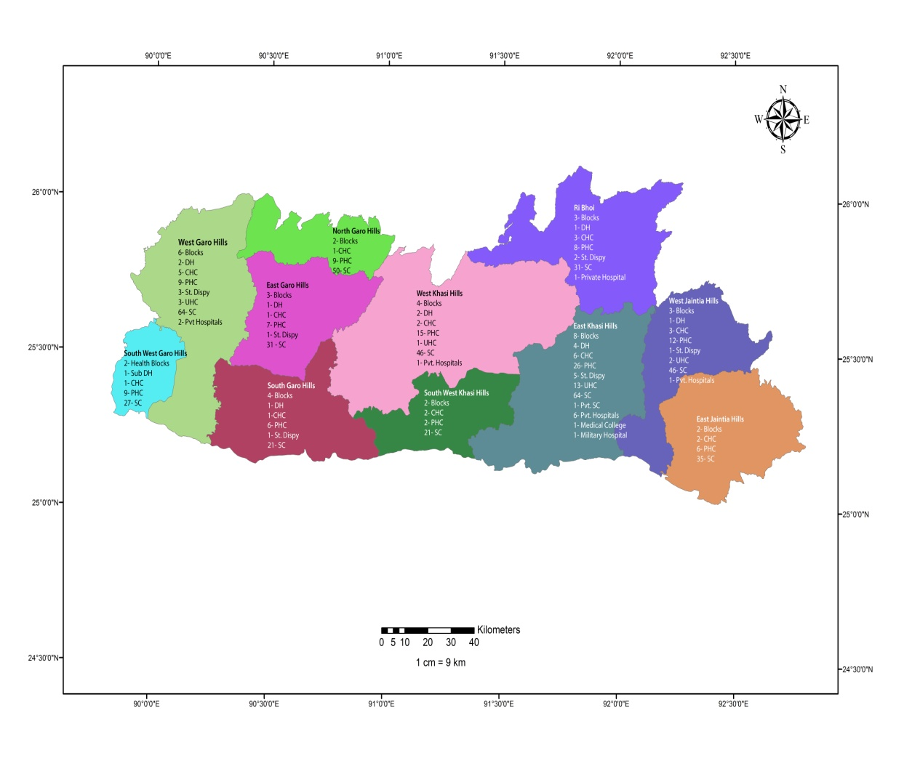


Meghalaya RKSK profile
3211474
State Population
518410 (adolescent population)
297455
In school WIFS
19524
OOSG WIFS
3414 schools
&
5115 AWC – coverage
11Districts
7RKSK Districts
Notes:
OOSG- out of school girls
7 RKSK districts : WGH,SWGH,WJH,EJH,SGH,WKH,SWKH

Slide 3
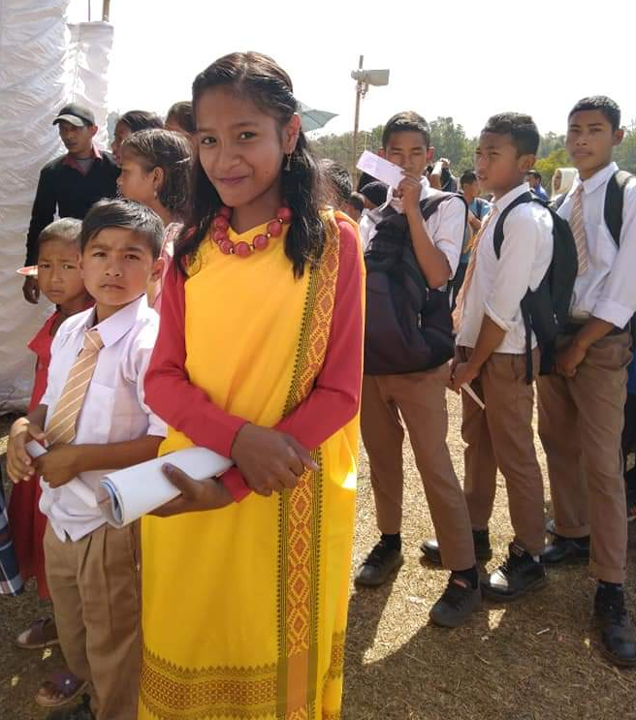
RKSK status - Meghalaya
122 AFHCs( Friends Corner) in all 11 Districts(86 in RKSK districts, 36 in non RKSK)
21 Dedicated counsellors in 9 DHs and 12 CHCs .156 MOs & 519 ANMs trained on RKSK
4256 PE selected, 3743 trained.
1064 villages in 17 Blocks implementing Peer Educator (PE) programs in 7 RKSK Districts.
WIFS implemented in the entire state

Slide 4


RATIONALE
Several rising problems among young & adolescents.
  Teenage pregnancy
  Substance misuse
  Vulnerability to RTI/STI
  Malnutrition
  Changing dietary habits
Under utilization of AFHC (Friend’s Corner) by Adolescents
Meghalaya an education hub in north east
Known as the rock capital of north east
Popular in football ,music, MMA and Music
The campaign aimed to set platform for adolescent and engage them to realize their potential and help them make informed and healthy choices.

Slide 5
CAMPAIGN - FRAMEWORK
STATE COMMITTE FOR ADOLESCENT HEALTH- SECY LEVEL
ORGANISING COMMITTEE AT DIRECTORATE LEVEL
ISSUE GUIDANCE NOTE TO ALL DISTRICTS
DISTRICT COMMITTEE FOR AH PLANNED FOR DISTRICT AND BLOCK LEVEL ACTIVITIES
DOCUMENTATION & IEC
STATE AND DISTRICT LAUNCHED HELD
ACTIVITIES PUBLISHED IN MEDIA
COMMUNICATION & DOCUMENTATION RECORDED AT STATE AND DISTRICT
COMMUNITY LEVEL THROUGH AFHC, AND PE PROGRAM
BLOCK LEVEL ACTIVITIES CONDUCTED IN ALL DISTRICTS
Notes:
Implemented in all the districts of the state (RKSK and NON RKSK)

Slide 6
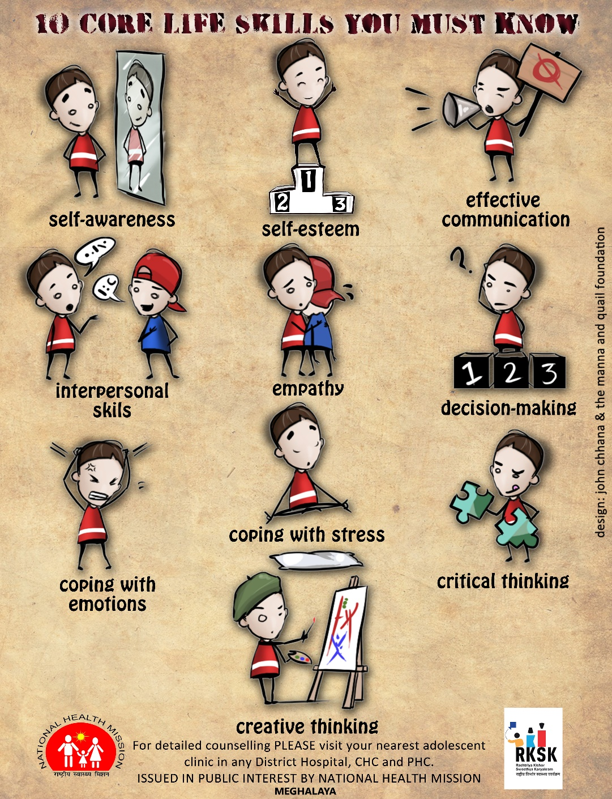
Campaign Description
Key Organizer: National Health Mission, Health & Family Welfare Department, Government of Meghalaya
Stake holders: local Youth Clubs, NGOs, , Panchayat (local dorbar) Development Partners.
Inter departmental Convergence: Education,Sports & Youth affairs, Social Welfare Departments.
National Programme Convergence: RBSK, National Mental Health Program (NMHP), National Oral Health Program (NOHP), NPCDCS and AYUSH.
District Teams: Deputy Commissioners of districts, Social Welfare Department, Sports Department, RBSK teams, National Mental Health Program, National Oral Health Program, NPCDCS and RKSK team.

Slide 7

Snapshots
174 events with 12 programme activities held in all 11 districts.
Direct Adolescent Engagement : 20,000+ youths
Topics covered------Teenage pregnancy, Substance misuse, Vulnerability to RTI/STI, Nutrition & physical fitness, Mental health and wellbeing, Oral health, Skin diseases & NCDs
Budget - Rs 1.5 lakhs at State level, Rs 1 lakh for activities in each District & all Blocks and Rs 2500 per Village in PE Implementing villages.
Special attention: Shri Conrad Sangma, Chief Minister, Meghalaya delivered a speech in West Garo Hills Shri P.W. Ingty, IAS, Additional Secretary H& FW to the Government of Meghalaya Shri P. Bakshi, IAS, Secretary Health and Family Welfare & Mission Director, NHM, Government of Meghalaya

Slide 8
KEY INTERVENTIONS OF THE CAMPAIGN
Health screenings, fun-fests
during the events to engage the adoloscents.
Football matches, marathons cyclothon, traditional sports & games.
Beauty contest, dancing and singing competition. Road shows health awareness theme
Engaging RKSK Goodwill Ambassador as
Role models for adolescents

Slide 9
Communication Plan
State Level IEC Activities: Documentation and Print and Electronic Media Coverage including social media platforms for all activities of the campaign
District/ Block / Village Level IEC Activities: Media Coverage , Social media, Facebook, Print media etc.
Hoardings/ banners/ Posters/ Road Shows/Talent shows/ meetings/ IPC etc.

Slide 10
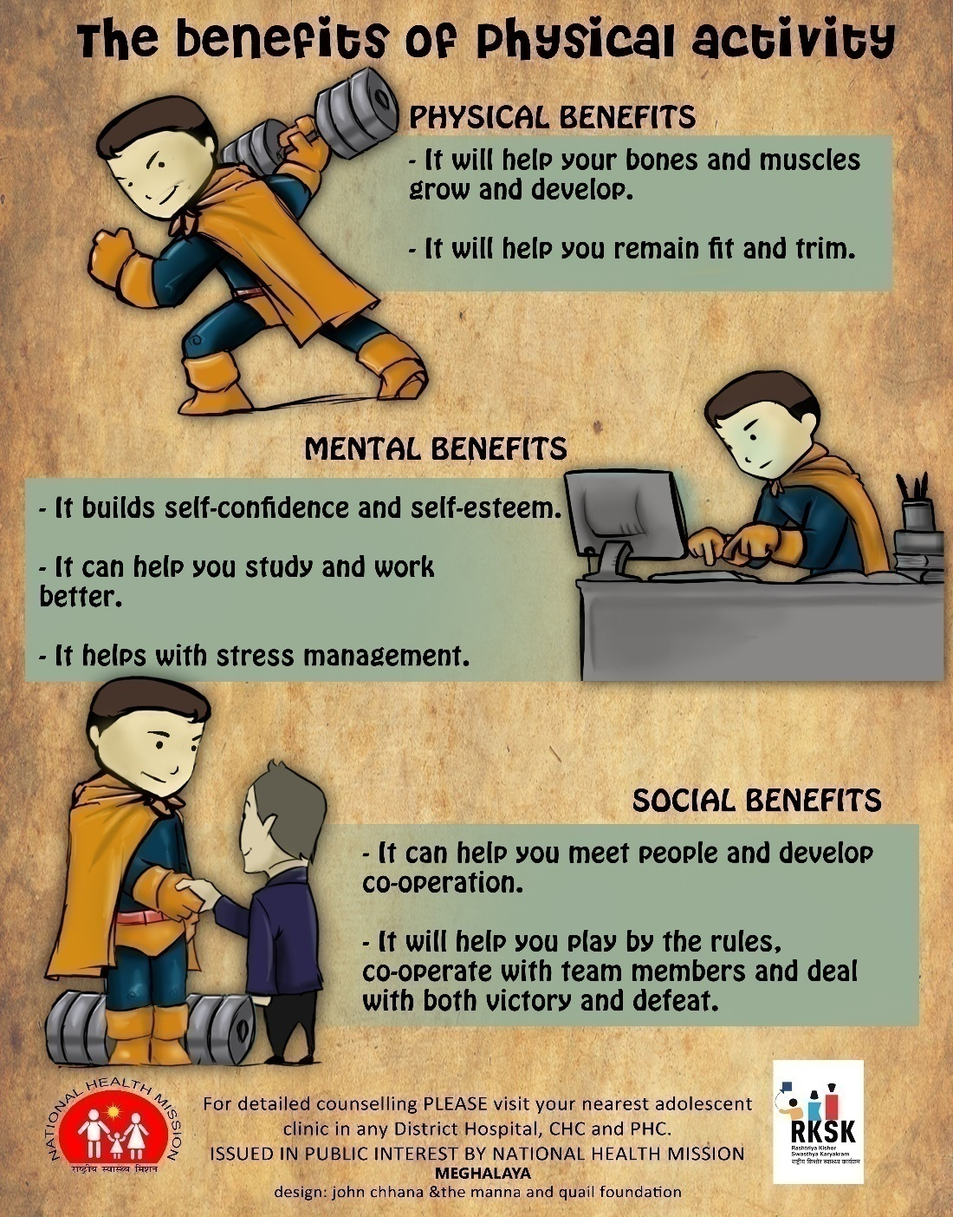
OUTCOMES
RKSK Program have gained popularity, increased awareness amongst the masses, especially the adolescents.
Strong convergence with NOHP, NMHP, RBSK and NPCDCS for targeted intervention and cost effectiveness.
Behaviour Change Communication is inevitable during this month long campaign.
Hundreds of adolescents have been reached and screened ( anaemia, BMI & oral health)
Health seeking behavior among adolescents has initiated & improved.
Act as a platform to increase footfalls at the AFHCs

Slide 11
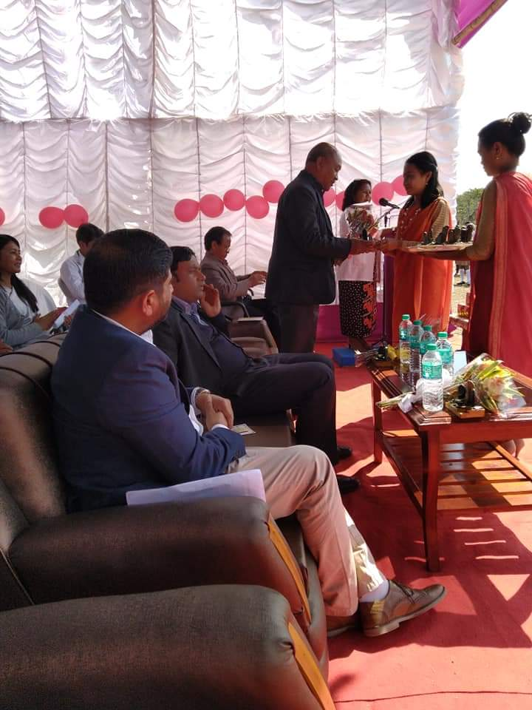
IMPLEMENTATION PARTNERS
Intra departments- Directorate of Health and Family Welfare, National Oral Health Program , National Tobacco Control Program, National Mental Health Program, National Program For Prevention And Control Of Cancer Diabetics Cardio Vascular Diseases and Stroke, National Leprosy program, RBSK , AB-HWC, PMMVY.
Inter departments - District Administration, Social Welfare Department, Sports and Youth affairs, Education departments
NGOs - Youth clubs, Gram Panchayats, Faith based organisation.
Development partners- JHPIEGO(USAID) in 3 three district implementing AB-HWCs, namely Ri Bhoi District, West Jaintia Hills and West Garo Hills.

Slide 12


SCALABILITY
Block Level Campaign was held in 1st quarter of 2019-20 with a theme “ Effects of tobacco use and drug misuse among adolescents” .
Healthy lunch box competition was held in the form of mega AHD ( adolescent health days ) during the Poshan Abhiyan (2nd Quarter ) with a theme “ Eat Well Feel Good” for anaemia prevention and promoting local balanced and healthy diet.
These activities can be organized at block and village level in close convergence with existing programs & departments by sharing the same platforms for maximum outcomes.

Slide 13
RKSK Video
RKSK Video.mp4

Slide 14
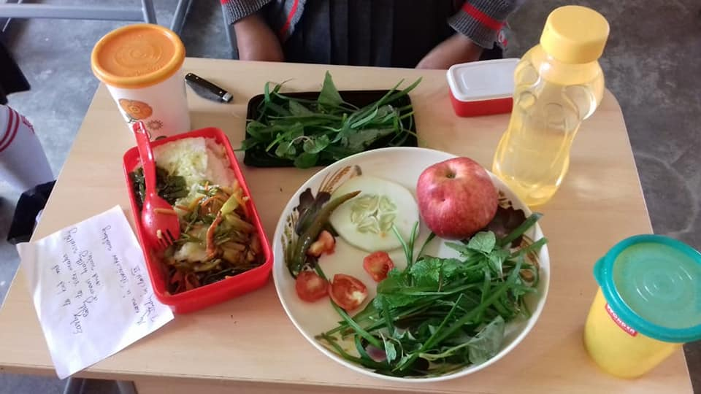
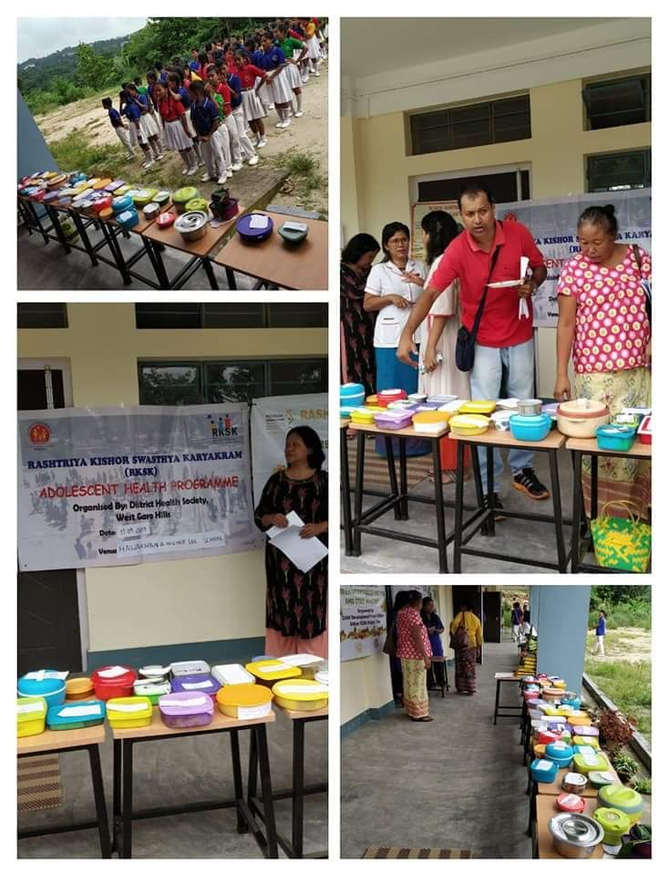
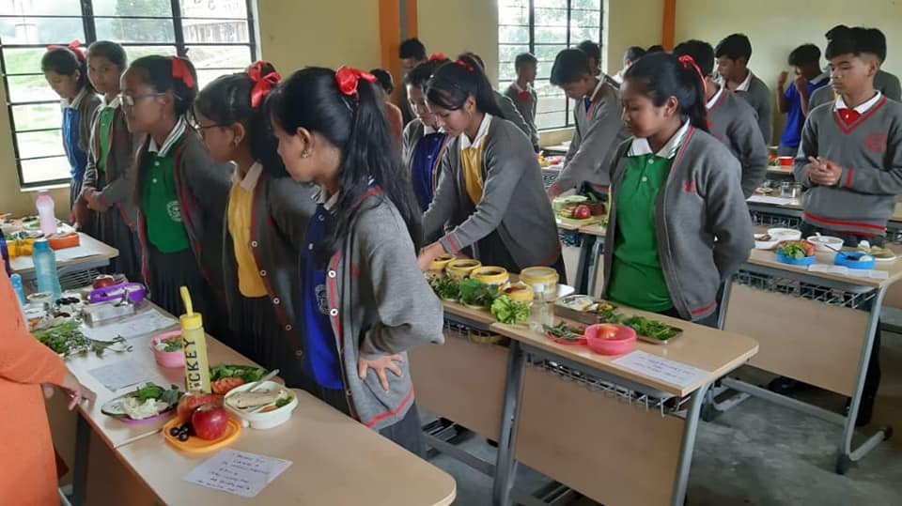
TIFFIN BOX COMPETITION

Slide 15
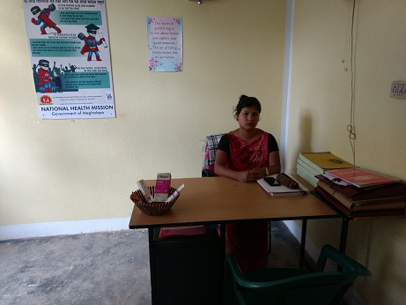

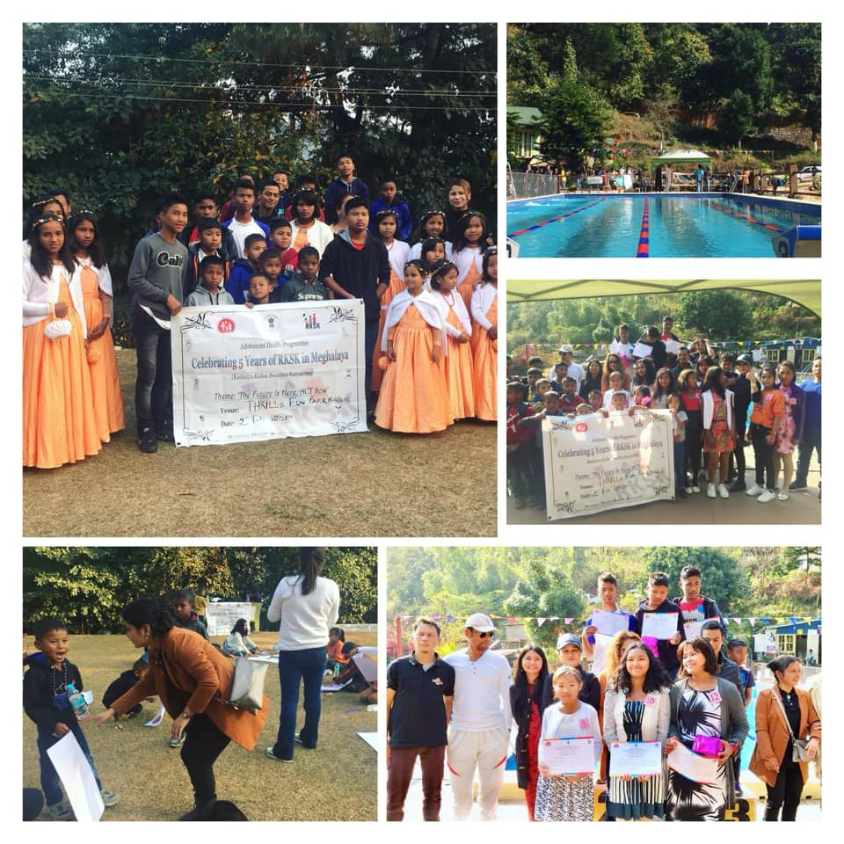
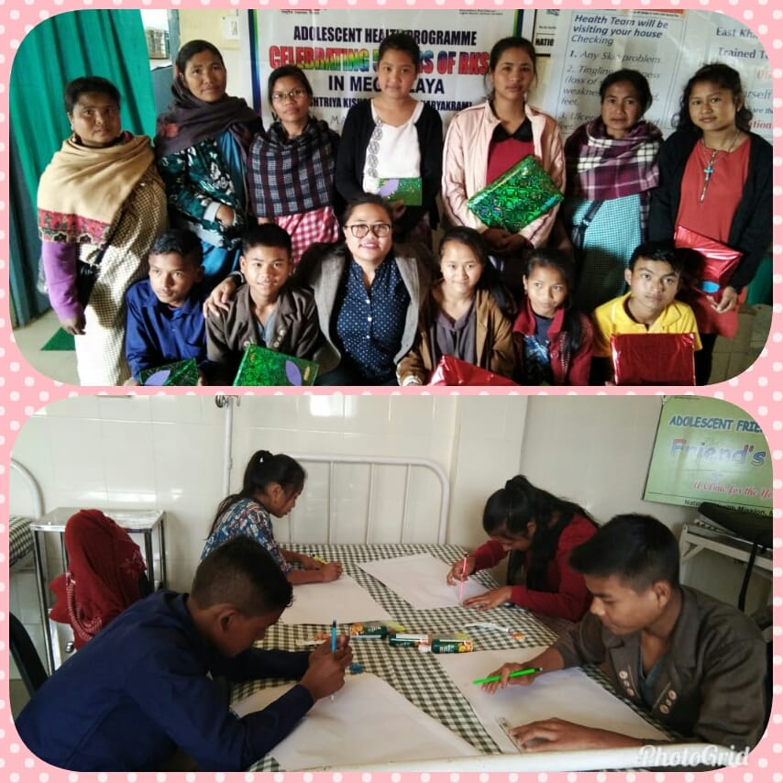
Each AFHCs organised specially designed field activities

Slide 16
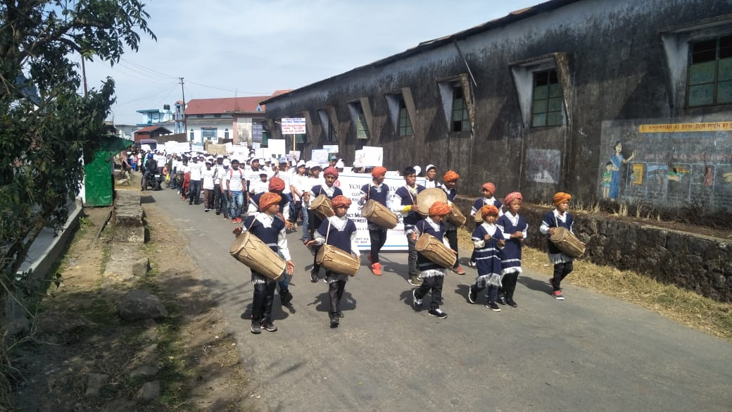
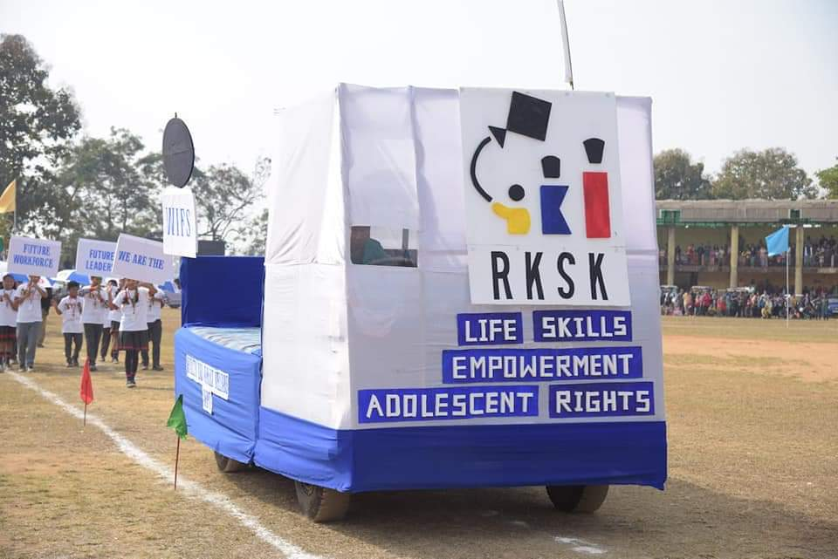
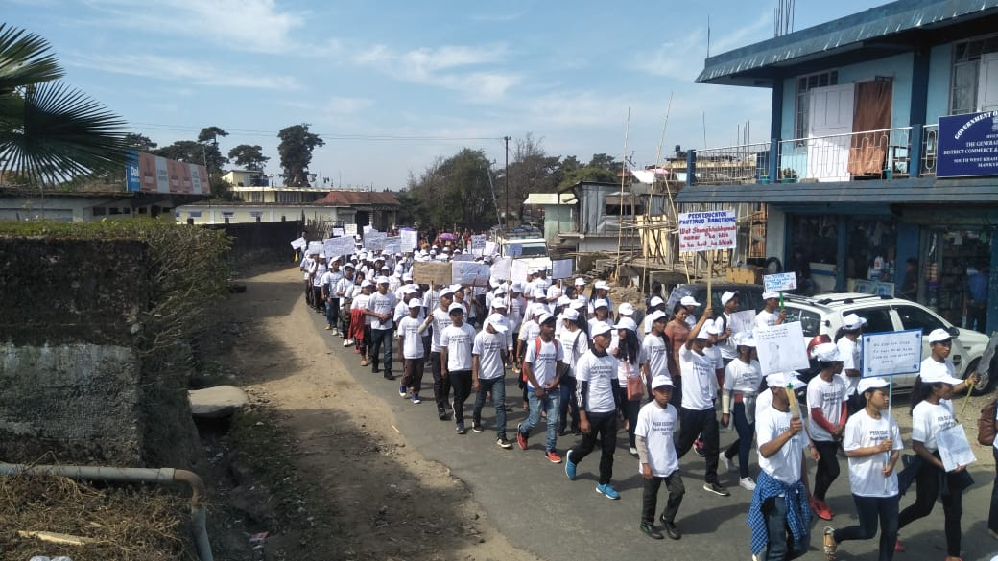
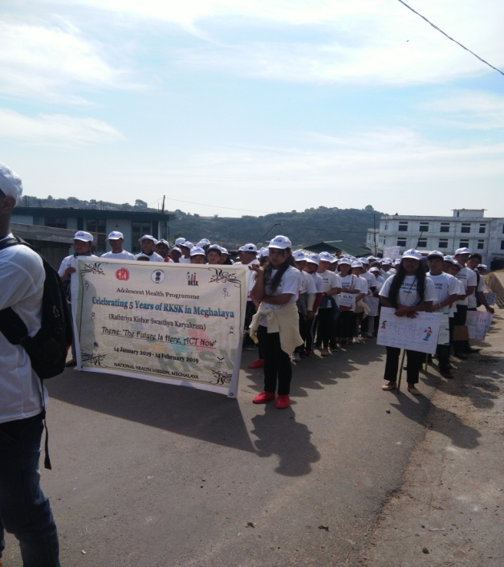
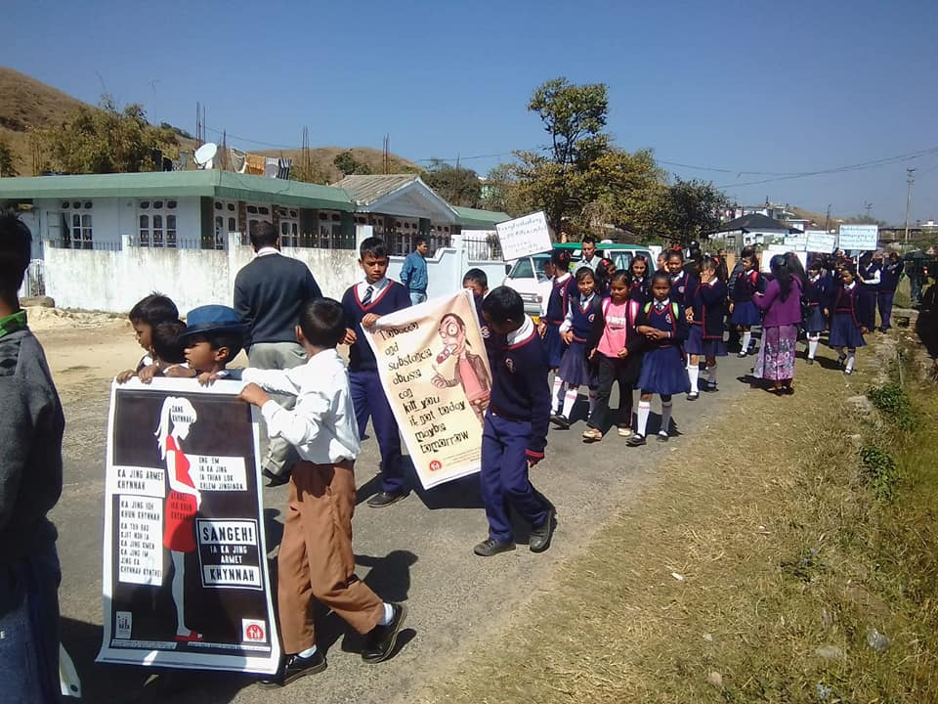
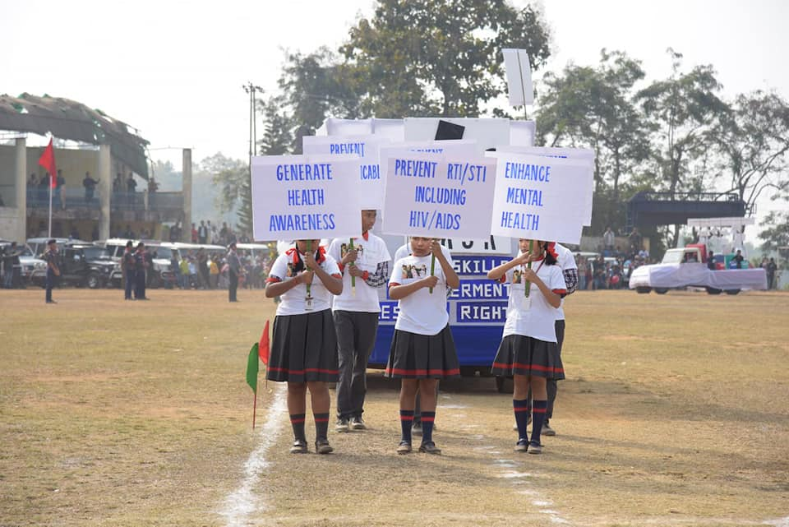
Road Shows

Slide 17
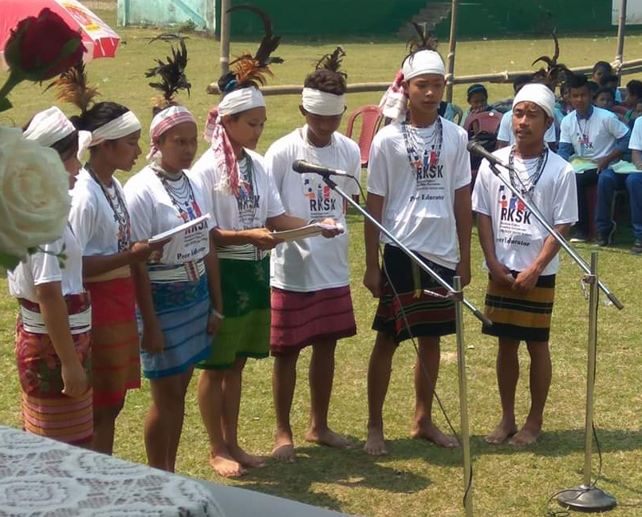
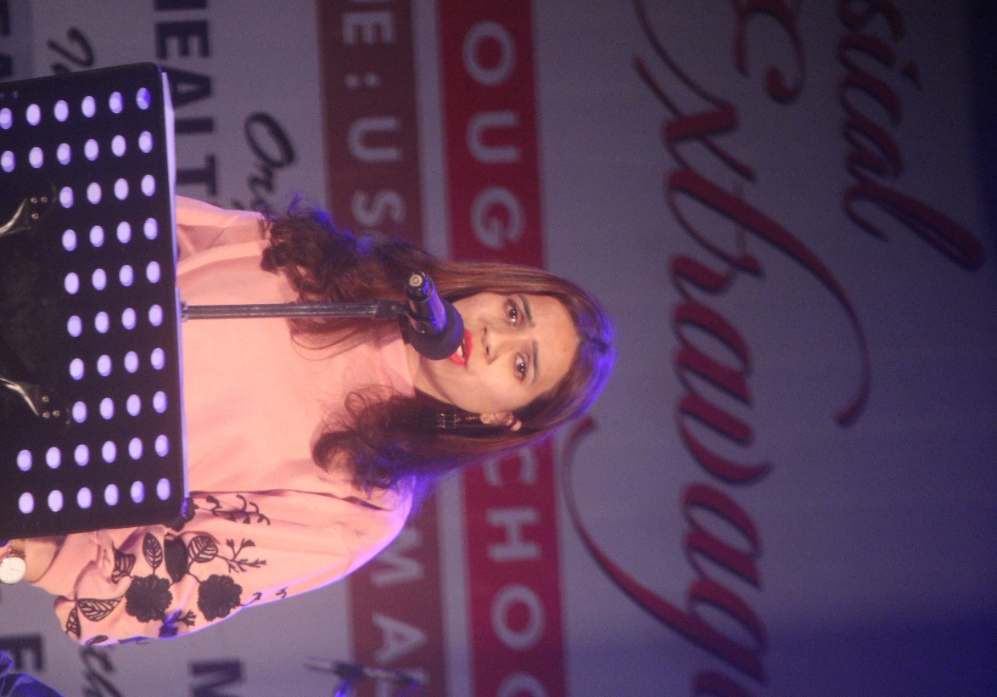
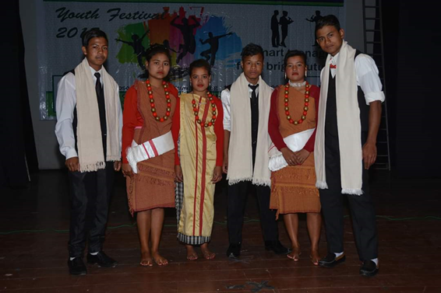
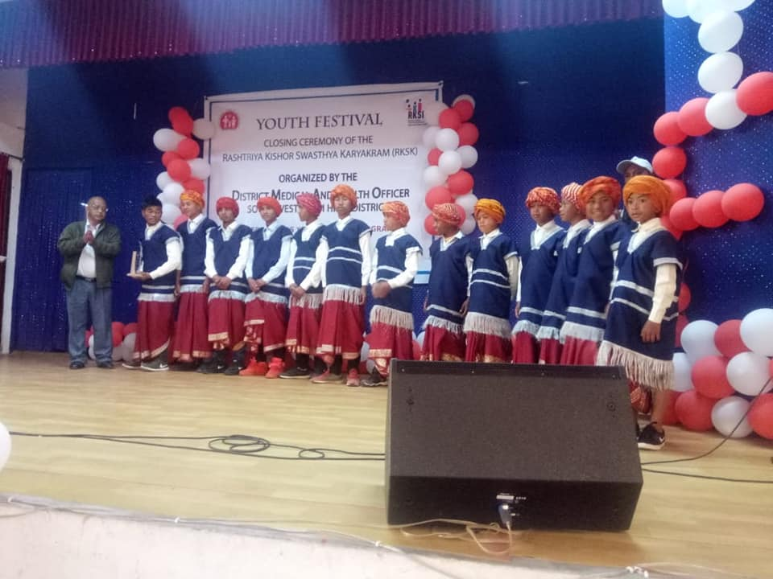
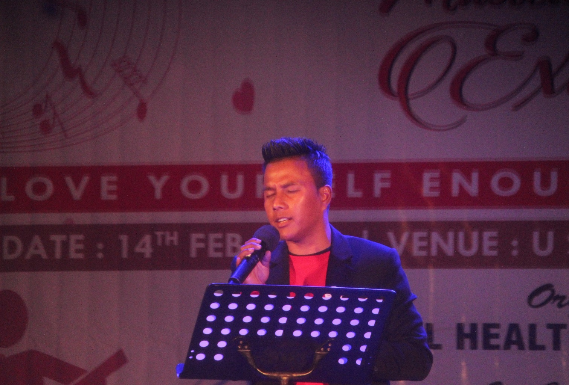
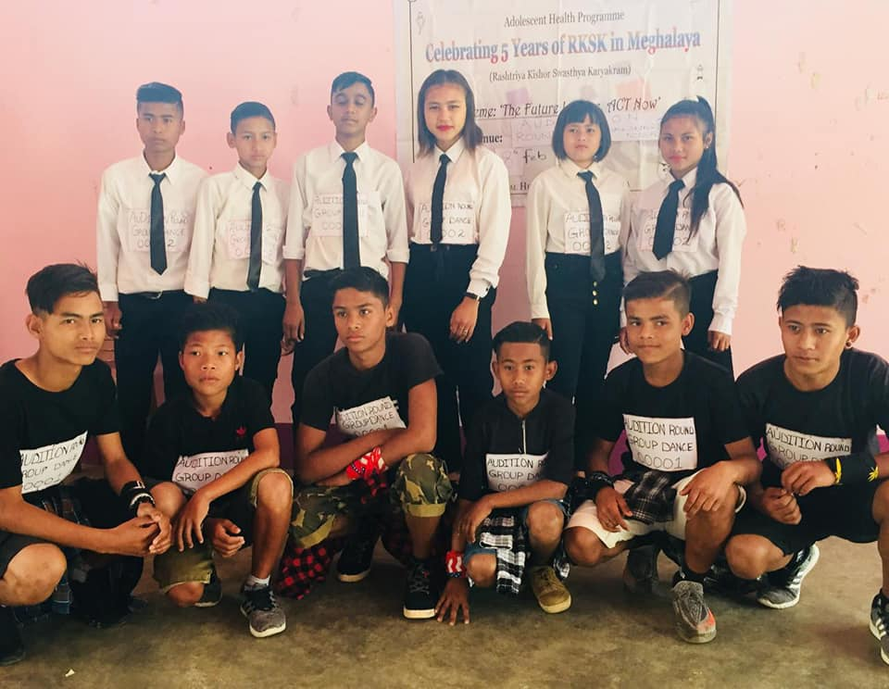
Talent Show (Dancing & Singing)

Slide 18
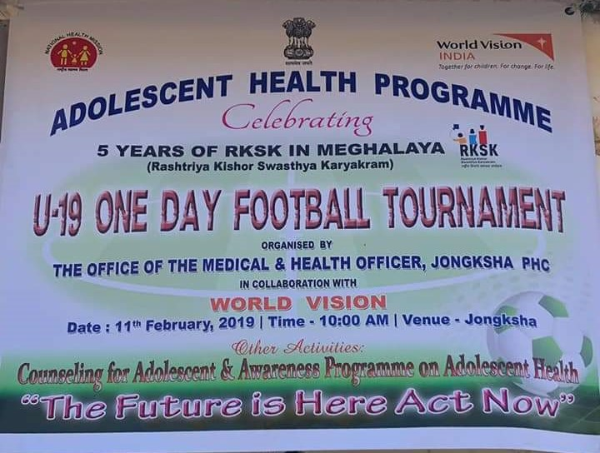
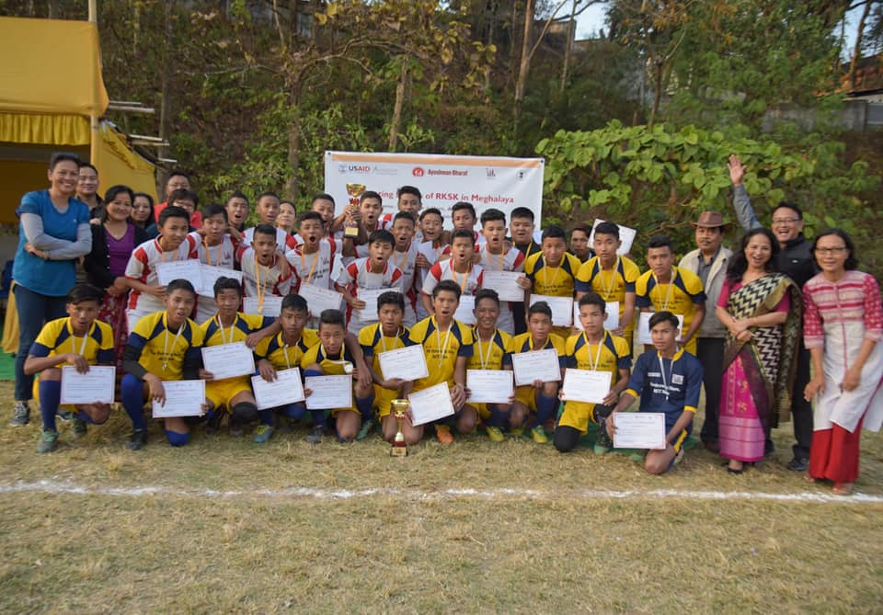
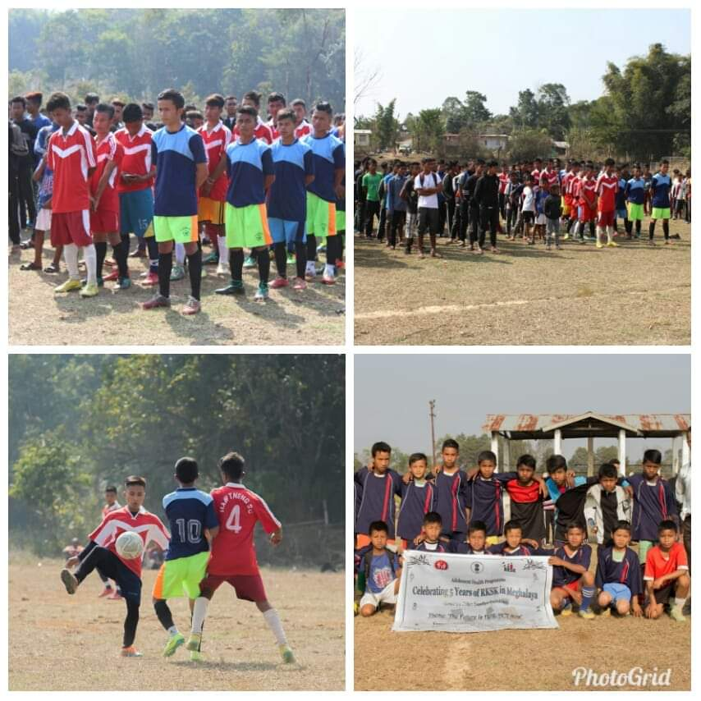
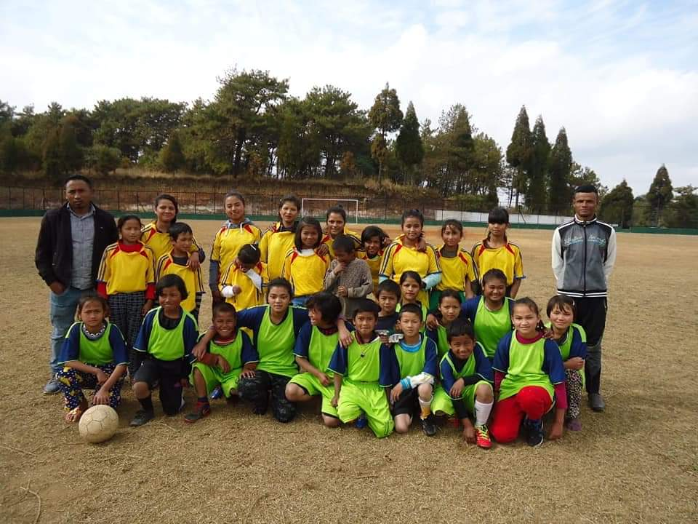
Football & Outdoor Games

Slide 19
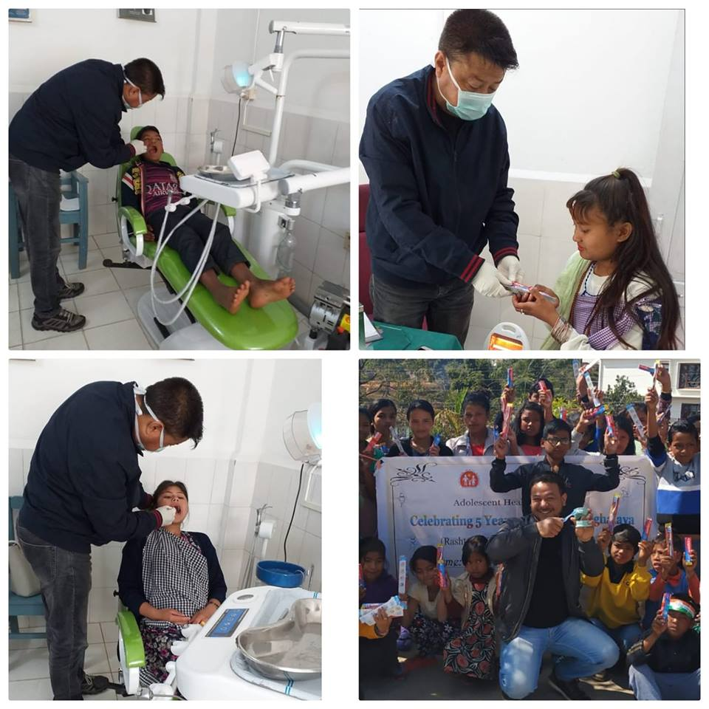
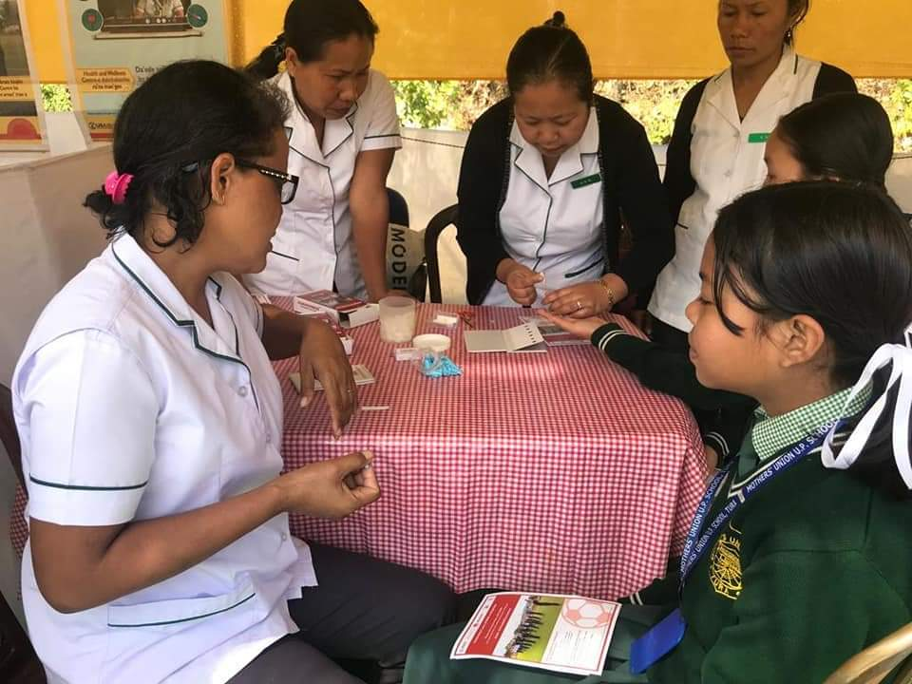
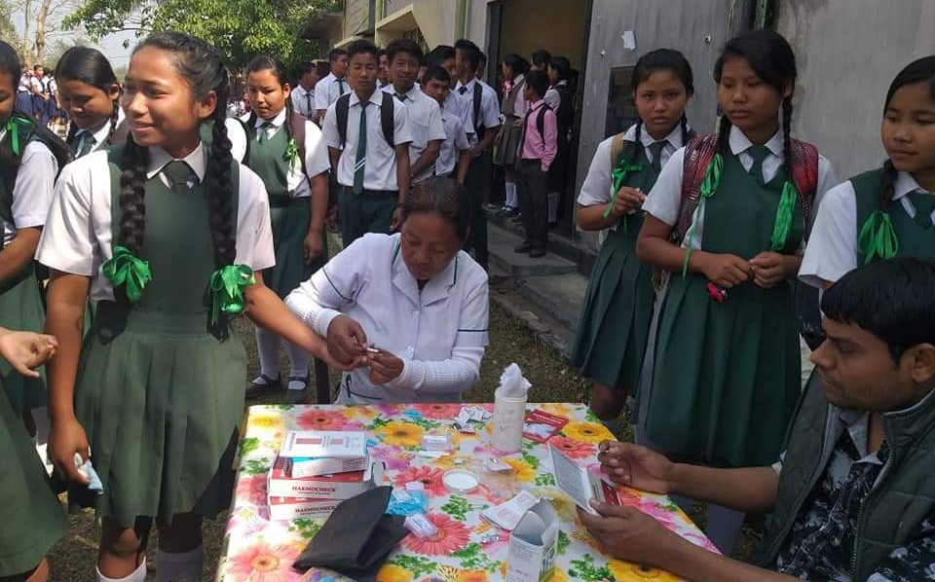
Health Screenings during various events

Slide 20
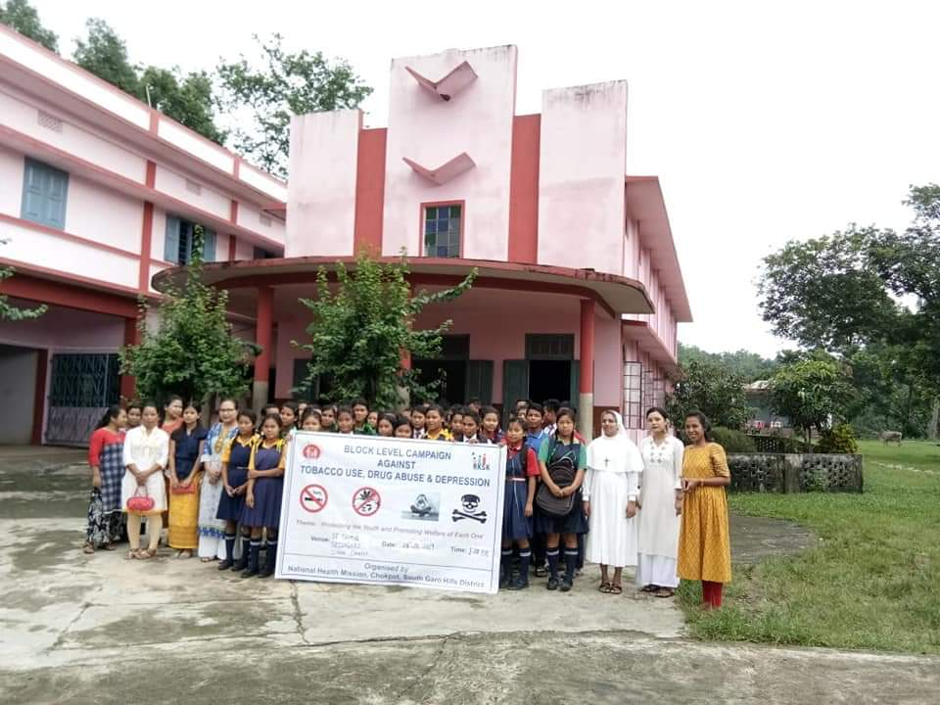
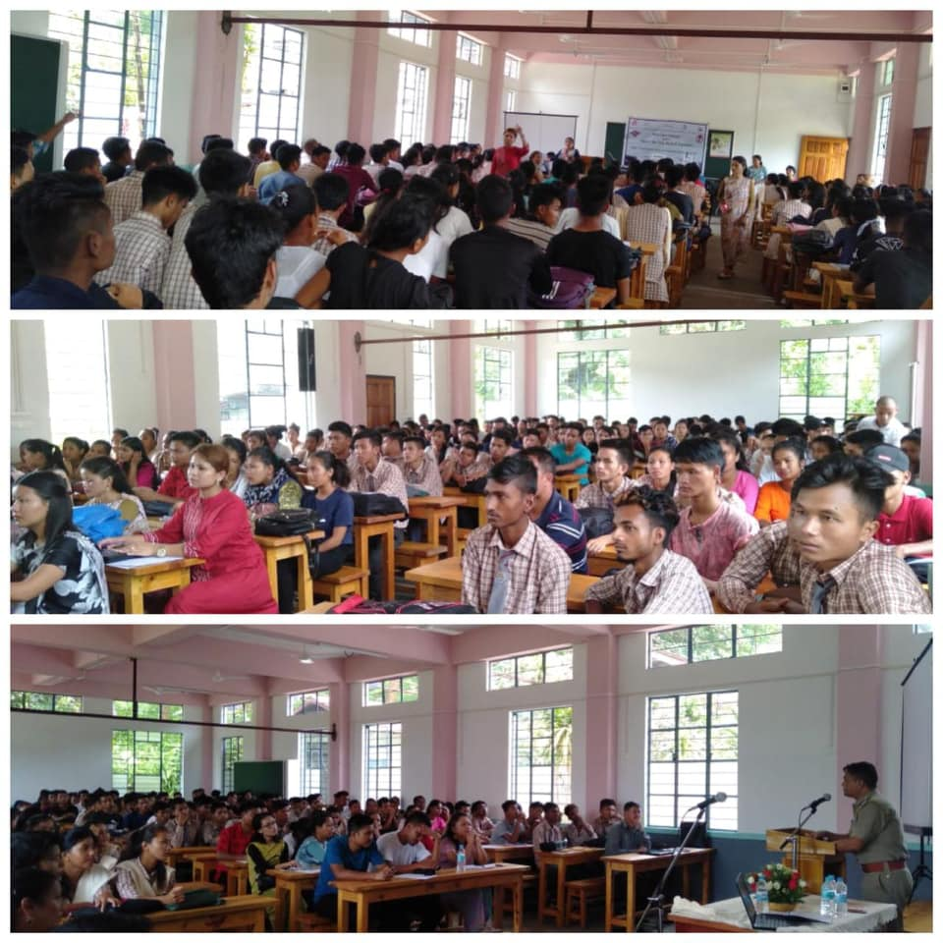
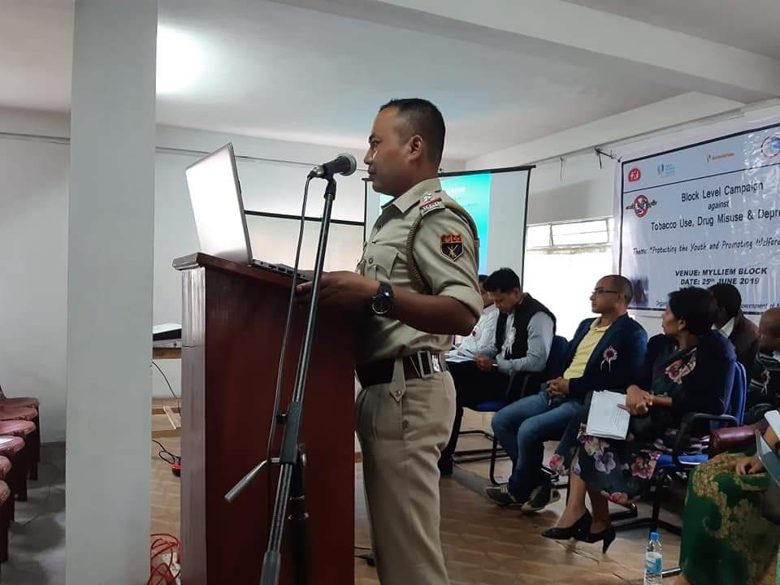
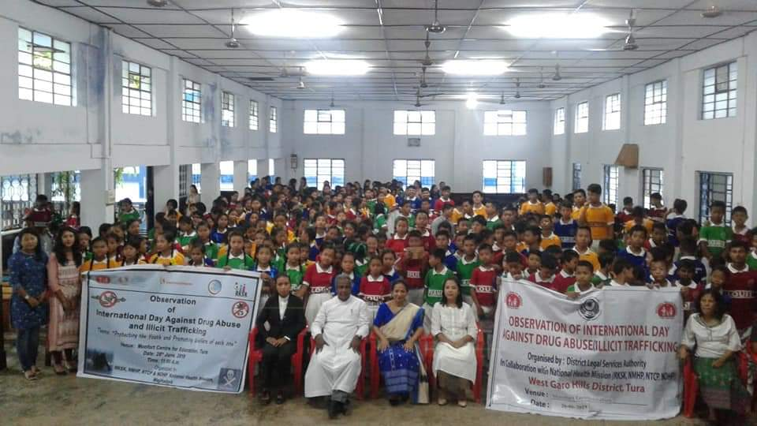
Convergence with Stakeholders

Slide 21
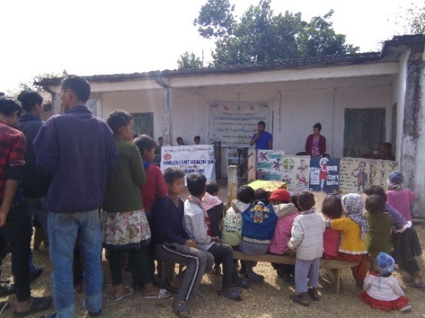
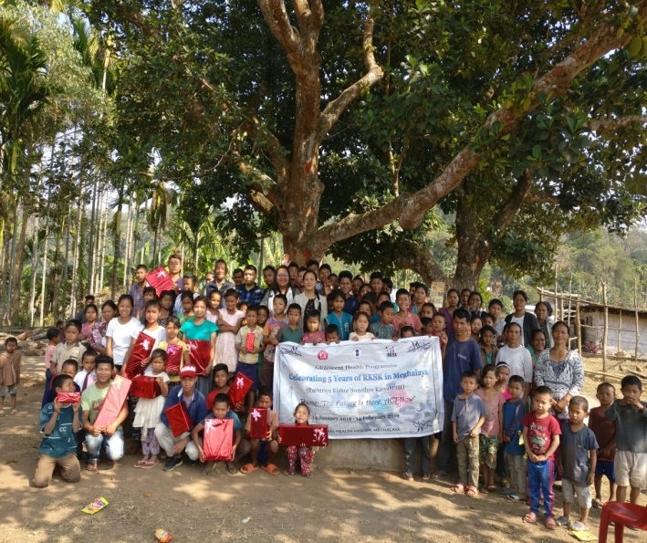
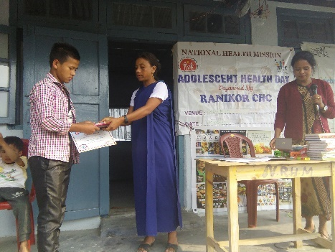
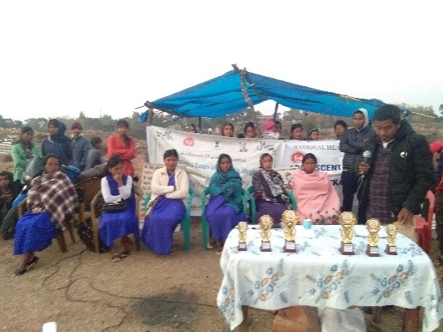
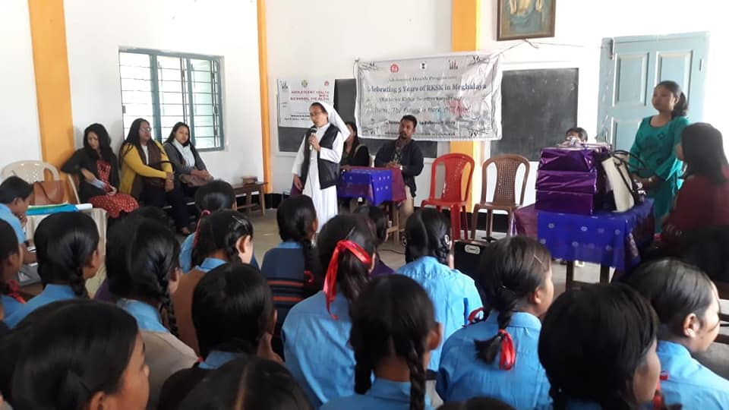
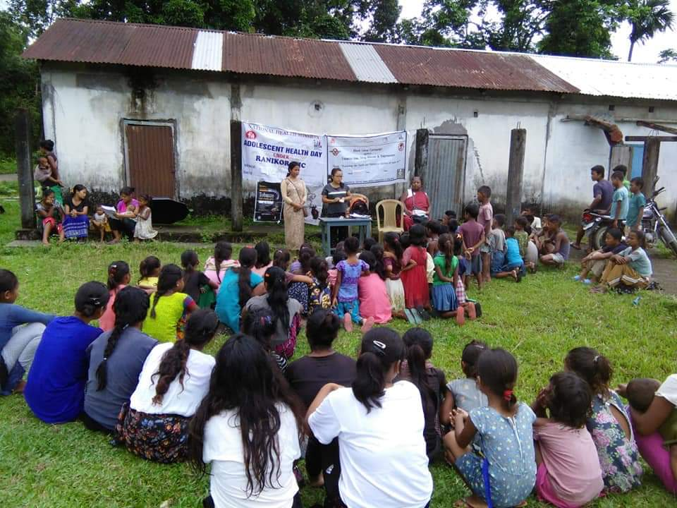
Community participation

Slide 22
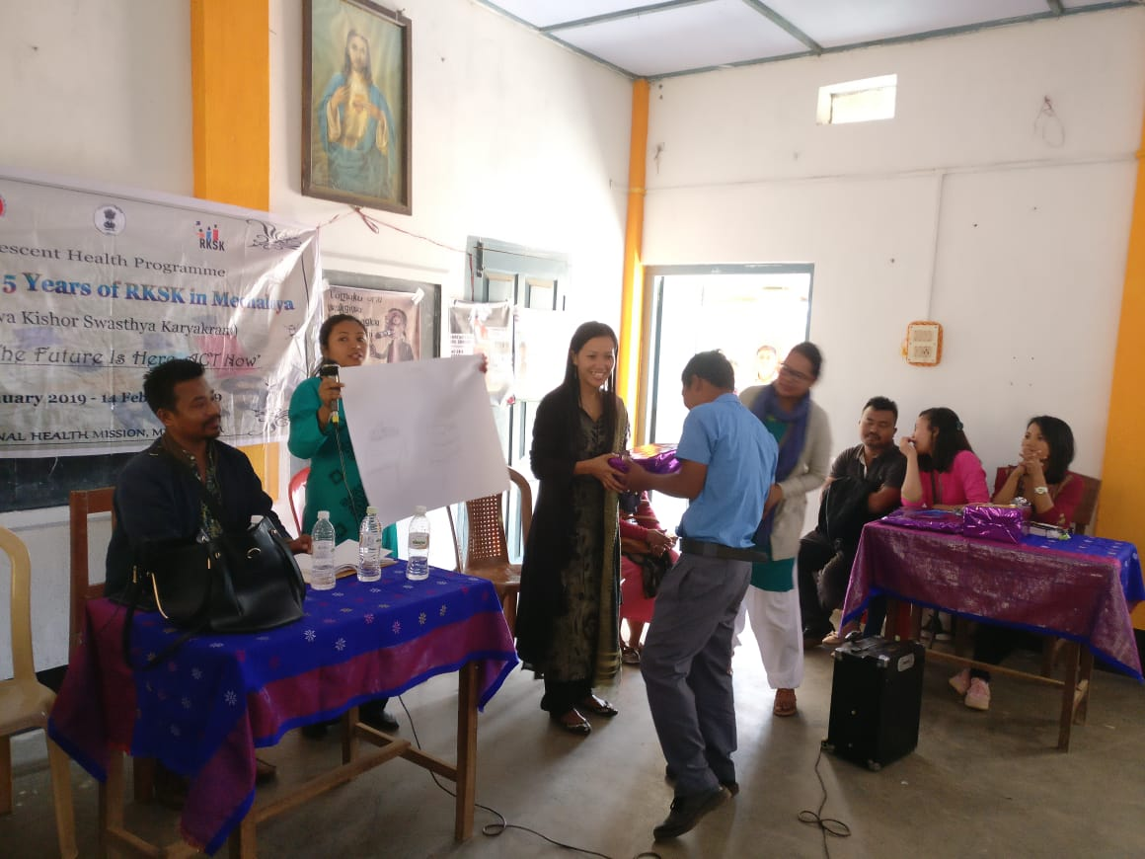
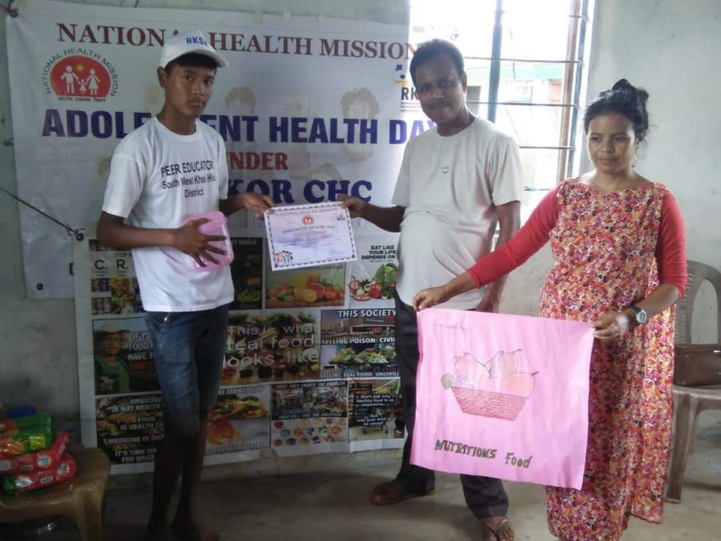
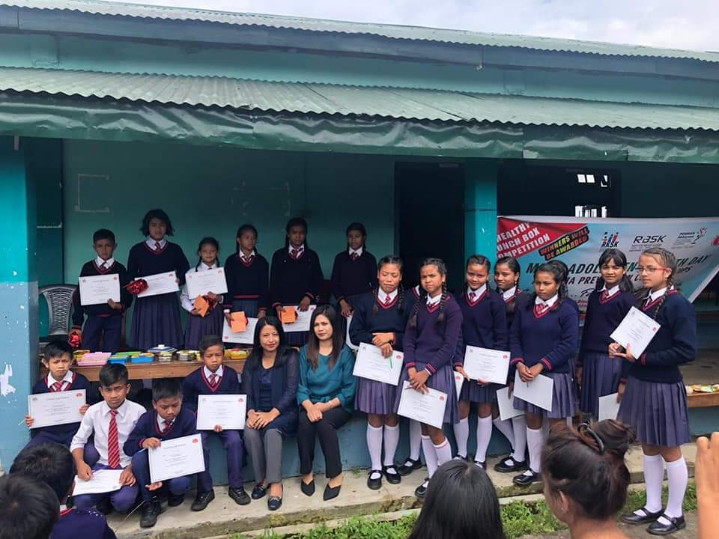
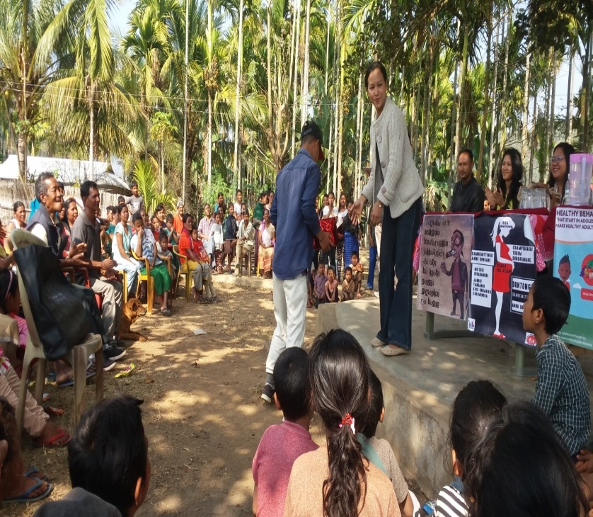
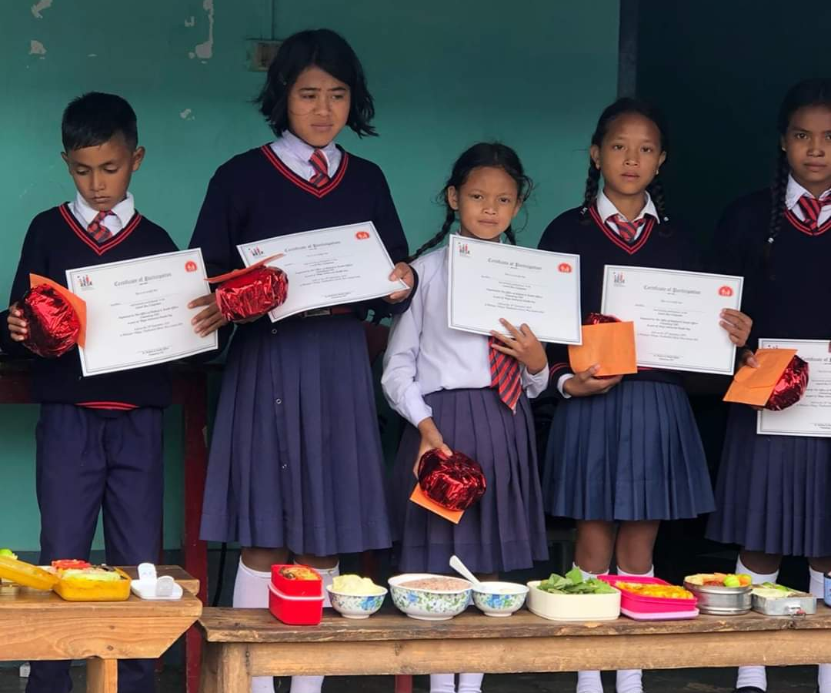
Prizes and Awards

Slide 23

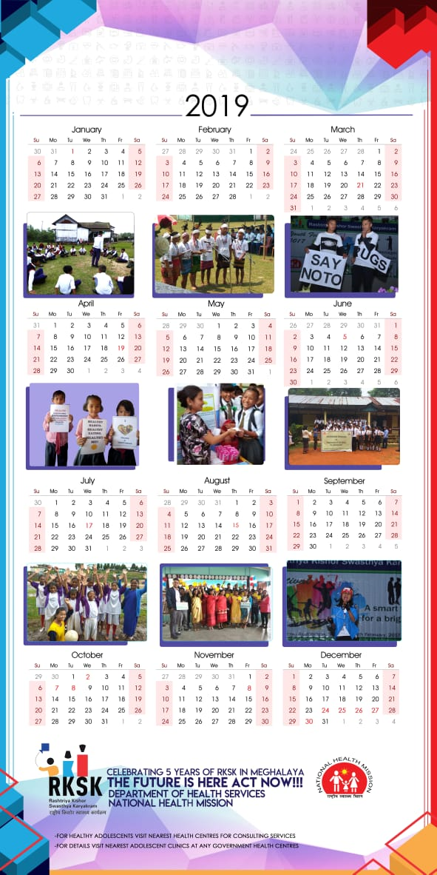
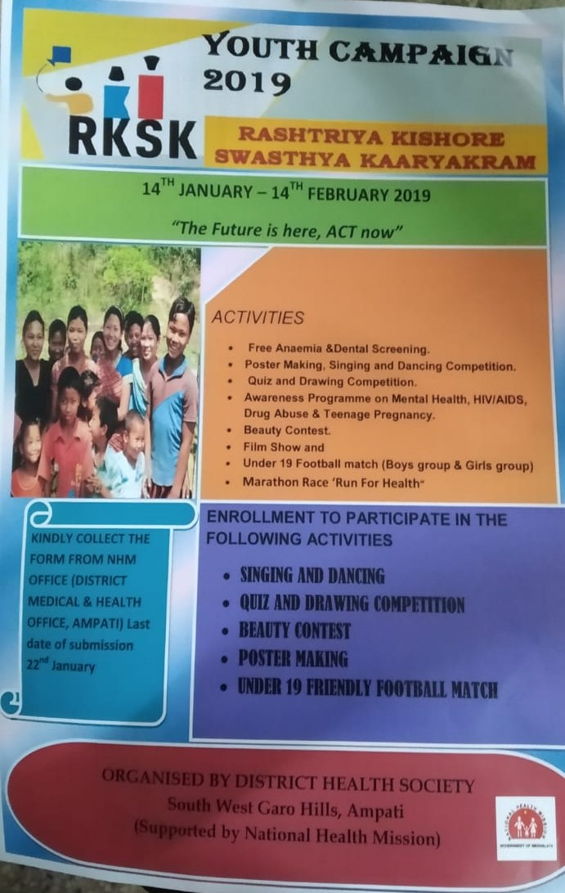
RKSK Publications

Slide 24
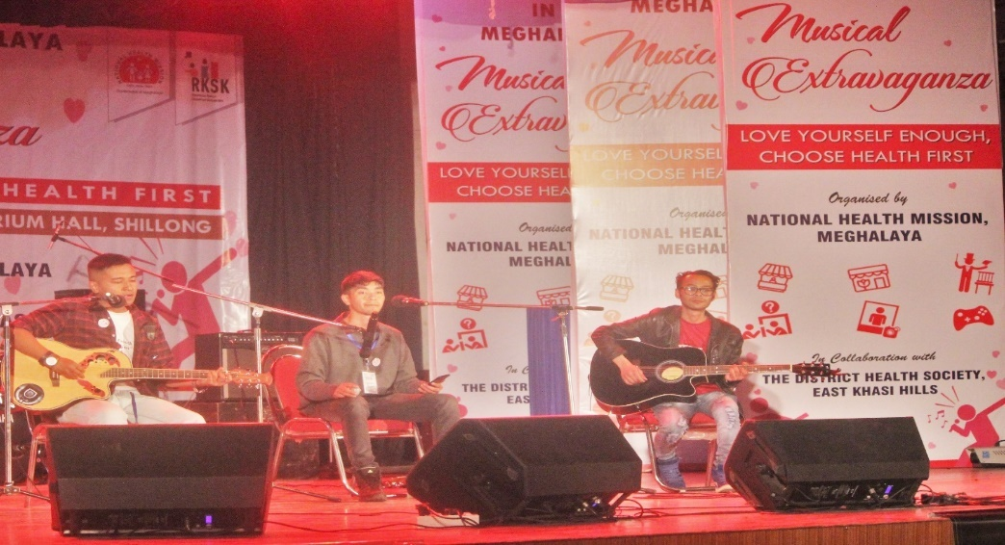
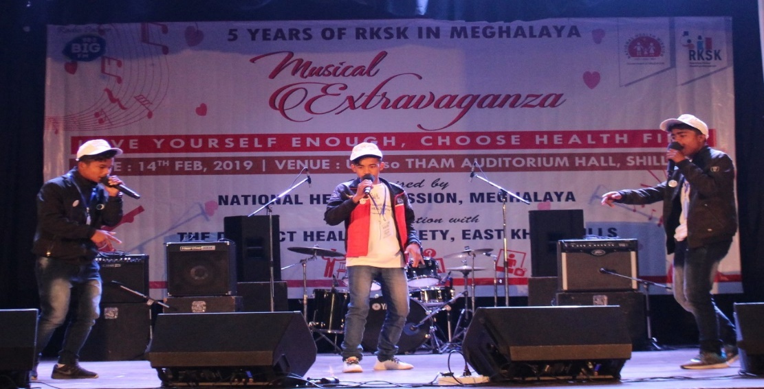
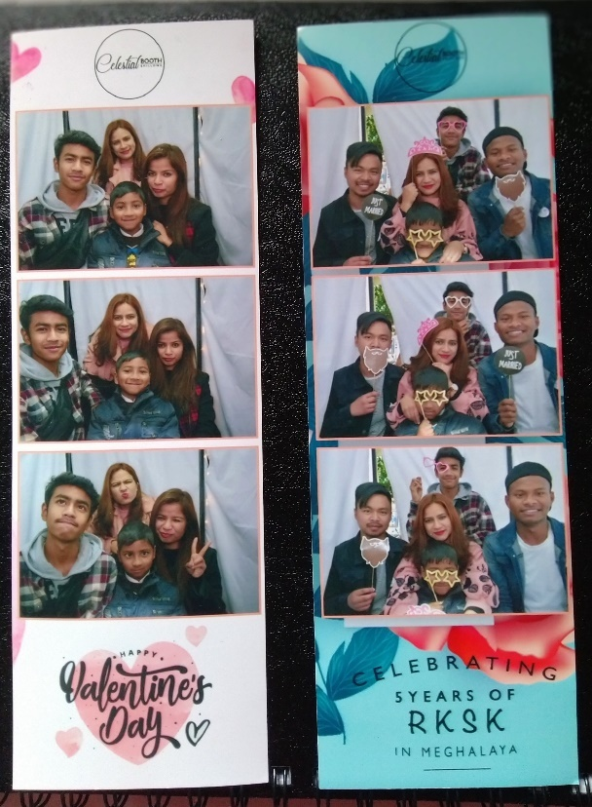


GRAND OPENING & CLOSING CEREMONY (Musical Extravaganza)

Slide 25

“Alone we can do so little ; together we can do so much“- Helen Keller

